Slide 1
Nuclear Physics
Part 1: The Standard Model
Varan Satchithanandan
Mentor: Dr. Richard Jones

Slide 2
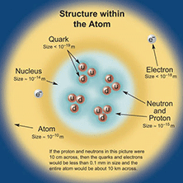
Standard Model
explains what the world is and what holds it together
consists of:
  6 quarks
  6 leptons
  force carrier particles
two types of elementary particles
  fermions and bosons
    F: obey Pauli Exclusion and have half integer spin
    B: do not obey and have integer spin

Slide 3


Quarks
compose protons and neutrons
quarks also have color charge
3 quarks in a group = baryon
1 quark plus 1 anti-quark= meson
Up 2/3 + charge | Charm 2/3 + charge | Top 2/3 + charge
Down 1/3 – charge | Strange 1/3 – charge | Bottom 1/3 – charge

Slide 4
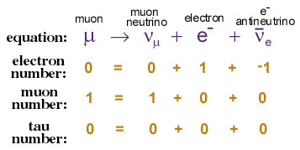
Leptons
3 have charge
  electron (e)
  muon (μ)
  tau (τ)
3 do not
  electron neutrino (ν_{e})
  muon neutrino (ν_{μ})
  tau neutrino (ν_{τ})

Slide 5
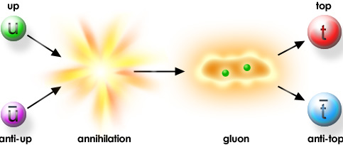
Anti-Matter
every particle of matter has a corresponding anti particle
they look and behave just like their opposites except in charge
  e.g. protons (+) antiprotons (–)
Notes:
This was the reaction during 1995 at Fermilab which discovered the top quark, the U was buried inside a proton while the anti-u was inside anti proton

Slide 6

Force Carrier Particles: A Background
four fundamental interactions between particles
  gravity
  electromagnetic
  strong
  weak
a force is something that passes between two particles

Slide 7
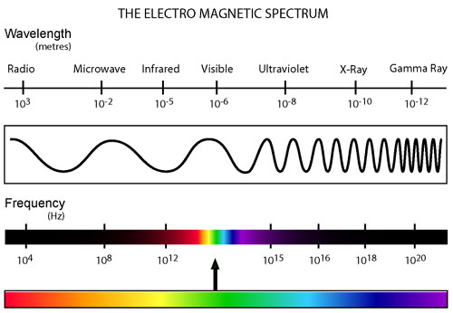
Electromagnetism
this causes opposite electrical charges to attract and same charges to repel
  allows different atoms to bind together
    residual electromagnetic force
carrier particle is the photon (γ)
  zero mass
  travel at light speed
  makes up electromagnetic spectrum

Slide 8
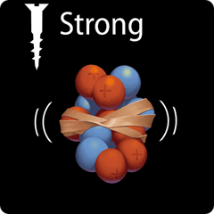
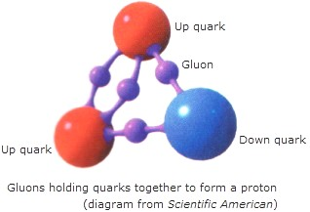
Strong Force
holds quarks together to form hadrons
very powerful
carrier particle is the gluon (g)
Notes:
Relate diagram to string and glueball (image is an artist’s conception). The essential physics can be represented this way. Model of this was built and studied at site to see how it behaves

Slide 9
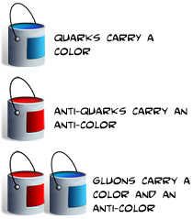
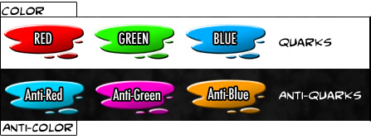
Color Charge
quarks have both electromagnetic charge as well as color charge
gluons have color charge as well
color charged particles exchange gluons in interactions
Notes:
Mention color charge has to add to neutral (white)

Slide 10
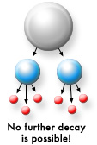
Weak Force
weak interactions result in the decay of massive quarks and leptons
carrier particles are W⁺, W⁻, and Z

Slide 11
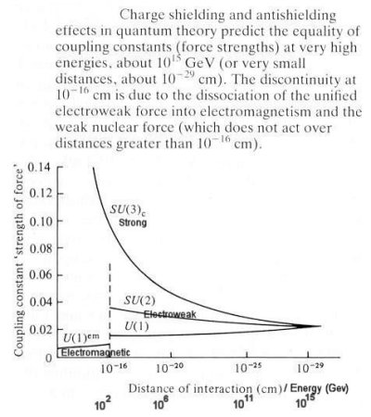
Electroweak
Standard Model has united weak and electromagnetic force
at short distances the attraction is roughly equivalent
same under high energy–short distance scale

Slide 12
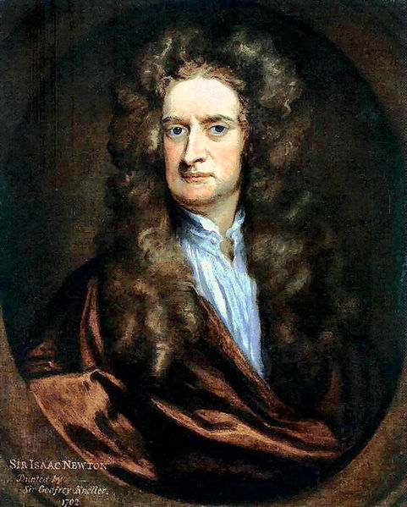
Gravity
SM does not explain
physicists searching for the graviton
force is very small – almost negligible

Slide 13
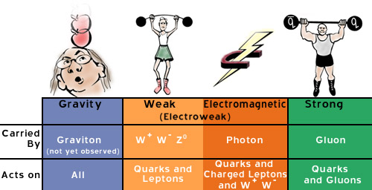
Summary

Slide 14

Questions
Quarks?
Leptons?
Force Carrier Particles?
Other?

