Slide 1
Nuclear Physics
Varan Satchithanandan
Mentor: Dr. Richard Jones

Slide 2
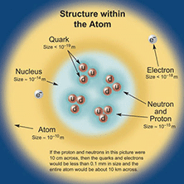
Standard Model
explains what the world is and what holds it together
consists of:
  6 quarks
  6 leptons
  force carrier particles
two types of elementary particles
  fermions and bosons
    F: obey Pauli Exclusion and have half integer spin
    B: do not obey and have integer spin

Slide 3


Quarks
compose protons and neutrons
quarks also have color charge
3 quarks in a group = baryon
1 quark plus 1 anti-quark= meson
Up 2/3 + charge | Top 2/3 + charge | Charm 2/3 + charge
Down 1/3 – charge | Bottom 1/3 – charge | Strange 1/3 – charge

Slide 4
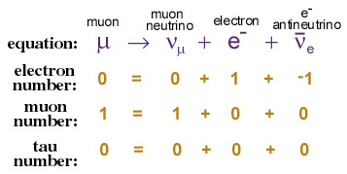
Leptons
3 have charge
  electron (e)
  muon (μ)
  tau (τ)
3 do not
  electron neutrino (ν_{e})
  muon neutrino (ν_{μ})
  tau neutrino (ν_{τ})

Slide 5
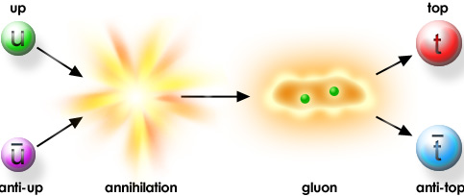
Anti-Matter
every particle of matter has a corresponding anti particle
they look and behave just like their opposites except in charge
  e.g. protons (+) antiprotons (–)

Slide 6

Force Carrier Particles: A Background
four fundamental interactions between particles
  gravity
  electromagnetic
  strong
  weak
a force is a consequence of interactions between force particles

Slide 7
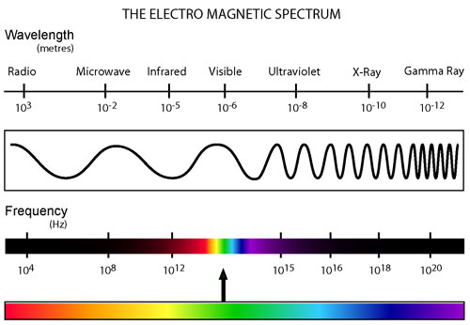
Electromagnetism
this causes opposite electrical charges to attract and same charges to repel
  allows different atoms to bind together
    residual electromagnetic force
carrier particle is the photon (γ)
  zero mass
  travel at light speed
  makes up electromagnetic spectrum

Slide 8

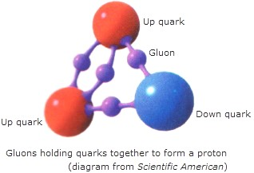
Strong Force
holds quarks together to form hadrons
very powerful
carrier particle is the gluon (g)

Slide 9
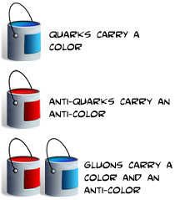
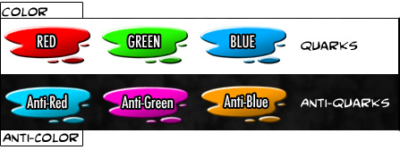
Color Charge
quarks have both electromagnetic charge as well as color charge
gluons have color charge as well
color charged particles exchange gluons in interactions

Slide 10
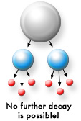
Weak Force
weak interactions result in the decay of massive quarks and leptons
carrier particles are W⁺, W⁻, and Z

Slide 11
Electroweak
Standard Model has united weak and electromagnetic force
at short distances the attraction is roughly equivalent
same under high energy–short distance scale

Slide 12
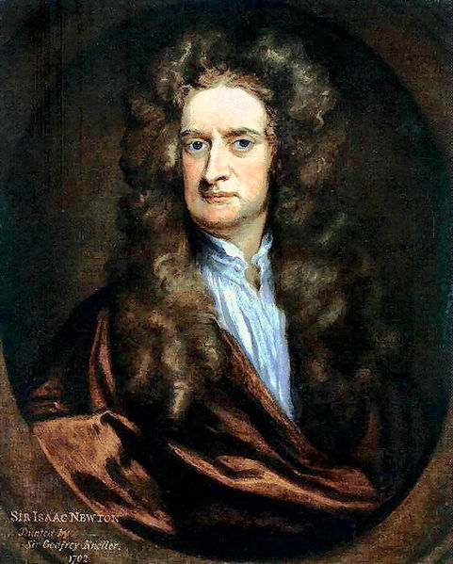
Gravity
SM does not explain
physicists searching for the graviton
force is very small – almost negligible

Slide 13

GlueX
exciting gluonic field generating exotic mesons
understanding the principle of confinement

Slide 14
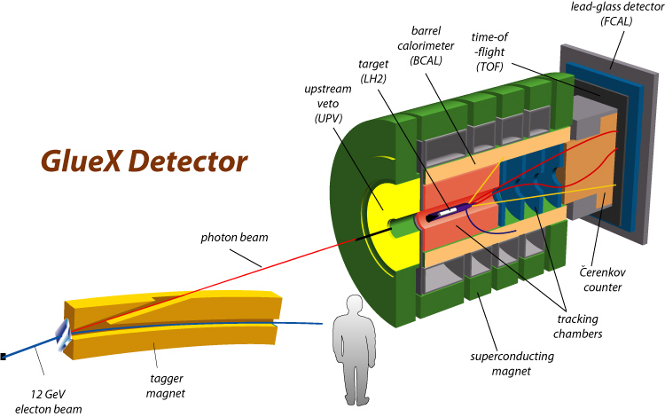
Process

Slide 15
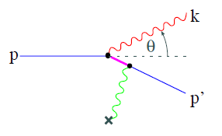
Bremsstrahlung: Introduction
translated: braking radiation
produced by acceleration of charged particle after deflection from another charged particle

Slide 16
Coherent Bremsstrahlung
coherent: multiple particles of the same field involved in a process
two requirements:
  multiple atoms
  correct angle

Slide 17
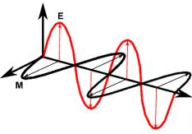
Criteria for Photon Beam
linear polarization
  electromagnetic field perpendicular to wave
high energy resolution
  ability to take individual photons at high energy
  property of detector
low background radiation

Slide 18
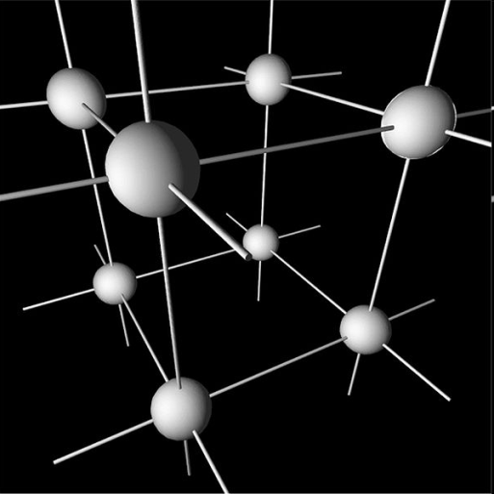
Reciprocal Lattice Vectors
an arrangement of crystalline points

Slide 19
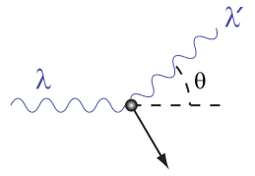
Possible Methods
Compton Scattering
  ideal polarization
  little background radiation
Bremsstrahlung
  energy
  flux

Slide 20
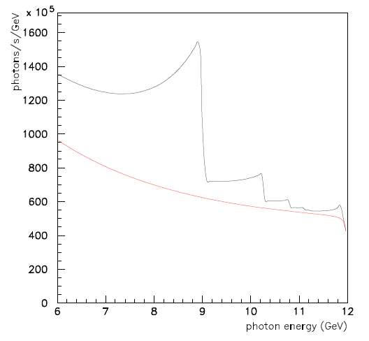
Coherent Bremsstrahlung Cot’d
increases flux of photons
low background radiation
linear polarization

Slide 21
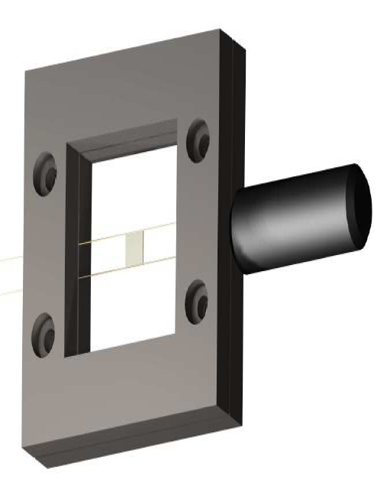
Our Part
crystal is mounted by carbon fiber wires
resonance frequency determined

Slide 22
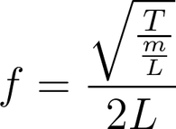
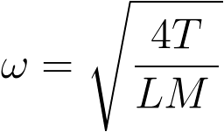
Vibrating String
resonant frequency
  tendency to oscillate with a larger amplitude
base must be stable
  calculate tension of wires

Slide 23
Theory vs. Data

Slide 24
Conclusion
a review
  Standard Model
  mathematical concepts
  GlueX

