Slide 1
Nuclear Physics A Glimpse into the Quantum Universe
Ramone Brown, Solomon Utain
Mentor: Dr. Richard Jones
Nuclear Physics

Slide 2
Outline
Fundamentals
Particles
Forces
Accelerators and Detectors
Higgs Boson
GlueX Experiment
Laser Ablation
Relevance to GlueX
Experimental Calculations

Slide 3
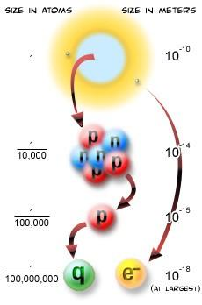
The Hidden Fundamental World Breaking Down Particles
Structure of matter
molecules → atoms → nuclei → hadrons → quarks and leptons
Hadrons – integer charge
Two varieties: baryons and mesons
Baryons – three-quark groups
Mesons – two-quark pairs
Notes:
Structure of matter
Molecules → Atoms → Nuclei → Hadrons (baryons and mesons) → Quarks (top, bottom; charm, strange; top, bottom), Leptons (electron, muon, tau, and their three neutinos)
Hadrons – particles consisting of fraction-charged quarks forming a net integer charge. (Neutrons are composed of one up and two down quarks resulting in its charge of 0; one down and two up quarks make up protons, giving it its 1+ charge.)
Two varieties of hadrons exist in nature: baryons and mesons.
Baryons are three-quark groups (protons are one example).
Mesons are two-quark pairs and consist of a particle and an antiparticle, making it more unstable than baryons (such as pions).
There are six varieties of quarks (of different charges and masses) and each type has its own anti-quark.
Six varieties of leptons also exist: the electron, muon, tau, and three neutinos; each type of neutrino is affiliated with one of the other leptons (i.e. the electon neutrino, muon neutrino, and tau neutrino).

Slide 4
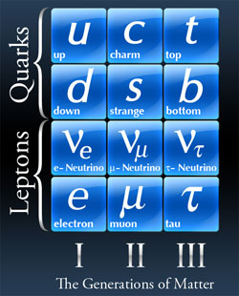
The Hidden Fundamental World (cont.) Particle Types
Six varieties of quarks, each type with its own anti-quark
Six varieties of leptons: the electron, muon, tau, and their three neutinos
Fermions – resist existing in same state
Bosons – can exist in same state

Slide 5
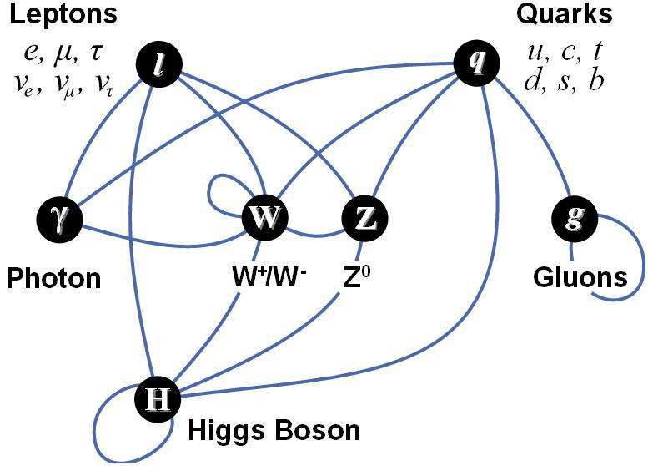
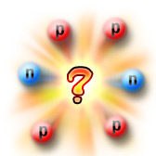
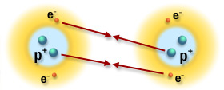
The Hidden Fundamental World (cont.) The Four Forces and Their Mediators
Electromagnetic (photons)
molecules, light, magnetism, friction
Strong (gluons)
holds nucleus and quarks together
Weak (W+, W-, and Z particles)
decay of quarks and leptons
equal in strength to the electromagnetic force (on small scales)
has been unified with electro-magnetism into the “electro-weak” force
Gravity (gravitons; not yet detected)
attraction between all particles
the Standard Model can actually function without explaining gravity
Notes:
On smaller scales, the electromagnetic and weak forces are essentially equal in strength. Their difference on larger scales is mainly attributed to the different masses of their force carrying particles, as the W+, W-, and Z particles are relatively massive.
On atomic and subatomic scales, gravity has very little effect on massive particles, and thus the standard model works with only three forces and no gravity.
Electromagnetic (photons)
Binds atoms to form molecules, accounts for light, and causes magnetism and friction.
Strong (gluons)
Keeps nucleus from flying apart in pieces and holds quarks together.
Weak (W+, W-, and Z particles)
Responsible for the decay of massive quarks and leptons into lighter quarks and leptons.
Essentially equal in strength to the electromagnetic force; both have been unified into the electroweak force.
Gravity (gravitons; never detected)
Accounts for attraction among massive bodies.
The Standard Model can actually function without explaining gravity.

Slide 6
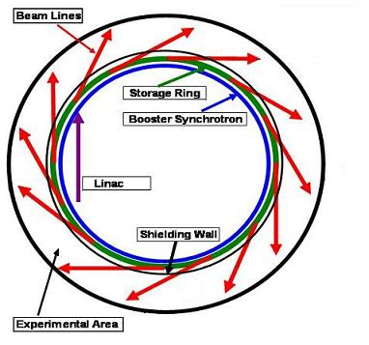
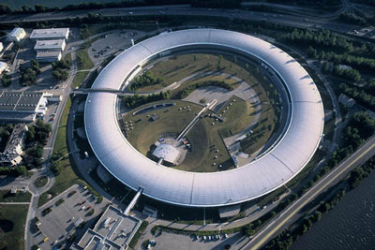
Viewing the Unseen Accelerators and Detectors
Particle accelerators take a particle, speed it up using electromagnetic fields, and slam it into a target or other particles.
Surrounding the collision point are detectors that record all information (charge, mass, direction, energy, type, etc.) about the particles that are produced in the collision, or that result when those particles decay.
Linear accelerators
Synchrotron accelerators
Notes:
6
Stanford Linear Accelerator

Slide 7
Viewing the Unseen (cont.) Comparison of Accelerators
Advantages of synchrotron
Can provide very high-energy particles without having to be of tremendous length
Particles go around many times means that there are many chances for collisions at those places where particle beams are made to cross
Linear accelerators
Easier to build
Don't need the large magnets required to coerce particles into going in a circle
Synchrotron accelerators also need enormous radii in order to get particles to high enough energies, so they are expensive to build

Slide 8
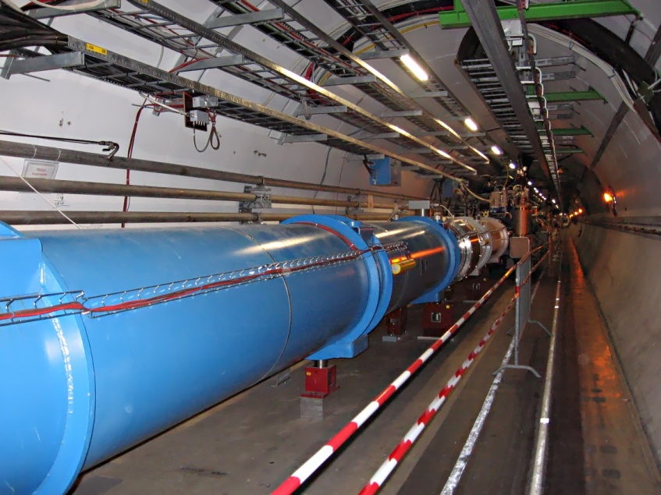
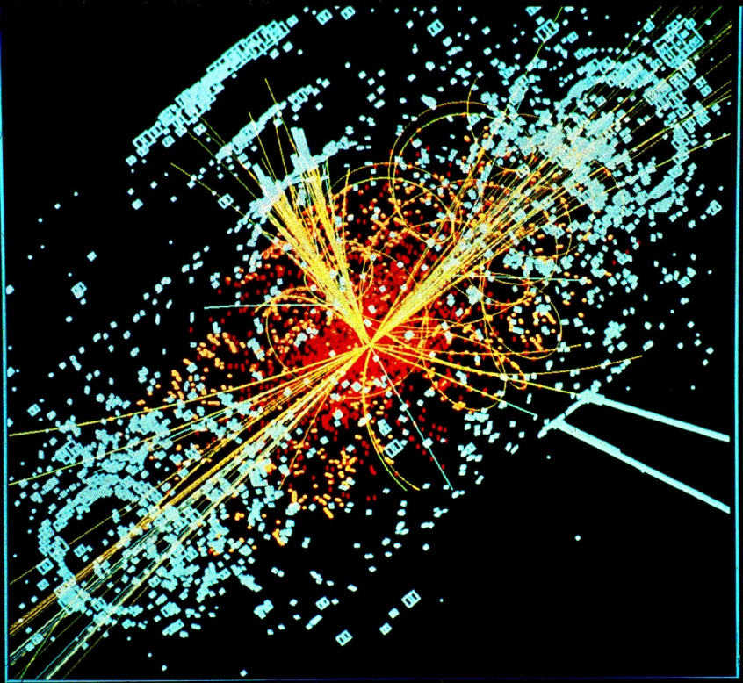
Current Event Tentative Discovery of the Higgs Boson
Higgs field: responsible for mass
Existence of Higgs boson implies existence of Higgs field
Higgs boson difficult to detect
Requires much energy to create
Decays quickly (${10}^{−25}s$)
Decay signature is shared
Announcement on July 4, 2012 from CERN in Geneva, Switzerland
Evidence is strong, but more data needed to verify
Notes:
Like all force carrying particles, the Higgs is a boson; it is theorized to be a particle responsible for the attribution of the property of mass to matter.
Data collected supporting its existence on July 4, 2012 in the Large Hadron Collider (LHC) at CERN in Geneva, Switzerland
Presence of the Higgs boson implies the existence of the Higgs field – a relatively simple explanation for the mechanism by which elementary particles acquire mass
Disclaimer: while the data CERN gathered does indicate the discovery of a new boson consistent with the predicted properties of the Higgs, this data in still under analysis and results, while enticing, is inconclusive.
Existence of higgs particle implies existence of higgs field
10^-25 125gEV
1 yocto second
ANNOUNCEMENT on July 4
Evidence is strong, but more data needed to verify but evidence is strong

Slide 9
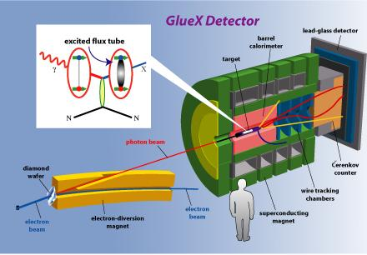
Beyond the Higgs The GlueX Experiment
Dr. Jones and various understudies have been working on GlueX since 1997
They are conceiving an experiment to observe the results of a high energy particle striking a gluonic bond
Requires a new experimental facility being built at Jefferson Lab, in Newport News, Virginia
Scheduled to be completed and the first trials to start near the end of 2014
Notes:
9

Slide 10
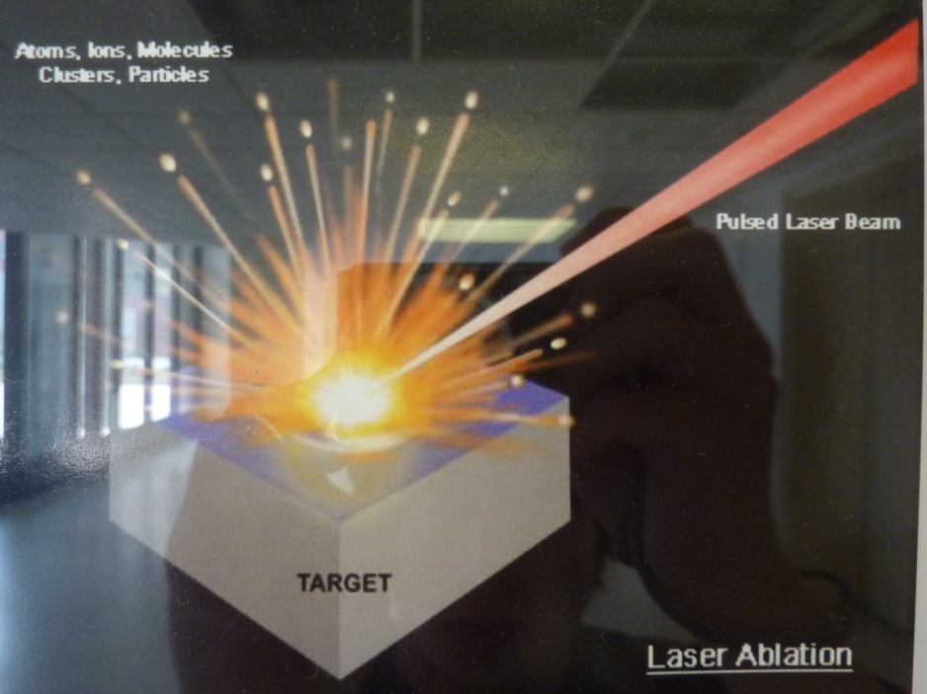
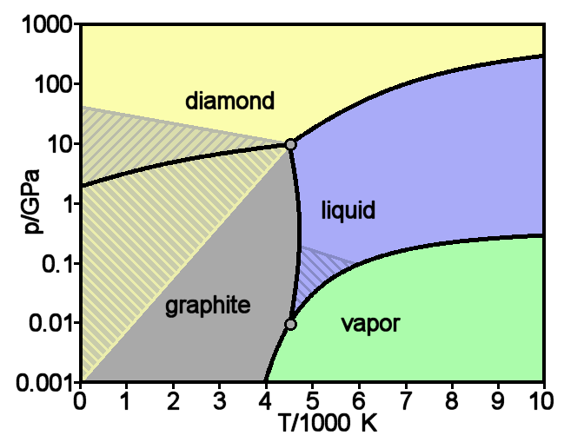
Of Laser Ablation and Diamond Wafers
Thin diamond necessary for GlueX
20μm thick sheet
Coherent bremsstrahlung
Laser ablation with respect to traditional milling techniques
Precise control of area and depth
No warping
“Violent” sublimation
Wafers produced by industry and ablated in UConn lab facility

Slide 11
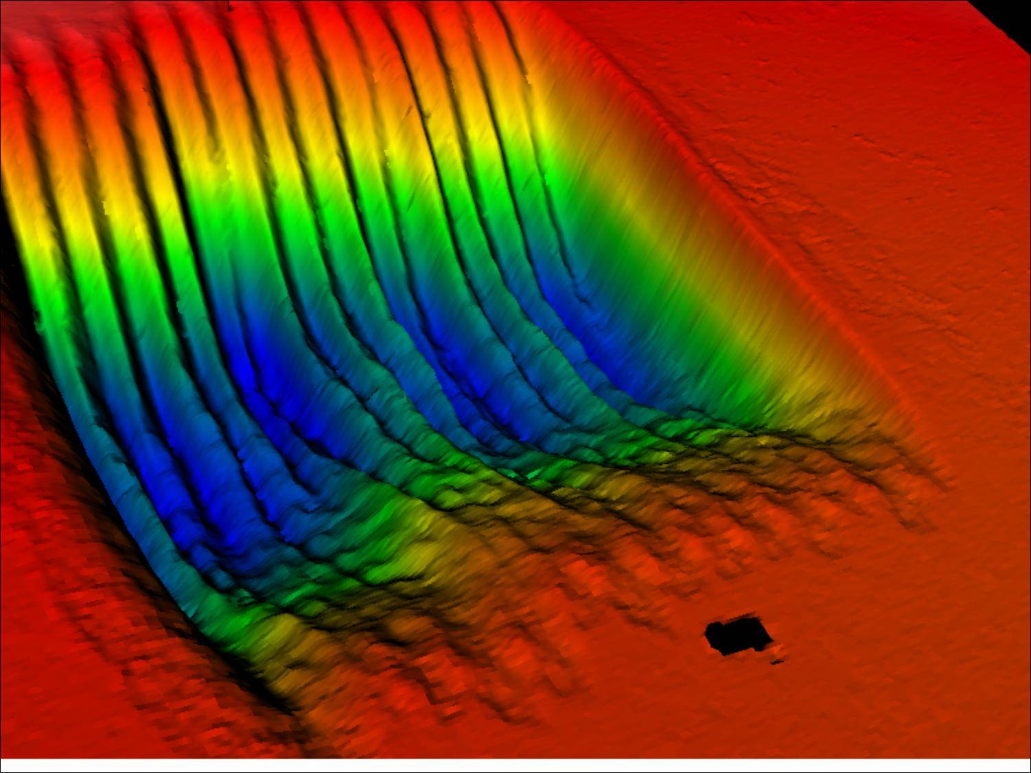
Ablation Products
Final product from UConn lab facility
Threshold energy for ablation needs to be determined
Courtesy of John Smedley, et al.
Notes:
Brookhaven National Lab

Slide 12
Determining the Threshold for Ablation
Laser
a
$$E=\text{πabhd}\text{[}\text{s}\text{+}\text{c}\text{(}T_{sub}−T_{0}\text{)]}$$
$E$= threshold energy ———————————————— 0.10 $J$ $⇒$ 3.5 $J/{{cm}^{2}}$
a = minimum of ellipse ———————————————————— 0.05 $cm$
b = maximum of ellipse ———————————————————— 0.19 $cm$
h = absorption length of 193nm laser in diamond ————————— 1.466 * ${10}^{−5}cm$
d = density of diamond ———————————————————— 3.52 $g/{{cm}^{3}}$
c = specific heat capacity of diamond —————————————— 2.1 $J/{gK}$
s = bond association energy —————————————————— $5.87 ∗ {10}^{4} J/g$
$T_{sub}$ = minimum temperature of sublimation ——————————— 4200 K
$T_{0}$ = initial/room temperature ————————————————— 300 K
b
h

Slide 13
Summary
The Standard Model
Six quarks
Six leptons
Four forces
Accelerators and Detectors
Particle collisions
Linear and synchrotron
The Higgs Boson
Generates mass of fundamental particles
GlueX
Observation of the properties of gluons
Laser Ablation
Thinning diamonds
Notes:
Fundamentals
Particles
Forces
Accelerators and Detectors
Higgs Boson
GlueX Experiment
Laser Ablation
Relevance to GlueX
Experimental Calculations

Slide 14
Questions?
Thank you for listening!

