Slide 1
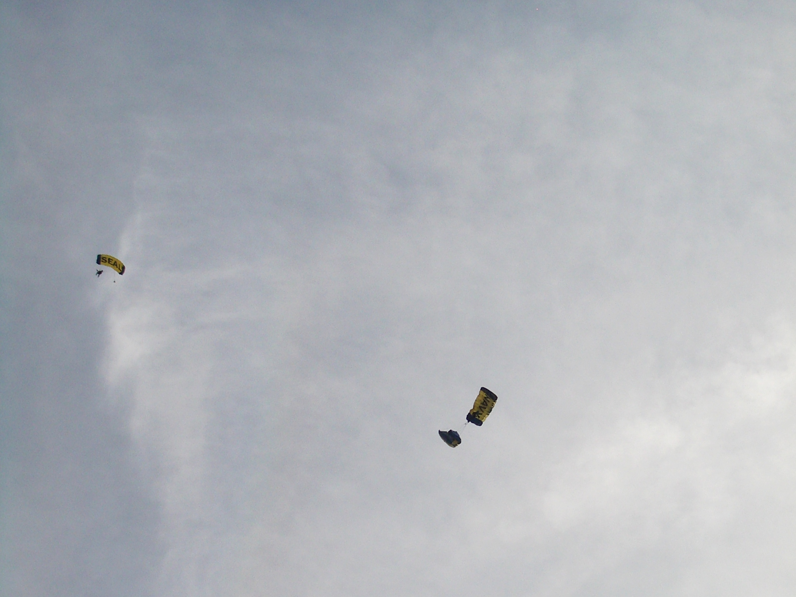

Tagger Microscope
Detector & Electronics
Status
GlueX Collaboration Meeting
JLab, May 21-23, 2012
James M^{c}Intyre, Alex Barnes

Slide 2
GlueX Collaboration Meeting, JLab
May 21-23, 2012
Outline
TDR Status
  photon beam section
  updates
Construction Status
  scope of contract
  contract timeline
  construction area
Electronics
  overview
  readout comparison, cross talk, saturation
  high and low gain comparison
  single pixel measurement, cosmic ray spectrum, power

Slide 3
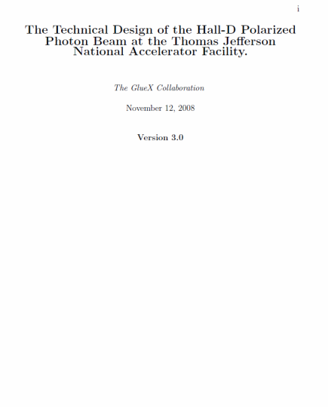
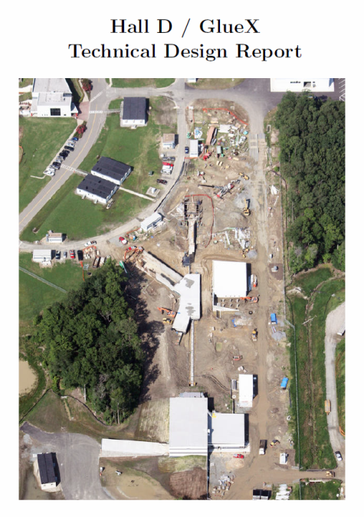
GlueX Collaboration Meeting, JLab
May 21-23, 2012
TDR Status
Photon Beam Section
  Starting draft – Beamline paper 3/2009 doc-1127
  Updates:
    Triplet polarimetry
    Collimator cave layout
    Permanent magnet
    Realization of neutron background
      changes to remediate affects
    Many components beam tested
      modify language on operational
      readiness

Slide 4
GlueX Collaboration Meeting, JLab
May 21-23, 2012
Construction Status
Scope of contract
  Fabrication of the Hall D Tagger Microscope & Active Collimator
  tagger microscope - JLab supplied material, services & equipment
    supply SiPMs
    provide engineering consultation
    approve all construction drawings & electronics
  active collimator - JLab supplied material, services & equipment
    provide components
    provide engineering consultation
    approve all electronics
    responsible for all aspects of integration into photon beamline controls, data acquisition, and trigger

Slide 5
GlueX Collaboration Meeting, JLab
May 21-23, 2012
Construction Status
Scope of contract
  UConn supplied material, services & equipment
    consumables, machinery, and facilities for fabrication & assembly
    labor
    construction manager – J. M^{c}Intyre
    Construction Plan
    Quality Assurance & Acceptance Test Plan
    written update (every two weeks) on construction status
    monthly progress reports on:
      construction relative to baseline schedule
      cost for input to the projected Earned Value Management System

Slide 6
GlueX Collaboration Meeting, JLab
May 21-23, 2012
Construction Status
Scope of contract
  UConn responsibilities:
    develop detailed schedules & procedures for fabrication & testing
    construction drawings of the tagger microscope
    design, lay out, and test preamplifier board for tagger microscope
    deliver & test one first article preamplifier board
    purchase electronics for active collimator
    fabricate tagger microscope IAW approved construction drawings
    report all results from the Quality Assurance Plan
    package & ship all equipment to JLab

Slide 7
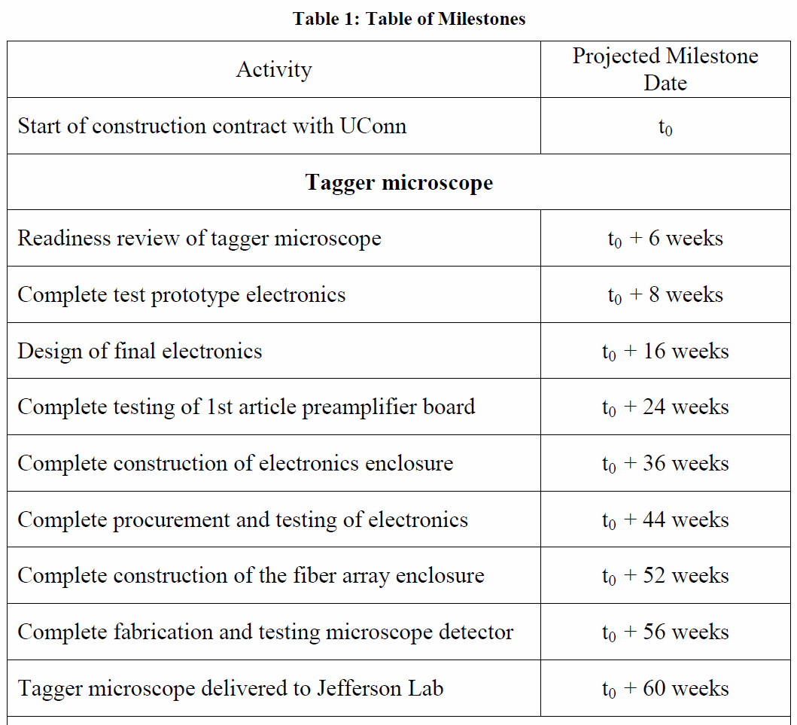
GlueX Collaboration Meeting, JLab
May 21-23, 2012
Construction Status
Contract timeline
  Tagger Microscope
  t₀ anticipated to be in October 2012

Slide 8
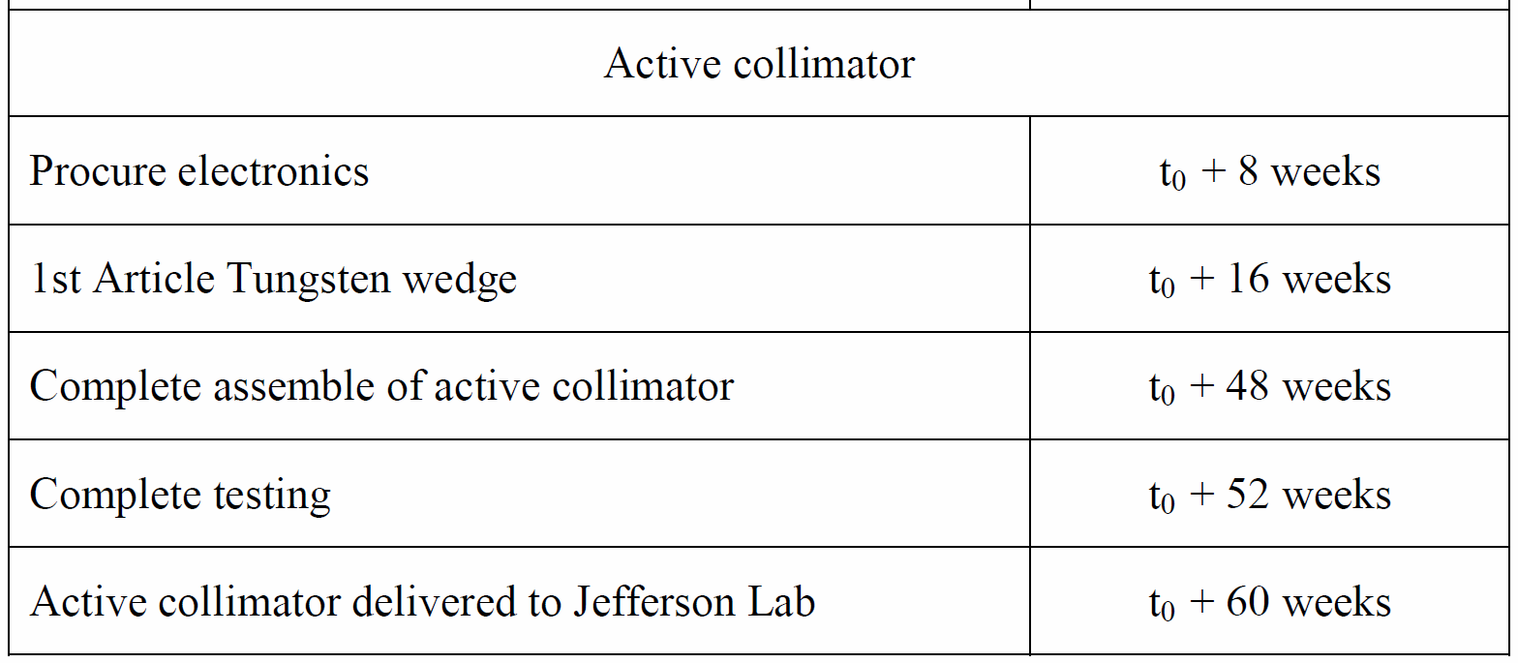
GlueX Collaboration Meeting, JLab
May 21-23, 2012
Construction Status
Contract timeline
  Active Collimator

Slide 9
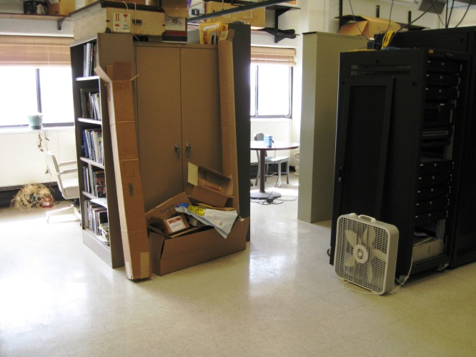
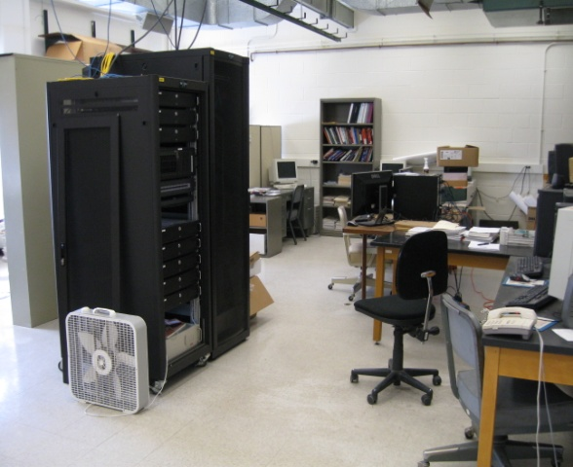
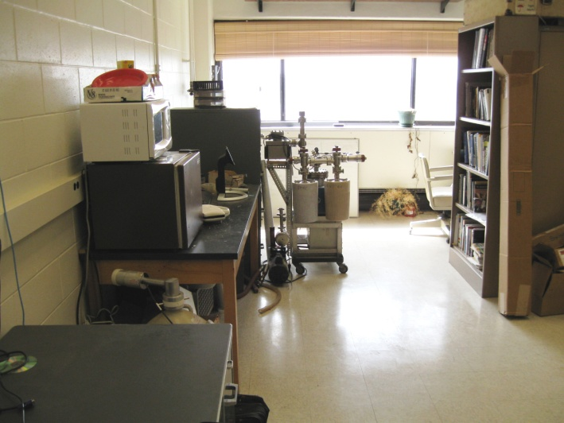
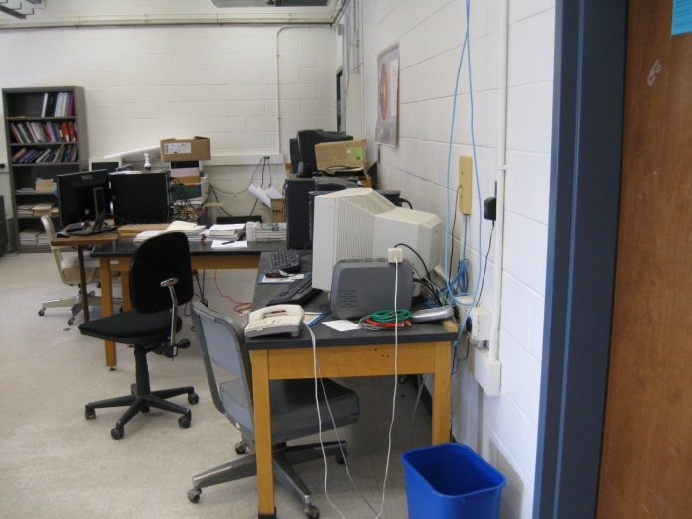
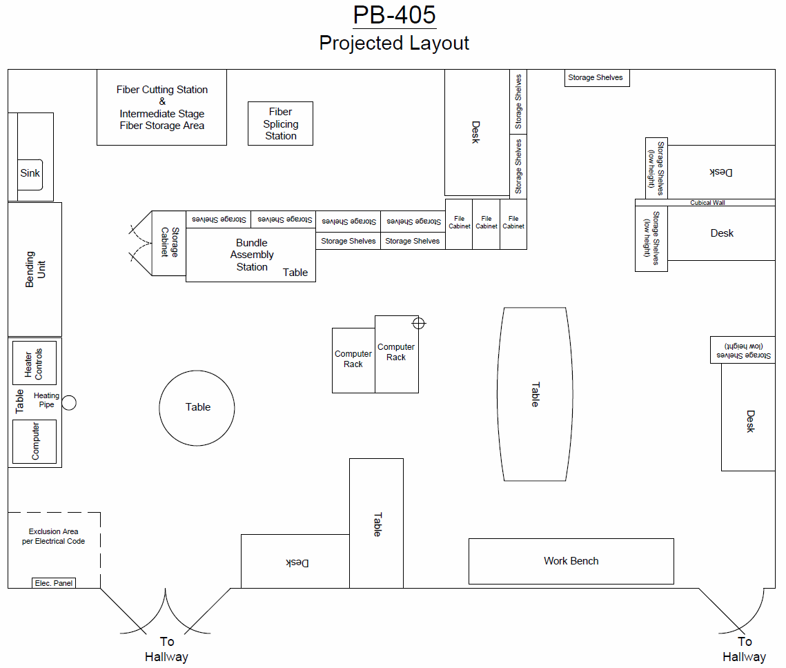
GlueX Collaboration Meeting, JLab
May 21-23, 2012
Construction Status
Construction Area
  cleaning & setup underway
  summer staff:
    physics program graduate
    engineering undergraduate

Slide 10
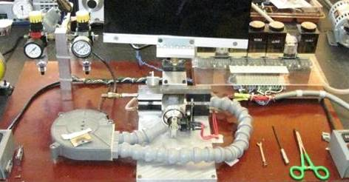
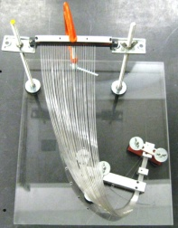
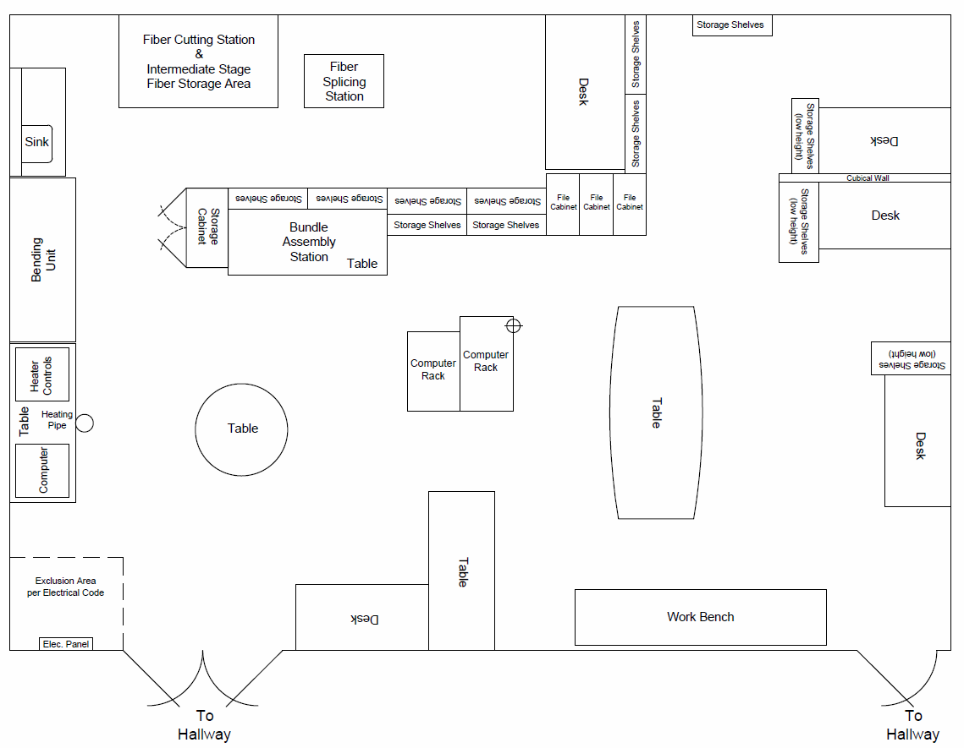
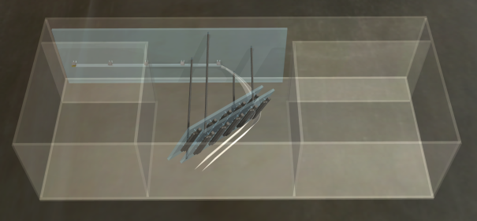


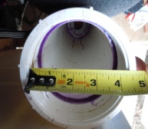

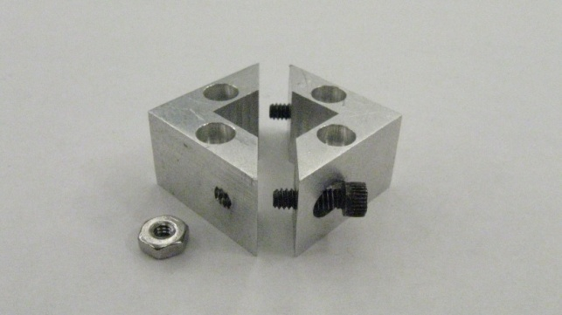
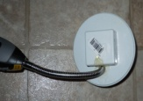
GlueX Collaboration Meeting, JLab
May 21-23, 2012
Construction Status
Populating the Construction Area
  on track for “Readiness Review”
    estimated November 2012

Slide 11
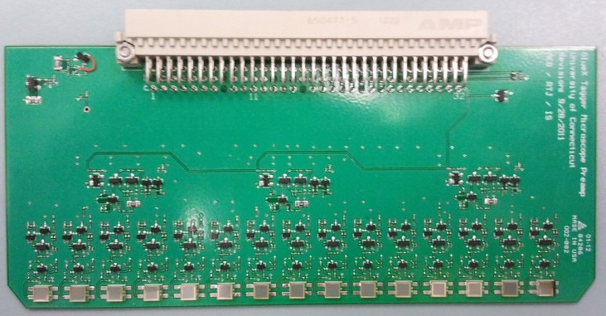
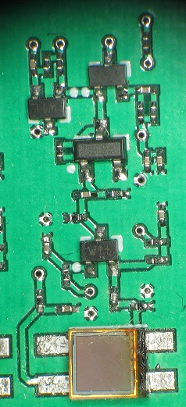
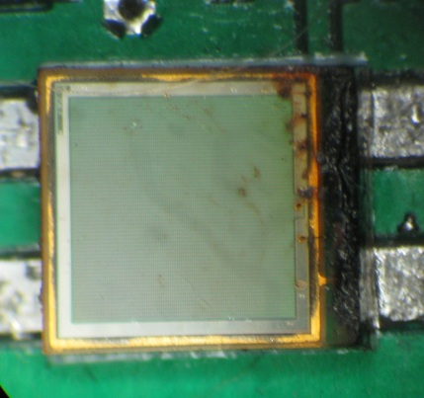
GlueX Collaboration Meeting, JLab
May 21-23, 2012
Preamp Version 2.0
Hamamatsu SiPMs
Improved upon previous design
15 individual channels
3 summed channels containing 5 summed individual channels
Summer has high and low gain modes
Amplifier circuit has more space and ground between traces
Our first attempt at mounting the SiPMs resulted in a discolored component but it still functions properly

Slide 12
GlueX Collaboration Meeting, JLab
May 21-23, 2012
Comparison between the individual and summed readouts
Single channel readout of one biased SiPM
Comparison between outputs:
One SiPM biased, others left unbiased
Averaged over 128 samples
Summed output replicates individual readout when only one signal input
Rise time is about 2ns, fall time about 12.5ns
Summed readout of one biased SiPM

Slide 13
GlueX Collaboration Meeting, JLab
May 21-23, 2012
Cross talk between summers for single biased SiPM
Low light amplitude
One SiPM biased, measured through the summed output
Pulse signal measured in biased summed output and the cross talk is measured in the unbiased summed outputs
Conducted in both low and high light levels
Cross talk is less than 2%
High light amplitude

Slide 14
GlueX Collaboration Meeting, JLab
May 21-23, 2012
Saturation of a single SiPM in high gain mode
One SiPM biased in high gain mode
Averaged over 128 samples
Saturation measured for multiple Vcc levels
SiPM saturates at approximately 1800mV at typical operational voltage as predicted

Slide 15
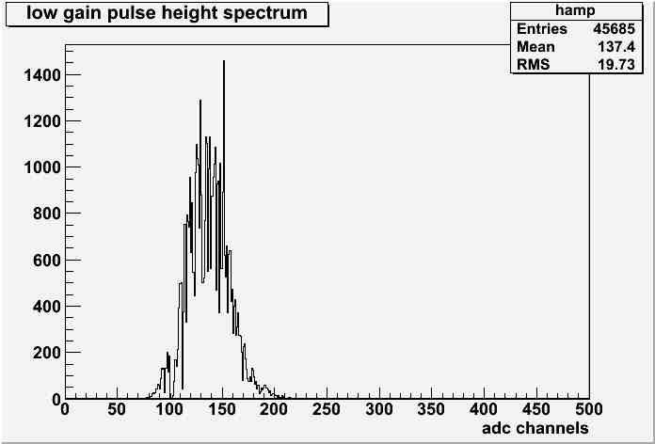
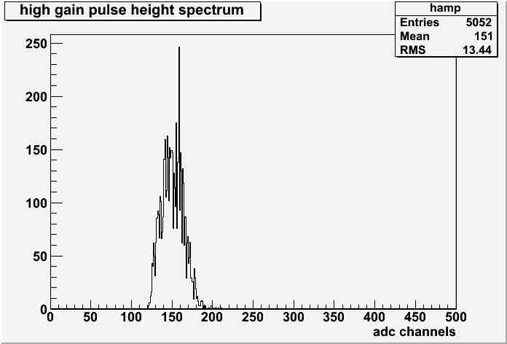
GlueX Collaboration Meeting, JLab
May 21-23, 2012
High and low gain comparison
Single SiPM biased with light source in low gain
Every 50 channels corresponds to 50mV
Mean pulse height of 137.4mV
50mV per 50 channels
Single SiPM biased with light source in high gain
Every 50 channels corresponds to 500mV
Mean pulse height of 1510mV
Factor of 10 in amplification
500mV per 50 channels

Slide 16
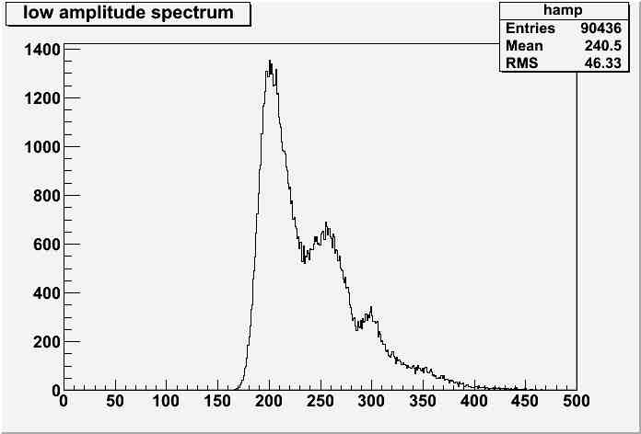
GlueX Collaboration Meeting, JLab
May 21-23, 2012
Single-pixel spectrum
pedestal
Single biased SiPM in high gain mode
Every 50 channels corresponds to 10mV
Each pixel in high gain corresponds to 10mV, as predicted
In low gain this is 1.0mV per pixel
one pixel
two pixels
three pixels
adc channels

Slide 17
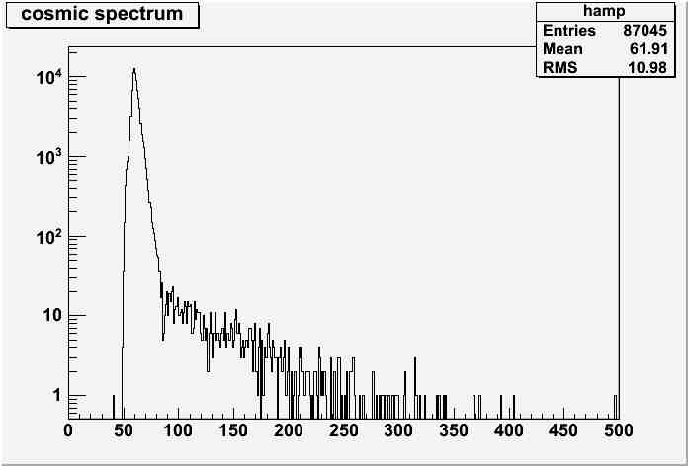
GlueX Collaboration Meeting, JLab
May 21-23, 2012
Extracting photoelectron yield from cosmic spectrum
We expect a rate of
We expect photoelectrons per cosmic, where
  1.7 is the loss per distance traveled in plastic
  0.25 is the thickness of the fiber
  0.06 is the capture fraction of the fiber
  0.10 is the detector efficiency
  0.9 is the attenuation of the fiber
1pe = 5 channels
pedestal tail
adc channels

Slide 18
GlueX Collaboration Meeting, JLab
May 21-23, 2012
Extracting photoelectron yield from cosmic spectrum
Expected rates are low: 700 / day
Run for 3 days and look
Cosmics clearly visible, but peak is hidden under the pedestal tail
N₀ = 5 MHz
1pe = 5 channels
pedestal tail
pedestal rate ~ N₀ e^{-1.15} ^{Npe}
adc channels
To see a signal at 7 10⁻⁸ N₀ , pulse height must be > 18 pe
Give up on <n>, measure percentiles instead : spectral integral is known
Implies result for tagged electrons: N_{50%} = 16 * 8 = 130 pe / tag
about <n> !
55’th percentile (close to median) = 18 pe ± 10% (syst. error)
too low !
18

Slide 19
GlueX Collaboration Meeting, JLab
May 21-23, 2012
Extracting photoelectron yield from cosmic spectrum
Expected yield: 700 / day
Requirement: 200 pe/tag
Solution: use 50 micron SiPM
Relative PDE: factor 2 larger
1pe = 5 channels
pedestal tail
adc channels
Other differences: gain is factor 3 larger, current is factor 3 larger
Unchanged: capacitance, bias voltage, active area, package form, price !
Ready to test immediately
Would like to borrow a 50 micron 3mm SiPM from Jlab for test
Cosmic peak will separate from pedestal, show clearly what <n> is.

Slide 20
GlueX Collaboration Meeting, JLab
May 21-23, 2012
Power per channel
Our operating voltage will be 5.80V
The power per channel is approximately 75mW
The total power for all 500 channels is 40W

Slide 21
Summary
TDR update well underway
Construction contract paperwork submitted
On track for readiness review (estimated 11/2012)
No more preamplifier board revisions
Know how to mount SiPMs but it would be nice to have a robot
Know how to calculate photoelectrons, measured and got a consistent answer ±10%
Median 200 p.e. for axial moving electrons
Enough light for time resolution needed

Slide 22
GlueX Collaboration Meeting, JLab
May 21-23, 2012
Questions?

Slide 23
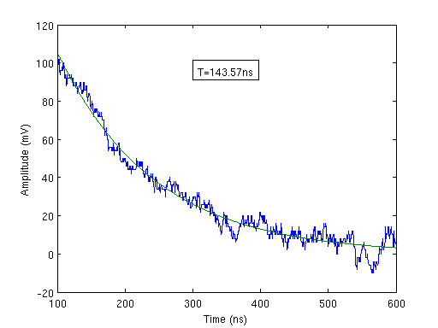
GlueX Collaboration Meeting, JLab
May 21-23, 2012
Differentiation Time
In high gain mode there is an over swing on the signal return with an exponential decay
Each SiPM was tested and the average time constant is 157.80ns
Intentionally saturated
This effect is not noticeable in low gain mode

