Slide 1


INTRODUCING PARTICLE IDENTIFICATION TO ALGEBRA-BASED PHYSICS STUDENTS
Ricky Dube, Richard Jones

Slide 2
Open Science in Particle Physics
In recent years, we have seen outreach projects in various stages of the analysis pipeline:
Public Data
Particle Identification
Event Reconstruction

Slide 3

Open Science in Particle Physics
In recent years, we have seen outreach projects in various stages of the analysis pipeline:
Public Data
Particle Identification
Event Reconstruction
CERN releases lots of its data and analysis tools through its Open Data portal, which allows anybody who knows what they are doing to analyze data from 6 experiments at CERN
(Photo Courtesy of the CERN Open Data Team)

Slide 4
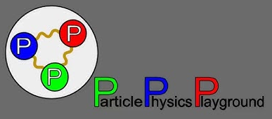
Open Science in Particle Physics
In recent years, we have seen outreach projects in various stages of the analysis pipeline:
Public Data
Particle Identification
Event Reconstruction
Particle Physics Playground is a set of activities which introduce students to event reconstruction using real data from a variety of particle physics experiments. Data is provided in the form of pre-identified particles, and students are tasked with identifying particles and resonances.
(Photo Courtesy of Matt Bellis)

Slide 5
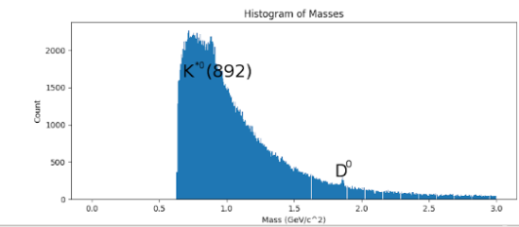
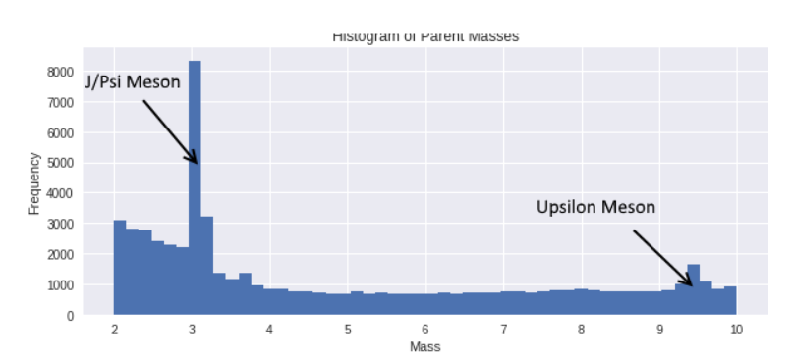
Particle Physics Playground
Notes:
Ideas for opening:
Maybe talk about PPP
Talk about how we are recruiting new people to join the collaboration?

Slide 6
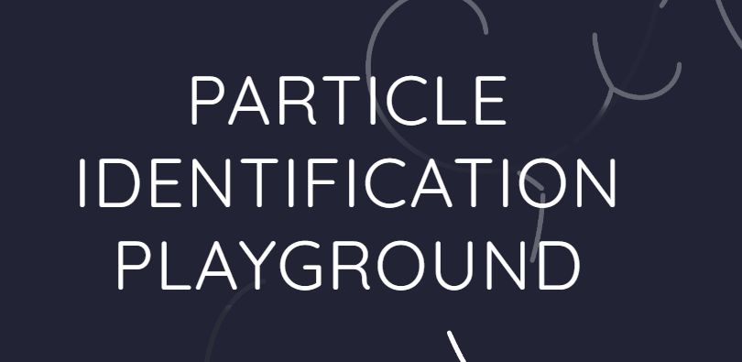
Open Science in Particle Physics
In recent years, we have seen outreach projects in various stages of the analysis pipeline:
Public Data
Particle Identification
Event Reconstruction
Particle Identification (PID) Playground is a set of activities that introduce students to common PID methods and the GlueX detector. The only prerequisites are:
Python
Algebra-based Physics

Slide 7
Google Colaboratory
The activities of Particle Identification Playground are Jupyter notebooks hosted on Google Colaboratory, which has several advantages:
Interactive
Jupyter notebooks (which Google Colaboratory uses) supports interactive applets, which can help build intuition.
Browser-Based
Google Colaboratory allows students to run code without installing or downloading anything on their local machine.
Scalable
Because the activities don’t run on any GlueX machines, students will never have to compete for disk space of computing power, regardless of the number of users.

Slide 8
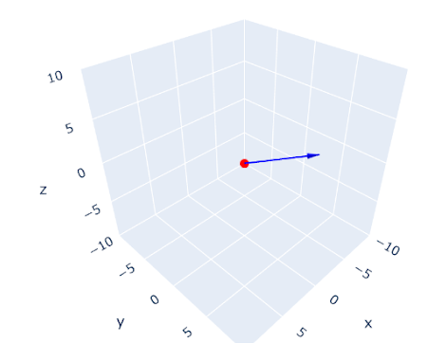
Foundational Topics
PID Playground is designed to be accessible to algebra-based physics students, so students need to take some time to learn about foundational topics in particle physics:
Vectors (adding and rescaling)
Relativistic mass, energy, and momentum
Definitions of hadrons, baryons, and mesons
Students also learn how to use pandas, a Python package that streamlines the processing of tabular data.
A 3D interactive plot of a vector, as seen in the “Introduction to Vectors” activity

Slide 9
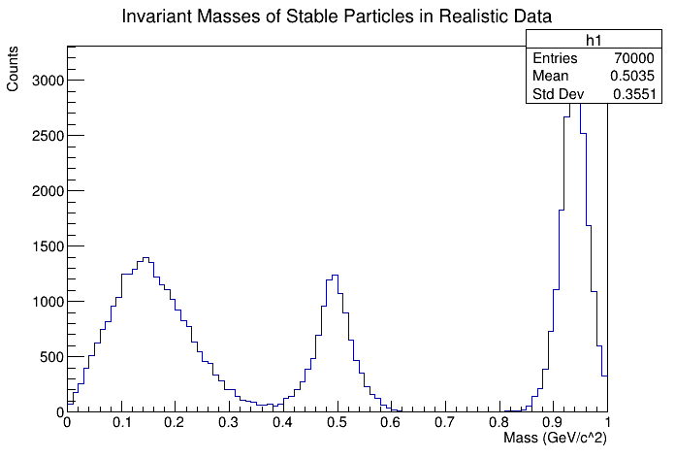
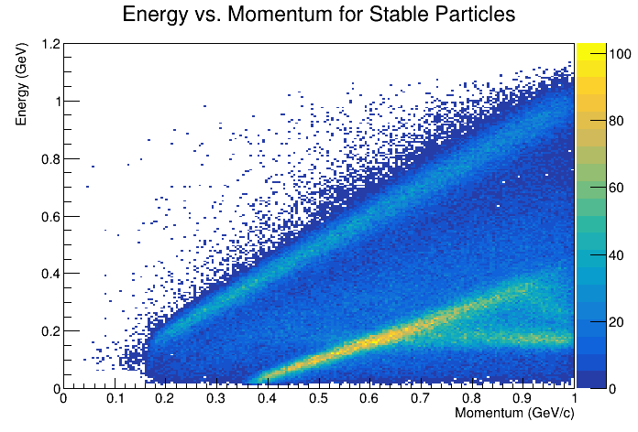
Introduction to ROOT
Students will also learn to use PyROOT to create 1D and 2D histograms, which includes:
Creating canvases
Creating TH1Ds and TH2Ds
Filling TH1Ds and TH2Ds
Drawing TH1Ds and TH2Ds
Because students have likely never seen a histogram before, the activities also walk them through the process of interpreting 1D and 2D histograms.

Slide 10
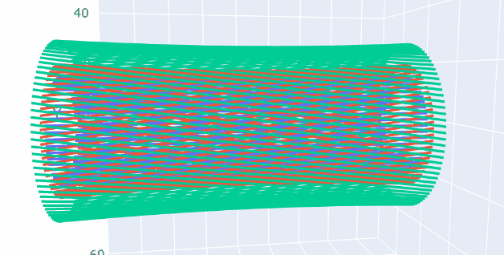
Drift Chambers
Students study the geometry and working mechanisms of the Central Drift Chamber (CDC), learning how to:
Describe the role of drift chambers in particle physics experiments
Define tracks and hits
Identify which particles leave tracks
Identify the role of stereo and axial straws during track fitting
A 3D Model of three rings of the Central Drift Chamber (CDC) from the “Drift Chambers and Tracks” activity

Slide 11
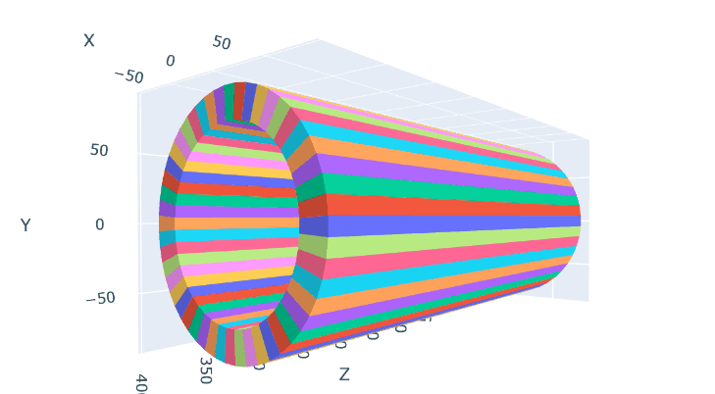
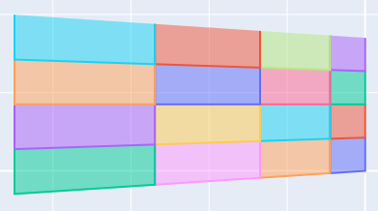
The Barrel Calorimeter
Students are introduced to the Barrel Calorimeter (BCal) and use 2D and 3D models to see how we can detect and identify neutral particles. Students learn to:
Describe the role of calorimeters in particle physics experiments and summarize how they work
Describe the difference between electromagnetic and hadronic calorimeters
Use pulse information (integral, timing) in the barrel calorimeter to measure energy deposition and shower positions.

Slide 12
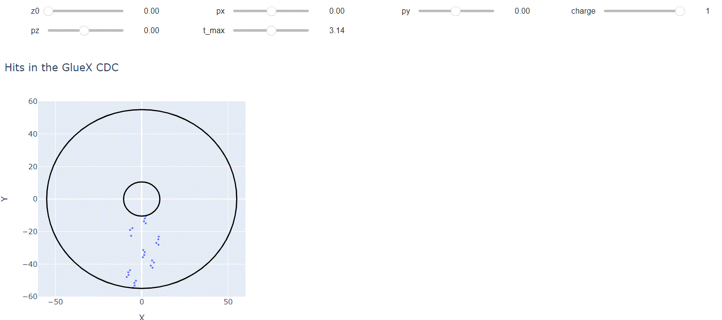
Track Fitting
Based on the geometry of the CDC, students are tasked with:
Using individual hits to determine the parameters of the track
Finding the momentum and charge of a particle based on the curvature of a track
Understanding how a track can be parameterized based on its momentum, charge, and vertex coordinates
A track fitting applet for hits in the CDC from the “Drift Chambers and Tracks” activity

Slide 13
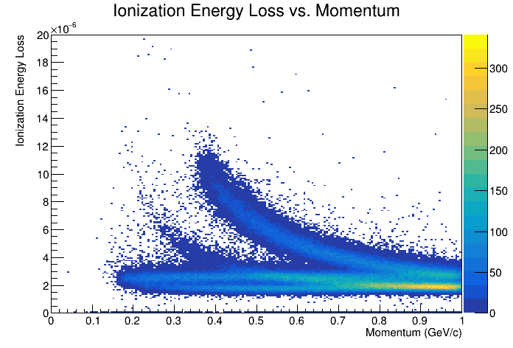
Ionization Energy Loss
Based on the geometry of the CDC, students are tasked with
Calculate ionization energy loss based on detector readout (pulse integral, time)
Demonstrate the separation power of dE/dx analysis using a ROOT TH2D
Classify different charged particles based on their energy loss at fixed momentum
Place 2D cuts based on ionization energy loss and momentum

Slide 14
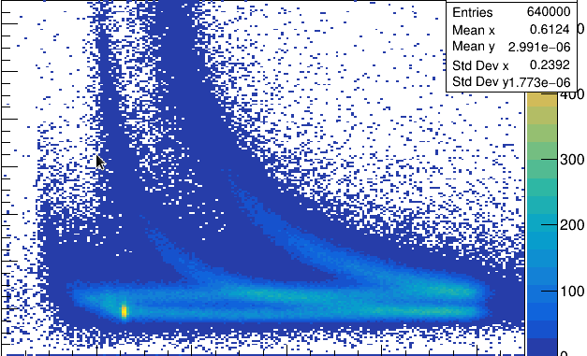
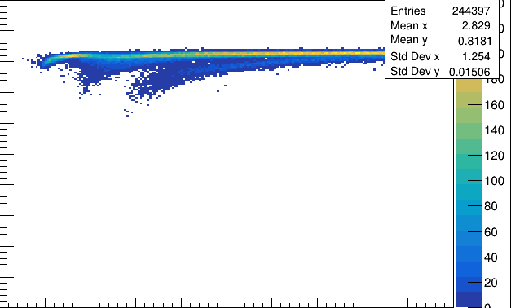
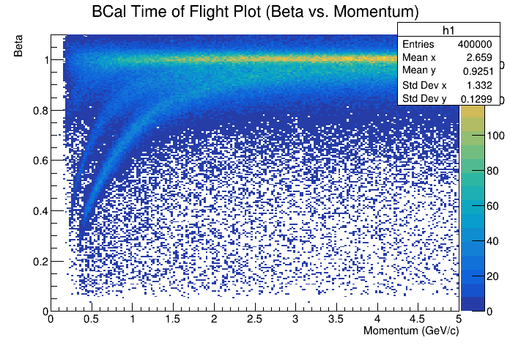
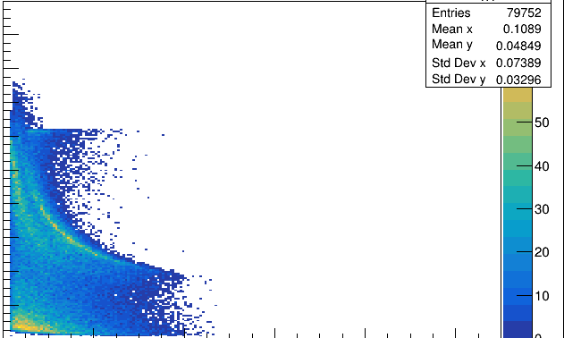
Particle Identification Methods
Ionization Energy Loss
Cherenkov Radiation
Time of Flight
Neutral PID
Notes:
The plot in the bottom right is Energy vs sigTheta

Slide 15
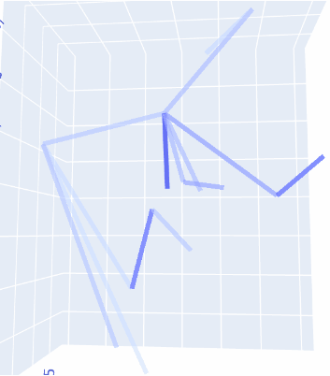
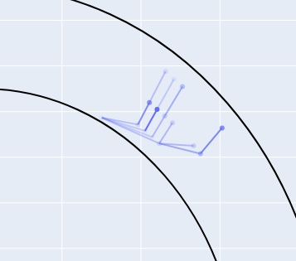
Visualizing Hadronic Showers
To show that neutral PID is substantially harder than charged PID, students are asked to study the properties of showers in the barrel calorimeter, which includes:
Visualizing and comparing showers
produced by different particles
Defining summary statistics of
showers in the BCal and FCal
A 3D Model of a shower in the GlueX BCal as seen in the “Calorimeter and Neutral PID” activity

Slide 16
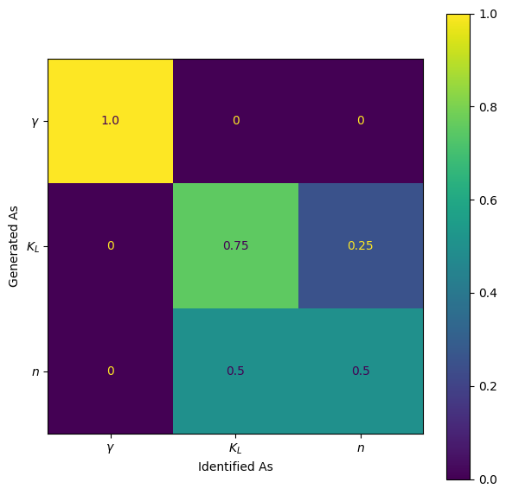
Machine Learning
Students are introduced to the fundamentals of machine learning, and learn to:
Create and interpret confusion matrices
Explain the advantages and disadvantages of machine learning
Create and train a Scikit-learn boosted decision trees model
Identify signs of overfitting and bias in machine learning models
Implement practices to minimize bias when training a machine learning model

Slide 17
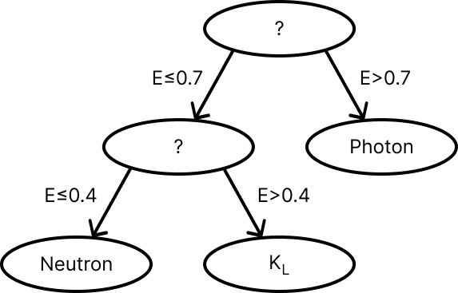
BDT Training
Decision trees make sequential cuts to classify particles
A boosted decision trees (BDTs) model builds decision trees sequentially to predict and correct the errors of previous trees
PID Playground guides students in training BDTs that are trained on:
  Particle gun (single-particle monte carlo) REST events
  Charged particles: exactly one track and one associated shower
  Neutral particles: exactly one shower, no tracks

Slide 18
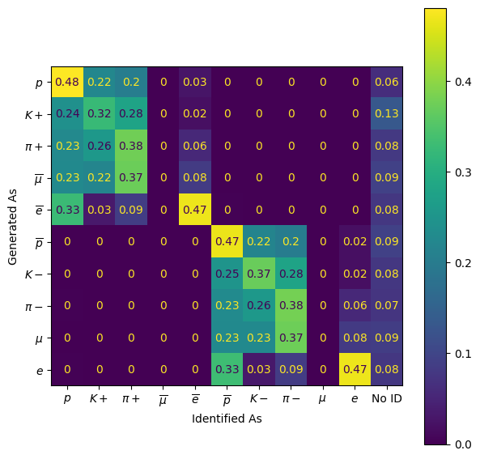
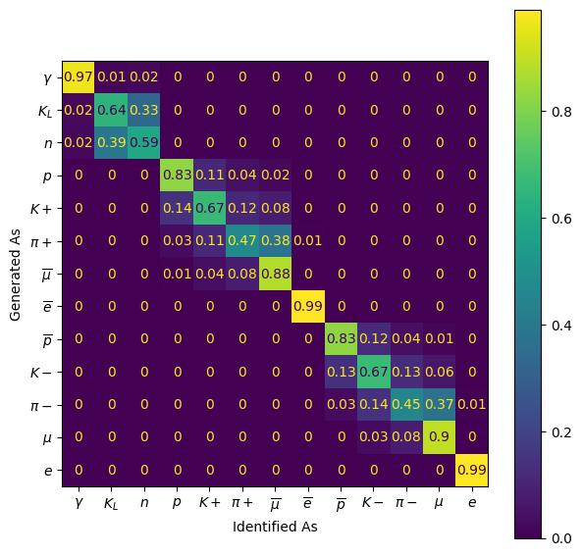
Cuts-based PID
BDT-Based PID

Slide 19
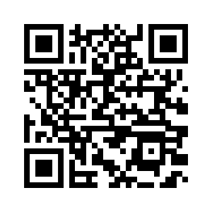
Thank You!
References
Visit PID Playground:
duberii.github.io/pid-playground/
CERN Open Data Team. Logo of CERN Open Data Portal. Github,
https://github.com/cernopendata. Accessed 16 Apr. 2024.
Bellis, Matt. Particle Physics Playground Logo. 12 June 2018. YouTube,
https://www.youtube.com/watch?v=oQXFZU9RuCY. Accessed 16 Apr. 2024.

Slide 20
Possible Next Steps
Event Reconstruction
  Although event-reconstruction-type activities are included in Particle Physics Playground (PPP), PPP doesn’t have any GlueX-specific event reconstruction activities.
Making useful analysis tools in Python
  Reworking the visualization and analysis tools used in the notebooks to be useful in a broader analysis context for students
Experimental data
  Integrating real data from GlueX presents a more realistic picture of PID and allows students to “discover” resonances
Notes:
Add Collaboration meeting, name, newport news, date, etc

