Slide 1



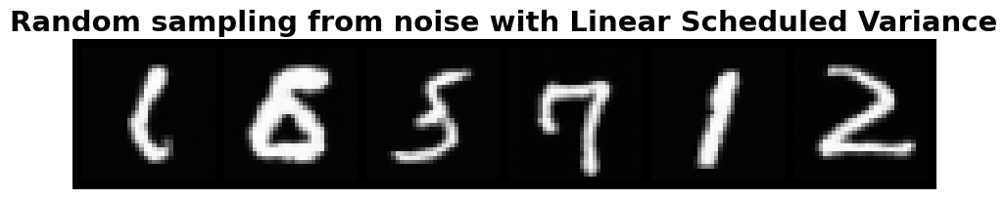
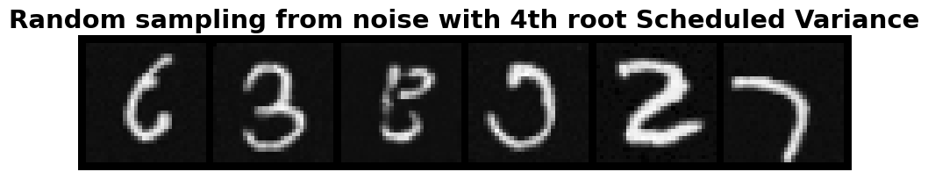
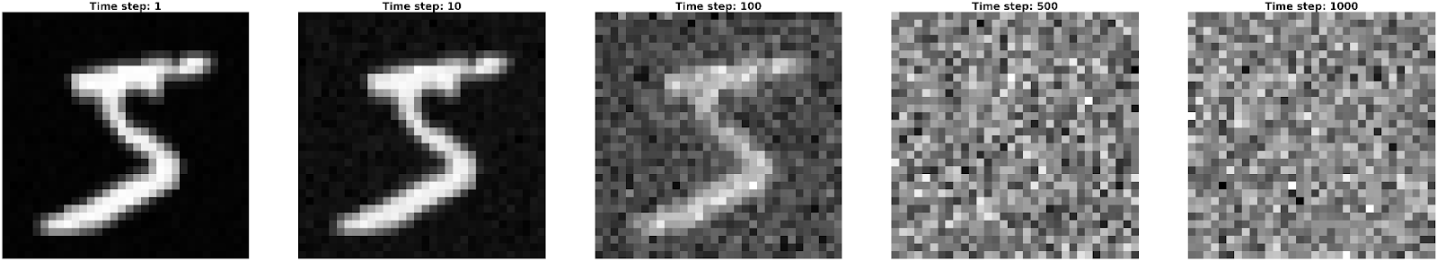
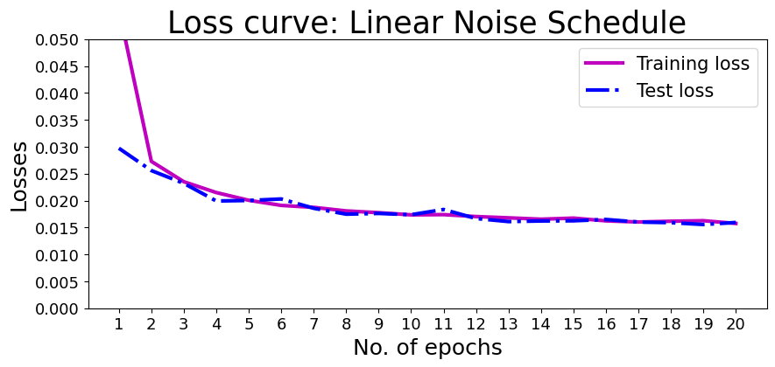
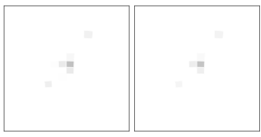
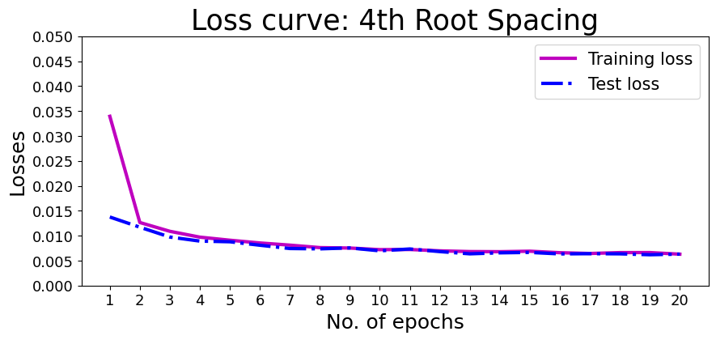
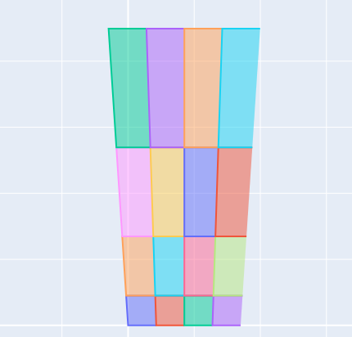
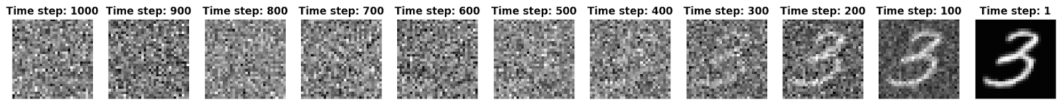
Development of a Diffusion Model for Stochastic High Energy Particle Event Generation
MacChesney Semmelroth, Dr. Richard Jones
University of Connecticut Physics Department
Introduction
Summary
When a nuclear collision occurs, the particles produced in the reaction travel through the detector and leave behind signals in the sensitive elements. In an electromagnetic calorimeter, an electron or photon generates a cascade of low energy particles in the passive absorbing material whose total energy read out by the electronics is a predictable function of the incident photon or electron energy. Much less clean and predictable is the response to hadrons like protons, neutrons, and pions whose response in the calorimeter is much more chaotic. The response of the calorimeter to hadrons must therefore be modeled by Monte Carlo (MC) Simulations. But imperfect modeling of hadron interactions with the detector material limits the accuracy of these simulations. The goal of this project is to replace detailed MC simulations with a data-driven approach using a DDM [1] to generate response patterns that imitate those seen in actual experimental data. As a first step I experiment with ways to optimize the use of a DDM for image generation trained on the MNIST dataset
What have I learned about DDPMs?
Different noise schedules can help the model perform better
Effective at generating diverse outputs
There are many variables one could modify to optimize generation quality
The slow training and sampling time can be overcome with high-power computing
With limited training data, the model was still able to perform impressively. With much more data, it would undoubtedly perform even better
Figure 3:
Random Sample of 6 images from the MNIST dataset
Figure 4b:
6 samples of outputs of a DDM trained with 4th root scheduled noise
Figure 4a:
6 samples of outputs of a DDM trained with linear scheduled noise
Next Steps: Applications to Calorimeter Data
How a Diffusion Model Functions
Denoising Diffusion Models (DDMs) generate random outputs, usually images, from random noise.
With my newfound knowledge of DDPMs I will start applications towards physics.
The first step is to match current MC simulations' outputs (Figure 6) by training a DDPM on the current MC results.
  Figure 6 shows simulated light pulses within 3 neighboring modules of the Barell Calorimeter (BCal) where the LHS is the upstream end and RHS is the downstream end
  Figure 7 is a graphic representing the different layers and sections within a module of the BCal
After the model can match the quality of MC simulations, the training with real detector data can begin
  With hopes of exceeding the accuracy of the outputs of the MC simulations
DDMs consist of 2 major processes
A forward" noising process, Figure 1, where random noise is added to the input image. The noise is represented by spaced variances across multiple steps.
A reverse denoising process, Figures 3a and 3b, where the model
estimates the noise added at a given step and samples from the respective posterior distribution
Figure 1:
The forward noising process at various subsequent timesteps, from 1-1000
Figure 5a:
RMS Error Loss at each epoch in the training/testing process.
I used the UNET architecture [2] which consists of downscaling and upscaling
Training is performed by estimating the noise added for a given time-step and comparing the error with the actual noise using RMS
The better the model can guess the added noise, the better the estimate of the noise's mean and the posterior distribution.
Figure6
MC results of light pulses within 3 modules of the BCal
There is a height of 10 squares which correspond to one square of a section of a module of the BCal
The darker the square, the more energy was deposited
Effects of Different Noise Schedules
Changing the noise schedule changes the amount of noise added at a particular time step
Figures 2a and 2b show the denoising process of a trained network on all the MNIST data with different noise schedules
Figures 4a and 4b show other generated outputs from models trained on both kinds of schedules and a sample of MNIST data is seen in Figure 3 for reference
Both generate high quality outputs, however comparing Figure 5a to Figure 5b it is seen that there is much less statistical loss with 4th root spacing.
Figure 5b:
RMS Error Loss at each epoch in the training/testing process.
Figure 7 is a graphic showing the front cross section of one of the 48 modules of the BCal
Horizontal Sections: "Layers"
Vertical Sections: "Sectors"
The bottom row is 1 square tall the row above is 2 squares tall and so on
Figure 7:
Graphic showing the different regions of a module of the BCal
Figure 2a
Denoising from a Linear Schedule
Figure 2b:
Denoising from a 4th Root Schedule
REFERENCES
ACKNOWLEDGEMENTS
Ho, Jonathan, Ajay Jain and Pieter Abbeel. "Denoising Diffusion Probabilistic models."
2. Ronneberger, Olaf, Philipp Fischer, and Thomas Brox. "U-net: Convolutional networks for biomedical image segmentation."
Thank you to Dr. Richard Jones along with the rest of the group; Mezmur Edo, James McIntyre and William Livesay. As well as the McNair Scholars Program for the opportunity to present at this conference

