Slide 1
Part 3: The Vibrating String
Nuclear Physics:
Put a Quark In it
By Chelsea Sidrane
Mentor: Dr. Richard Jones

Slide 2
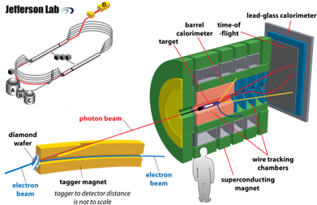
GlueX
The goal of GlueX is to study the concept of confinement in those particles that display some degree of gluonic freedom; hybrid mesons.
Notes:
We plan on doing this by shooting a high-powered beam of electrons at a target of liquid hydrogen and measuring the results
Radius of curvature of an electron in magnetic field is related to the energy>scinti

Slide 3
Our Part
Of the many components that went into constructing the GlueX setup, we worked on the photon source, specifically, the mount for the crystal
radiator
Photon source
Tracking
Calorimetry
GlueX

Slide 4
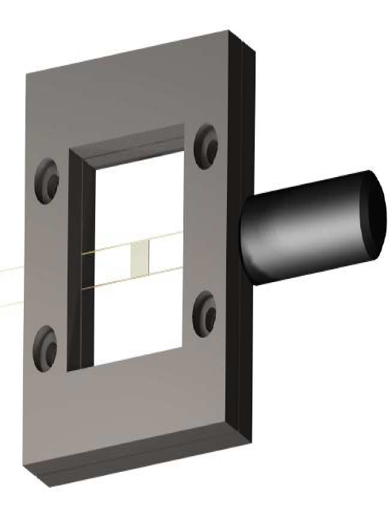
Mounting the Radiator
Diamond mounted on
carbon fibers
Goal
Avoid low energy
background bremsstrahlung
Notes:
the diamond wafer must be mounted on carbon fibers, chosen for good material properties, (quick damping time?) and is largely unaffected by the high beam operating temperatures (~500 C)

Slide 5
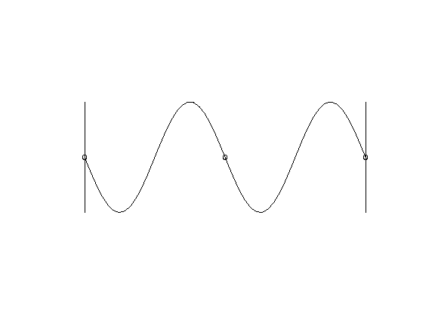
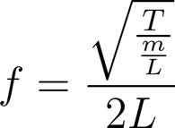
The Principles Behind Our Experiment: Ensuring Radiator Stability
Vibrating Wire
Crystal radiator must be stable
Must be finely tunable to create Coherent Bremsstrahlung
Resonance-
a system’s tendency to vibrate with a larger amplitude at certain frequencies
Constructive intereference
Notes:
that will allow for precise adjustment in order to produce coherent bremsstrahlung when placed in the electron beam’s path
-We calculated the resonant frequency of the carbon fibers so that once fixed to a metal frame, we could calculate the tension of the wires. (Knowing the tension of the wires tells you how rigidly held the diamond is thus how vibrations might disturb the path of the photon beam.)

Slide 6
Weighting the Wire
Tension (T)
Tension (T)
drop of glue
Wires assumed massless
L/2
M
L/2
Length (L)
Making Measurements
-resonance frequency of carbon fibers
-increased mass lowers resonant frequencies
Angular
Frequency
Notes:
Resonant frequency of carbon fibers ~10,000 Hz

Slide 7
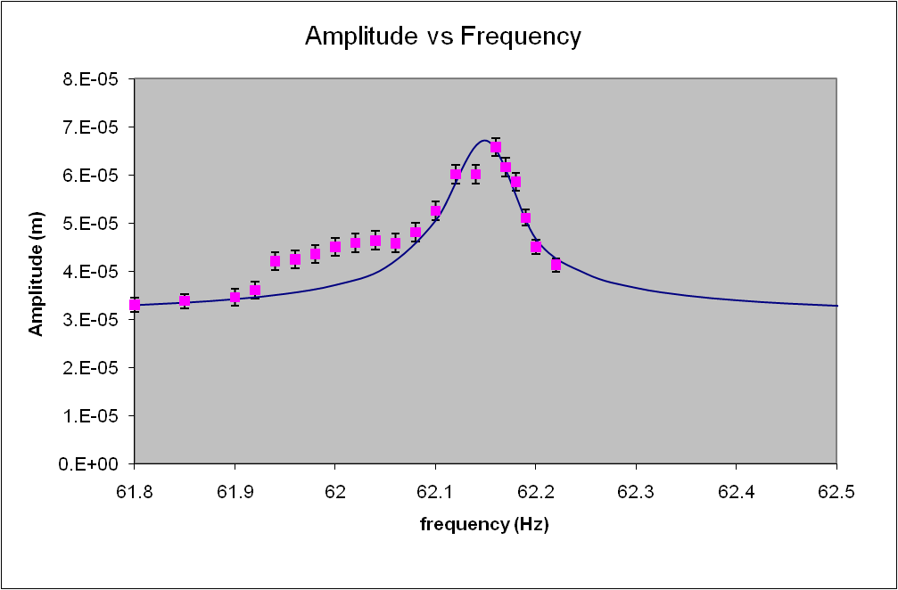
Weighting the Wire:
Theory V. Data
Theoretical Data estimated to find resonant curve
*Enlarged view*
Peak of Resonance Curve is maximum resonant frequency

Slide 8
Conclusion
The Standard Model and the origin of particle physics
The GlueX experiment
Our work on the radiator mount

Slide 9
Acknowledgements
Thanks!
Dr. Jones
Professor Mannhiem
Brendan Pratt
Chris Pelletier
Igor Senderovich
George Rawitscher
Thanks!
Thanks!
Thanks!
Thanks!
Thanks!
Thanks!
Thanks!
Thanks!
Thanks!
Thanks!
Thanks!

