Slide 1
The Gluex Experiment
By Chelsea Sidrane
Mentor: Dr. Richard Jones

Slide 2
Nuclear Physicists
have long pondered these two questions:
What is the world made of?
What holds it together?
(Is a theory that scientists have formulated explain the world around us walk through picture)
The standard model includes 2 different types of elementary particles, fermions and bosons. -2 main groups of fermions, leptons and quarks -4 main types of bosons; responsible for 3 of the 4 fundamental interactions (forces)
The Standard Model was born
Notes:
4 fundamental interactions between particles,

Slide 3
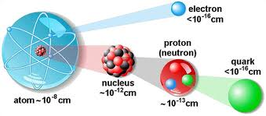
What Happened to the Atom?!
The atom is no longer fundamental
The atom is made up of:
Nucleus
Protons/Neutrons
Quarks
and Gluons
Electrons
Elementary=no observable internal structure, aka not composite

Slide 4
The Standard Model states
SM
Two groups of elementary particles; fermions and bosons
Fermions
Bosons
Known as quarks and leptons; as force-carriers-resposible for fundamental fources
-Two main groups
-Have half-integer spin(1/2, etc.)
-Obey the Pauli exclusion principle
-Four main types
-Have integer spin (0,1,2)
-Do not obey the Pauli exclusion principle
Wait, Pauli what?
Pauli Exclusion Principle tells us that no two particles can occupy the same quantum state at the same time.

Slide 5
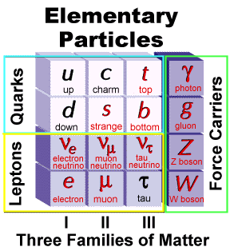
Fermions
Quarks
Fractional Charge
Color charge
Compose protons and neutrons
Leptons
Families/Flavors
Integer charge
Solitary
Fermions-left half-3 generations
Quarks- fractional charges (2/3, -1/3) and combinations of these make up protons and neutrons.
Quarks carry color charge, a different type of charge that is not related to actual color
Leptons each gen=a family the electron, e⁻, the muon, μ⁻, and the tau, τ⁻
In each family there is a charged particle that gives each family its name, and a neutrino, ν, corresponding to the charged particle
Ex: The electron family consists of the electron e⁻ and the electron neutrino ν_{e}
Tau and muon are like massive electrons, all -1 charge,
Neutrinos-tiny mass and no charge
Three Generations of Matter

Slide 6
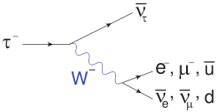
Decay
Lightest=Most Abundant
Flavor Changes

Slide 7
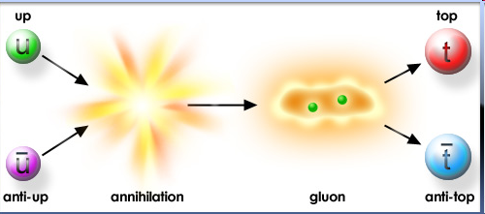
Antimatter
Note:
The corresponding antimatter particle is generally represented by a bar placed over the symbol of the particle:
Up quark
Mention protons and antiprotons(composites) ALL charges get reversed including lepton number except for spin
Also mention kinetic energy to produce heavier particles^
Decay slide-zig zag, top quark into strange quark (via W) then into up quark (via W)
Elementary particles have antiparticles
equal and opposite charges
u
ū
Anti Up quark

Slide 8
The Standard Model states
SM
Interaction is EM, strong etc, force is something that passes b.n2 particles
Quickfact: the fourth fundamental force is gravity, but it has yet to be incorporated into the standard model
The elementary (fermion) particles interact by exchanging (boson) force-carrier particles
The photon{ γ }
force carrier for electromagnetic force
affects electrically charged particles
The gluon{ g }
force carrier for strong nuclear force
affects color-charged particles (quarks); holding them together in composite particles
The Z boson{ Z }, and W bosons{ W⁺, W⁻ }
force carrier particles for weak nuclear force
couples to particles with weak charge
W bosons intermediate flavor changes (a tau[τ] changing into a muon[μ] for example)
Three Generations of Matter

Slide 9
The Standard Model states
SM
These interactions fall into 3 categories: electromagnetic force; weak nuclear force; and strong nuclear force
Electromagnetic Force
Causes attraction and repulsion between electrically charged particles
Carrier particle is the photon γ
Photons, massless, travel at speed of light, makes up the electromagnetic spectrum
Is responsible for : chemistry, biology, magnetism, many other forces we encounter everyday
Notes:
Photon-has zero mass
–travels at the speed of light in a vacuum
-of different energies make up EM spectrum from radio waves to gamma rays

Slide 10
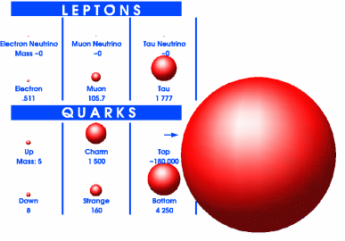
Weak Force
All stable matter in the universe is made up of the least massive type of each particle:
Decay is orchestrated by the carrier particles of weak interactions: W⁺ W⁻ particles
Feynman diagram!!!
&
quarks
Muon
Tau
Notes:
So all other more massive particles
decay or change flavor into less massive particles

Slide 11
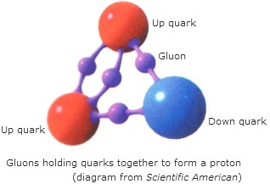
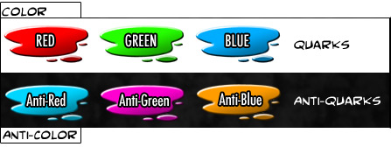
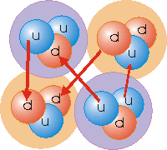
Strong Force
Force between color-charged particles (mainly quarks) is strong force (responsible for hadrons)
Color-charged particles exchange gluons; creating color force field
Residual strong force : holds the nucleus together
Strong Force
Color must always be conserved just as energy and electric charge
meson
Notes:
Color…-but more on that later
-Strength of the field increases as quarks move farther away from one another, thus color confinement arises
Residual-attractive color force between quarks in different hadrons in the nucleus that (being stronger than EM force

Slide 12
Composite Particles
Hadrons
composed of strongly interacting particles (quarks or gluons)
have a integer EM charge and no net color charge
Baryons
Mesons
Quark
Quark
Quark
U
Ū
Up
Quark
Anti Up
Quark
All hadrons must be color neutral
Notes:
Baryons
particles which are composed of a set of three
quarks. Two well-known examples are the proton,
two up-quarks and a down quark, and the
neutron, two down quarks and an up quark
-All madly exchanging gluons

Slide 13
Quantum Numbers and Conservation
Quantum Numbers/Conserved Properties
Angular Momentum/Spin
*Lepton number(s)
*Baryon number
*Electric charge
Flavor: Strangeness Charm Bottomness Topness Isospin
Color Charge
Momentum/Energy
Weak Charge/Isospin
Notes:
The W and Z bosons decay to fermion-antifermion pairs but neither the W nor the Z boson can decay into the higher-mass top quark.
Position from origin x linear momentum; orientations in space
+1 for each family
Quarks 1/3, Baryons 1
+2/3, -1/3 for Quarks, -1,0 for Leptons, 1 or 0 for baryons
-1 for Strange Quark
+1 for Charm Quark
-1 for Bottom Quark
+1 for Top Quark
+1/2 for Up Quark, -1/2 for Down Quark
Has to remain the same or add to white
E=Mc² ;Matter is never created or destroyed
*Left-handed, -1/2 or 1/2

Slide 14
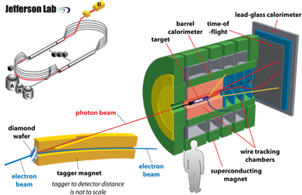
GlueX
The goal of GlueX is to study the concept of confinement in those particles that display some degree of gluonic freedom; hybrid mesons.
Notes:
We plan on doing this by shooting a high-powered beam of electrons at a target of liquid hydrogen and measuring the results
Radius of curvature of an electron in magnetic field is related to the energy>scinti

Slide 15
Our Part
Of the many components that went into constructing the GlueX setup, we worked on the photon source, specifically, the mount for the crystal
radiator
Photon source
Tracking
Calorimetry
GlueX

Slide 16
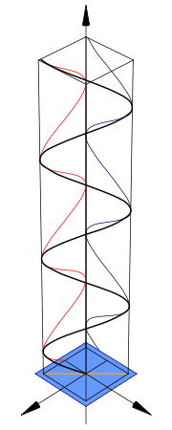
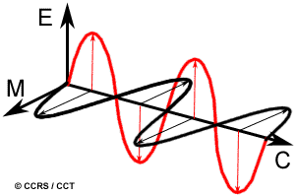
The Requirements for the Photon Source
9 GeV Photon Beam
Low background radiation
Linear polarization:
both electric and magnetic fields are oriented
in a single direction; as is the resulting photon
beam
Notes:
The tip of the vector traces out a single line in the plane
High energy resolution: ability to detect individual photons at high energy (property of the detector not of the photon beam)

Slide 17
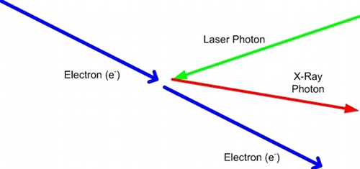
Two Methods
Compton Back-Scattering
polarization
no background radiation (laser)
Bremsstrahlung
Sufficient Energy
Sufficient Flux

Slide 18
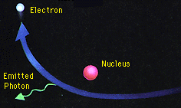
The Principles Behind Our Experiment
Feynman Diagram
of an atom in a radiator
Bremsstrahlung; or Braking Radiation
-Deflection/Acceleration
=radiation
Virtual photon
AKA bremsstrahlung radiation
Notes:
Brem- is EM radiation produced from the acceleration of a charged particle when deflected by another charged particle, like the nucleus of an atom within a thin sheet of metal, called a radiator

Slide 19
Coherent Bremsstrahlung
Coherent bremsstrahlung greatly increases the flux of photons/GeV; represented by the peaks on this graph
Coherent Bremsstrahlung
Replace the radiator with a crystalline substance
Correct Orientation->Peaks
Sufficient flux
Lower background
Linear polarization
Notes:
When the radiator is replaced with a thin wafer of a crystalline substance, and when properly oriented, a radiated electron can cause multiple atoms in the crystal lattice to recoil in sync
-multiple atoms in a crystal lattice absorb the recoil momentum from a high-energy electron when it radiates a bremsstrahlung photon
-peaks are produced at certain energies of the radiation spectrum that can be made to correspond to the reciprocal lattice vectors of the crystal and significantly enhance the required high-energy photon flux.
-CB also reduces low-energy background relative to the increased amount of high energy radiation.
-Lastly, CB radiation also has significantly more net linear polarization compared to B radiation.

Slide 20
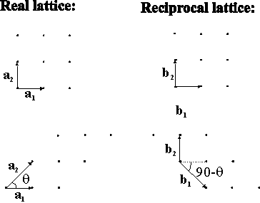
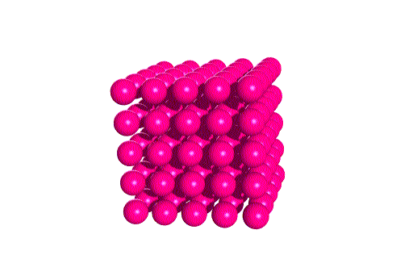
Reciprocal Lattice Vectors
In reciprocal space
model for diffraction in crystals
measured in units of
1/distance

Slide 21
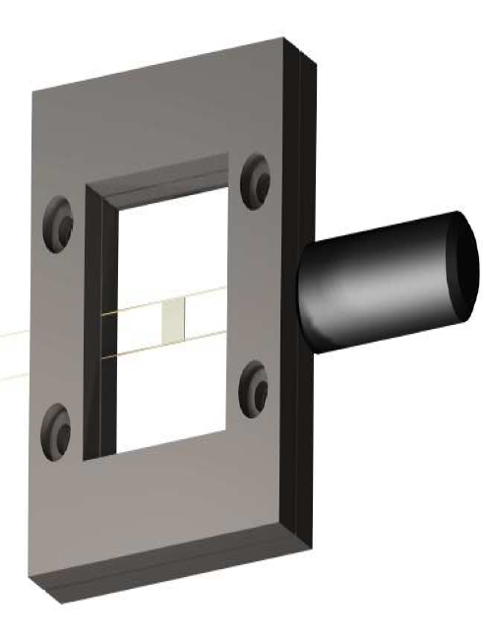
Mounting the Radiator
Diamond mounted on
carbon fibers
Goal
Avoid low energy
background bremsstrahlung
Notes:
the diamond wafer must be mounted on carbon fibers, chosen for good material properties, (quick damping time?) and is largely unaffected by the high beam operating temperatures (~500 C)

Slide 22
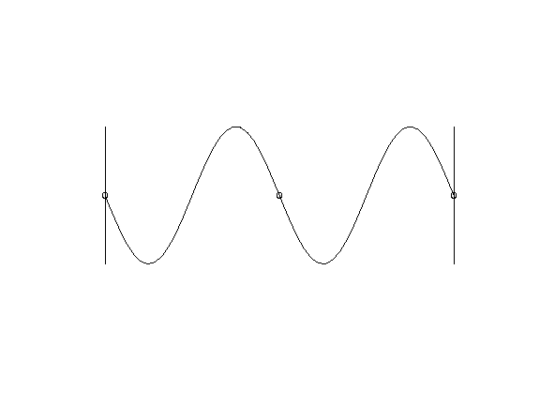
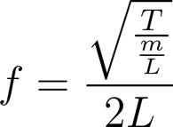
The Principles Behind Our Experiment: Ensuring Radiator Stability
Vibrating Wire
Crystal radiator must be stable
Must be finely tunable to create Coherent Bremsstrahlung
Resonance-
a system’s tendency to vibrate with a larger amplitude at certain frequencies
Constructive intereference
Notes:
that will allow for precise adjustment in order to produce coherent bremsstrahlung when placed in the electron beam’s path
-We calculated the resonant frequency of the carbon fibers so that once fixed to a metal frame, we could calculate the tension of the wires. (Knowing the tension of the wires tells you how rigidly held the diamond is thus how vibrations might disturb the path of the photon beam.)

Slide 23
Weighting the Wire
Tension (T)
Tension (T)
drop of glue
Wires assumed massless
L/2
M
L/2
Length (L)
Making Measurements
-resonance frequency of carbon fibers
-increased mass lowers resonant frequencies
similar to frequency
Notes:
Resonant frequency of carbon fibers ~10,000 Hz

Slide 24
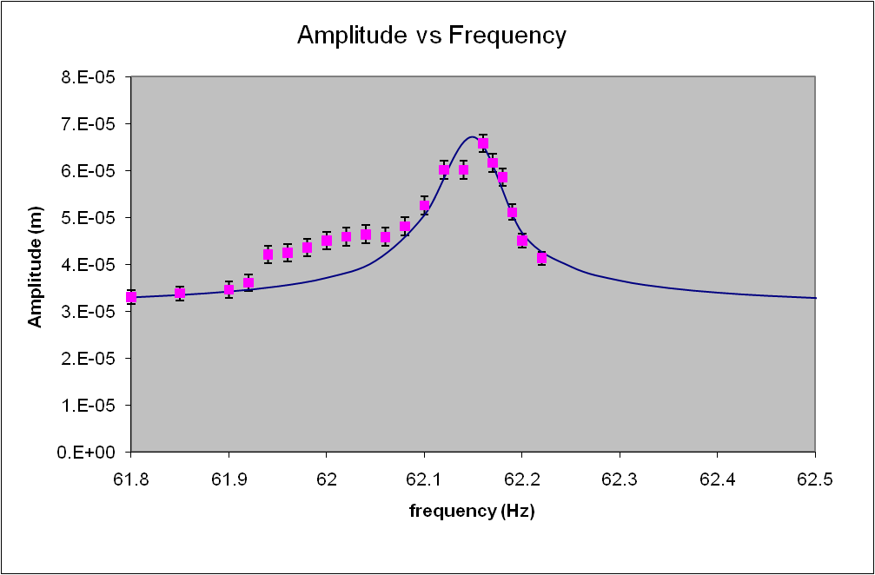
Weighting the Wire:
Theory V. Data
Theoretical Data estimated to find resonant curve
*Enlarged view*
Peak of Resonance Curve is maximum resonant frequency

Slide 25
Conclusion
The Standard Model and the origin of particle physics
The GlueX experiment
Our work on the radiator mount

Slide 26
Acknowledgements
Thanks!
Dr. Jones
Professor Mannhiem
Brendan Pratt
Chris Pelletier
Igor Senderovich
George Rawitscher
Thanks!
Thanks!
Thanks!
Thanks!
Thanks!
Thanks!
Thanks!
Thanks!
Thanks!
Thanks!
Thanks!

