Slide 1
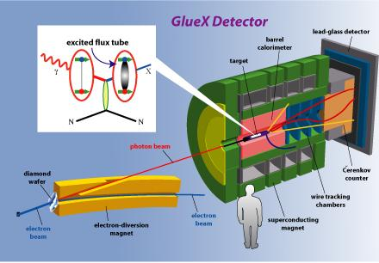
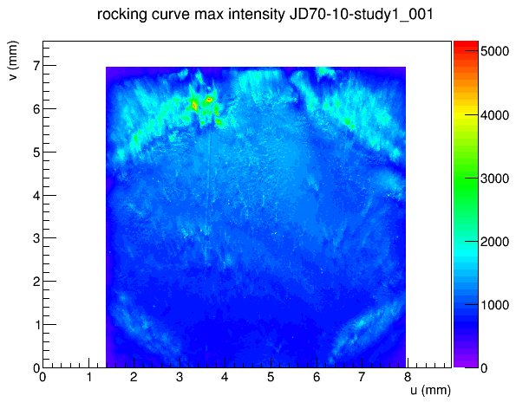
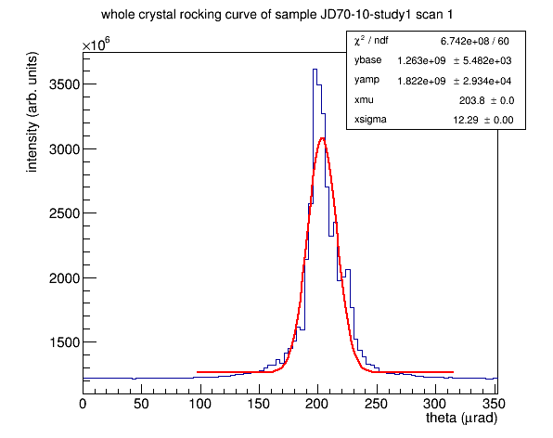
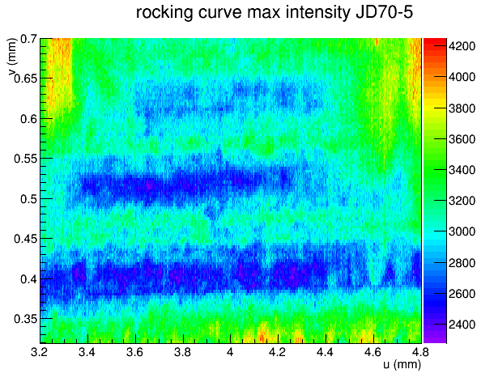
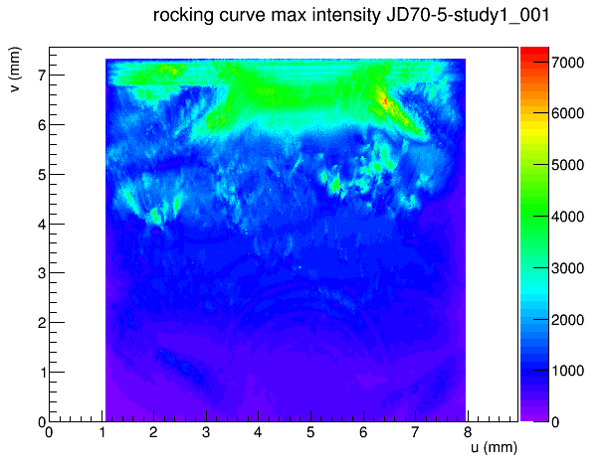
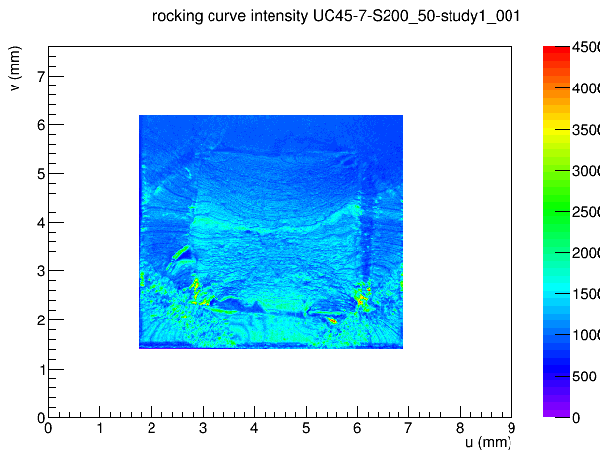
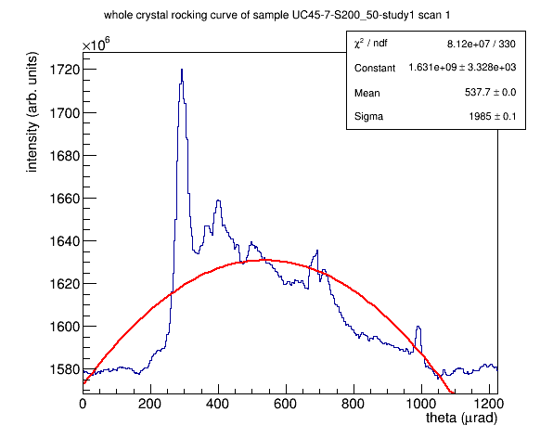
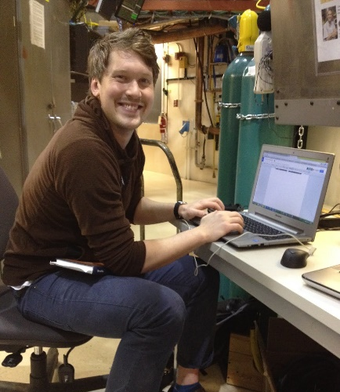
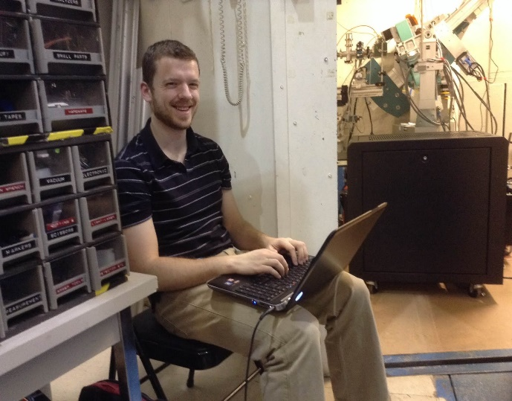
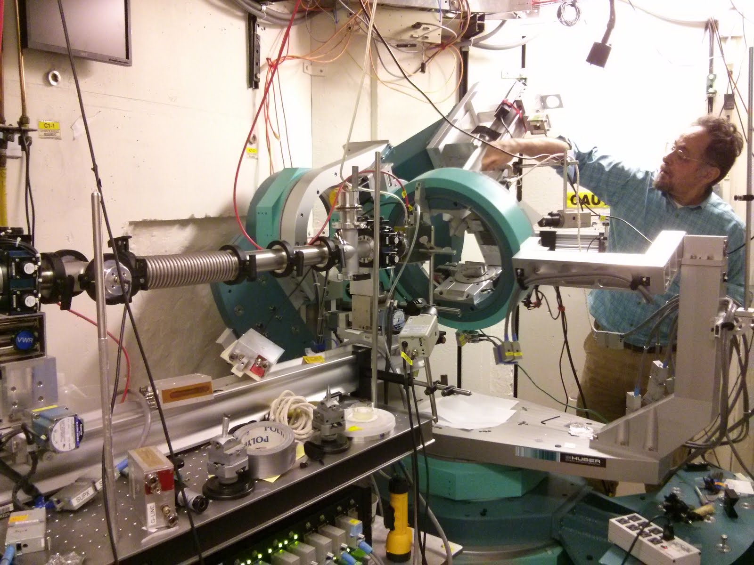
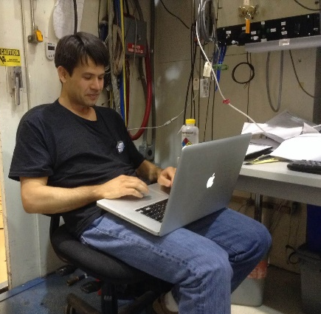
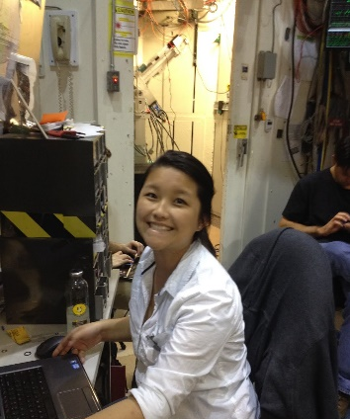
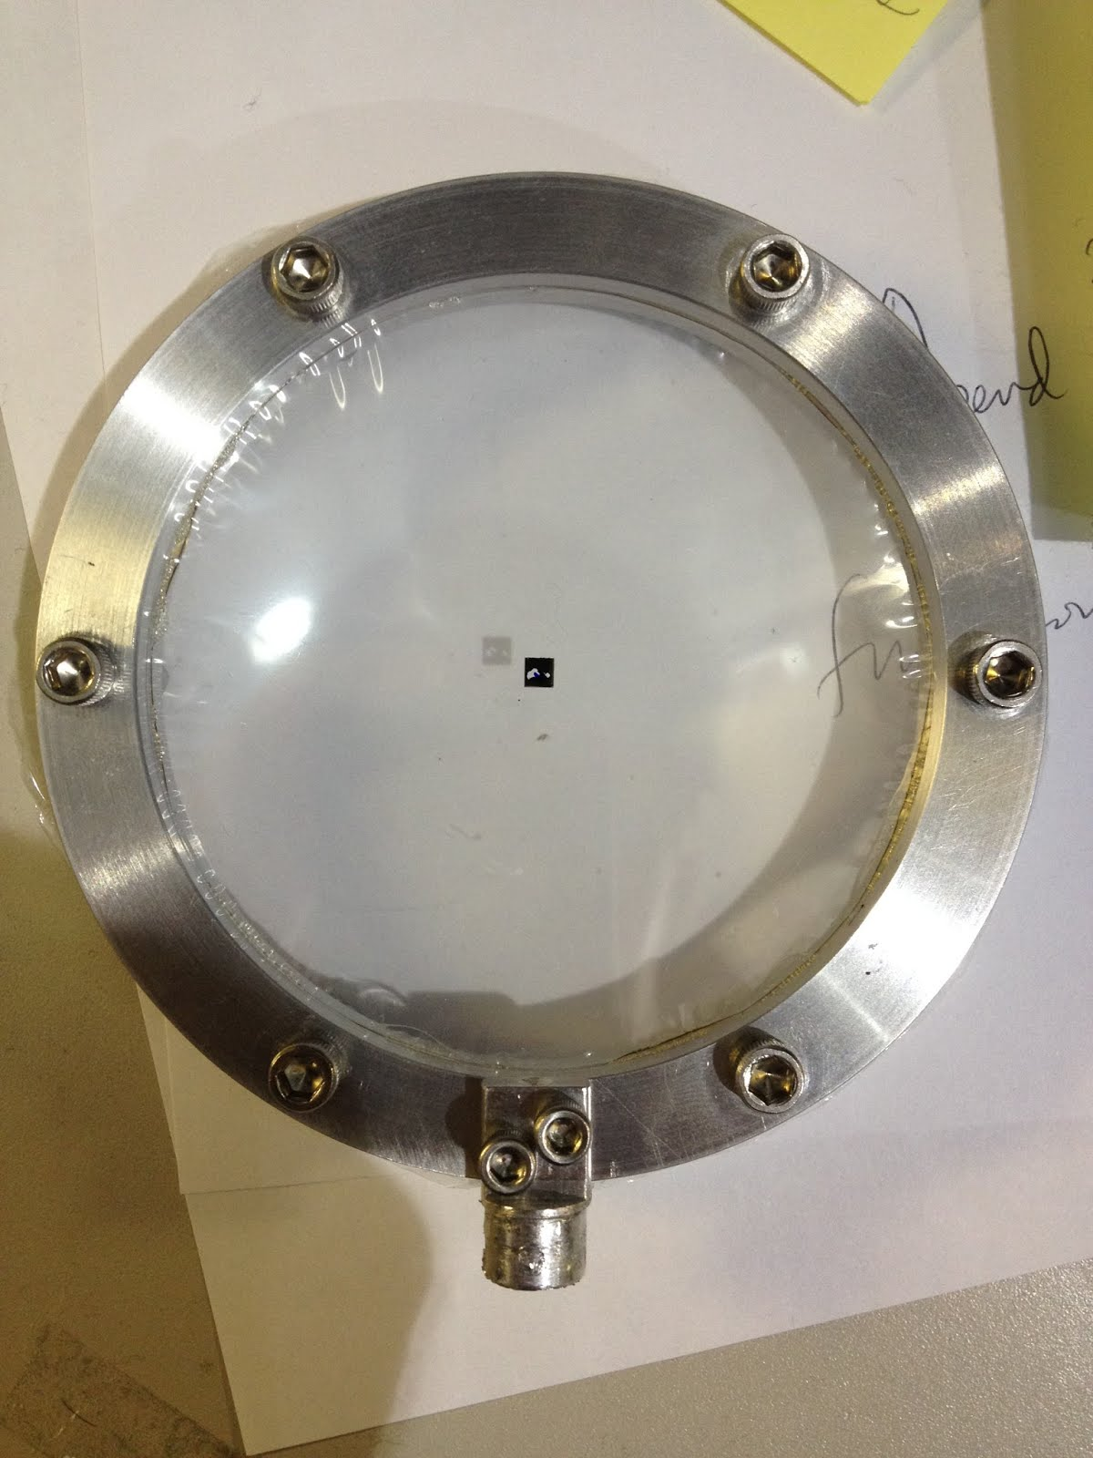
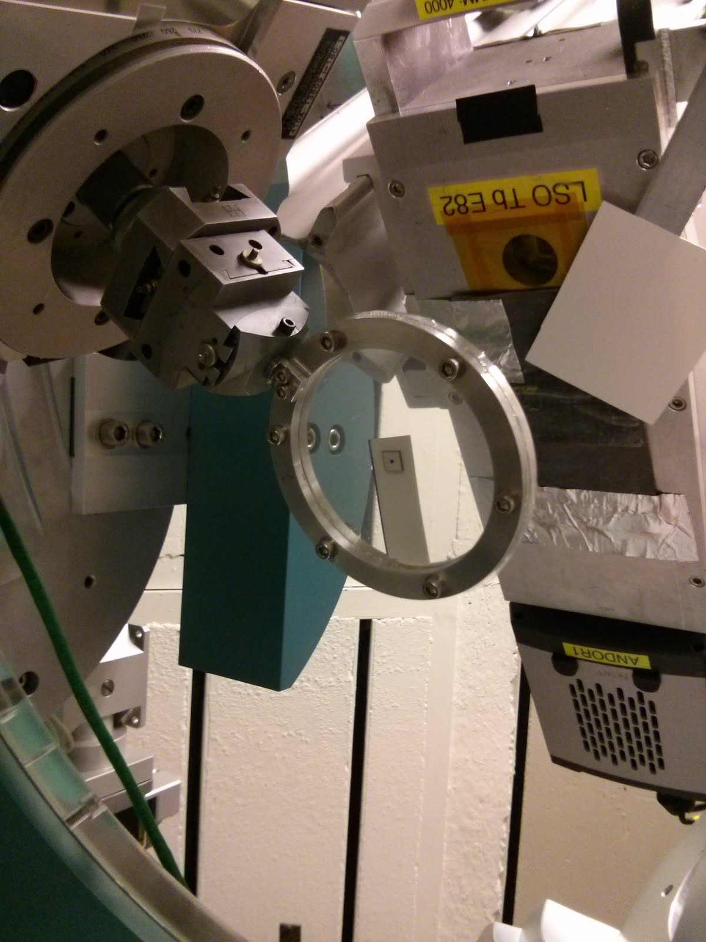
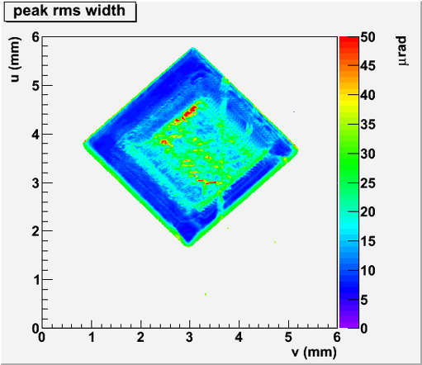
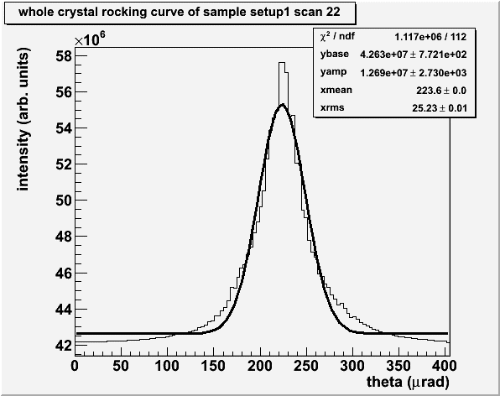
Thin Diamond Radiator Characterization at CHESS for The GlueX Experiment
Brendan Pratt¹, Alex Barnes¹, Nathan Sparks², Liana Hotte¹, Ken Finkelstein³ and Richard Jones¹
¹University of Connecticut, ²Catholic University of America, ³Cornell High Energy Synchrotron Source
University of Connecticut
Abstract
X-Ray Rocking Curves of UConn Samples taken at CHESS
Pendelloesung Effect in 1.2mm CVD diamond
Extremely flat, thick crystals
µrads
The Laue diffraction of thick crystals shows excellent single crystal behavior and X-rays coming off edge show dynamic x-ray diffraction and the Pendelloesung effect with many fringes visible
X-ray rocking curve of a 7x7x1.2mm thick sample which will be thinned and be of the first radiators commissioned for the GlueX experiment.
A very narrow whole crystal rocking curve for untouched CVD diamond.
The GlueX experiment at the Thomas Jefferson National Lab in Newport News Virginia uses a polarized beam of 9GeV photons incident on a liquid hydrogen target to explore the excitations of gluonic bonds between quarks. 9GeV photons are generated by a 12GeV electron beam passing through a 20µm thick diamond wafer and undergoes coherent bremsstrahlung.
Optimum polarization requires that the mosaic spread of the diamond be negligible, but experience with thin diamond wafers has shown that internal stress caused by defects produce large scale warpage. The GlueX group at UConn has developed a laser ablation process to create 20μm CVD diamond radiators free from strain and warping. Surface profiles and rocking curve measurements are presented which demonstrate that this process results in diamond radiators which meet the GlueX criteria for thickness, flatness, and crystal mosaic spread.
Thin, but warped
The GlueX CHESS Club Members
µrads
Setup for Diamond Diffraction at CHESS
Brendan Pratt, Alex Barnes, Nathan Sparks, Liana Hotte, Richard Jones
CHESS staff scientist Ken Finkelstein making adjustments to the goniometer in hutch C1
In collaboration with GlueX, corporate collaborator Sinmat has been developing vapor phase ion etching techniques to thin diamond to 30µm. So far, their process leaves a very wide rocking curve, as seen by the figure on the right.
Originally a pristine 500µm crystal, the vapor phase ion etching technique used by Sinmat leaves a severely warped diamond.
Custom Si(331)
monochromator
UConn design,
built at CHESS
monochromatic 15 keV
highly-parallel X-ray beam
8mm x 8cm spot size
dispersion-matched to
diamond (2,2,0) planes
CCD
camera
Thin AND Flat!!
He gas
first crystal,
water cooled pure Si
15.3° miscut from (3,3,1)
expansion factor b ~ 8
at 15 keV X-ray energy
second crystal
symmetric Si(3,3,1)
The diamonds were held using a stretched mylar hoop to avoid mounting strain.
Huber 4-circle goniometer
θ, χ, φ, 2θ
References
white
beam
from C-line
bending magnet
The GlueX Experiment, ((http://www.gluex.org).
http://zeus.phys.uconn.edu/wiki/
This work is supported by the U.S. National Science Foundation under grant 1207857
3. "This work is based upon research conducted at the Cornell High Energy Synchrotron Source (CHESS) which is supported by the National Science Foundation and the National Institutes of Health/National Institute of General Medical Sciences under NSF award DMR-1332208."
X-ray rocking curves of a 3x3x0.3mm³ diamond with a 30µm interior window thinned at the University of Connecticut’s Diamond Ablation Facility
The first diamond radiator to be of the proper thickness and rocking curve requirement. The ablation process has proved to be the most viable option for thinning diamond down to 30µm.

