Slide 1
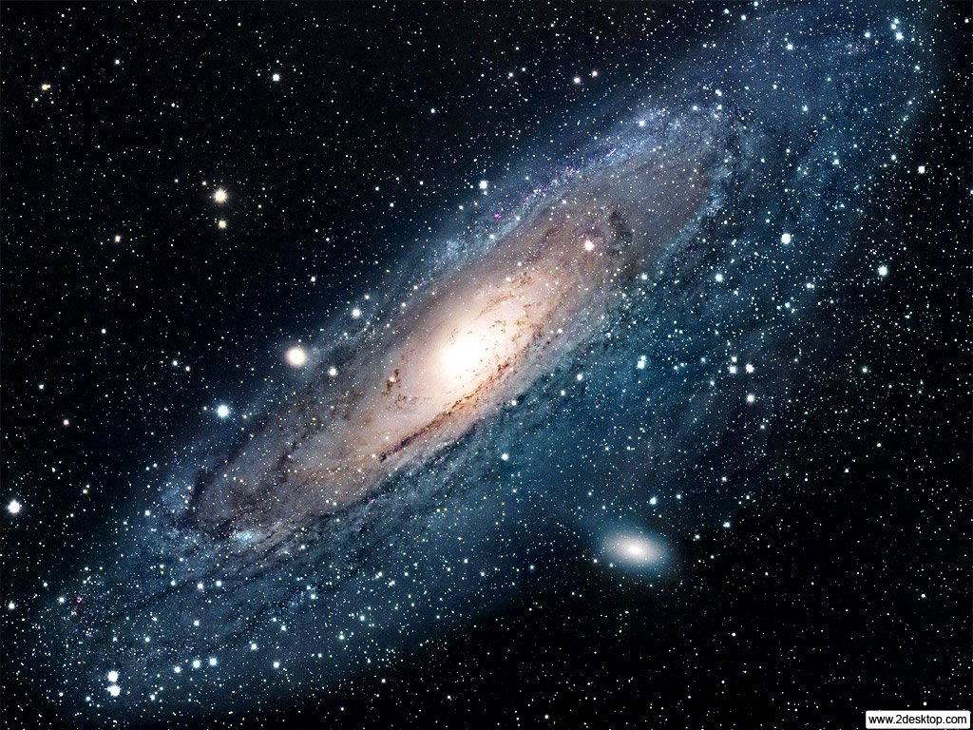
The Other Side of The Universe: Dark Matter
Searching for this elusive substance in the Cosmos
Alex Popescu
Mentor: Dr. Richard T. Jones

Slide 2
Dark Matter Facts
Only 20% of all known matter is the matter we can see, or “normal matter.”
The other 80% is Dark Matter, which is also around us just as much as normal matter is.
Dark Matter doesn’t interact with light or ordinary matter very frequently.
Dark Matter is a “Perfect Fluid,” meaning its molecules do not transfer heat, and they move around without touching one another.
We have been looking for it since 1933.

Slide 3
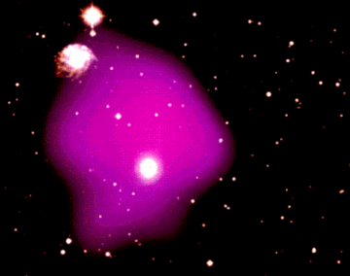
How Do We Know Dark Matter Exists?
Gas Observations “Missing Mass”
Galaxy Rotation Curves
Gravitational Lensing
Galaxy Cluster Formation & Movement
Hot gas in a galaxy cluster

Slide 4
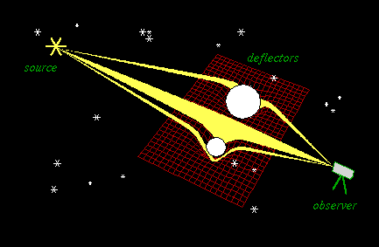
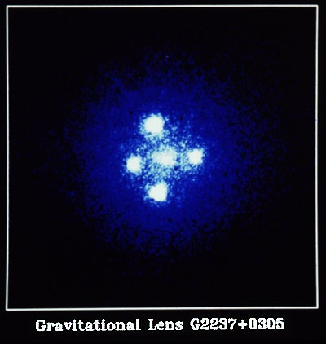
Gravitational Lensing

Slide 5
Galaxy Rotation Curves
Without Dark Matter, stars and planets in our galaxy would fly off into space.

Slide 6
Sources Cited
Images:
NASA Images. http://www.2desktop.com/wallpapers/NASA__The_Andromeda_Galaxy_M31_Spyral_Galaxy_2035_1024_768.jpg
Information:

