Slide 1
Microscope light guide fiber cladding analysis with SEM/EDX
search for second cladding layer
Richard Jones, Liana Hotte
University of Connecticut

Slide 2
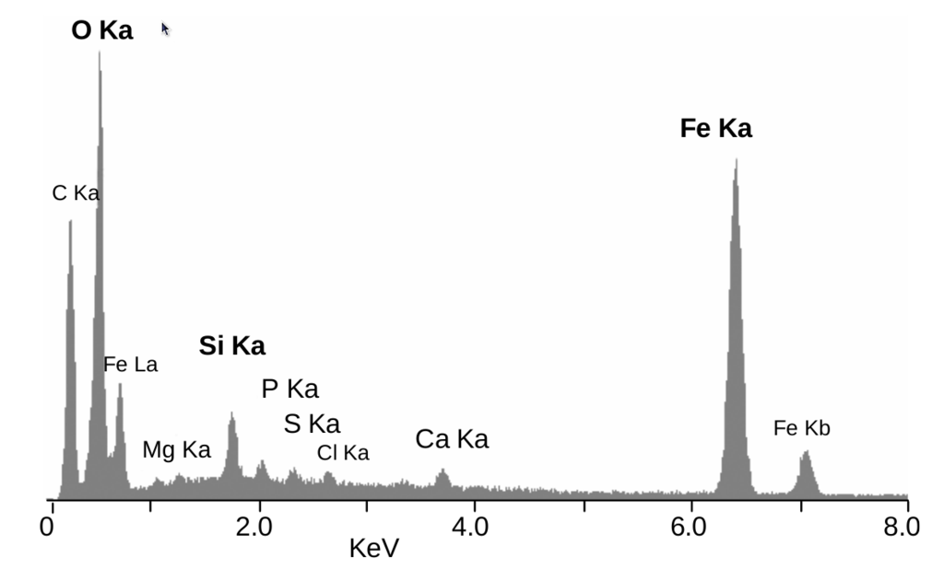
Overview
SEM - scanning electron microscope
EDX - energy-dispersive X-ray spectroscopy
"EDS - Rimicaris exoculata". Licensed under CC BY 3.0 via Wikimedia Commons

Slide 3
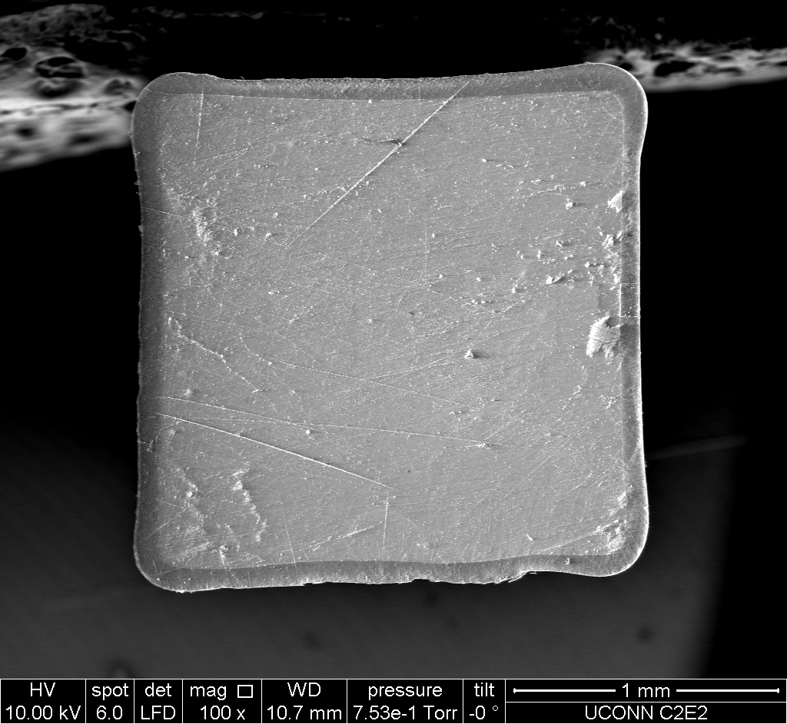
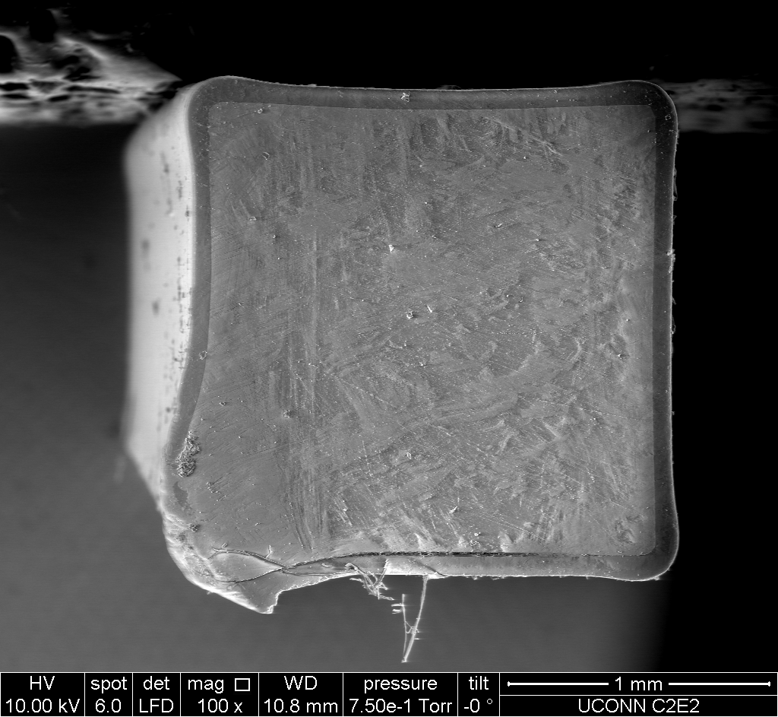
SEM images - light guide cross sections
old light guide sample
new light guide sample

Slide 4
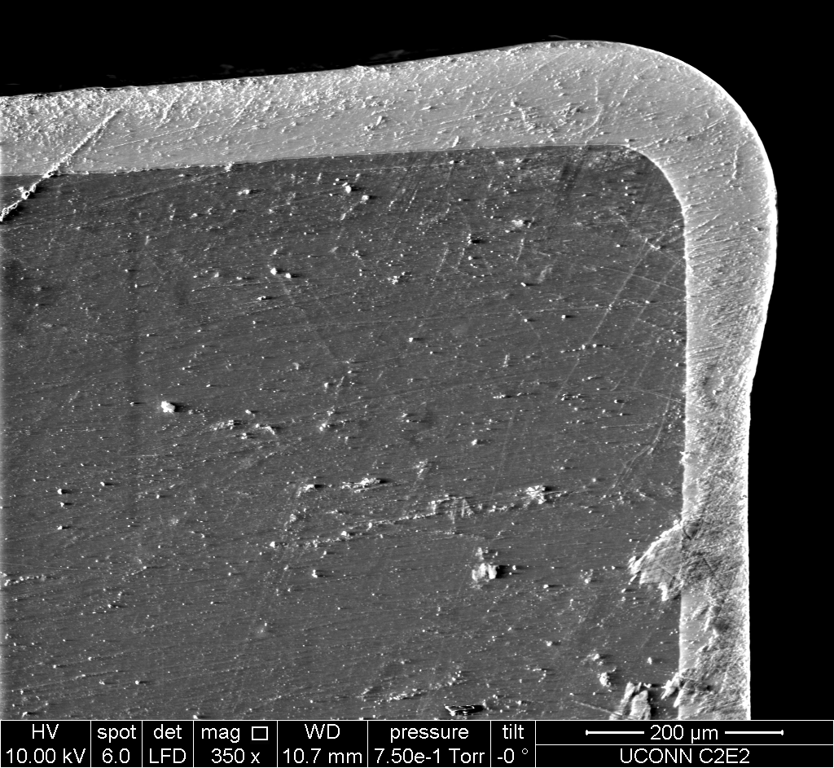
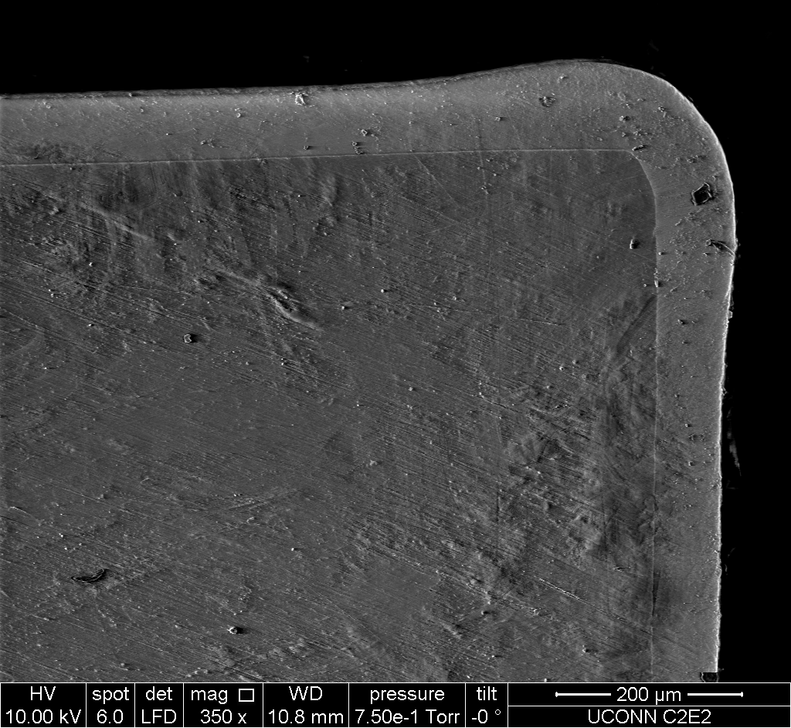
SEM images - light guide cross sections
old light guide sample
new light guide sample

Slide 5
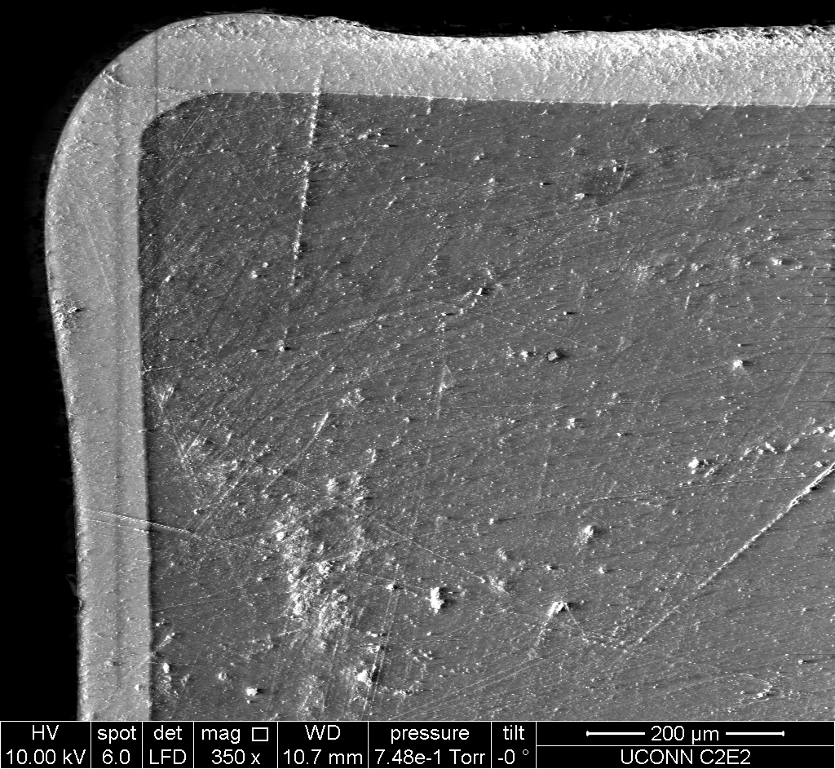
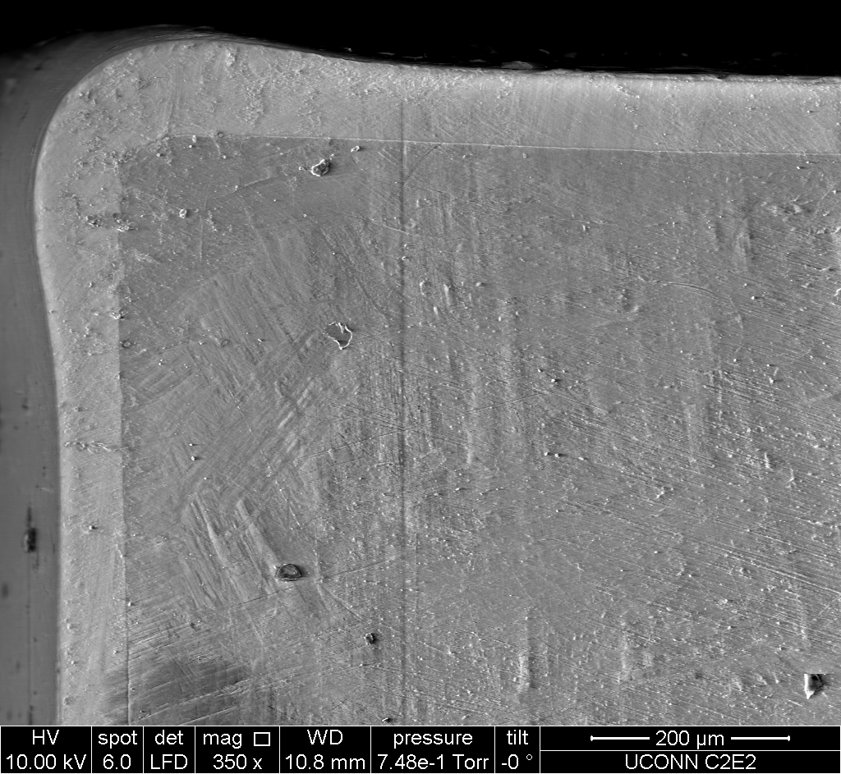
SEM images - light guide cross sections
old light guide sample
new light guide sample

Slide 6
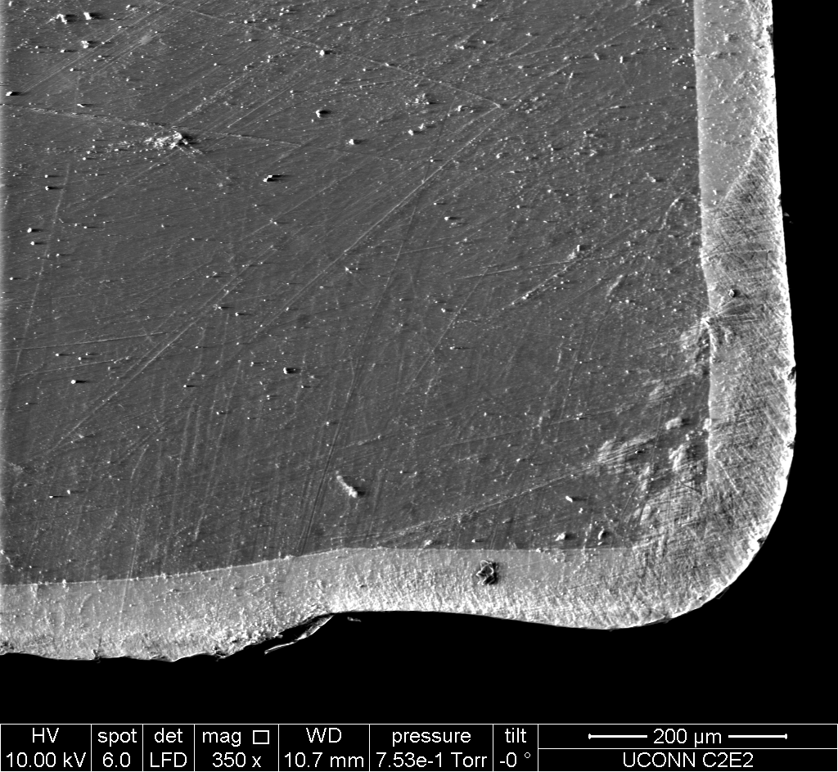
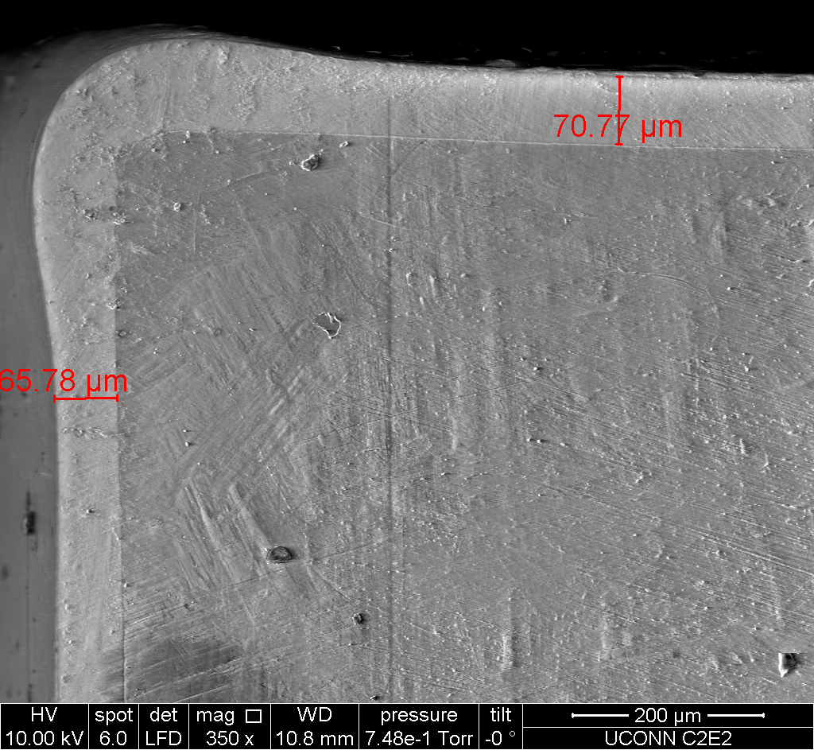
SEM images - light guide cross sections
old light guide sample
new light guide sample

Slide 7
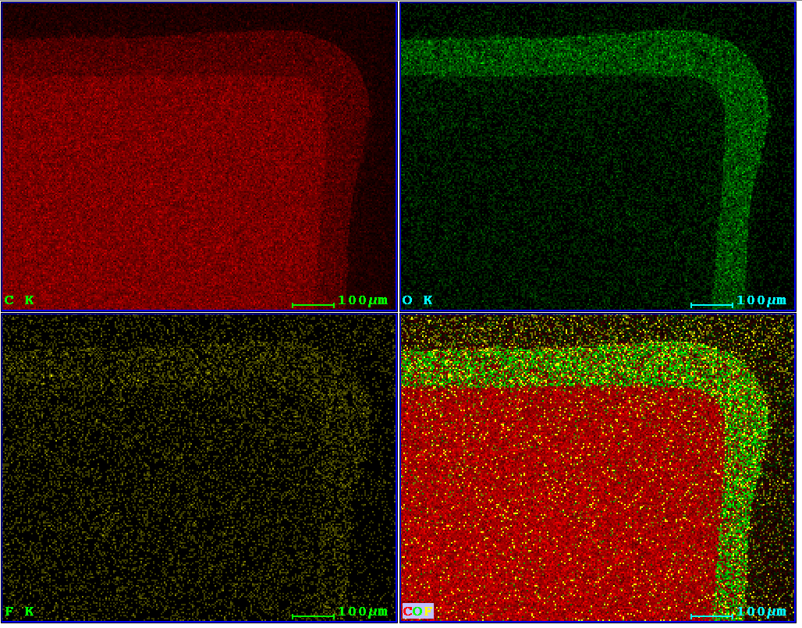
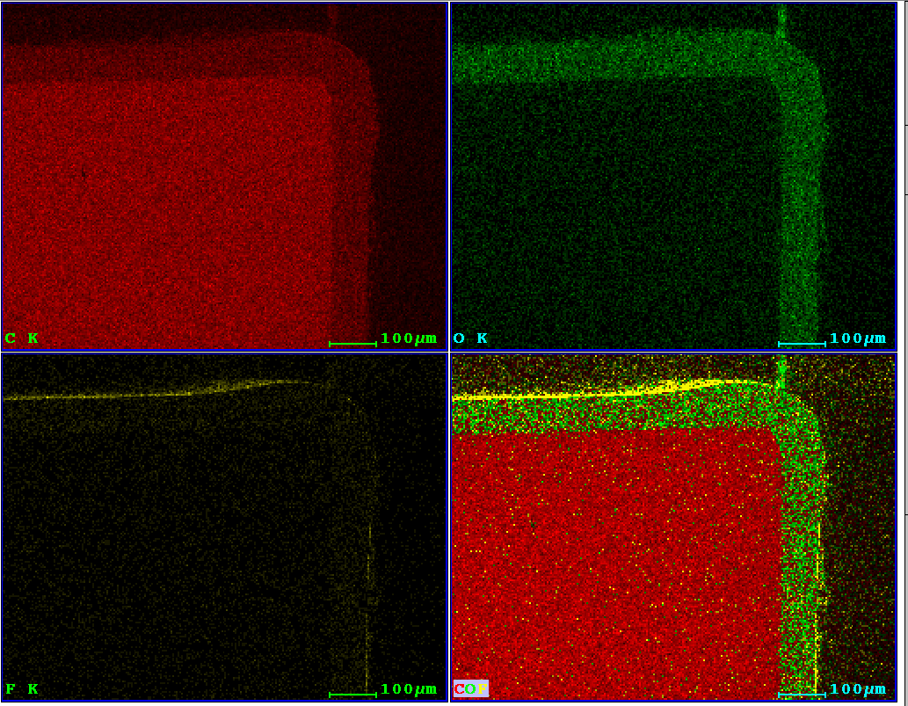
EDX images - light guide cross sections
EDX image: old light guide sample
EDX image: new light guide sample

Slide 8
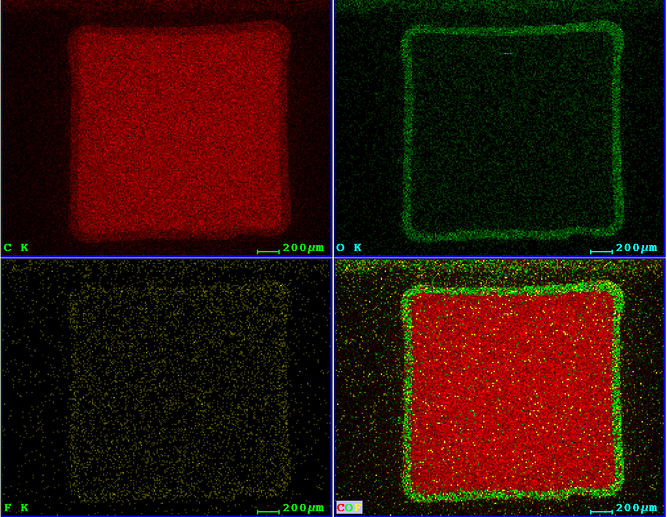
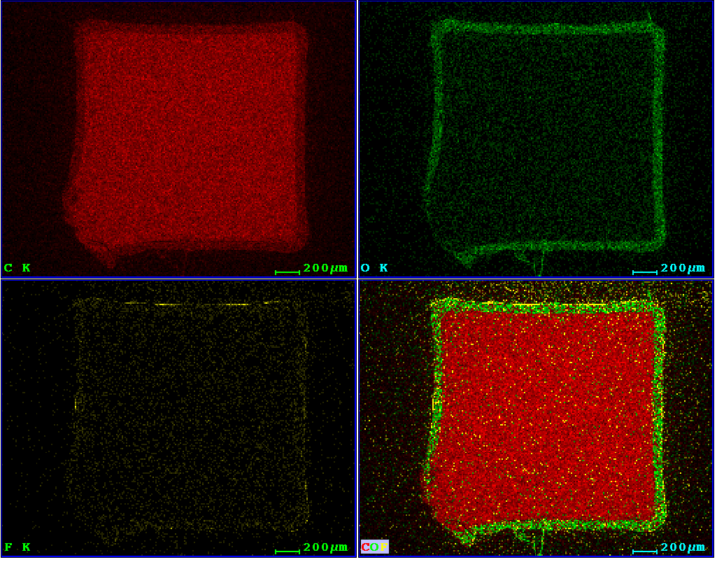
EDX images - light guide cross sections
EDX image: old light guide sample
EDX image: new light guide sample

Slide 9
Conclusions
the new lg product clearly has an outer fluorinated layer
it is very thin (5-8 microns vs 40 as claimed in brochure)
thickness seems irregular, maybe missing in places
Take-away message: The new product may be marginally better, but repeating the same construction techniques with the new product is not likely to produce much better results.
A new production method is being tested now

