Slide 1
Status of Low-granularity PS Detectors
Sam Andrews
UNCW

Slide 2
Monte Carlo Calculation
Using a Vacuum Chamber length of 250cm +70cm behind vacuum chamber, distance to second counters = 320cm. B=1.8T
Energy Bins (GeV) | X0 (cm) | X1 (cm) | dX (cm)
3.0-3.25 | 56.21 | 61.02 | 4.81
3.25-3.5 | 52.11 | 56.21 | 4.1
3.5-3.75 | 48.58 | 52.11 | 3.54
3.75-4.0 | 45.49 | 48.58 | 3.08
4.0-4.5 | 40.37 | 45.49 | 5.12
4.5-5.0 | 36.29 | 40.37 | 4.08
5.0-5.5 | 32.96 | 36.29 | 3.33
5.5-6.25 | 28.98 | 32.96 | 3.98
8 counters in each PS arm. Total 16 counters
*Provided by Alexander Somov

Slide 3
Dimensions of Detector
Average dX for 3.0-6.25 GeV energies = 4.005cm
Include 2.0mm overlap on either side of counter to minimize energy loss
This results in a counter width = 4.4cm
Our suggested dimension for each counter:

Slide 4
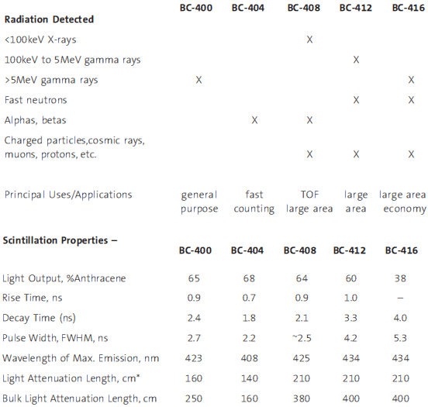
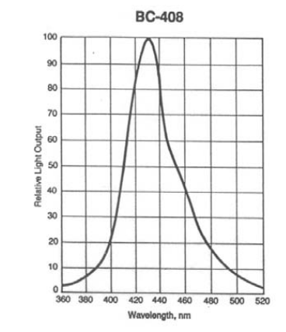
Plastic Scintillator from Saint-Gobain (BC-408)
*Figures from www.detectors.saint-gobain.com

Slide 5
Option of PMTs
Eugene suggested us to explore the possibility to use old 1” PMTs from Bogdan. We will inspect those PMTs before make decision.
We will also obtain the quotations from Hamamatsu to see how much it would cost for new high quality PMTs.

