Slide 1
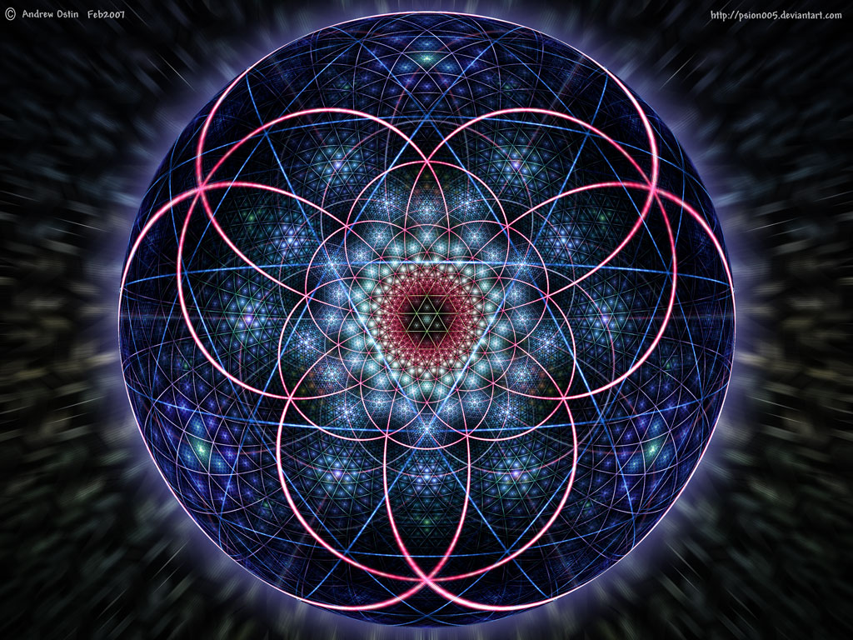


Design and Build of
Calibration Device for Scintillating Fibers of Tagger Microscope
for use in GlueX’s Quantum Chromodynamics Experiment
Probing the Confinement of Quarks and Gluons
By Emily Briere

Slide 2
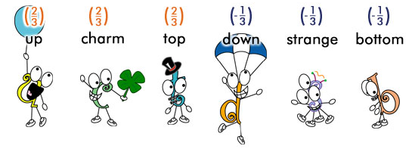
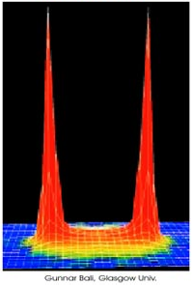
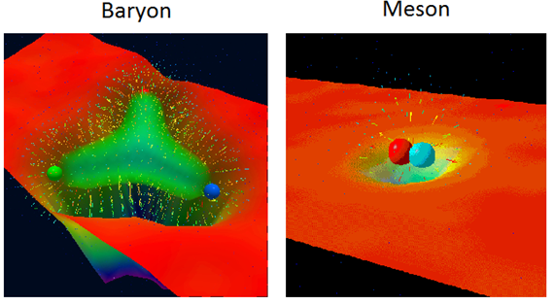
Background Physics
Quarks
QED
Hadrons

Slide 3
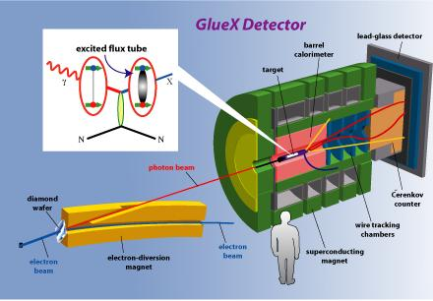

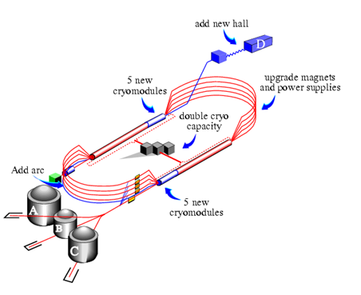

GlueX
Create a virtual vector meson via photoproduction
Hall D, Jefferson Lab, VA

Slide 4
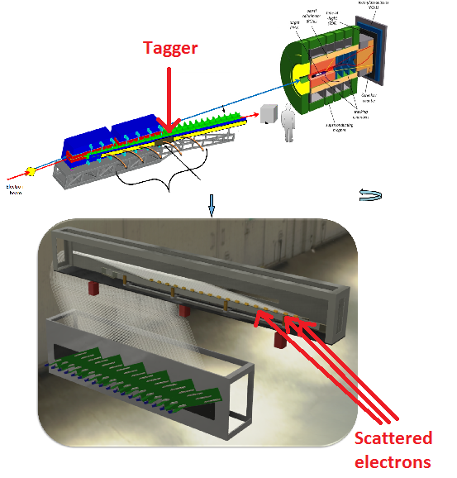
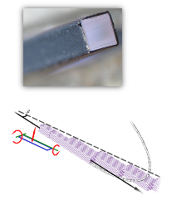
Tagger Microscope
The two magnets bend the electrons. Different energy levels correspond to different bend angles.
Use this to “tag” photons with an initial energy.
1 Fiber = 2mm²

Slide 5
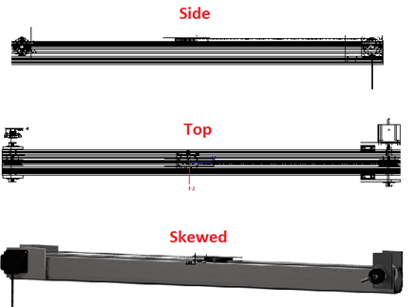
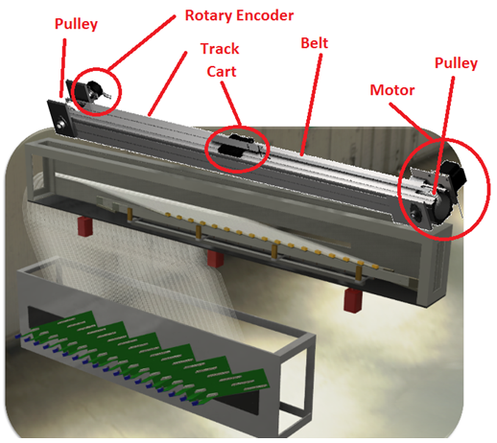
Calibration Device
Need a calibration device to test fibers before experiment!
Cart slides above tagger and extends an “arm” down to flash a light pulse at the fibers

Slide 6
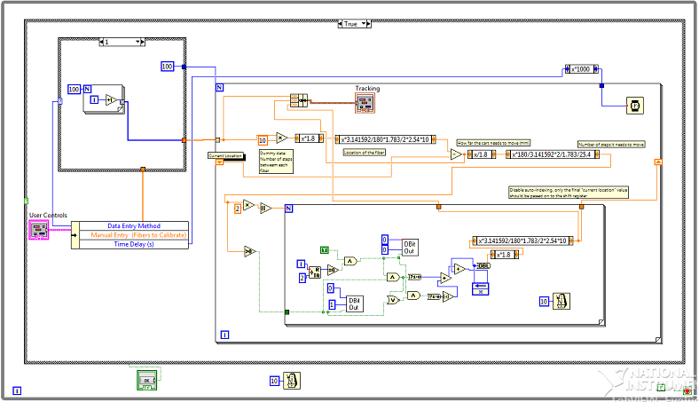
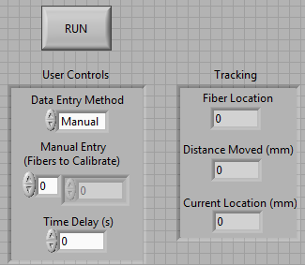
Electronics
Mechanical movement controlled via LabVIEW

Slide 7
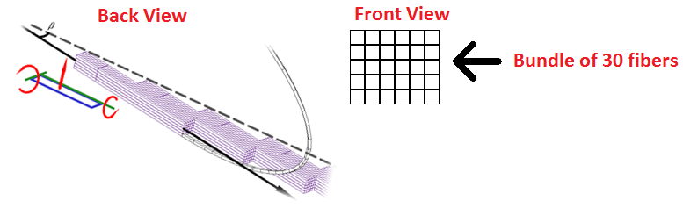
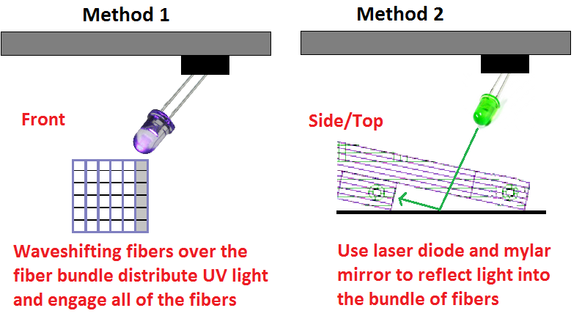
Method for Distributing Light

Slide 8
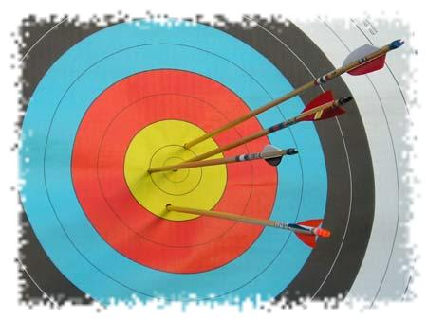
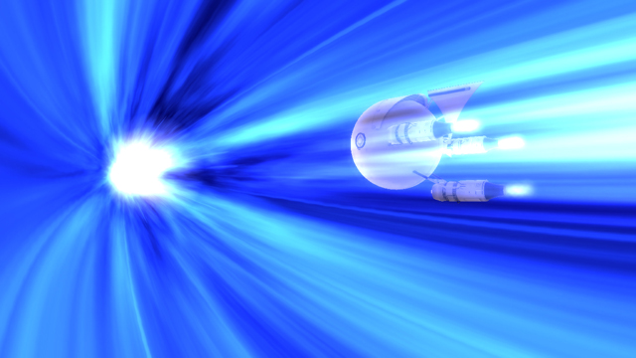
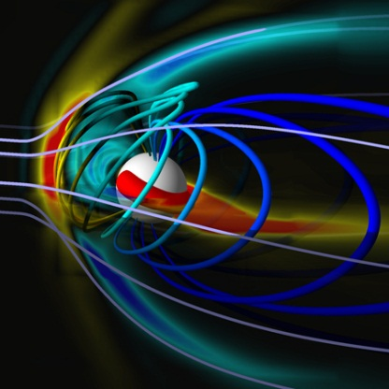


Why it Matters
For GlueX:
Experimental Accuracy
Checking mechanism
For the World:
Understand a new part of physics
Technological advances
Energy advancements
Space travel
A new tool for comprehending the world around us

