Slide 1
Calibration of the Tagger Detectors with GlueX Commissioning Data
Alex Barnes University of Connecticut
Tagger Microscope
Nathan Sparks The Catholic University of America
Tagger Hodoscope

Slide 2
Outline
Hall D experimental program
Photon beamline overview
Tagging detector calibrations

Slide 3
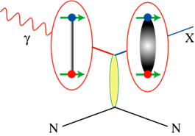
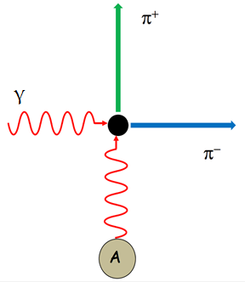
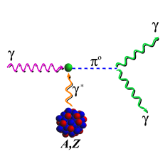

Hall-D Experimental Program
Search for hybrid mesons, resonances with gluonic field excitations (GlueX)
  Gluon acts as a constituent particle
  Exotic J^{PC} states possible (0⁻⁻, 0⁺⁻, 1⁻⁺, 2⁺⁻)
  Exotic states provide unambiguous signal
Charged π polarizability (γγ →π⁺π⁻)
  α_{π} - Electric polarizability, β_{π} - Magnetic polarizability
  Measure (α_{π}- β_{π})
  σ(γγ →π⁺π⁻) from Primakoff production
Γ(η →γγ) from Primakoff method
  Determine light quark mass ratio
  Measure η - η’ mixing angle

Slide 4
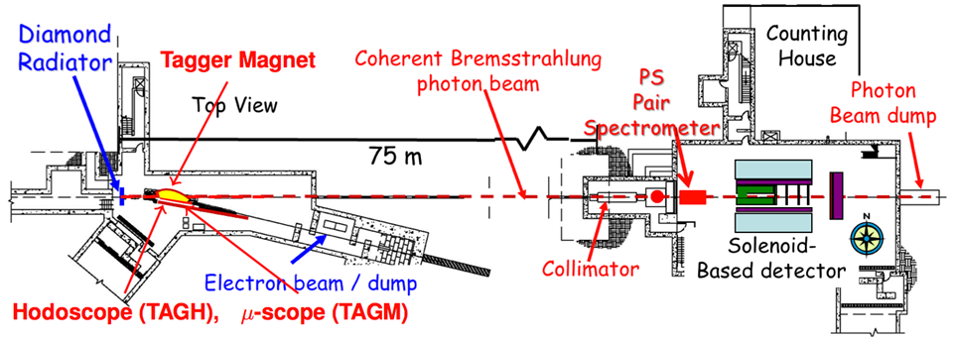
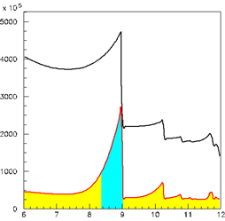
Photon Beam
12 GeV e⁻ beam
Coherent bremsstrahlung from 20 μm diamond wafer
Coherent peak: 8.4 - 9.0 GeV, 40% linearly polarized
3.4 mm collimator 75 m downstream from radiator
Magnet bends e⁻’s into tagger detectors (3.0 - 11.8 GeV)
no collimator
Intensity (/GeV/s)
collimator
E_{γ} (GeV)
Notes:
Discuss detectors more, define tagger as sum of tagm tagh

Slide 5
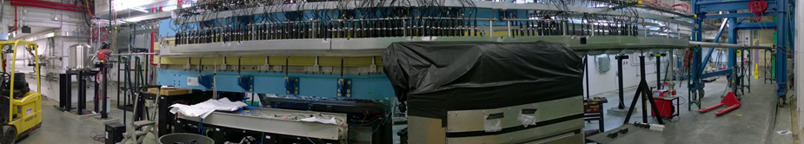
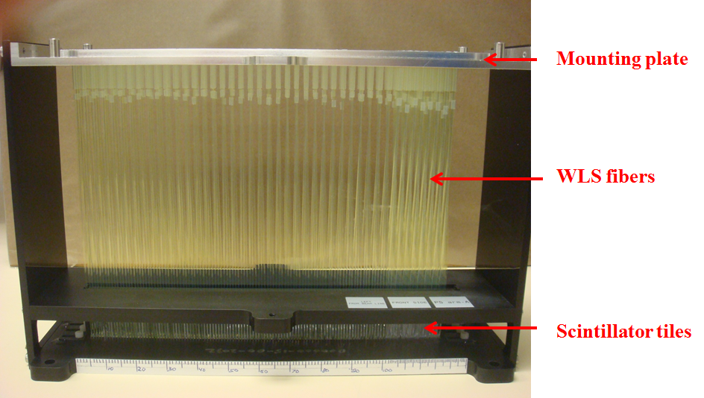
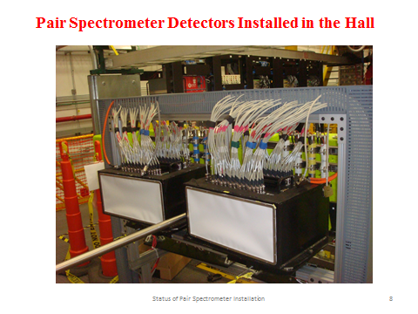
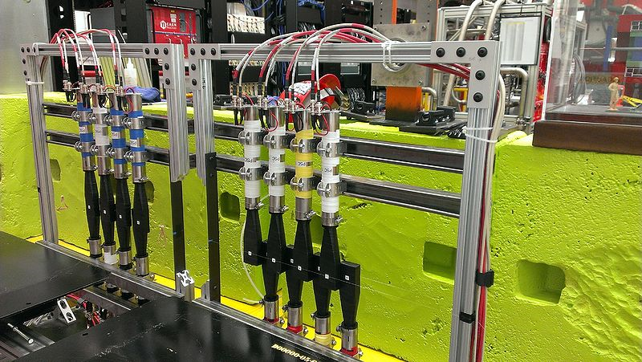
Tagger Hodoscope
Tagger Microscope
Pair Spectrometer

Slide 6
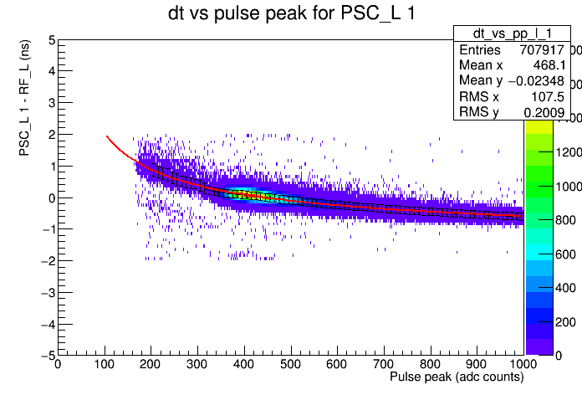
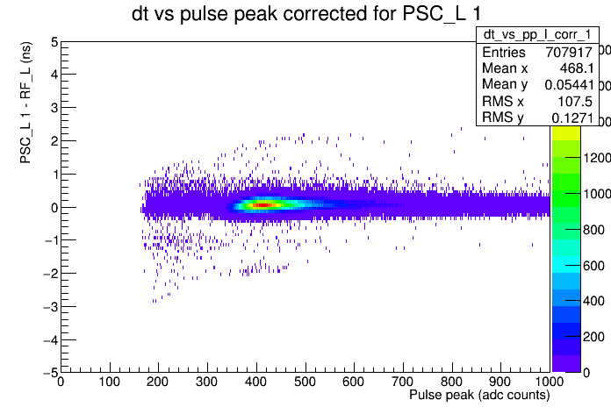

Pair Spectrometer (PS) Time-walk
f is the fit function where a, b, and c are fit parameters, P is the pedestal subtracted pulse height, and T is the adc threshold
Notes:
Explain more about RF, people don’t know what that means, typcial channel

Slide 7
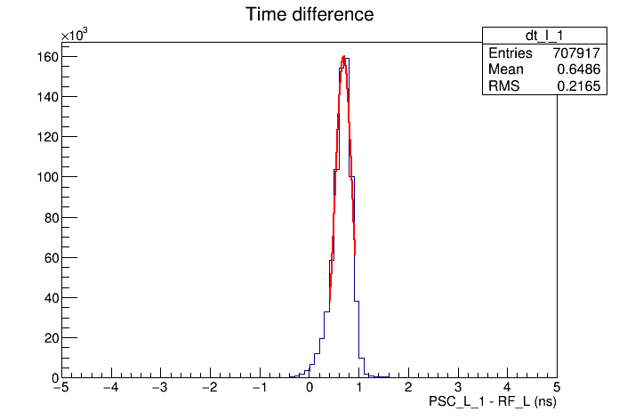
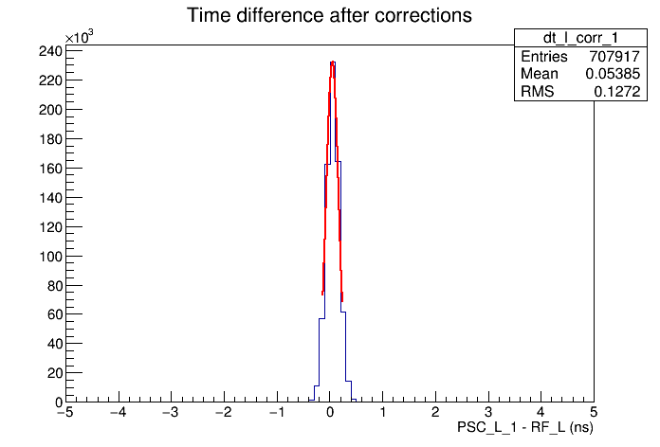
Pair Spectrometer (PS) Time-walk
Before
Sigma = 167 ps
After
Sigma = 119 ps
Average sigma for all 16 modules is 120 ps
Notes:
State that these are typical channels

Slide 8
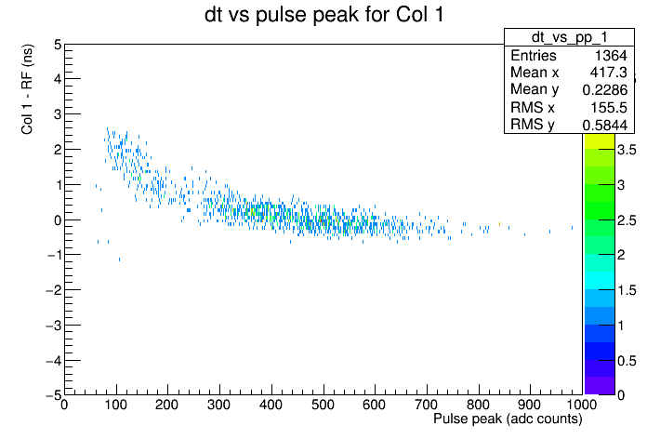
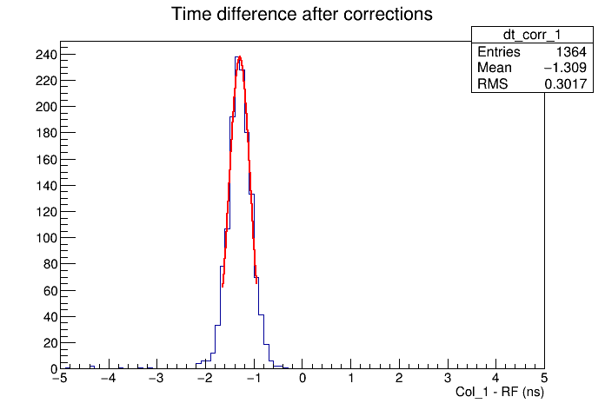
Tagger Microscope (TAGM) Time-walk
Initial dt vs pulse peak plot for a typical single channel
Corrected time difference distribution for a typical channel, sigma = 215 ps
Notes:
typical channel, maybe get average of good channels, mention that the bias voltages are being optimized for even better performance (make it positive sounding)

Slide 9
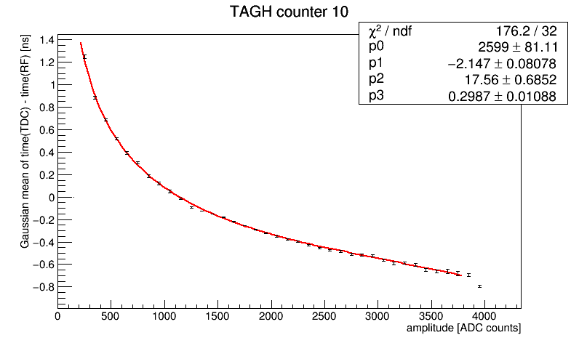
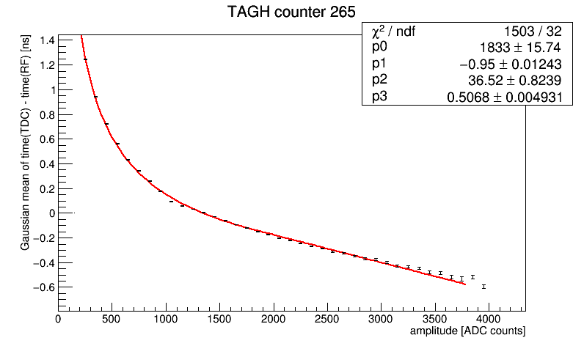
Tagger Hodoscope (TAGH) Time-walk
Typical time-walk curves for the tagger hodoscope
Average sigma for all channels is 180 ps
Notes:
typical channels, add 180 ps average

Slide 10
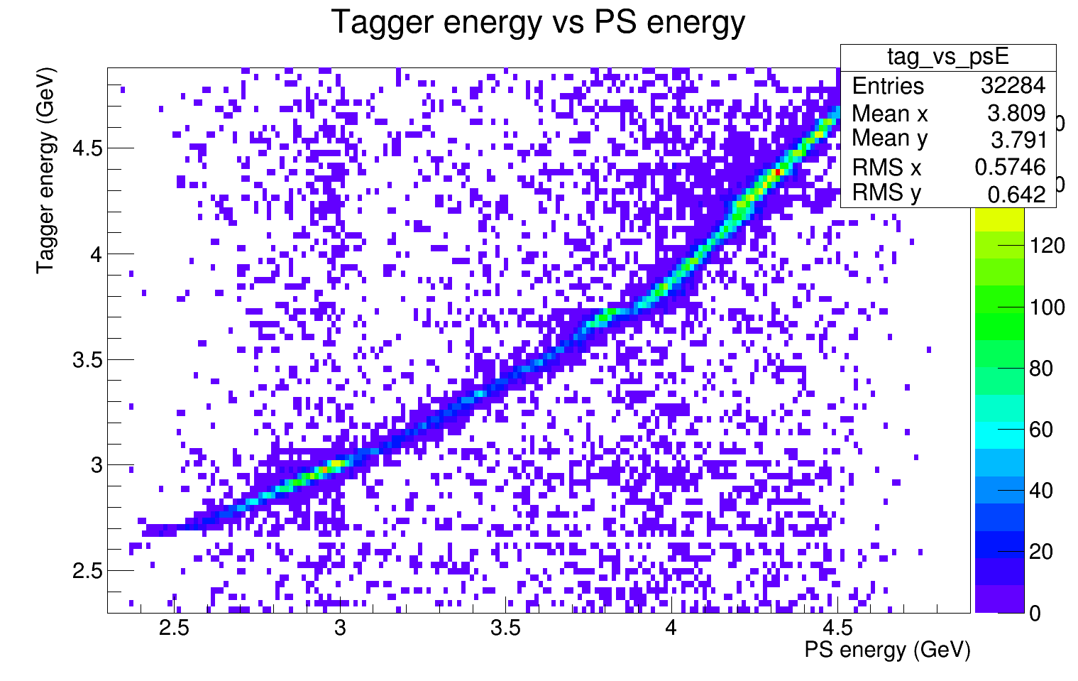
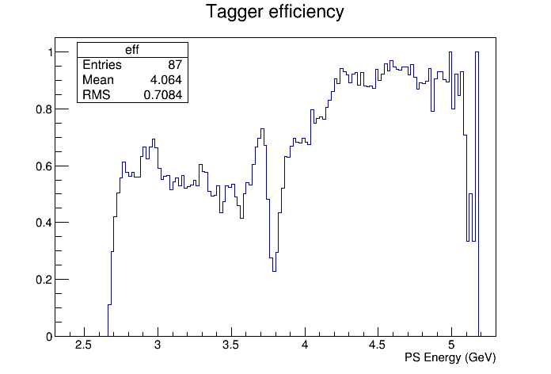
Tagger Efficiency
The tagger efficiency is the fraction of events that are seen by both the tagger and PS compared to all of the events seen by the PS
Due to a physical shift in the TAGM, there is a dip in the efficiency
TAGM
Notes:
maybe two smaller circles for shift

Slide 11
Summary
GlueX has successfully collected commissioning data
These data have been used in calibrating the tagging detectors
The timing resolution of the PS and tagger detectors are at or near design resolution
The efficiency of the tagger detectors is near design efficiency
Commissioning/opportunistic physics data will be taken spring 2016 at 12 GeV
Notes:
active voice

