Slide 1
Hall D Tagger Infrastructure
Presented by Tim Whitlatch
Hall D Engineer

Slide 2
What will be presented?
Overall layout
Interfaces
Infrastructure
  Electrical system requirements and layout
  Cooling systems requirements
Assembly/Installation of the Tagger components
Alignment
ES&H
Summary

Slide 3
Who is working on the mechanical design/fab?
Chuck Hutton – Lead Designer - design integration, Start counter, FDC, Pair spectrometer, scheduling
William Crahen - Mechanical Engineer- FDC, TOF, FCAL, conventional analysis and FEA
George Biallas – Senior Engineer (50%) – Solenoid cryogenics, magnetic fields and mechanical integration design
Vladislav Razmyslovich – Designer – CDC, gas systems, collimator and beamline, target
James Lagner – Contract Designer – BCAL, Tagger magnet, vacuum chamber and Hodoscope
Floyd Martin – Contract Designer– Solenoid magnetic field FEA, cryogenic test setup and mechanical design
Mark Stevens – Technician – FDC and solenoid
Jim Stewart – Scientist/Engineer – Tagger (gone to BNL)

Slide 4
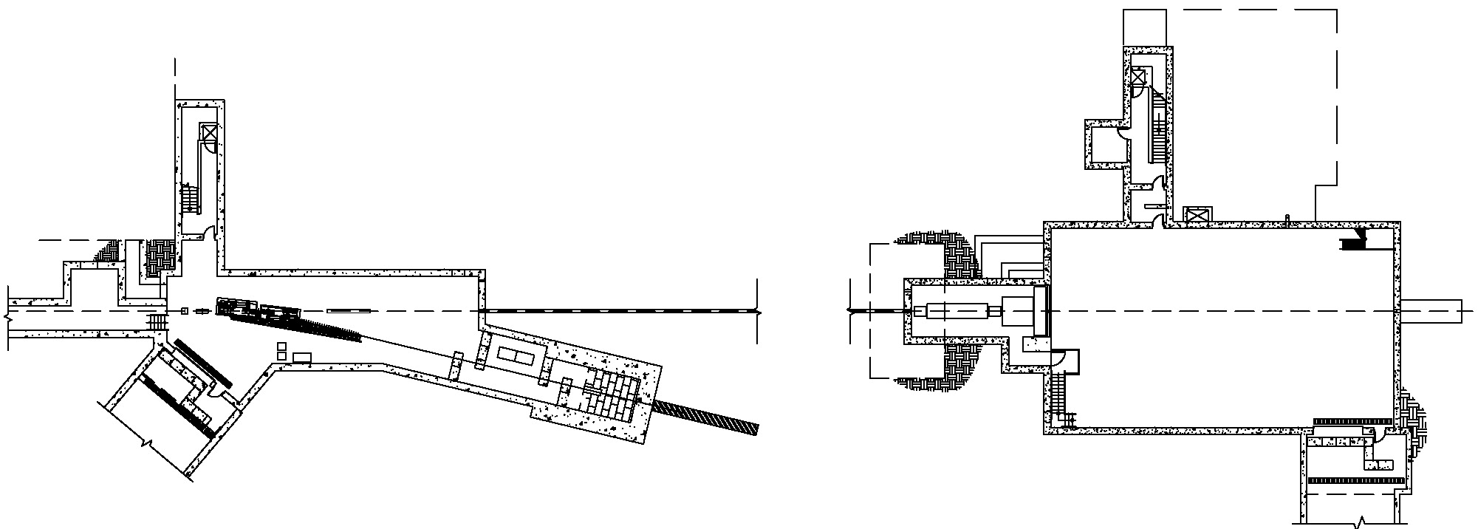
Photon beam and experimental area
Tagger
area
Hall D
North linac
Electron
Beam dump
East arc
Counting
House
Tagger
Coherent Bremsstrahlung
photon beam
Radiator
Pair
Spectrometer
Photon
Beam dump
Top View
75 m
Solenoid-
Based detector
Collimator
Electron beam / dump
Tagger Area
Collimator Cave
Experimental
Hall D

Slide 5
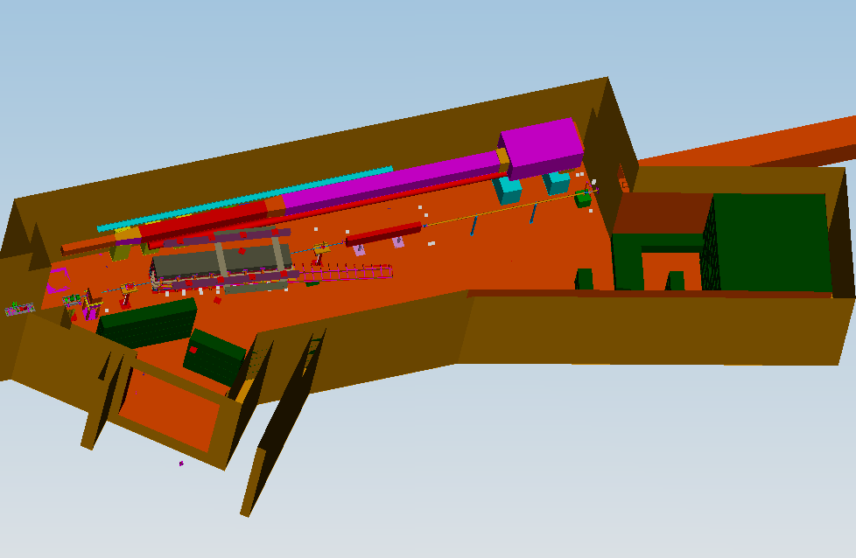
Tagger Area
Permanent Magnet
North Wall
AC ducts
Vacuum gages and pump
Beam Current Monitor
Photon Beamline
Beamline encasement to Hall D
Quad
Radiator
Vacuum Chamber
Electron dump
Tagger Magnet
Shielding
Truck ramp entrance

Slide 6
Interfaces
Civil (utilities, structural loading)
  Utilities (LCW, Chilled water, power…)
  Structural
Accelerator
  Vacuum
  MPS
  PSS
  Electron Dump
  Cryogenics
  Survey and alignment

Slide 7
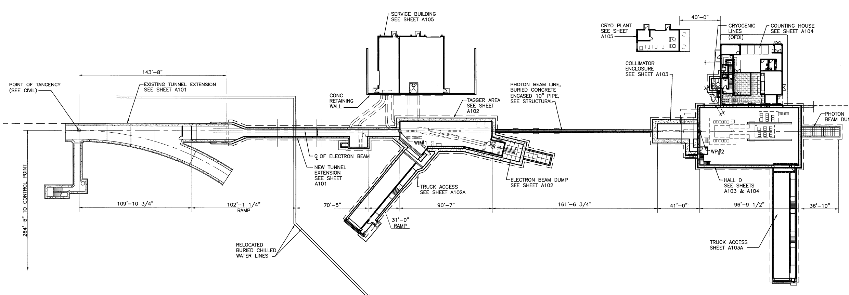
Hall D Complex – Site Layout
N
Service Building
(Power Supplies, LCW equipment)
Counting House
Cryogenics Plant
Connection to existing tunnel
Collimator Enclosure
Photon Beam Pipe
(10” concrete encased pipe)
Hall D
109’ – 10 ¾”
102’ – 1 ¼”
70’ – 5”
90’ – 7”
161’ – 6¾”
41’
98’ – 9 ½”
Personnel & truck access ramp
Personnel & truck access ramp
Tagger Area: Tagger magnet separates the electrons and photon beam continues to Hall D
Dimensions are driven by the beam line requirements
Hall D Complex Drawings A001

Slide 8
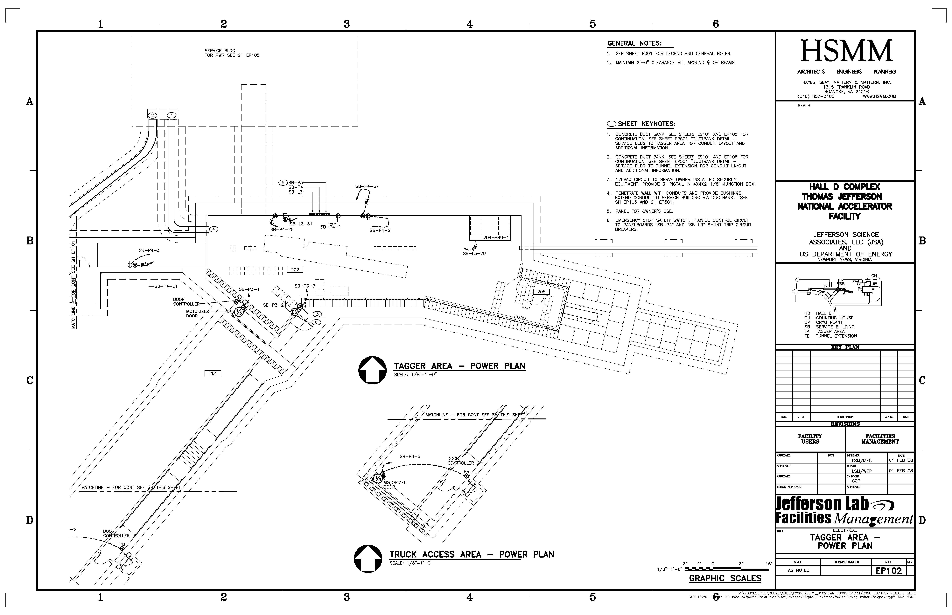
Tagger Service Building/Tagger Hall
Service Building
28 - 4” ducts for power and signal cables
Electrical panels
LCW from tunnel extension (85GPM available)
Magnet power supplies in service building
Vacuum gage controllers in service building
Tagger Hall temp. controlled (70°F, 55% hum max)

Slide 9
Electrical System Requirements
AC Power – “clean” and “utility”
  All electronics crates grounded to ground grid
  Extra power and conduits available for growth

Slide 10
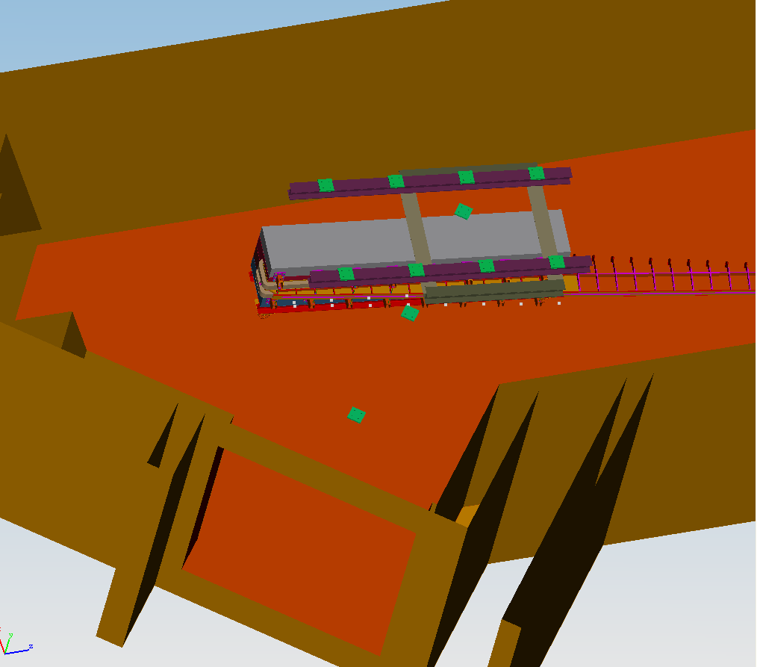
Installation Concept
I-beam track
Magnet built in pieces < 25 tons
Support plates embedded in ceiling
Strong back for handling vacuum vessel needed
Magnet
25 Ton carriage
Support plates

Slide 11
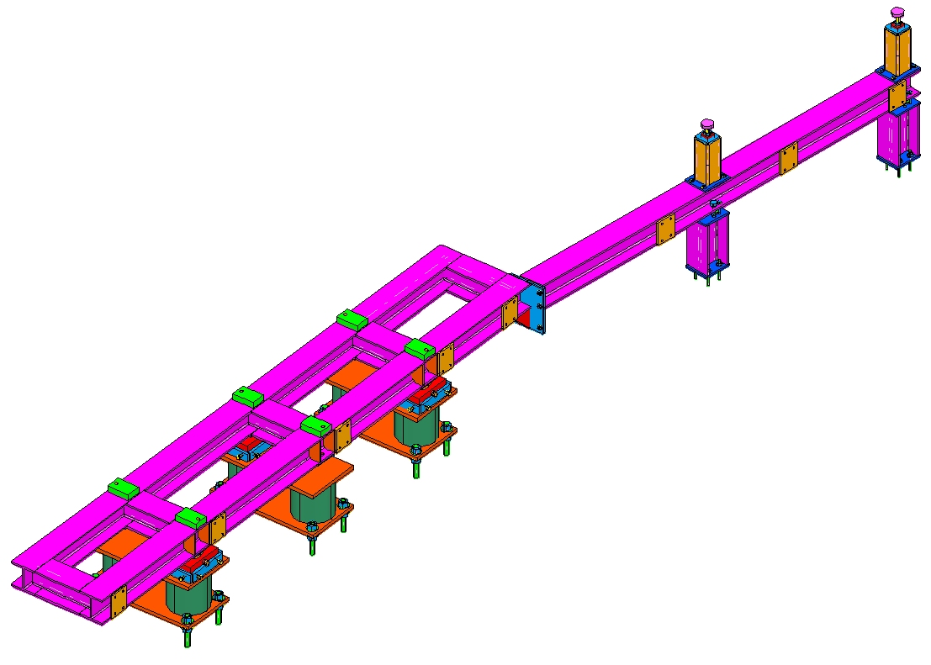
Tagger Support
I-beam strongback
3-point adjustment
±9mm vertical adjustment
±1cm x-y adjustment
Vacuum chamber support
Stands grouted in place after alignment
Final magnet alignment after install
Strongback
Hodoscope attach points
Adjustment cartridges
Vacuum Chamber supports
Base stands

Slide 12
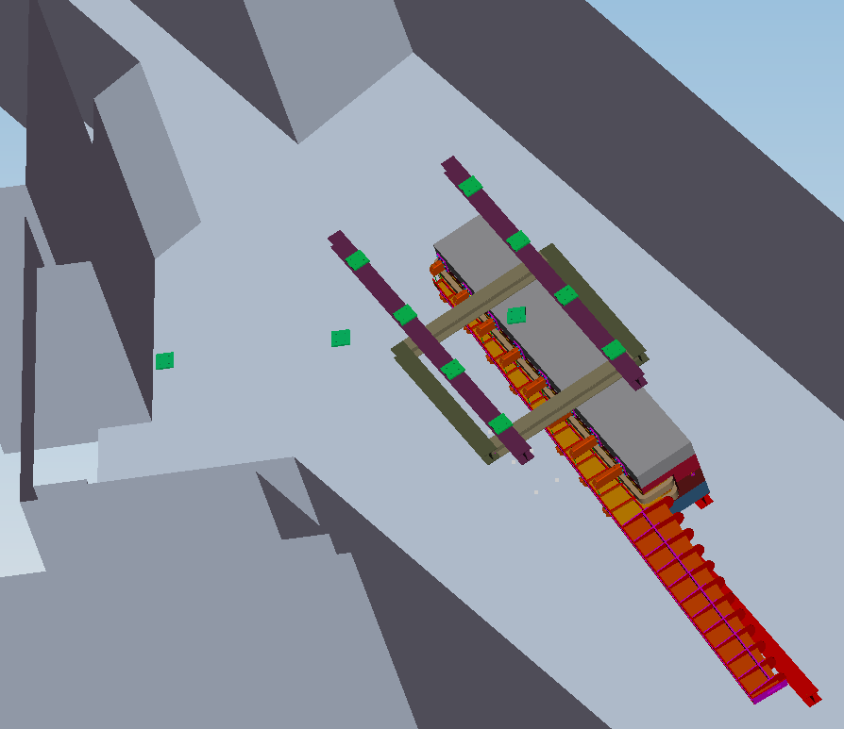
Installation View
Pieces lifted from floor
Pieces unloaded from truck bed and put on rollers
Pieces lifted from rollers onto stands
See movie
Truck backs into area

Slide 13
ALIGNMENT CONSIDERATIONS
Network of fiducial monuments around the tagger hall tie into the main accelerator within 0.75 mm.
Visible fiducials on tagger steel for alignment relative to electron beam
Measure alignment with magnet off and magnet on

Slide 14
Environmental Safety & Health
Prior to installation safety review…
Task Hazard Analysis
HDList
TOSP/SOP
Specific Procedures written
Use Design Authority for pressure systems
Design Review

Slide 15
Environmental Safety and Health
Personnel Safety System (PSS)
  Magnetic door locks
  Vestibule cameras
  Run/stop boxes
  ODH alarms
  Radiation Alarms
  Magnet power alerts/barricades
  Exhaust fans
  Fire suppression system

Slide 16
Environmental Safety and Health
Machine Protection System (MPS)
  Vacuum monitoring
  Magnet temperature monitoring
Equipment Protection
  Temperature monitoring (Electronics and magnets)
  Radiation monitoring
  Current/voltage monitoring
  Klixons to shut off magnets

Slide 17
Summary
Interfaces have been addressed
Infrastructure consistent with magnet requirements
ES&H plans in place – to be developed further as the tasks grow near.
Installation and alignment addressed.

Slide 18
Back Up Slides

Slide 19
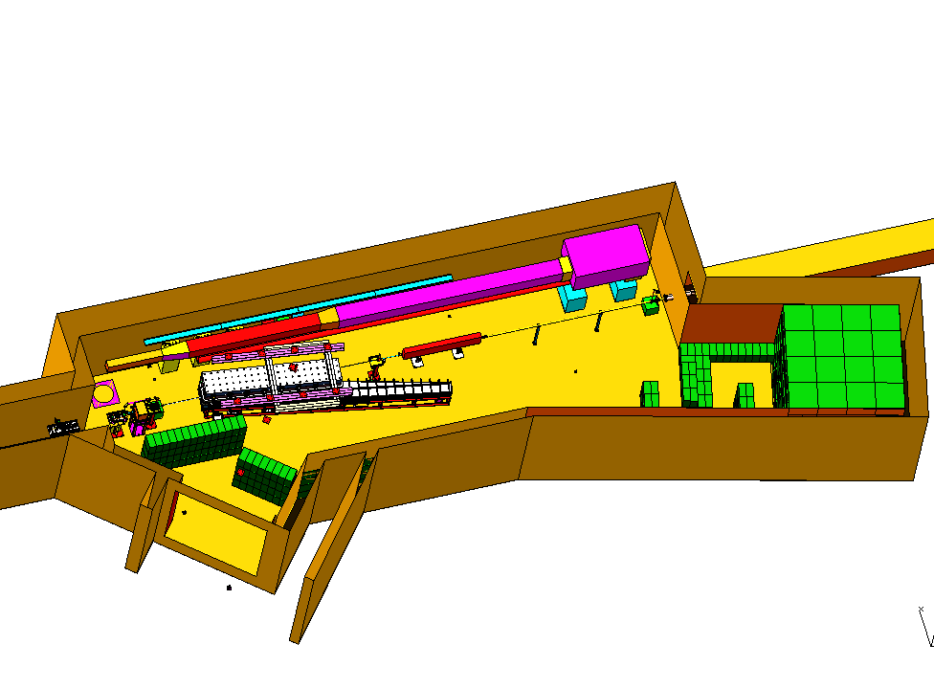
Tagger Area
Permanent Magnet (MPS)
North Wall
AC ducts
Vacuum gages, Ion gages and pump (MPS)
Photon Beamline
Beamline encasement to Hall D
Quad
Radiator
Vacuum Chamber
Electron dump
Tagger Magnet
Shielding
Truck ramp entrance

Slide 20
Tagger Achievable Alignment
Use optical means to determine relation between pole edges and fiducials on each slab within 50 microns
Laser tracking fiducial targets on tagger magnet to position relative to monuments within 40 microns
Absolute position relative to accelerator within 0.75mm
Targets visible after install on upstream end

Slide 21
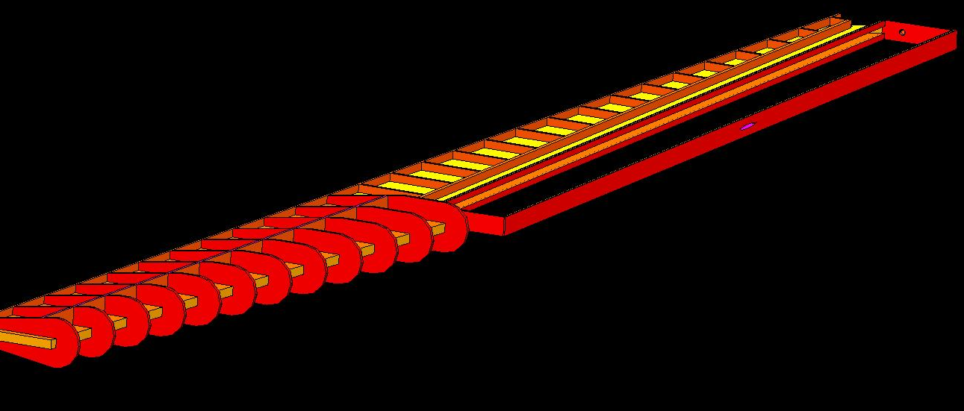
Vacuum Chamber
O-ring groove along entire edge, top and bottom
Skin, 0.25 inch plate
Cut out for photon beam tube
Stiffening ribs 1 inch plate

Slide 22
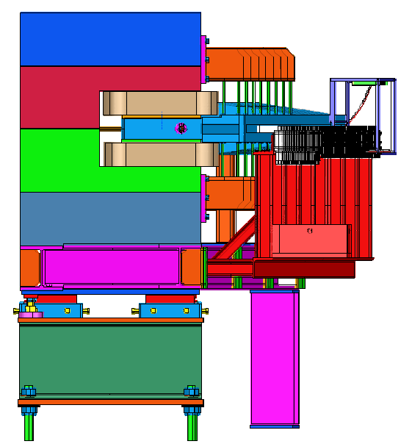
Tagger End View
Adjustment cartridges use wedge type for vertical
Sliders for X-Z
+/- 2cm horizontal plane adjustment
+/- 9mm vertical adjustment
Adjustment cartridges

Slide 23
Environmental Safety & Health
Task Hazard Analysis for Hall D Forward Drift Chamber (FDC) per JLAB ES&H manual chapter 3210
Task ID # | System Description | Resp | Hazard | Cause | Risk Code (pre) | Mitigation Administrative | Mitigation Engineering | Applicable ES&H Manual Chapter | Risk Code (post)
 | Gas System | ENG/TECH
N/A |  |  | Pressure related injury | Over pressure of system | 2 | written procedure for maintenance/repair | System will release pressure at more than a couple of PSI | 6150, 6151 | 0
 |  |  | ODH | Gas leak | 2 | use proper labeling and handling procedures | Design system to limit gas flow | 6500 | 0
 |  |  | Burns | Flammable gases | 3 |  | Use non-flammable gas mixtures | 6152 | 0
N/A | Assembly | ENG/TECH | Hand Injury | Sharp edges | 2 | Wear gloves when necessary, use tools properly | require radii/chamfers on all edges | 6120, 6620 | 1
 |  |  | Back/Body Injury | Back Strain | 3 | Use proper lifting techniques | Where possible use mechanical equipment for heavy lifting | 6140 | 1
 |  |  |  | Slip/Trip/Fall | 2 | Clean work areas, use proper tooling, work planning | Design proper tooling | 6131 Trip and Fall Hazards | 1
 |  |  | Chemical exposure | Exposure to glues and cleaning agents | 2 | Use Proper PPE | Spec only non-toxic chemicals | 6610 | 0
N/A | Electronics | ENG/TECH | Electrical shock | exposed live wires/components | 2 | Put Procedure in place to ensure power off when handling | Design system so there are no exposed live components | 6210, 6220, 6230 | 1
 |  |  | burns | over heat, sparks, fire | 2 | use proper fab techniques | Cooling where required | 6240 | 1
N/A | Cooling system | ENG/TECH | pressure related injury | Overpressure of system | 2 | written procedure for maintenance/repair | Provide pressure relief in design | 6151 | 0
N/A | Installation | ENG/TECH | Hand Injury | Pinch point, | 2 | Work at a pace conducive to safety. Wear gloves, use written procedure | Design proper tooling | 6120, 6620 | 1
 |  |  | Back/Body Injury | Back Strain | 3 | Use proper lifting techniques | Where possible use mechanical equipment for heavy lifting | 6140 | 1
 |  |  |  | Slip/Trip/Fall | 2 | Clean work areas, use proper tooling, work planning | Design proper tooling | 6131 Trip and Fall Hazards | 1
 |  |  |  | Elevated work | 3 | Proper positioning, PPE | Provide proper railings etc… | 6131 | 1
 |  |  | Foot injury | Dropped equipment. | 2 | Work at a pace conducive to safety. Steel toes |  |  | 0
 |  |  | Head Injury | Dropped/moving equipment. | 3 | Proper PPE (Hard hat) and use qualified crane operators | Design proper tooling and pick points | 6140 | 1

Slide 24
Design Load Data
Component | Weight | Load capability
Solenoid | 307 tons | --------------
BCAL | 30 tons | --------------
CDC | 600 lbs | --------------
FDC | 200 lbs | --------------
Target/Start counter/structure | 800 lbs | --------------
FCAL | 15 tons | --------------
Pair Spectrometer | 65 tons | --------------
Upstream Platform | 9 tons | 35 tons
Cryo platform | 1 ton | >2 tons
Downstream platform | 4 tons | 20 tons
Overhead crane | -------------- | 20 tons
Tagger Magnet | 80 tons | ------------
Shielding | 5 tons (max per piece) | ---------------

Slide 25
Hall D AC Power Requirements
Room to grow!
Hall D Program Power Requirements |  |  |  |  | Hall D Program Power Requirements (continued)
Load Description | Load | Clean Pwr | Util Pwr |  | Load Description | Load | Clean Pwr | Util Pwr
Experimental Equipment |  |  |  |  | TOF Readout | 6 kVA | 6 kVA
CDC | 12kVA | 12kVA |  |  | TOF HV | 3 kVA | 3 kVA
FDC | 24 kVA | 24 kVA |  |  | Collimator I&C | 5 kVA | 5 kVA
CDC HV and Bias Supplies | 3 kVA | 3 kVA |  |  | Trigger System | 12 kVA | 12 kVA
FDC HV and Bias Supplies | 6 kVA | 6 kVA |  |  | Network Gear | 3 kVA | 3 kVA
Barrel Calorimeter | 48 kVA | 48 kVA |  |  | Target Instrumentation | 2 kVA | 2 kVA
Bcal HV and Bias Supplies | 6 kVA | 6 kVA |  |  | Control System Instrumentation | 16 kVA | 16 kVA
Start Counter | 4 kVA | 4 kVA |  |  | Solenoid PS | 75 kVA | 25 kVA | 50 kVA
Start Counter HV & Bias | 2 kVA | 2 kVA |  |  | Sweep Magnets PS | 10 kVA | 10 kVA
FCAL | 24 kVA | 24 kVA |  |  | Platform Power (Chill blowers, Vacuum pumps, lights etc) | 30 kVA |  | 30 kVA
FCAL HV and Bias supplies | 3 kVA | 3kVA |  |  | Envelope and Other (Crane, lights outlets., Air handlers.) | 200 kVA |  | 200 kVA
Pair Spectrometer PS | 190 kVA | 10 kVA | 180 kVA |  | Subtotal |  | 225 kVA | 460 kVA
Pair Spectrometer HV | 1 kVA | 1 kVA
Total Required 685 kVA
Total Available > 1000 kVA

Slide 26
Hall D Equipment Cooling Requirements
Summary of Requirements (including Tagger)
System | LCW |  | Chilled Water
 | GPM | KW | GPM | KW
Tagger PS | 5 | 8 | ---- | -----
Tagger and quad Magnet | 48 | 71 | ---- | ----
Collimator | ---- | ---- | .4 | .5
Sweep Magnets | 7 | 10 | ---- | ----
Pair Spec. PS | 13 | 20 | ---- | ----
Pair Spectrometer | 116 | 171 | ---- | ----
Solenoid Power Supply | 50 | 73 | ---- | -----
FDC Electronics | ---- | ---- | 1.5 | 2
CDC Electronics | ---- | ---- | .7 | 1
Rack Space Cooling | --- | --- | 36 | 50
BCAL Si PM cooling | ---- | ---- | 3.5 | 5
FCAL dark room cooling |  |  | 3.5 | 5
Total Required | 239 | 353 | 46 | 64
Chilled water used to supply cooling to heat exchangers
FDC and collimator use liquid cooling
CDC, BCAL, FCAL and racks use air cooling

Slide 27
Hall D Complex - Cooling Requirements
Summary of Requirements
Area/System | LCW |  | Chilled Water
 | GPM | KW | GPM | KW
Physics Equipment (PE) | 239 | 353 | 45 | 65
Tagger (excluding PE) | 39 | 57 | 33 | 49
Hall D & Collimator (exc. PE) | ---- | ---- | 159 | 223
Service Bldg (Excluding PE) | 24 | 35 | 48 | 70
Counting house | ---- | ---- | 123 | 174
Tunnel extension | 50 | 74 | 11 | 16
Total Required | 352 | 519 | 419 | 597
Total Available | 400 | 585 | 600 | 880
With room to grow!

Slide 28
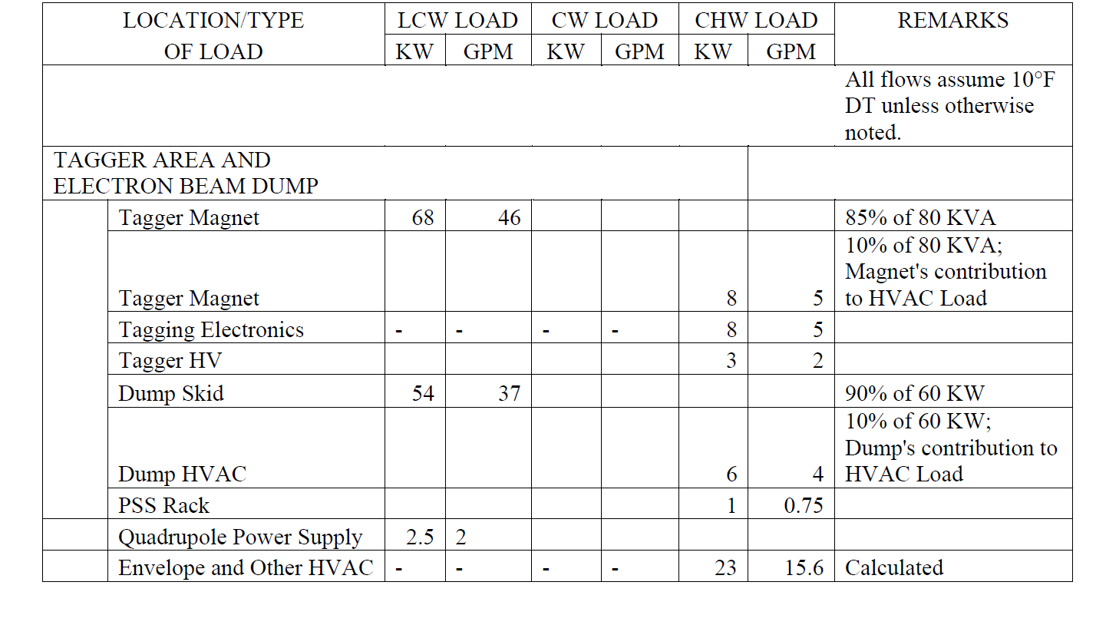
Allowables in “Space Program”

