Slide 1
Tagger Magnet Procurement Schedule
Jim Stewart
JLAB
Internal Review
May 2009

Slide 2
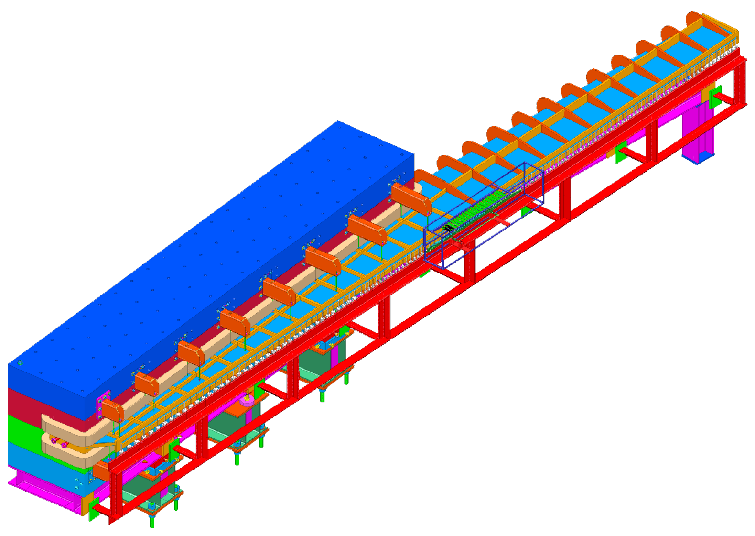
Tagger magnet design
1.5 T nominal field
1.1 m wide 1.4 m high 6.3 m long
Slabbed construction
Heaviest piece < 25 t
12 GeV e⁻ bent 13.4 °
Electron measurement
  30 mm pole gap
  9 – 0.3 GeV electrons
  11.7 to 3 GeV photons
  ~0.02% E/E0 intrinsic resolution!

Slide 3
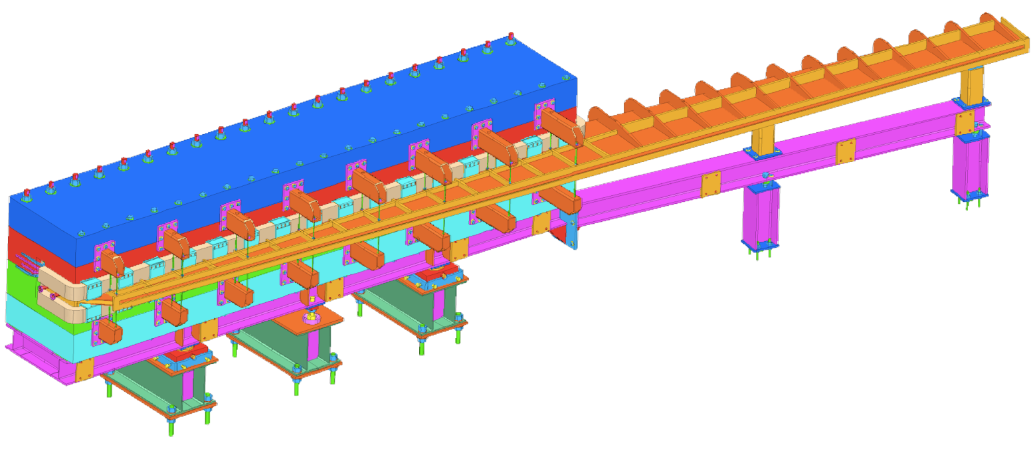
Design Status Summary
Initial 3-D models exist but they are not final.
  Changes still being made.
No real assembly or detail drawings exist.
Substantial FEM analysis has been done at Glasgow.
Substantial FEM analysis is being done now @ JLAB.
Need bolts row to compress o-ring
Need jacks to separate iron plates

Slide 4
Procurement possible Strategies
Issue a design and build contract
  Here the company will take our design proposals and then finish the design or start from scratch.
Finish the design and then issue a set of build contracts.
  Here we have to generate all documentation and shop drawings ourselves.

Slide 5
Design and build contract
JLAB will define the specification and the statement of work for the Magnet and the vacuum chamber.
  Will include a drawing set which represents a proposal for how the magnet could be built.
Companies bid on the magnet with a proposal how it will be built.
  They can change the design as long as meets our requirements.
When the final design is finished it will be reviewed.
Material procurement and manufacturing starts.

Slide 6
Build contract
JLAB will design all the components of the magnet system.
  Magnet Yoke
  Magnet Coils
  Stands
  Vacuum chamber
We need final drawings with tolerances.
We need exact specifications for all materials, handling, and quality control.
We need to produce all safety related analysis and documentation.

Slide 7
Pros and Cons
Design and Build
Pros
  Do not need to finish the design.
  Can benefit from company’s experience .
  Company will generate the necessary documentation.
  Company can test the magnet before delivery.
    Know we will receive a working magnet!
Cons
  Must review the company’s proposal.
  Must pay for all design work at the company.
Straight Build
Pros
  Do not have to review the company’s final design.
  Cost of contracts may be less as the companies do not need to engineer.
Cons
  Cannot benefit from company’s experience.
  More work in procurement here due to multiple contracts.
  Q&A is more important as only partial testing can be done before delivery.
  First assembly and testing at JLAB.

Slide 8
Pros and Cons
 | Design and Build | Build
Design Effort | We don’t have to finish the design. Must review their design. | Must finish our design.
Cost | Must pay for all design work and testing at the company (+profit). Must integrate their documents into JLAB | Must pay to finish the design. Must produce full documentation set.
Risk | Can benefit from outside experience . Company accepts responsibility for mistakes. Additional optimization may save cost. | If we make a mistake it we will need to fix it. (How to evaluate risk?)
Q&A | Will test/map the magnet at the company. | We must assure Q&A.

Slide 9
Results from RFI issued 1 year ago
Companies claiming to be able to build
Rough Cost mentioned
Babcock Noell GmbH
Bruker Biospin
Everson Tesla
General Atomics
Milhous Company
Precision Custom Components
Sigmaphi
$950k
$920k
$500k
Note: The dollar-euro rate and steel prices have changed in the last year.

Slide 10
SigmaPhi
Tim met with the a rep. from SigmaPhi recently to discuss the magnet.
If it is a design and build they would start from scratch as they will be responsible. Plan for 2 years between issuing the contract and delivery. Cast ~$1.2M for the magnet only. They can map if we request.

Slide 11
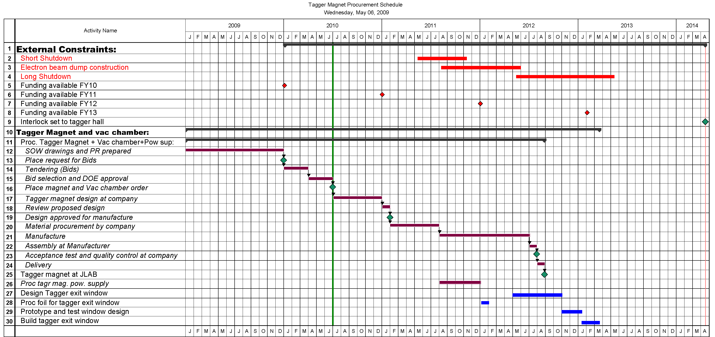
Design and Build contract timeline
Post RFQ Jan 2010
Receive Quotes
March 2010
Place Order
June 2010
Receive Design
Jan 2011
Approve Design
Feb 2110
Iron and Cu Available
July 2011
Manufacturing Complete
July 2012
Acceptance Test Aug 2012
Delivery JLAB
Sept 2012
~6 mo
Float
Test Magnet
Study Hysteresis
Excitation Curve
Precision Map
Install Detectors

Slide 12
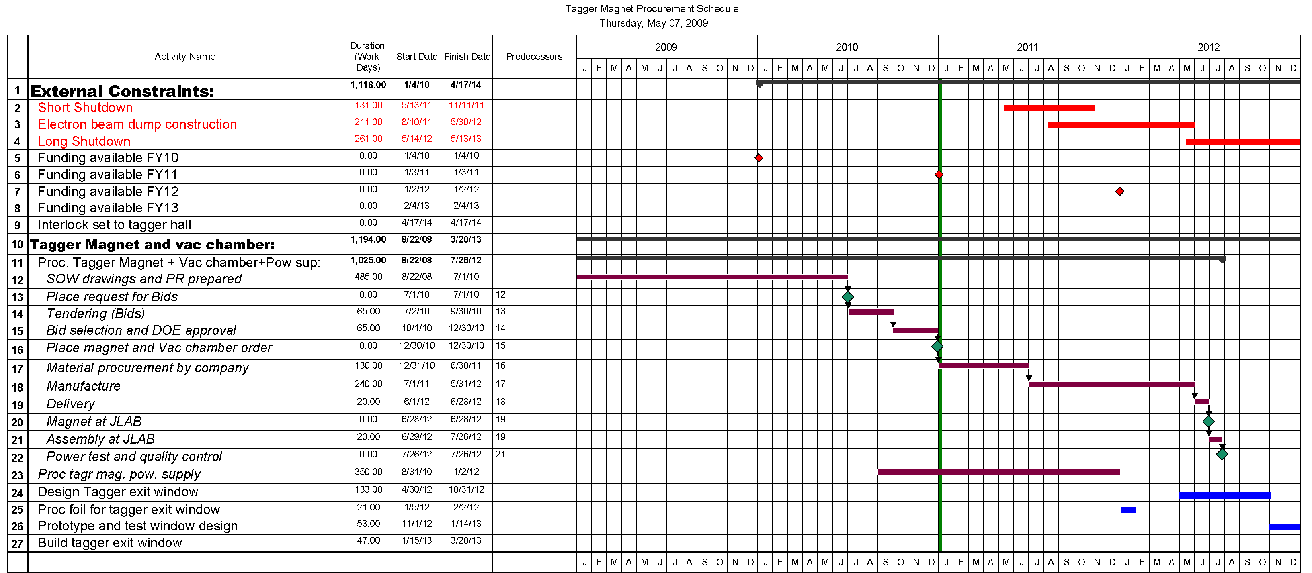
Build Only Schedule
Post RFQs July 2010
Receive Quotes
Oct. 2010
Place Orders
Jan 2011
Iron and Cu Available
July 2011
Manufacturing Complete
June 2012
Magnet Delivery
July 2012

Slide 13
Effort for Design and Build
Now to RFQ | 5 mw Engineer | Finish SOW and PR.
 | 7 mw Designer | Finish drawing package for bid.
Review Bids | 6 mw Engineer | 3 mw answer questions from companies. 3×1 wk committee reviews bids .
Design phase support | 3 mw engineer | Reviews at 1.5 mo and 6 mo. Check design and documents.
 | 2 mw designer | Support for design review.
Build phase | 4 mw engineer | Site visits. Testing review.
Delivery | 4 mw | Documentation and Safety integration.
Total : 22mw Eng. 9 mw Designer (~$85k)

Slide 14
Effort for a build only contract
Now to RFQ | 14 mw Engineer | Finish FEA. Documentation. Safety analysis.
 | 32 mw Designer | Finalize design. Make all drawings. Get signed archived drawings.
Review Bids | 6 mw Engineer | Review 4 different contracts.
Build phase | 4 mw engineer | Site visits. Testing review.
Delivery | 3 mw | Certificates Documentation and Safety review.
Total : 27 mw Eng. 32 mw Designer (~$148k)

Slide 15
Overview of what is in P3E for the tagger magnet
→excluding installation←
Activity Activity Start Finish Bud. Labor Bud.Labor Bud. Mat. Bud. Total
ID Name Cost Cost Cost Cost
15511005 Drawings for Yoke Steel 01-Apr-10 20-Sep-10 43.0w $41,676 $0 $41,676
15511010 Drawings for Coils 01-Apr-10 20-Aug-10 65.0w $52,966 $0 $52,966
15511015 Drawings for Vac Chamb 01-Apr-10 20-Sep-10 65.0w $52,966 $0 $52,966
15511025 Dsgn Stands for Mag 01-Apr-10 24-Jun-10 37.0w $41,676 $0 $41,676
15511030 Dsgn Supprt for Vac Chamb 01-Apr-10 03-Sep-10 37.0w $41,676 $0 $41,676
15511040 Write Pwr Supply Spec 23-Aug-10 27-Sep-10 11.0w $6,938 $0 $6,938
15511045 EH&S Review of Dsgn 21-Sep-10 27-Sep-10 0.0w $0 $0 $0
15511050 Proc Yoke Steel 05-Jan-11 26-Aug-11 2.0w $1,334 $541,992 $543,326
15511060 Proc Vac Chamb 05-Jan-11 30-Mar-11 3.0w $2,000 $70,948 $72,948
15511065 Proc Pwr Supply 05-Jan-11 31-Mar-11 0.0w $0 $64,735 $64,735
15511105 Tag Mag Acceptance Test 02-Jul-12 02-Jul-12 0.0w $0 $0 $0
15511110 Shipping to JLab 03-Jul-12 27-Aug-12 0.0w $0 $34,074 $34,074
Power Supply Subtotal 11.0w $6,938 $64,735 $71,673
Tagger Dipole Subtotal 252w $234.3k $647k $881.3

Slide 16
Budgeted cost for installation
Activity ID Activity Name Start Finish Bud. Labor Bud. Material Bud. Total
1562045 Install Tagger Magnets & Chamber 28-Aug-12 30-Oct-12 04:00 PM $26,035 $27,685 $53,720
1562050 Install Tagger Pwr Supply (Installtn) 27-Jun-12 24-Jul-12 04:00 PM $17,612 $10,648 $28,261
1562055 Install LCW Connections (Installtn) 25-Jul-12 21-Aug-12 04:00 PM $9,248 $2,130 $11,378
1562060 Survey & Align Magnets (Installtn) 31-Oct-12 13-Nov-12 04:00 PM $16,090 $0 $37,392
1562061 Field Map Tagging Magnet 14-Nov-12 19-Feb-13 04:00 PM $22,581 $0 $22,581
Total $91.5k $20.4k $112k
Summary: 2 technician man years of effort and $20k material
Remember this includes: Magnet Survey, Magnet Assembly, Power Supply Installation, Cables, Cable Trays, Water, Temperature Switches, Controls, Programming Controls, Testing the Magnet, Hysteresis Suppression Studies, Generation of the excitation table for CEBAF, Mapping the Magnet, A Mapping Machine if needed including software ….

Slide 17
Must decide on the best plan!
Main Factors to consider:
  Manpower availability
  Risk
  Cost

Slide 18
Backup

Slide 19
Manpower cost
Mech Eng $63.81 per hr
  63.81*40*(52/44)= $3.0 k per mw
    Fully burdened non-escalated effort
  Mech Designer $43.84 per hour
  $43.84 *40*(52/44)=$2.1 k per mw
    Fully burdened non-escalated effort

Slide 20
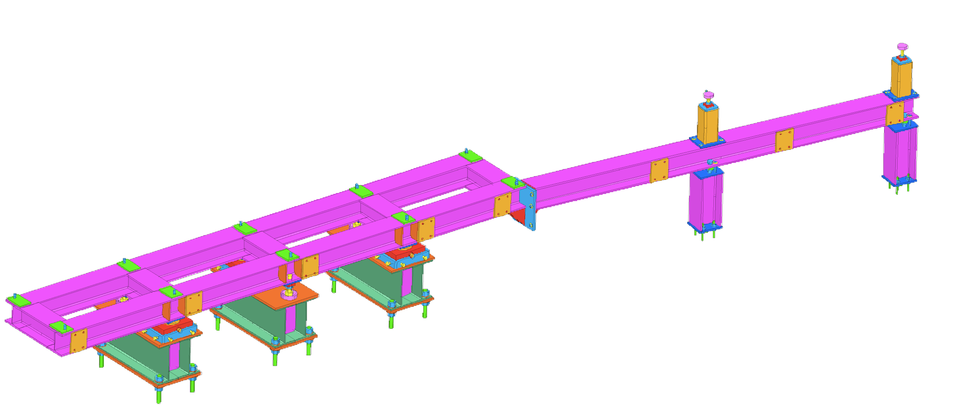
Overview
3 additional support screws.
  Function→ “warm fuzzy feeling”
3 point support.
±9 mm vertical adjustment.
  Shims for more.
2 cm x-y tables.
3 support stands.
Welded double I-beam construction.
80t load

Slide 21
Overview
Vacuum chamber support.
Mounting plates for the detector support.
  Above alignment cartridges.
  Detectors move with magnet

Slide 22
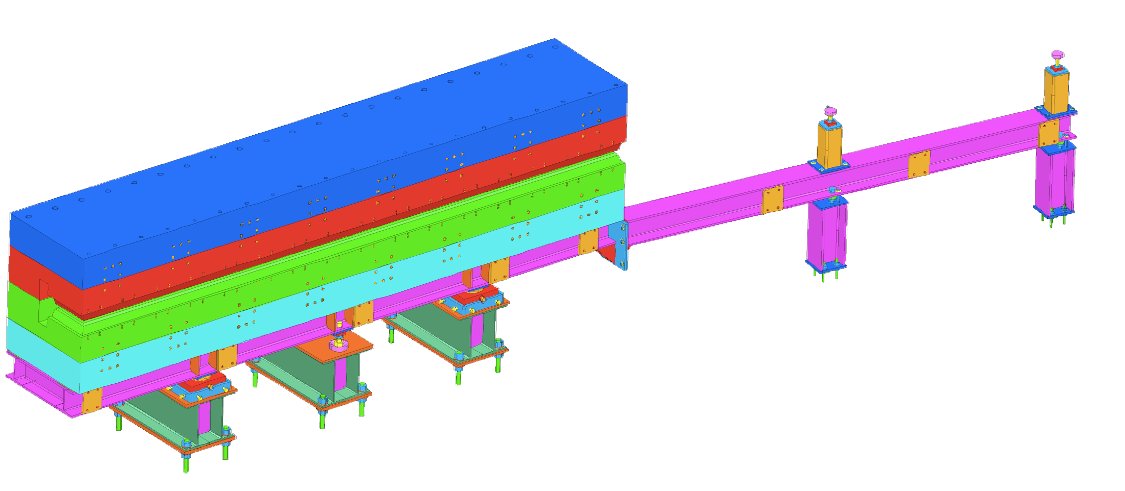
Overview
Constructed of 4 iron plates.
  Color TBD→Big enough for serious artwork.
470 mm wide pole.
2 surface pole contour.
Effective field width ~470 mm.
Magnetic force between poles @1.5 T ~ 240t.
Magnetic deflection of poles ~0.1 mm.
2” tension rods along back

Slide 23
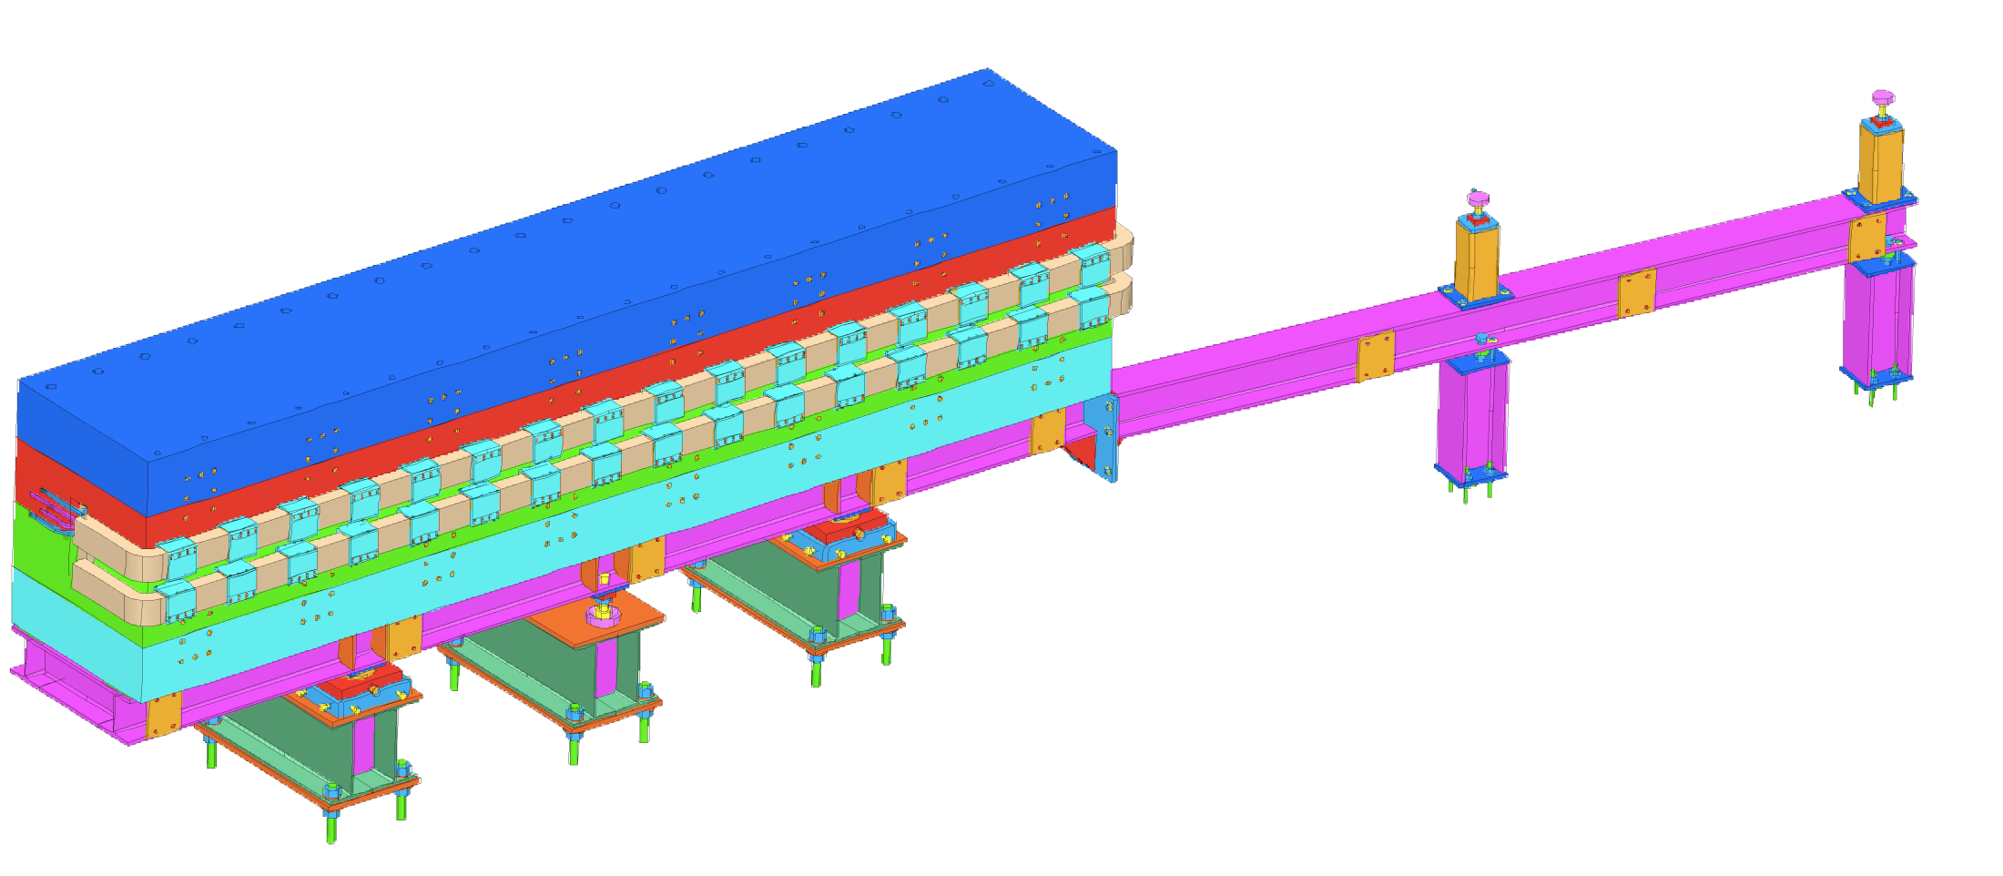
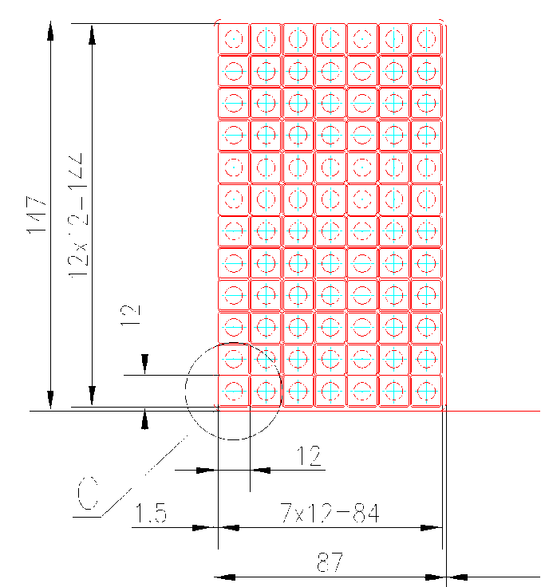
Overview
Magnet CoilsCoil
  12 by 7 cu matrix.
  11 mm sq cu
  7 mm water path
  1.5 T→ 220A 105V
  1.8 T→ 366A 200V
6.509 m
548 mm

Slide 24

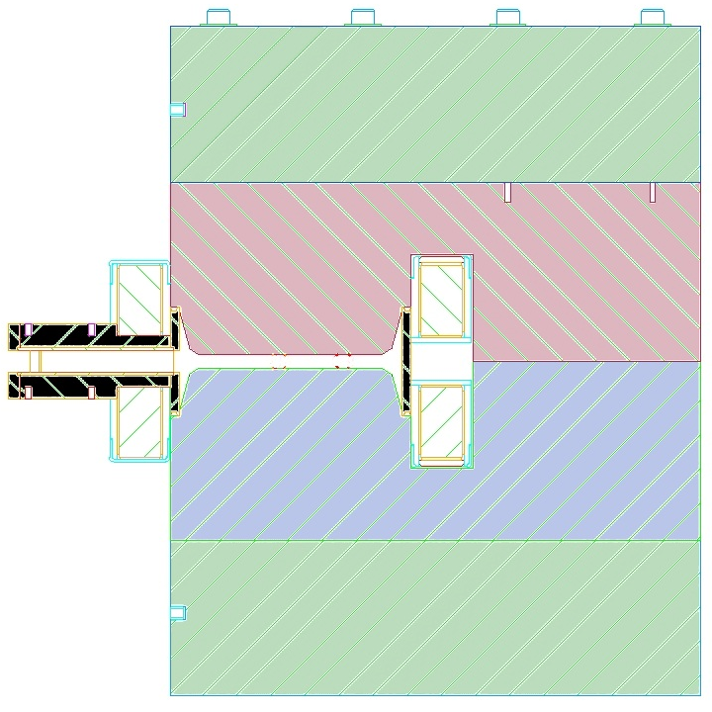
Overview
1” reinforcing ribs.
¼” Stn.Stl. Shell
  Max 1 mm deflection
3/8” (9.5 mm) O-ring
Brackets to support vacuum forces.
11.1 m long
Exit Window
Two NMR probes for field stabilization and monitoring.

Slide 25
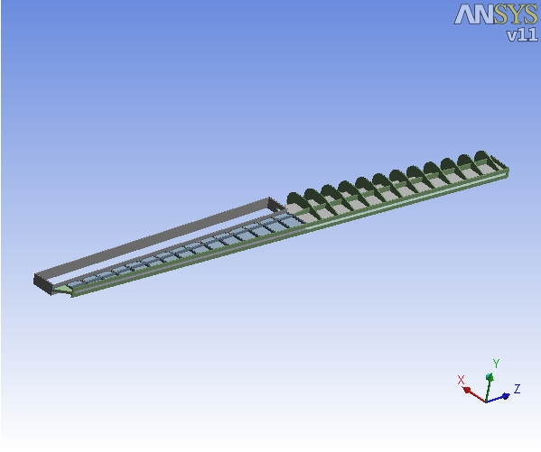
Status of FEA (Vacuum Chamber)
Vacuum Chamber has been modeled with ANSYS

Slide 26
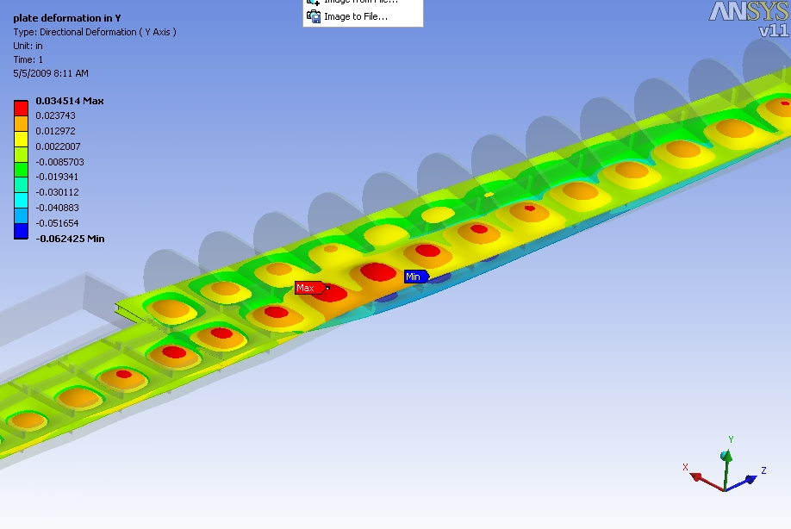
Status of FEA
Deformation of the stainless steel skin due to the vacuum forces has been modeled.
The distance between supports and the thickness of the skin are reasonable.
Here maximum deformation of skin is 0.035” (0.9 mm).

Slide 27
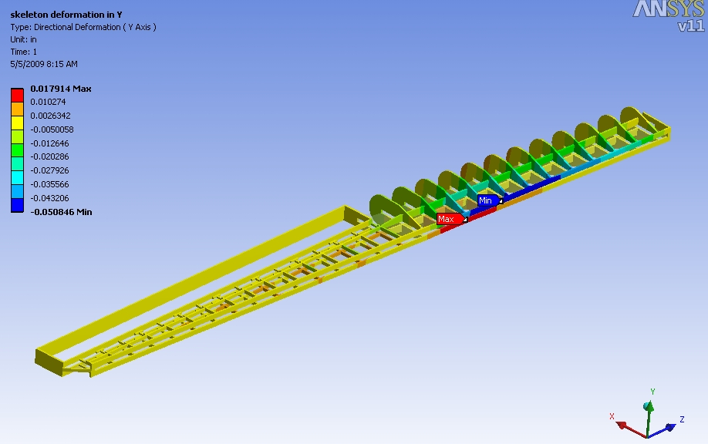
Status of FEA
Deformation of the stainless steel window opening.
Here maximum deformation of flange which supports the window is 0.018” (0.5mm).

Slide 28
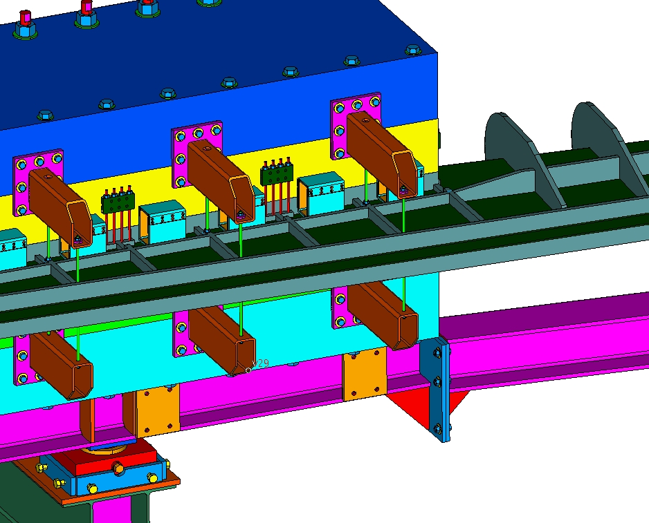
FEA results
Deflection along o-ring seal was a couple of millimeters. Decided to install support rods similar to the original Glasgow design.

Slide 29
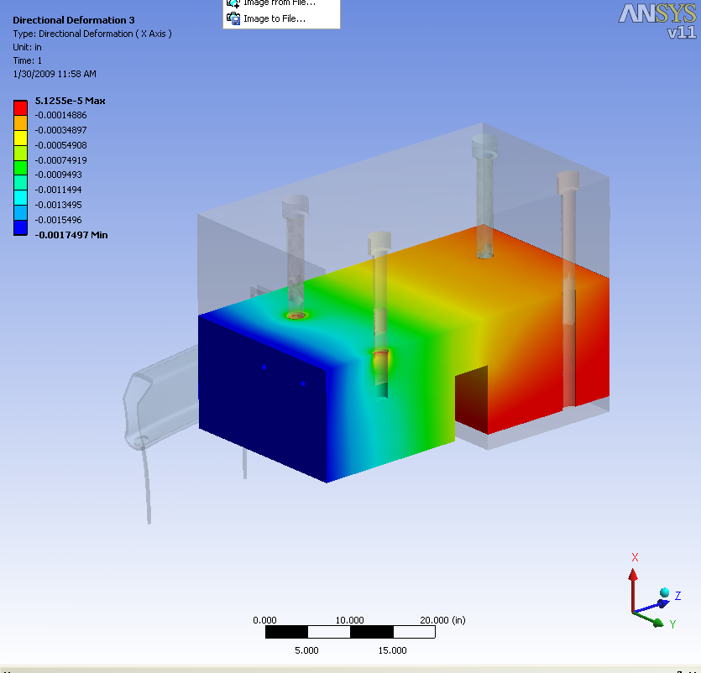
FEA Magnet Yoke
The total force on the poles was taken from Yang’s earlier analysis.
The total deflection of the pole due to magnetic and vacuum forces was computed to be 0.02” (0.05 mm)
The change in gap will be then ~0.1 mm. We should remember that the Mainz magnet had twice the deflection calculated but 0.2 mm would still be good.

Slide 30
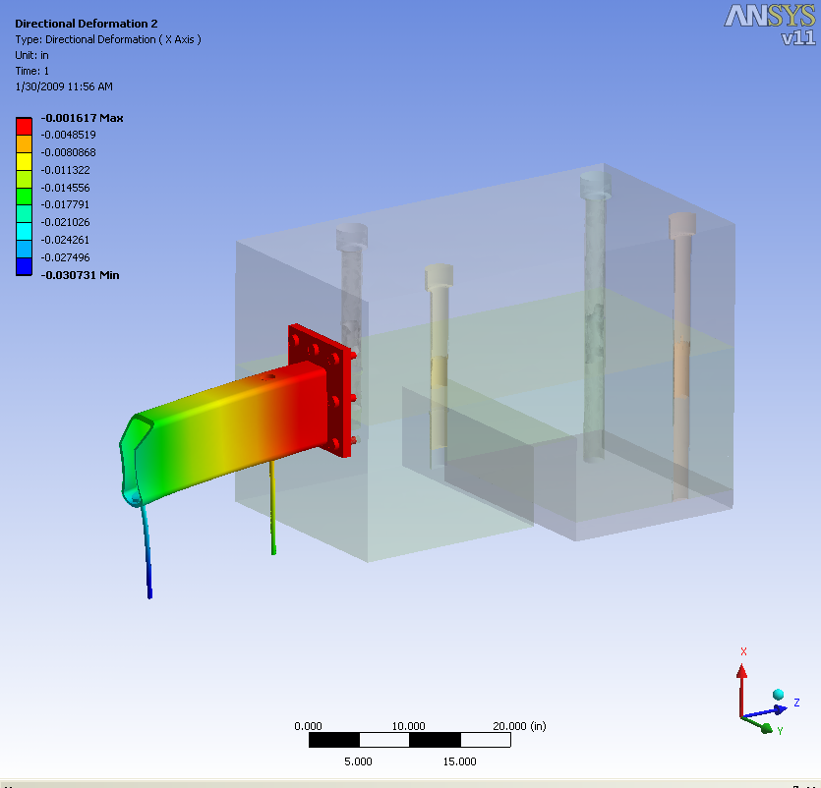
FEA Chamber Support Bracket
The deflection of the support bracket was modeled and found to be reasonable.

Slide 31
FE Analysis
Models are well advanced
Final results could be available in about a month.
Would need ~3 months to covert these to a set of documentation acceptable to JLAB as fulfillment of Safety and ES&H requirements.

