Slide 1
Tagger Microscope Electronics Construction
Readiness Review Feb. 7, 2013
Alex Barnes

Slide 2
Outline
Readiness Review
February 7, 2013
Final Construction Plan
Facilities
Quality Assurance Plans and Acceptance Test Plans
Documentation and Travelers
Personnel Training
Schedule and Tracking

Slide 3
Final Construction Plan
Readiness Review
February 7, 2013
Board design packages submitted to JLab for review
Assembly of 1st articles
Complete testing of 1st article boards
Complete assembly and testing of all boards
Complete software for cosmic-ray testing
Complete software library for control/monitoring of bias voltages
Complete cosmic-ray testing of detector

Slide 4
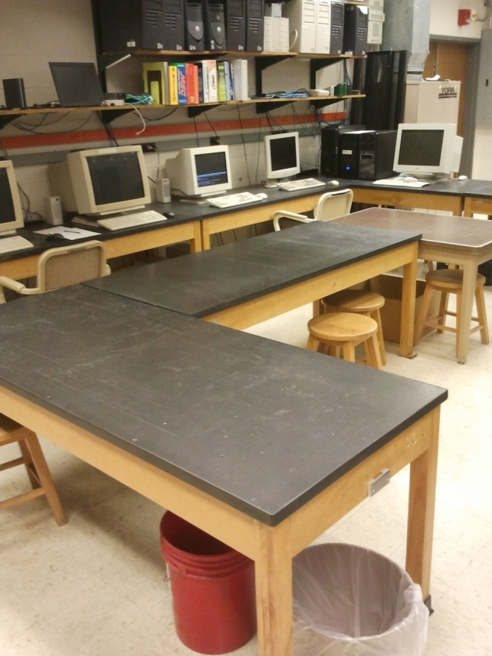
Facilities – Receiving and Inspection
Readiness Review
February 7, 2013
Dedicated receiving and inspection benches
An ESD mat will be added to our inspection bench

Slide 5
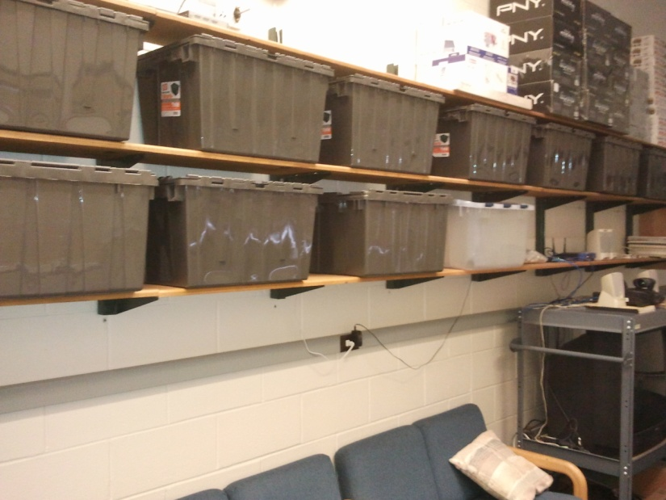
Facilities - Storage
Readiness Review
February 7, 2013
Electronic components will be stored in bins with static bag layers
Each type of board has its own set of bins
There will be a bin for each stage of construction
Each will be labeled appropriately

Slide 6
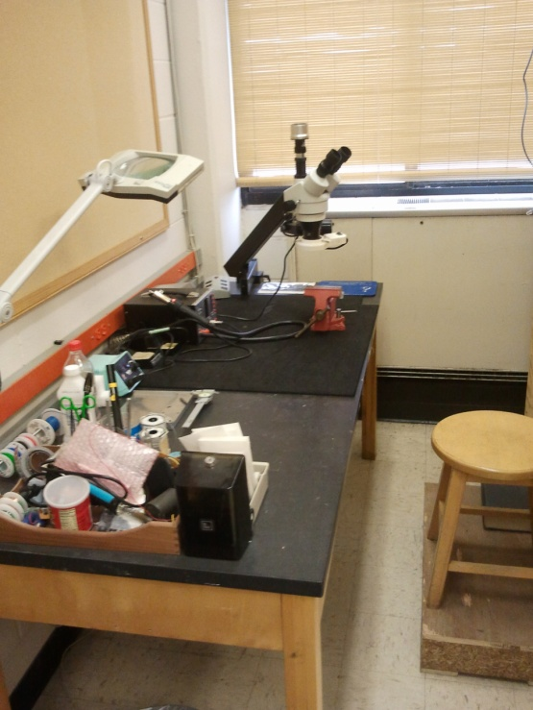
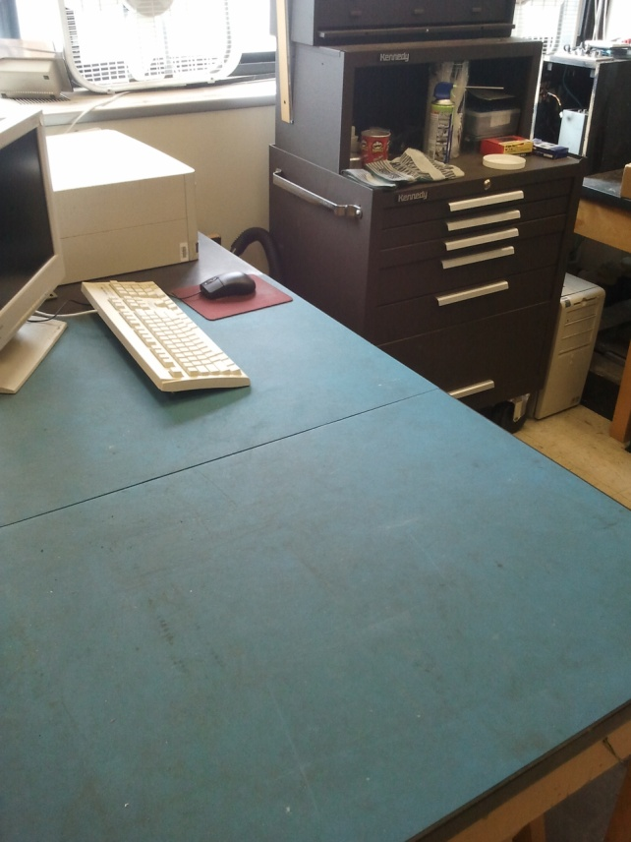
Facilities – Assembly and Repair
Readiness Review
February 7, 2013
The micro-inspection and repair bench has both a soldering iron and a hot air gun
Microscope for small components
Dc testing bench has an ESD mat and will have its own power supplies

Slide 7
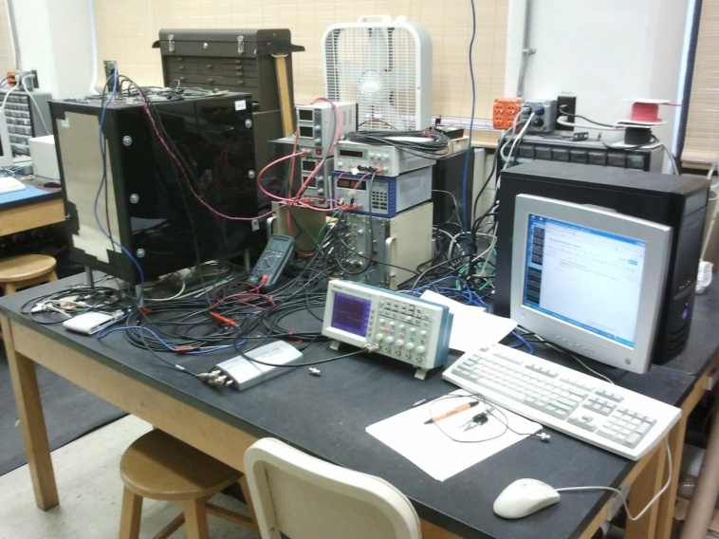
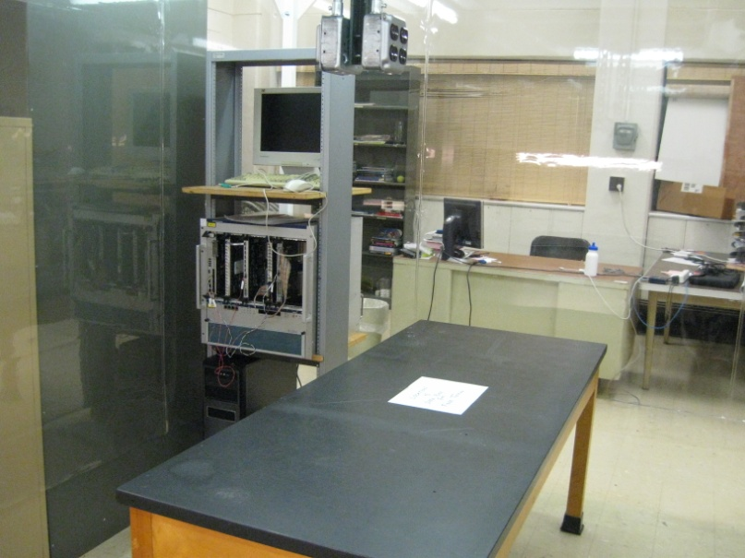
Facilities - Testing
Readiness Review
February 7, 2013
  Control board testing bench:
  Original dark box
  Can test new control boards
  Pulser capabilities
Second testing bench:
  JLab FADC
  Computer with CODA
  Can be used for all aspects of quality assurance

Slide 8
Quality Assurance - Preamplifiers
Readiness Review
February 7, 2013
Initial visual component inspection
Preamp regulated voltages and dc levels
High/low gain pulse shapes with pulser circuit
  Low: measure and compare single and summed outputs
  High: use 10x attenuator, measure and compare low and high summed outputs, measure single pixel pulse height
Electronic crosstalk
Performance tests
  Cosmic ray detection
  Extended runtime with pulser circuit

Slide 9
QA – Control Board and Backplane
Readiness Review
February 7, 2013
Control board
  Initial visual component inspection
  Programming of the FPGA
  FPGA execution of the software suite
Backplane
  Initial visual component inspection
  Visually examine Lemo connectors

Slide 10
Documentation and Travelers
Readiness Review
February 7, 2013
Travelers will be kept with the parts
Preamplifiers: Inspection, soldering, dc voltage tests, pulse shape tests, crosstalk, cosmic, final performance
Control boards: inspection, soldering, FPGA programming, software suite execution notes
Backplanes: inspection, soldering

Slide 11
Personnel Training
Readiness Review
February 7, 2013
Students will be required to complete UConn lab safety training
I will teach students how to inspect boards
Soldering of the Eurocards will be supervised and only students deemed capable will be trained
Students measuring dc voltages will have a reference sheet as well as a logbook and will be taught by me

Slide 12
Schedule and Tracking
Readiness Review
February 7, 2013
All boards will have their SN engraved upon inspection
Assuming 01 Jan 2013 start date:
  Board design submission – 25 Mar 2013
  Receipt of 1st article boards – 20 May/17 Jun 2013
  Assembly of 1st article boards – 17 Jun/01 Jul 2013
  Testing of 1st article boards – 15 Jul/12 Aug 2013
  Receipt of all boards – 12 Aug 2013
  Assembly and testing of all boards – 21 Oct 2013
  Software for cosmic testing – 03 Jan 2014
  Software library for control of bias voltages – 03 Jan 2014
  Complete cosmic ray testing – 31 Jan 2014

