Slide 1
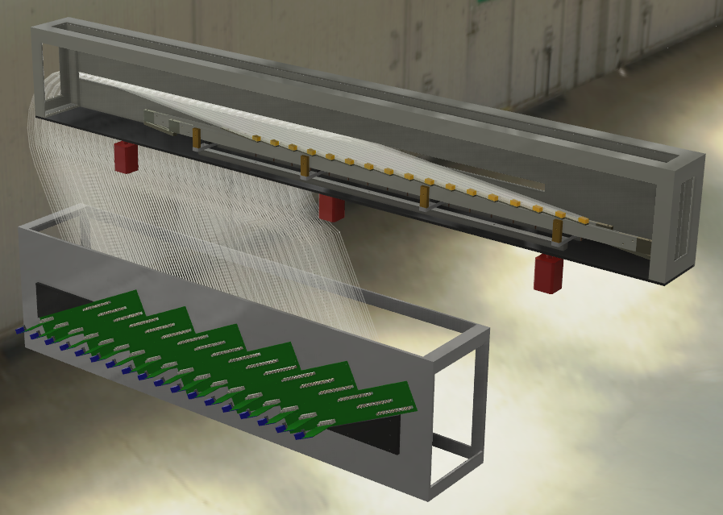

Tagger Microscope Fabrication Readiness Review
James M^{c}Intyre

Slide 2
Microscope Fabrication Readiness Review
Feb 07, 2013
Outline
Overview
  TAGM Milestones
  Documents & Travelers
  Personnel Training
  Special Training & Hazards
Construction Plan
  Scheduling
  Testing & Acceptance Plans
  Documentations & Tracking
Questions
James M^{c}Intyre

Slide 3
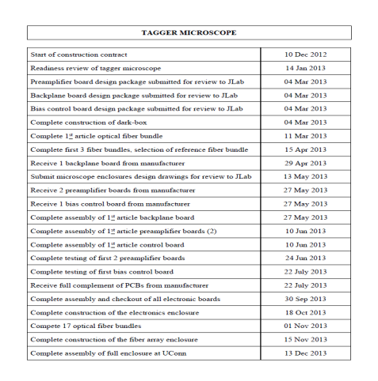
Microscope Fabrication Readiness Review
Feb 07, 2013
Overview
TAGM Milestone
  Dark Box Construction
    End Date: 06 May 2013
  1st Article Optical Fiber Bundle
    End Date: 13 May 2013
  Complete First 3 Bundles / Select Ref. Bundle
    End Date: 17 Jun 2013
  Submit TAGM Enclosure Design Drawings to JLab
    End Date: 15 Jul 2013
  Complete Construction of Electronics Enclosure
    End Date: 20 Dec 2013
James M^{c}Intyre

Slide 4
Microscope Fabrication Readiness Review
Feb 07, 2013
Overview
TAGM Milestone
  Complete 17 Optical Fiber Bundles
    End Date: 03 Jan 2014
  Complete Construction of Fiber Array Enclosure
    End Date: 17 Jan 2014
  Complete Assembly of Full Enclosure at UConn
    End Date: 14 Feb 2014
  TAGM Disassembly / Packing for Shipment to JLab
    End Date: 28 Mar 2014
  Delivery of TAGM components to JLab
    End Date: 07 Apr 2014
James M^{c}Intyre

Slide 5
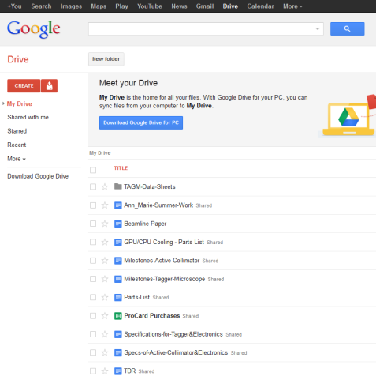
Microscope Fabrication Readiness Review
Feb 07, 2013
Overview
Documentation & Travelers
  TAGM Milestones
  https://docs.google.com/document/d/1WeUDsoiMD2ogm2zvRaglJVA-r9s5hWlLZktTXJdQ6JE/edit?usp=sharing
  Construction Plan for the TAGM
  https://docs.google.com/document/d/15OreBfdhb5mdpdXz6KMTVQt8ZWMU-4OV9i8Y6vp97Ms/edit?usp=sharing
  Specifications of the TAGM Detector
  https://docs.google.com/document/d/1rHl580R3X3r2yn3hw1Mh-JC136NzWyE6IE_SoGRjR50/edit?usp=sharing
  Quality Assurance & Acceptance Test Plan for the TAGM
  https://docs.google.com/document/d/1JL40gx7tPDDFu4aSiad3fTemAp0yiVBPI6D8FB5zb6o/edit?usp=sharing
James M^{c}Intyre

Slide 6
Safety/Conduct Training
Microscope Fabrication Readiness Review
Feb 07, 2013
Chemical Health and Safety Training
  Hazard and chemical characterization/ assessment
  Chemical Hygiene Plan including standard operating procedures
  Waste disposal
  Air quality
  Protective equipment
  Emergency response protocol
Collaborative Institutional Training
  Collaborative research
  Conflict of interest
  Responsible code of conduct
  Mentor and trainee responsibilities
  Research Misconduct
James M^{c}Intyre

Slide 7
Job Training
Microscope Fabrication Readiness Review
Feb 07, 2013
Walk-through the lab areas
  Where safety stations, chemical storage, fume hood, MSDS, waste stations, etc. are located
Standard operating procedure
  These will be located at each work station
  Shift checklist to track adherence
Cooperative or supervised first shift
Someone else always present on the floor
Spot checks
James M^{c}Intyre

Slide 8
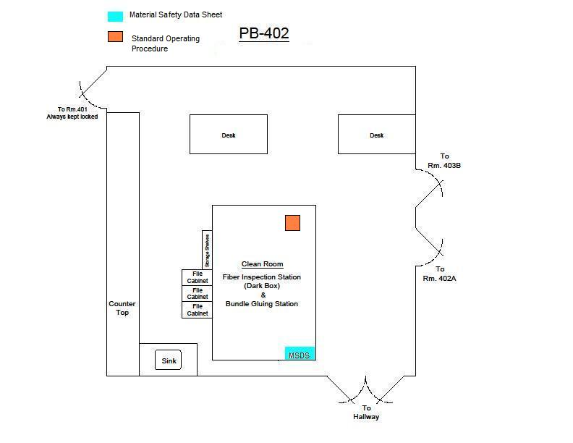
Microscope Fabrication Readiness Review
Feb 07, 2013
James M^{c}Intyre

Slide 9
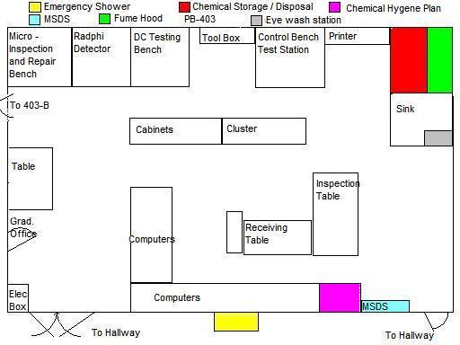
Microscope Fabrication Readiness Review
Feb 07, 2013
James M^{c}Intyre

Slide 10
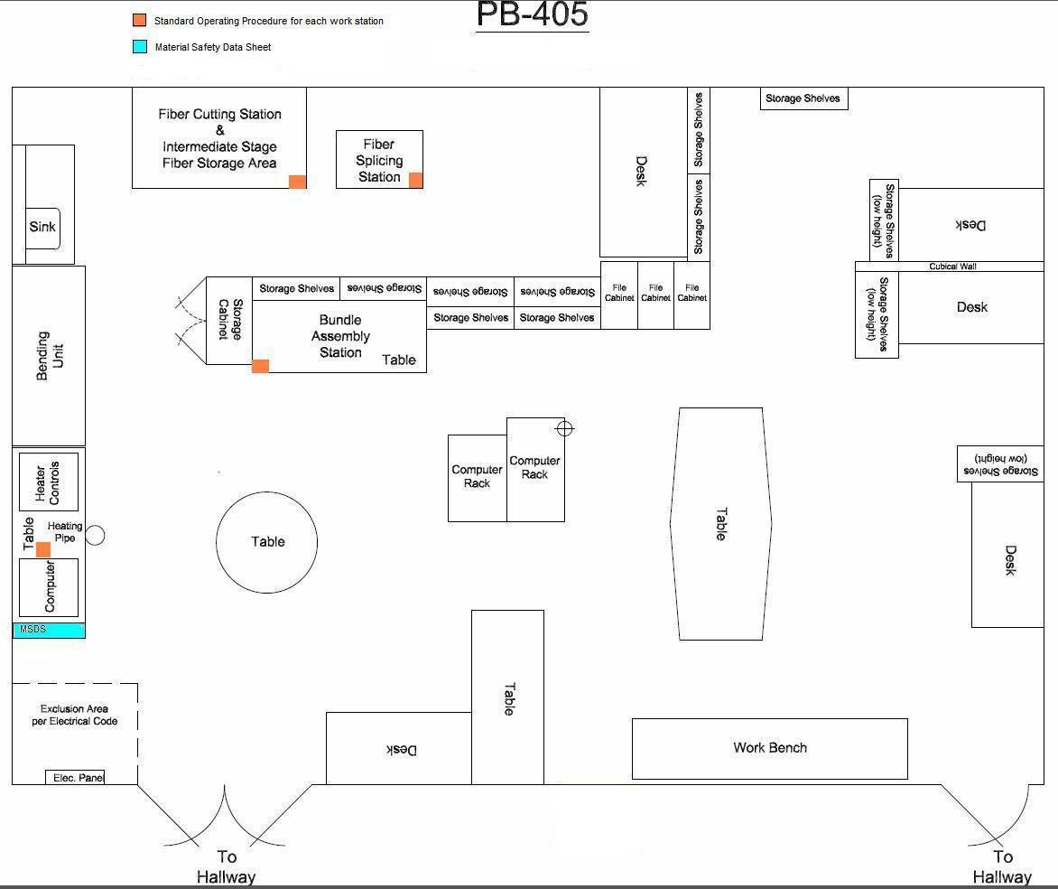
Microscope Fabrication Readiness Review
Feb 07, 2013
James M^{c}Intyre

Slide 11
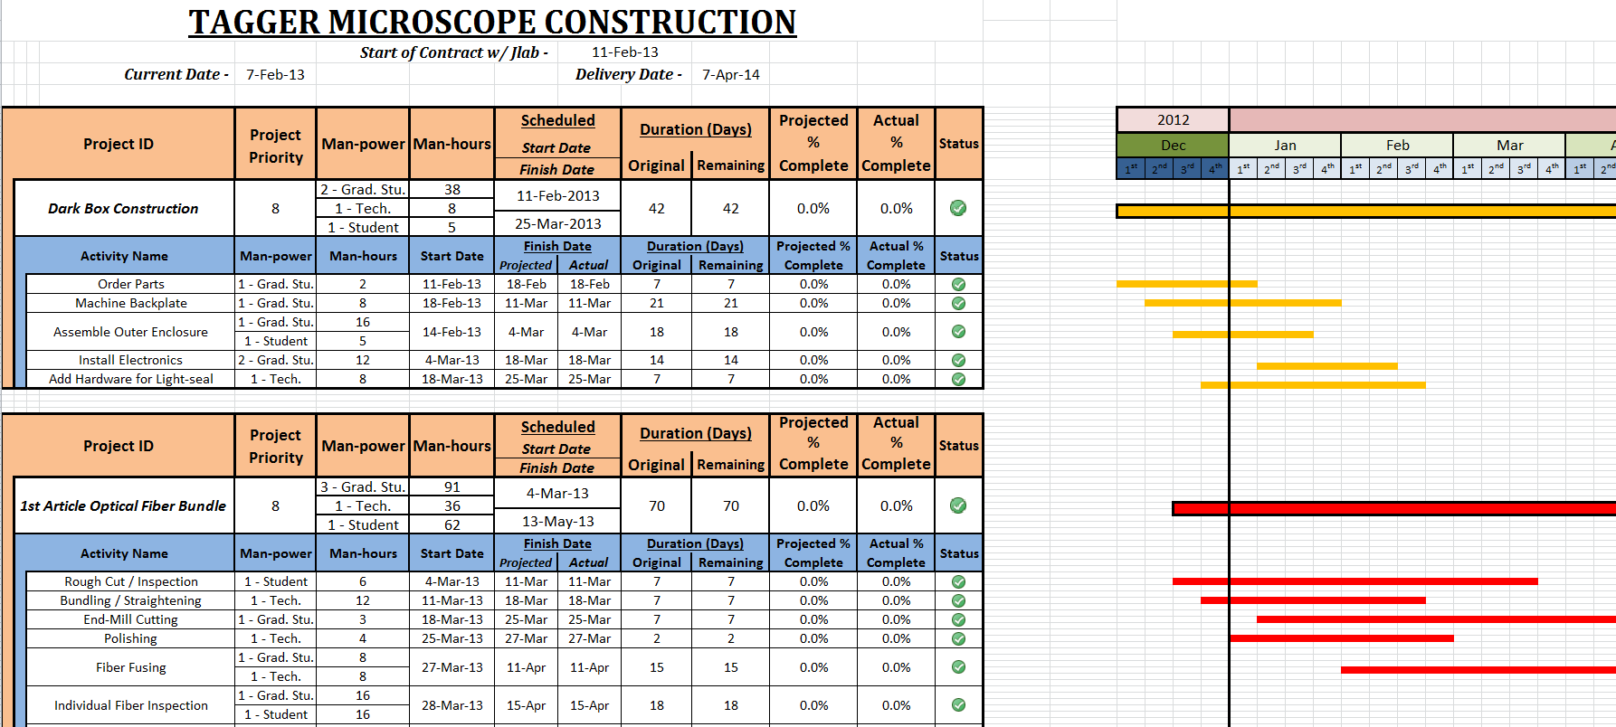
Microscope Fabrication Readiness Review
Feb 07, 2013
Construction Plan - Overall
Scheduling
  Completion Date – 07 Apr 2014
  Total Man-power :
  3 Grad. Students @ 2140 Grad-hours (total)
  1 Technician @ 718 Tech-hours
  2 Student Workers @ 1179 Student-hours (total)
  1 Machinist @ 840 Machining-hours
James M^{c}Intyre

Slide 12
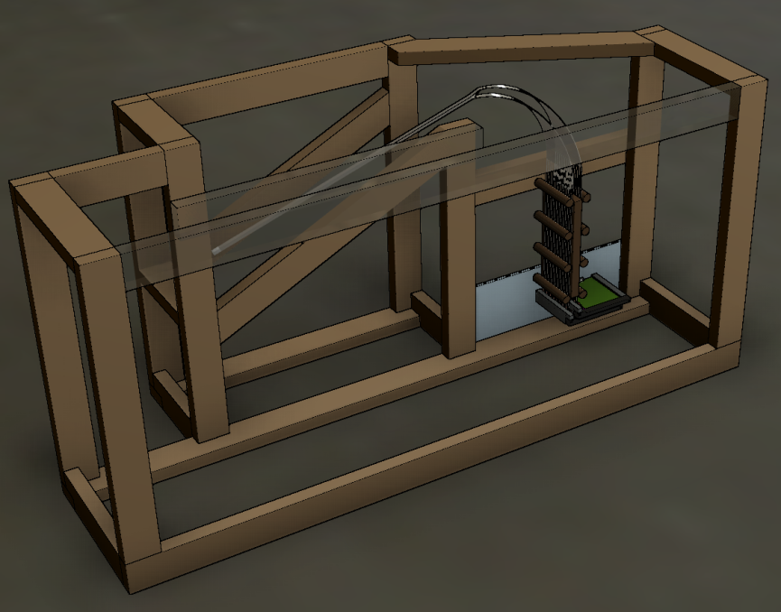
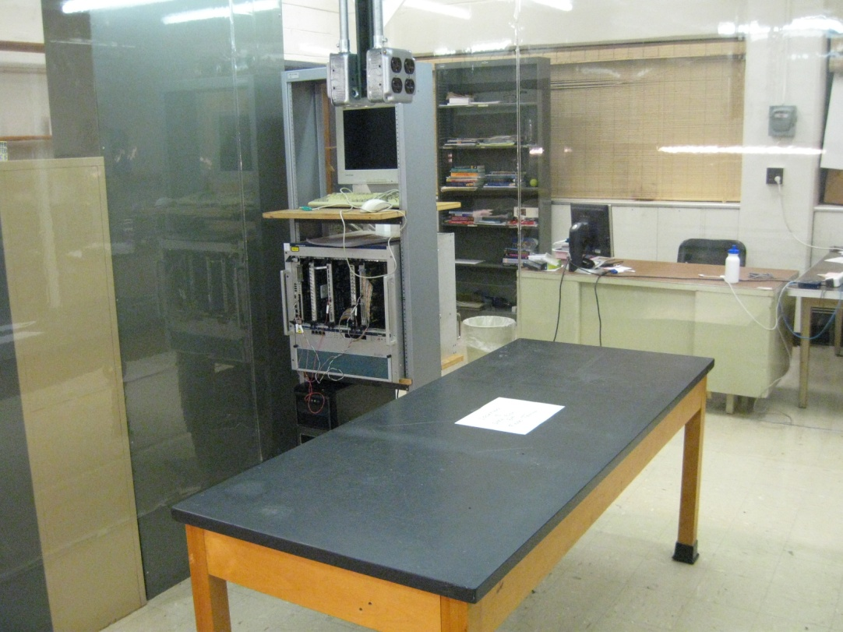
Microscope Fabrication Readiness Review
Feb 07, 2013
Construction Plan
Inspection & Acceptance Test Areas
  Dark Box Testing Area
    Testing Optical Fibers
    Electronics
Allows for testing of:
  Single fused fibers
  Fiber bundles
  Cooling unit for the electronics’ enclosure
James M^{c}Intyre

Slide 13
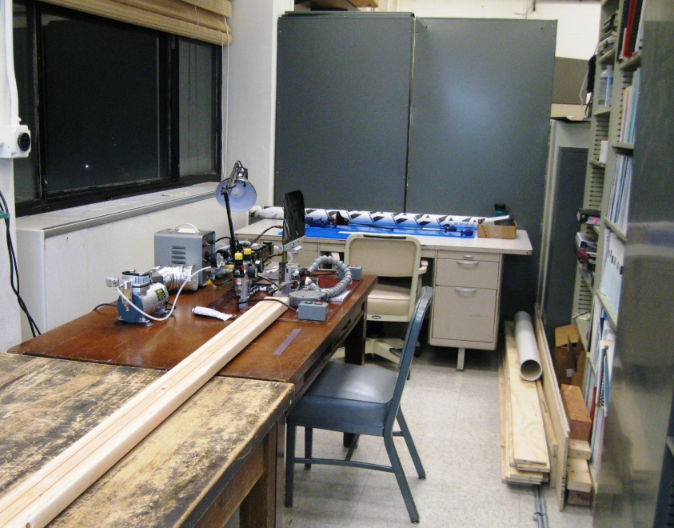
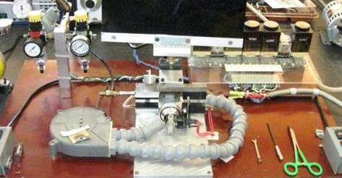
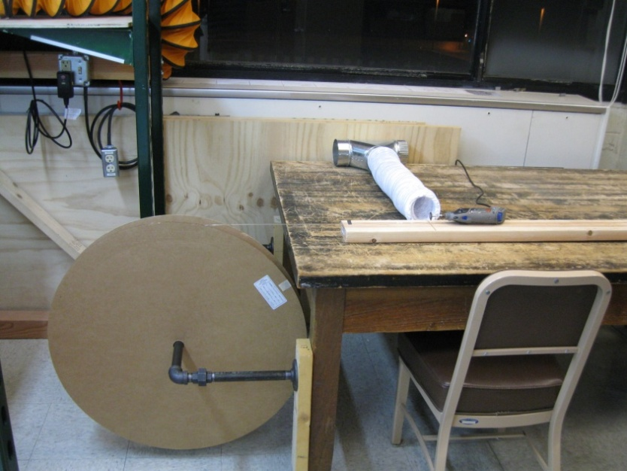
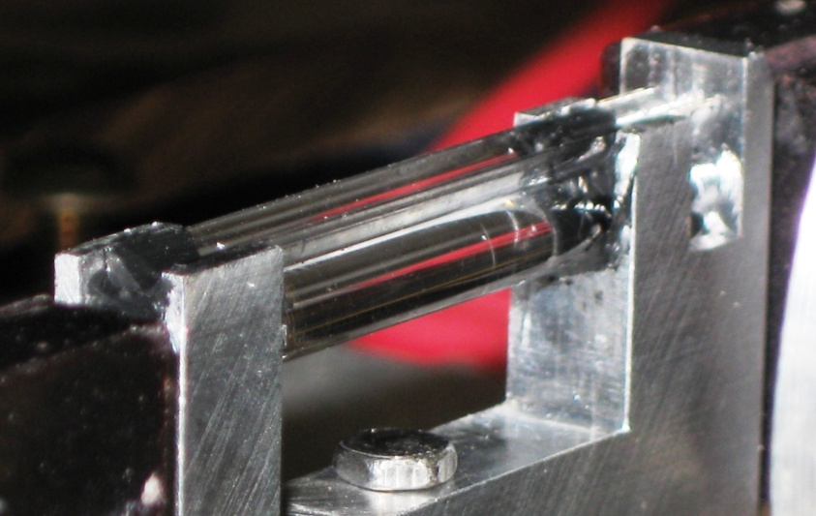
Microscope Fabrication Readiness Review
Feb 07, 2013
Construction Plan
Inspection & Acceptance Test Areas
  Rough Cut / Fusing Area
    Cross-sectional Dimension
    Cladding Inspection
James M^{c}Intyre

Slide 14
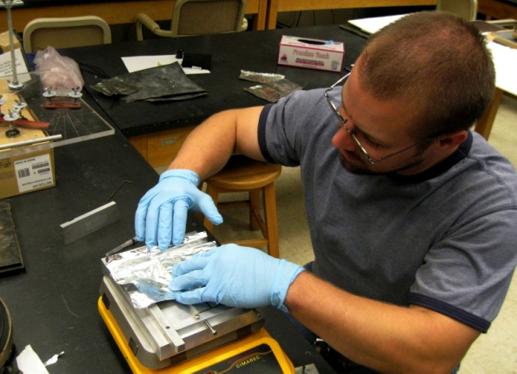
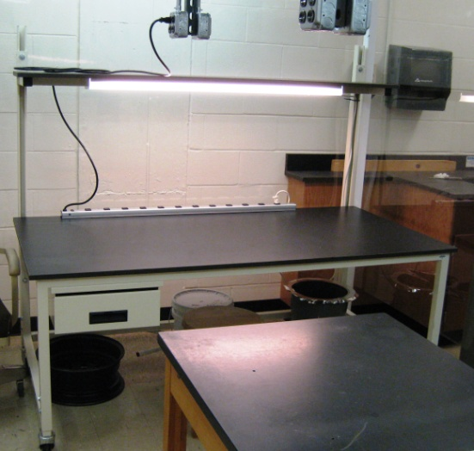
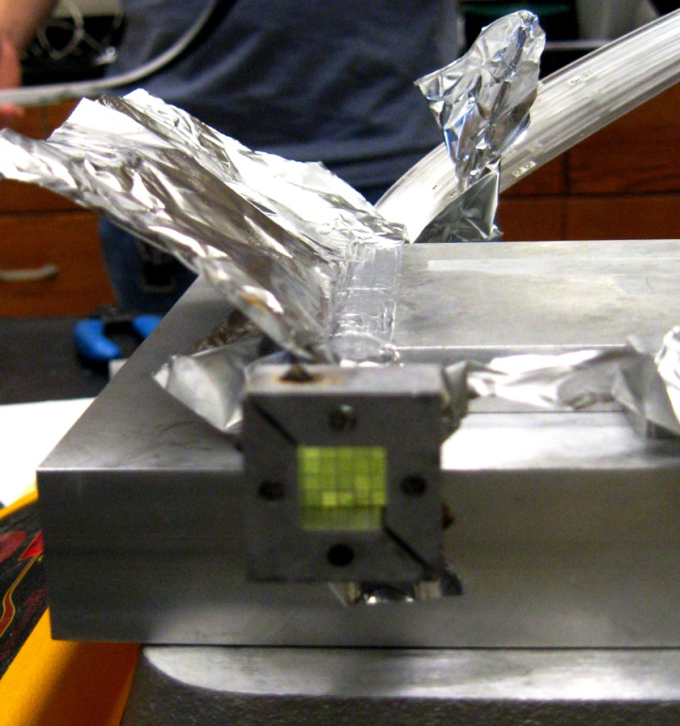
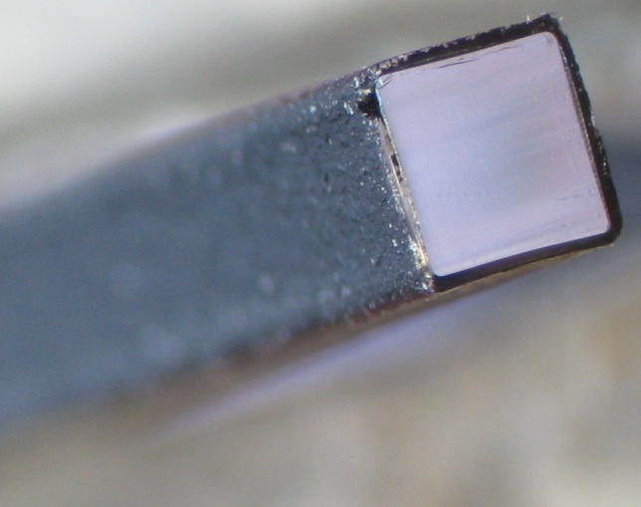
Microscope Fabrication Readiness Review
Feb 07, 2013
Construction Plan
Inspection & Acceptance Test Areas
  Gluing Area
    Bundle Dimensions
    Paint Coverage
Gluing Station
(Clean room)
James M^{c}Intyre

Slide 15
Microscope Fabrication Readiness Review
Feb 07, 2013
Construction Plan
Documentation & Travelers
  Use of Google Documents to Track:
    Rough Cut
    Bending
    Light Transmission Testing
    …
  Provides up-to-date progress tracking
  Envelopes with complete data list accompany components to JLab
James M^{c}Intyre

Slide 16
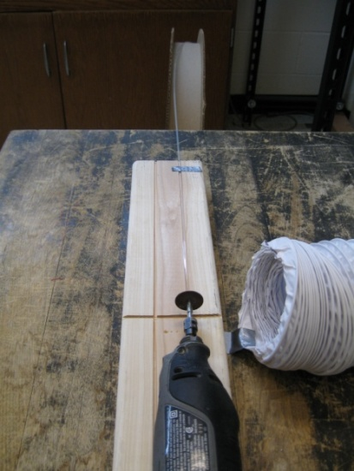
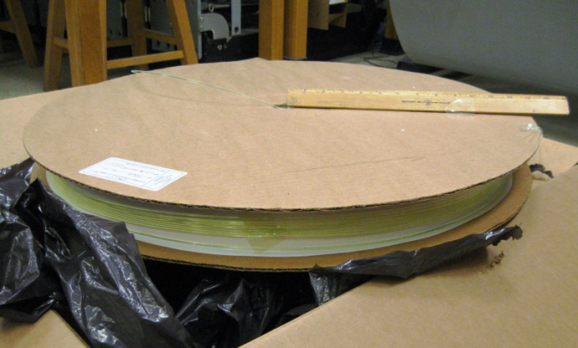
Microscope Fabrication Readiness Review
Feb 07, 2013
Construction Plan – Rough Cut
Scheduling
  End Date – 03 Jan 2014
  Man-power:
  1 Student Worker @ 102 hours
Inspection, Testing, & Acceptance Plans
  Cross-sectional dimensions
    SciFi – Measure every 3 cm (prior to cutting)
    Light Guides – Measure 4cm from each end & 3 other locations
        (~ 40cm apart)
  Documentations & Tracking
  Rough Cut Data Sheet
  https://docs.google.com/spreadsheet/ccc?key=0Am3YqcbK4xUxdGdldUt5Nk53UENKUUg5ejgyLWE2bFE&usp=sharing
James M^{c}Intyre

Slide 17
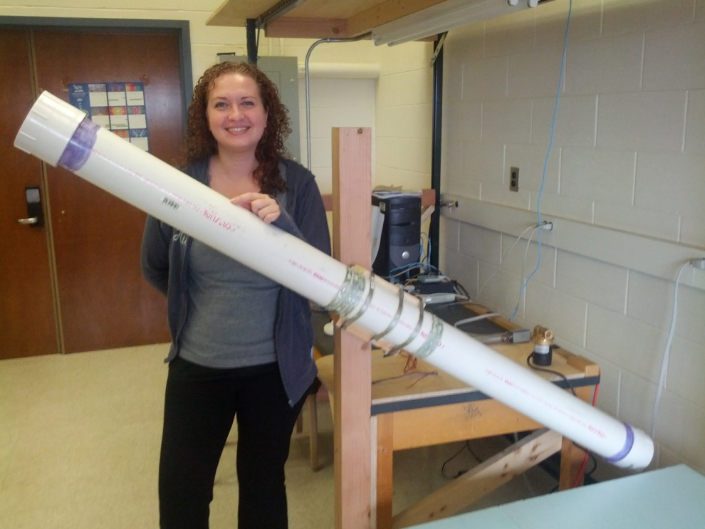
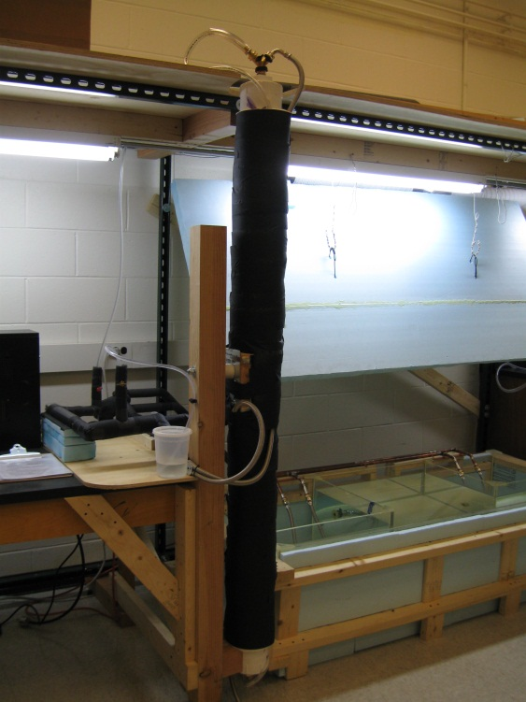
Microscope Fabrication Readiness Review
Feb 07, 2013
Construction Plan – Fiber Straightening
Scheduling
  Man-power:
  1 Technician @ 204 hours
Inspection, Testing, & Acceptance Plans
  Check for damage to cladding
  Crazing of fibers
  Monitoring & recording temperature
  Documentations & Tracking
  Straightening Temperature Data Sheet
  https://docs.google.com/spreadsheet/ccc?key=0Am3YqcbK4xUxdGdldUt5Nk53UENKUUg5ejgyLWE2bFE&usp=sharing
James M^{c}Intyre

Slide 18
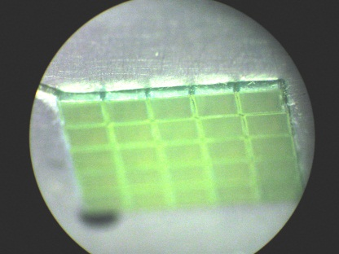
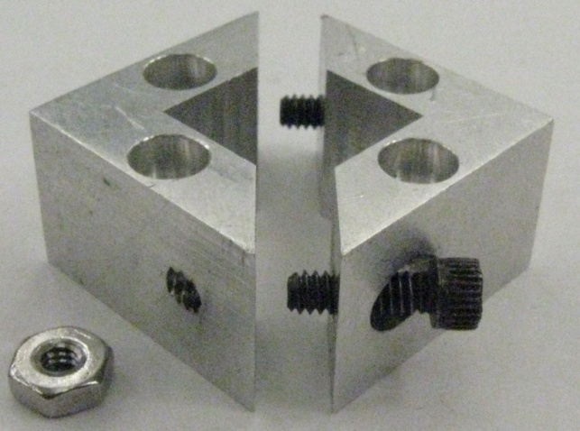
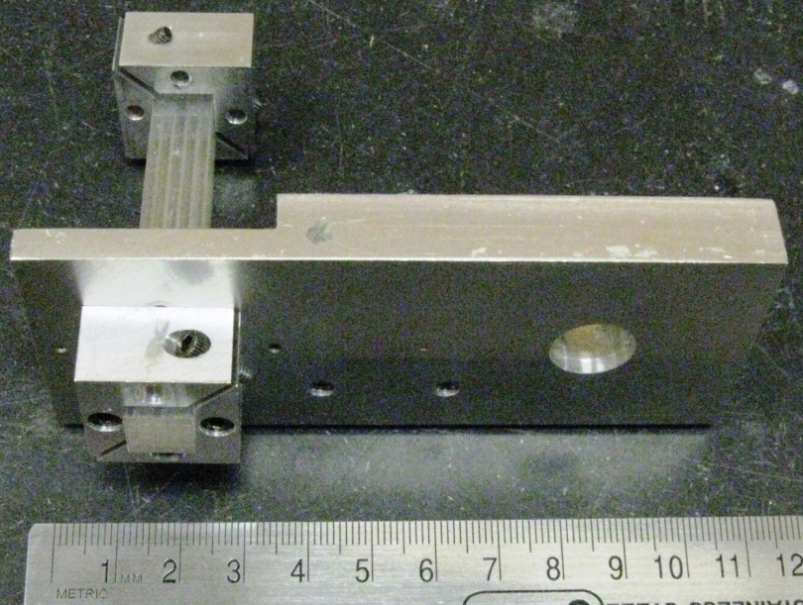
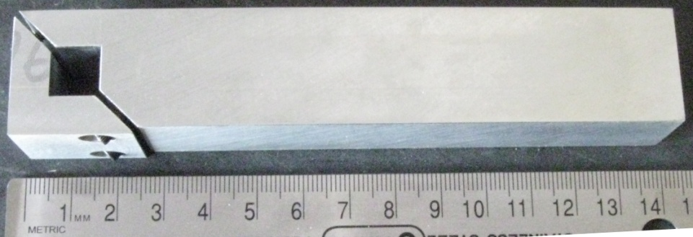
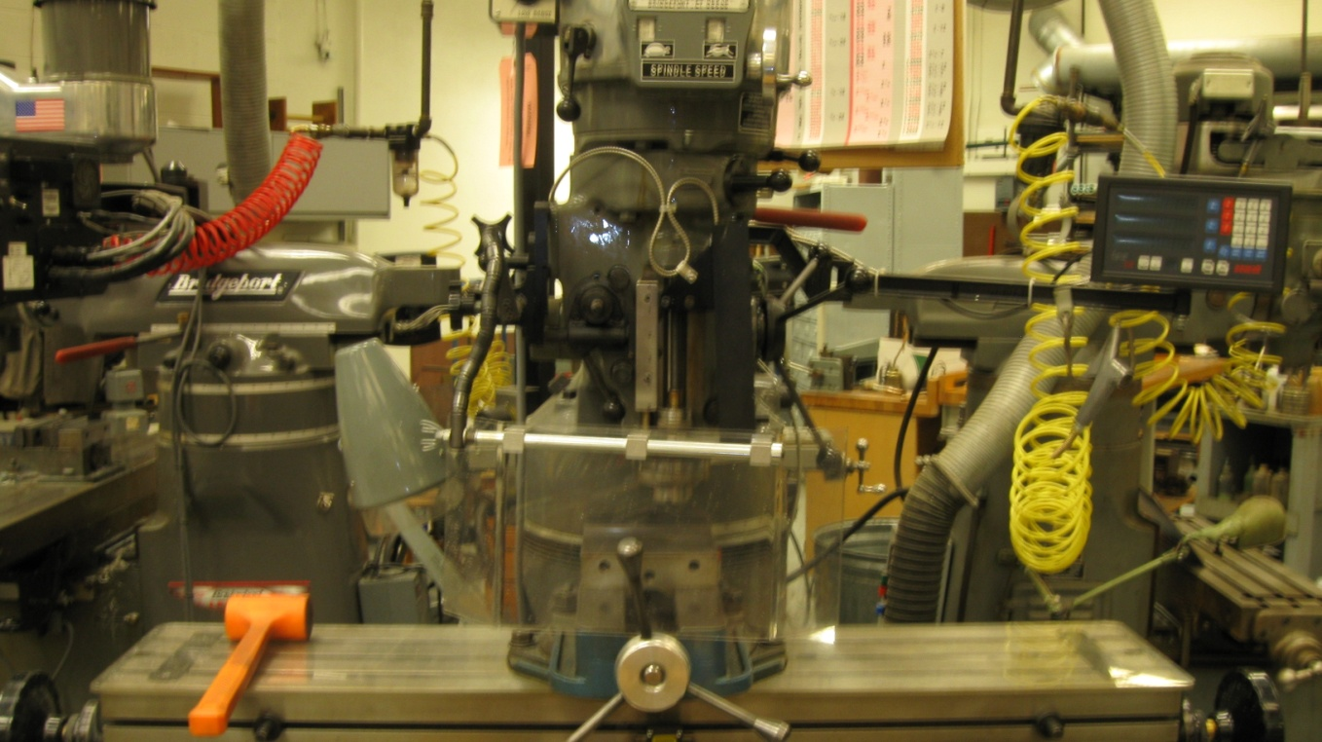
Microscope Fabrication Readiness Review
Feb 07, 2013
Construction Plan – End-Mill Fiber Cut
Scheduling
  Man-power:
  1 Grad. Student @ 51 hours
Inspection, Testing, & Acceptance Plans
  Check for damage to cladding
  Measuring Length
  Documentations & Tracking
  End-Mill Data Sheet
  https://docs.google.com/spreadsheet/ccc?key=0Am3YqcbK4xUxdDdBcHlPbERlejlYbmhlSnRqVElxZGc&usp=sharing
James M^{c}Intyre

Slide 19
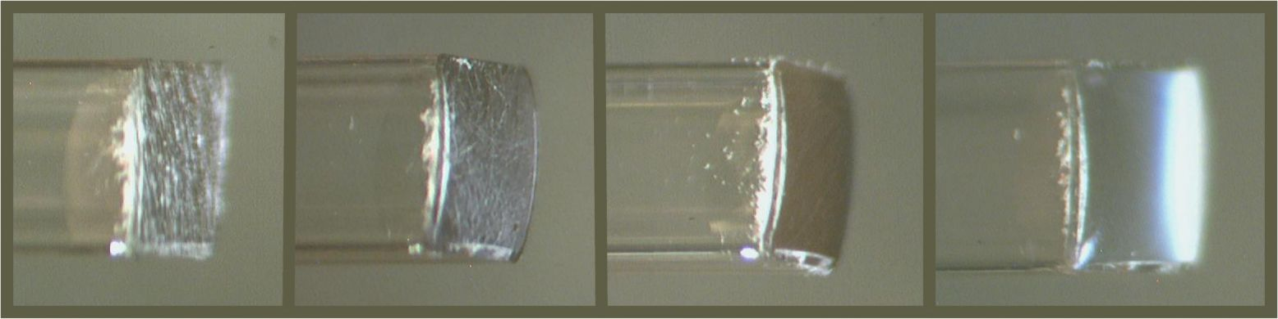

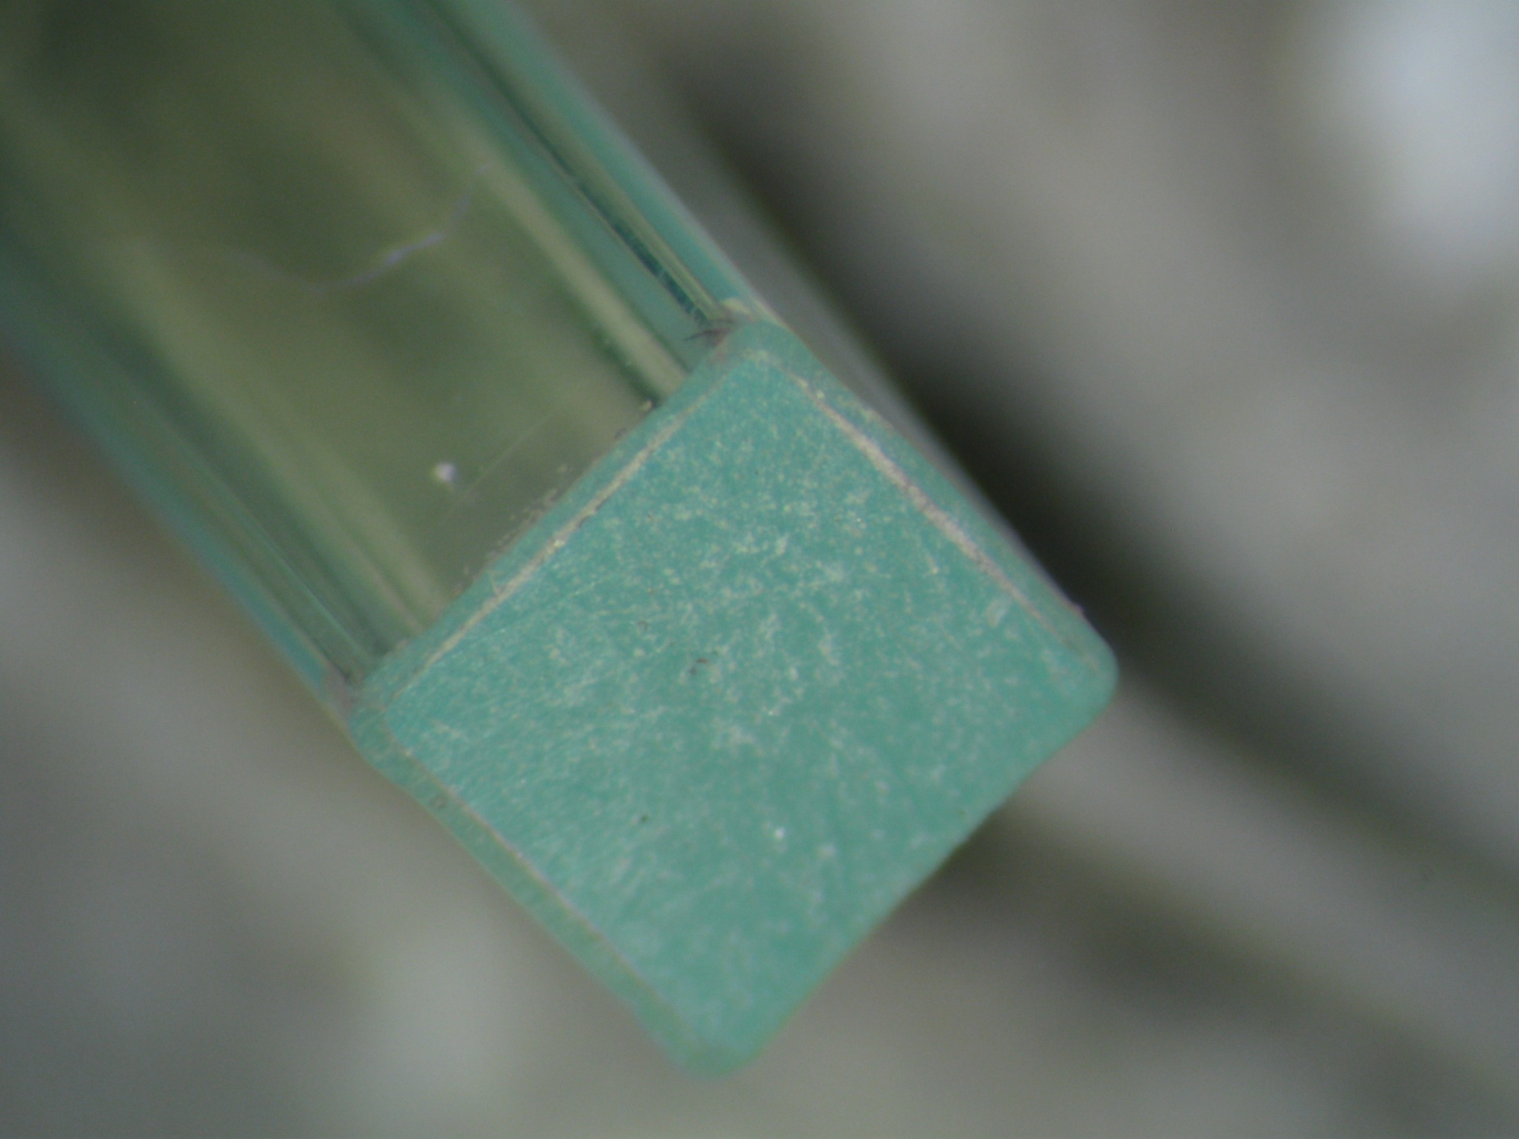
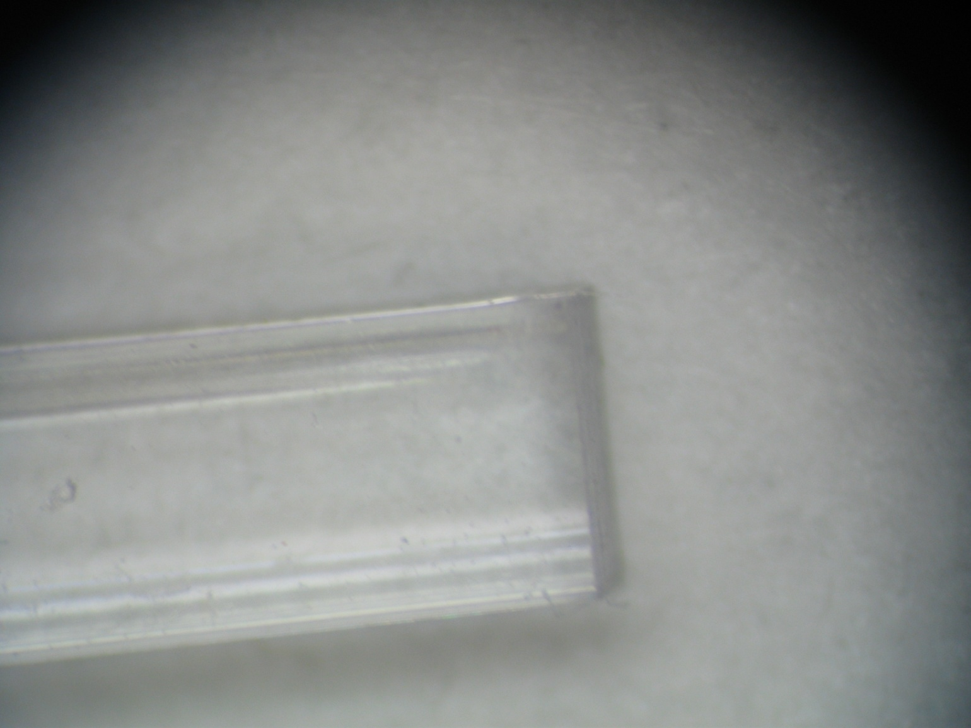
Microscope Fabrication Readiness Review
Feb 07, 2013
Construction Plan – Fiber-End Polishing
Scheduling
  Man-power:
  1 Technician @ 68 hours
Inspection, Testing, & Acceptance Plans
  Check for damage to cladding
  Check for surface imperfections
  Documentations & Tracking
  Polishing Data Sheet
  https://docs.google.com/spreadsheet/ccc?key=0Am3YqcbK4xUxdERoaXd6UnRldXhaVzVzd1d2dVB4R2c&usp=sharing
Polishing: End-Mill to copier paper
Straight edge when polished in collar
(shown above)
James M^{c}Intyre

Slide 20
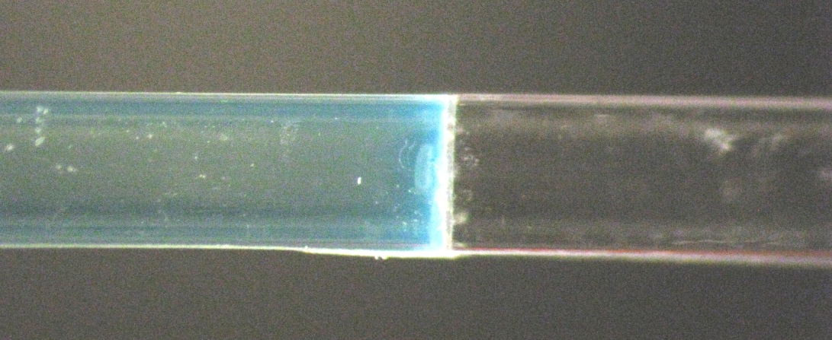
Microscope Fabrication Readiness Review
Feb 07, 2013
Construction Plan – Fiber Fusing
Scheduling
  Man-power:
  1 Grad. Student @ 136 hours
  1 Technician @ 136 hours
Inspection, Testing, & Acceptance Plans
  Cross-sectional dimensions at the fusing joint
  Cladding damage
  Documentations & Tracking
  Fiber Fusing Data Sheet
  https://docs.google.com/spreadsheet/ccc?key=0Am3YqcbK4xUxdDB2VFRtcVplLUxJdzJpU0RiQUYxUnc&usp=sharing
James M^{c}Intyre

Slide 21
Microscope Fabrication Readiness Review
Feb 07, 2013
Construction Plan – Individual Fiber Inspection
Scheduling
  Man-power:
  1 Grad. Student @ 272 hours
  1 Student Worker @ 272 hours
Inspection, Testing, & Acceptance Plans
  Light transmission
  Documentations & Tracking
  Individual Fiber Inspection Data Sheet
  https://docs.google.com/spreadsheet/ccc?key=0Am3YqcbK4xUxdFpLdGd6R3l4SUFNTzRKNWk3b3QyVXc&usp=sharing
James M^{c}Intyre

Slide 22

Microscope Fabrication Readiness Review
Feb 07, 2013
Construction Plan – Fiber Painting
Scheduling
  Man-power:
  1 Grad. Student @ 68 hours
Inspection, Testing, & Acceptance Plans
  Cross-sectional dimensions
  Even coating
  Documentations & Tracking
  Fiber Painting Data Sheet
  https://docs.google.com/spreadsheet/ccc?key=0Am3YqcbK4xUxdGZyN2ptMVZUcnFySDRnZThmcDF2SGc&usp=sharing
James M^{c}Intyre

Slide 23
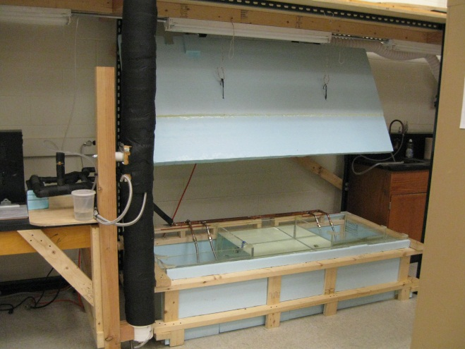
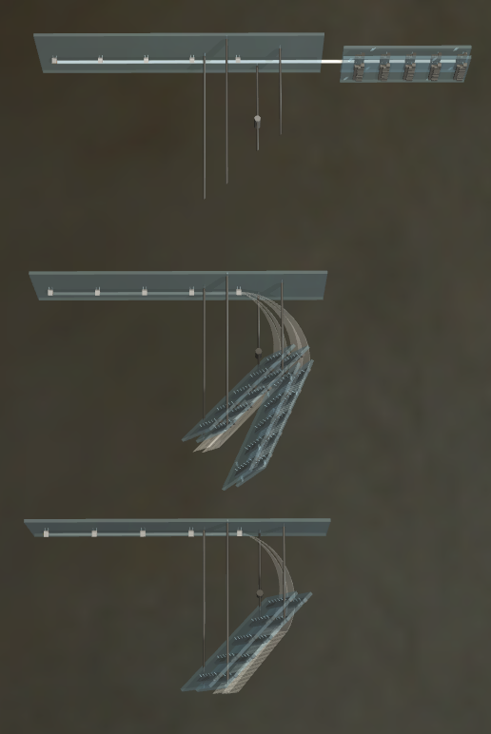
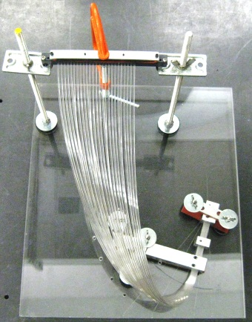
Microscope Fabrication Readiness Review
Feb 07, 2013
Construction Plan – Bundle Bending
Scheduling
  Man-power:
  1 Grad. Student @ 272 hours
  1 Student Worker @ 272 hours
Inspection, Testing, & Acceptance Plans
  Fiber cross-sectional shape
  Crazing
  Cladding cracking
  Documentations & Tracking
  Bundle Bending Data Sheet
  https://docs.google.com/spreadsheet/ccc?key=0Am3YqcbK4xUxdGZNREdVSXc4UEo1LW9FbWNYY1FYR3c&usp=sharing
Start
Finish
James M^{c}Intyre

Slide 24
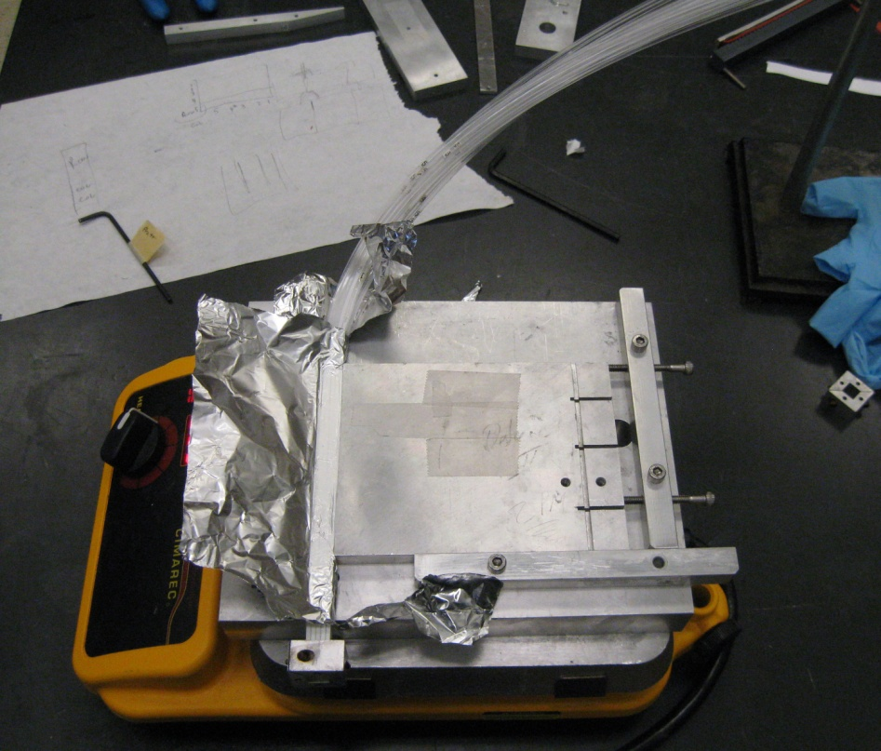
Microscope Fabrication Readiness Review
Feb 07, 2013
Construction Plan – Bundle Drying
Scheduling
  Man-power:
  1 Grad. Student @ 136 hours
Inspection, Testing, & Acceptance Plans
  Inspect for fiber damage
  Ensure completely dry prior to gluing
  Documentations & Tracking
  None needed
James M^{c}Intyre

Slide 25
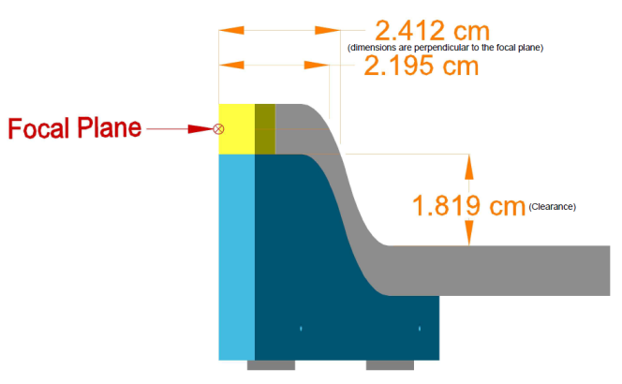
Microscope Fabrication Readiness Review
Feb 07, 2013
Construction Plan – Gluing
Scheduling
  Man-power:
  1 Grad. Student @ 408 hours
  1 Student Worker @ 408 hours
Inspection, Testing, & Acceptance Plans
  Cross-sectional dimensions
  Damage to fiber ends
  Excess glue
  Documentations & Tracking
  Bundle Gluing Data Sheet
  https://docs.google.com/spreadsheet/ccc?key=0Am3YqcbK4xUxdEs0WUtxb1oySHNqVFhydU9NTFpmTlE&usp=sharing
James M^{c}Intyre

Slide 26
Microscope Fabrication Readiness Review
Feb 07, 2013
Construction Plan – Fiber Bundle Inspection
Scheduling
  Man-power:
  1 Grad. Student @ 204 hours
  1 Technician @ 204 hours
Inspection, Testing, & Acceptance Plans
  Light transmission
  Documentations & Tracking
  Individual Fiber Inspection Data Sheet
  https://docs.google.com/spreadsheet/ccc?key=0Am3YqcbK4xUxdFpLdGd6R3l4SUFNTzRKNWk3b3QyVXc&usp=sharing
James M^{c}Intyre

Slide 27
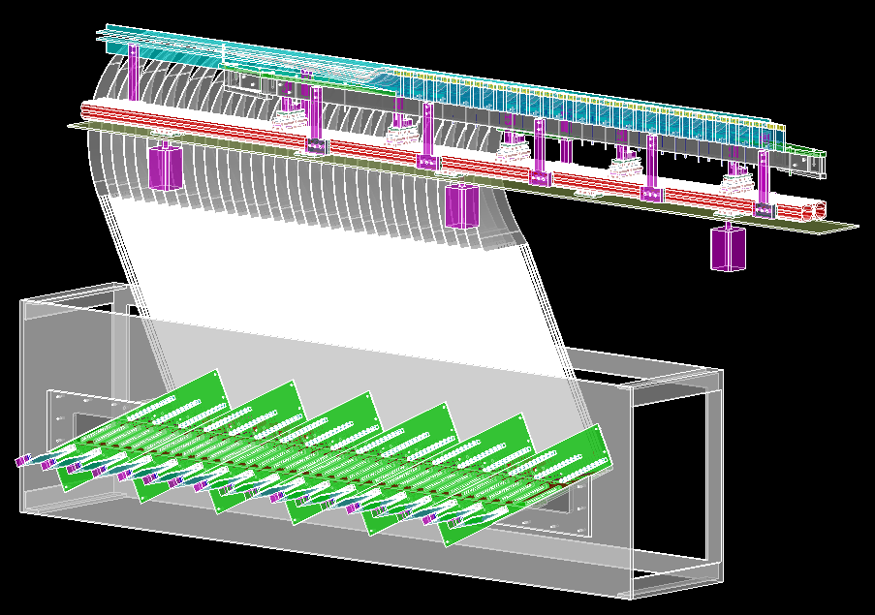
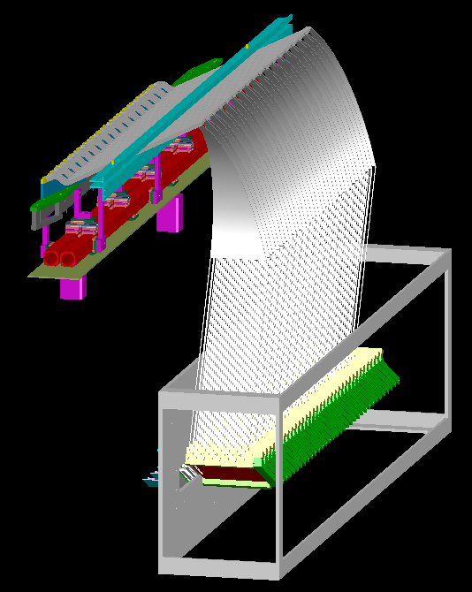
Microscope Fabrication Readiness Review
Feb 07, 2013
Construction Plan – TAGM Drawing Submission
Scheduling
  End Date – 15 Jul 2013
  Man-power:
  1 Grad. Student @ 144 hours
  1 Technician @ 36 hours
Inspection, Testing, & Acceptance Plans
  Spot check of dimensions by technician
  Documentations & Tracking
  TAGM Drawings located on UConn PAN Wiki
  http://zeus.phys.uconn.edu/wiki/index.php/Full_Scale_Tagger_Microscope_Drawings
James M^{c}Intyre

Slide 28
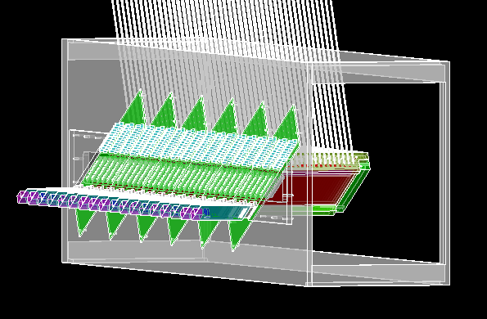
Microscope Fabrication Readiness Review
Feb 07, 2013
Construction Plan – Construction of Electronics Enclosure
Scheduling
  End Date – 20 Dec 2013
  Man-power:
  3 Grad. Student @ 144 hours
  1 Technician @ 20 hours
  1 Student Worker @ 40 hours
Inspection, Testing, & Acceptance Plans
  Light seal test
  Documentations & Tracking
  Pictures & construction notes maintained on the UConn PAN Wiki
James M^{c}Intyre

Slide 29
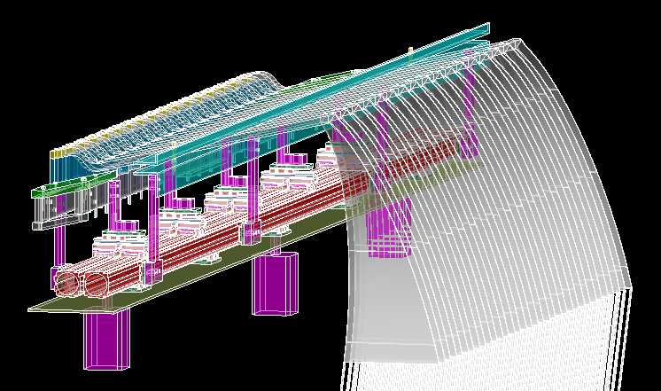
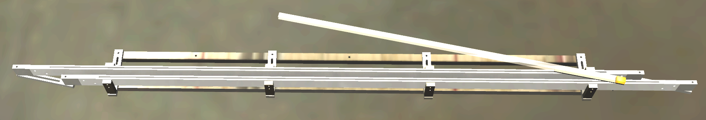
Microscope Fabrication Readiness Review
Feb 07, 2013
Construction Plan – Construction of Fiber Array Enclosure
Scheduling
  End Date – 17 Jan 2014
  Man-power:
  3 Grad. Student @ 165 hours
  1 Technician @ 20 hours
  1 Student Worker @ 40 hours
Inspection, Testing, & Acceptance Plans
  Light seal test
  Documentations & Tracking
  Pictures & construction notes maintained on the UConn PAN Wiki
e⁻
James M^{c}Intyre

Slide 30
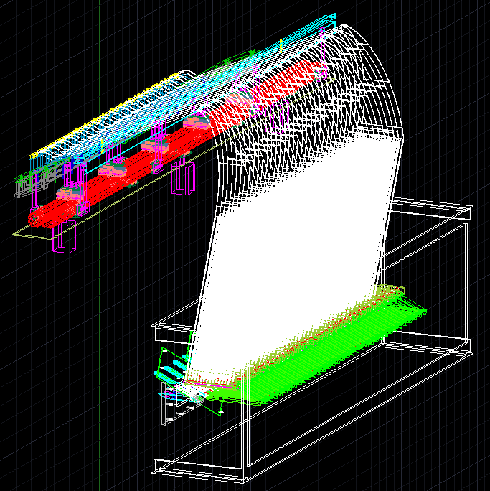
Microscope Fabrication Readiness Review
Feb 07, 2013
Construction Plan – Construction of Full TAGM
Scheduling
  End Date – 14 Feb 2014
  Man-power:
  2 Grad. Student @ 68 hours
  1 Student Worker @ 16 hours
Inspection, Testing, & Acceptance Plans
  Light seal test
  30 Day Cosmic-Ray Testing of the TAGM
  Documentations & Tracking
  Cosmic-Ray Testing Data Sheet
  https://docs.google.com/spreadsheet/ccc?key=0Am3YqcbK4xUxdEFGUENRT0hETVNIVzlOUkNGVGNaWUE&usp=sharing
James M^{c}Intyre

Slide 31
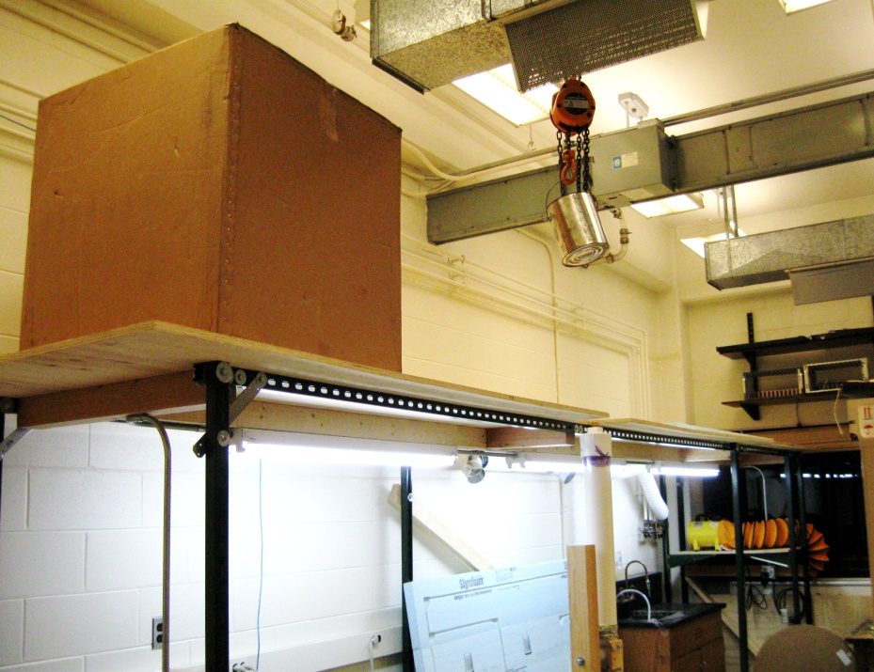
Microscope Fabrication Readiness Review
Feb 07, 2013
Construction Plan – Delivery to JLab
Scheduling
  End Date – 07 Apr 2014
  Man-power:
  2 Grad. Students @ 72 hours
  1 Technician @ 30 hours
  1 Student Worker @ 29 hours
Inspection, Testing, & Acceptance Plans
  Ensure proper documentation is shipped with the components
  Spot checks
  Documentations & Tracking
  Travelers
    Sent in shipping boxes
    Available also online
James M^{c}Intyre

Slide 32
Microscope Fabrication Readiness Review
Feb 07, 2013
Questions???
James M^{c}Intyre

