Slide 1
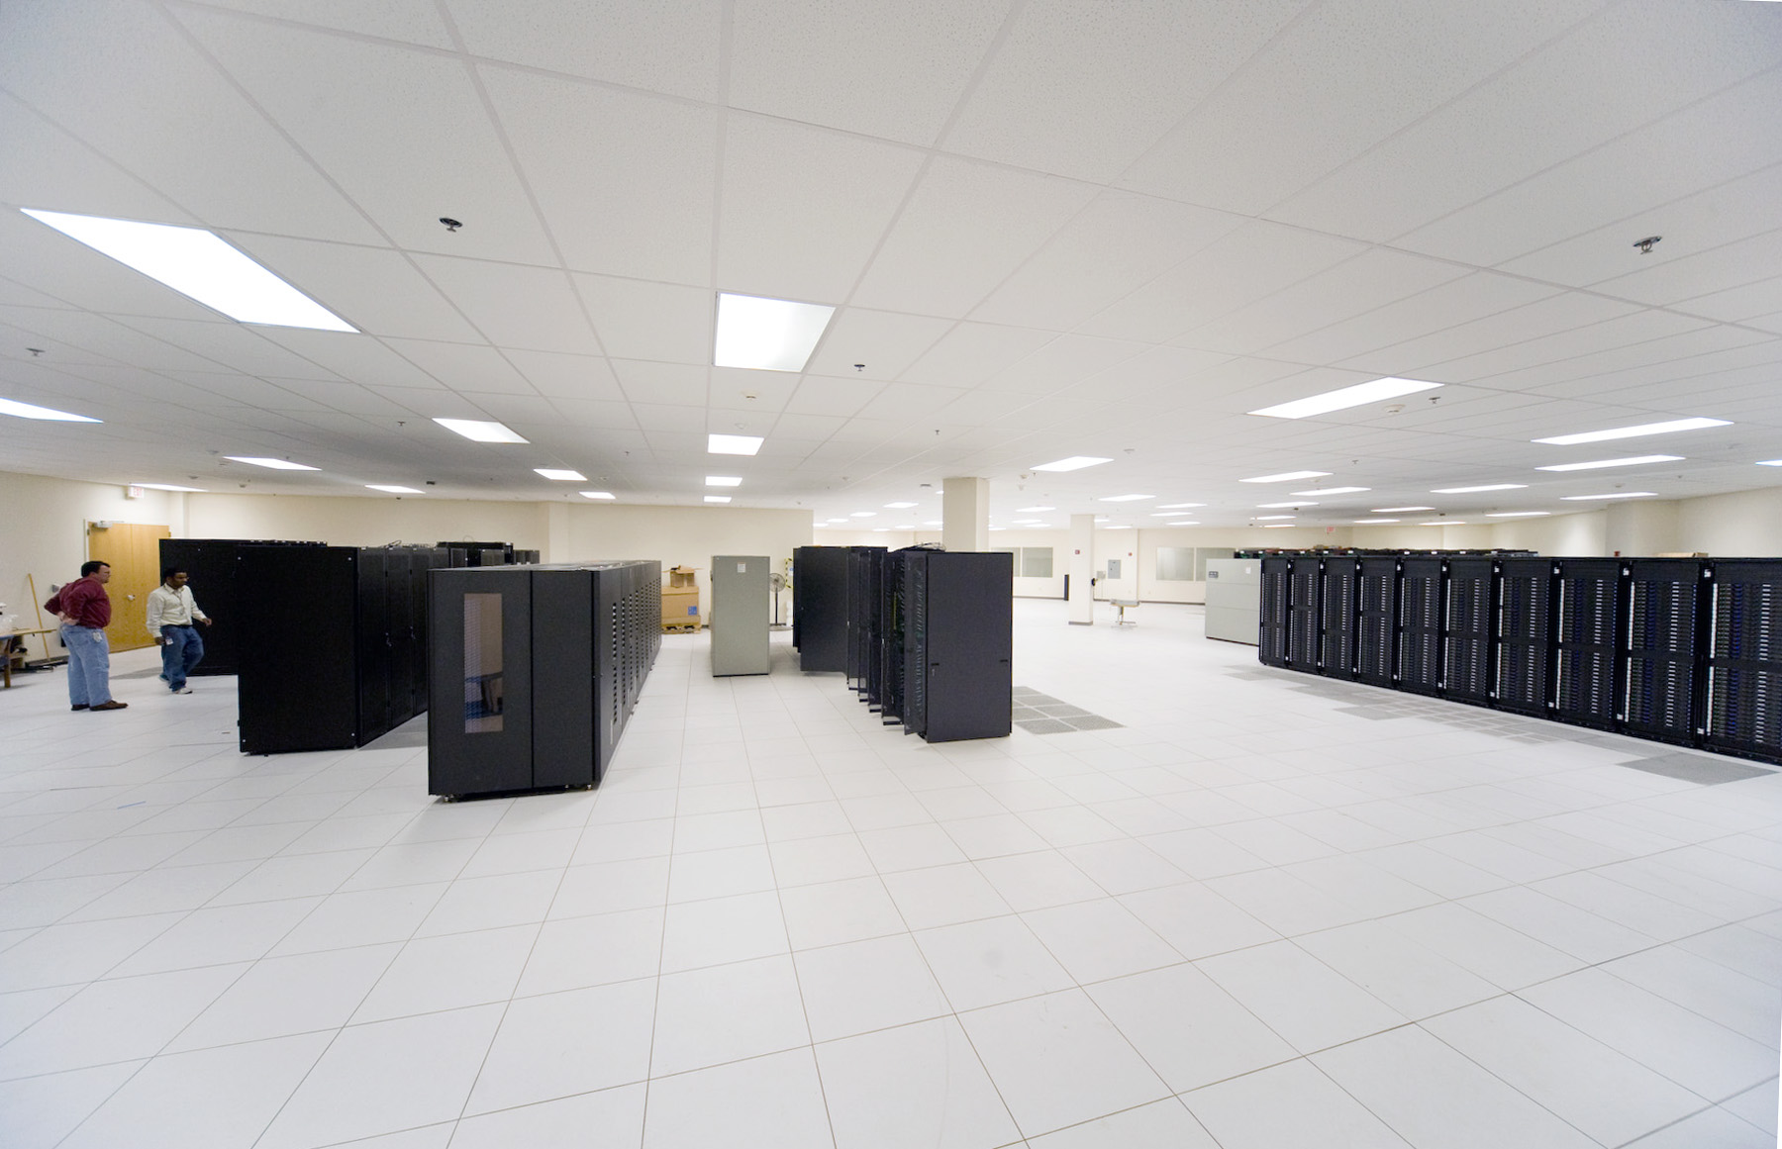
Scientific Computing
Experimental Physics
Lattice QCD
Sandy Philpott
Sandy Philpott
May 20, 2011
IT Internal Review
12GeV Readiness

Slide 2
Overview
Scientific Computing at JLab
Software and Systems
  Current
  12GeV era
Infrastructure
Management
12GeV Resources
  Budget
  Staffing
LQCD Details
Summary

Slide 3
Scientific Computing at JLab
Compute Clusters
  Theoretical Physics
    Lattice QCD, as part of the USQCD national collaboration
    High Performance Computing: 45 racks
      Infiniband: 8000 cores
      GPUs – disruptive technology – 530 gpus, 200,000 cores
  Experimental Physics: 2 racks
    Data Analysis “Farm”: 1400 cores
Mass Storage System
  Tape Library
    Raw experimental physics data
    Processed results
    Other lab-supported efforts
      Mostly LQCD
The Theory clusters are outside the scope of this review. DoE reviews USQCD annually, most recently last week.

Slide 4
Mass Storage System
IBM TS3500 Tape Library
JASMine – JLab software to manage data on tape, including 60TB cache manager
12 frames, expandable to 16; 6800 slots; Current capacity ~6.8PB
8 LTO-4 drives
  800GB/tape uncompressed; ~1TB per tape
  120MB/s
4 LTO-5 drives
  1.5 TB/tape uncompressed
  140MB/s
  Have just begun writing LTO-5 media, first copying oldest LTO-4s and duplicates
1GB/s aggregate bandwidth
LTO-6 drives and media expected well in advance of 12GeV turn-on
3.2 TB per tape, 210MB/s
A new 15-frame library with 1300 slots each = 19,500 slots x 3TB ea = 58.5PB capacity
purchase as needed
12GeV projections from Physics include a second tape library procurement in 2014, expecting 10-15PB yearly storage requirements.

Slide 5
Data Analysis Cluster
JLab Auger software for user interface, job management
Maui/PBS open source resource manager/scheduler
Mysql open source database
100 compute nodes, 1000 cores – CentOS 5.3 64-bit
  mostly dual quad core Nehalem, 24GB RAM
  new: 6 quad eight core Opteron, 64GB RAM
    For supporting move to multithreaded codes
Moore’s Law holds true; replacing the oldest ¼ compute nodes every 4 years keeps pace with increasing computing requirements.
Also, reallocate 4-year-old HPC compute nodes to the farm, after nodes don’t function well in large parallel system but are fine individually.
100TB work disks for storing working farm job data.

Slide 6
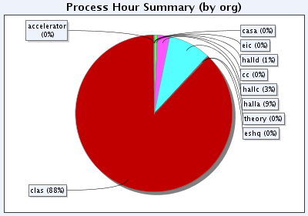
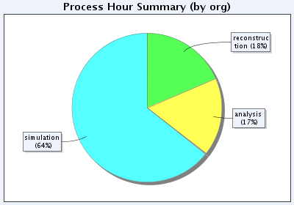
Data Analysis 2010
  7,232,985 process hours in FY10.
  4,033,425 so far in FY11.
  For comparison, LQCD has delivered 68M.

Slide 7
Filesystems
Traditionally, NFS (Network File System)
Lustre FS already added for HPC, 225TB production
Implementing for Experimental Physics
  Improves scalability and I/O performance.
  Require a specific kernel and Lustre client, no direct NFS.
  Servers will replace very old slow cache servers in use now.
  Volatile space will replace auto-managed work disks on older servers.

Slide 8
Infrastructure
Networking
  Gigabit compute nodes
  Trunked gigabit fileservers
  Moving to Infiniband at 10 gb
  ESNet wide area connection for offsite data transfers
Hardware Technicians, Students
  Interface to Facilities Management
  System installation, relocation, removal
HelpDesk
  CCPR trouble ticket system
This staffing is in the Computing and Networking Infrastructure IT group.

Slide 9
Management
Scientific Computing manages the computing and storage systems for Experimental Physics, as a Service Provider (SP).
Requirements for physics computing are gathered and conveyed by the Physics Coordinator to the Scientific Computing Head.
Funding for staffing, hardware, and storage media are in the Physics budget.
JLab’s annual work plans (AWP) define the labor, funding, and requirements.
Each physics hall has an offline Computing Coordinator to manage their requirements.
Each physics experiment/run group communicates with their hall offline computing coordinator for resource allocation..
Regular meetings occur between Physics and IT Scientific Computing to make sure requirements are met and issues are addressed.
The JLab Users Group Board of Directors includes a Computing coordinator.
The JLab IT Steering Committee includes both Physics Computing Coordinator and the UGBoD Computing contact.

Slide 10
12GeV Era Budget and Staffing
The funding model for scientific computing (not counting labor) is modest, ~$150k per year.
Current plans: $50+50+50+whatever:
  $50k disk storage
  $50k compute nodes
  $50k other costs: infrastructure, networking, software licenses, etc.
  Whatever else Physics can get their hands on
    The plan is the minimum to meet the requirements
Funding will be supplemented in FY14/15 by an increase to cover simulation and the start of raw data and reconstruction – tape library, compute nodes.
Labor is constant, for both operations and development, at 3.64 FTE. The Scientific Computing group is 10 FTE total.

Slide 11
LQCD Summary
Jefferson Lab is a part of a national collaboration that has installed computers at BNL, FNAL, and Jlab.
One component of this collaboration’s activities, the 2009-2010 ARRA LQCD Computing Project, deployed
  10 Tflops conventional infiniband systems
  416 TBytes disk, backed by multi-petabyte tape library
  508 GPUs equivalent to 100 Tflops sustained capacity for anisotropic clover inverter-heavy jobs, and 63 Tflops for the mix of jobs running this year
This is in addition to an older cluster of about 6 Tflops installed in 2007.
Roughly ever 3 years, another large installation will take place at the lab, with the next installment expected in FY2012 (next year).

Slide 12
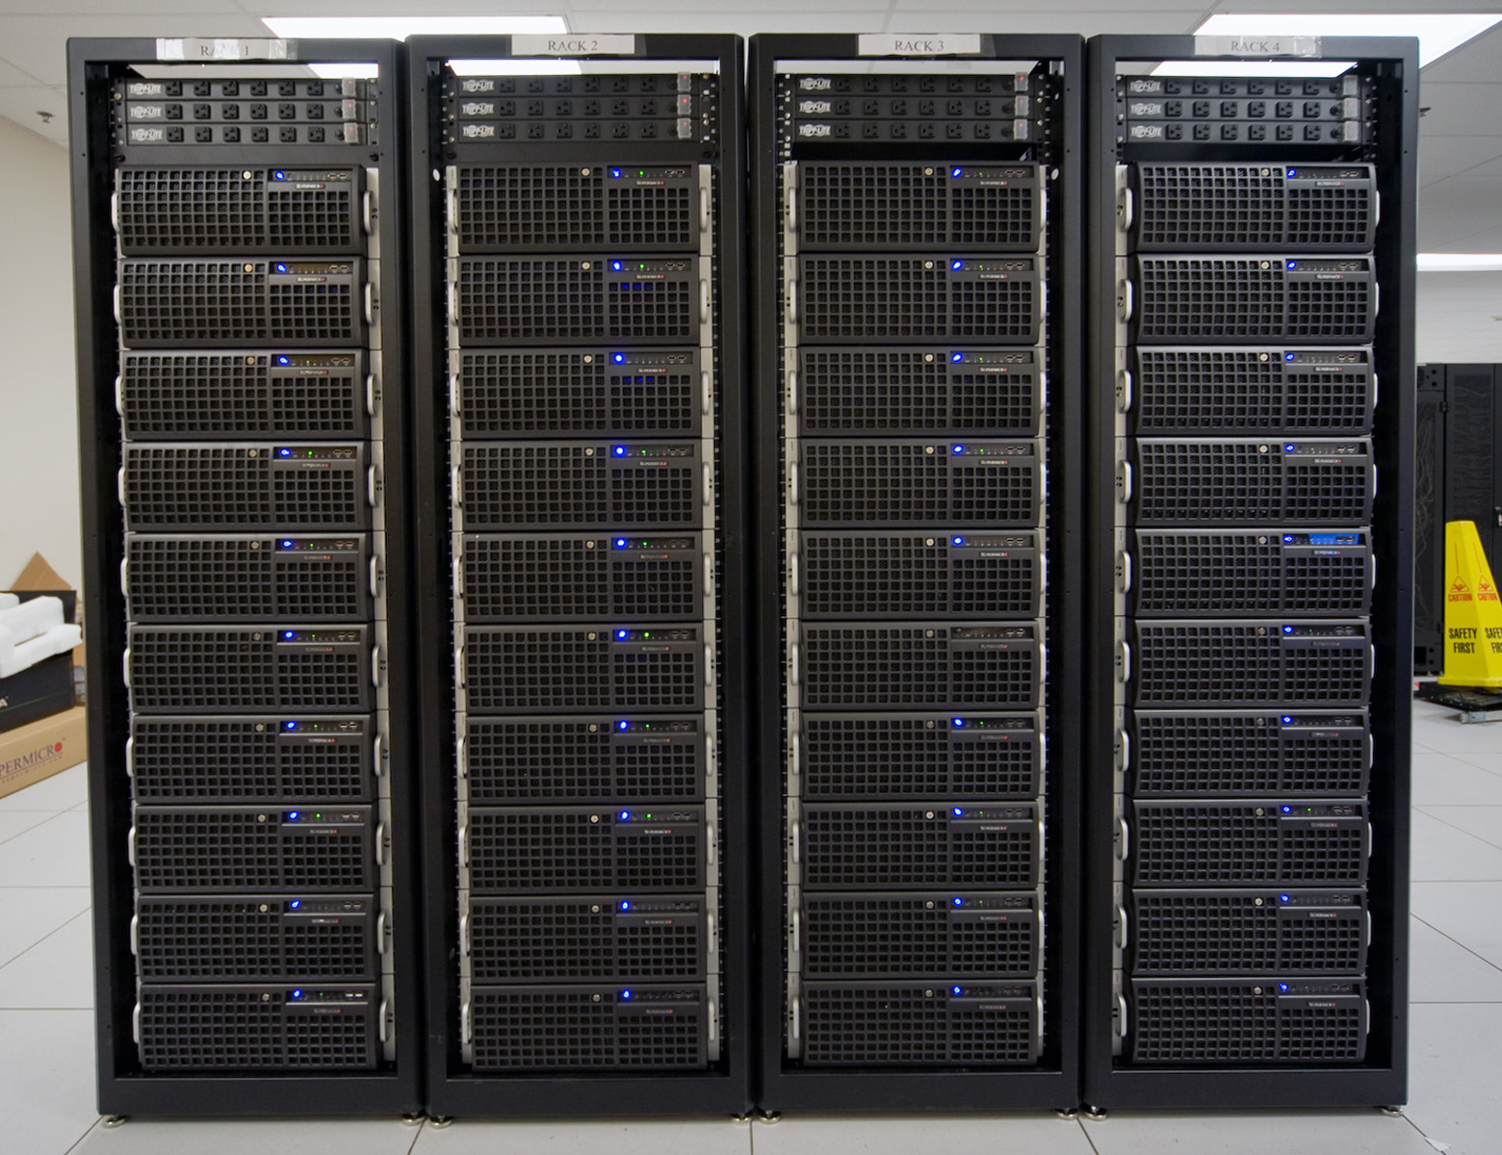
2009 Hardware Summary
Infiniband Cluster:
  320 nodes, 5.5 Tflops aggregate on LQCD codes
  dual quad core Nehalem 2.4 GHz, 24 GB memory
  QDR (quad data rate, 40 Gbps) Infiniband
GPU Cluster:
65 nodes, 200 GPUs
    16 dual GPU, QDR Infiniband
    42 quad GPU
    7 empty (future R&D, alternate GPU cards)
  192 of the 200 GPUs were gaming cards, GTX-285
Host nodes all had the same specs as the conventional cluster (above) except some had 48 GB memory & all had dual 5520 chipsets to support 4 GPUs or Infiniband cards
File Servers:
  224 TB Lustre system, on Infiniband, >1GB/s

Slide 13
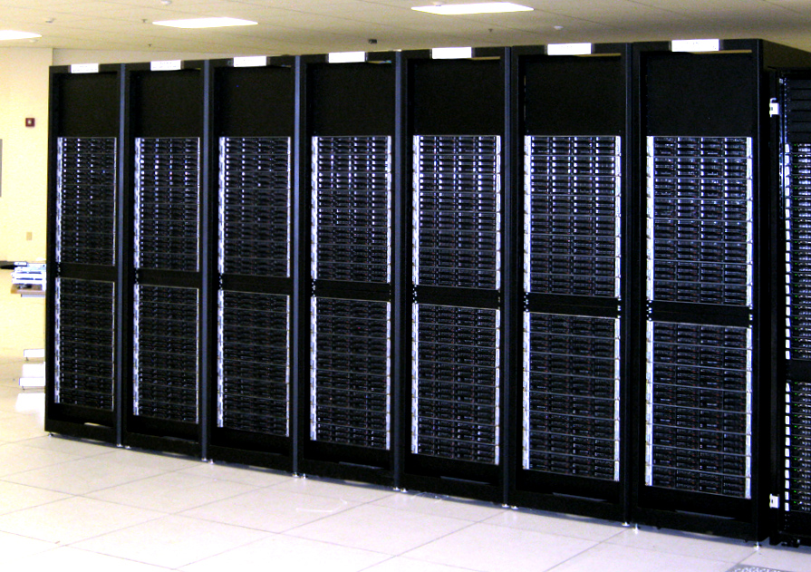
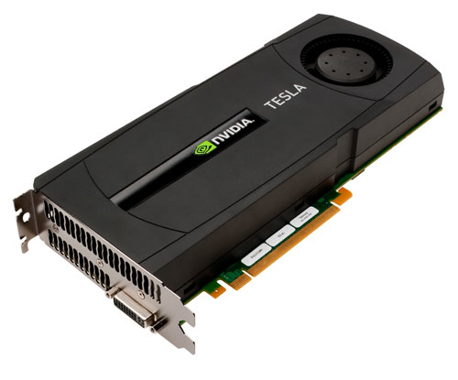
2010 Hardware Summary
Infiniband Cluster:
  224 nodes, 4.0 Tflops aggregate
  dual quad core Westmere 2.53 GHz
  24 GB memory
  QDR Infiniband
  all racks configured as 32 nodes, no oversubscription
  all nodes capable of holding one GPU (future upgrade)
GPU Cluster:
52 nodes, 338 GPUs (all NVIDIA Fermi)
  16 quad GPU, QDR Infiniband in half bandwidth slot
  36 quad GPU
  32 additional GPUs to upgrade the Phase 1 duals to quads
  28 additional GPUs to fill the Phase 1 empty nodes
  36 additional GPUs to go into one rack of the Phase 2 Infiniband cluster (above)
128 of the GPUs were Tesla Fermi (with 3 GB ECC memories) => 32 quad servers w/ half QDR
GPU hosts have same specs as the IB cluster above except that they all have 48 GB memory, and only some have QDR IB. Also: all Phase 1 GPU nodes were upgraded to 48 GB memory.
File Servers:
  Additional 192 TB added to Lustre

Slide 14
Overview of LQCD Roadmap
Today
  28 racks of Infiniband clusters, 920 nodes
  14 racks of GPU clusters, 120 nodes
  2 racks of file servers, 18 nodes
  450 KW power (depending upon job types);
  installed capacity is 630 KW (A/C only good for 540 KW)
FY 2012
  Decommission 11 racks, install 16-18 racks
  Add one additional 30 ton A/C unit
FY 2015
  Replace 20-25 racks, stay within same power budget (estimate, tbd)

Slide 15
Summary
The experimental physics data analysis cluster and mass storage system are sized appropriately for current needs.
Funding and staffing resources are appropriate.
The future growth of both systems is requirements driven, and is based on numbers provided by the halls.
12GeV IT requirements for scientific computing need to be revisited and updated by Physics on a regular basis.
Space, cooling, and power are available for the 12GeV era computing and storage needs in CEBAF Center F113, the IT Data Center.

