Slide 1
Data Acquisition
Graham Heyes
May 20th 2011

Slide 2
Outline
Online organization - who is responsible for what.
Resources - staffing, support group budget and resources.
Requirements - scope of 12 GeV data acquisition.
Plan - technology and concepts.
How the plan meets the requirements.
Online farms.
Experiment control.
Status Front end and electronics.
Status Back end.
The path forward.
Summary.

Slide 3
Organization
Hall online groups
  A - Alexandre Camsonne, B - Serguey Boyarinov, C - Brad Sawatzky, D - Elliott Wolin.
  Responsible for the trigger, hall specific hardware and software, management and operation of hall online systems.
DAQ support group
  Staff
    Manager - me
    Front end systems and software - David Abbott and Bryan Moffitt.
    Custom electronics - Ed Jastrzembski and William Gu
    Data transport, experiment control and back end software - Carl Timmer and Vardan Gyurjyan.
  Responsibilities
    Support resource for new development and implementation.
    Support resource for hall operation.
    Develop generic custom software and hardware.
    Develop experiment specific custom software and hardware.

Slide 4
Resources
DAQ group
  $120k per year non-labor funding for R&D and operations support.
  R&D lab on 1st floor of F-wing, “cluster” in F-wing data center.
  Five DAQ group members have 15+ years of experience at JLab and a proven record.
  Adding two group members in 2010 the group is two deep in the three core areas.
    Prior to that hire we were only two deep in back-end but most of the 12 GeV work is front-end and electronics.
  Group is now sized for both 12 GeV implementation and operation.
  Dip in 6 GeV operation load matches bump in 12 GeV construction.
Hall Online groups
  Three 6 GeV halls have existing mature online groups and mature DAQ systems.
  Hall-D has an online group that has existed for a few years and is lead by a former DAQ group member.
  The hall-online groups are appropriately sized for operation and support from the DAQ group and collaborators will provide manpower for construction.
  DAQ systems are funded by the halls.

Slide 5
12 GeV Requirements
A - Various short experiments with varying rates. Highest, 100 kByte events at 1 kHz = 100 MByte/s ~ 2016. This high rate running is two 60 day periods.
  SOLID detector planned for 2018+ has 1 kByte events at 500 kHz in the front end but a level 3 software trigger is planned before storage.
B - 10 kHz and 10 kByte events = 100 MByte/s ~ 2015
C - Various rates but highest is 10 kHz and 4 kByte events = 40 MByte/s
D - The detector and hardware trigger are capable of producing rates one to two orders of magnitude larger than those seen in 6 GeV hall-B running. A level 3 is planned but is outside the 12 GeV scope. Initial running will be at low luminosity tuned to maintain a manageable storage rate
  Data spread over 50+ front end systems.
  Front end rates (requires level 3), 300 kHz, 20 kByte events = 6 GByte/s
  Rate to storage, 10 kHz, 20 kBytes = 200 MByte/s - assumes online farm.

Slide 6
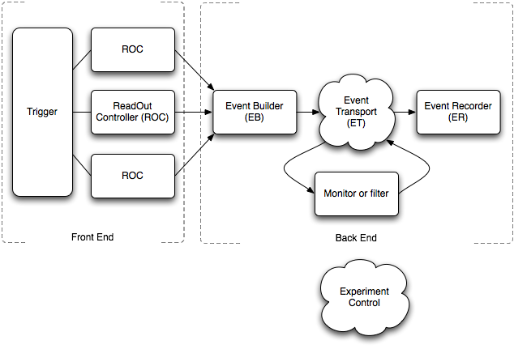
Plan to meet requirements
DAQ system anatomy will be similar in each hall.
  High trigger rates:
    Pipelined ADC and TDC electronics.
    New Trigger Supervisor (TS), Trigger Distribution (TD) and Trigger Interface (TI)boards.
    Updated data format to support pipeline readout.
    Rewritten front-end software (ROC) under Linux on Intel hardware.
  More complex systems of 50+ ROCs:
    New experiment control to control more complex systems.
    New inter-process messaging system cMsg.
  High data rates
    Rewritten event transport to move data more efficiently in complex webs of components.
    Distributed event building.

Slide 7
How the plan meets the requirements
Pipelined electronics and trigger meets the trigger rate requirements in the front end by decoupling the trigger from the readout.
Data rate requirements for individual readout controllers are still modest. The most exacting requirement is to read out the modules over VME fast enough to not introduce dead-time. Since the readout is decoupled from the trigger it loses any real time OS requirements and we use Linux instead of VxWorks.
Data rates of 300 MBytes/s coupled with the need to reformat data and build events at that rate is close to the “single box” limit. Use a “divide and conquer” method:
  Staged event building where one physical EB deals with data from only a few readout controllers. Each EB outputs to a second stage where each EB handles a few first stage EBs.
  Parallel event building where each stage of EBs can output to one or more EBs in the next stage.
  EB becomes a network of Event Management Units (EMUs) that take data from a number of sources, processes the data and sends it to a number of destinations.
  The EMU can be customized and reused in various parts of the system.
  In the unlikely case where the output data rate is too large to store on a single device CODA will manage multiple data streams to different disks.

Slide 8
Online trigger and/ or monitoring farm
If not on day one then at some date each of halls A, B and D have a requirement for an online filter.
  Monitor data quality in real time.
  Reject unwanted data.
  Keep rate to storage down to reasonable levels.
We are working on a generic solution for all three halls.
  A modified EMU will manage starting, stopping and monitoring online processes for monitoring or filtering data.
  An ET (Event Transport) system will distribute events between processes based on a user definable algorithm and gather results or filtered events for storage.
Hall-D will start with a prototype farm and implement a larger farm in stages. The infrastructure (power, cooling etc) is part of the 12 GeV project scope in the counting house civil construction.
Hall-B was originally to have an online farm in the 6 GeV program that was never implemented. A farm for 12 GeV is in the early stage of planning.
Halls A and C may also implement online farms but they are similar in size to the systems that are already used for monitoring in 6 GeV.

Slide 9
Experiment control
A totally rewritten online control system will be used that has the following features:
  Can control more complex systems than the ROC-EB-ER chain of CODA 2.
  Can implement user definable state machines.
    Allows more or less complex control of the system. For example hall A likes one big button marked “Start Run” while hall B likes to perform extra steps and require operator input during the startup.
  The system is distributed which removes speed and complexity restrictions.
  The system can talk to other control systems, for example EPICS, to allow feedback loops and semi-autonomous control of test data runs.
  As a “spin off’ the underlying framework AFECS along with the cMsg message passing system used in CODA have been used to develop CLARA, a distributed offline analysis framework for CLAS.

Slide 10
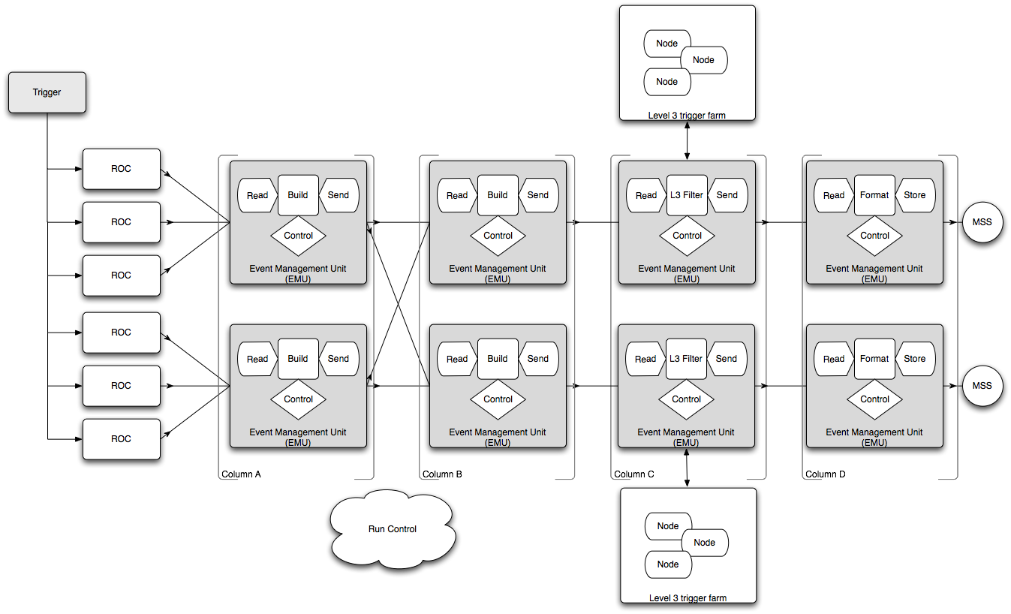
Put it all together

Slide 11
Other online requirements
System administration support.
Network bandwidth from the halls to the data center to support at least 600 MB/s, of this 300 from hall-D and 300 from existing counting house.
Disk buffer storage for one or two days running 25 - 50 TB.
Support for offline databases of comparable scope to the databases already managed for the existing 6 GeV halls scaled up by the addition of hall-D (4/3).
Support for remote access to control systems and data.
Control of magnets, beam-line components, targets and other hardware:
  EPICS for most systems - help from Accelerator control group.
  CODA experiment control, AFECS, for other systems.
  Some Labview and Windows software for commercial systems - may be layered under AFECS.

Slide 12
Status - Front end
Linux ROC code and module drivers for most DAQ hardware modules have been written and tested in the 6 GeV program.
Custom hardware, ADCs, TDCs, TD (trigger distribution) and TI (trigger interface)designed and prototypes tested.
  Production run of 12 TI modules, summer 2011, will allow full crate tests of pipelined readout and detector testbeds.
TS is being designed and expected to be ready in 6 months to 1 year. Each TD can fan out the trigger to up to 8 TI modules. The TS can fan out the trigger to up to 16 TDs for 127 readout controllers in total (the 128th is reserved for the global trigger processor).
Self configuring readout list software being designed in conjunction with all halls.
  Use an online database to store crate configuration.
    Can the database be populated automatically? - under discussion.
  Database will be used by the disentangler at a later stage of readout.
Event format is stabilizing with feedback from all four halls.
  Needs to handle entangled and disentangled data.
  Needs to handle the trigger and status info from up to 127 crates.

Slide 13
Status - Back end
EMU framework is written and is being integrated with the Linux ROC.
Multi stage EB and parallel EB modules for EMU have been written and tested.
Libraries to read and write EVIO format data have been implemented in C, C++ and Java.
  Working with hall-D to generate files of simulated data that can be fed through the DAQ components. Hopefully what comes out = what goes in!
Aim to test a parallel EB at hall-D rates on the DAQ group cluster by the end 2011
ET system is complete and in use in 6 GeV program.
cMsg messaging system is complete and in use in 6 GeV.
Event disentangler at design stage. Prototype in FY12.
Experiment Control
  Main framework is complete and in use in 6 GeV program.
  Same underlying technology used in CLARA offline - in use by hall-B
  SPR from hall-D to design and implement custom GUIs for hall-D.

Slide 14
The path forward
Much of the underlying software and hardware framework and technologies have been designed, implemented and tested in the 6 GeV program.
We have plans for testbeds and technology tests over the next two years before online hardware needs to be procured and technology choices locked down.
The responsibility of implementing the online systems and budget for materials falls to the halls.
R&D for custom hardware and software and non generic support tasks are funded by the hall online groups and work done by hall staff or via SPRs to the DAQ support group.
Generic tasks to provide services shared by all four halls is funded from general physics operations.
  During FY12 through FY15 DAQ group funding is 50% OPs and 50% 12 GeV SPRs.
  The hall online groups are lean but DAQ work in halls B and D is staged so that the DAQ group can assist hall D first then hall B.
Hall D has generated a task list in the Mantis tracking system for DAQ group staff and there is funding beginning in FY11 for that work.
Hall B is not at the same advanced stage as hall D but their DAQ work comes later.

Slide 15
Summary
I think that we are in good shape!
  Mature online groups in each hall.
  Much of the software and hardware components tested in 6 GeV running.
  Clear series of tests of technology planned before final hardware procurements for online components such as processors and networking.
  Infrastructure already in place in three existing halls and part of 12 GeV scope for hall D.
  Staffing and funding is adequate to meet the milestones between now and turn on.
    This depends on the current timeline with hall B DAQ tasks falling after D.
    Careful ballet to not over subscribe key people. Six staff in the DAQ group gives us two people in each key area of expertise. That is certainly better than what we had two years ago but is not ideal. We recognize that the lab is running a lean staffing model.

Slide 16
A Blank Slide
This slide is left deliberately blank to provide minimum entertainment while questions are asked.

Slide 17
Offline summary
Organization
  Offline data processing for each hall is “owned” by the hall collaboration as an integral part of each experiment approved by the PAC.
  At some level it is the responsibility of the experiment to assure that the resources required for data analysis exist.
    Converting what needs to be done into what is needed to do it is difficult.
    Knowing what is available as part of a shared resource requires coordination.
  Each hall has an offline coordinator.
  I am available as a technical resource to help translate requirements into hardware specifications.
    Requirements are given to SCI who return a proposal with a cost and schedule.
    I confirm that the proposal meets the requirements and communicate that to the hall groups.
    I work with the division to set a budget that funds the proposal at some level.
    Given the proposal and funding I communicate to the groups what can or can’t be done.
    I manage the budget, this includes staging the work done by SCI so that we can react to changing requirements.

Slide 18
12 GeV requirement summary
Hall | A | B | C | D | Total | Cost k$
2011 vintage cores | 60 | 2000 | 70 | 9000 | 11,500 | 600
Raw data, PByte/yr | 0.1 - 1 | 1 | 0.1 - 0.5 | 3 | 6 | 120 / yr
All data, including Raw, PByte/yr | 0.2 - 3 | 5.5 | 0.7 - 2 | 8 | 14 - 18.5 | 280 - 370 / yr
Disk TB | 100 | 800 | 200 | 200 | 1300 | 650
The numbers presented are 2015 and beyond, pre-2015 levels are down by a factor of 10 and covered by the scale of the existing analysis farm. The total represents “worst case” with all four halls running at once which probably won’t happen.
The rough cost is based on a few assumptions:
  The halls benchmarked against 2011 vintage 64-bit processors. In four years we assume a performance per $ three times better than today’s $160 per core.
  Assume LTO6 tapes at 3 TB and $60 per tape.
  Assume $500 per terabyte of disk.
The 9,000 core figure for hall-D is conservative (maybe high). It includes multiple passes through the data and neglects any off-site simulation.

Slide 19
Concluding remarks
The total requirement for disk storage and compute nodes is a $1.25M+ investment, this does not include racks, cables, network hardware, labor for installation etc.
  This is a larger number than originally estimated but there are still uncertainties in the generation the requirements.
    Time to process is based on existing code, we expect optimization.
    Calculations contain integer multipliers, “number of passes through data” that are currently 2 or 3 but could well be lower.
    There is still uncertainty about what off-site resources collaborating institutions will provide.
  Each group does have a plan to refine these numbers. Effort in this direction is extremely important!
The current NP analysis cluster budget is approximately $150k with a breakdown of $50k spent on each of cluster nodes, disk and “other”. If we are to meet the current requirements for a cluster capable handling the sustained load from the 12 GeV experiments either this budget needs to be at least doubled for the next four years or a single investment made prior to FY15 running.
Given the relative uncertainty in the requirements it is likely that the best approach is to plan for a late one time investment but still make an increased annual investment.

