Slide 1

Jefferson Lab
IT in the 12GeV Era - Review
Free-Electron Laser and
Photon Sciences
Wesley Moore
FEL Computer Scientist
2011-05-20

Slide 2
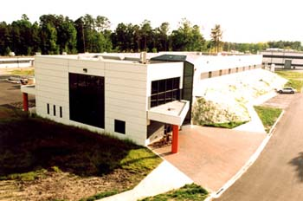
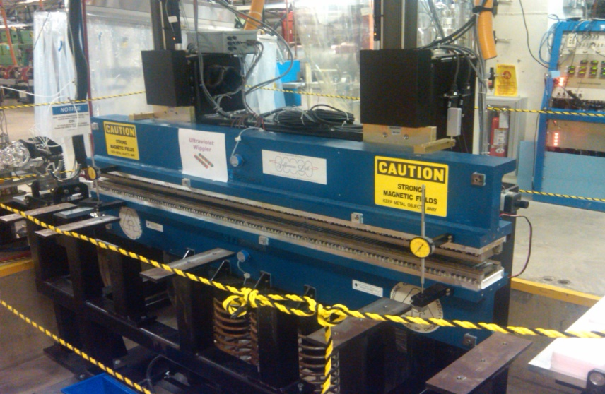
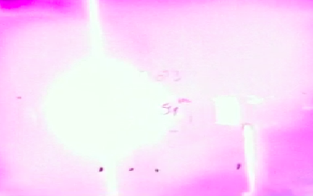
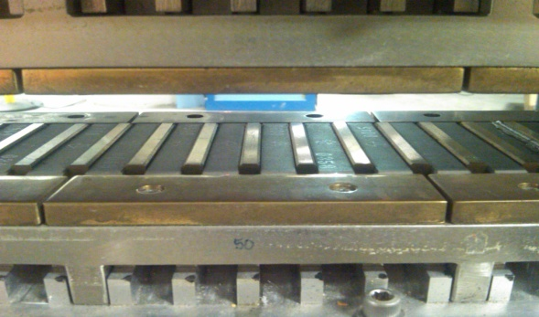
Description of JLab’s FEL
The FEL is the world's most powerful free-electron laser. It is primarily an infrared laser, although it can also produce ultraviolet and other colors of laser light.
The FEL also holds the world record as the brightest source of Terahertz (THz) light and have now demonstrated its UV and VUV capability.
VUV users are being reviewed and experiments scheduled for late summer 2011.
UV Lasing
UV Wiggler
IT Infrastructure in place!

Slide 3
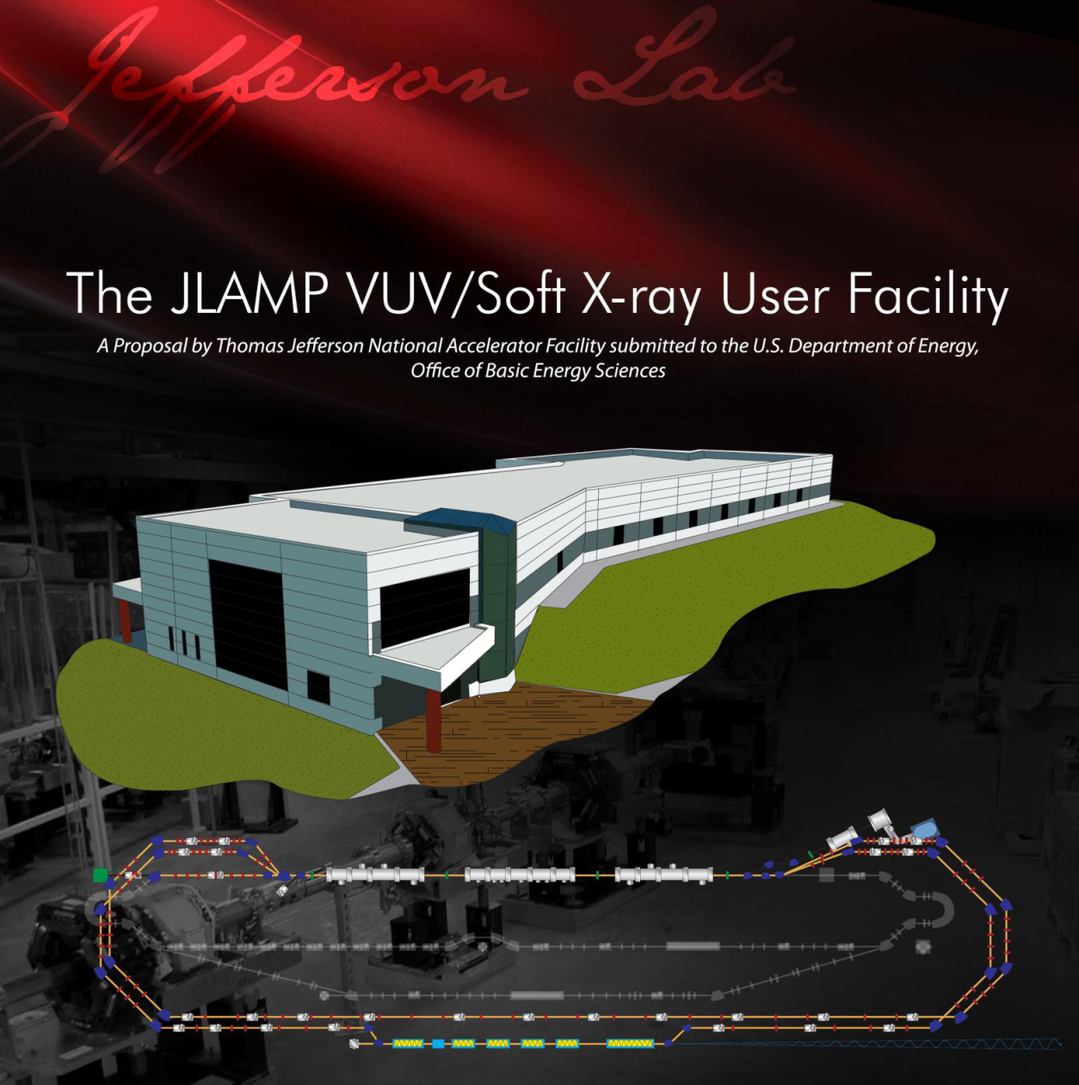
The Possibilities…
JLAMP?
4th Generation Light Source?
???
Construction of a future light source could have a serious IT footprint.
However, there would be no impact to IT services for the early years of the 12GeV era.

Slide 4
Questions?
This slide is intentionally left blank.

