Slide 1


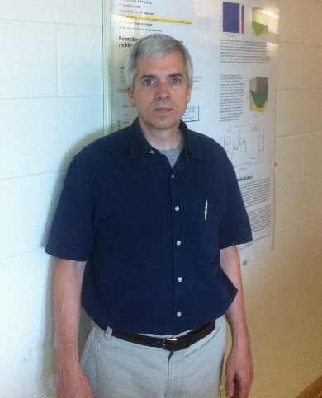
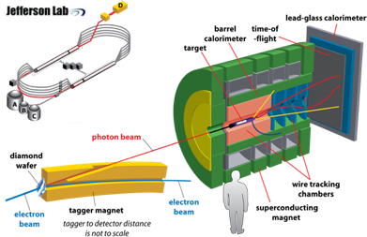
High-energy Polarized Photon Beams for Nuclear Physics
Fabricating thin, ultra-flat diamond mono-crystals
Richard T. Jones
Photonuclear experiments, such as the GlueX experiment at Jefferson Lab in Newport News Virginia, require high energy, low emittance photon beams
The photon beam is created through the process of coherent bremsstrahlung.
Diamond is chosen for photon production due to its high Debye temperature and well ordered crystal lattice.
It must have well defined crystal structure with whole crystal rocking curves less than 20μr
Radiators also restricted to 20μm thickness due to multiple scattering
Advanced materials processing for
accelerator-based science.

Slide 2
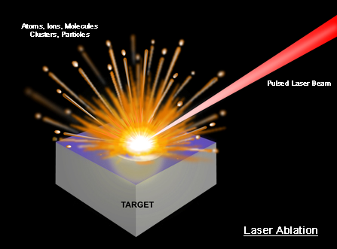
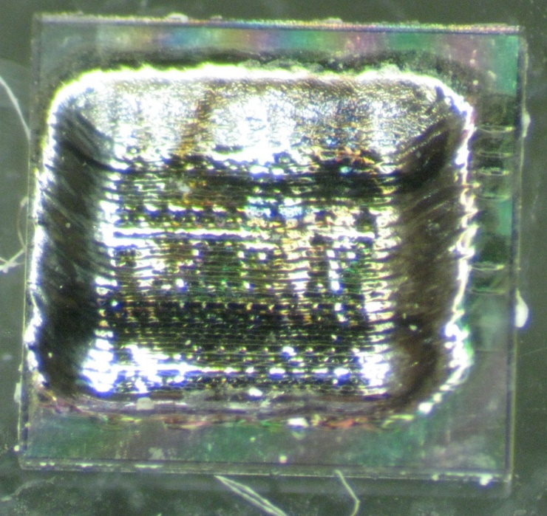
Diamond Target Fabrication for Nuclear Physics Experiments
Standard industry techniques for thinning leave diamonds warped with rocking curves >>20µr
Ablation with above band gap energy (193nm ArF Excimer laser) removes about 100 nanometers of material per pulse (energies vary between 70-120mJ)
Laser ablation preserves crystal planarity
Process is “self cleaning”, leaving minimal amorphous carbon on surface
>250µm Wall
Ablation Chamber
Diamond
L₁
L₂
L₃
X-Y
Translation
Stage
LASER
LabView
3.0x3.0x0.312mm diamond wafer with 40µm central region

Slide 3
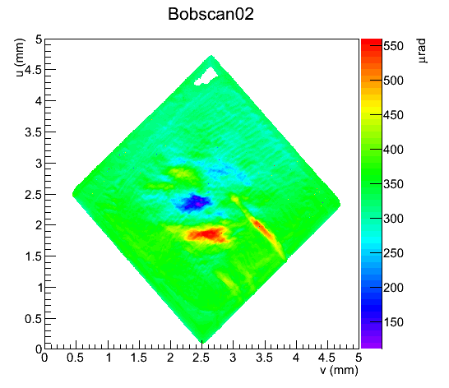
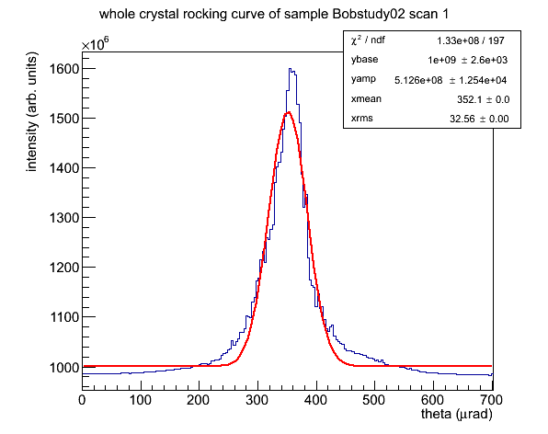
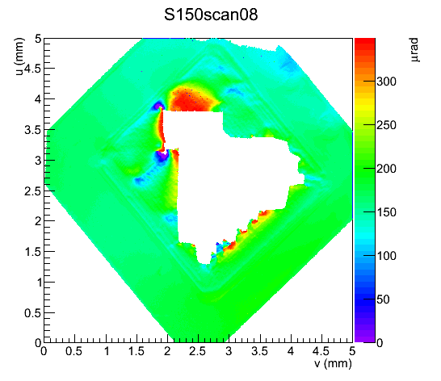
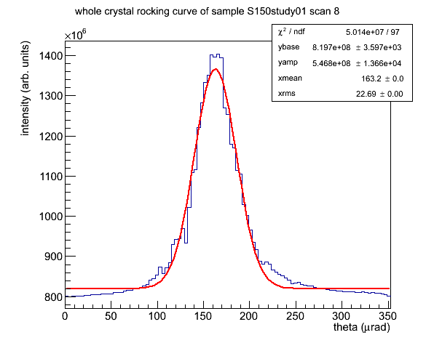
Diffraction topography using synchrotron X-rays
measurements at Cornell High Energy Synchrotron (CHESS) diffraction end-station C
special monochromator setup and diffractometer configured for these measurements
Measurements taken reveal whole crystal rocking curves of the diamonds machined at the UConn ablation facility
Diamonds machined at Uconn prove to be within the specifications of GlueX

