Slide 1


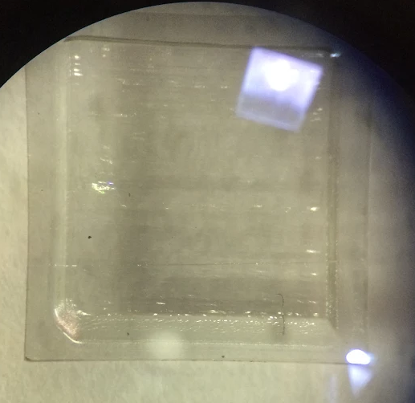
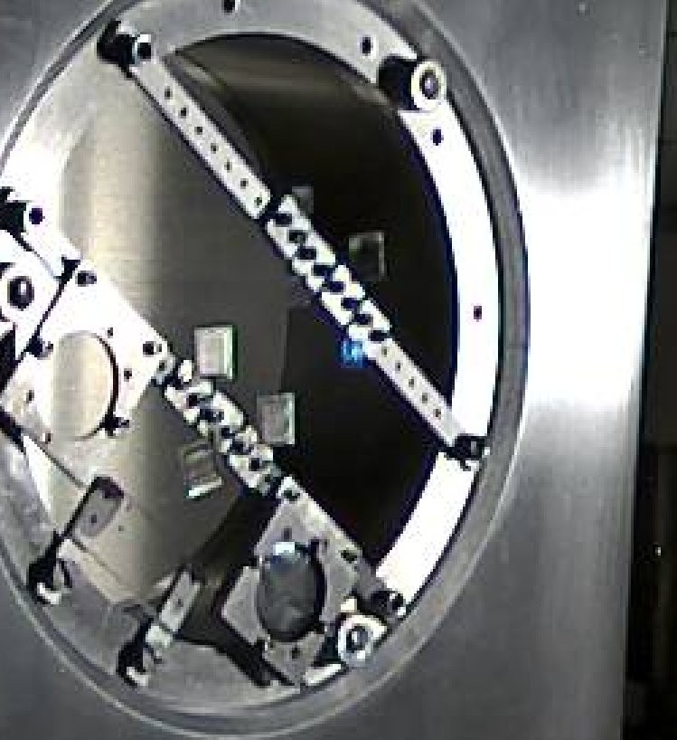
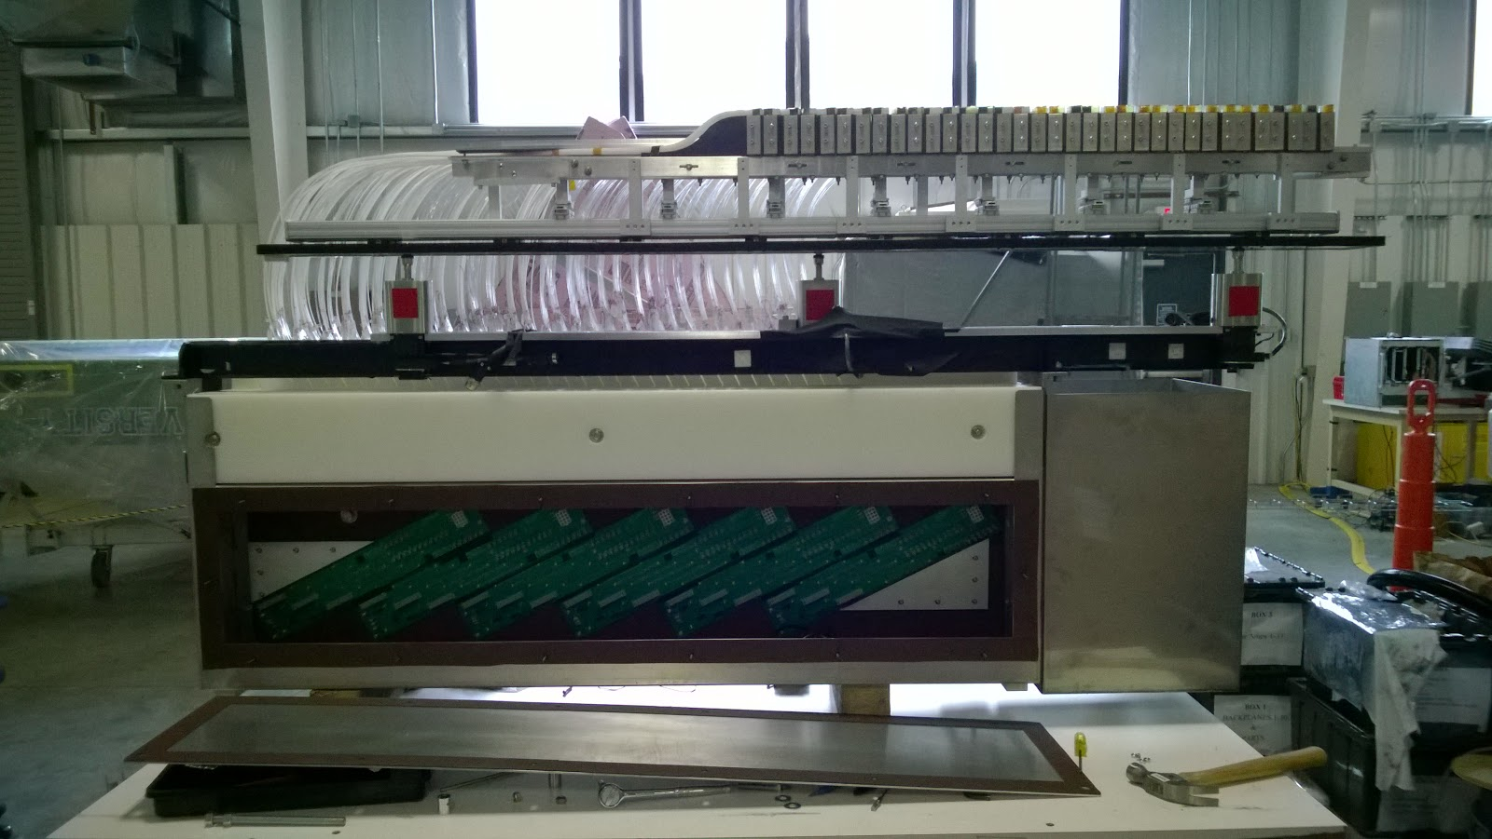
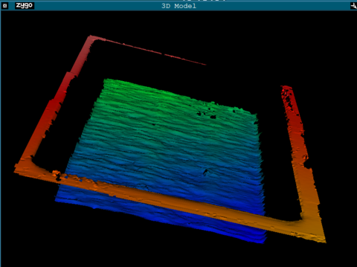
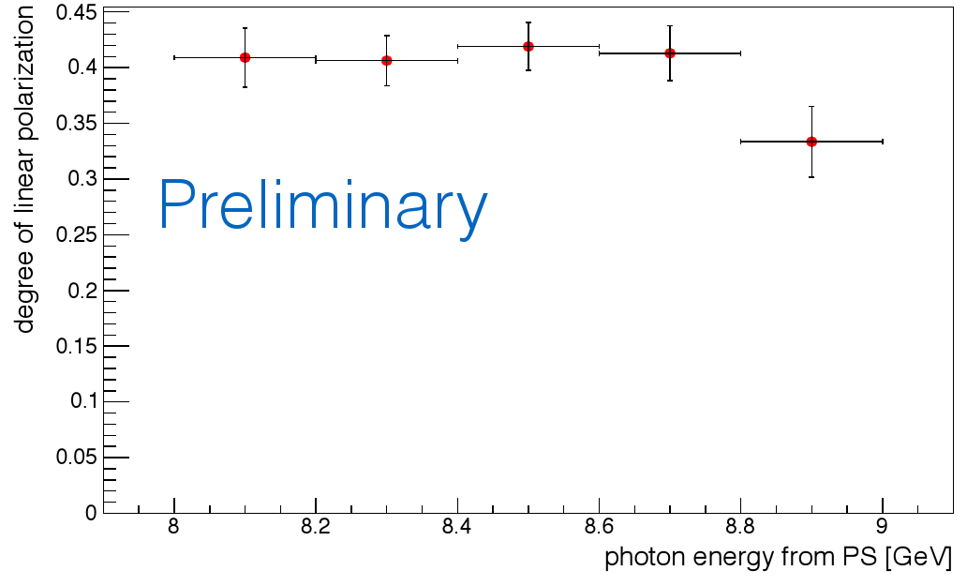

Cutting a thin window in a diamond plate using UV laser ablation
The Hall D tagger microscope
the GlueX polarized photon source
40% polarization over range 8-9 GeV
8 MeV energy bins
200 ps time resolution
10⁸ γ/s rate capability
thinned diamond radiator results from Spring, 2016
This material is based upon work supported by the National Science Foundation under Grant No. 1508238

