Slide 1


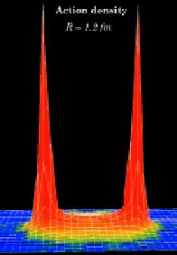
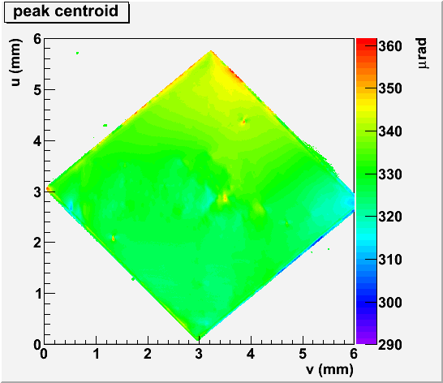
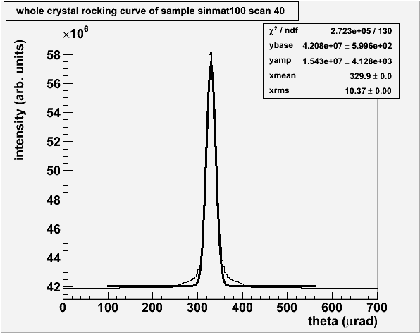
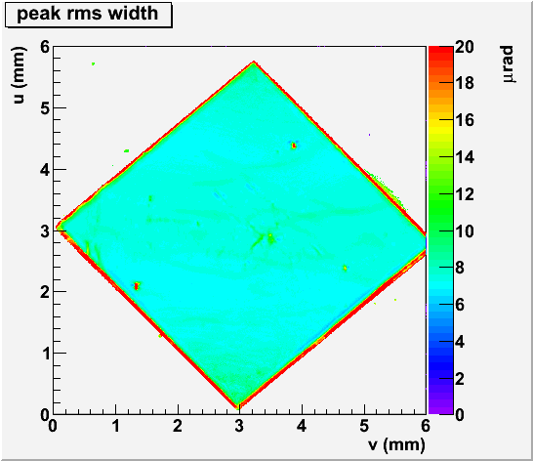
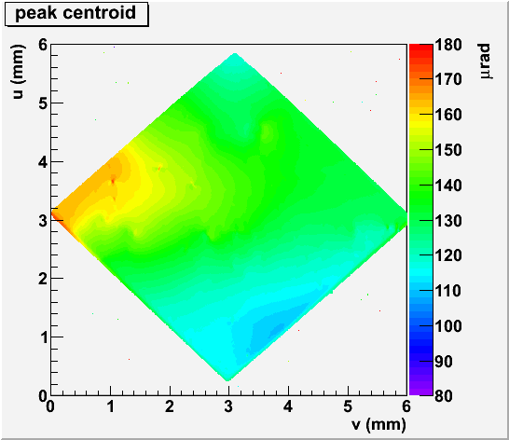
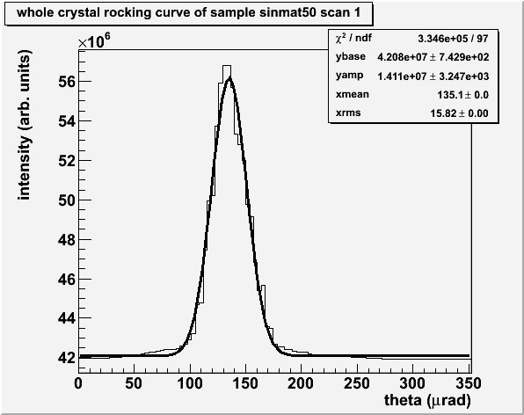
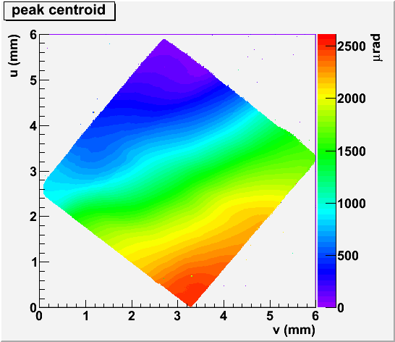
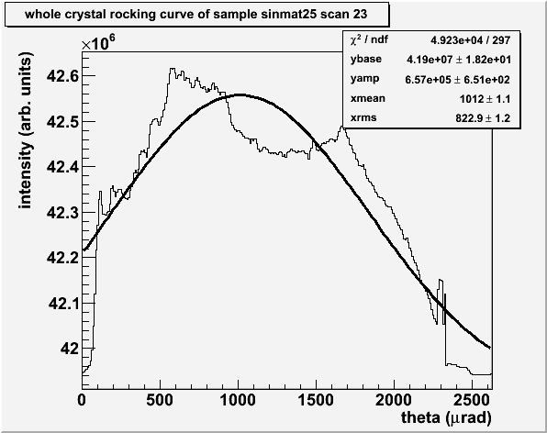
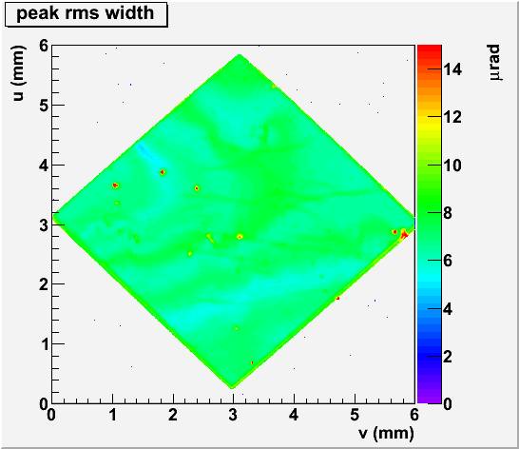
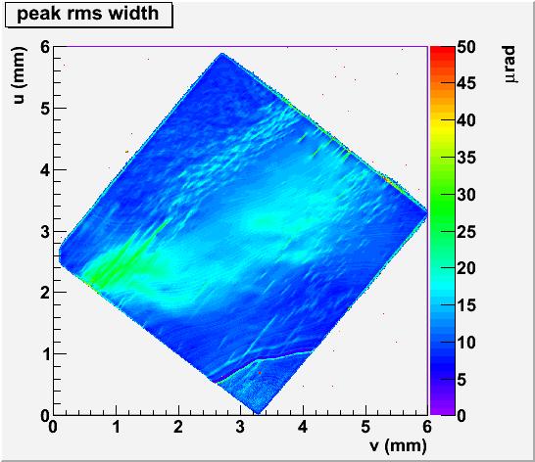
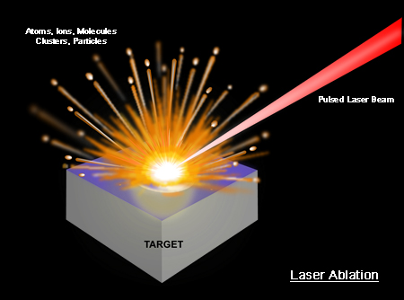
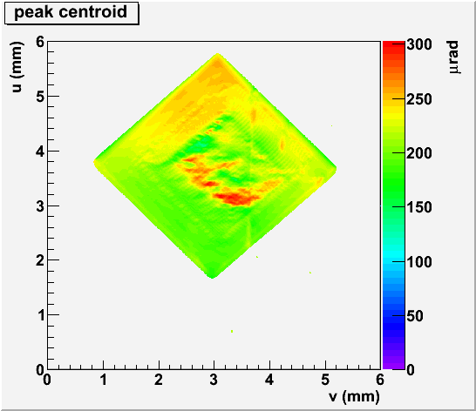
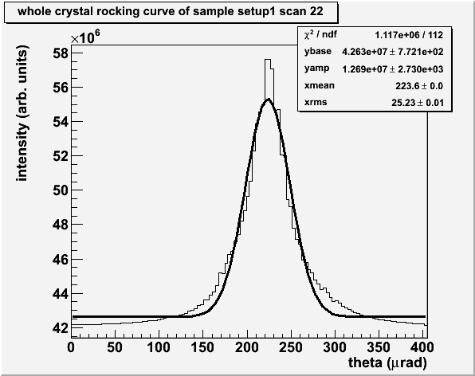
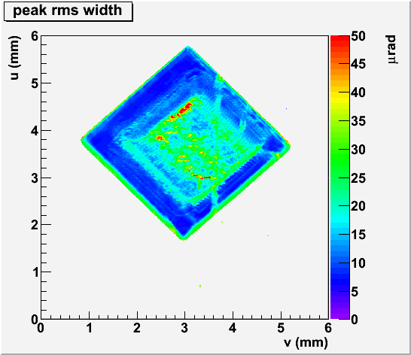
CHESS Rocking Curve Measurements of Diamond Radiators for the GlueX Experiment
Brendan Prattª, Alex Barnesª, Fridah Mokayaª, Ken Finkelstein^{b}, Richard Jonesª
ªUniversity of Connecticut, ^{b}Cornell High Energy Synchrotron Laboratory
Abstract
CHESS X-Ray Rocking Curves of Sinmat Vapor Pressure Ion Etched Diamonds
Why Coherent Bremsstrahlung?
The GlueX experiment at Jefferson Lab in Newport News Virginia is a photonuclear experiment design to study the excitations of gluonic fields in mesons, as illustrated in the figure at the right. The excited mesons are produced by the absorption of a high energy photon on a proton in a liquid hydrogen target. The photon beam is created through the process of coherent bremsstrahlung.
X-ray rocking curve topographs of several diamond wafers, thicknesses 150μm, 90μm, and 30μm were measured at the Cornell High Energy Synchrotron Source (CHESS). These samples were thinned using a proprietary thinning technique by industrial firm Sinmat, Inc. The 150μm diamond topograph shows a whole-crystal rocking curve peak width for the (2,2,0) lattice vector at 15 keV that is close to the ideal Darwin width. In the 90μm sample one sees that the peak begins to broaden. The original material for all of these samples was previously determined to be the same. The 30μm sample produced by Sinmat illustrates why creating thin diamond radiators by polishing is problematic: the crystal planes are severely warped and completely unusable for GlueX. These measurements lead to the critical conclusion that the best polishing techniques available cannot produce diamonds that are both thin enough and intrinsically flat enough to meet the requirements for GlueX.
Bremsstrahlung produces electromagnetic radiation when a charged particle passes through a material and is deflected by collisions with the atoms along its path. In the GlueX experiment, a 12 GeV electron will undergo bremsstrahlung when it passes through a diamond radiator producing high-energy photons with
the energy spectrum shown below.
A 12GeV electron beam passes through a thin diamond wafer and undergoes bremsstrahlung, releasing energy in the form of a high energy polarized gamma ray. To obtain optimum photon beam polarization, the diamond must be nearly perfect in crystal quality, 20μm thick, and self-supporting. The unique properties of diamond make it the best choice for a radiator. However, machining a single-crystal diamond to such small thicknesses without distorting its lattice geometry is not achievable with established diamond polishing techniques. Using a high power UV pulsed laser, we have developed the capability to cut diamonds with novel shape profiles. X-ray rocking curve topographs measured at the CHESS light source have been used to assess their crystalline quality.
The Ablation Process
CHESS X-Ray Rocking Curves of UConn Laser Ablated Diamonds
In order to create the sharp peak in the otherwise broad bremsstrahlung radiation energy spectrum, the diamond is oriented at a specific angle, causing peaks to appear in the bremsstrahlung energy spectrum due to coherent scattering from all of the atoms in the crystal. This coherence is enhanced by collimating the photon beam to a small angle around the forward direction, producing the narrow spike shown in green in the spectrum above.
Thinking of ways to beat diamond’s inherent tendency to warp at the 20μm thickness scale, Uconn proposed the idea of leaving a rigid “picture frame” around the thin diamond membrane. Using laser ablation, a 2x2mm area 40μm thick was milled from a 315μm thick diamond. This sample, known as U40, was taken to CHESS for X-ray measurements. As shown, U40 is the very first diamond to meet the GlueX requirements for both diamond thickness and whole crystal rocking curve rms. These measurements are a crucial component in validating the process developed by the University of Connecticut for creating thin diamond radiators of arbitrary profiles for the GlueX experiment at Jefferson Lab.
Laser Ablation Facility
Diamond
Ablation Chamber
The appeal of using an ablation process to micro-machine diamond wafers is that it cleanly removes material from the surface without affecting the bulk of the sample. The 193nm ultraviolet light from a ArF excimer laser is above the band gap for diamond, so it has an extremely short absorption length, confining power absorption to a thin layer at the surface of the sample. At a sufficient power level, the surface layer is transformed into a plasma which comes off the surface in supersonic plume. Traditional milling with a lapping technique is found to result in highly deformed thin diamond films. By leaving a thick frame around the outside and ablating a thin window from the interior region of the diamond, we are able to produce thin radiators without significant deformation of the intrinsic crystal structure.
LASER
L₁
L₂
L₃
X-Y
Translation
Stage
LabView
Citations
The GlueX Experiment, (http://www.gluex.org).
Richard T. Jones, Diagnostics of Deformation in Thin Diamonds for Coherent Bremsstrahlung Radiators
Project web page http://zeus.phys.uconn.edu

