Slide 1
Excimer Laser Progress Report
Brendan Pratt
University of Connecticut
Advisor: Dr. Richard T. Jones

Slide 2
Recap
Acquired all components required for initial testing.
Initial pulses showed lasing for approximately 5 minutes.
Discovered correct procedure for passivation from a Lambda Physik Engineer.
Duration of light produced from passivation indicates the quality of the laser system.
Laser intensity increased to 140mJ, but duration still lasted only 5 minutes.

Slide 3
Plan of Attack
After talking with a local laser group, it was decided that the interior of the gas cavity may be contaminated.
We decided to undergo a major disassembly to remove any debris that could contaminate the fluorine gas.

Slide 4
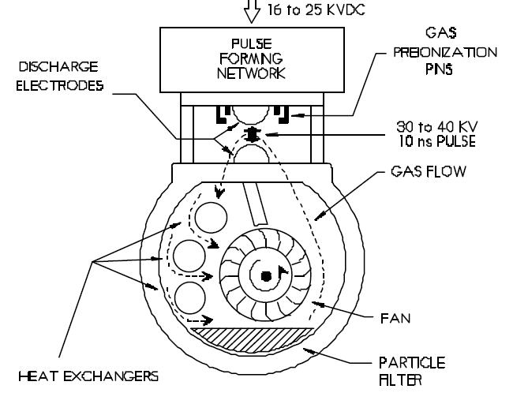
Inside the Gas Cavity

Slide 5
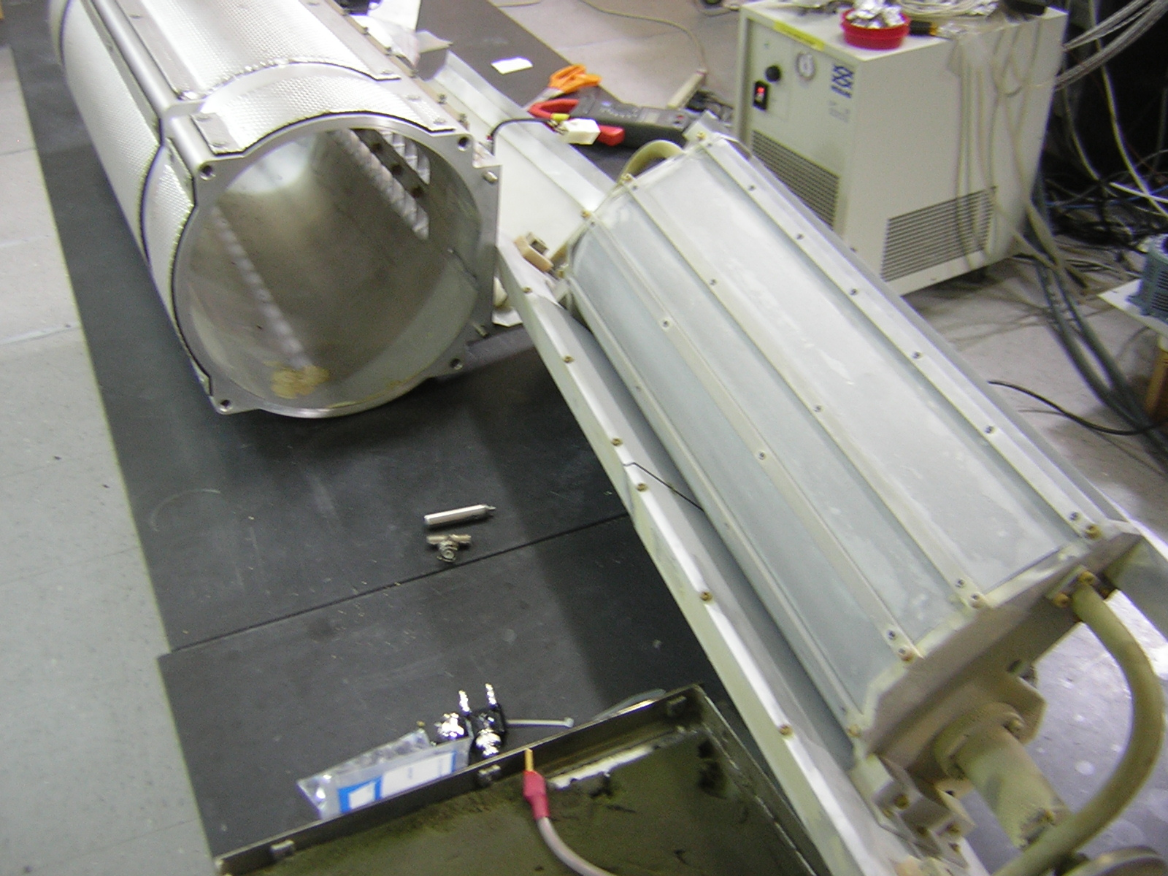

Slide 6
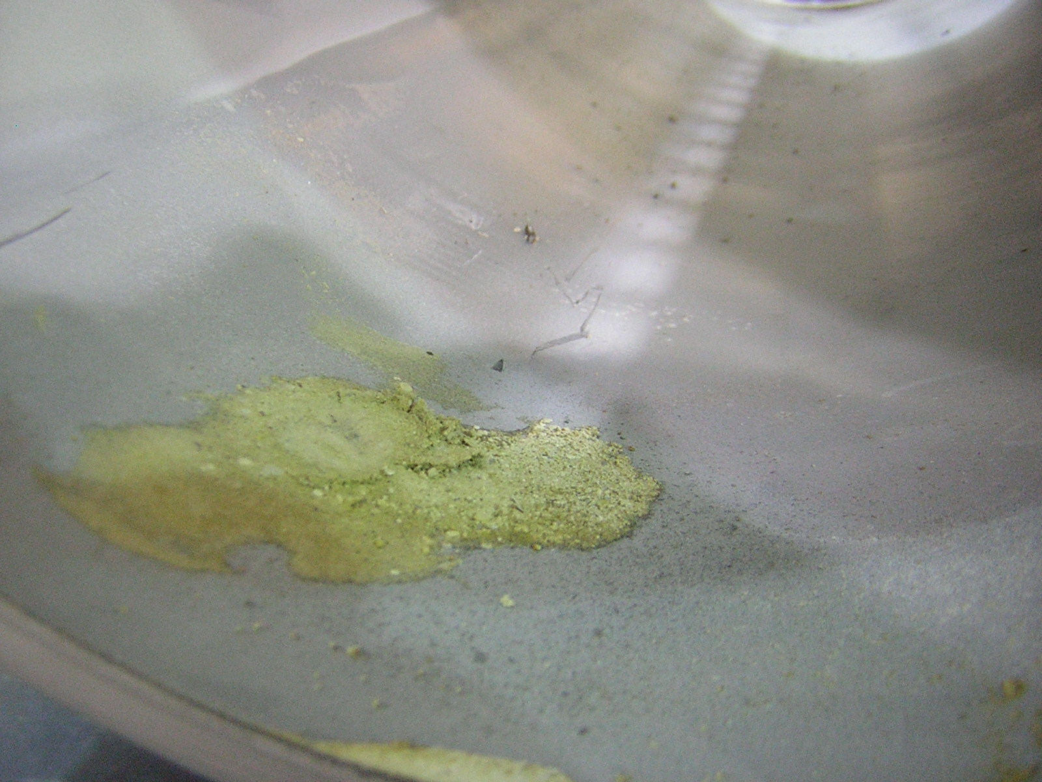

Slide 7
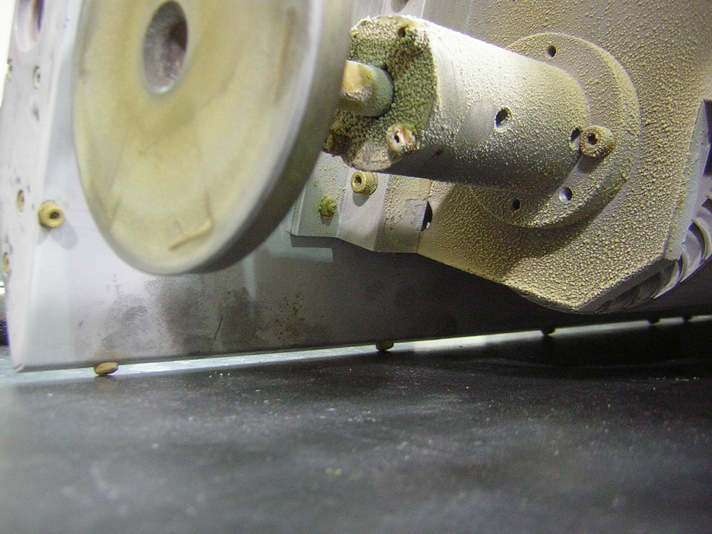

Slide 8
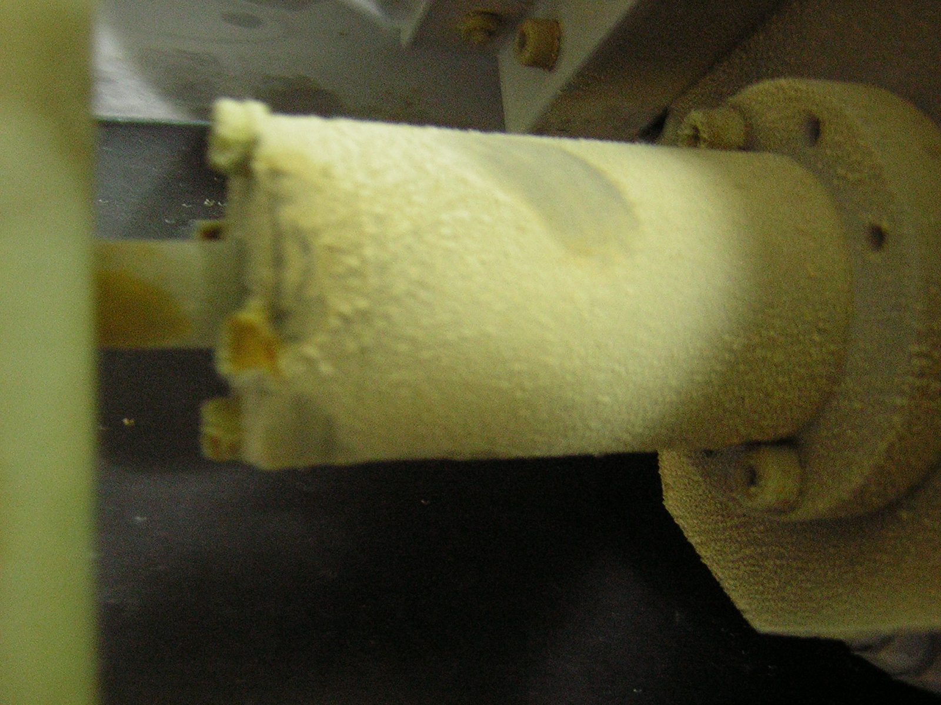

Slide 9
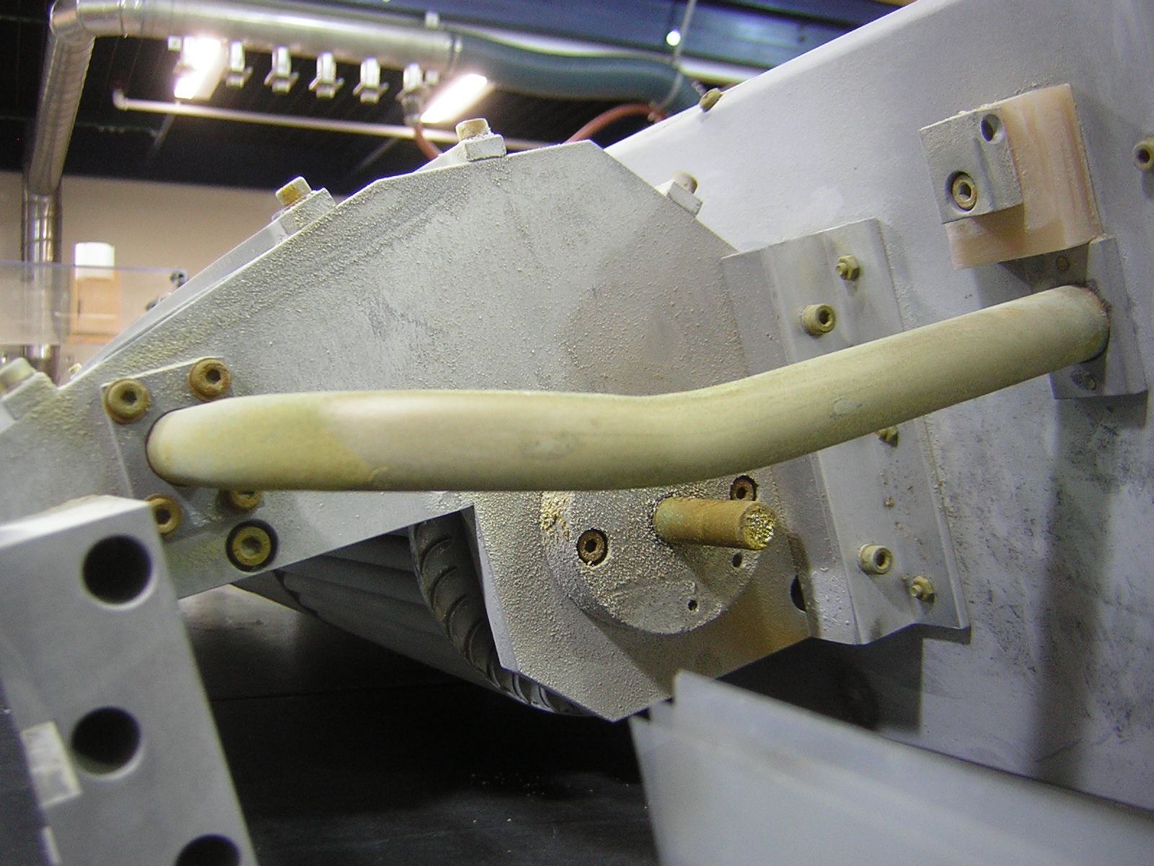

Slide 10
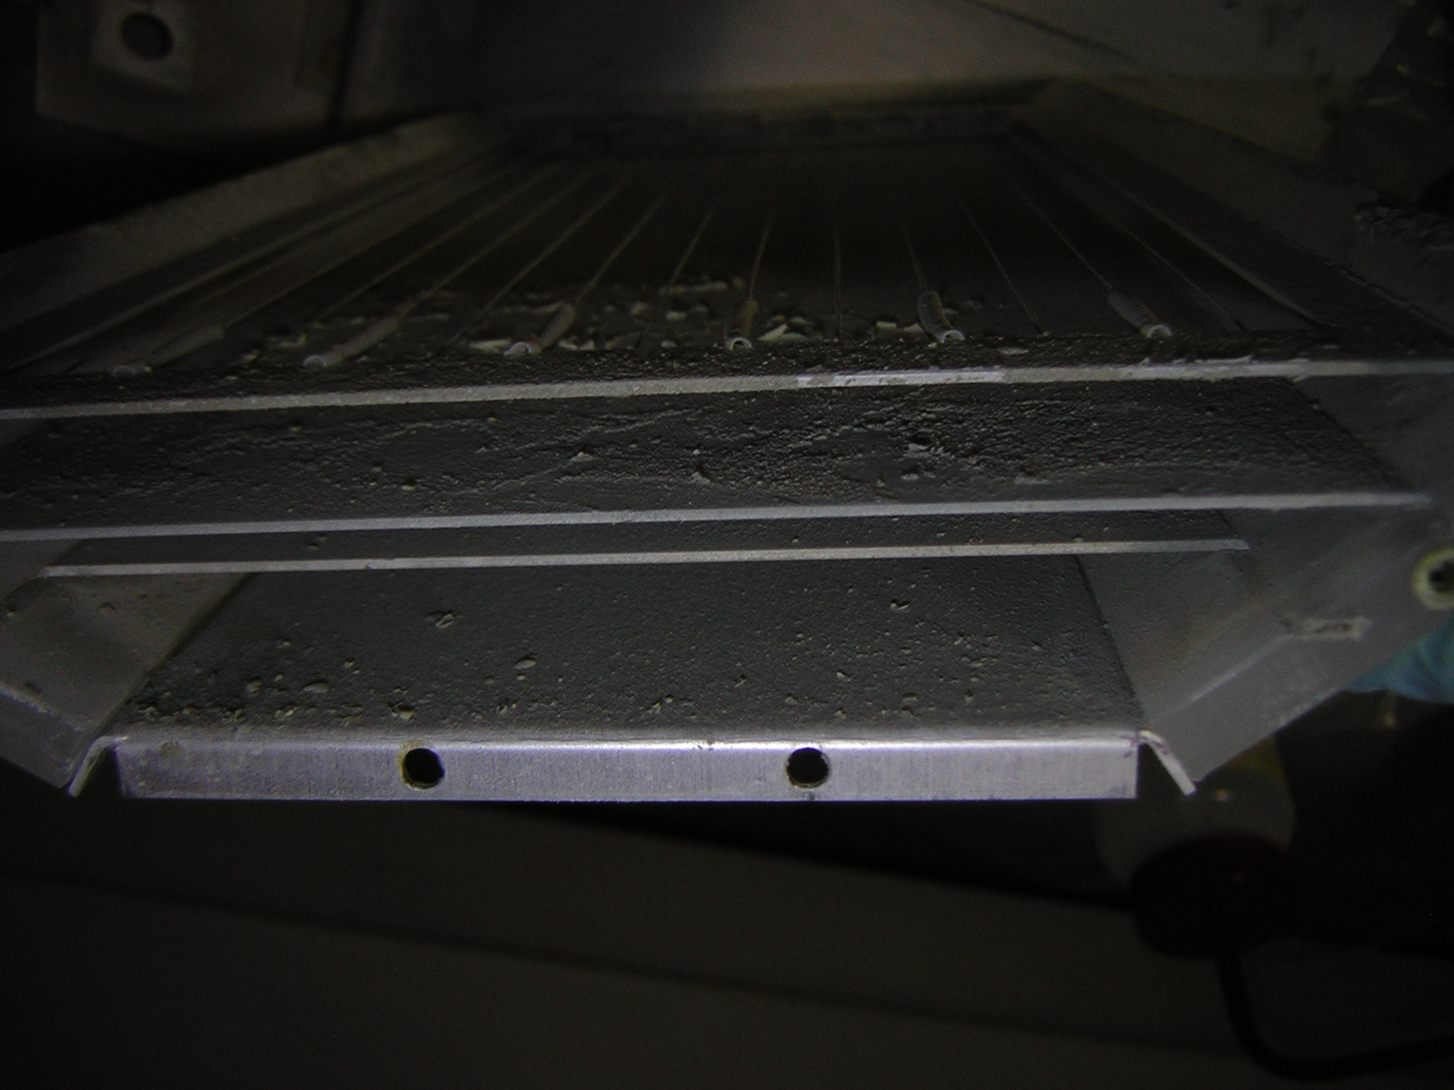

Slide 11
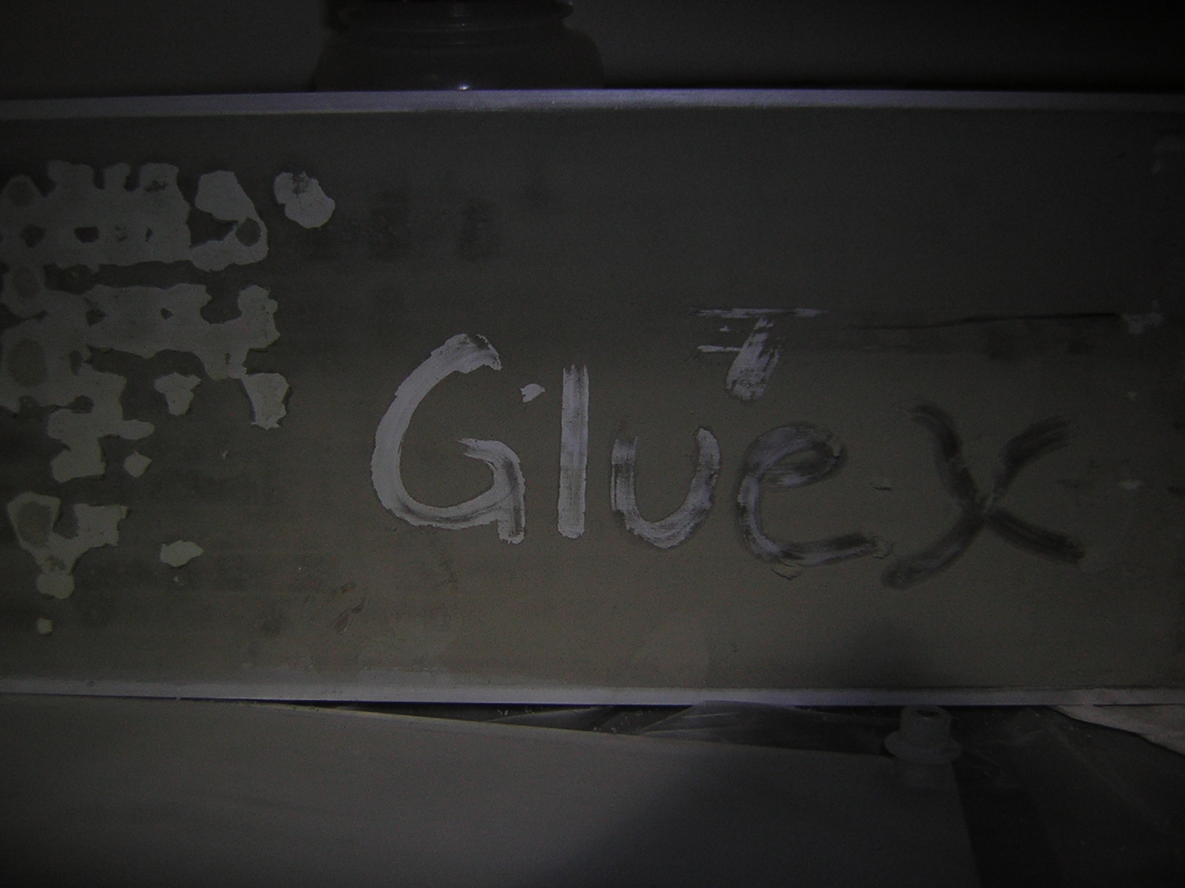

Slide 12
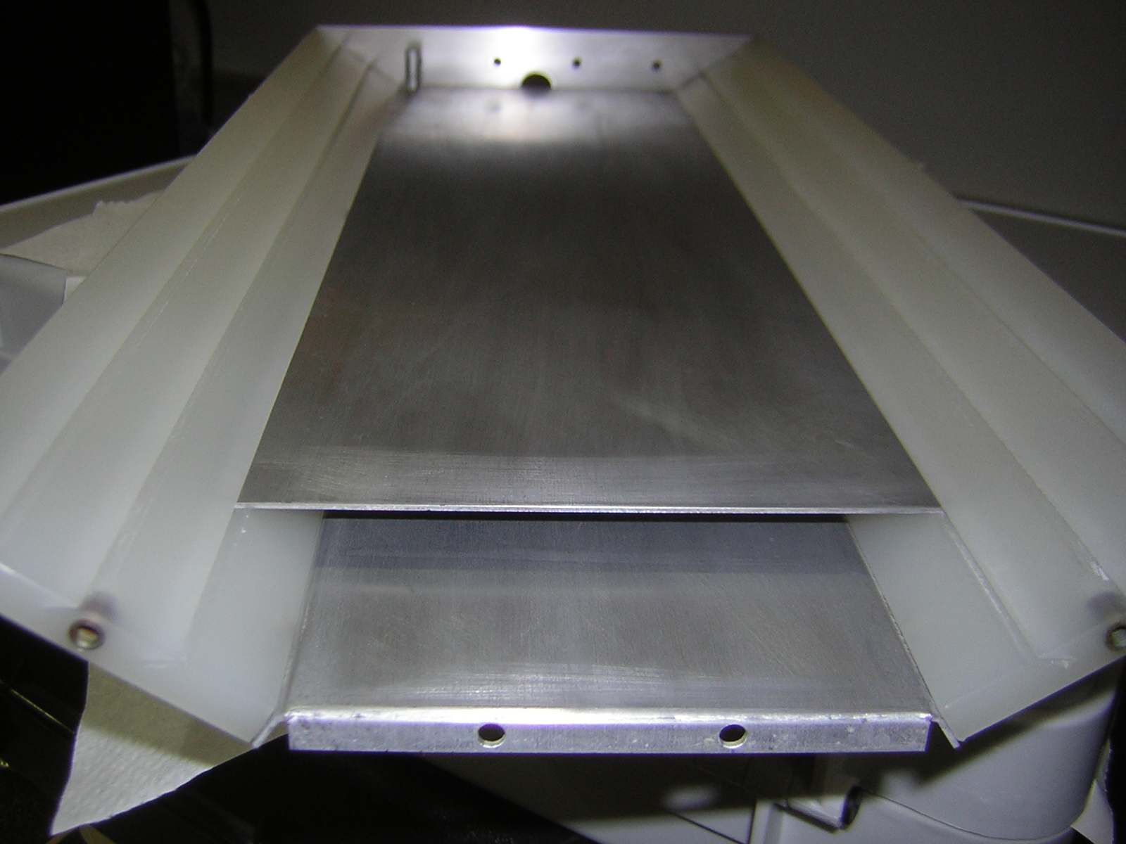

Slide 13
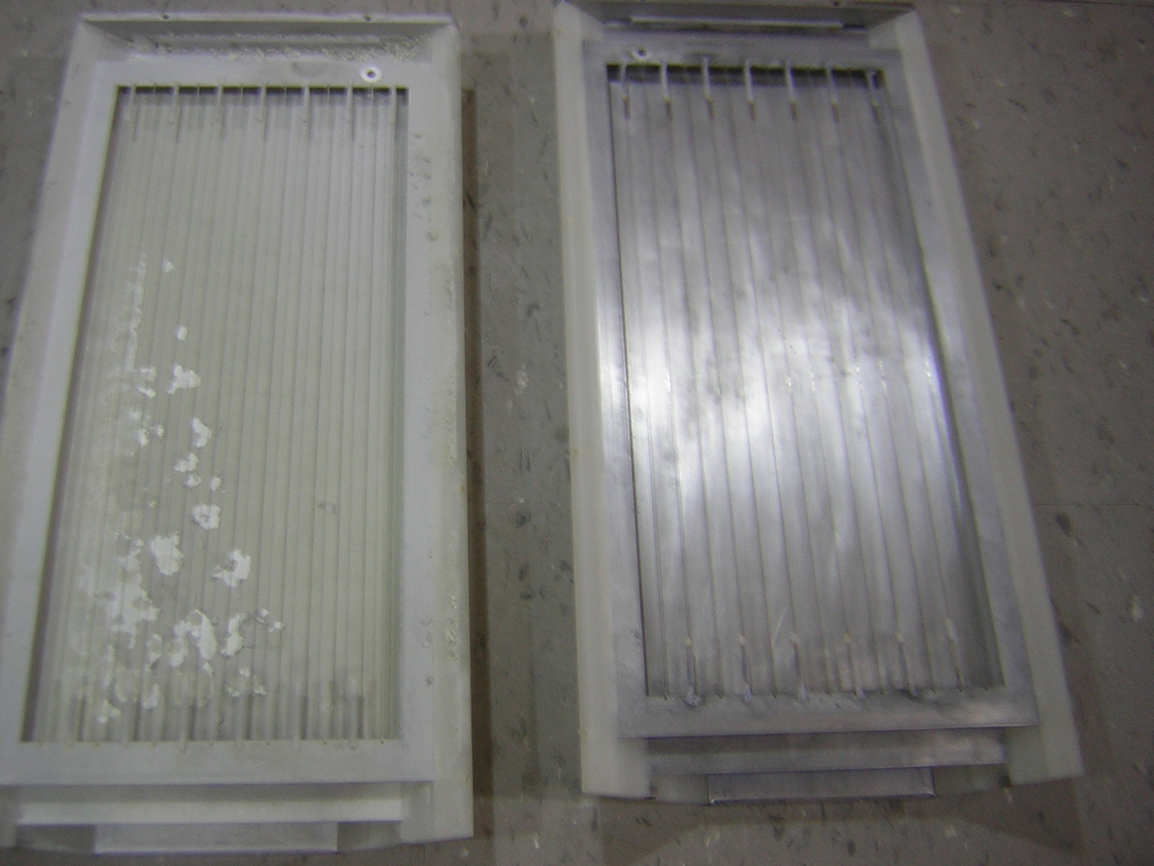

Slide 14
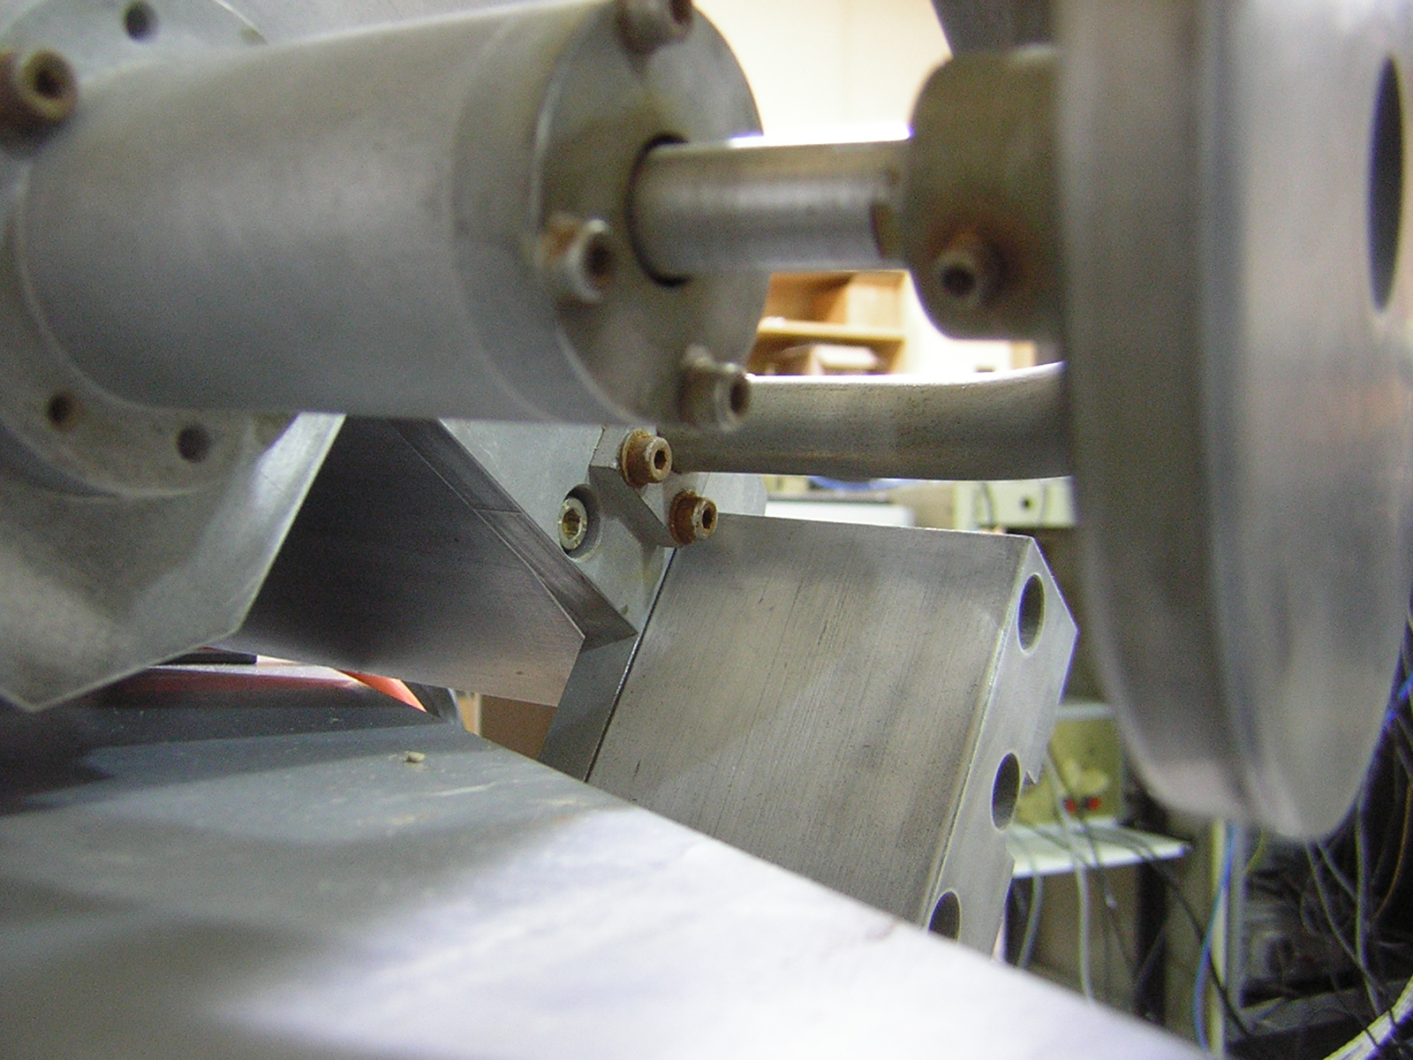

Slide 15
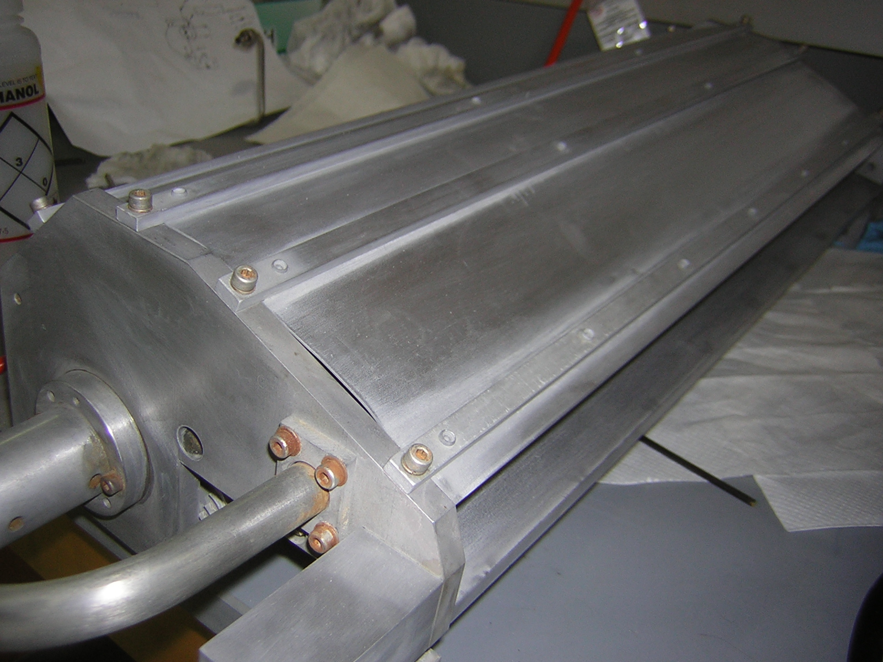

Slide 16
Results
We have now seen red light for over 4 hours
The laser beam has not yet been profiled quantitatively.
However, lasing can be visually seen for over 25 minutes.
We plan to continue passivation procedures until we hit a limit.

