Slide 1
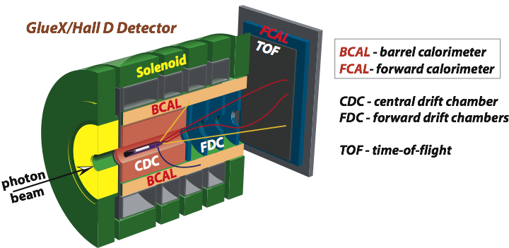


Status of the Pair Spectrometer
A. Somov
GlueX Collaboration Meeting,
May 12, 2015

Slide 2
Overview
Pair spectrometer trigger and data sample
Hardware performance during beam test
Photon beam monitor

Slide 3
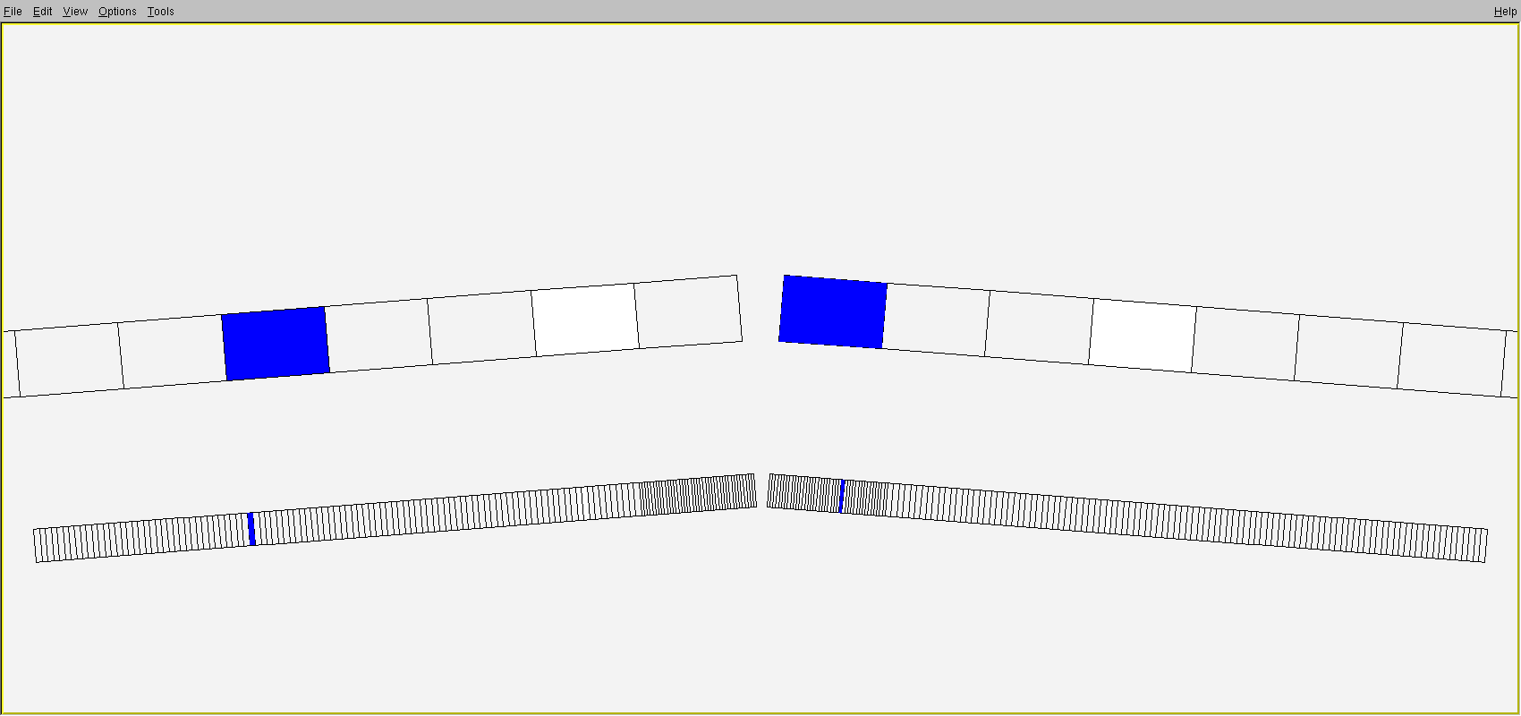
PS Trigger and Data Sample
Trigger based on hit coincidence between two arms of PSC
PSC used in trigger
PS hodoscope
Took calibration data with the PS trigger
- read out pair spectrometer and TAGM/TAGH crates.
Operated PS trigger in parallel with other trigger types for
production runs.

Slide 4
PS Trigger and Data Samples
Conditions for calibration runs:
- PS magnetic field was lowered to ~0.7 T in order to be able to see
coherent peak in the photon energy spectrum. PS hodoscope energy
range : 2.3 GeV – 4.8 GeV (energy range for 12 GeV is 6 – 12 GeV)
- Data taken with diamond crystal (S145-S90, 90μm) and amorphous
(2x10⁻⁵ and 10⁻⁴ X₀) radiators
- Typical rates : 500 Hz – 1 kHz.
- Acquired about 8 M events for the PS and tagger detectors calibration

Slide 5
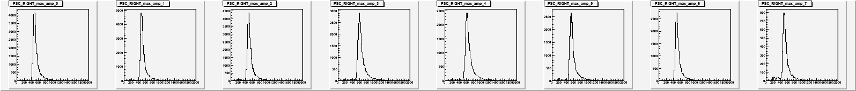
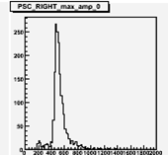
Maximum Amplitudes PSC
150
Relatively large pulses, peak amplitude ~600 fadc counts

Slide 6
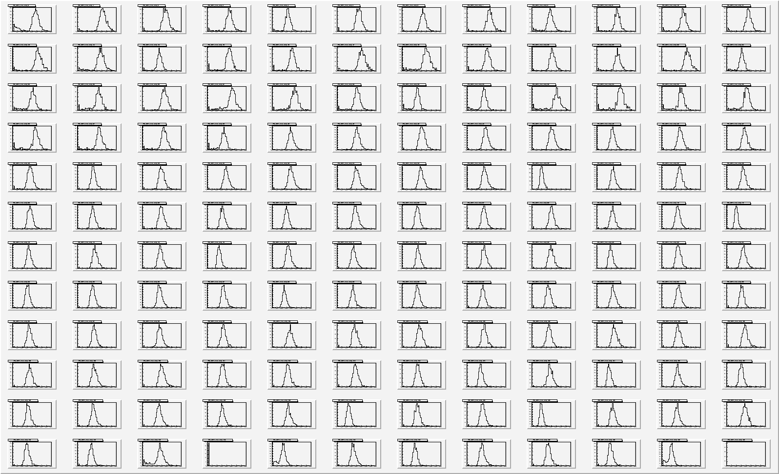
Maximum Amplitudes: PS

Slide 7
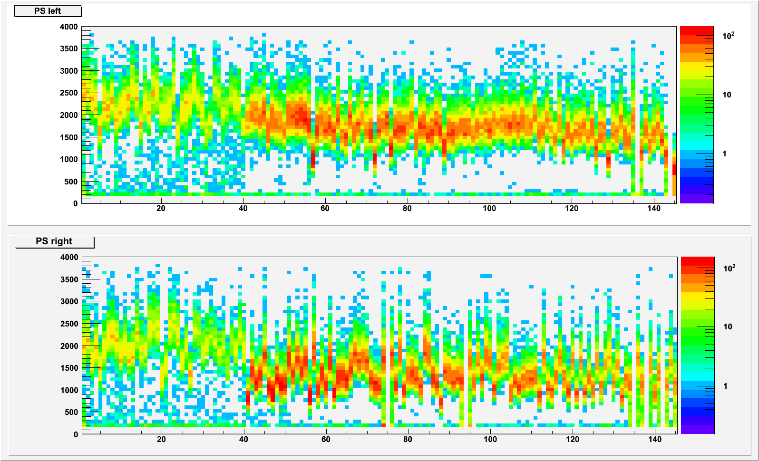
Maximum Amplitudes: PS
Amount of light collected from tiles corresponds to 60 – 90 pixels
Several bad channels: 3 (arm A) and 4 (arm B)
No “new” bad channels since the run in the fall 2014.

Slide 8
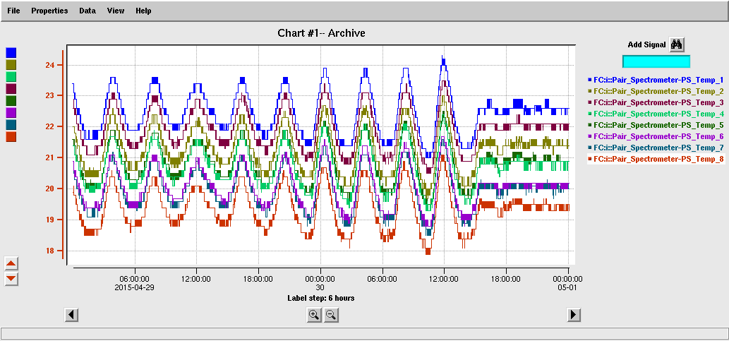
Temperature Control
Temperature stabilized in the Hall
Temperature monitored for various detector rates:
- no “large” temperature dependence observed
Temperature span less than 3° C

Slide 9
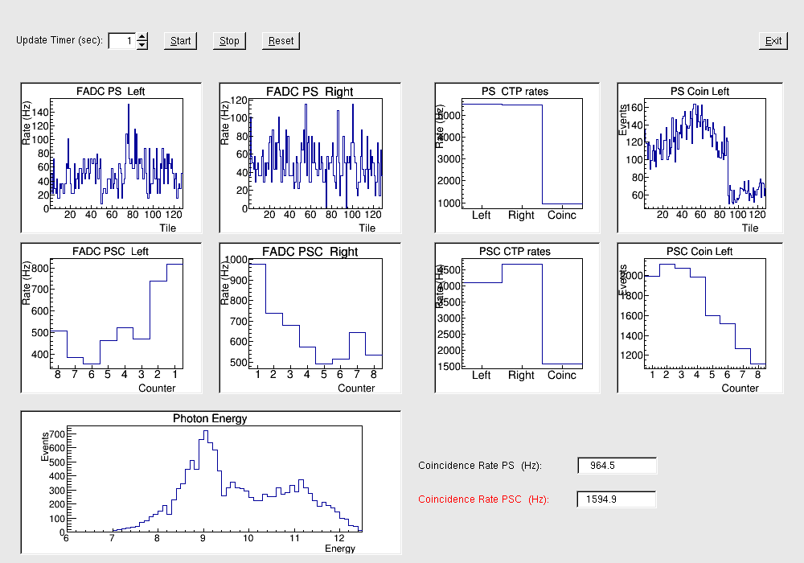
Online PS/PSC Monitor
Beam spectrum
Continuously monitor photon beam spectrum using CTP scalers (32 ps channels are
positioned in another crate – not accessible for monitoring)
Photon spectrum is not acceptance corrected (work in progress)

Slide 10
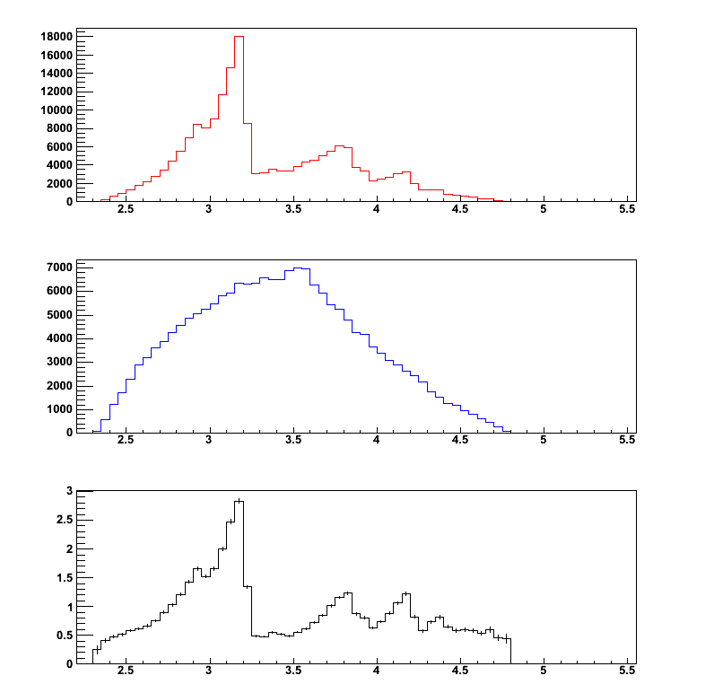
Photon Spectrum Measured with PS
Diamond crystal
Not acceptance
corrected
Amorphous radiator
Not acceptance
corrected
PS hodoscope energy
has not yet been calibrated
Magnetic field lowered to 0.7 T
Detector acceptance ~2.5 GeV
Ratio
End-point energy

Slide 11
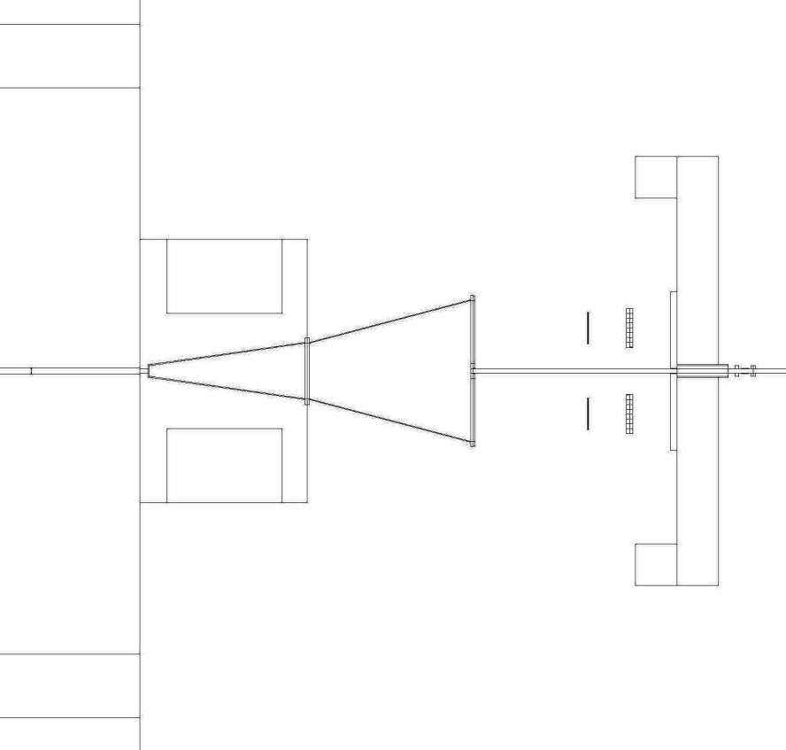
PS Geometry in Geant
Magnet
Vacuum Chamber
Initially implemented in Geant
about 2 years ago
Tuned by Simon during commissioning
runs
Counters geometry has to be tuned
Magnetic filed map is being implemented
PS and PSC
SEG blocks

Slide 12
Summary
Pair spectrometer detectors were successfully operated during the beam test in
spring 2015.
Large data sample (~8 M events) was acquired using the PS trigger with the
diamond crystal and amorphous radiator.
The PS trigger was operated in parallel with other trigger types during production
runs .
The PS online photon beam monitor allowed to monitor the position of coherent
peaks in photon energy spectrum

Slide 13
To Do List
Study performance of PS detectors during spring run ( try to fix 8 bad channels
during summer break)
Update PS geometry in Geant, implement magnetic field map (compare PS field
measurements with TOSCA simulation)
Perform PS energy and time calibration, add calibration parameters to the DB.
Study detector efficiency . Refine energy calibration of tagger detectors.
Start working on tools for the luminosity (beam flux) determination

Slide 14
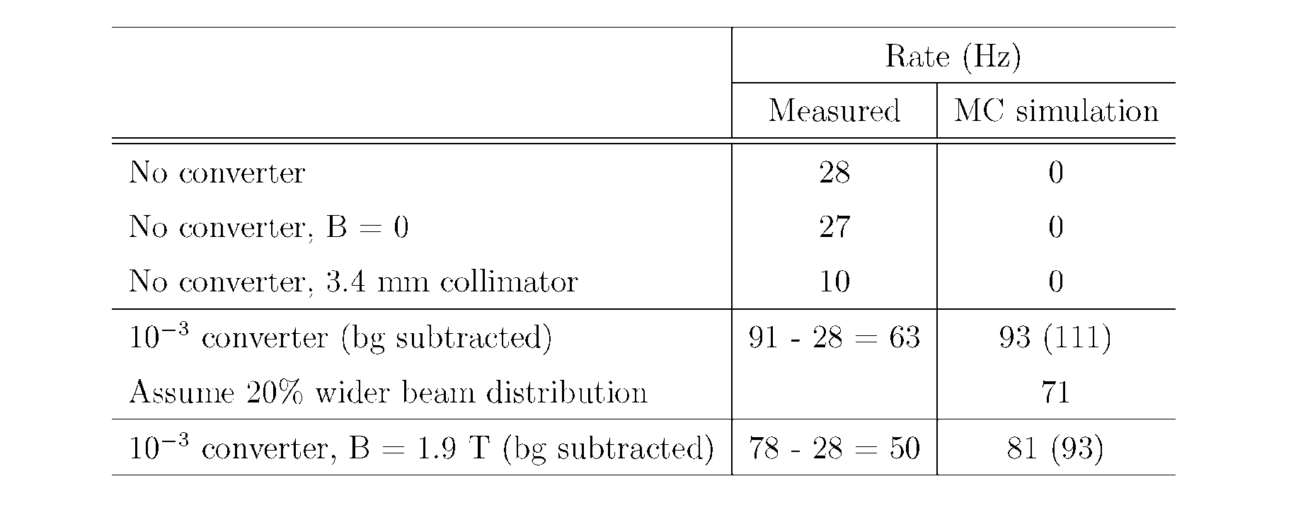
Photon Flux Prediction
Smaller rate observed than predicted by MC
- beam profile at collimator
- position of counters

Slide 15
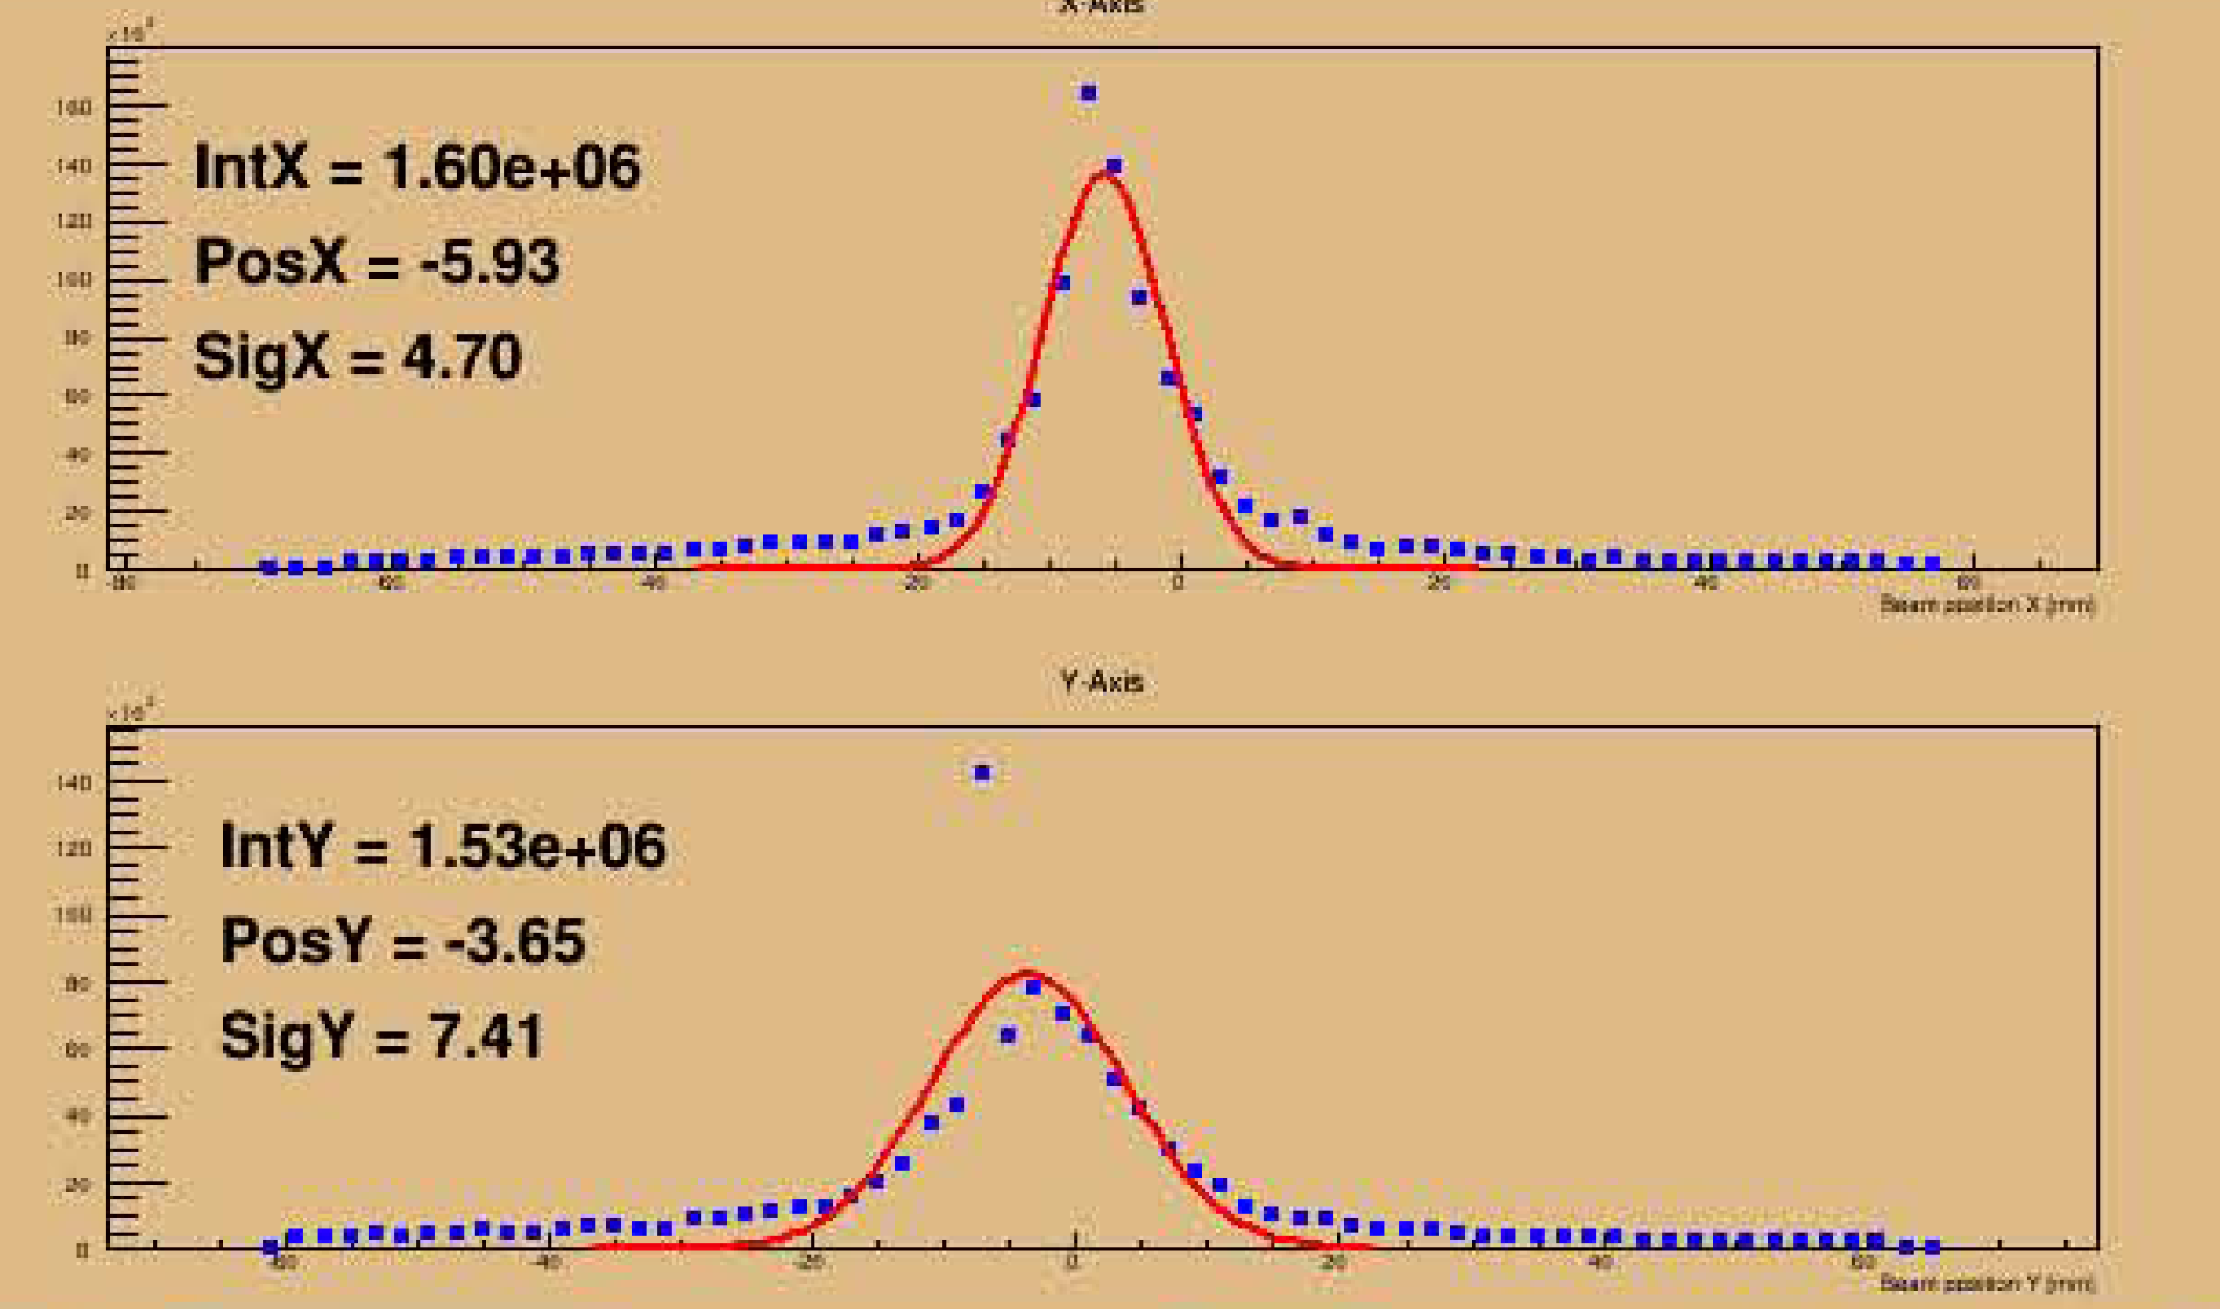
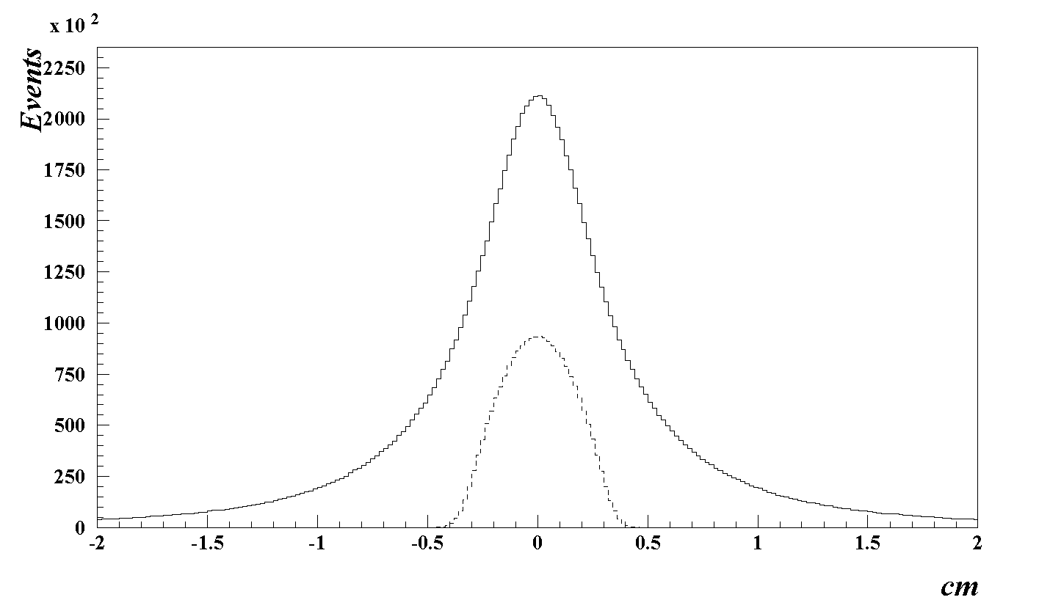
Photon Flux Prediction
About 20 – 30 % wider beam spot measured with the beam profiler
- has to be studies

Slide 16
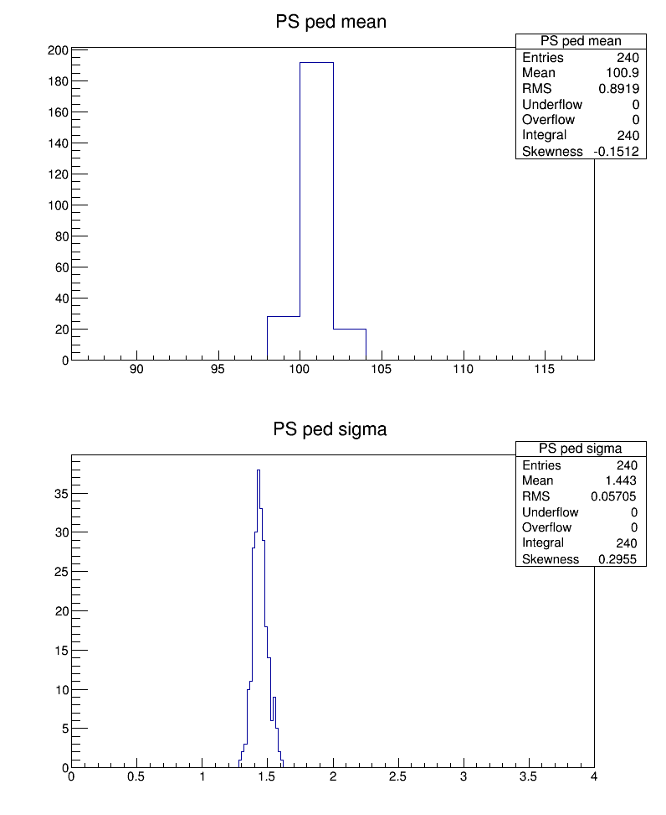
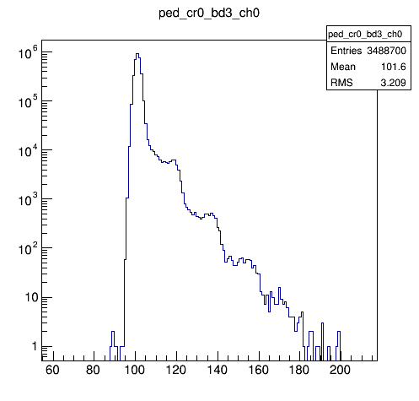
Calibration
Maximum fadc250 amplitude
PS (rocps1)
Single pixel
ADC count
ADC count
Pedestals calibrated in the beginning of the run, didn’t change since then
Single pixel amplitude ~20 fadc counts. The single pixel amplitude is similar for all
channels

Slide 17
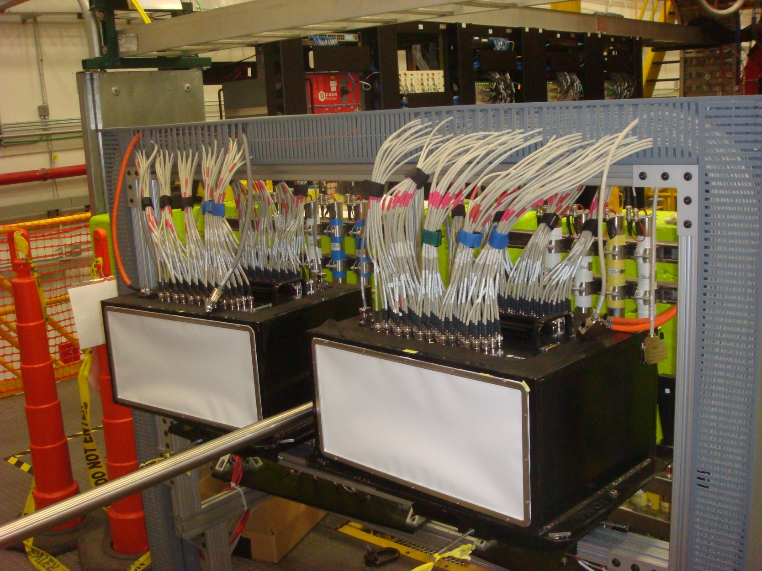
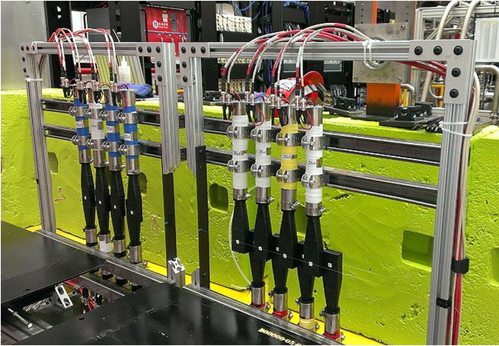
Pair Spectrometer Installed in Hall D
Coarse counters

Slide 18
