Slide 1
Diamond Radiator Fabrication & Assessment Update
Brendan Pratt
Richard Jones
University of Connecticut

Slide 2
Outline
CHESS RUN
UPGRADES
NEW RESULTS

Slide 3
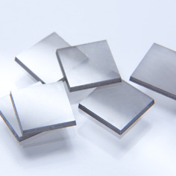
CHESS MAY 2014
Visit scheduled for May 28th-Jun 2nd
Jlab to procure 10 large element6 crystals
Have (2) 4.5x4.5mm diamond samples out to Sinmat
UConn milled samples (including our inventory of 45 stones)

Slide 4
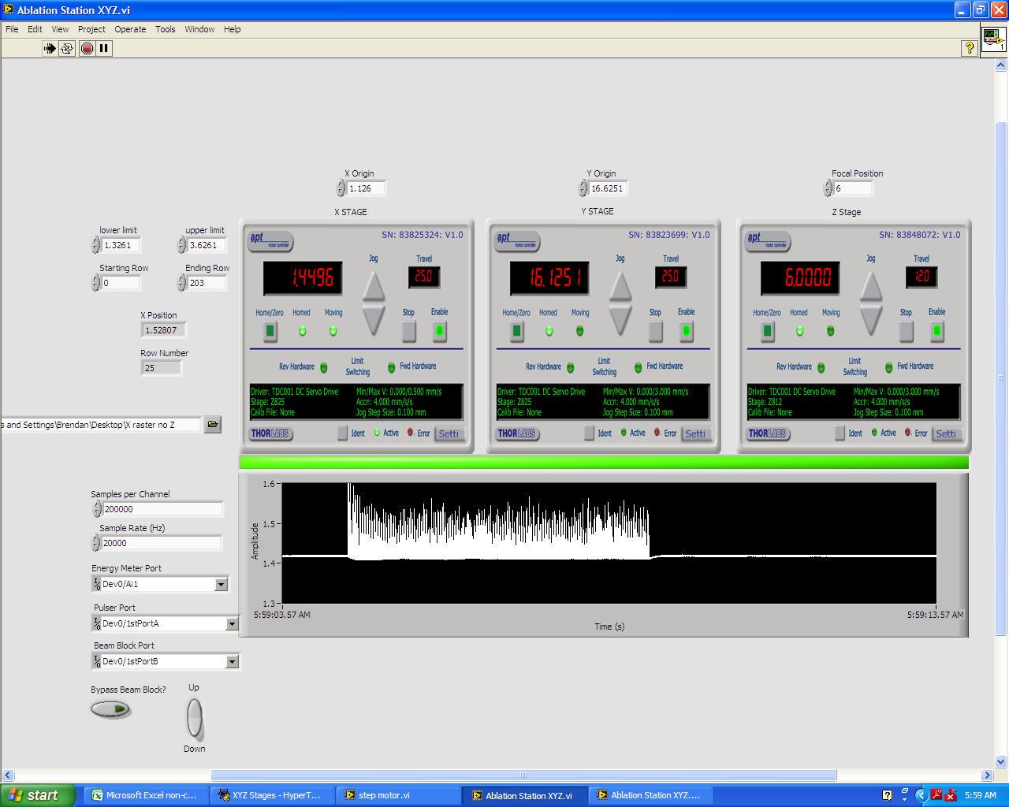
UPGRADES
(software)
LabView now runs sweeping raster
  Moves beam across diamond’s horizontal axis incrementing in y by 0.025mm
  A run takes about 19 minutes (2.6x2.6mm)
  Motor acceleration and backlash have been corrected for.

Slide 5
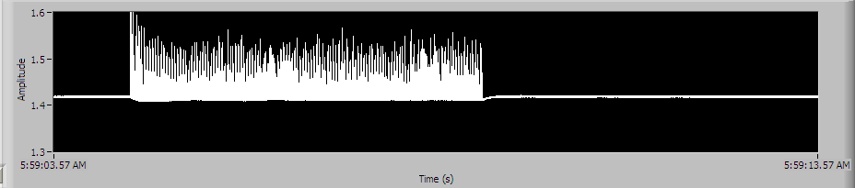
UPGRADES
(electronics)
Integrated Arduino based oscillator to control laser pulse train (50Hz)
Energy meter records laser energy for each “line” of the diamond
All electronics are now encased in aluminum shielding to protect the against large EMP produced by the laser

Slide 6
UPGRADES
(hardware)
Automatic beam aperture
  Blocks beam whenever LabView program is not in current use
  Prevents accidental blemishes caused by misfires of the laser
New 45° removable diamond chamber mount
  Allows for easy removal and replacement from ablation vacuum chamber
  Keeps diamond in plane with axis of translation

Slide 7
UPGRADES
(hardware)
A new translation stage was purchased and added to the sharp focusing lens.
  Allows for sub-micron positioning (12mm overall travel)
  We can now “chase” the focus as we move farther into the diamond
  Can now back focus off when reaching <50µm critical thickness

Slide 8
Focal Study
Cutting rate and beam profile highly dependent on being within the Rayleigh length.
Advanced the Z-axis through the focal point while ablating on diamond
Zygo images reveal the sharpest focus at 4.8mm (0.0mm farthest from chamber)

Slide 9
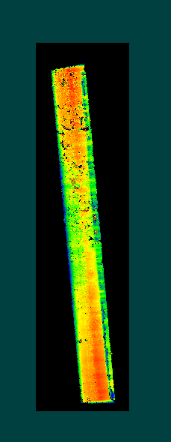
Measuring Thickness
Knowing how thick your virgin sample is obviously important, but hasn’t been easy to do in the past.
Turn diamond samples on edge and image their profiles using the Zygo

Slide 10
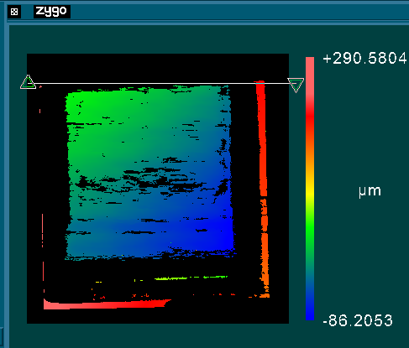
U300_25
According to our measurements, this diamond was cut down 275µm.
Resulting in an active area that is less than 25µm thick

Slide 11
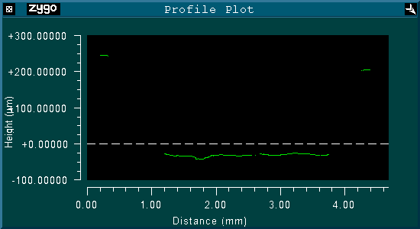
Thickness Profile Through Diagonal

Slide 12
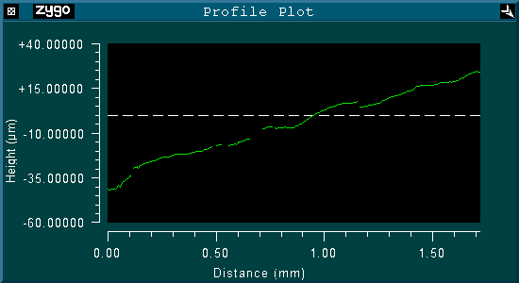
Surface Variation

Slide 13
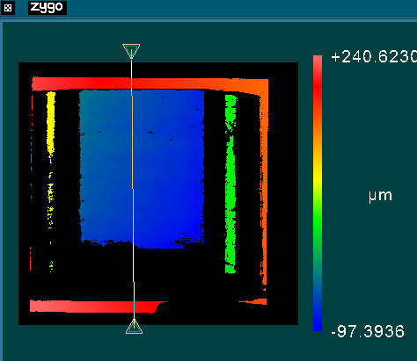
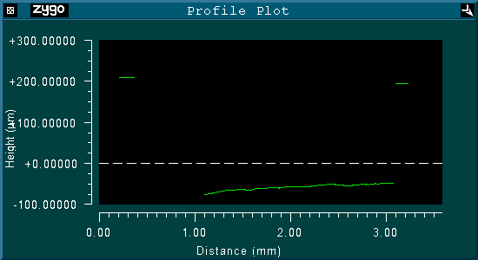
U300_20 Diamond
Average cut depth >270µm

Slide 14
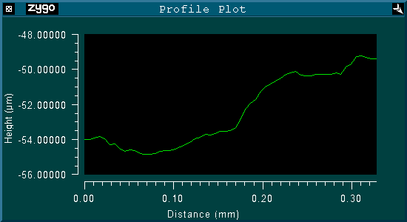
Surface Variation

Slide 15
Conclusions
UConn will be heading down to CHESS in the upcoming week with samples from
  Sinmat
  Element 6
  Uconn
Major upgrades to the ablation facility have been made since the beginning of the Jlab contract
The UConn laser ablation facility is producing diamonds with central region thicknesses of <25µm and <1µm surface variation

Slide 16

QUESTIONS?

