Slide 1
Tagger Microscope Construction Update
University of Connecticut GlueX group
Ann Marie Carroll, Alex Barnes, Richard Jones

Slide 2
Outline
Fiber bundle production - Ann Marie Carroll
  Overview of production stage
  Light yield measurements
  Manufacturer’s blunder
Absolute photon yields - Richard Jones
  Comparison with prototype
  Comparison with simulation
Task list prior to October run - Alex Barnes
1

Slide 3
Quick overview of steps in bundle production
Rough cut
Straighten light guide
End-mill to final length
Polish non-fused ends
Fuse 2 cm of scintillator to 166 cm light guide
Bend: s-bend near scintillator end, 110° bend near midpoint
Paint: 20 micron layer of titanium dioxide covering first 80 cm
Glue: holds fibers in precise mechanical alignment, first 20 cm
2

Slide 4
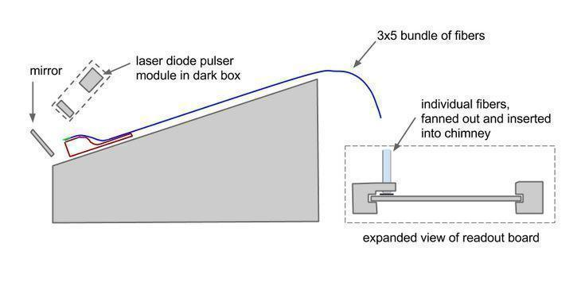
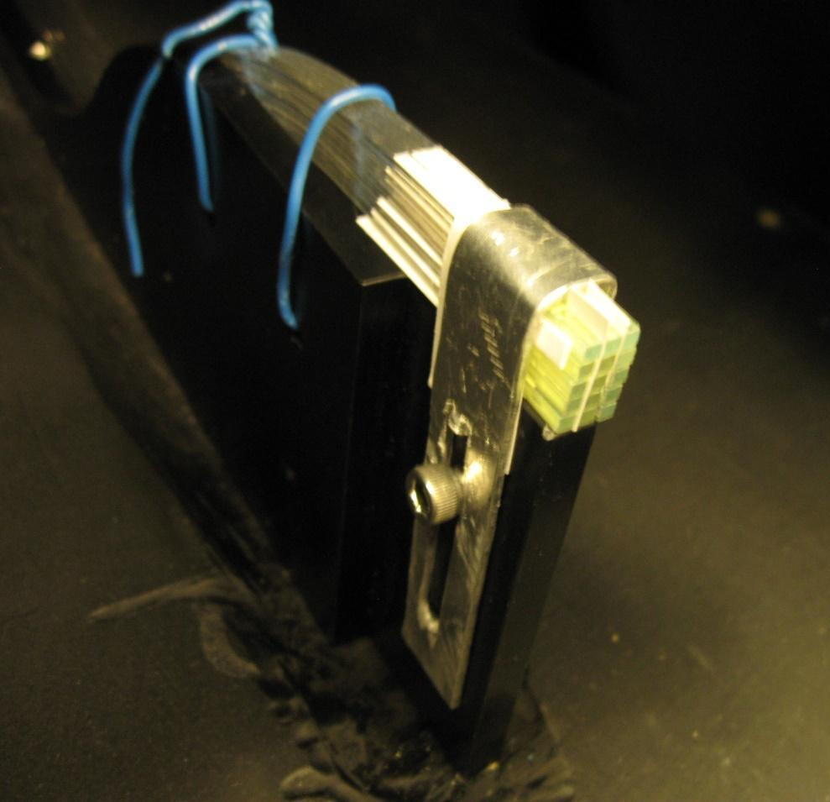
Fiber Light Yield
Measurement
Red laser diode with a diffuser in a 200 kHz pulsing circuit.
Black out material separating pulser end from SiPM’s
Minimal “wetted” surface contact
3

Slide 5
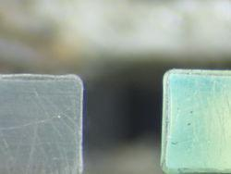
Manufacturer’s Blunder
Cosmic tests: First production bundle
  Fused
  Bent
  Painted
  Glued
1/4 expected yield!
Reason: missing cladding
Core is polystyrene
First cladding is 4% of core size - acrylic
Second cladding is 2% of core size – fluor-acrylic
Total fiber size is 2mm x 2mm
Procedures designed for double-clad scintillators and double-clad light guides
Prototype worked as expected, and easily met experimental needs. (double-clad light guide)
Single clad
Double clad
Visually difficult to distinguish difference
4

Slide 6
Fibers categorized according to production steps:
.
“C” - Cut off the spool, never otherwise touched.
“S” - Cut, straightened, but not fused or otherwise touched.
“F” - Cut, straightened, fused, bent, but not otherwise touched.
“B” - Cut, straightened, fused, bent, but not otherwise touched.
“P” - Cut, straightened, fused, bent, painted, but not glued.
“R” - Cut, straightened, fused, bent, painted, and then had the paint removed.
“G” - Cut, straightened, fused, bent, painted, and glued.
5

Slide 7
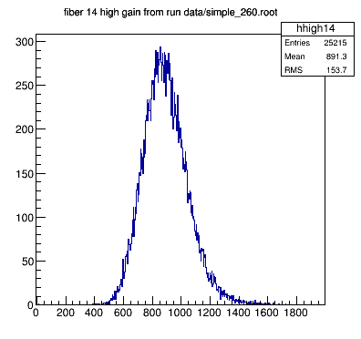
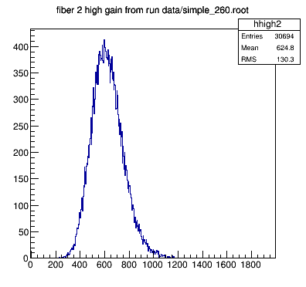
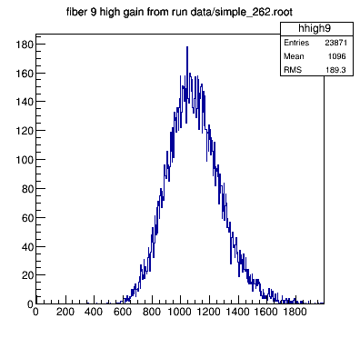
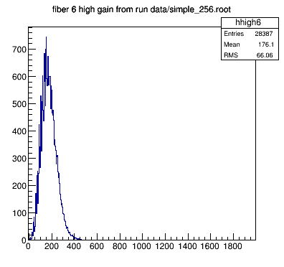
“C”
Mean = 891.3 ADC count.
~ 70 pixels/pulse
“B”
Mean = 624 ADC count.
~ 50 pixels / pulse
“S”
Mean = 1096 ADC count.
~ 85 pixels/pulse
“P”
Mean = 176.1 ADC count.
~15 pixels/pulse
Not expected!
6

Slide 8
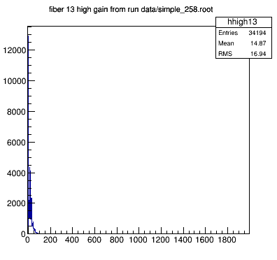
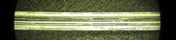
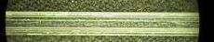
Paint removed: Type “R”
~ 1 pixel/pulse
After paint is removed
He’s dead Jim!
Never painted
7

Slide 9
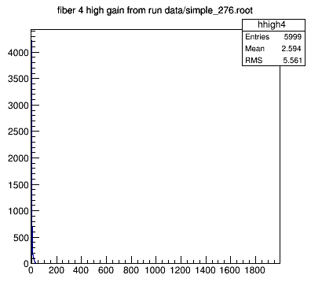
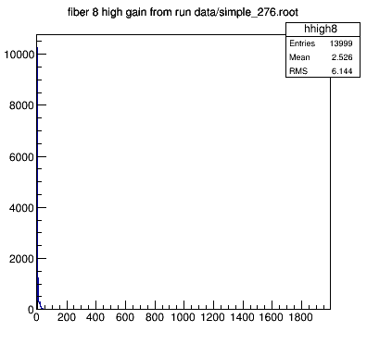
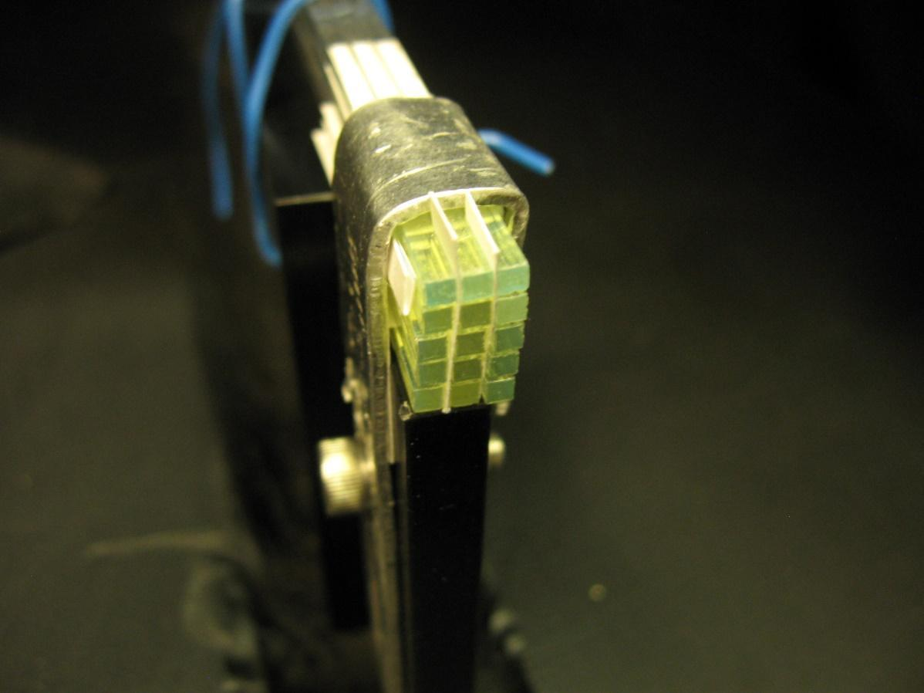
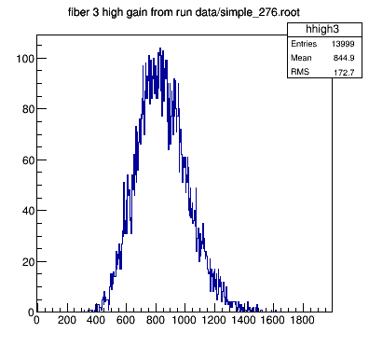
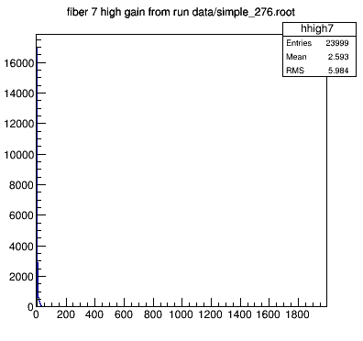
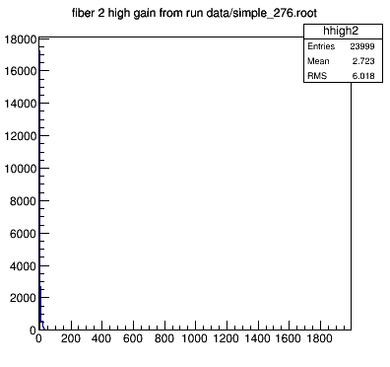
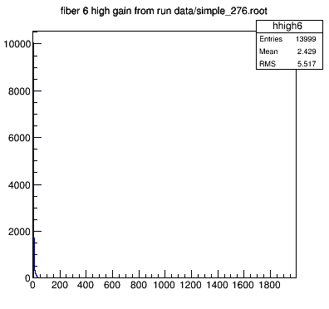
Optical Crosstalk
Negligible optical crosstalk even without paper spacing <1%
Paint not necessary
8

Slide 10
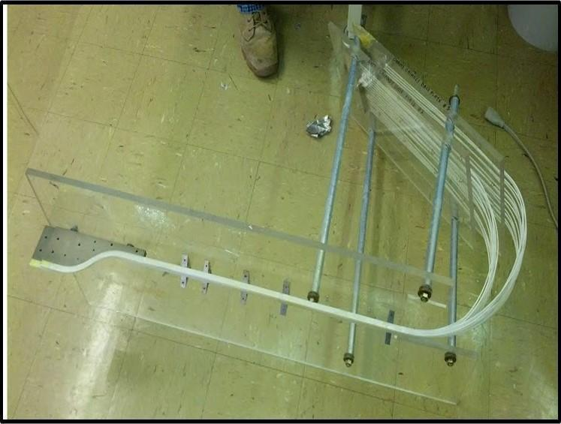
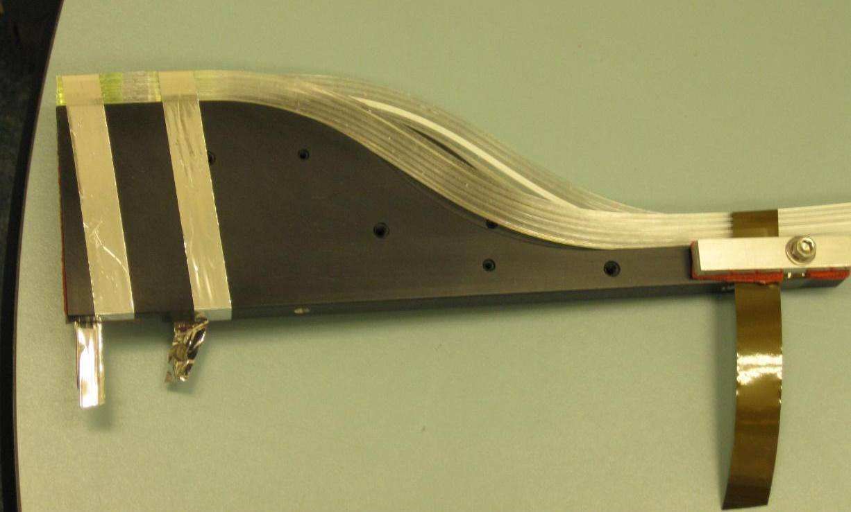
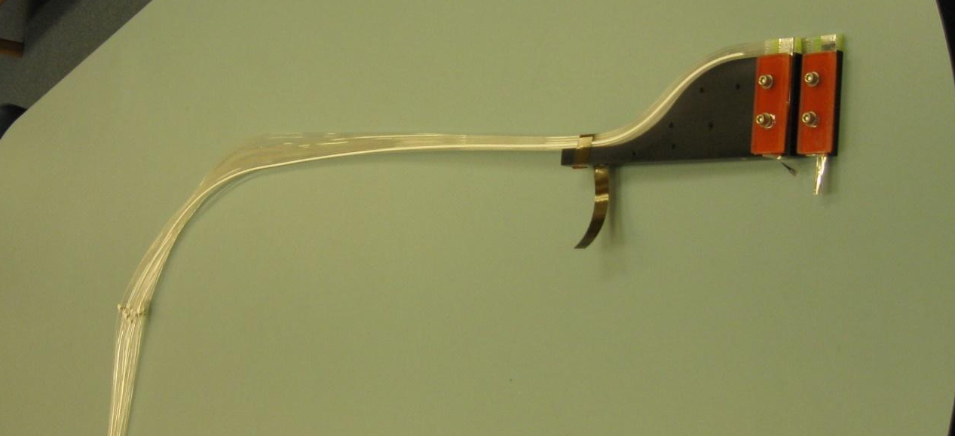
No more gluing
Gluing was permanent.
With new mount, individual fibers can be replaced if needed.
3 Kapton straps hold fibers in place.
Plates and gasket fit tight “popsicle stick” mount placement.
Gasket keeps straps from moving.
Keeps the fibers square and in line.
9

Slide 11
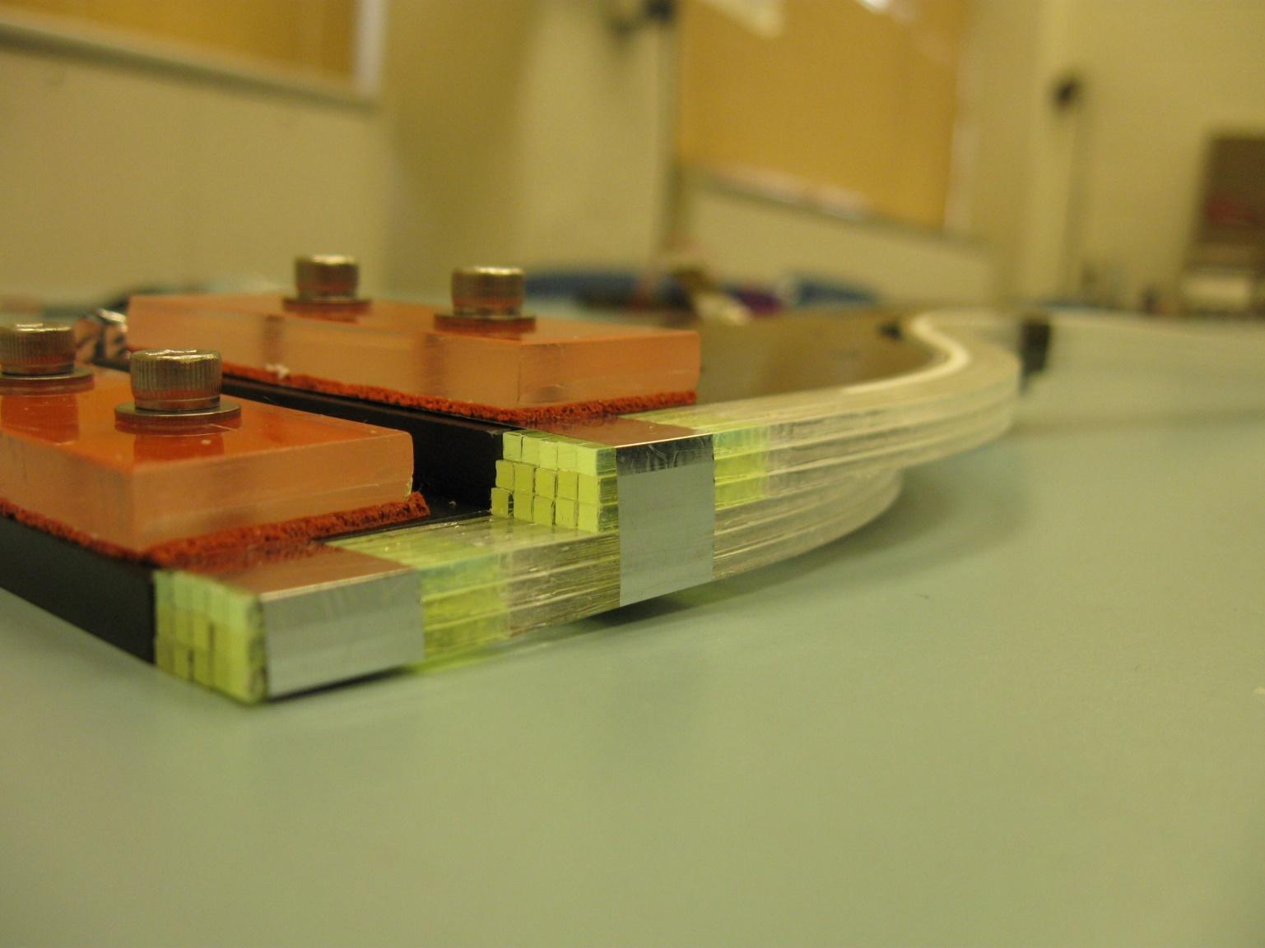
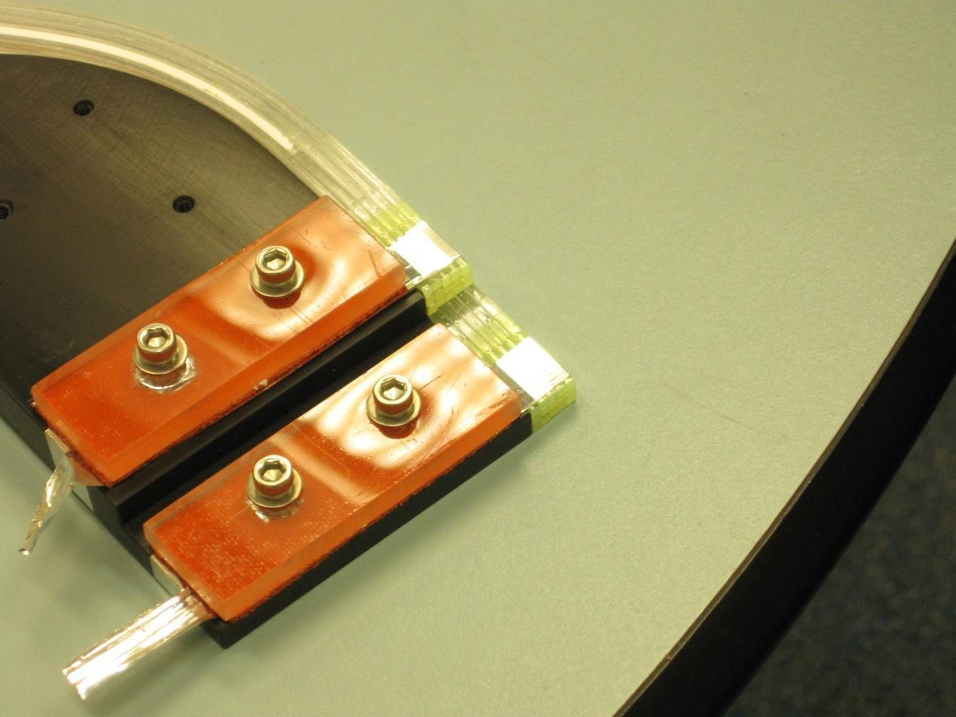
Final product will have a reflector on the face of the SciFi’s.
Degree of misalignment horizontally is a fraction of a millimeter.
Better alignment in the vertical direction where it is most necessary.
Columns and rows aligned well with this mounting setup.
10

Slide 12
Current Status
Contracted to deliver 102 columns of fibers.
Planned contingency of 24 extra columns.
Can chose the best 102 columns to put in the final detector
126 columns fused already
114 columns bent, 12 columns remain unbent as of now
60 columns painted already, 48 still painted, 12 with paint removed
66 columns never painted
Able to deliver 66 never painted columns (65% of our contracted columns) to JLab in one month, plus 42 additional columns performance below spec.
Saint Gobain agrees to deliver 100% of original order with multi-clad light guide at zero cost, delivery date unknown (fluorinated acrylic material deficit)
11

Slide 13
Absolute photon yields
mean cosmic yield =
(8000 /MeV) * (1.6 MeV/cm) * (mean cosmic scint path length) *
(SiPM pde) * (fiber transmission fraction) * (factor for reflection)
mean cosmic scint path length = 0.21 mm (from Geant)
SiPM pde is 25% in this wavelength range
reflection factor = 1.7 for aluminized mylar
design goal 200 pixels per electron => 200ps time resolution rms
minimum fiber transmission factor 1.8%
12

Slide 14
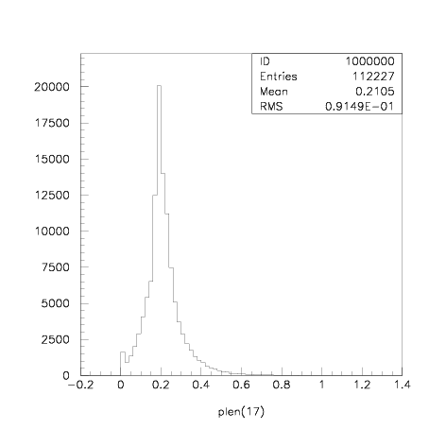
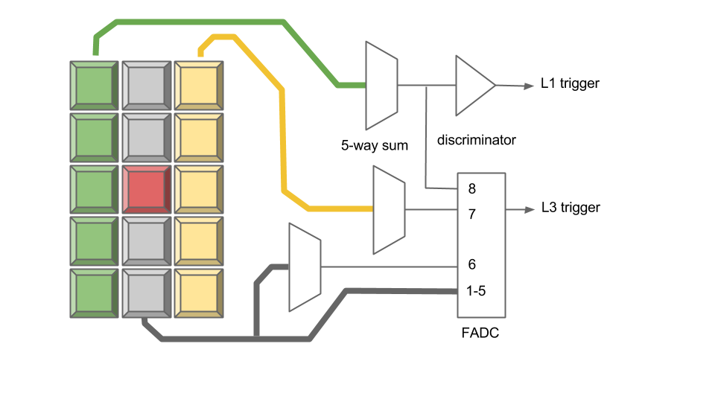
Light yield from cosmic rays
path length (cm)
Cosmic ray simulation:
path length of triggered cosmic ray in
plastic scintillator, middle column is
~2.1 mm
Cosmic ray
13

Slide 15
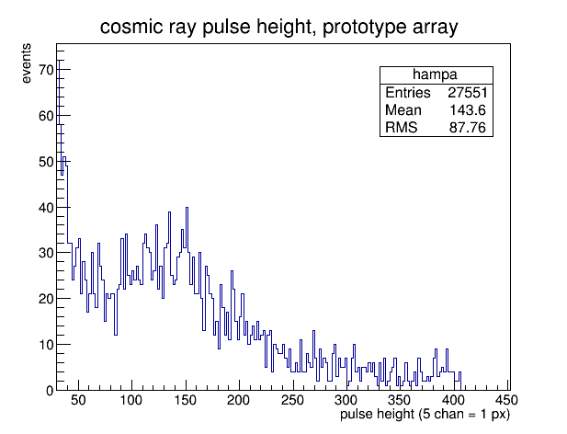
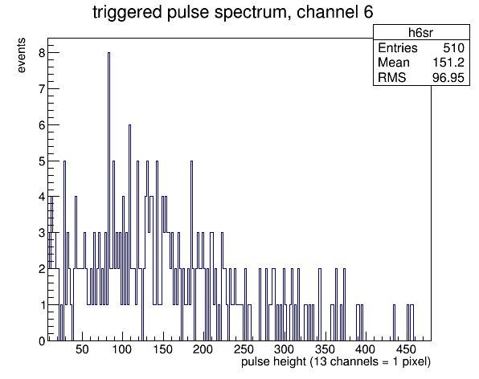
Light yield from cosmic rays
(from several weeks of data collection)
(B-type bundle, several days of data collection)
14

Slide 16
Differences of production from prototype
junction fused instead of glued (yield-neutral)
light guide 166cm instead of 80cm
different bend pattern, prototype bend was more severe
prototype was painted the full length, and glued
simulation points to cladding: single-clad is highly sensitive
  bends, paint, scratches, random defects all lead to significant loss
  second cladding layer reduces sensitivity by ~1 order magnitude
15

Slide 17
Tagger Microscope Installation
Alex Barnes
(moving to JLab after H2014)

Slide 18
Data Monitoring and Calibration
Pulse height spectra in the TAGM counters
Time spectra relative to the accelerator clock
Total rates per TAGM channel
Measure pedestals for all FADC channels, time offsets for F1TDCs
Calibrate the individual channel gains from pulse height spectra
Measure time-pulse height correlations to derive optimal time-walk corrections
Run in raw mode occasionally to make sure pulse window is properly aligned with actual pulses relative to trigger
Things to monitor online
for the tagger microscope
1

Slide 19
Control and Monitoring Software for Microscope
Interface for controlling TAGM power supplies
Interface for controlling SiPM preamplifiers
  Bias voltages (15 SiPMs x 34 boards = 510 voltages)
  Gain mode (1x, 14x)
Interface for controlling TAGM alignment
  3 stepper motors
Interface for slow controls monitoring
  DAC health voltage (1 for each control board, 17 total)
  Preamp reference voltages (1 per preamp, 34 total)
  Preamp temperatures (1 per preamp, 34 total)
  Alarms for values outside of acceptable ranges
2

Slide 20
Active Collimator and other work
Active Collimator
Work with John Bartolotta to optimize the algorithm
Implement algorithm and develop real-time visualization
Other work
Cable up the TAGM detector and run cosmic tests
Write software to calibrate and monitor TAGM performance within Hall D framework
3

