Slide 1
Gluex Data Challenge 2
Production on the Open Science Grid
Richard Jones

Slide 2
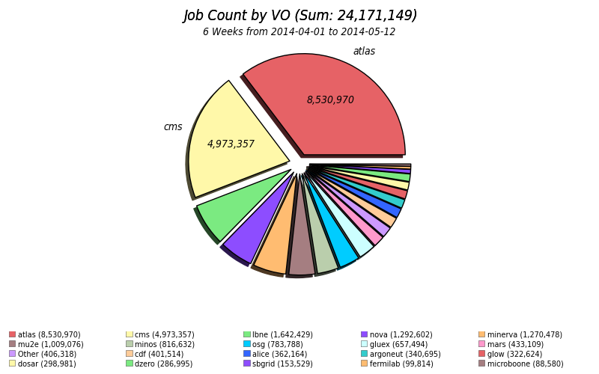
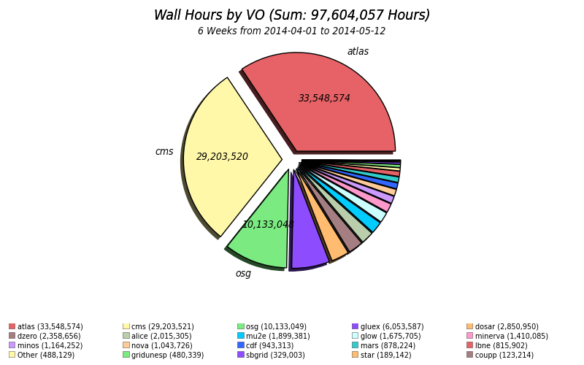
Production overview
Run number | Beam intensity | events (M) | files | cpu hours
9001 | 1 x 10⁷ | 3980 | 398017 | 2,049,321
9002 | 5 x 10⁷ | 240 | 48126 | 319,410
9003 | 0 | 945 | 94494 | 212,718

Slide 3
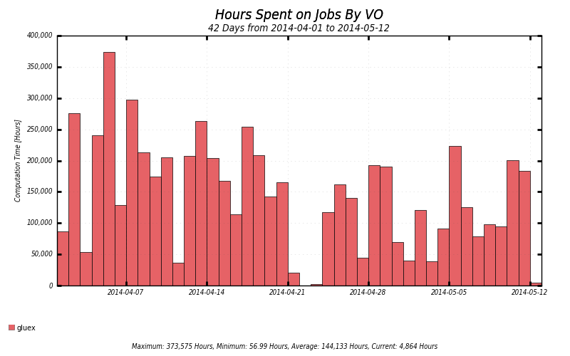
Wall time daily usage

Slide 4
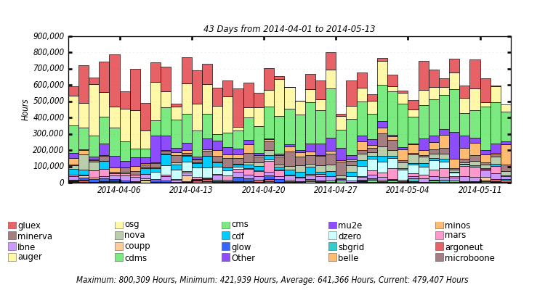
Usage on Fermilab site

Slide 5
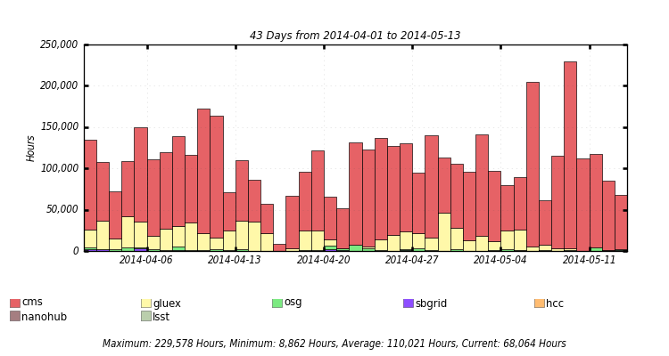
Usage on the Purdue site

Slide 6
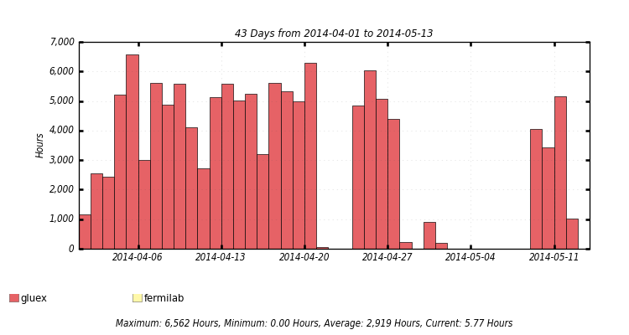
Usage on the Northwestern site

Slide 7
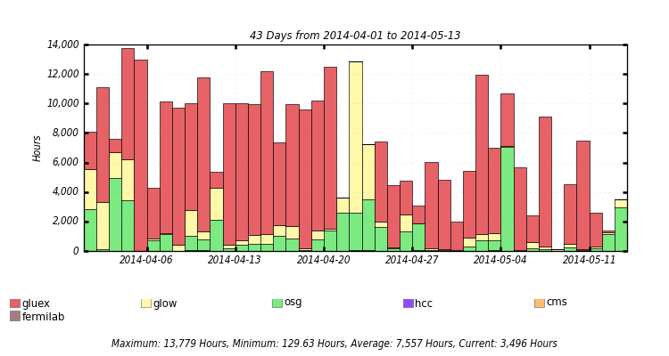
Usage on the UConn site

Slide 8
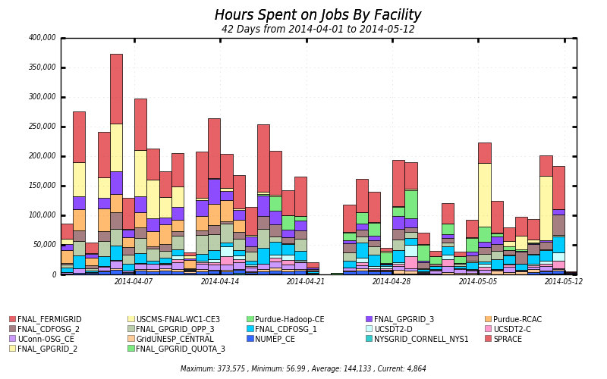
Production site summary

Slide 9
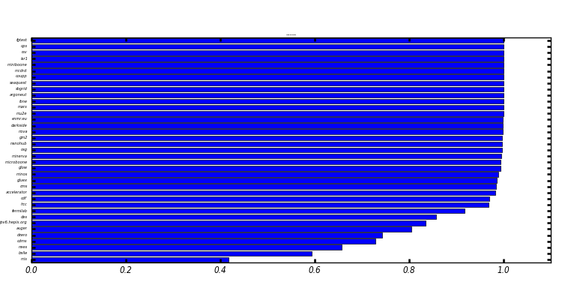
Finding the inefficiencies
Wall-clock-weighted job success rate

Slide 10
Digesting these results
450k files (14TB) now globally available online from UConn via srm
Virtually none of the inefficiency came from srm (non)availability
Jlab has started pulling dc2 files from UConn to archive on the mss
Substantial inefficiencies exist at several sites
Under study, one site at a time
Production works, even if there are remaining inefficiencies
More Gluex sites are needed to improve production stats

