Slide 1
Scientific Computing using GPUs
Jie Chen

Slide 2
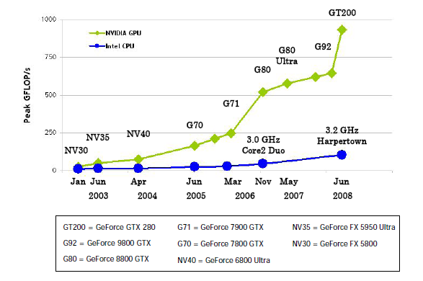
Why GPUs

Slide 3
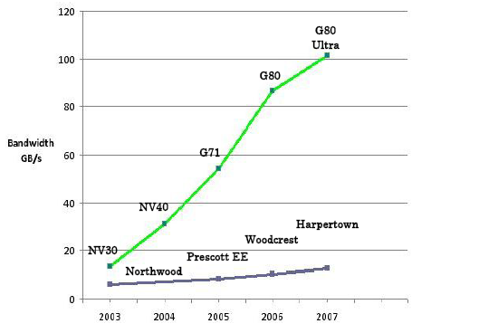
Why GPUs

Slide 4
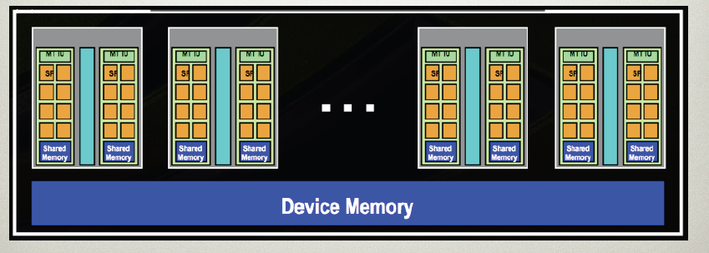
Why GPUs
30 Multi-Processors each contains 8 cores at 1.4 GHz
4GB GDDR3 memory offers ~100GB/s memory bandwidth

Slide 5
What is GPGPU?
General Purpose computation using GPU
in applications other than 3D graphics
  GPU accelerates critical path of application
Data parallel algorithms leverage GPU attributes
  Large data arrays, streaming throughput
  Fine-grain SIMD parallelism
  Low-latency floating point (FP) computation
Applications – see //GPGPU.org
  Game effects (FX) physics, image processing
  Physical modeling, computational engineering, matrix algebra, convolution, correlation, sorting

Slide 6
GPGPU
CUDA
  Compute Unified Device Architecture
    NVIDIA Specific
OpenCL
  The open standard for parallel programming of heterogeneous systems
    Hardware independent
    Industrial Standard
    Version 1.0 specification is out, Beta implementations
BrookGPU
  ATI Specific
Stream Programming (SIMD)

Slide 7
CUDA Programming Model
The GPU is viewed as a compute device that:
  Is a coprocessor to the CPU or host
  Has its own DRAM (device memory)‏
  Data parallel portions of an application: kernels
  A single kernel runs many threads in parallel
Differences between GPU and CPU threads
  GPU threads are extremely lightweight
    Very little creation overhead
  GPU needs 1000s of threads for full efficiency
    Multi-core CPU needs only a few

Slide 8
CUDA Thread Model
A kernel is executed as a grid of thread blocks
  All threads share data memory space
A thread block is a batch of threads that can cooperate with each other by:
  Synchronizing their execution
    For hazard-free shared memory accesses
  Efficiently sharing data through a low latency shared memory
Two threads from two different blocks cannot cooperate
Host
Device
Grid 1
Kernel 1
Block
(0, 0)‏
Block
(1, 0)‏
Block
(2, 0)‏
Block
(0, 1)‏
Block
(1, 1)‏
Block
(2, 1)‏
Grid 2
Kernel 2
Block (1, 1)‏
Thread
(0, 0)‏
Thread
(1, 0)‏
Thread
(2, 0)‏
Thread
(3, 0)‏
Thread
(4, 0)‏
Thread
(0, 1)‏
Thread
(1, 1)‏
Thread
(2, 1)‏
Thread
(3, 1)‏
Thread
(4, 1)‏
Thread
(0, 2)‏
Thread
(1, 2)‏
Thread
(2, 2)‏
Thread
(3, 2)‏
Thread
(4, 2)‏

Slide 9
CUDA Memory Model
Each thread can:
  R/W per-thread registers
  R/W per-thread local memory
  R/W per-block shared memory
  R/W per-grid global memory
  Read only per-grid constant memory
  Read only per-grid texture memory
(Device) Grid
Block (0, 0)‏
Block (1, 0)‏
Shared Memory
Shared Memory
Registers
Registers
Registers
Registers
Thread (0, 0)‏
Thread (1, 0)‏
Thread (0, 0)‏
Thread (1, 0)‏
Local
Memory
Local
Memory
Local
Memory
Local
Memory
The host can R/W global, constant, and texture memories
Host
Global
Memory
Constant
Memory
Texture
Memory

Slide 10
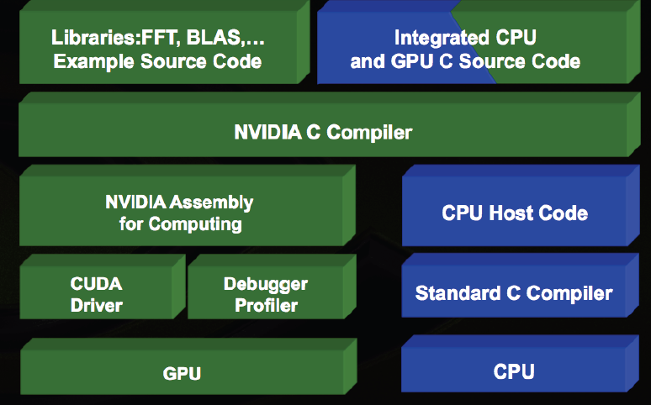
CUDA SDK

Slide 11
CUDA Extended C
Declspecs
  global, device, shared, local, constant
Keywords
  threadIdx, blockIdx
Intrinsics
  __syncthreads
Runtime API
  Memory, symbol, execution management
Function launch
__device__ float filter[N];
__global__ void convolve (float *image) {
__shared__ float region[M];
...
region[threadIdx] = image[i];
__syncthreads()
...
image[j] = result;
}
// Allocate GPU memory
void *myimage = cudaMalloc(bytes)‏
// 100 blocks, 10 threads per block
convolve<<<100, 10>>> (myimage);

Slide 12
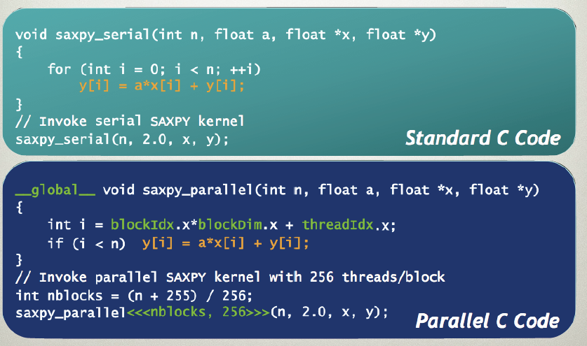
CUDA Program

Slide 13
LQCD Calculation at JLAB
Wilson-Dirac Matrix
  M = -1/2 * Dx,x’ + (4 + m)δx,x’
  M(U) x = b where U is gauge field, b is source spin vector
  Dslash is an application of D to a spinor field.
Quarks live on sites (24 floats each)
  Spinor (4 x 3 complex numbers)
Gluons live on links (18 floats each)
  Gauge field: 3 x 3 color complex matrices (SU(3) matrix)
Most calculations are multiplications of spinors and gauge field.

Slide 14
LQCD at JLAB
1 output quark site
(24 floats)
2 x 4 input quark site
(24 x 8 floats)
2 x 4 input gluon links
(18 x 8 floats)
1320 Flops/each site
4
Total memory: 4 x 32 x (24 + 4 x18) = 384 MB

Slide 15
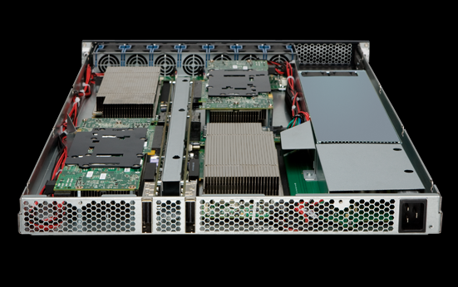
LQCD at JLAB
Dslash/Clover on Intel CPUs
  ~ 20 Gflops on Nehalem 8 cores.
Dslash/Clover on Tesla GPUs
  ~80 Gflops on single C1060
Dlassh/Clover on Multiple GPUs
  ~240 Gflops on 4 C1060 GPUs with MPI

Slide 16
Lessons Learned
Data Parallel
  Any non-data parallel code will slow down applications.
Memory layout
  Avoid memory access conflicts
  Half-warp threads (16 threads) could access all memory in one transaction
Use shared memory or registers
  Local and global memory too slow
    At least 100 times slower

