Slide 1
Ferrule and Fiber Measurements
Ann Marie Carroll
James M^{c}Intyre

Slide 2
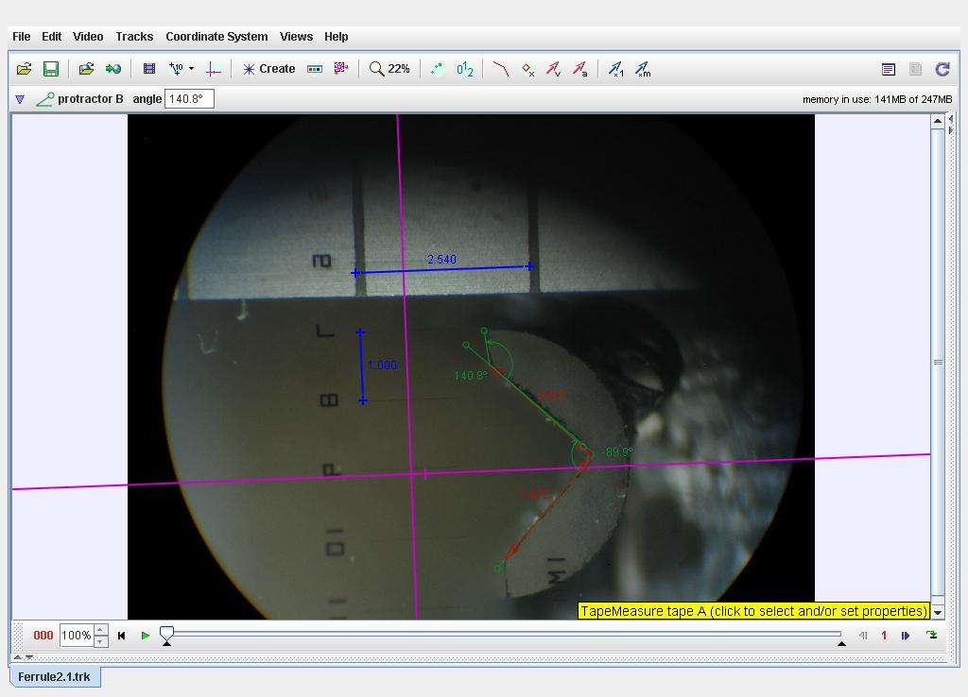

Slide 3
