Slide 1
Tagger Microscope and Diamond Fabrication
Alex Barnes, Ann Marie Carroll, James McIntyre, Brendan Pratt
Feb. 20-22, 2014
GlueX Collaboration Meeting

Slide 2
Outline
Update on fiber construction
  Process overview
  Current status and schedule
Update on final enclosure
Update on electronics and fiber QA
  Current status on electronics
  Current progress on fiber QA
Diamond fabrication
  Ablating status, schedule, explain purchasing process

Slide 3
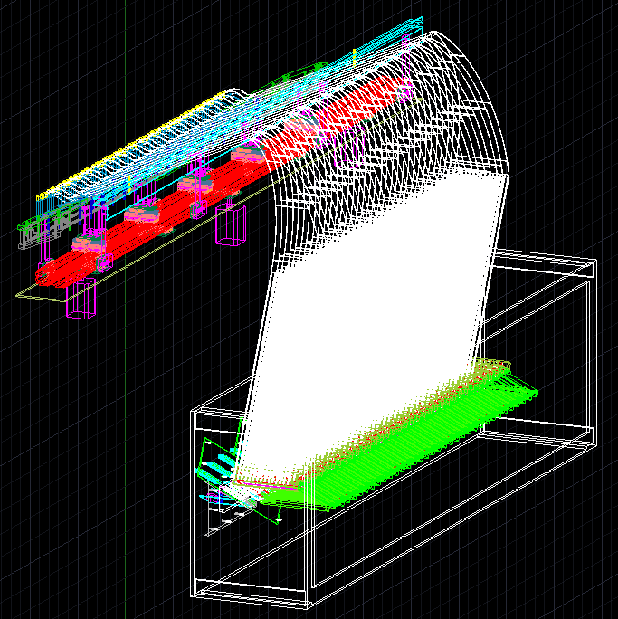
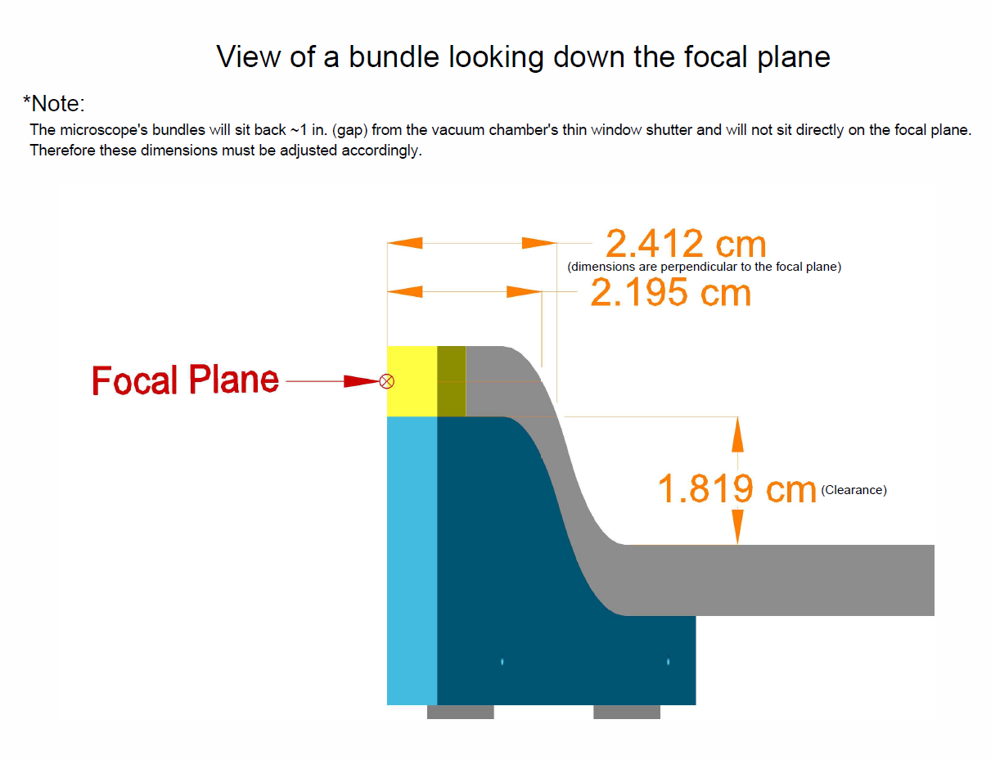
Fiber Bundle Overview
2 cm of scintillating fiber fused to 167 cm of lightguide fiber
30 fused fibers bundled (5x6) together
17 bundles of 30 fibers each
Painted and glued before large bend
Spread out after large bend
Each fiber terminates 0.5 mm above a SiPM
light guide fibers
SiPMs

Slide 4
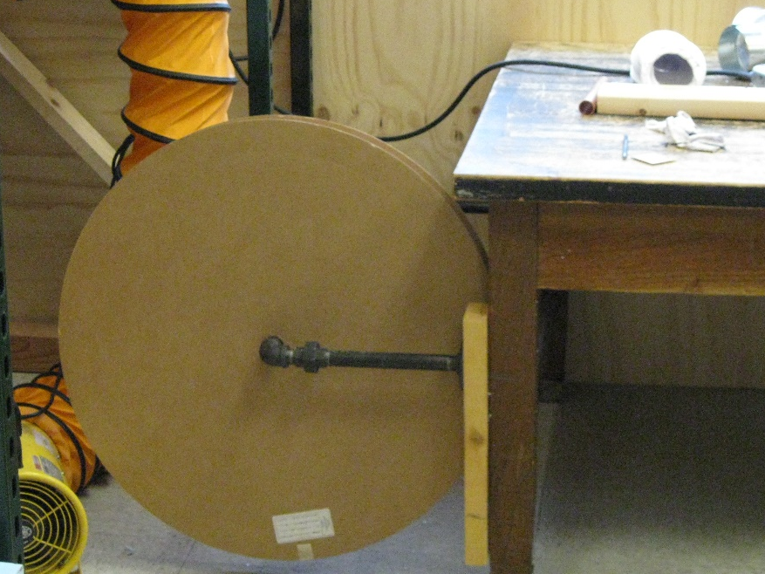
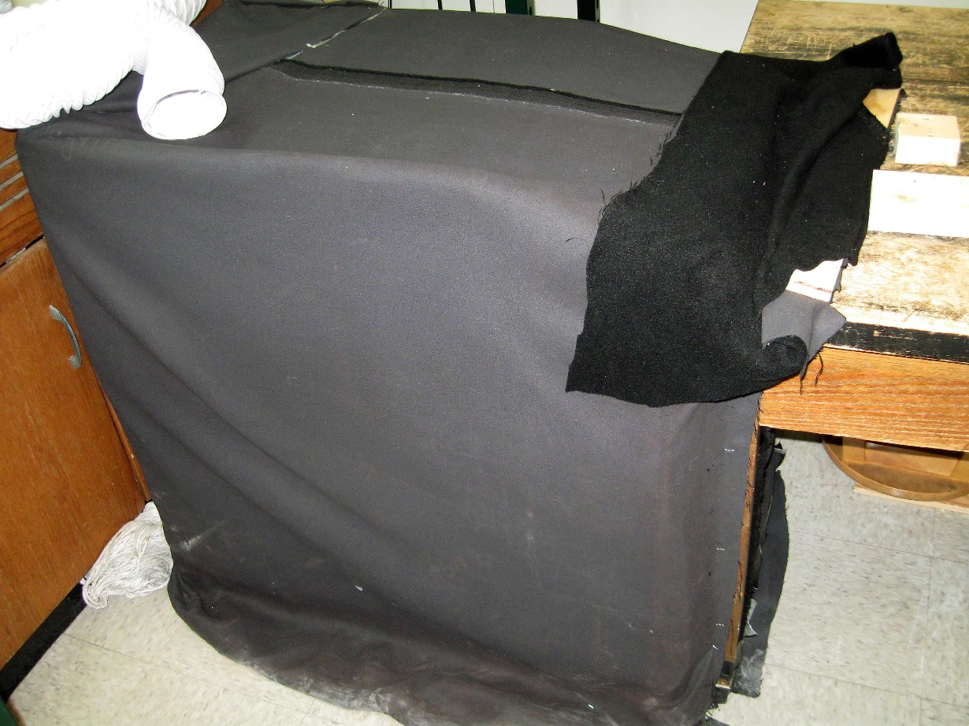
Rough Cut and Measure
800 m of total lightguide fiber used. 166.6 cm long segments.
Each lightguide measured for conformity in 5 places.
Step complete

Slide 5
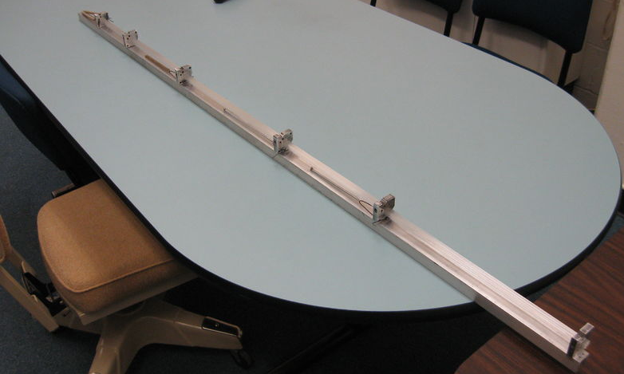
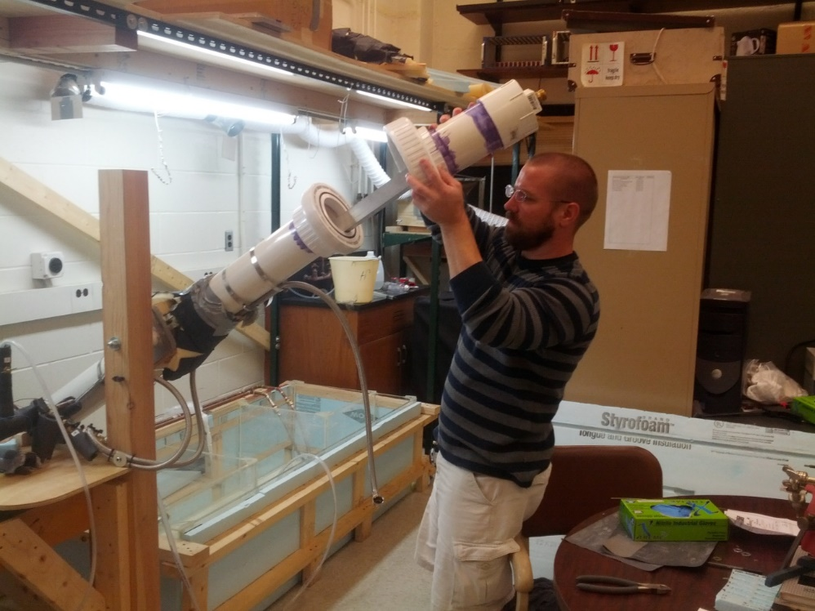
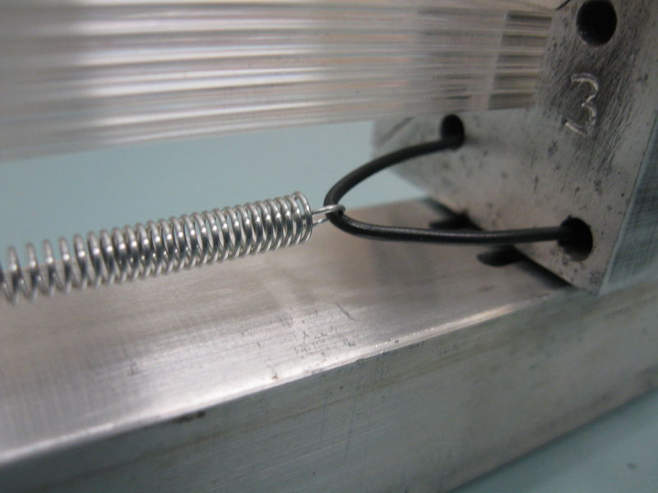
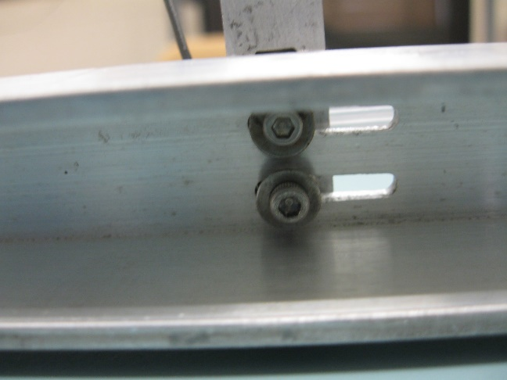
Straightening
Step complete

Slide 6
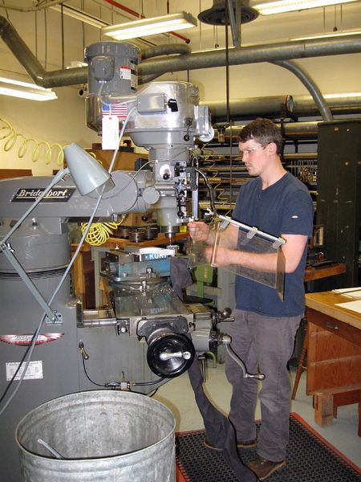
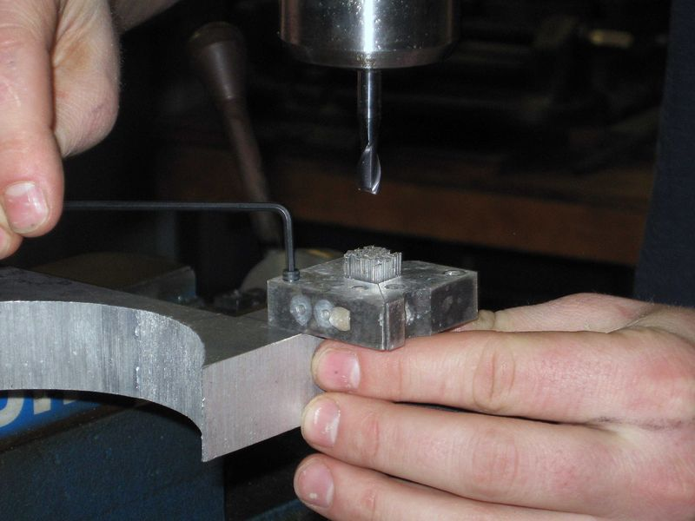
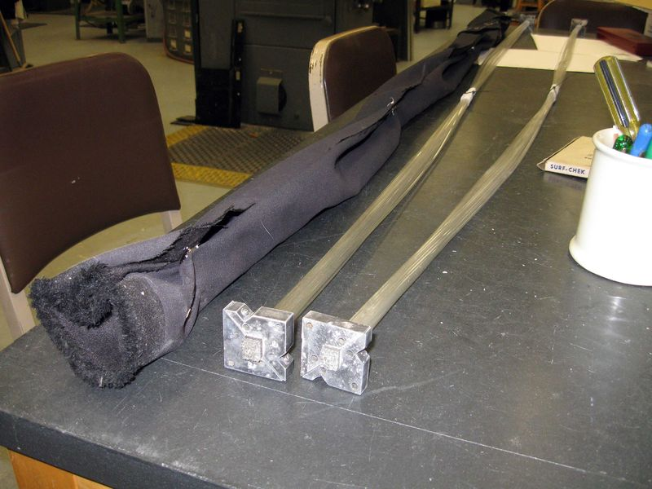
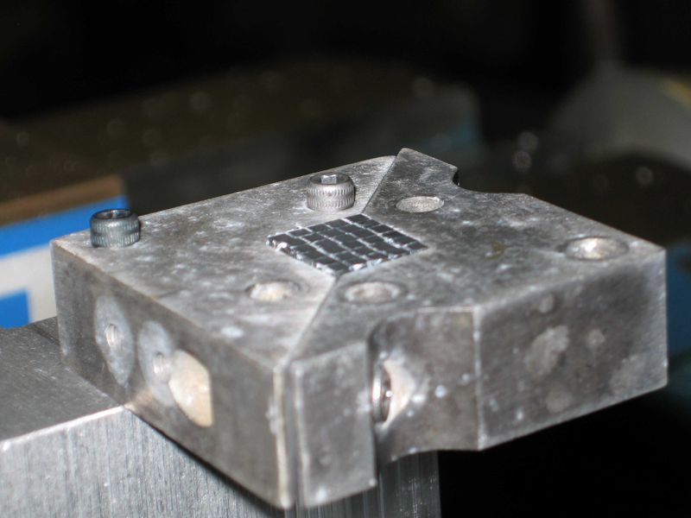
End Milling
Both scintillating and
lightguide fibers are cut
to final size in the physics
machine shop.
Step complete

Slide 7
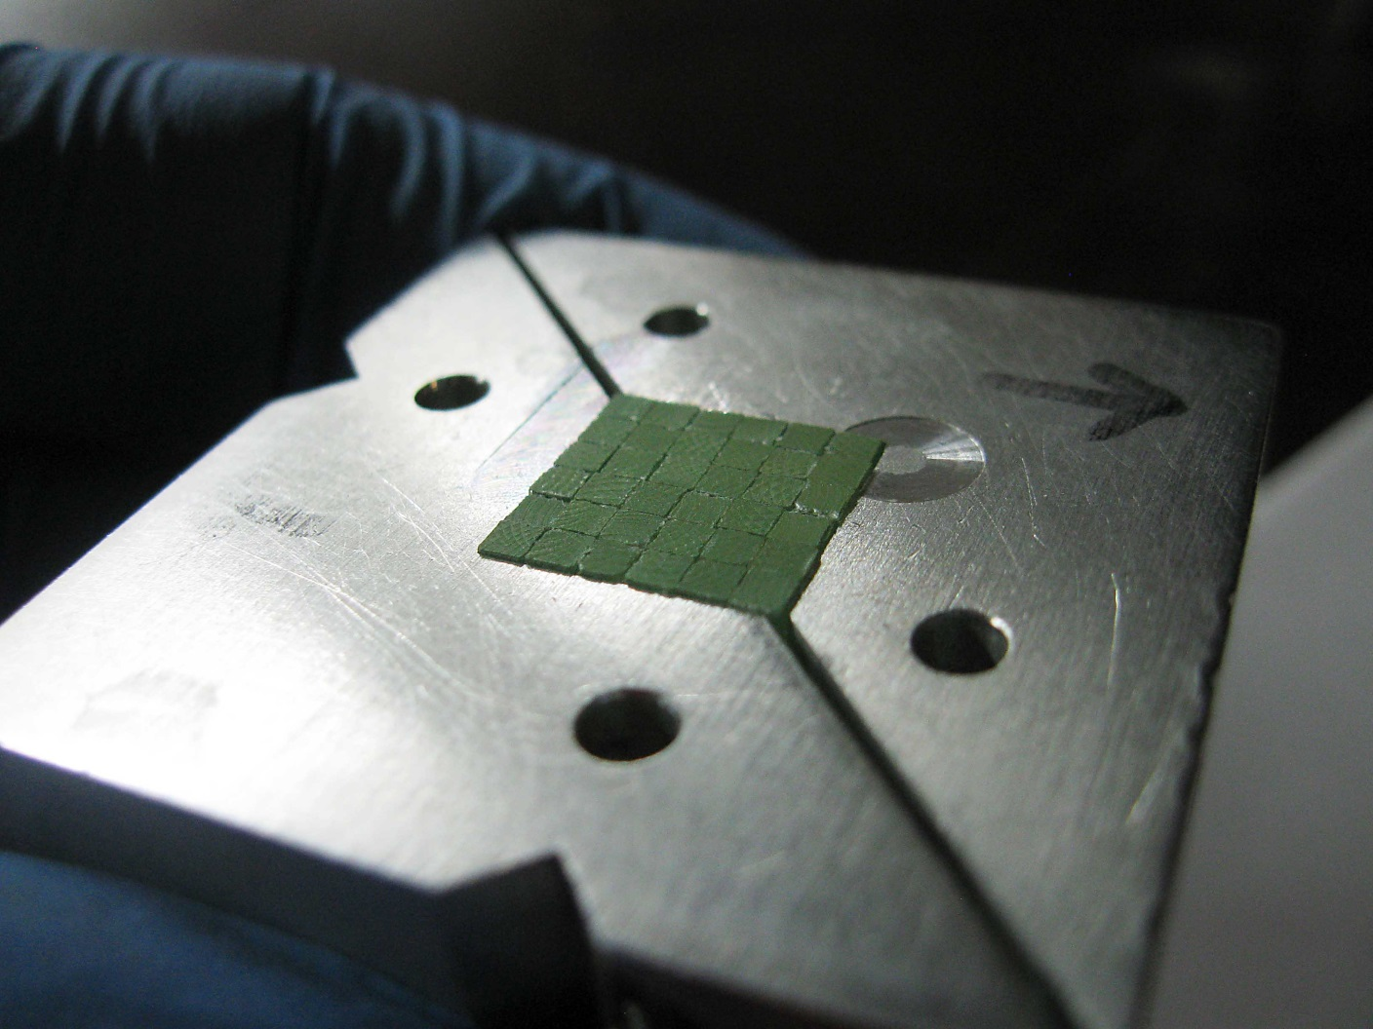
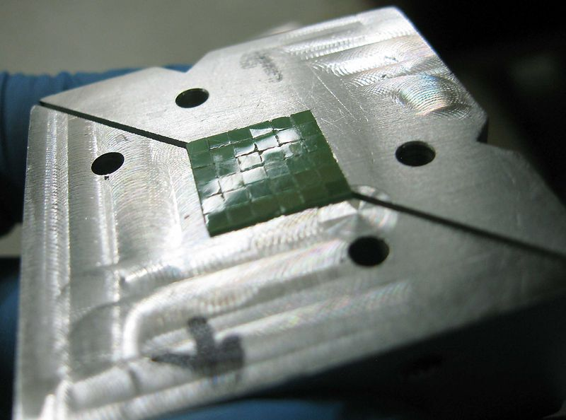
Polishing
Before
After
Step complete

Slide 8
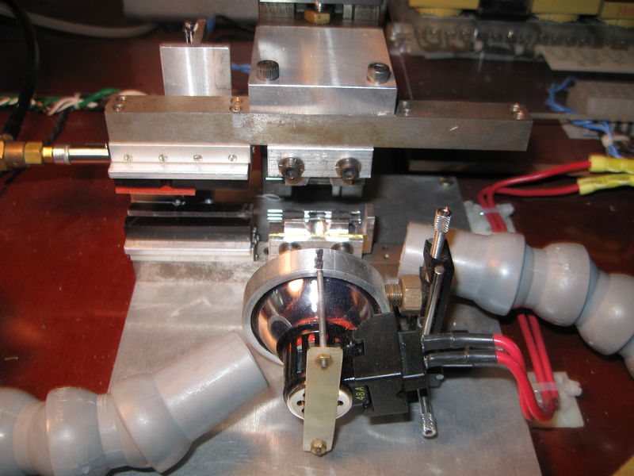
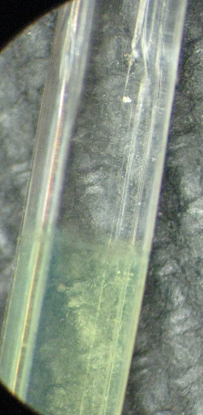
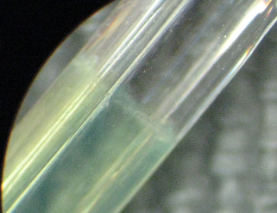
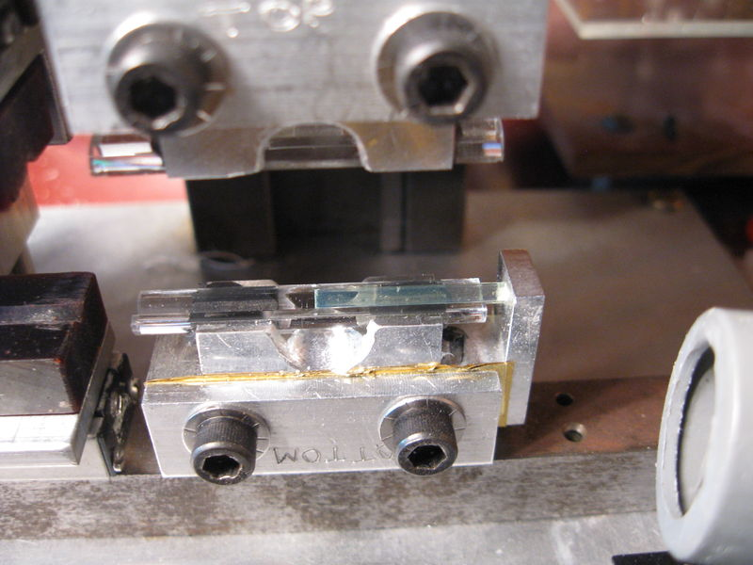
Fusing
AV photo lamp
Fibers enclosed in quartz ferrules
Tangential and linear pressure controls
Fuses hold 800 – 1000 g of transverse weight before breaking
  Stronger than optical epoxy
  More than enough strength to withstand bending
Step complete

Slide 9
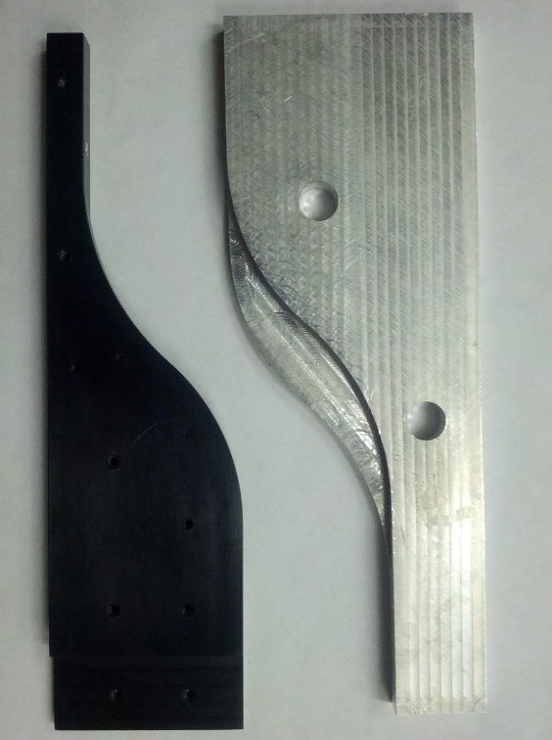
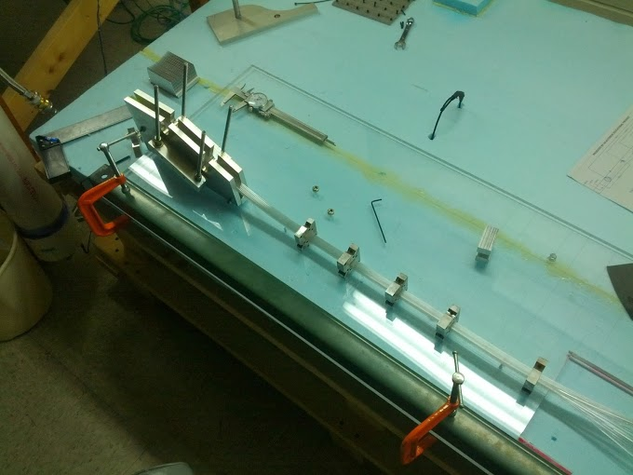
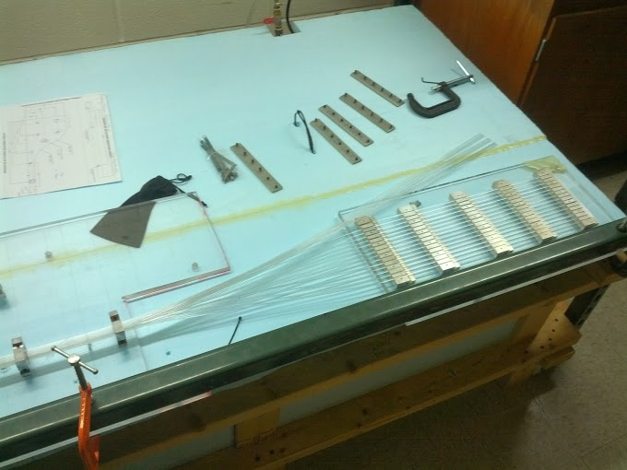
Bending
Fused fibers are bundled together
S-bend in bundled fibers on one end
Fibers spread out into chimneys at the other end
Heated up to 160⁰ F over a 12 hour period, then bent

Slide 10
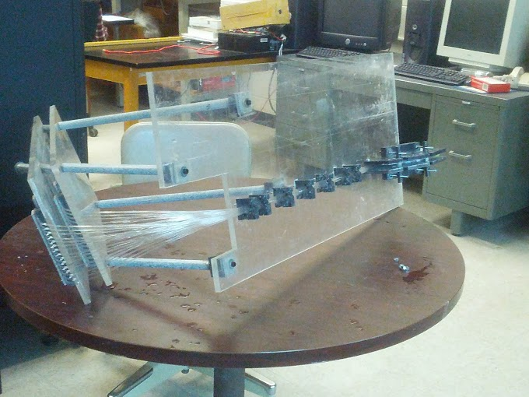
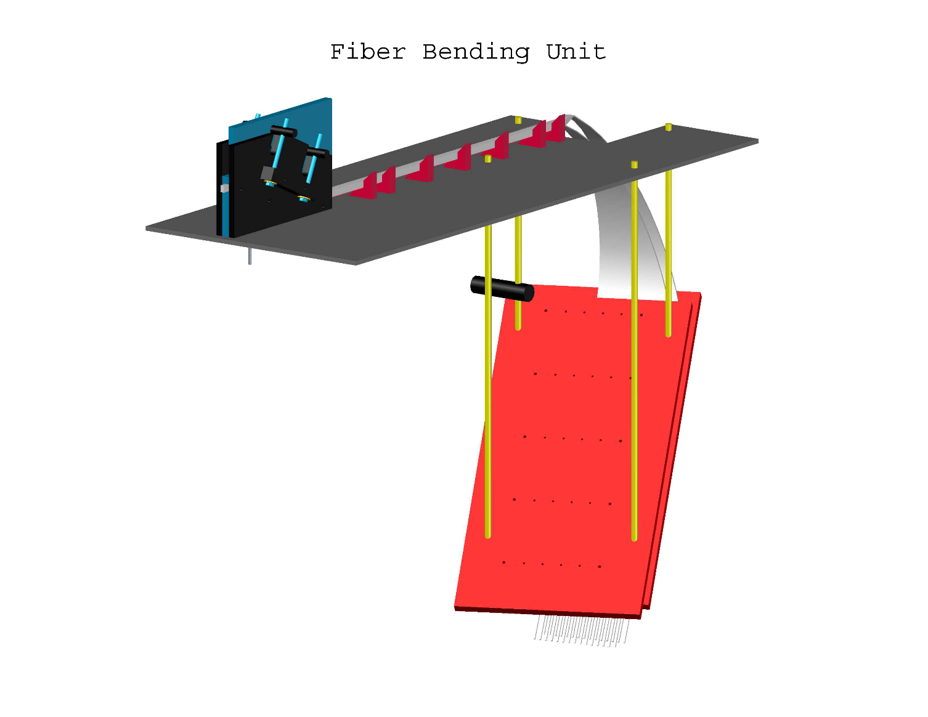
After Bending
7 of 17 bundles bent

Slide 11
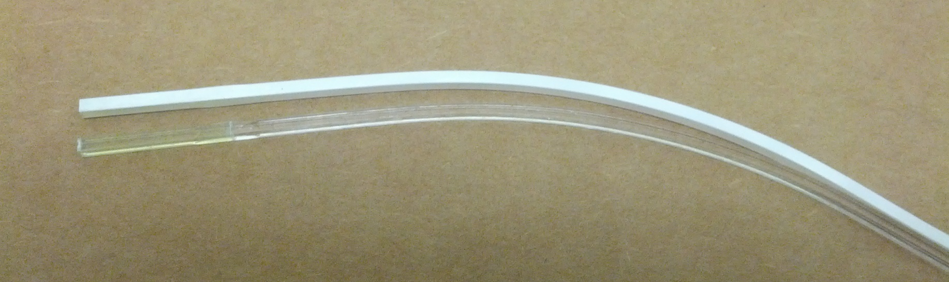
Painting
Water based titanium dioxide paint
10-20 microns thick
Painted only where fibers will contact one another
5 of 17 bundles painted

Slide 12
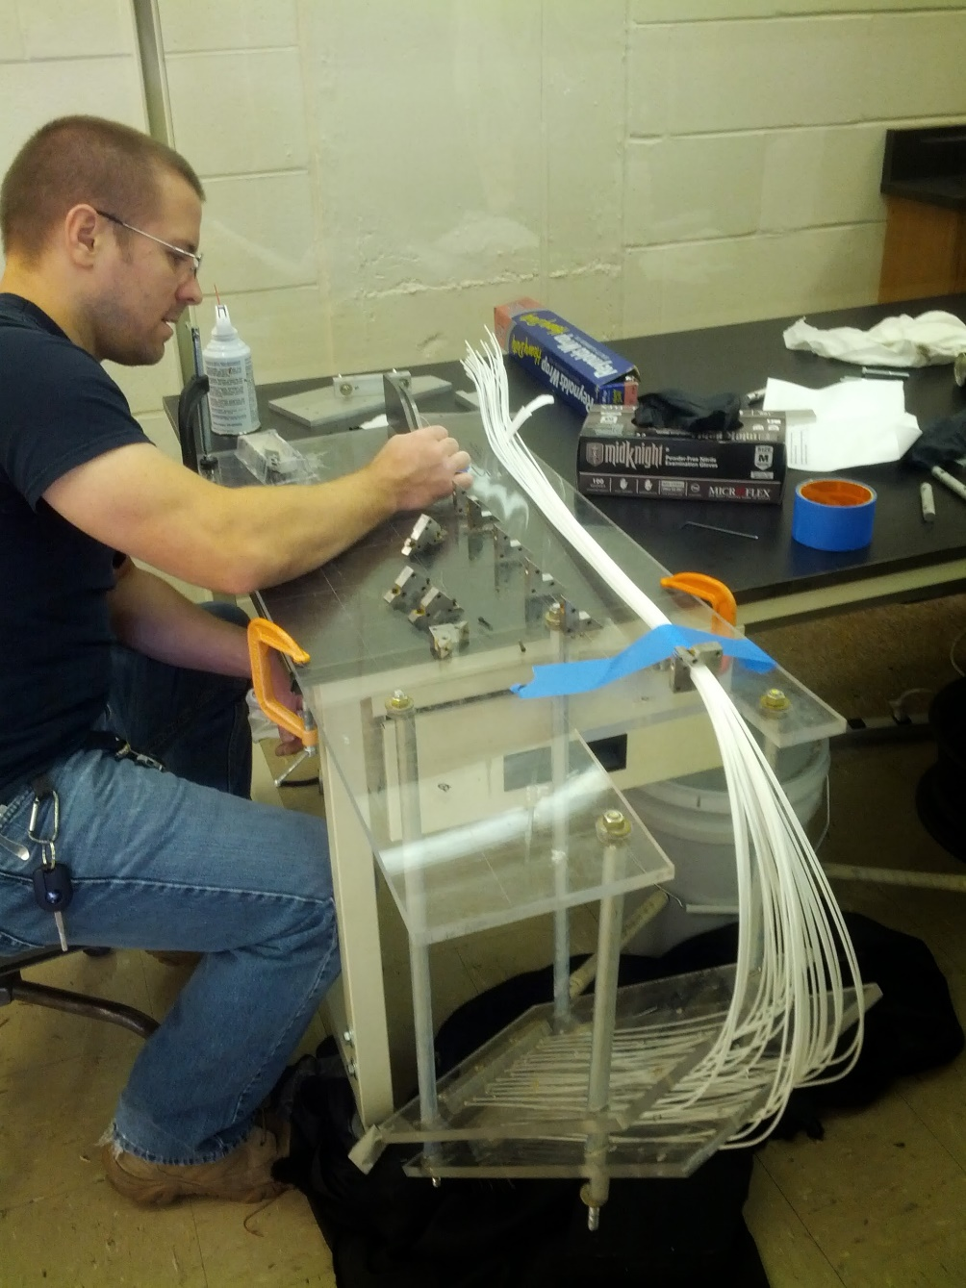
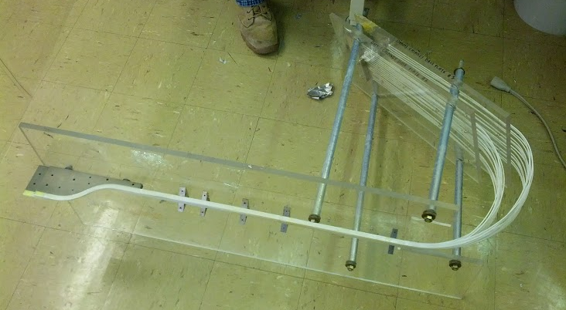
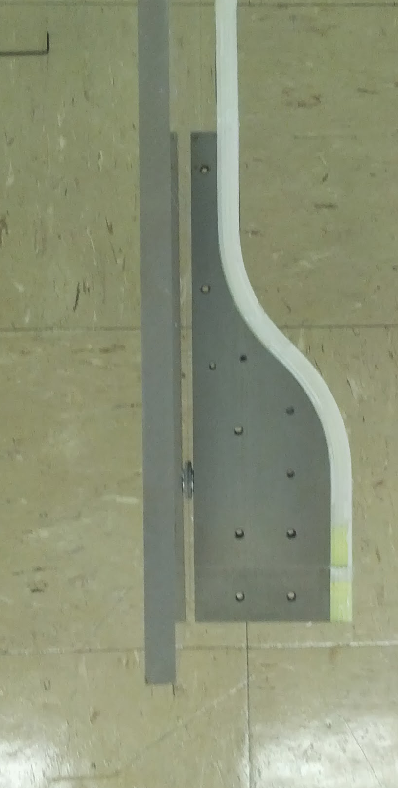
Gluing
Glued through straight portion
Fibers permanently
attached to metal mount
1 of 17 bundles glued… more to be glued soon!

Slide 13
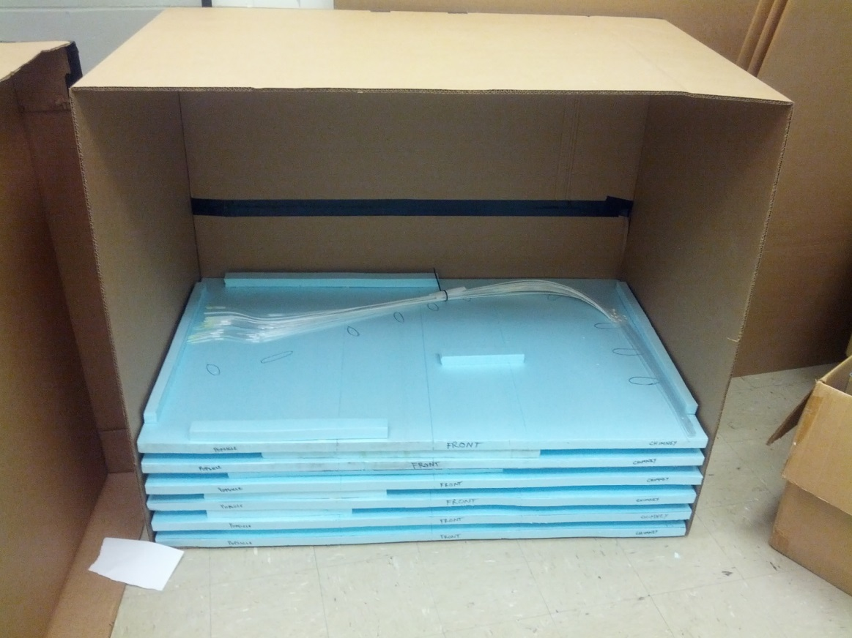
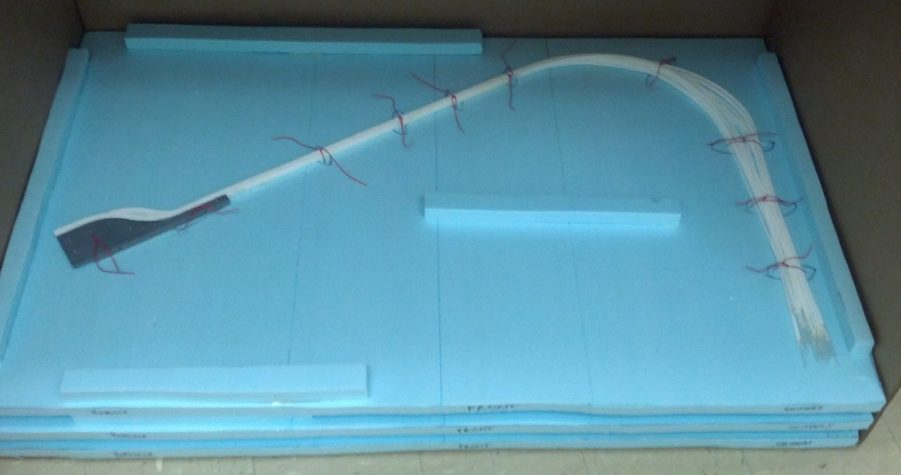
Shipping Preparations
Traveler Documentation (stored here)
Fibers strapped to Styrofoam
Traveler documentation included in with each bundle
Fibers will travel with members of the UConn team to JLab

Slide 14
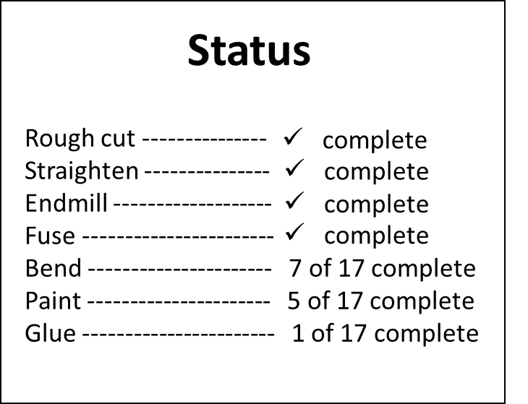
Schedule for Completion of Fiber Bundles
Bend 2 bundles per week
5 weeks until all fibers are bent
When not bending, paint and glue
New completion date of April 8, 2014

Slide 15
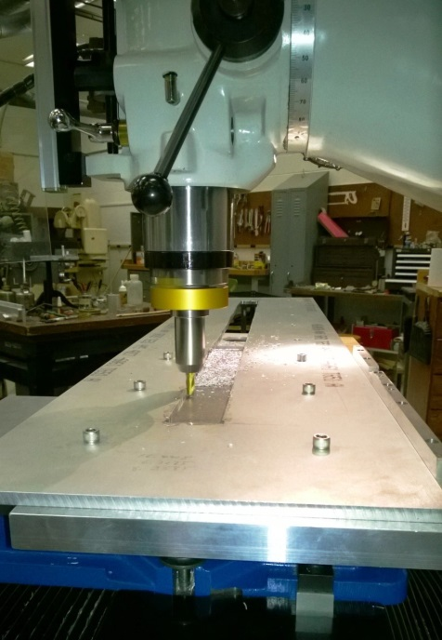

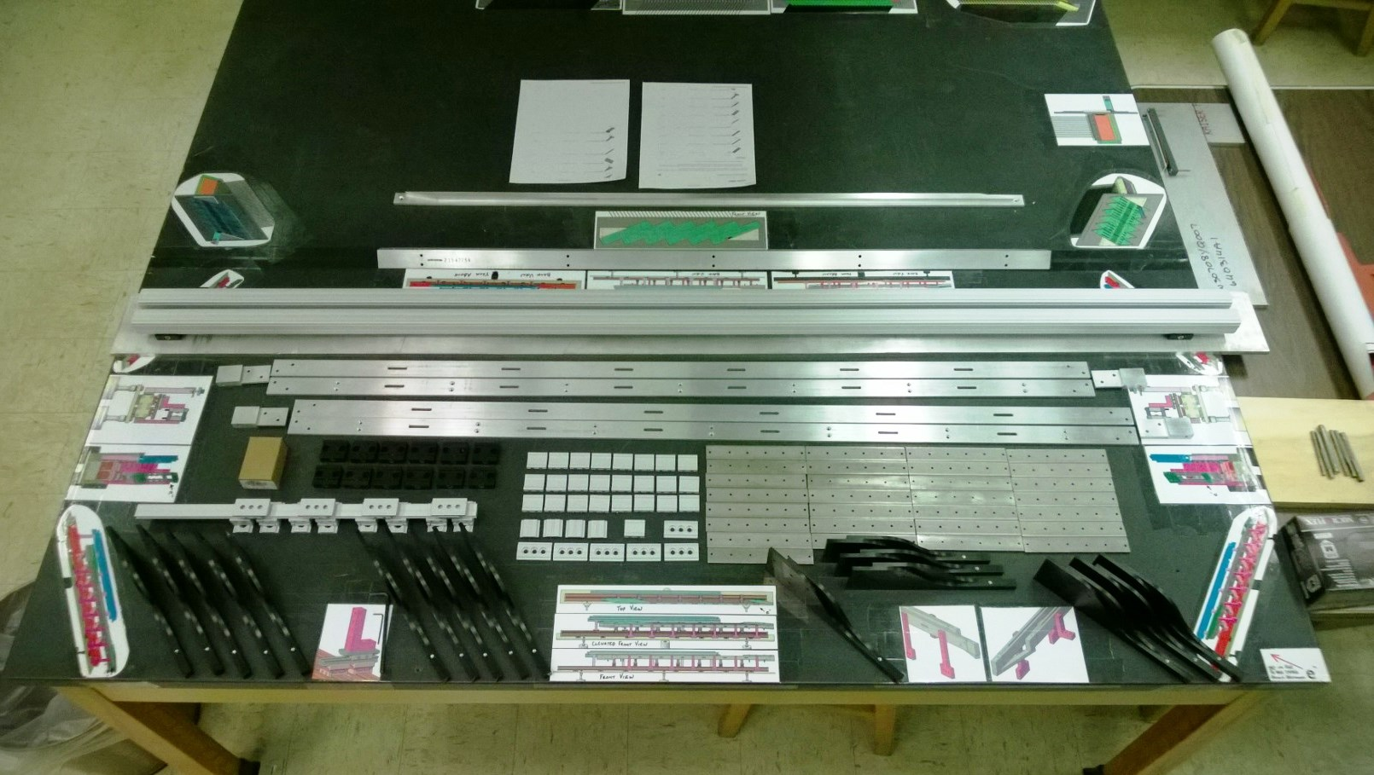
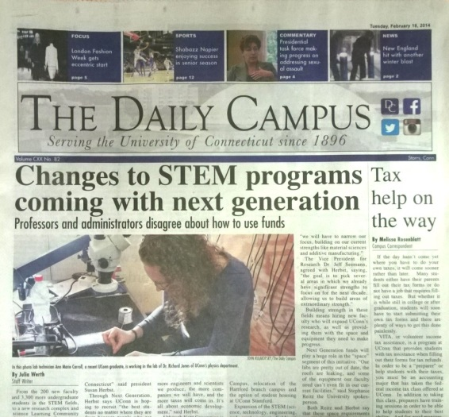
Upper & Lower
Enclosures
Currently have 238 of 364 required components
Work at 2 of 4 machine shops complete
Last 126 components scheduled to arrive < 2 weeks

Slide 16
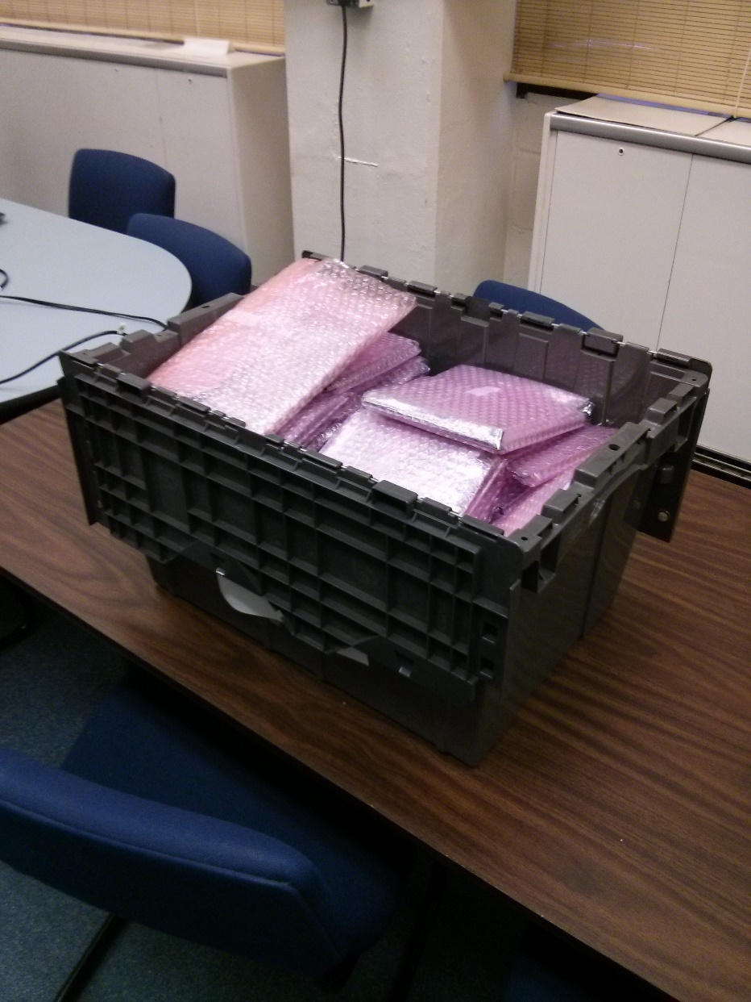
Electronics
Undergraduate researcher is calibrating the DAC offsets on the control boards
Fernando, Nick and Chris have finished attaching and testing the SiPMs on the preamps
Boards have arrived at UConn
Already have 2 which are being used for fiber QA

Slide 17
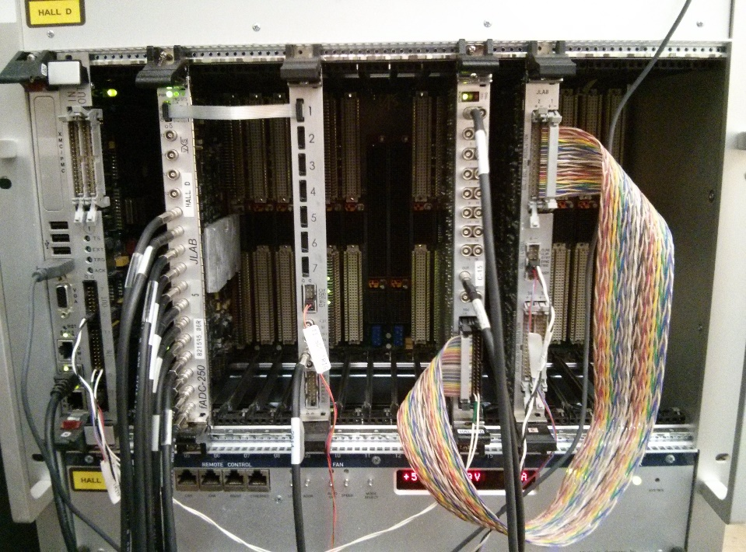
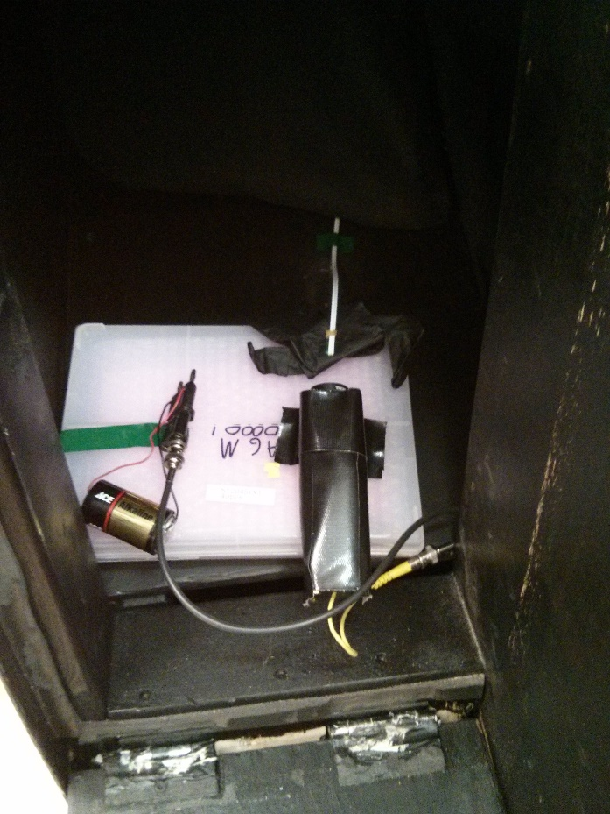
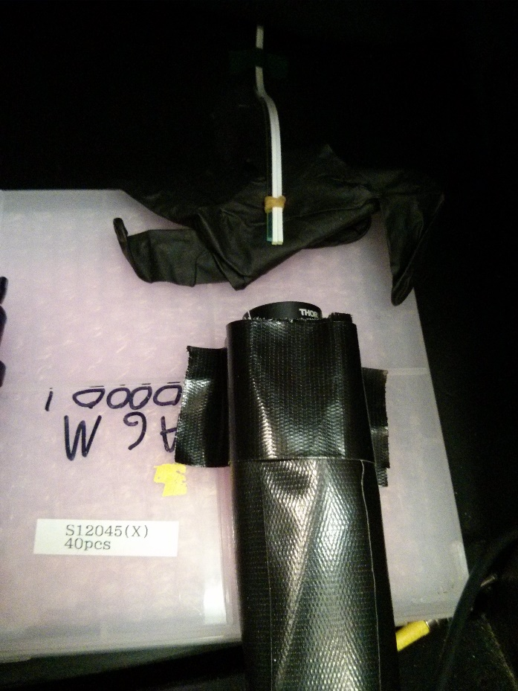
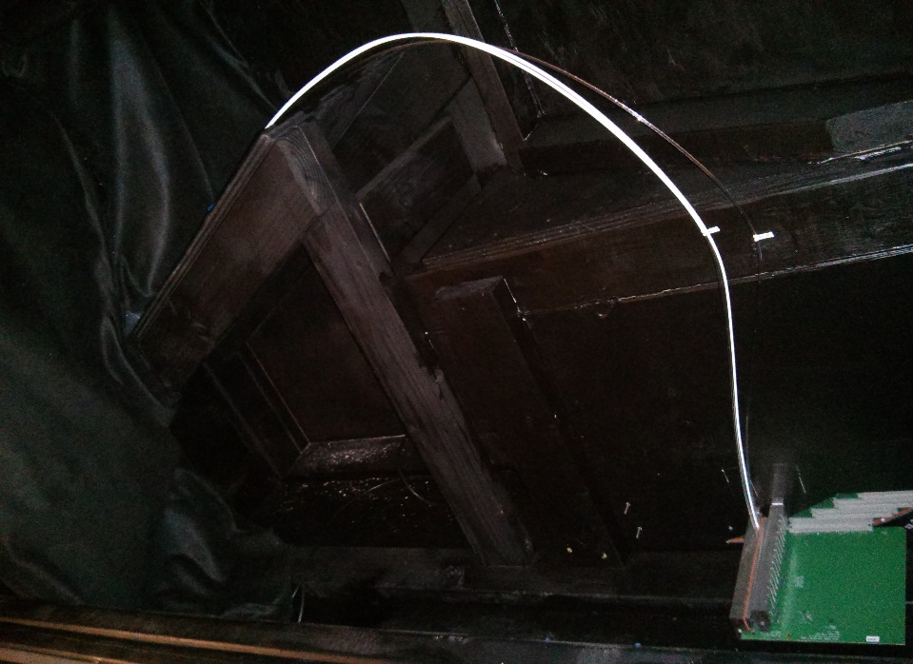
Fiber QA
Feb. 20-22, 2014

Slide 18
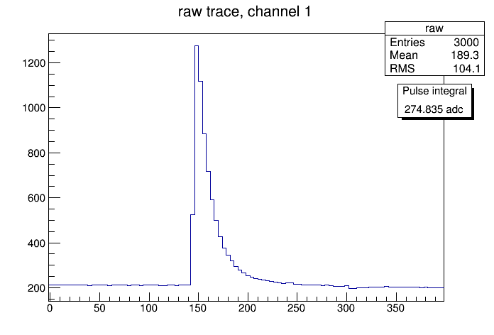
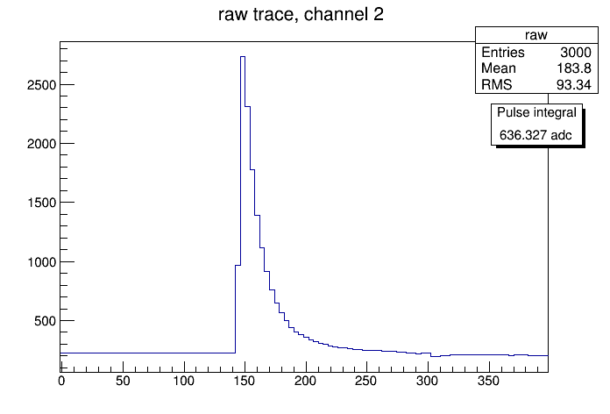

Relative comparison between fibers
Fully painted fiber
Averaged over all events
Pulse integral of 275 pixels
Unpainted fiber
Averaged over all events
Pulse integral of 636 pixels
Partially painted fiber
Averaged over all events
Pulse integral of 248 pixels
Channels triggered by separate pulser circuit
All channels measured at the same time
Single pixel = ~1 ADC count

Slide 19
Diamonds:2014
Brendan Pratt
Richard Jones
University of Connecticut

Slide 20
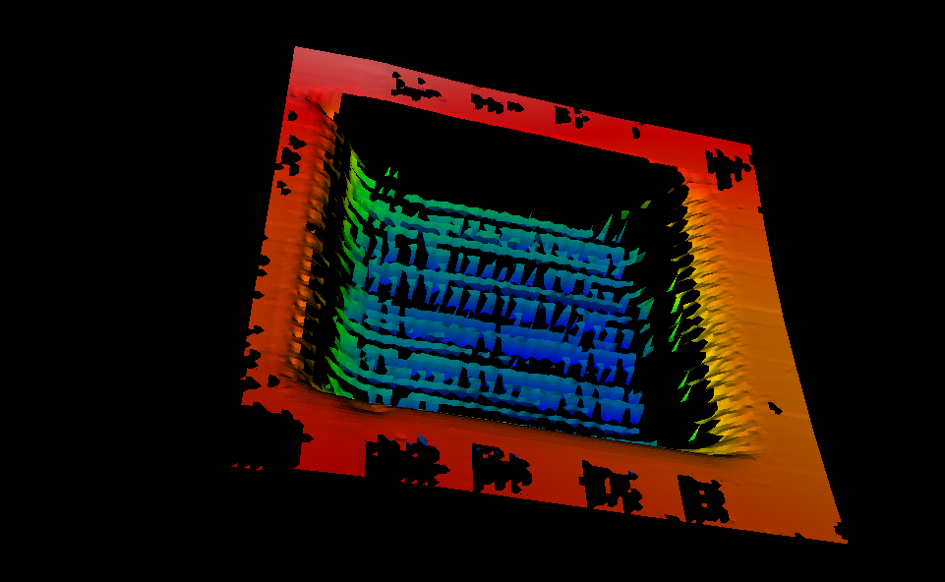
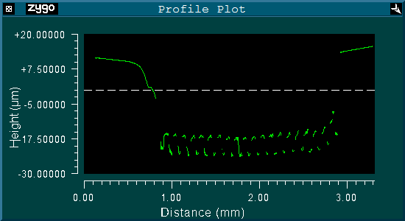
From 18 months ago…
best yet,
but took >40 hours

Slide 21
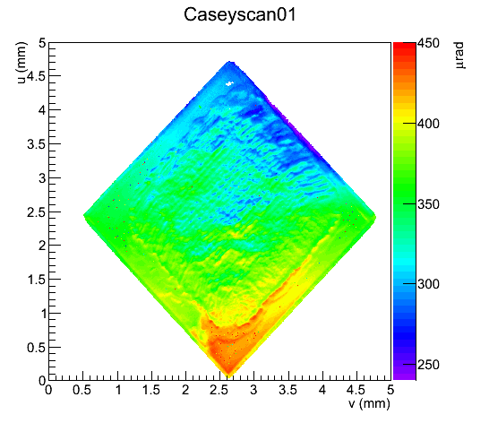
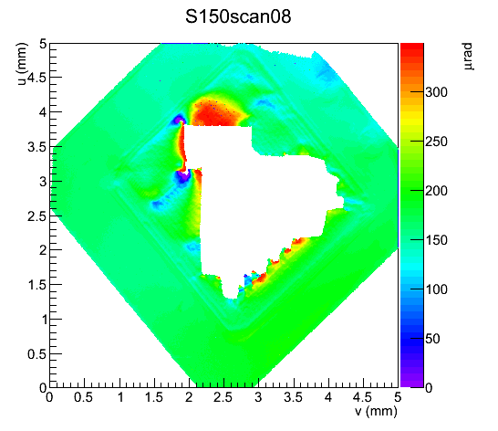
Much faster,
but sometimes too quick!

Slide 22
focused laser pulse
is there a better idea?
Translation stage moves in X while laser continues to pulse

Slide 23
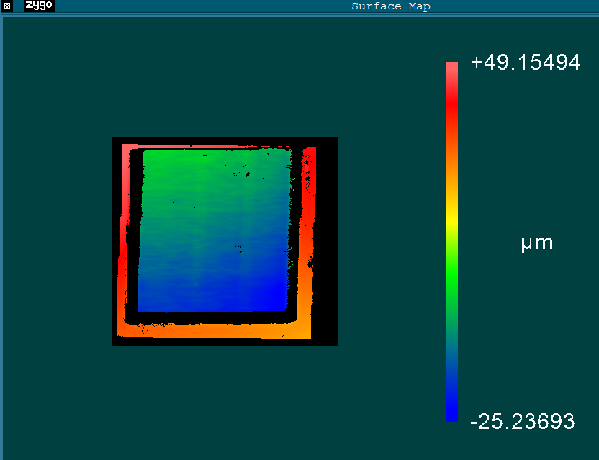
3x3x0.3mm crystal
Apparent gradient from tilt on microscope table
2.6mmx2.6mm window

Slide 24
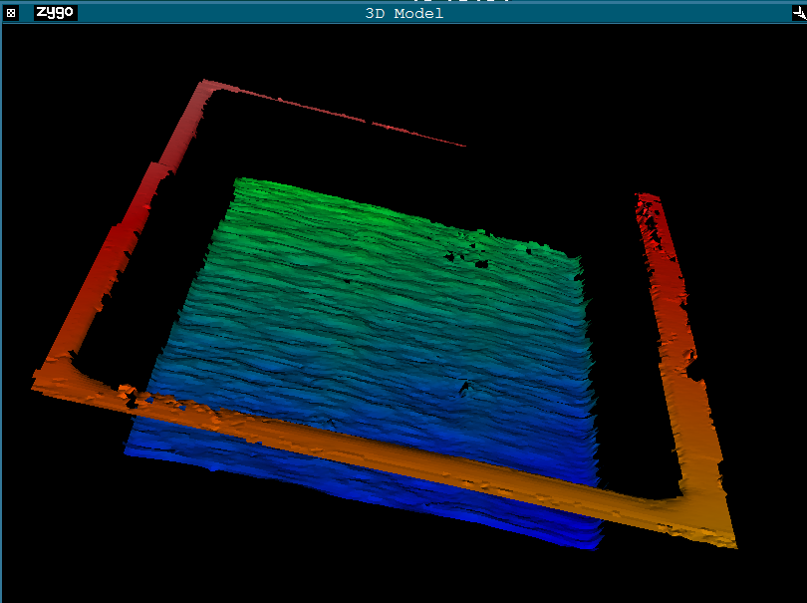

Slide 25
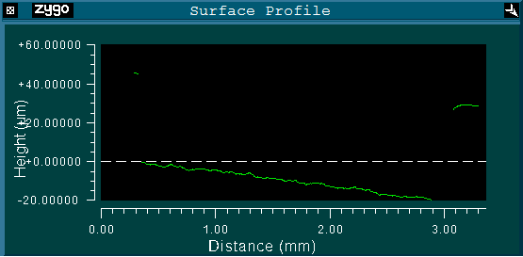
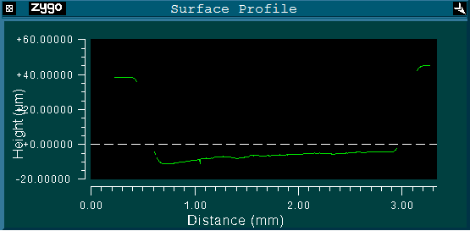
After 18 passes
cut through X
about 50μm depth
cut through Y

Slide 26
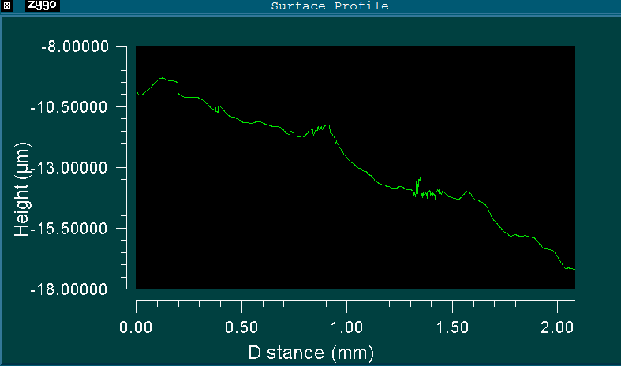
Ablated diamond,
nearly as smooth as butter
Butter
(not real butter data)
RMS about 400nm
Much better than +/-5micron spec

Slide 27
Conclusions from new raster
Excellent surface uniformity
Retains picture frame and steep edges
Cuts uniformly over long periods of time
Each pass is completed on the order of 15min (for 2.6x2.6mm²) active area, with a cut rate of 3microns per pass.
Cut rate scales with area

Slide 28
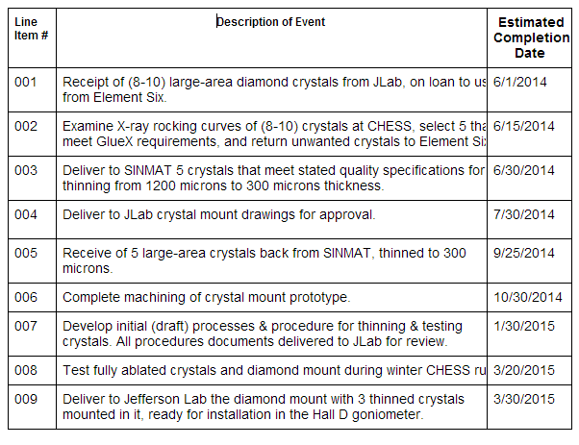
Upcoming Diamond Milestones UConn

