Slide 1

Tagger Microscope
Construction Plan
GlueX Collaboration Meeting
JLab, Feb. 16-18, 2012

Slide 2
Outline
Where we left off …
    Enclosure design
    Fiber construction
    Electronics upgrade
Current Status
Construction Plans
Manpower

Slide 3
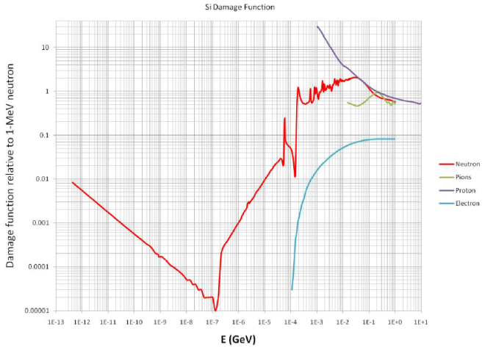
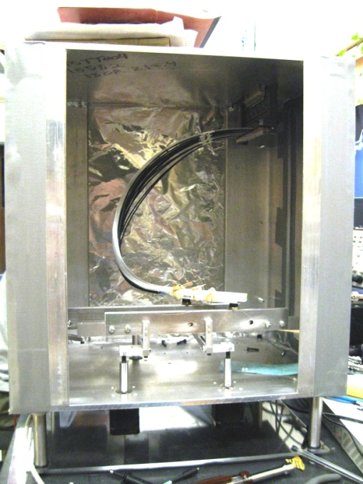
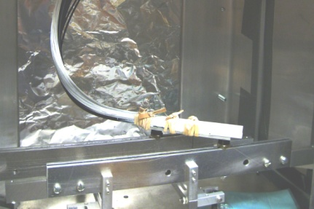
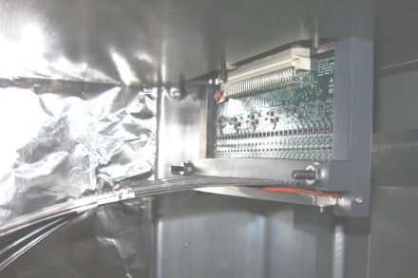
Tagger Microscope Enclosure
SiPMs sensitive to neutron radiation
  Solution ⇒ Separate and Shield Electronics (i.e. SiPMs)
Shielding Material
(Polyethylene)
Effective damage to Si detector
Relative to 1MeV neutron

Slide 4
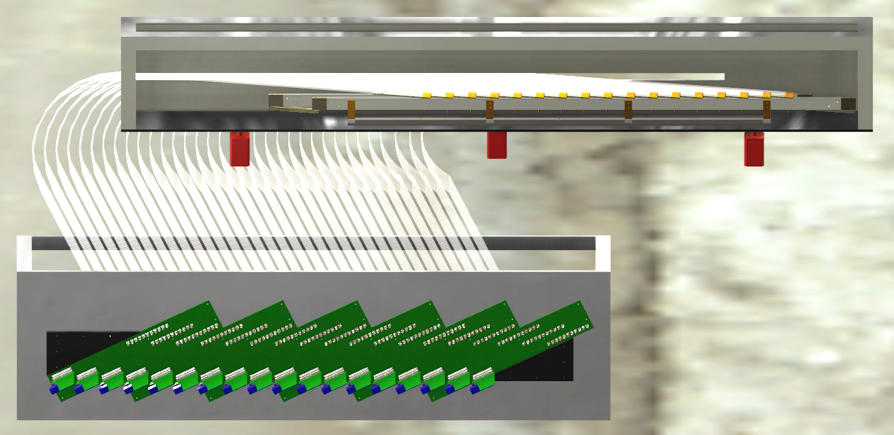
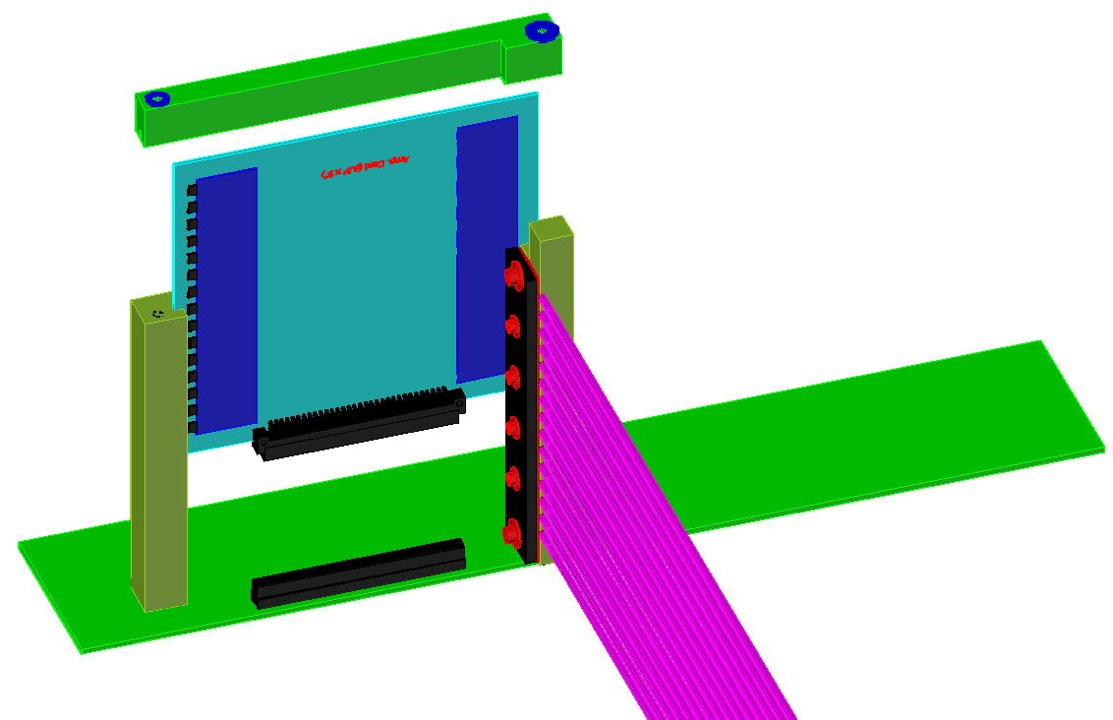
Tagger Microscope Enclosure
Redesign Complete
Advantages:
  Reduces curvature of waveguides from 180º to ~90º
  Allows for 20 cm of Polyethylene shielding
  Easier access to pre-amp cards
    One cover to remove, no need to disturb other electronics
Amplifier
Board
Backplane Board

Slide 5
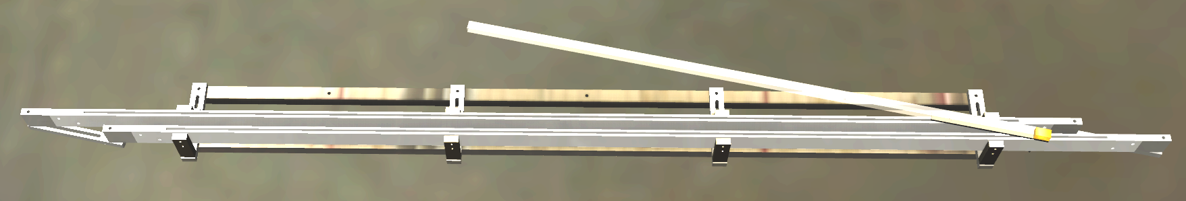
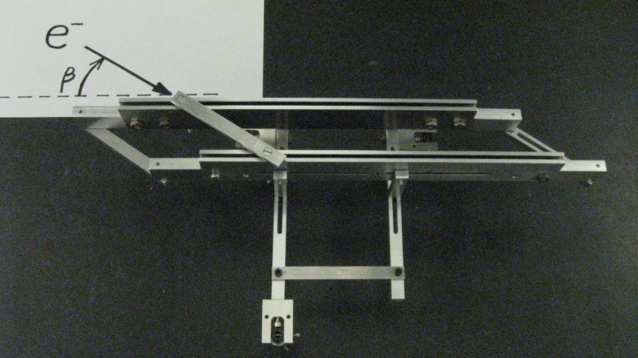
Tagger Microscope Enclosure
Parallel Railings
  Designed for a β angle between 10º – 30º
  Current design β = 11.9º
e⁻

Slide 6

Tagger Microscope Enclosure
Tagger Microscope 3-D Movie

Slide 7
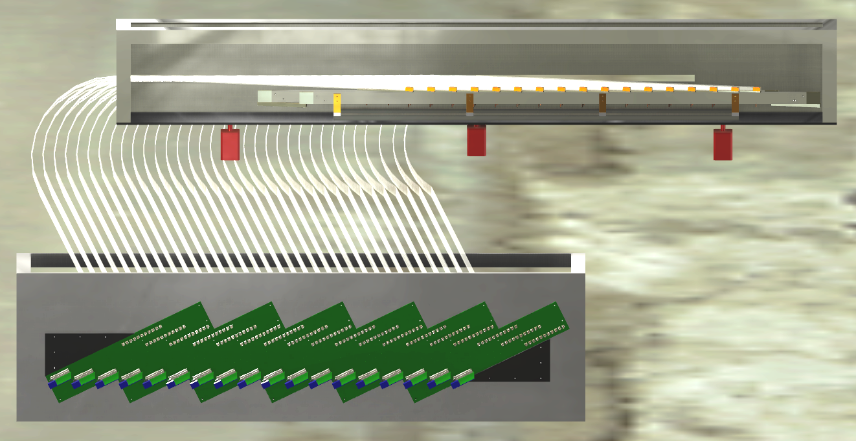
Tagger Microscope Enclosure

Slide 8
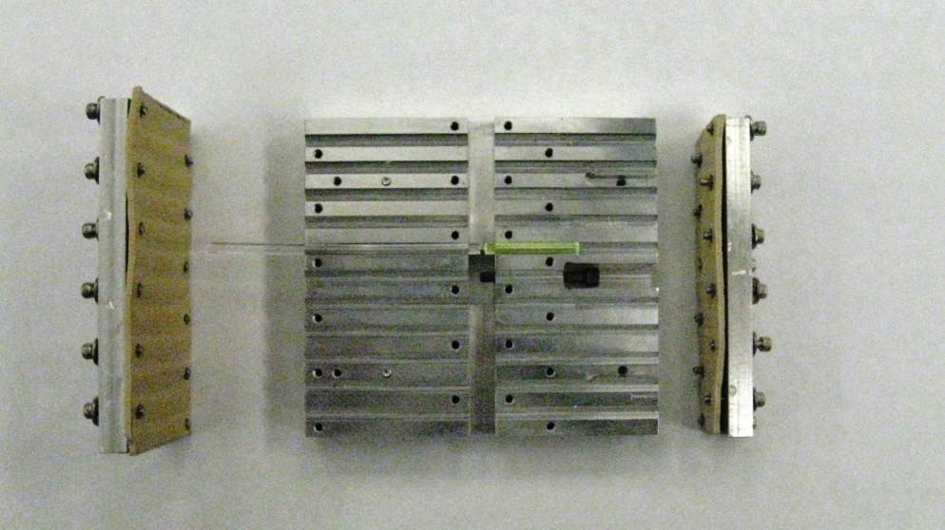
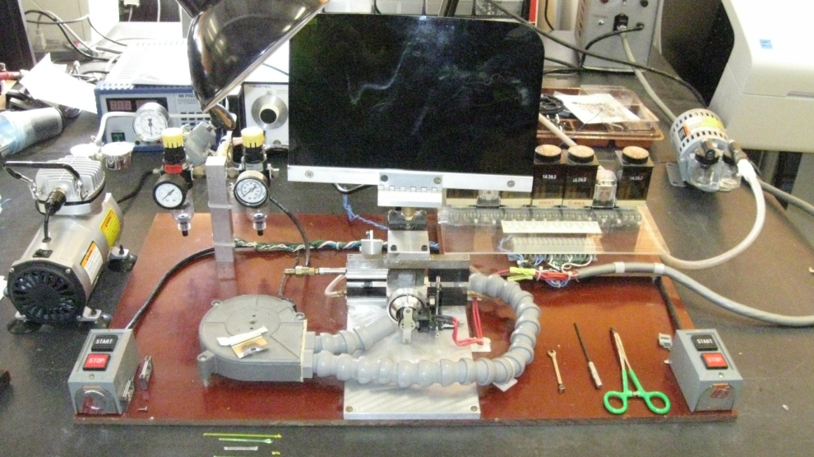
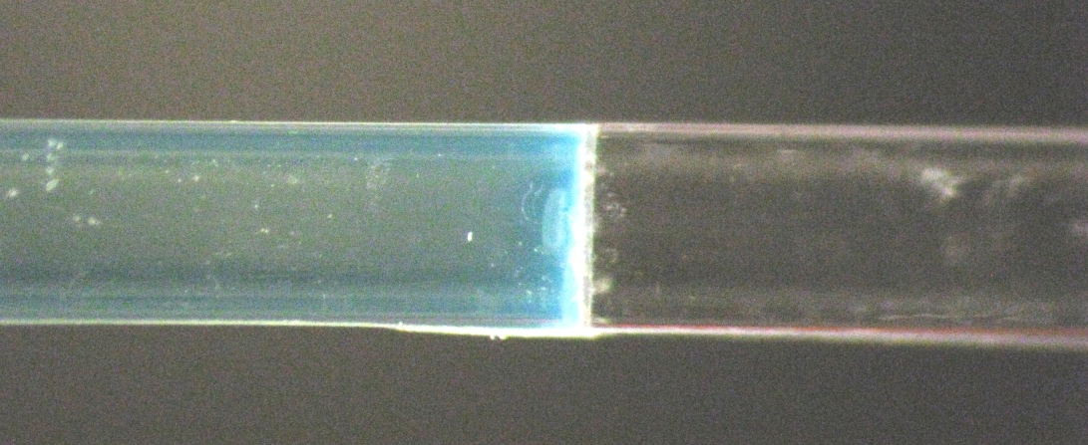
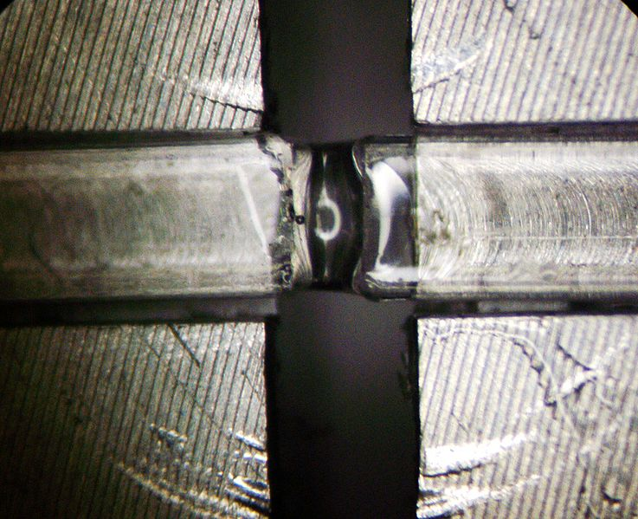
Tagger Microscope Fibers
Fusing vs. Gluing of Fibers (MSU Splicing Unit)
  Specialized glass ferrules received 6 Feb 2012
Vs.
Use of MSU Splicing Unit courtesy of Ron Richards

Slide 9
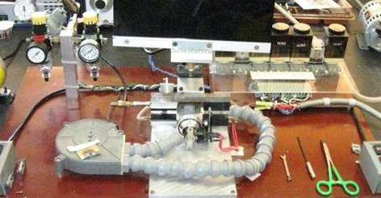
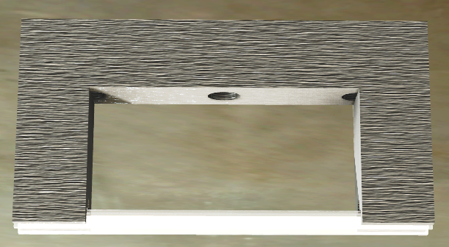
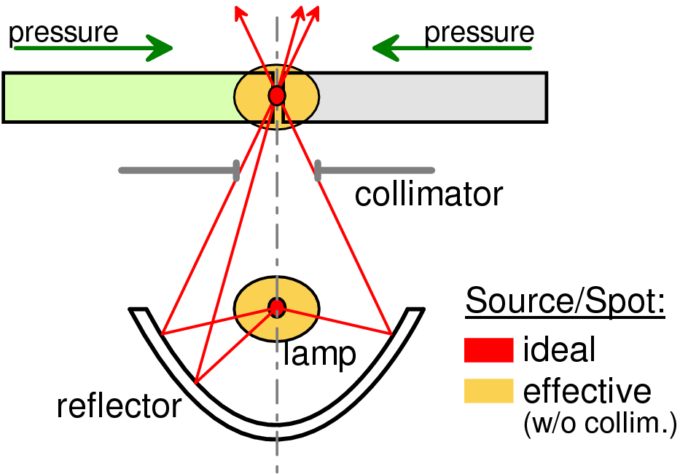
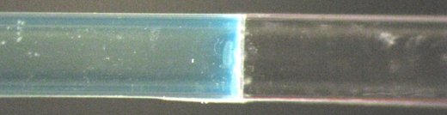
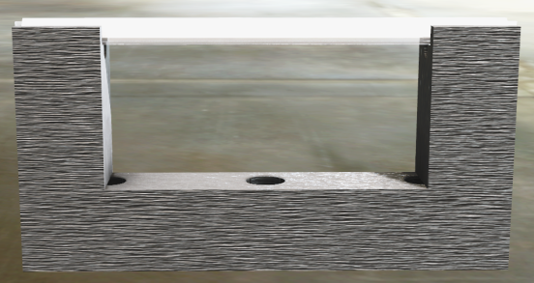
Tagger Microscope Fibers
Splicing Collar ready for fabrication

Slide 10
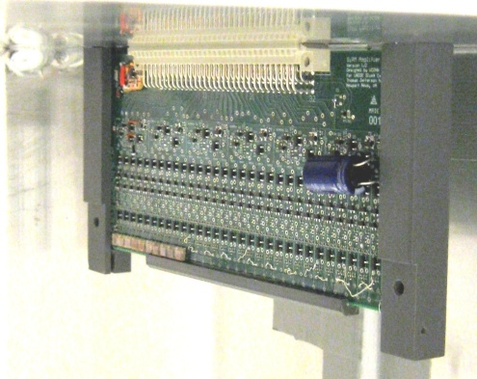
Tagger Microscope Electronics
Preamplifier Revision
  Layout completely redone from scratch
    template provided by Fernando
    ground flows between long signal traces
    better isolation between input and output stages
    reduced channel density
    impedance matching of outgoing signal traces
  Fabricated and assembled by Sierra Circuits and is estimated to arrive at UConn this week
  Bench tests using prototype enclosure will be sufficient to approve the revised design for production

Slide 11
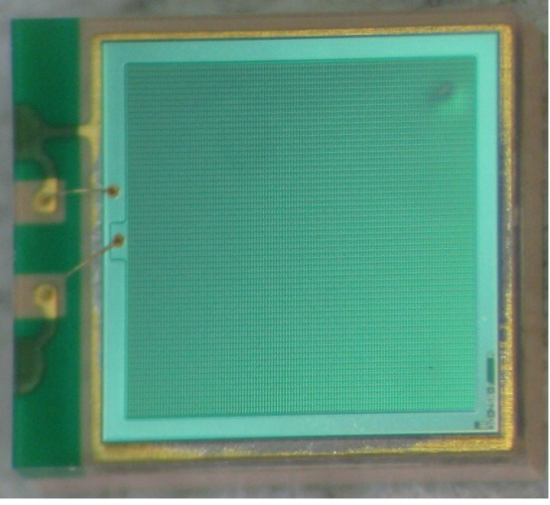
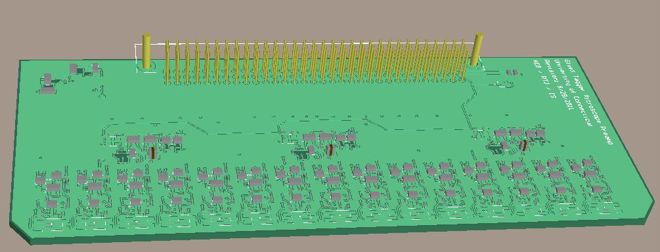
Tagger Microscope Electronics
Hamamatsu SiPMs received
Most in good condition
Hamamatsu was contacted about a couple unexpected features
  Dent doesn’t effect performance
  Given procedure for cleaning residual packing material
Currently finalizing our approach to precise placement of SiPMs
Once the SiPMs are attached we will perform a bench tests using the tagger microscope prototype
A report of the findings will be given once testing is complete

Slide 12
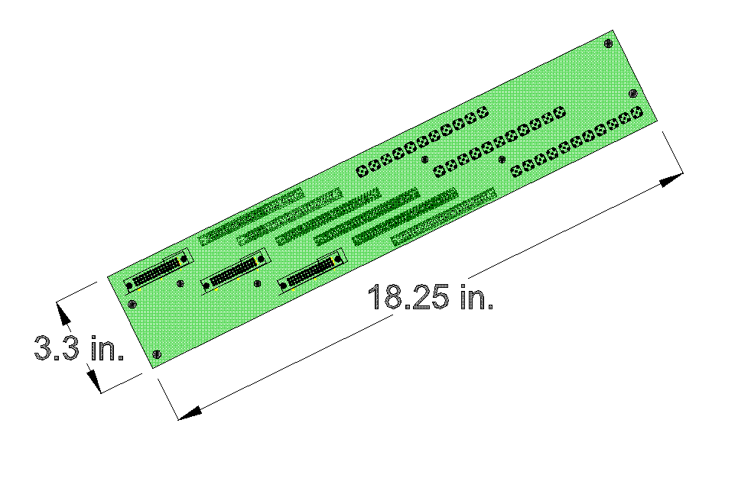
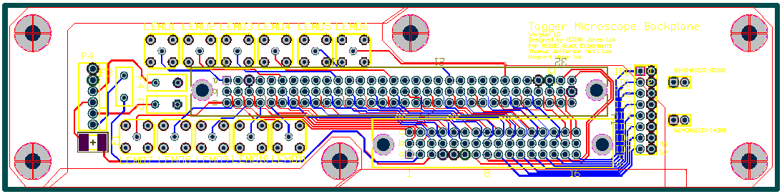
Tagger Microscope Electronics
Backplane Revision
  6 Preamplifier boards per Backplane
    Single board on old version
  New design does not require removal to access preamp. boards
  Better isolation between input and output stages

Slide 13
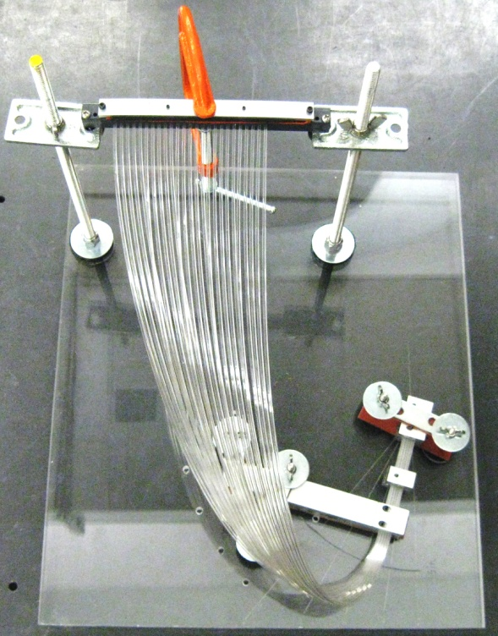
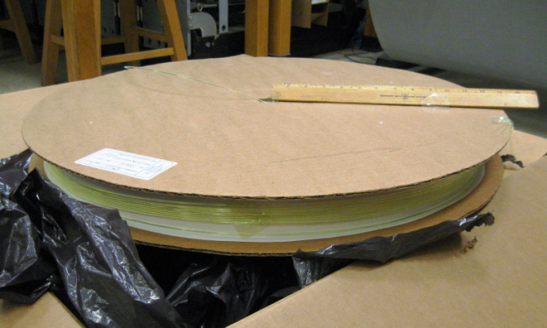
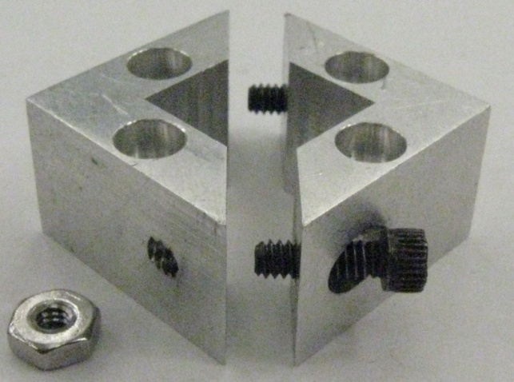
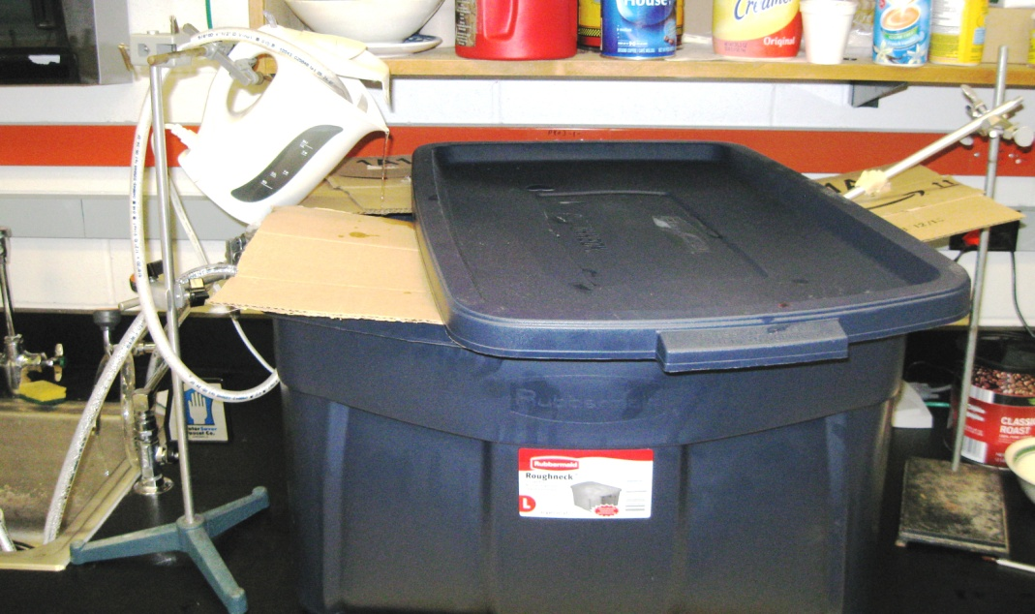
Tagger Microscope Construction Plan
Three Main Stages of Construction
  1. Bundle Preparation
    Straightening of fiber using heated water

Slide 14
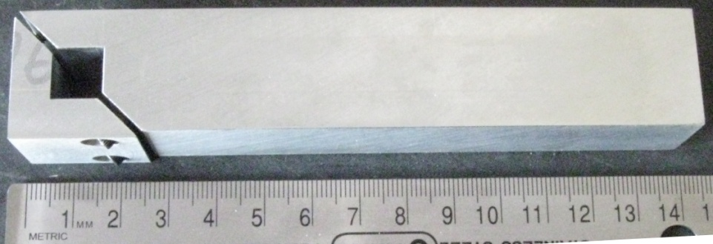
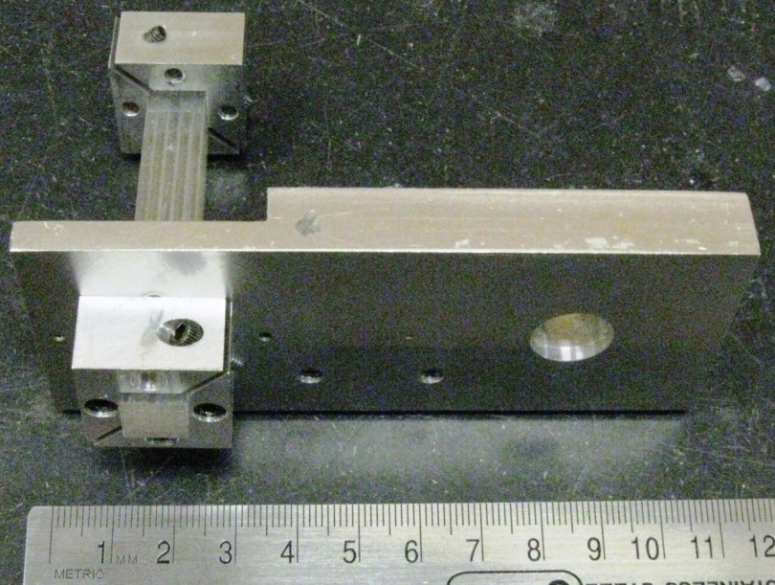
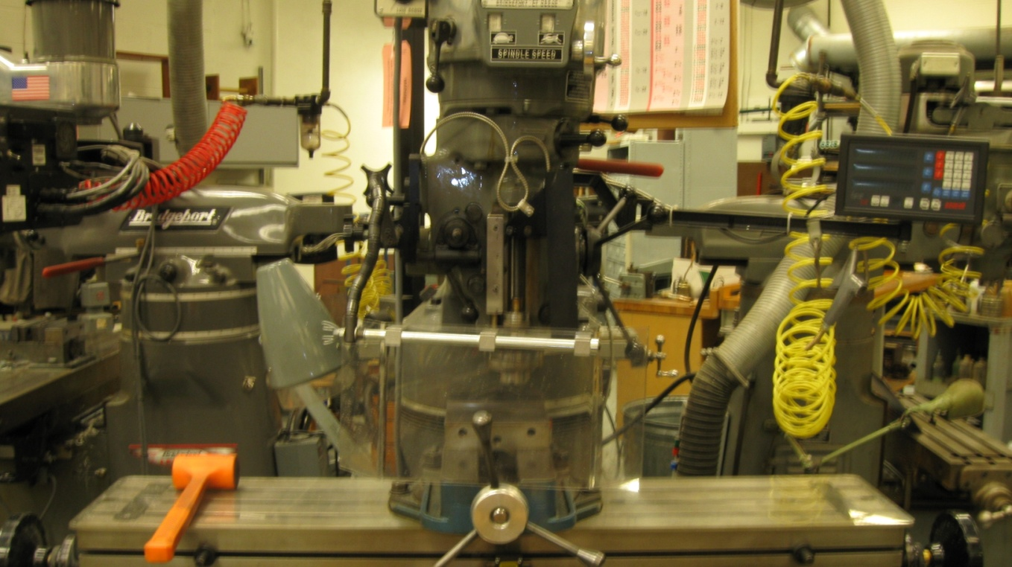
Tagger Microscope Construction Plan
Three Main Stages of Construction
  Bundle Preparation
    Fibers cutting using an End-Mill

Slide 15
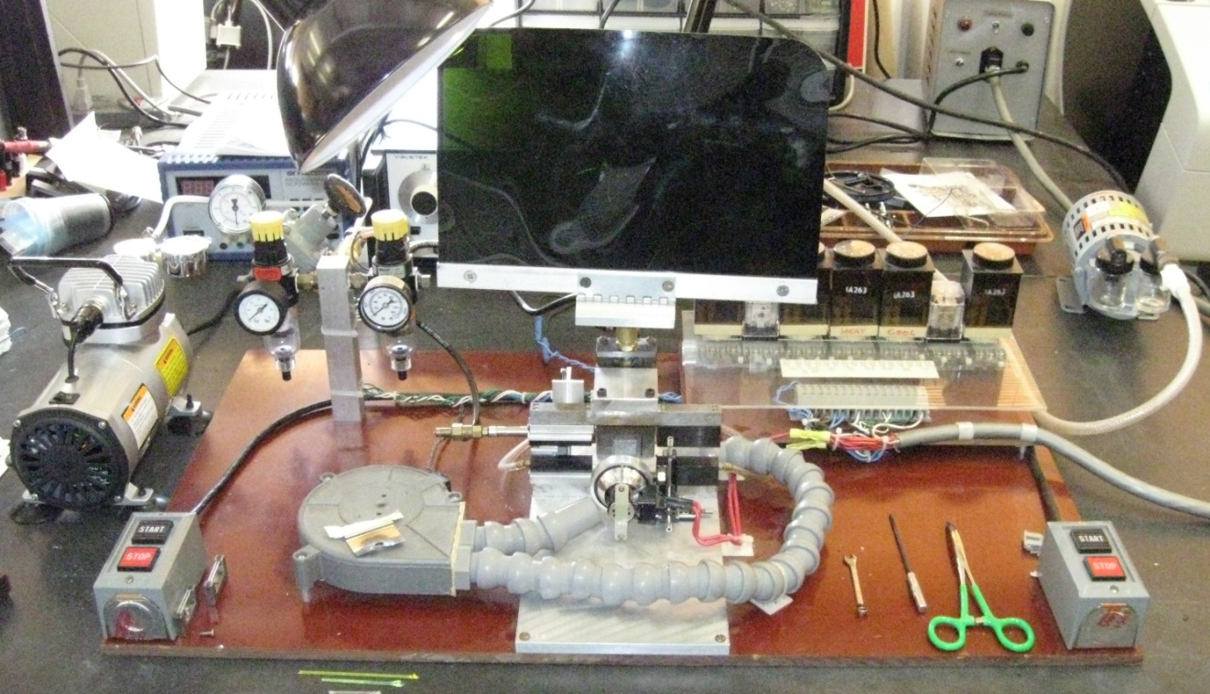
Tagger Microscope Construction Plan
Three Main Stages of Construction
  Bundle Preparation
    Fiber Splicing

Slide 16
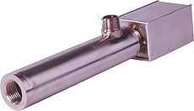
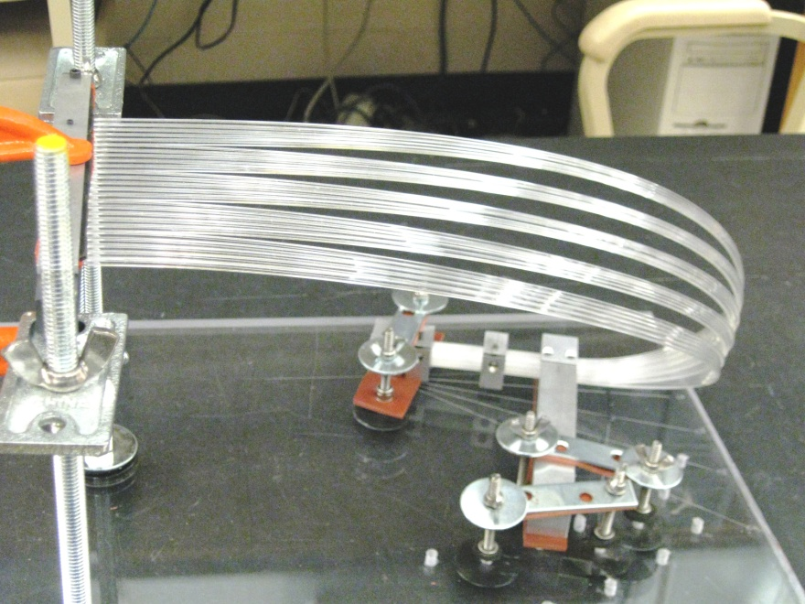
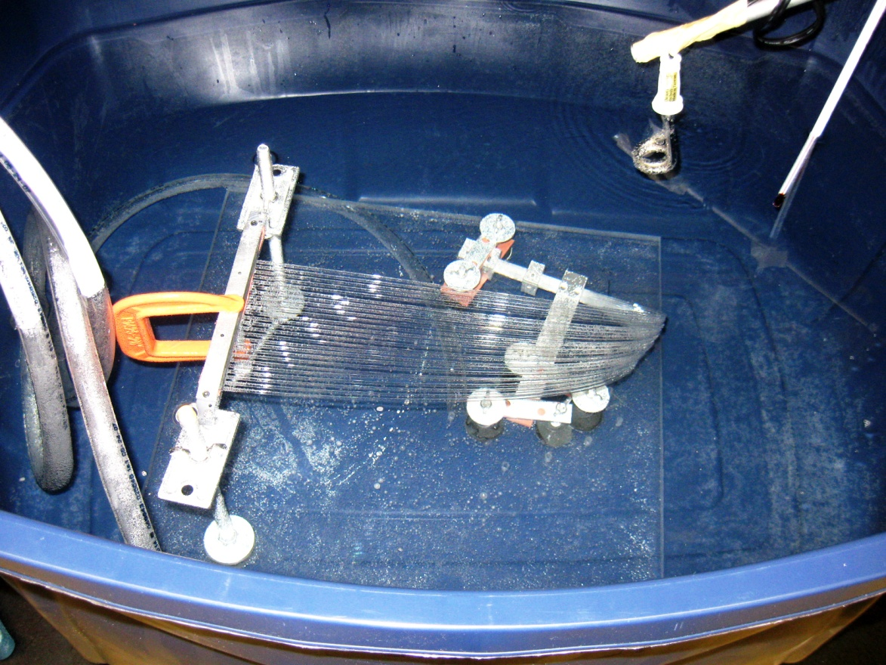
Tagger Microscope Construction Plan
Three Main Stages of Construction
  Bundle Preparation
    Bending of fibers using heated water
      Obtain 90º bend with a 11.9º twist

Slide 17
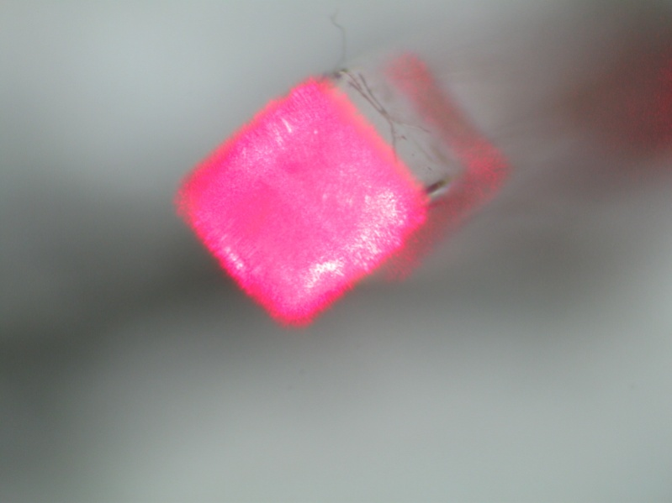
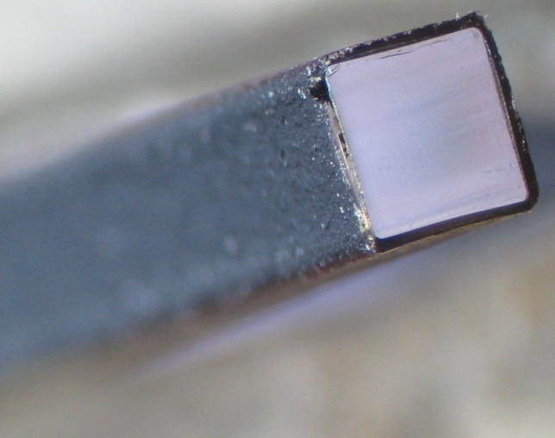
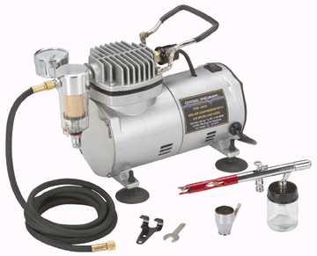
Tagger Microscope Construction Plan
Three Main Stages of Construction
  Bundle Preparation
    Painting (Titanium Dioxide Paint)
Glued fiber joint showing light transmission.
Air Gun used to paint the individual fibers after fusing.

Slide 18
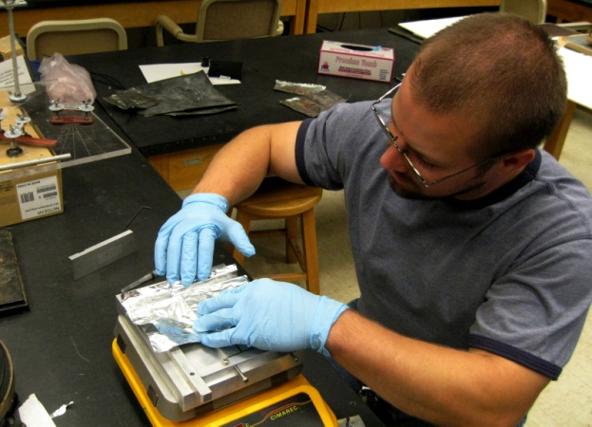
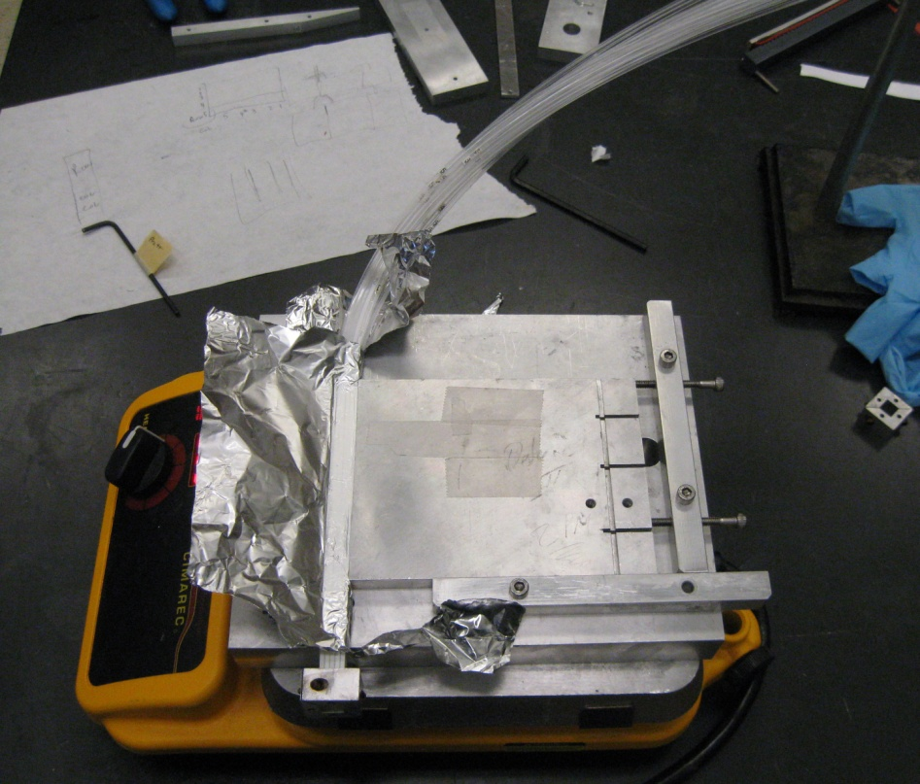
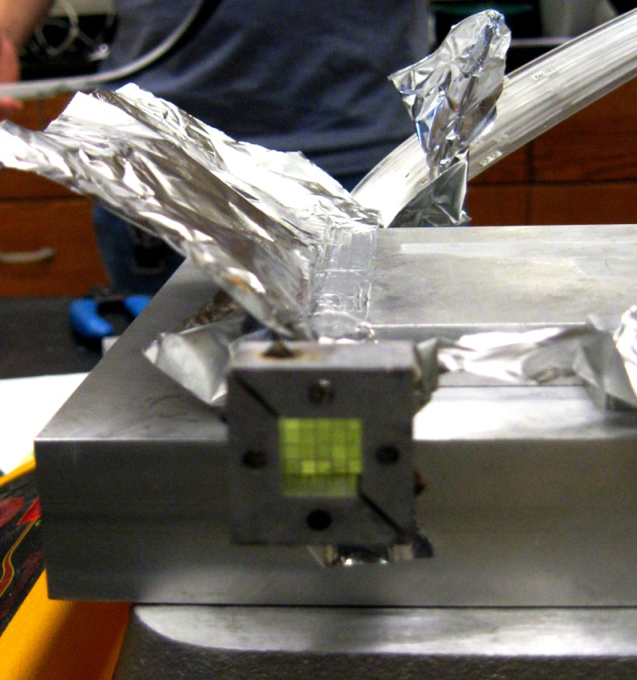
Tagger Microscope Construction Plan
Three Main Stages of Construction
  Bundle Preparation
    Bundle/Bundle Support gluing

Slide 19
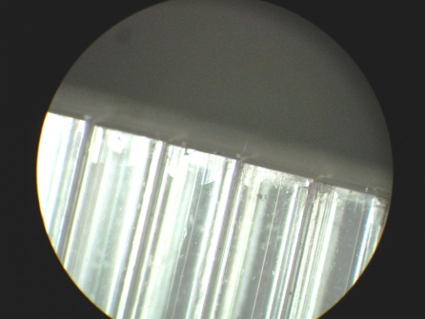
Tagger Microscope Construction Plan
Three Main Stages of Construction
  Bundle Preparation
    Installation of 90% reflective end-cap
    Fully assemble inside housing to perform full system bench test with pulser and readout
    Packaging for shipping
  2. Quality Assurance
    Performed in parallel with other construction steps
    A formal procedure is currently being written up
    Waveguides
      Visual inspection of light transmission of individual fused fibers
      Transmission tests for any questionable fibers
      Visual inspection of joint and optical insulation with the aid of coupled laser

Slide 20
Tagger Microscope Construction Plan
Three Main Stages of Construction
  3. Enclosure Construction
    Technical drawings have been completed
      Currently being passed through UConn group for review
    A Parts & Materials list is being produced
    Fabrication orders for individual components are being generated
  Integration with the Tagger
  3-point motor support in JLab’s scope

Slide 21
Manpower
Project Manager – J. McIntyre
Student Labor – 2000 person hours
(1 Tech x 20 hrs/wk x 15 months
+
2 Students x 10 hrs/wk x 10 months)
Machinist Labor – 500 hours
Estimated time for completion with foreseen manpower – 15 months, starting July 1, 2012
Assuming contract is in place by June 2012

Slide 22
Summary
Designs complete for:
  Full scale Tagger Microscope
  Auxiliary equipment needed for construction
Fabrication and procurement of construction components are currently underway and on schedule.
Project Schedule calls for delivery of completed detector to JLab by June 1, 2013; detector fully installed in Tagger Hall by December 31, 2013.
Six month installation period gives some room for completion of fiber bundles at UConn without missing the December 31, 2013 target date.

