Slide 1


Diamond Radiator Development
Brendan Pratt
University of Connecticut
GlueX Collaboration Meeting, Jefferson Lab, February 2012

Slide 2
Recap from 2011
Excimer Laser refurbished
Translation Stage
Vacuum Chamber Constructed
Optics and Railing Purchased
Chiller (allows for rep rate >3Hz, max 50Hz)
External Triggering circuit designed and built
Data Acquisition Card for pulse measurement
LabView program written
Made our first cuts into Diamond in October 2011

Slide 3
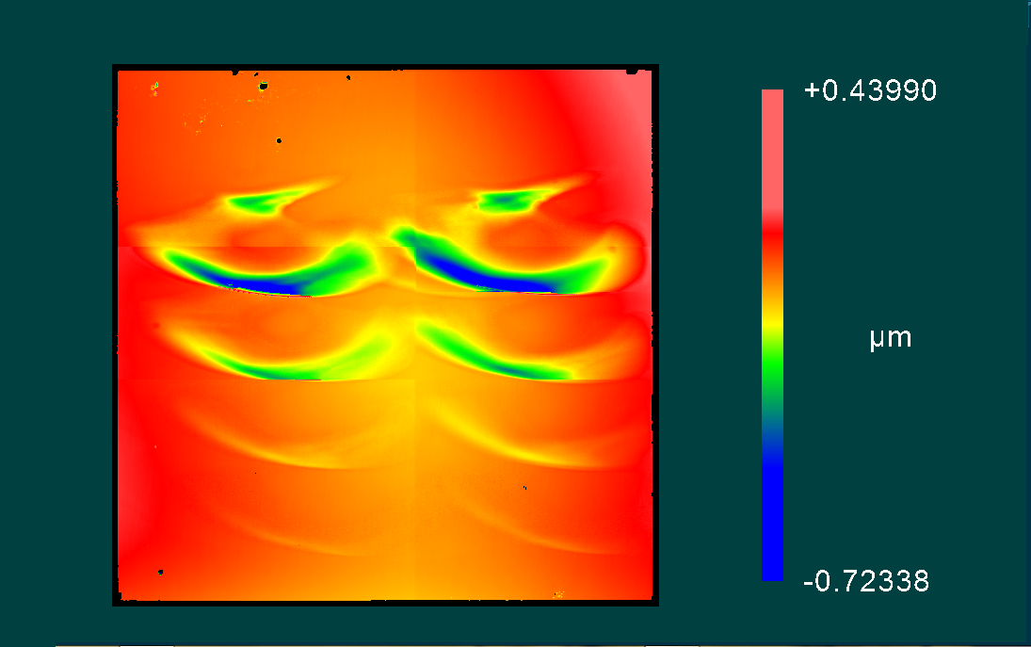
Results From 2011
Skewed Spot due to Spherical Abberations in Optics

Slide 4
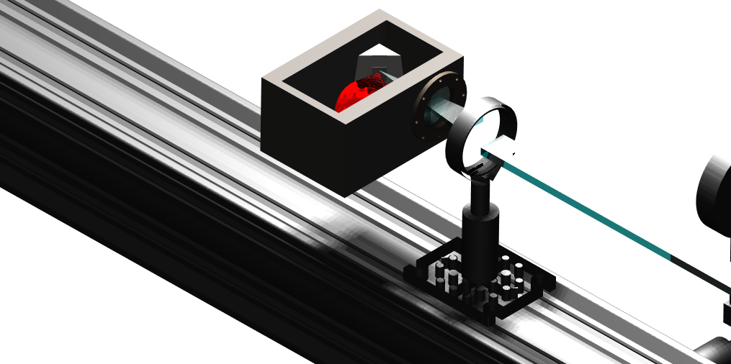
Old Optics
Single Fused Silica focusing lens creates large spherical aberrations in spot.

Slide 5
New Optics
Finally, the light is focused
Through L3, a fused silica lens
With a large radius of curvature (34.5mm)
Onto the target
First the laser beam is expanded
Setting L1 and L2’s focal lengths at the
Same point
The “Point” is then imaged through
L2, creating a parallel beam
L1
L2
L3

Slide 6
Results
This is where I’ll put a picture of a single blast site.

Slide 7
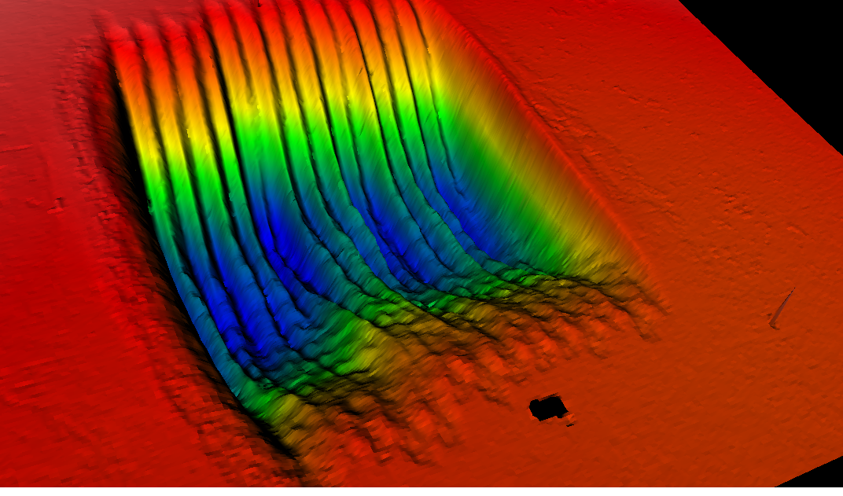
Using Raster Program
10 steps @
0.05mm increments
14 rows @ 0.05mm increments

Slide 8
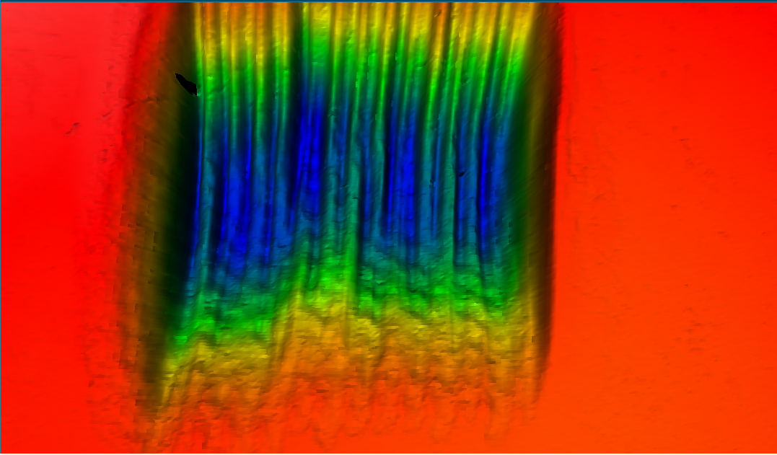
0.5mm
0.9mm
0.7mm

Slide 9
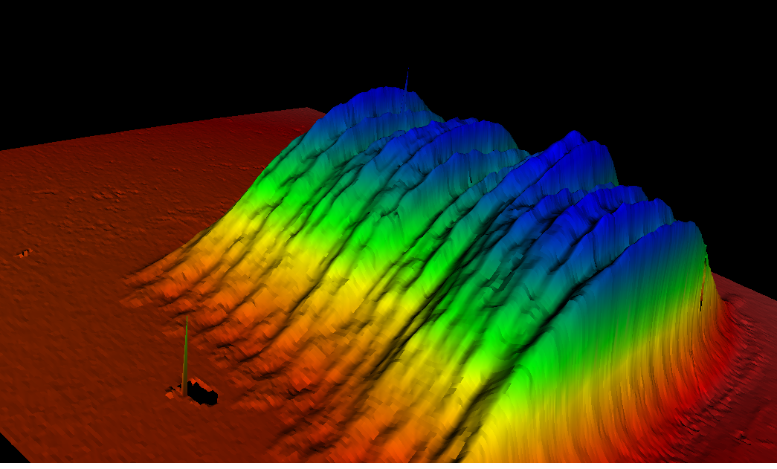
Trenches show 0.05mm step
After each carriage return

Slide 10
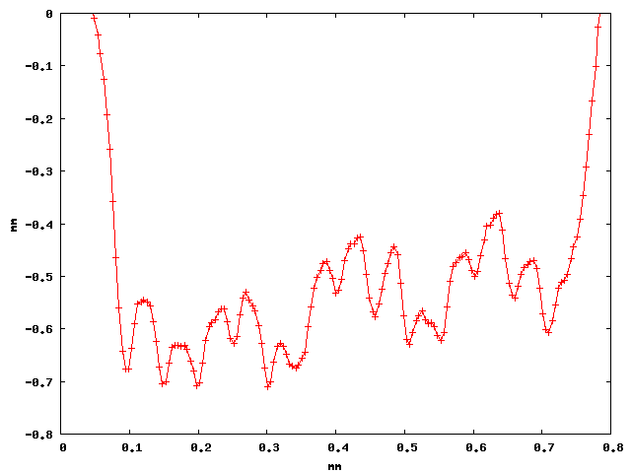
Vertical Cut

Slide 11
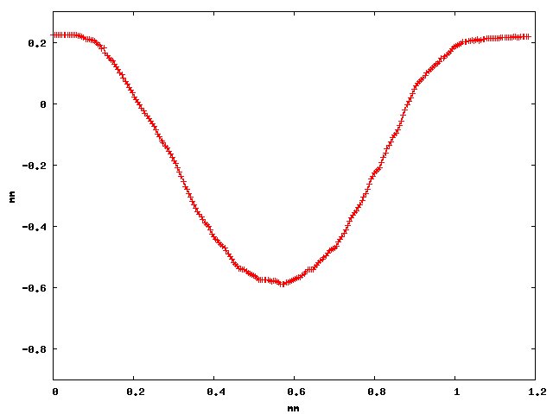
Single Horizontal Cut
Milling Depth
0.8mm

Slide 12
Summary
Laser is operating at above ablation energies for hours of run time
Automation of milling cycle is complete
Beam spot has been “cleaned” of spherical aberrations
Will begin milling 20micron diamonds within the next 6 months.

Slide 13

Questions

