Slide 1
GlueX Collaboration Meeting
February 2011
Jefferson Lab
Our 30’th Collaboration Meeting

Slide 2
New Collaborators

Slide 3
Developing the Physics
July 1997 - Workshop at Indiana University
Explore Community Interest
November 1997 – Workshop at NCSU
Explore the Physics Interest and Feasibility
March 1998 - Workshop at Carnegie Mellon
Explore Potential Detector Designs
May 1998 - WorkFest at Indiana University
Begin Simulation of Physics and Detectors
June 1998 - Presentation to the JLab User’s Group
Public Presentation to the JLab Community
September 1998 – Workshop at Florida State Univ.
Continues Exploration of the Physics and Detectors
Hall D Preliminary Design Report 170 pages

Slide 4
November 2007: Project Receives CD-2
The project received CD-2 (Approve Performance Baseline) on Nov. 9, 2007. Dr. Jehanne Simon-Gillo, the acting associate director for the DOE's Office of Science for Nuclear Physics, said the approval "marks a significant achievement for Jefferson Lab." She also added that, "The 12 GeV Upgrade Project will allow nuclear scientists to delve deeply into the heart of the nucleon, and will permit Jefferson Lab to remain a unique international facility for decades." CD-3 (Approve Construction Start) is expected in 2008 and CD-4 (Approve Start of Operations) scheduled for 2015.
September 2008: Project Receives CD-3
Construction funds are requested in the President's Fiscal Year 2009 Budget Request, and project completion is planned for 2015. "Today's approval is truly historic," said Dr. Jehanne Simon-Gillo, acting associate director of DOE's Office of Science for Nuclear Physics. "The 12 GeV CEBAF upgrade will enable scientists to seek answers to some of Nature's most perplexing questions, expand our knowledge of the universe and benefit people around the world. The project also clearly demonstrates our Nation's commitment to remaining in the forefront of scientific exploration and discovery." CD-4 (Approve Start of Operations) is scheduled for 2015.

Slide 5
Outside Construction Contracts
BCAL at Regina: Readiness Review November 2009.
FCAL at Indiana: Readiness Review June 2010.
CDC at CMU: Readiness Review October 2010.
Santa Maria: Close to complete.
MOUs with Outside Institutions
FSU, FIU (bridge), CUA, NCA&T, UNCW,
UMASS, Santa Maria are all signed or in signature phase.

Slide 6
Approved Experiments
E12-06-102 (GlueX): “Mapping the Spectrum of Light Quark Mesons and Gluonic
Excitations with Linearly Polarized Photons”
Rating: A
Due to the strength of its scientific program, GlueX is a flagship experiment of the 12 GeV upgrade with unique physics opportunities and the potential for groundbreaking discoveries. The PAC recommends the allocation of 120 days of beam time as requested by the collaboration.
E12-10-011 (PrimEx): “A Precision Measurement of the eta Radiative Decay Width via the Primakoff Effect”
Rating: A-
E12-11-005 (CLAS12): “Meson spectroscopy with low Q2 electron scattering in CLAS12”
Rating: A-

Slide 8
Making the Science Case
January 1999 - Presentation to the JLab PAC
Initial Review of the Science by an external Committee
March 1999 - Workshop at RPI COLLABORATION FORMED
Officially organize as an experiment – The HallD Experiment
August 1999 - Collaboration Meeting at Jefferson Lab
Hall D Design Report, Version 2 191 Pages
December 1999 - Collaboration Meeting at Jefferson Lab
Prepare for the external review
December 1999 - EXTERNAL REVIEW OF THE PROJECT
The first significant review of the project, an external
committee reviews things for 2 days.

Slide 9
Preparing for NSAC 2001
January 2000 - Report of the Cassell Committee
VERY POSITIVE
March 2000 - Meeting with DOE and NSF in DC
April 2000 - Collaboration Meeting at Indiana University
Solidify the Science Case. Educate the Community
August 2000 - Collaboration Meeting at Jefferson Lab
September 2000 – American Scientist Article
October 2000 - The APS DNP Meeting
The Duck Workshop on Key Questions in Hadronic Physics
Hall D Design Report: Version 3
December 2000 - The NSAC Town Meeting at JLab
January 2001 - New Administration Sworn in – Pres. Bush
March 2001 - Collaboration Meeting at Jefferson Lab
April 2001 - The NSAC Long Range Plan Meeting

Slide 10
After NSAC 2001
The JLab Upgrade and HallD were one of four recommendations
that came out of the NSAC Meeting.
June 2001 - Collaboration Meeting at Jefferson Lab
The collaboration begins the push for Critical Decision 0
October 2001 - Collaboration Meeting at Indiana Univ.
March 2002 - Collaboration Meeting at Jefferson Lab
New Name: The GlueX Collaboration
President Bush appoints Raymond Orbach to head the
DOE office of Science.
April 2002 The Long Range Plan is Published
June 2002 - Meeting with Raymond Orbach in D.C.
July 2002 - JLab Science and Technology Review
Review Carried out by DOE Nuclear Physics
August 2002 - JLab Institutional Review
Review Carried out by Raymond Orbach

Slide 11
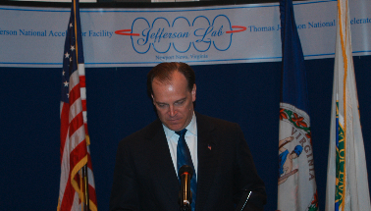
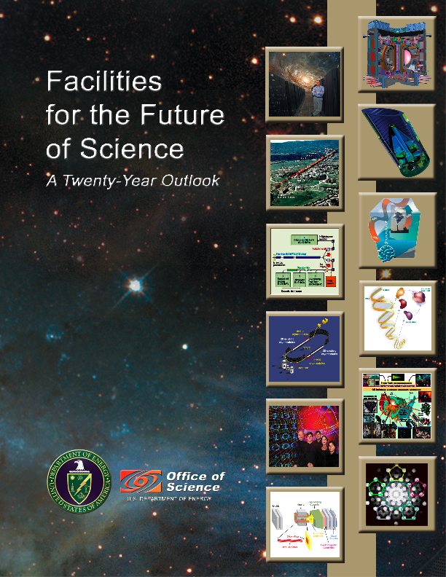
Finally into the CDs
12 GeV Upgrade
CD-0 Signing at
Jefferson Lab
April 19, 2004
Release of 20-year Science Plan
Deputy Energy Secretary
Kyle McSlarrow
November 2003

Slide 12
February 2006: Project Receives CD-1
Secretary of Energy Announces Approval and Funding for
Facilities Upgrade at the Thomas Jefferson National Lab and
Highlights Lab’s Successful Education Programs
NSAC Long Range Planning Meeting – May 2007
The 12 GeV upgrade was listed as the number
one priority of the field with the important physics
that can be carried specifically mentioned.

