Slide 1
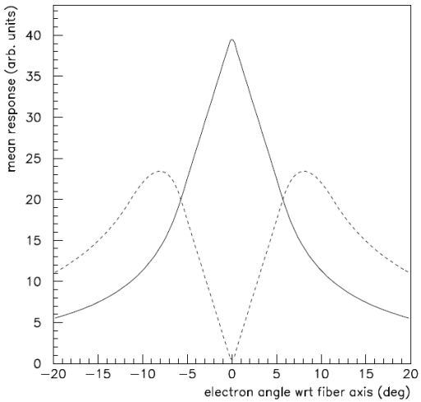
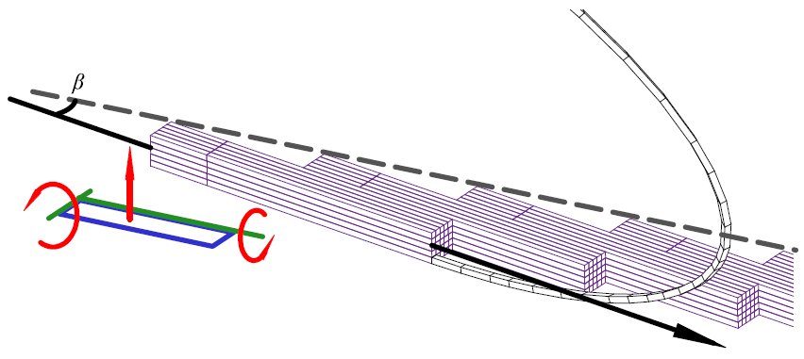
Beam Test in Hall B for Tagger Microscope
Tagger Microscope:
Performance Features Under Test
  Detector Alignment
    Simulations show that when fiber axis is aligned to < 3º of the e⁻ trajectory ⇒ Adjacent signal amplitudes have a factor of 3 separation
    Bench tests demonstrate alignment < 0.2º
  Readout
      First time SiPM signal will be read out with the designated GlueX fADC and F1TDC modules
      Examine the output on the equipment actually intended for reading out this detector
Fiber Bundle D.o.F.
e⁻
Trajectory

Slide 2
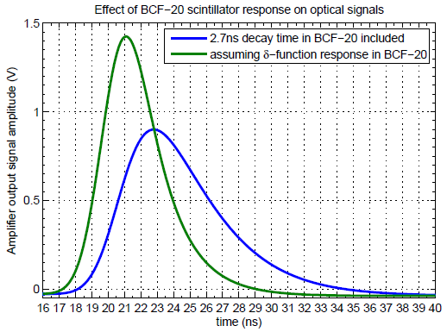
Beam Test in Hall B for Tagger Microscope
Tagger Microscope:
Performance Features Under Test
  Time Resolution
    Requirement: 200ps time resolution
    BCF-20 SciFi → decay time 2.7ns
    Collective photon emission time uncertainty goes as:
          2.7ns / √(N_{γ})
    ⇒ Minimum of 183 detected photons is required to meet 200ps time resolution specification
    Simulations predict the mean photoelectron count > 300

Slide 3
Beam Test in Hall B for Tagger Microscope
Tagger Microscope:
Performance Features Under Test
  Efficiency
    Random arrival, in a single channel, of tagging e⁻ result in the occasional overlap of these finite pulses
      ⇒ Resulting in the inability to resolve the two leading edges
    While calculations are effective → measurement of the pulse selection efficiency fed by pulses from an e⁻ beam would be extremely useful
  Cross-talk
      Need to investigate the degree of cross-talk between channels in a live beam
      Measure electronic cross-talk on the Amp. Board
      Measure optical cross-talk between adjacent fiber-SiPM junctions

Slide 4
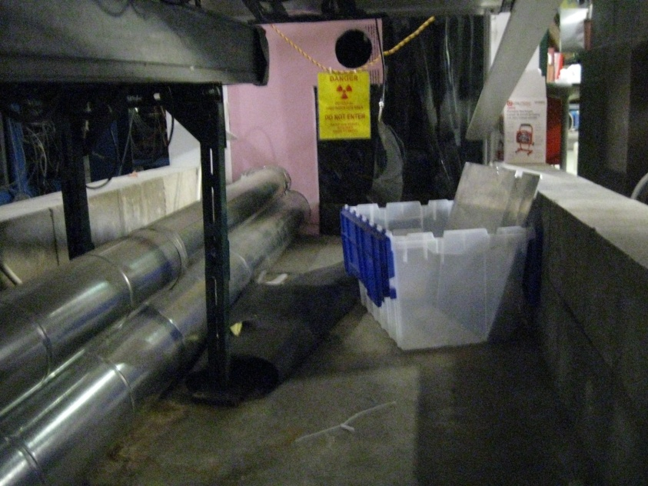
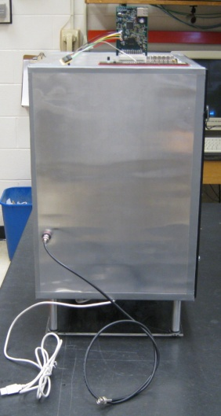
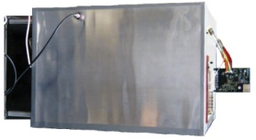
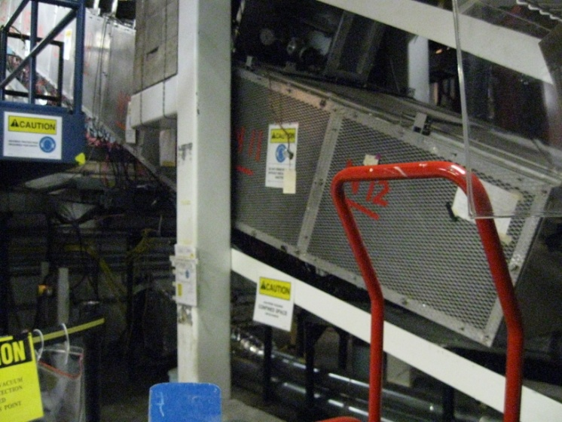
Beam Test in Hall B for Tagger Microscope
x

Slide 5
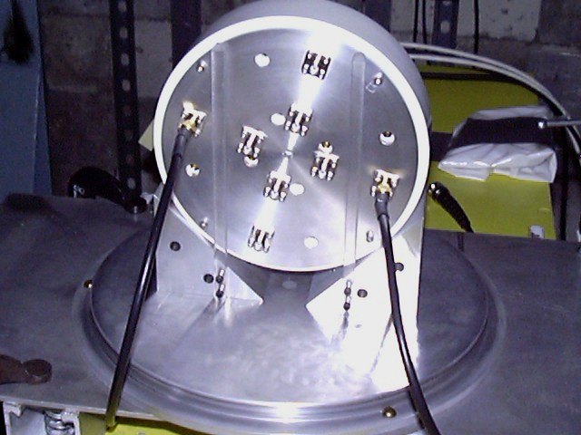
Beam Test in Hall B for Active Collimator
Active Collimator:
Parasitic Beam Test
    Goals:
      Determine the bandwidth limits of the position readout (signal noise vs. bandwidth of the detector signals)
        Will be used to stabilize the photon beam position in Hall D using a controlled feedback loop to electron beam correctors up stream of the radiator

Slide 6
Beam Test in Hall B for Active Collimator
Active Collimator:
Parasitic Beam Test
    Goals:
      Confirm anomalies in the 2007 beam test were correctly diagnosed and remedied successfully
        Larger than predicted currents (Good thing)
        (By Geant3 simulation)
          Factor of 3.5 higher
          Geant3 result was sensitive to the lower cutoff on the energy of the shower particles and deltas in the simulation
          The P.E.E. that dominates photon absorption at energies < 100 keV is a complex Z-dependent function of energy that is described in an average way by Geant3

Slide 7
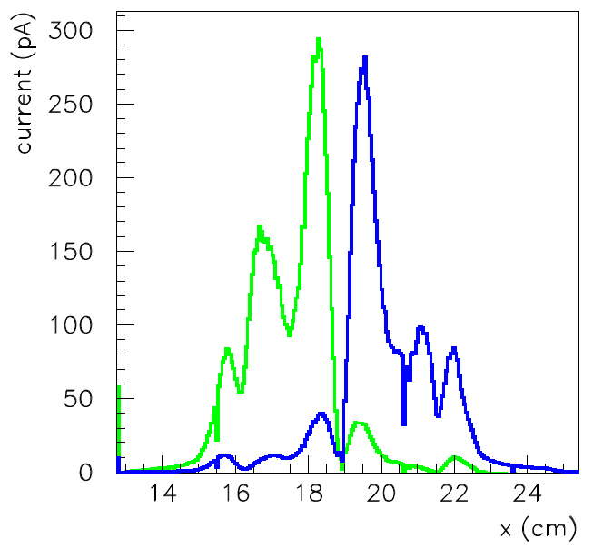
Beam Test in Hall B for Active Collimator
Active Collimator:
Parasitic Beam Test
    Goals:
      Confirm anomalies in the 2007 beam test were correctly diagnosed and remedied successfully
        Cross-talk
          Relatively large response on inner wedge when the photon beam interacts in the outer wedge
          (peaks at 15.5cm & 22.0cm)
          Simulation < 5% of peak current vs. ~ 25% during beam test
          Possibility that the photon beam directed on the wedge not being readout caused charges to built up to a high voltage . Surface leakage currents drained the charge along the insulator to the nearest path to ground (which was through the adjacent wedge connected to the readout).

Slide 8
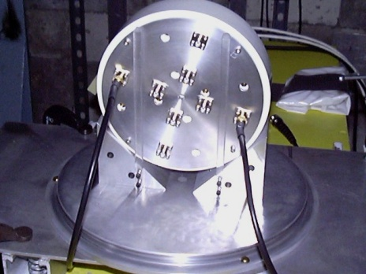
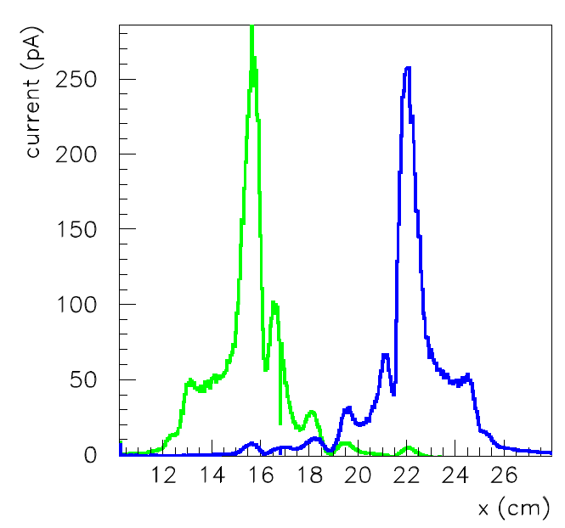
Beam Test in Hall B for Active Collimator
Active Collimator:
Parasitic Beam Test
    Goals:
      Confirm anomalies in the 2007 beam test were correctly diagnosed and remedied successfully
        Middle Peaks (Remedy: Use of 90º Connectors)
          Peaks seen at 16.5cm & 21.0cm on both the inner and outer wedge readouts
          Possibility that the readout cables hanging down in front of the detector acted as a pre-shower. The asymmetry between left and right most likely comes from the fact that one cable (16.5cm) hangs down from above, while the other (21.0cm) starts out from below, the center of the photon beam. Therefore one interacts with a smaller fraction of the beam than the other.
Current measured on two outer wedges

Slide 9
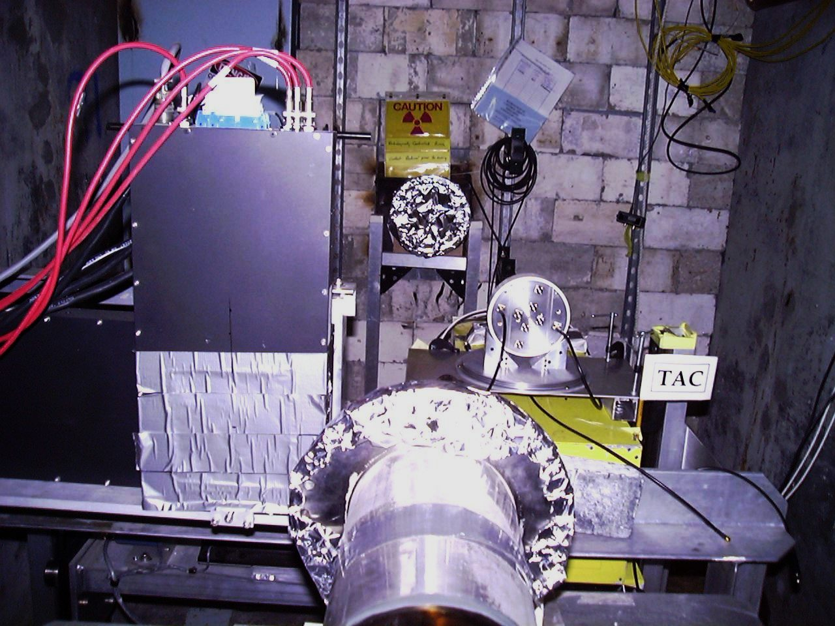
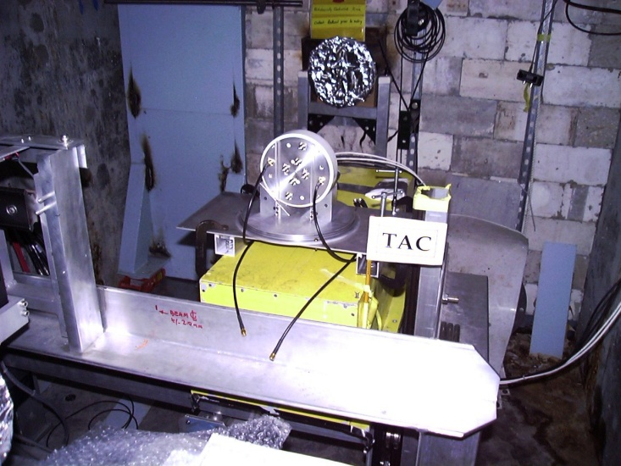
Beam Test in Hall B for Active Collimator
Beam Dump
Beam line

