Slide 1
Simulation of background in the Hall D tagger area
GlueX collaboration meeting, Newport News, Oct. 2-4, 2014
Richard Jones
University of Connecticut

Slide 2
Outline
review of electron beam model (CASA, 2006)
review of results from earlier simulations (Somov, 2011)
updates to the geometry
simulation parameters
new results
comparison with earlier results
effectiveness of TAGM shielding solution
remaining issues for study
1

Slide 3
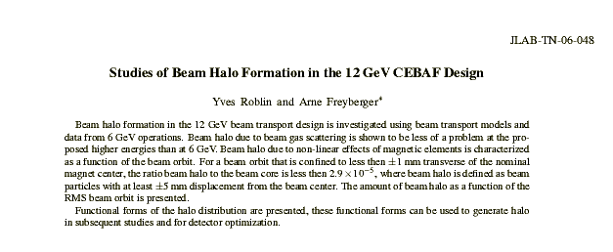
review: 12GeV e⁻ beam model
CASA published a study using a ray-tracing simulation of electrons in the 12 GeV machine, based on 6 GeV data.
2

Slide 4
GlueX sensitivity
Original estimate (July, 2006) was based on some brutal assumptions regarding the shape of the halo.
  uniformly distributed out to r = 25 mm
  same energy, direction distribution as core beam
Criterion was halo-related backgrounds in the tagging counters should contribute <1% to their rates.
Result:
CASA estimate: 3 · 10⁻⁵ beyond r = 5 mm boundary.
10⁻⁵ beyond the 5−σ ellipse
3

Slide 5
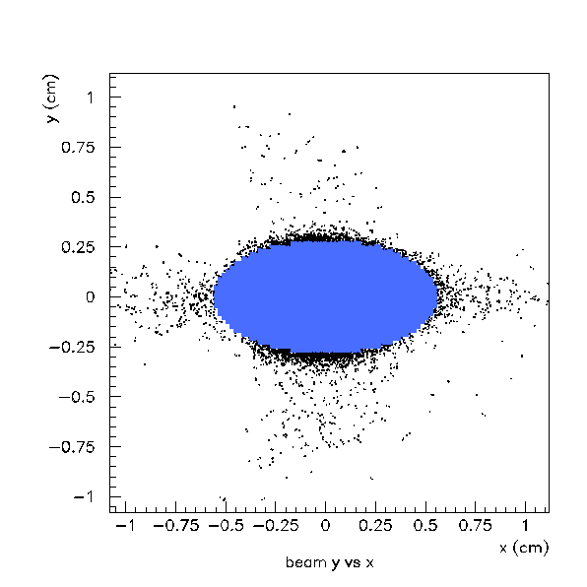
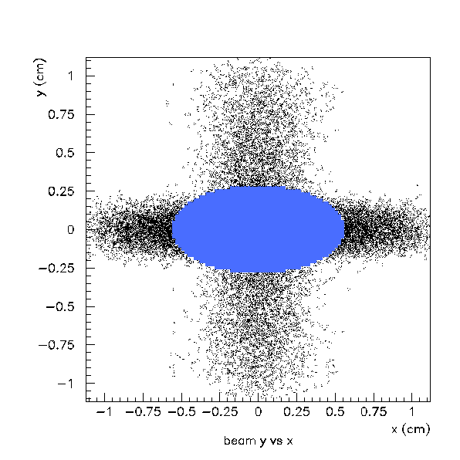
GlueX “gxtwist” simulation: e⁻ beam model based on TN-06-048
MC data from CASA ray-tracing simulation
xy projection of 5d halo model (this study)
4

Slide 6
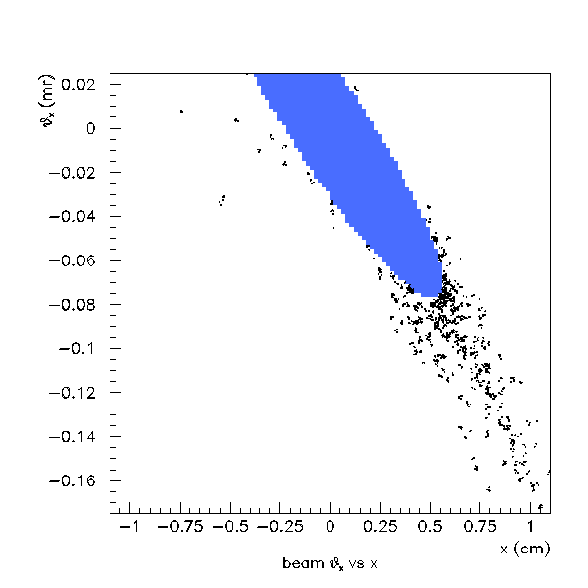
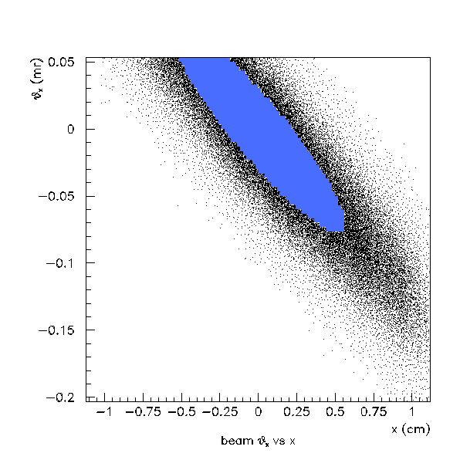
GlueX “gxtwist” simulation: e⁻ beam model based on TN-06-048
MC data from CASA ray-tracing simulation
xθ_{x} projection of 5d halo model (this study)
5

Slide 7
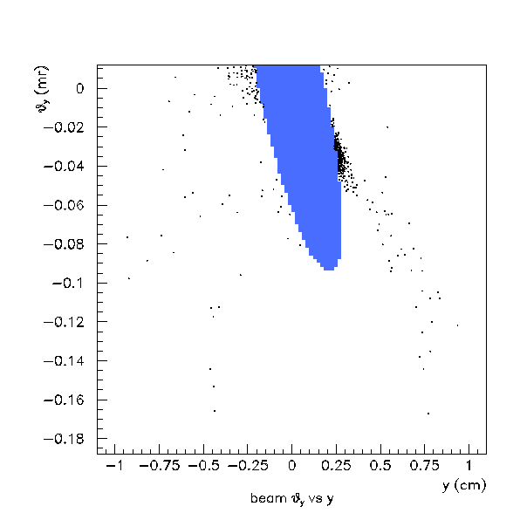
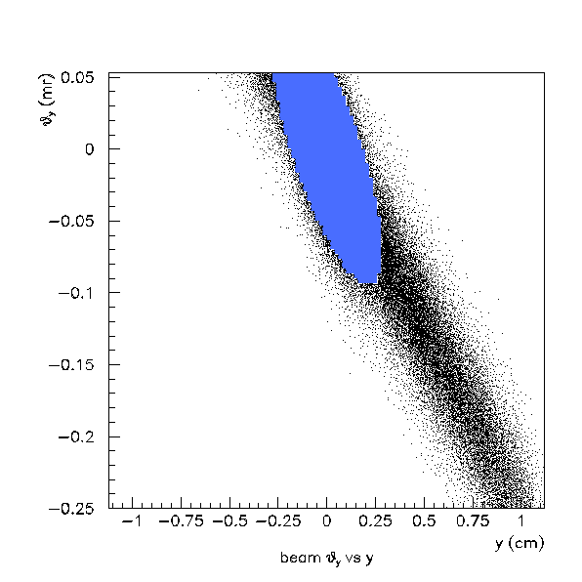
GlueX “gxtwist” simulation: e⁻ beam model based on TN-06-048
MC data from CASA ray-tracing simulation
yθ_{y} projection of 5d halo model (this study)
6

Slide 8
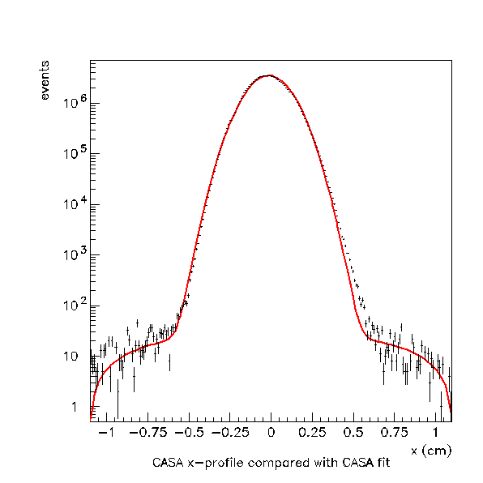
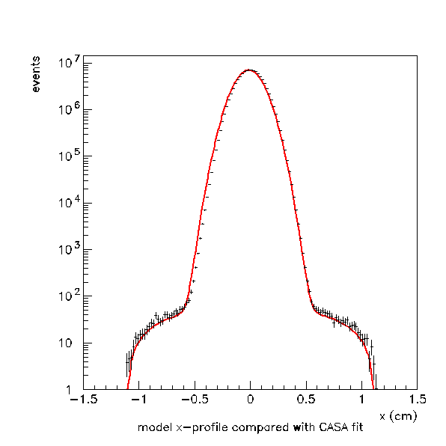
Comparison in projections
MC data from CASA for the 0.3mm case
GlueX model derived for the 0.3mm case
7

Slide 9
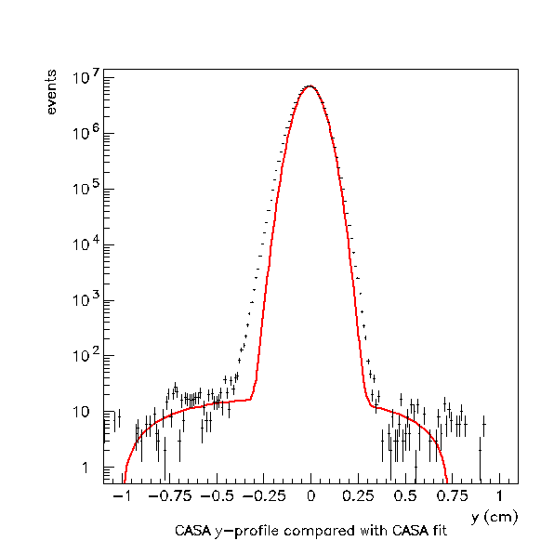
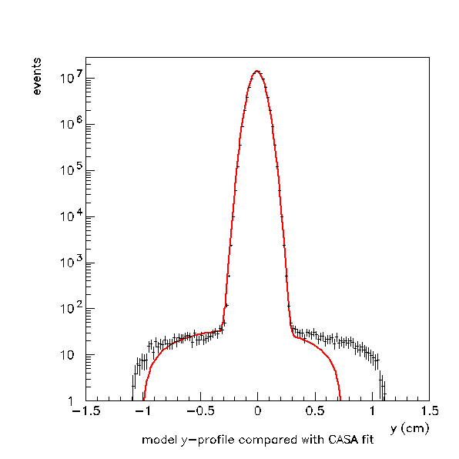
Comparison in projections
MC data from CASA for the 0.3mm case
GlueX model derived for the 0.3mm case
8

Slide 10
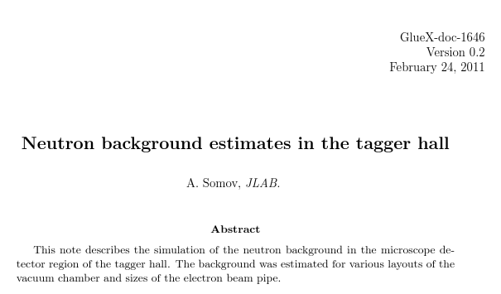
review: first gxtwist results
9

Slide 11
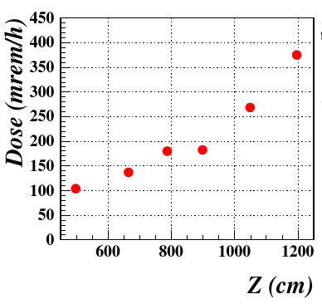
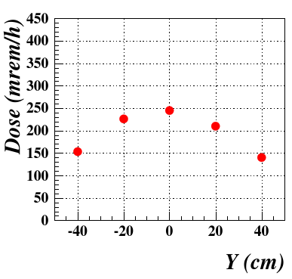
review: first gxtwist results
showed that neutron dose IS a concern for electronics, especially the SiPMs
50 rems => dark rate increase factor ~5 over baseline rate ~1MHz
assume dark rate increases linearly with dose: ~10 MHz / 100 rems
TAGM dark rate deemed significant at 1 GHz => unshielded lifetime 40khr
10

Slide 12
updates to the hall geometry
original simulation considered several options for e⁻ beam tube
recommended choice had exit 6” e⁻ beam tube
  starting from tagger vacuum chamber exit flange
  punching through the dump labyrinth walls
  all the way through labyrinth wall 3
  air between labyrinth wall and dump
  simulation stopped before air gap -- beam dump was not simulated
as-built geometry is somewhat different
  6” pipe necks down to 1.5” pipe before the first labyrinth wall
  girder with accelerator instrumentation is installed past first wall
  gaps are incompletely filled where the pipes punch through the walls
  labyrinth walls don’t extend all the way to the ceiling
  actual TAGM readout shielding is more hermetic
  … many other less important details in the shielding arrangement
11

Slide 13
new simulation results
emphasis on commissioning-phase conditions
  exaggerated e- halo: 10⁻² of total e- beam
  special interest in neutrons: tracked down to 10keV
  complete simulation: including full beam dump int.
  only amorphous radiator: 10 microns of graphite
  using latest TOSCA field map
normalized to full luminosity conditions for GlueX
  250 MHz total rate in TAGM
  10⁹ beam electrons simulated (300,000 core-hr on OSG)
  5000 hits seen in TAGM: 20μs @ 6.2μA (!)
12

Slide 14
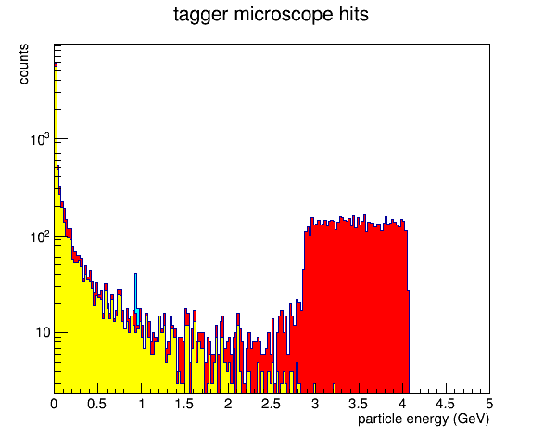
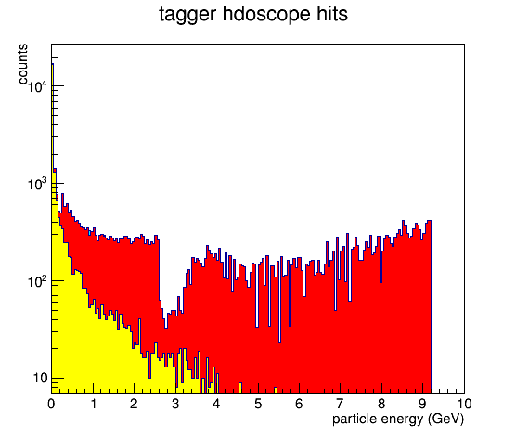
new simulation results
energy of particles reaching the tagging counters
photons
electrons/positrons
neutrons
photons
electrons/positrons
neutrons
13

Slide 15
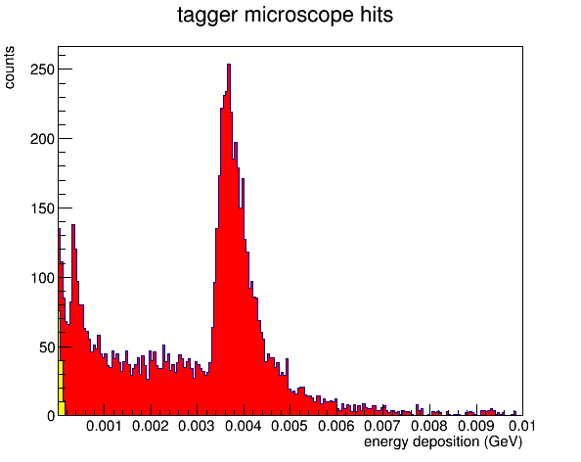
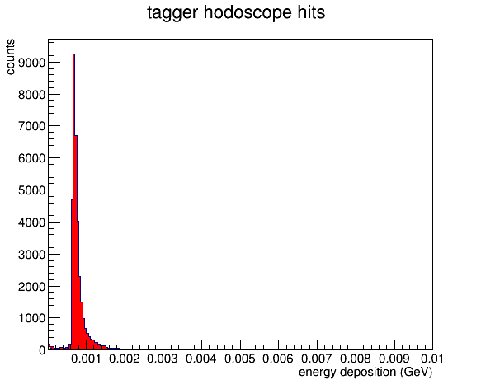
new simulation results
energy deposition in the tagging counters
photons
electrons/positrons
neutrons
1-2∘ misalignment
14

Slide 16
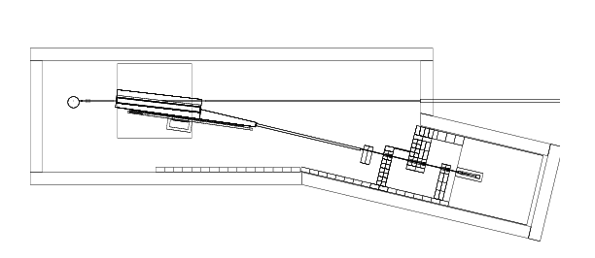
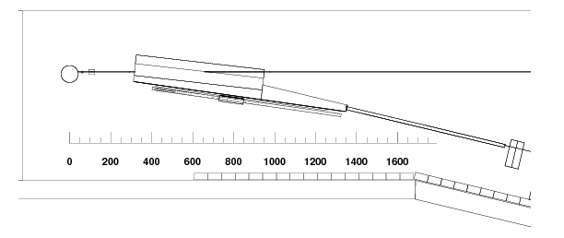
new simulation geometry
15

Slide 17
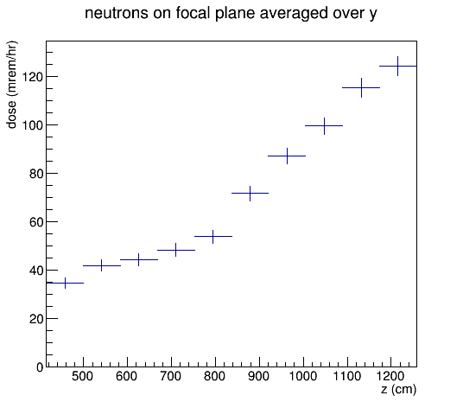
background dose rates: comparison with gluex-doc-1646
16

Slide 18
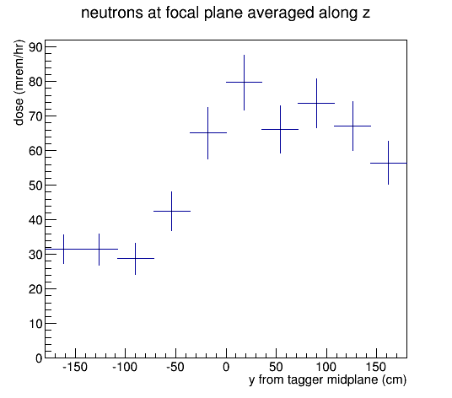
background dose rates: comparison with gluex-doc-1646
region partially shielded by
poly-enclosed TAGM readout
17

Slide 19
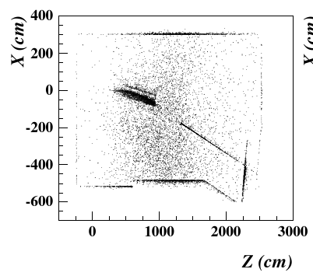
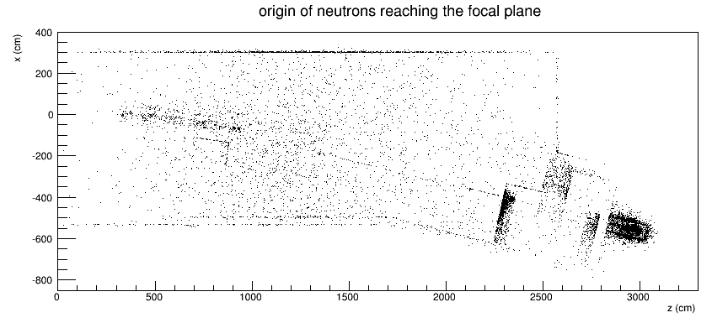
background sources: comparison with gluex-doc-1646
18

Slide 20
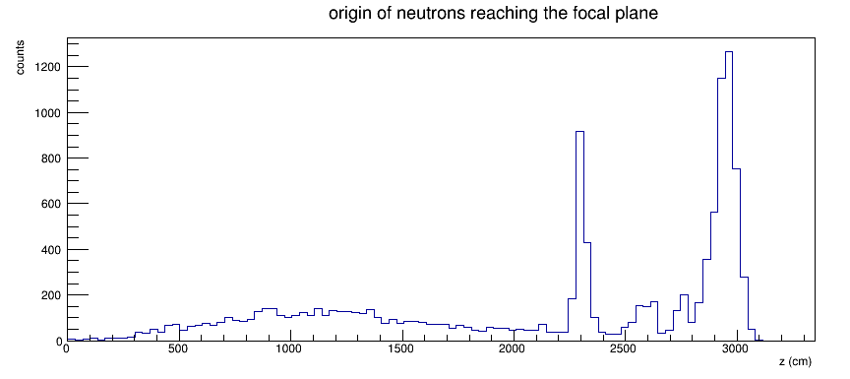
background sources origin of neutrons reaching the focal plane
19

Slide 21
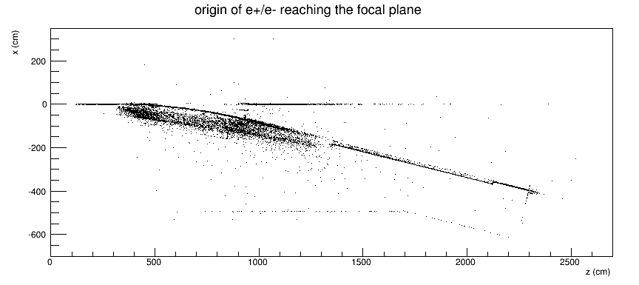
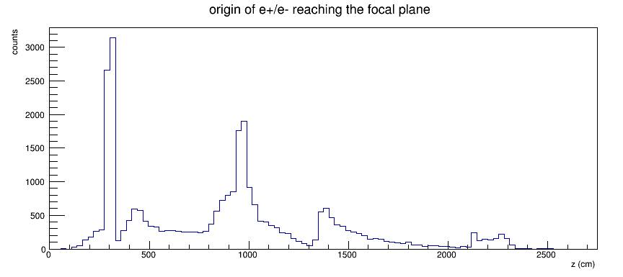
background sources origin of e⁺/e⁻ bg reaching the focal plane
20

Slide 22
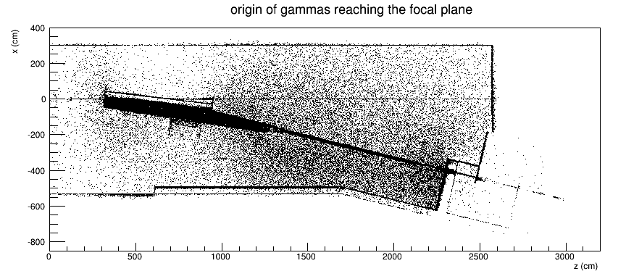
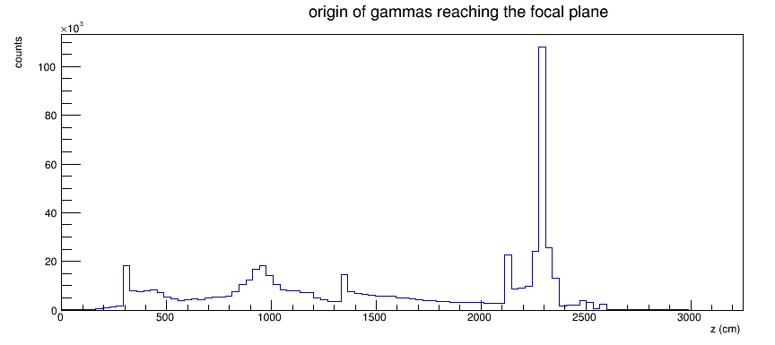
background sources origin of gammas reaching the focal plane
21

Slide 23
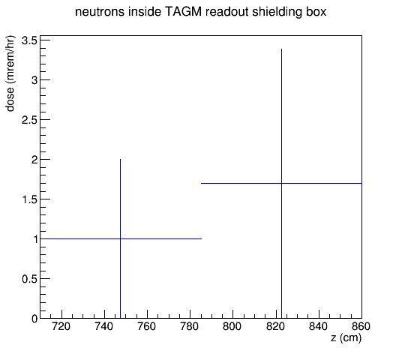
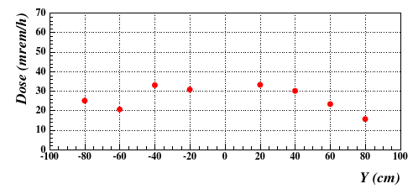
background sources neutron dose rate on TAGM readout electronics
Reduction for new configuration is much larger than the factor ~3 seen elsewhere in the hall.
New configuration may be overkill but it works!
22

Slide 24
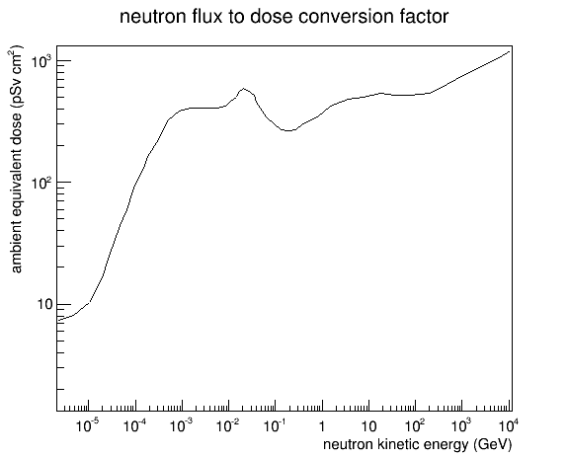
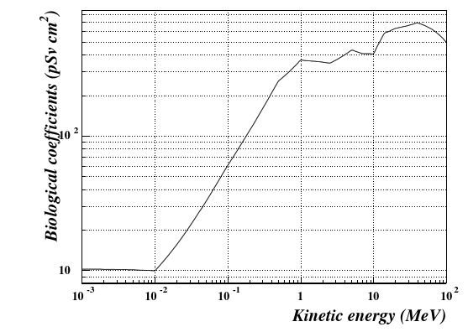
background comparison what has changed with the neutron dose?
Dose is computed using a weight factor that strongly depends on the kinetic energy of the neutron.
23

Slide 25
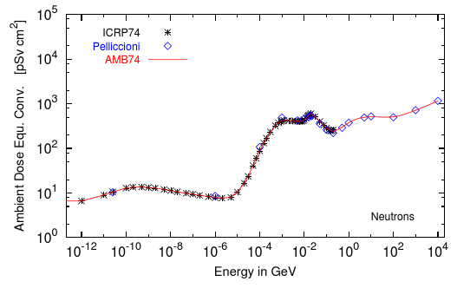
background comparison what has changed with the neutron dose?
Dose is computed using a weight factor that strongly depends on the kinetic energy of the neutron.
I used “ambient dose equivalent” but choice is not unique.
Fig. 2 taken from S. Roesler et.al., CERN-SC-2006-070-RP-TN
24

Slide 26
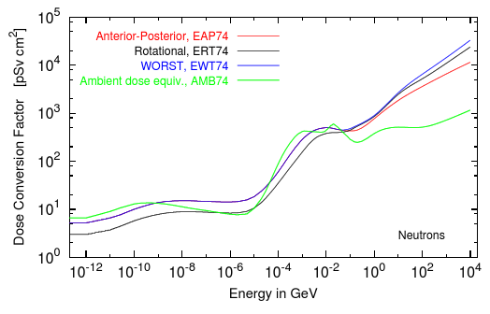
background comparison what has changed with the neutron dose?
Dose is computed using a weight factor that strongly depends on the kinetic energy of the neutron.
I used “ambient dose equivalent” but choice is not unique.
Fig. 2 taken from S. Roesler et.al., CERN-SC-2006-070-RP-TN
25

Slide 27
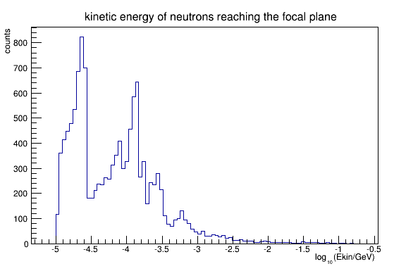
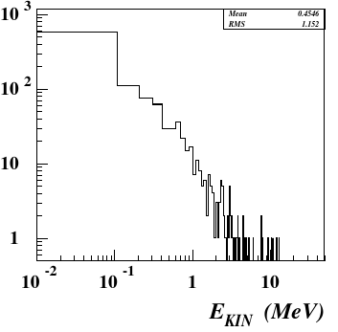
background comparison what has changed with the neutron dose?
Dose is computed using a weight factor that strongly depends on the kinetic energy of the neutron.
26

Slide 28
remaining issues
Nothing catastrophic has appeared due to changes in the beam line geometry.
Overall normalization needs to be set by measurement.
The beam dump is a dominant (~50%) source of all neutrons at the focal plane, so we cannot simulate bg without it.
Results are insensitive to halo using the current model, but it is critical to measure the halo during this run both before and after the tagger to check if this is correct.
27

