Slide 1


Status of the Tagger Microscope, Active Collimator, and Diamond Radiators
Alex Barnes, Brendan Pratt, Jim McIntyre
University of Connecticut

Slide 2
Outline
Tagger Microscope
  QA and installation pictures
  Status update
Active Collimator
  Assembly and installation pictures
  Status update
Diamond radiator update

Slide 3
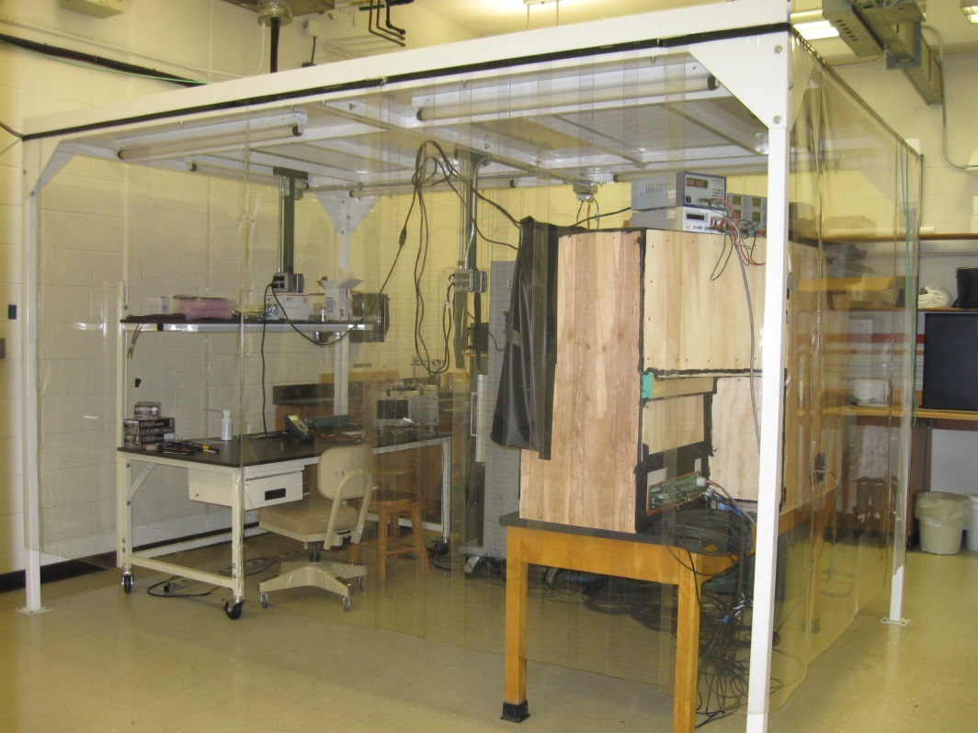
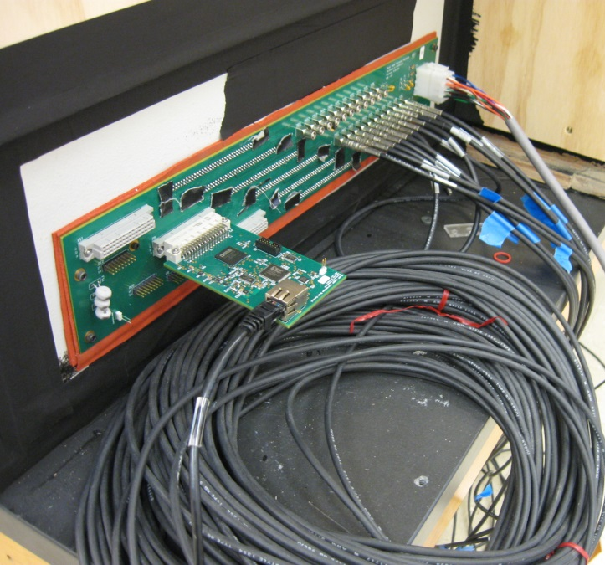
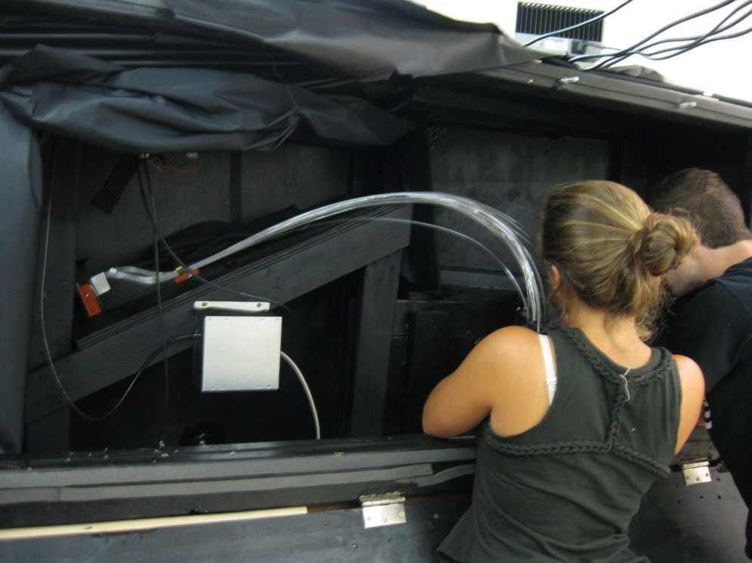
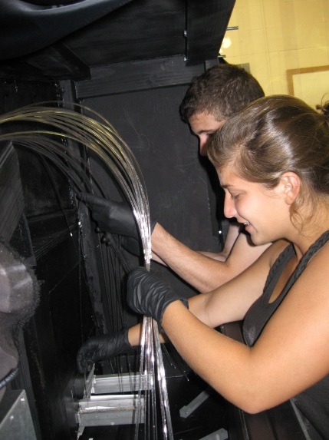
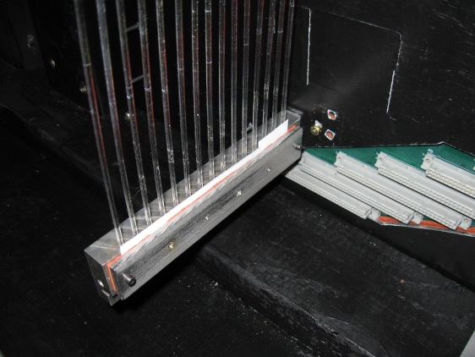
Fiber Testing

Slide 4
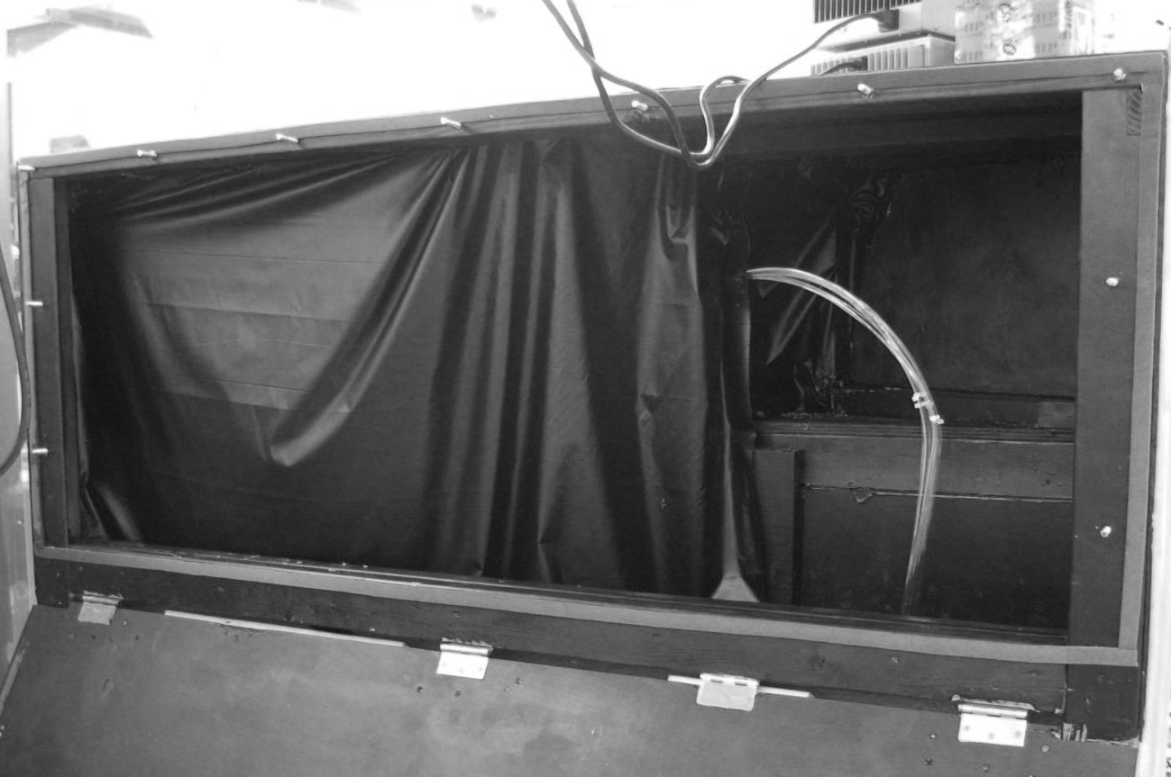
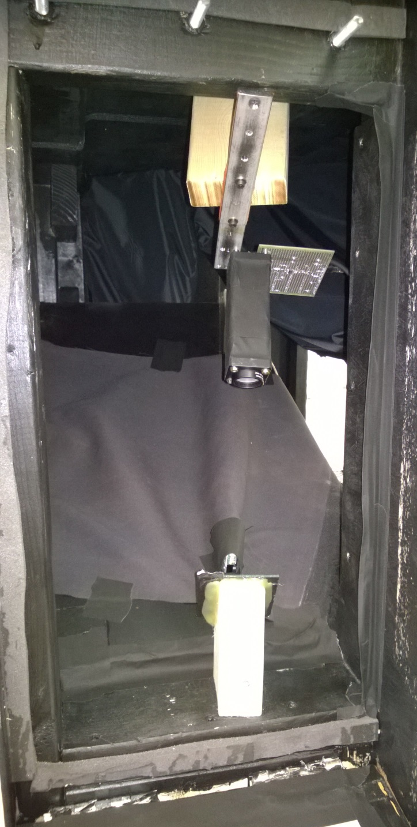
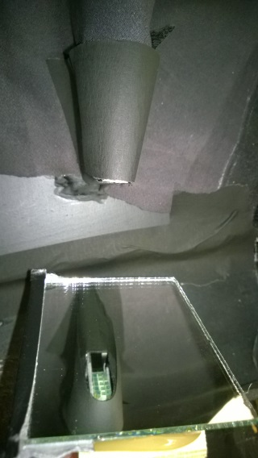
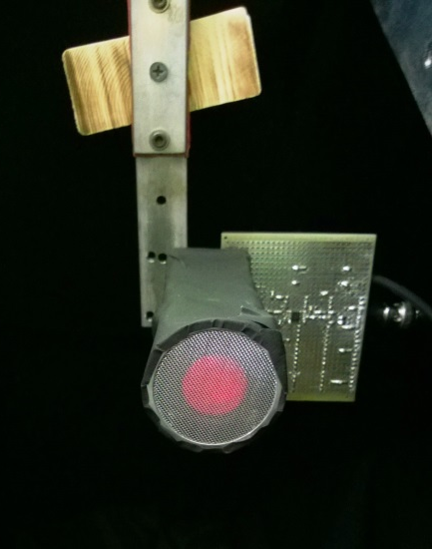
Fiber Testing
Travelers
https://docs.google.com/spreadsheets/d/1cjj6p-OVIR4cCQZWzbyLG4as_u3RQJ7Jt6vbKmPDzgY/edit?usp=sharing

Slide 5
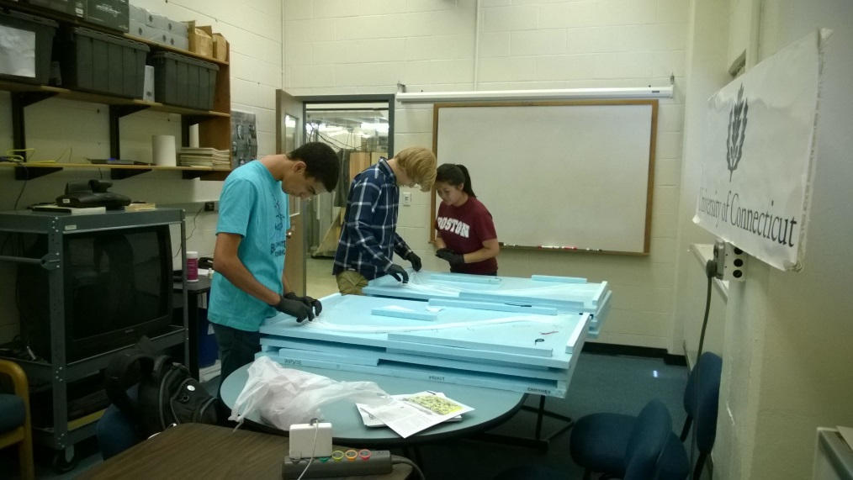
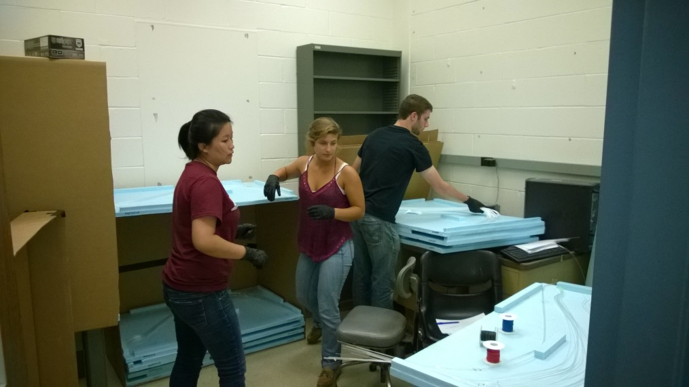
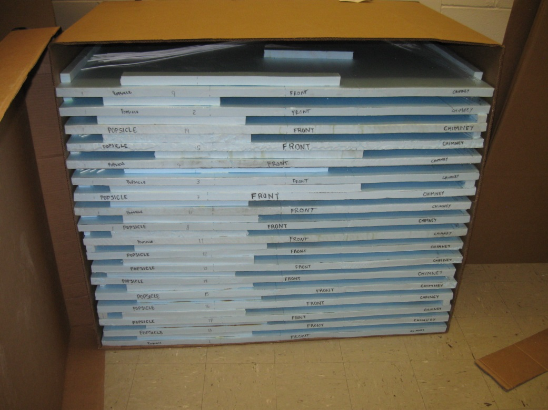
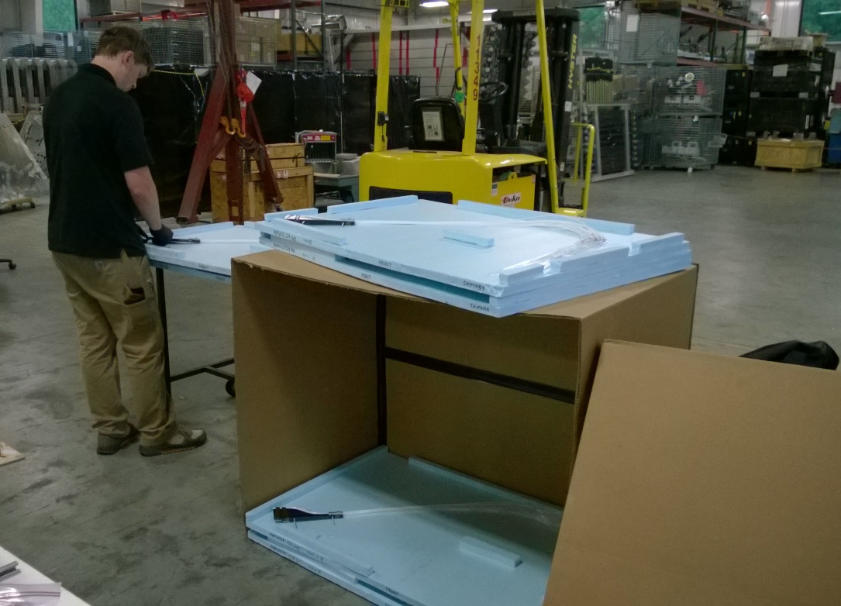
Storing Fibers for Shipment

Slide 6
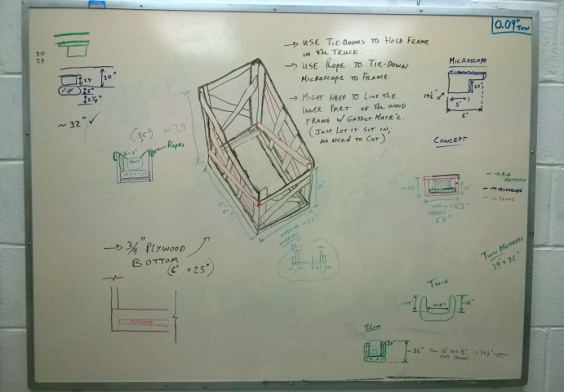
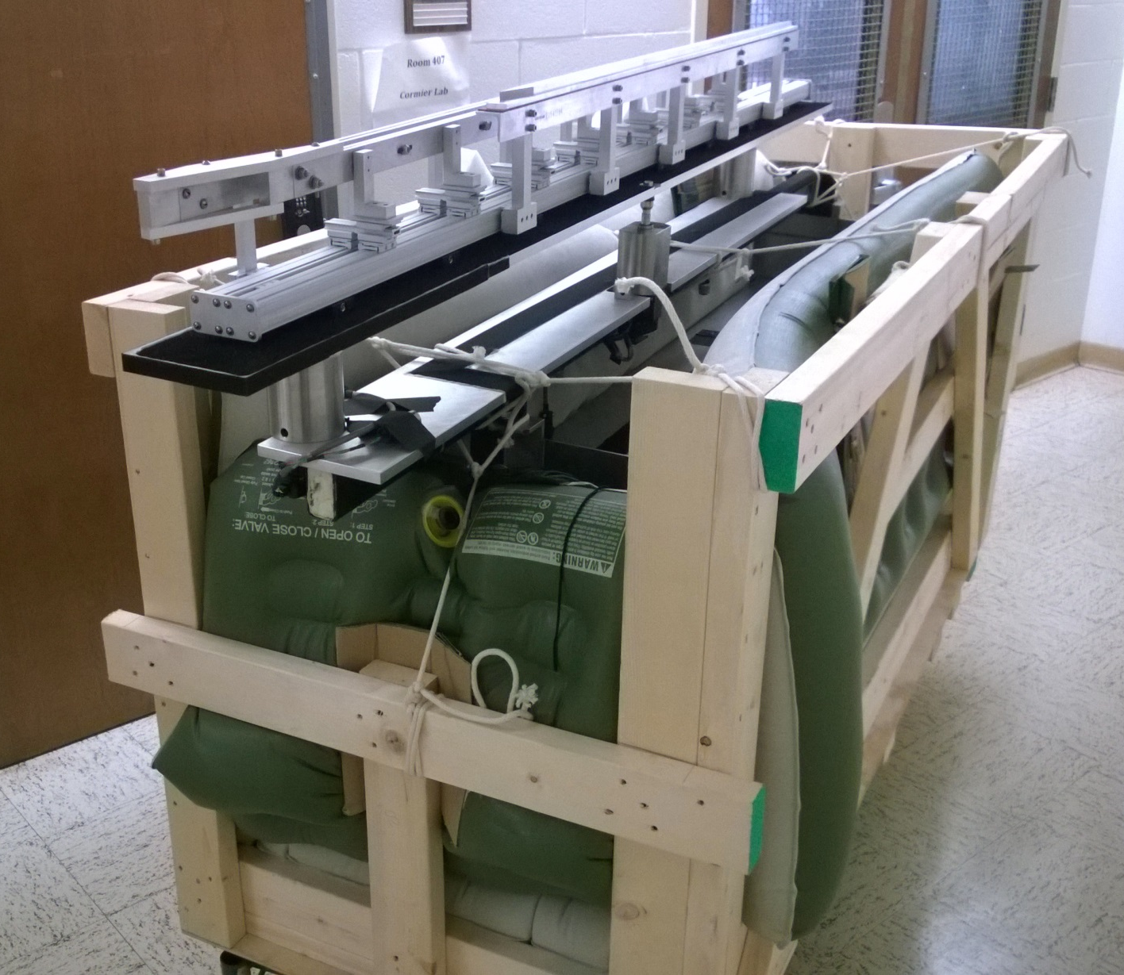
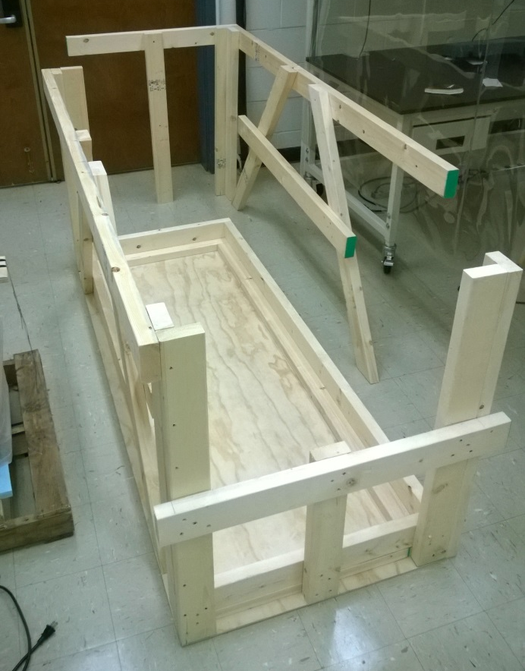
Packaging the Microscope for Shipment

Slide 7
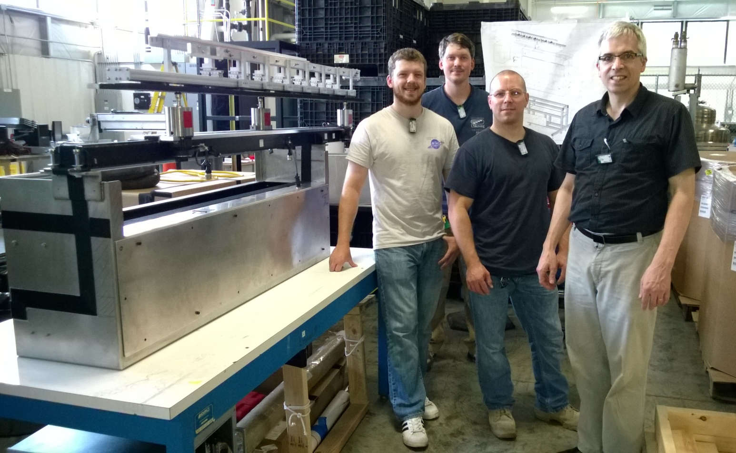

Delivery to ESB at JLab

Slide 8
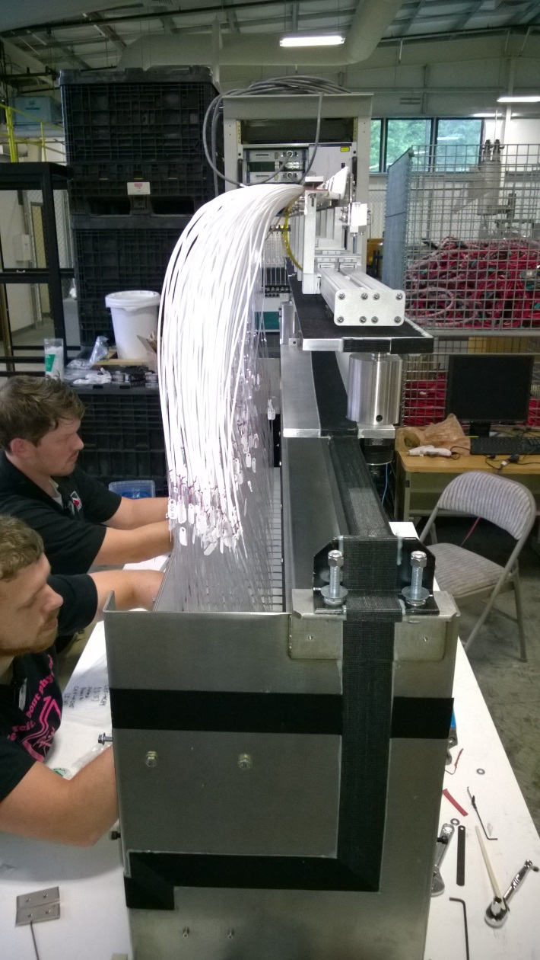
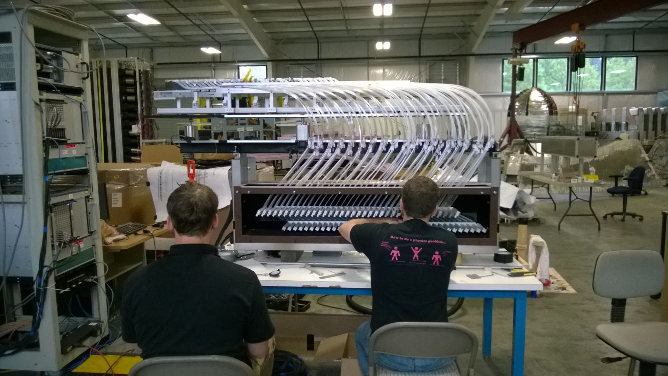
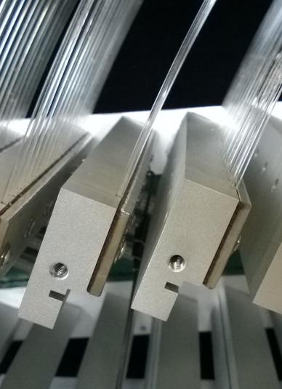
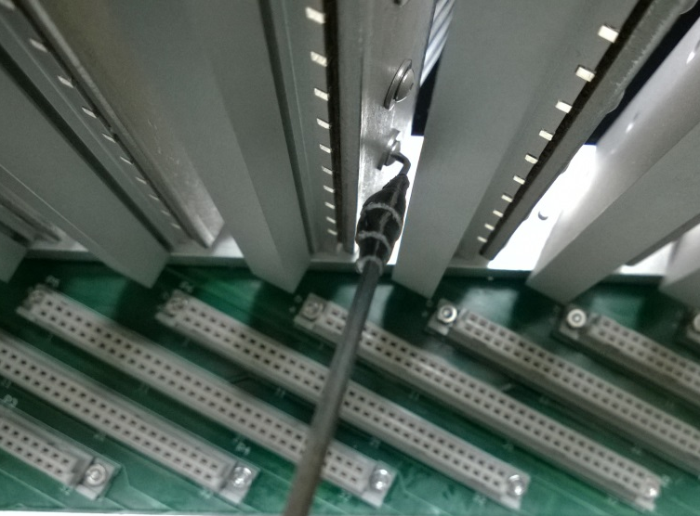
Installation of Optical Fiber Bundles
216
Screws

Slide 9
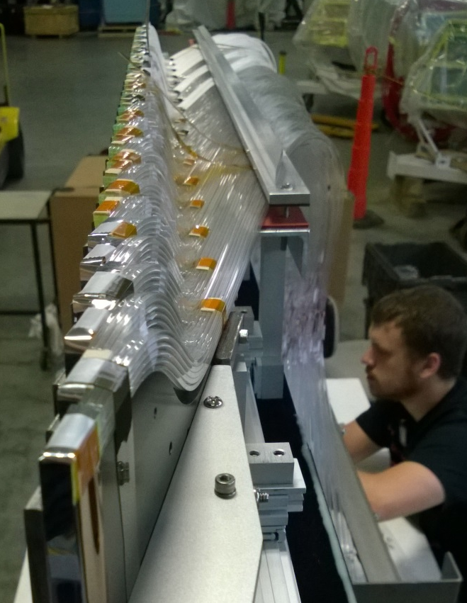
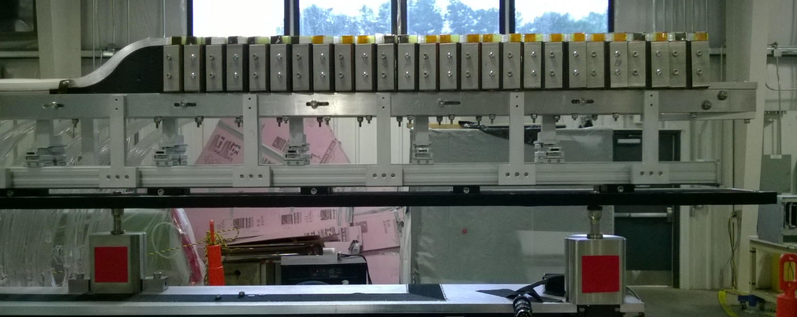
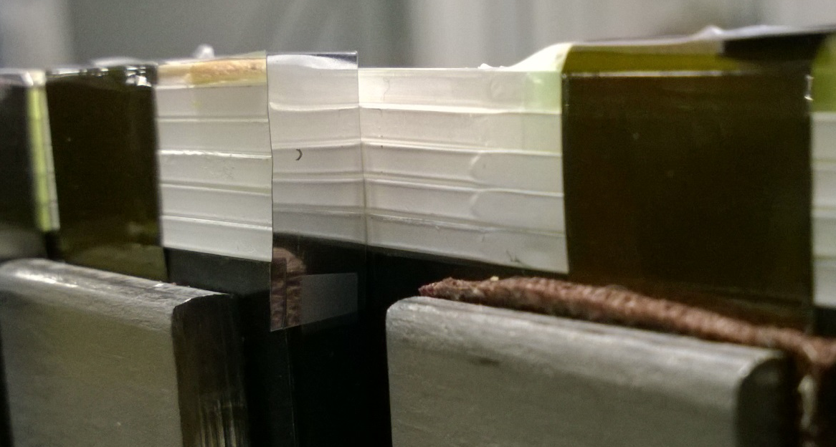
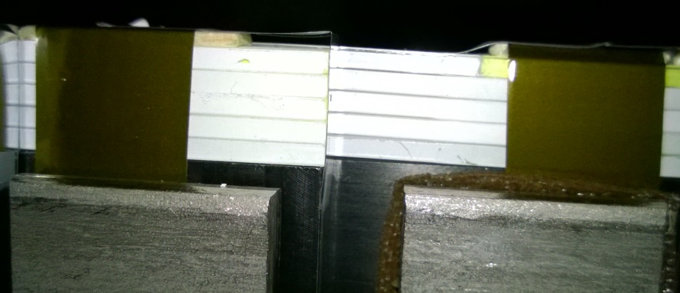
Installation of Optical Fiber Bundles
Mylar Reflector
Side View

Slide 10
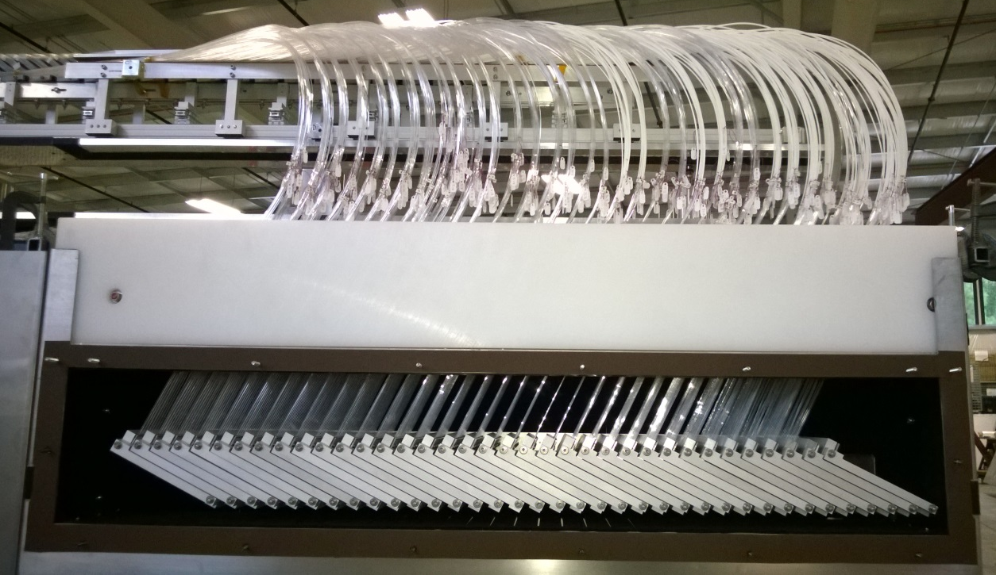
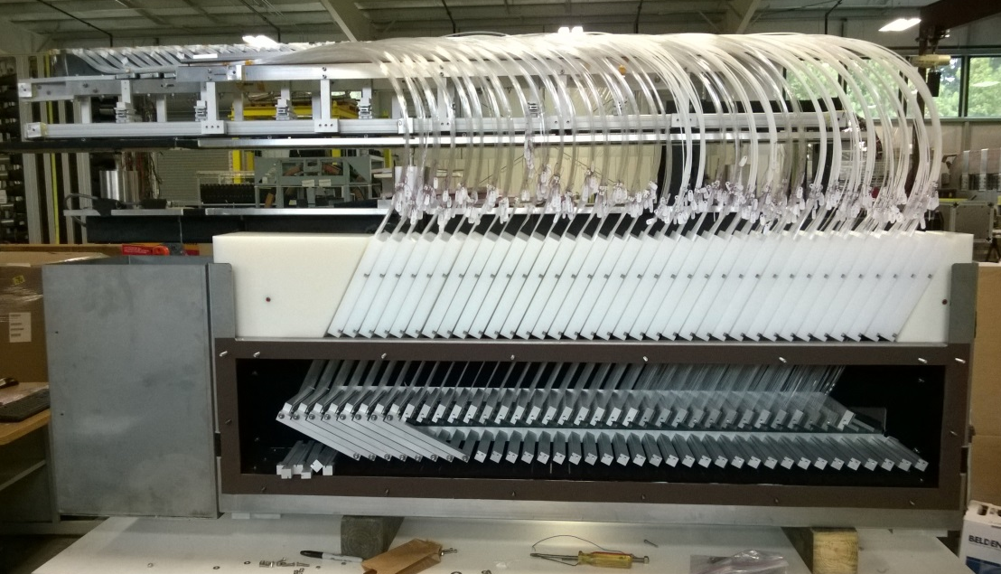
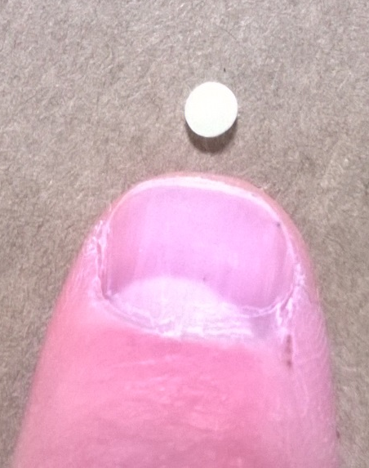
Installation of Shielding
Filled with
Granular Poly.
Shielding

Slide 11
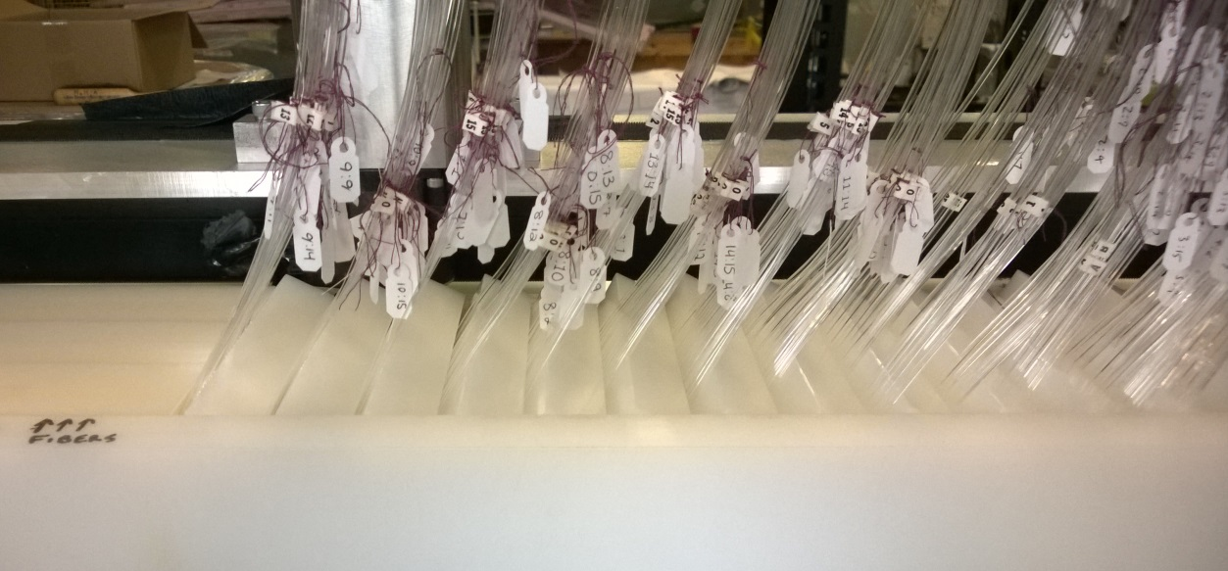
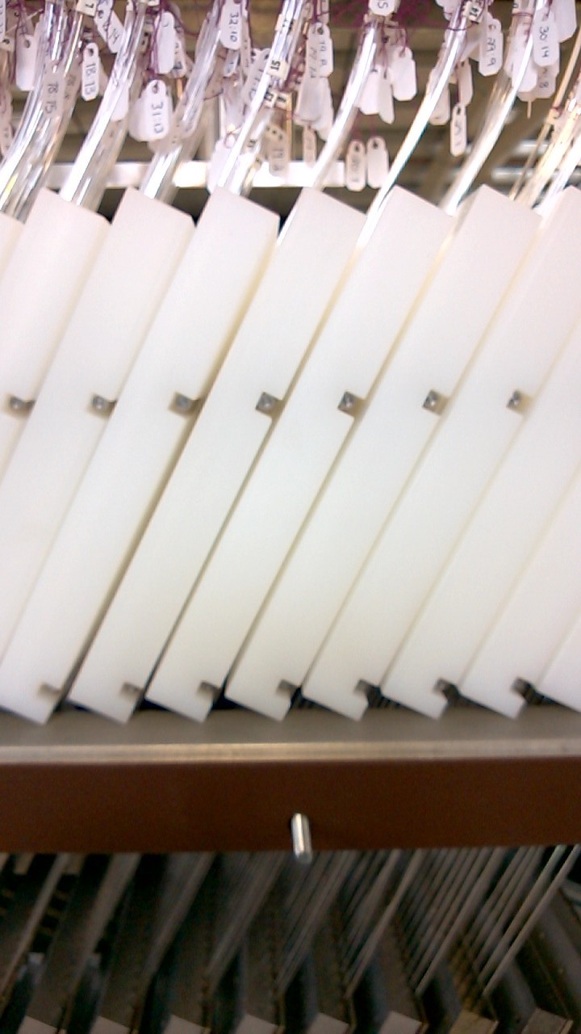
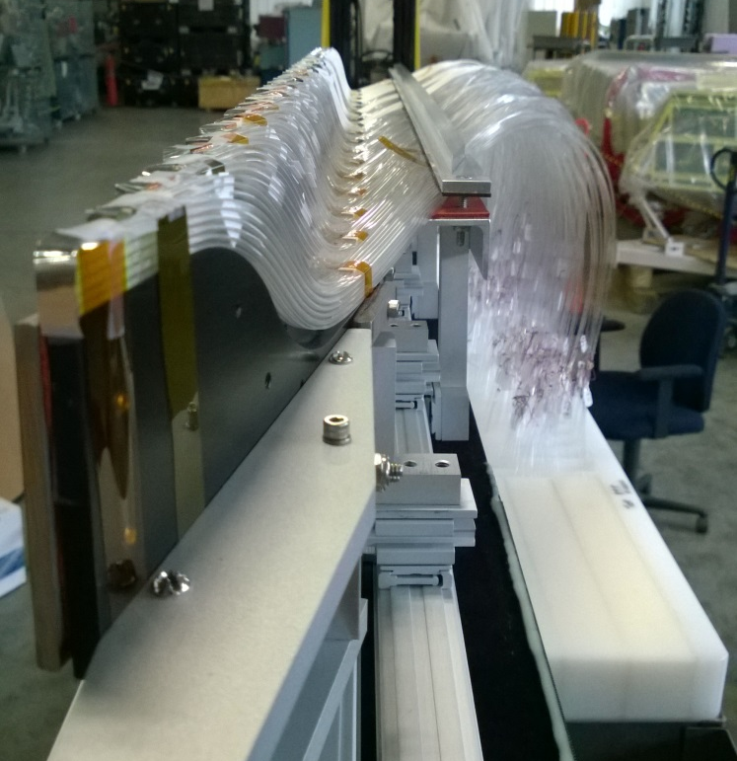
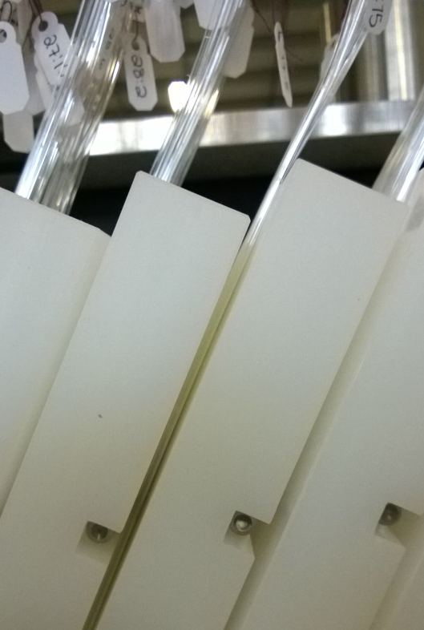
Installation of Shielding

Slide 12
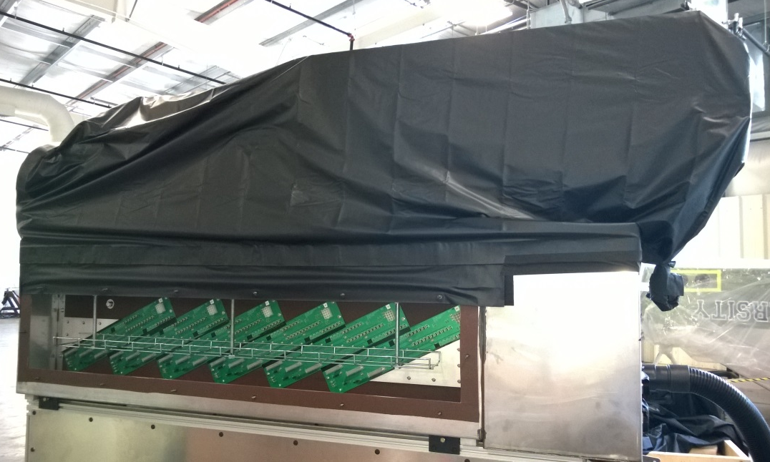
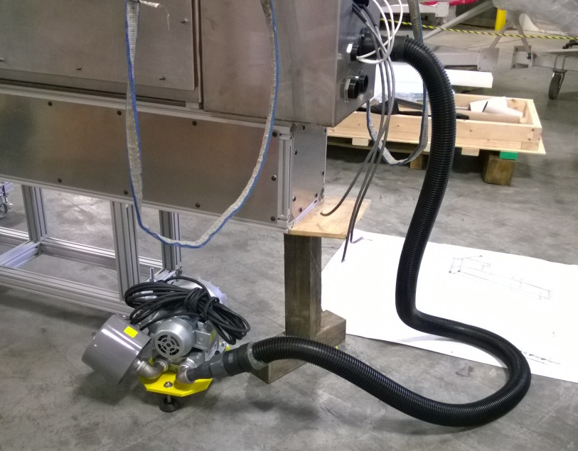
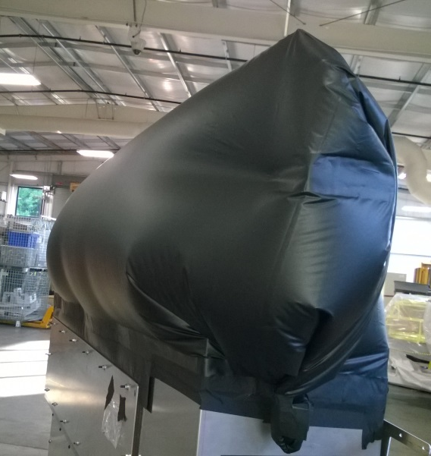
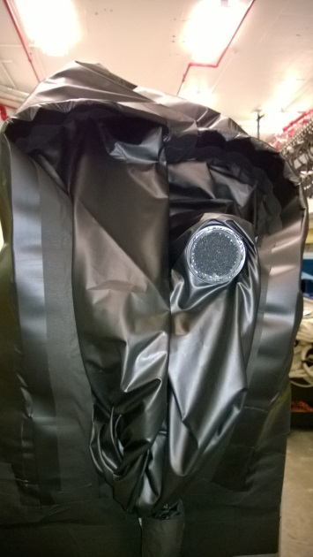

Installation of Darkening Shroud
+
Larger
Light Tight
Air Vent
Required
=
=

Slide 13
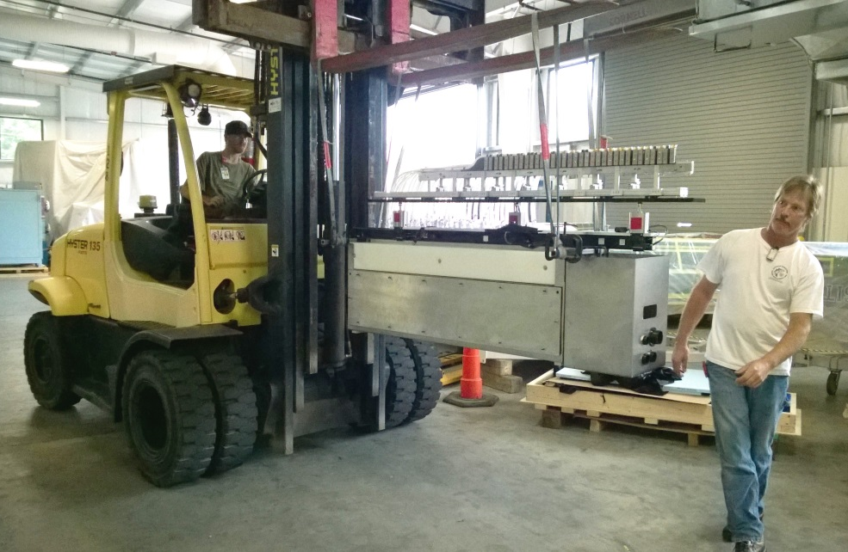
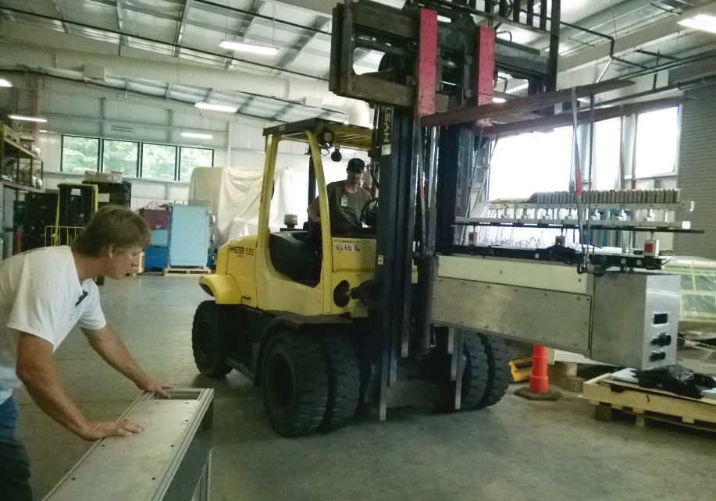
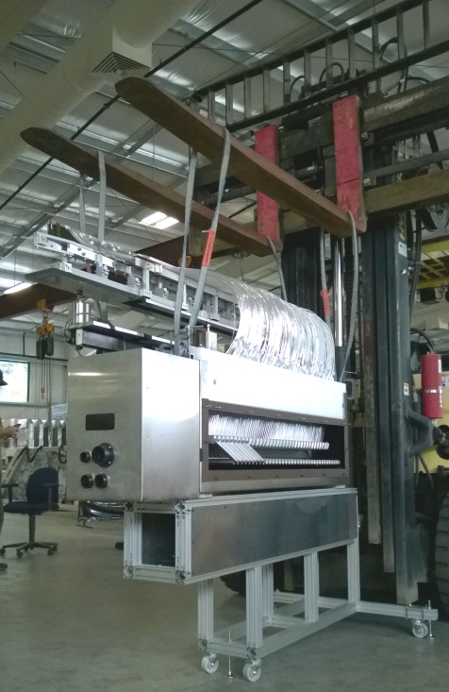
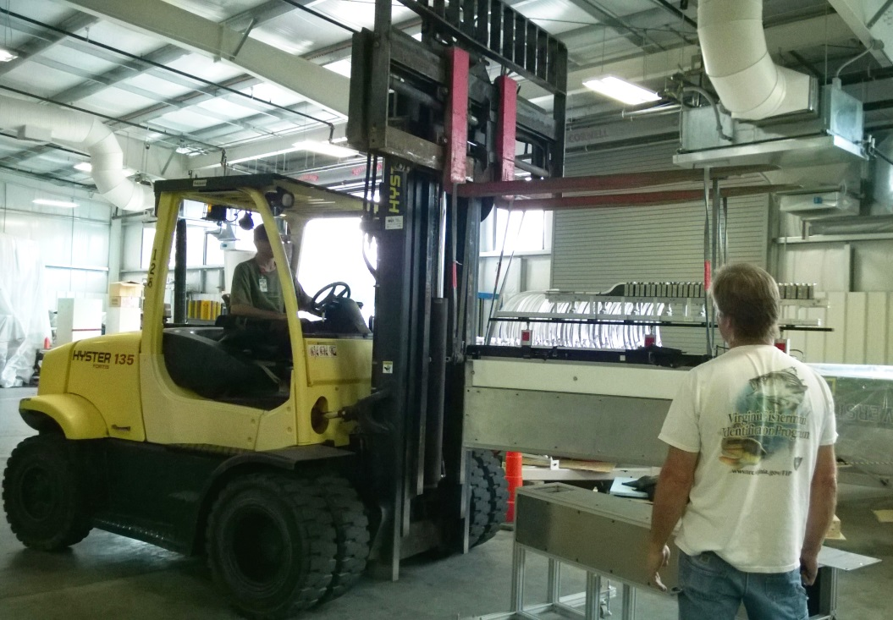
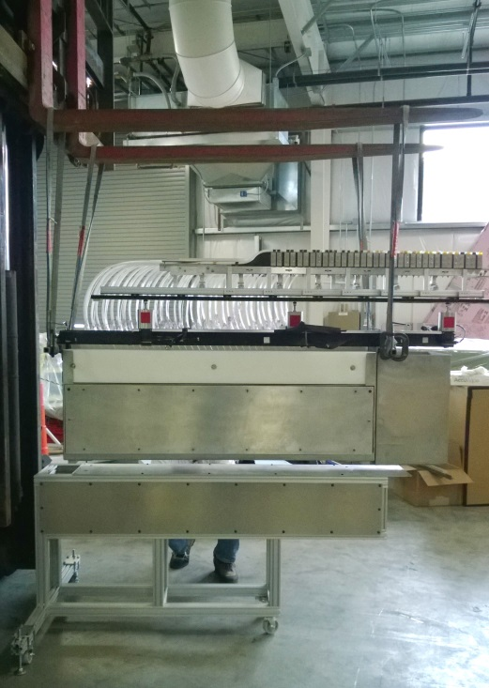
Mounting the Microscope

Slide 14
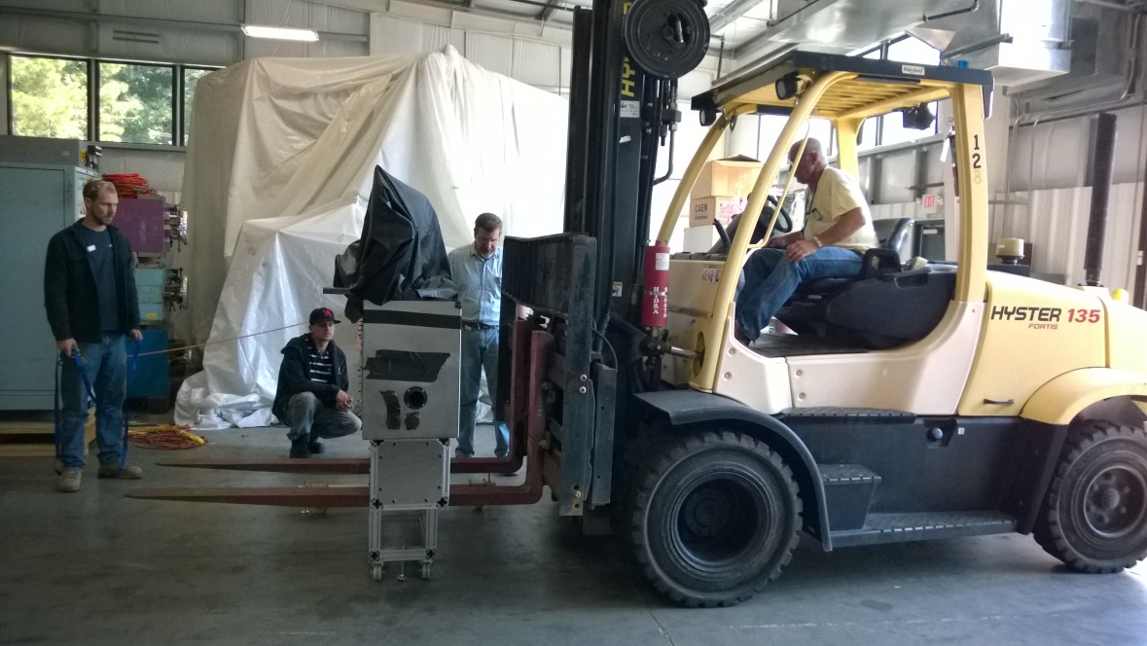
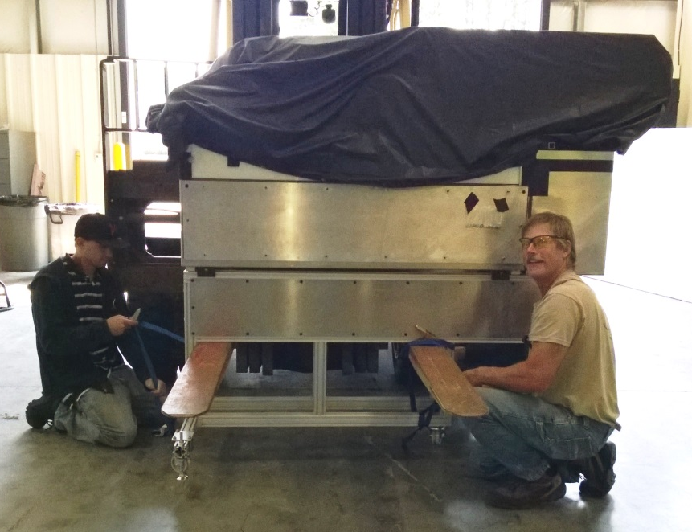
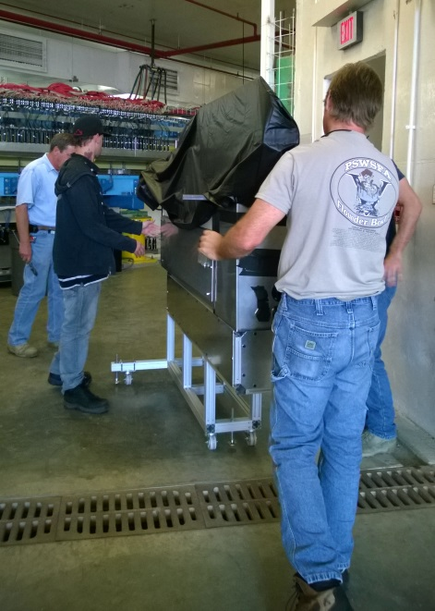
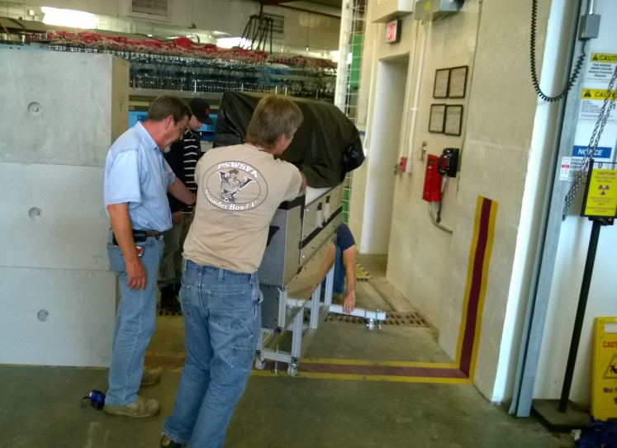
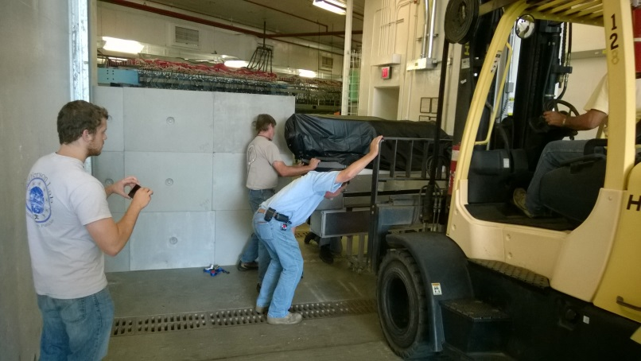
Moving to the Tagger Hall

Slide 15
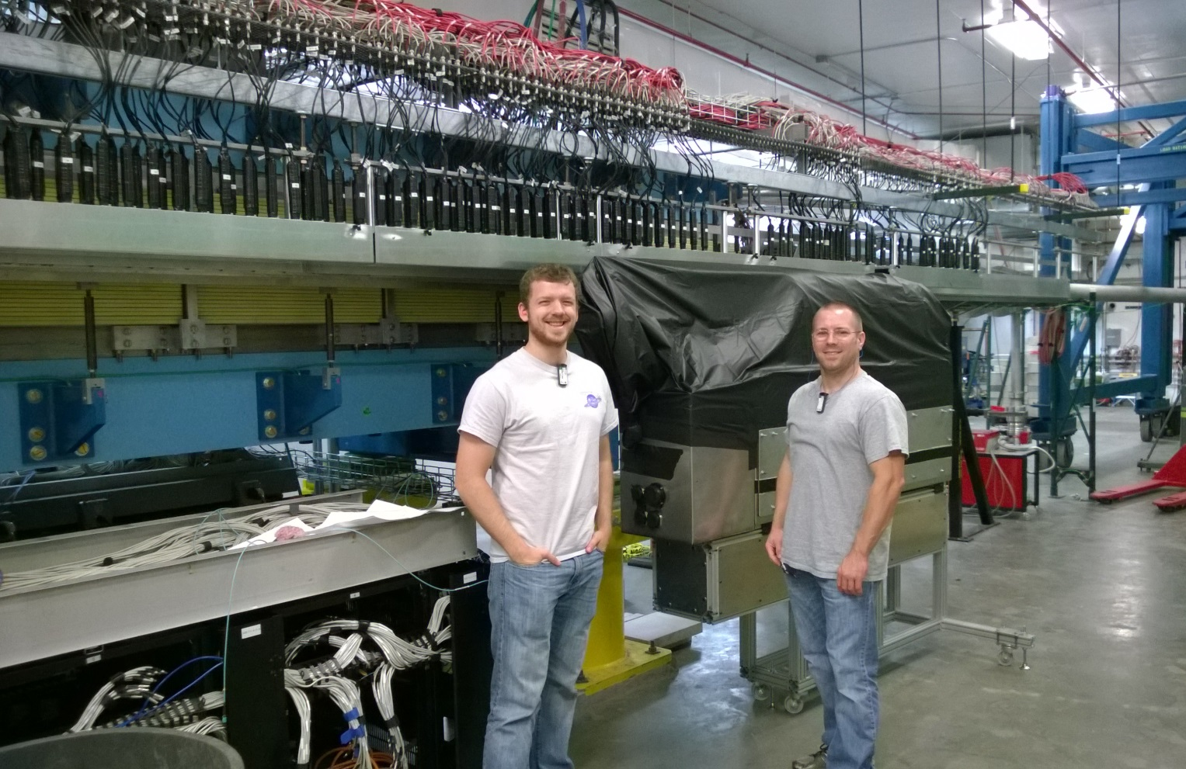
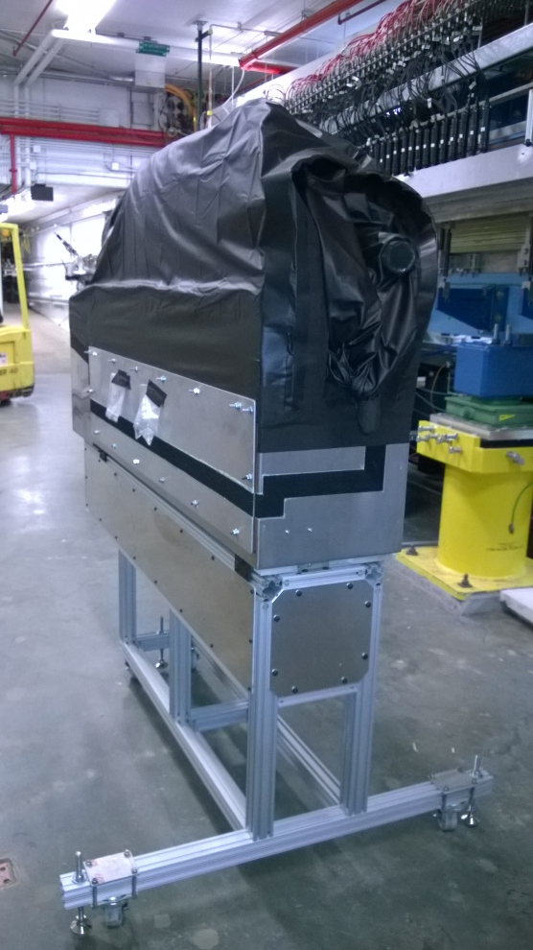
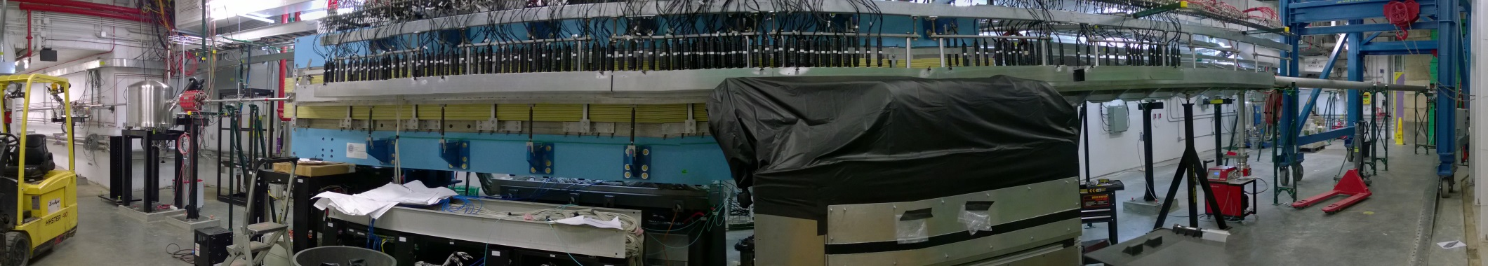
Moving to the Tagger Hall

Slide 16
Microscope Status
Installed, surveyed and cabled
Stepper motors tested, fibers lowered
Immediate work
  Set up and test the DAQ
  Want days of cosmics, need at least dark rate measurements
Future work
  Reduce internal pressure from air cooling system
  Add two more holes for cabling
  Control and monitoring software
  Data monitoring and calibration

Slide 17
Control and Monitoring Software
Interface for controlling TAGM power supplies
Interface for controlling SiPM preamps
  Bias voltages (15 SiPMs x 34 boards = 510 voltages)
  Gainmode (1x, 14x)
Interface for controlling TAGM alignment
  3 stepper motors
Interface for slow controls monitoring
  DAC health voltage (1 for each control board, 17 total)
  Preamp reference voltages (1 per preamp, 34 total)
  Preamp temperatures (1 per preamp, 34 total)
  Alarms for values outside of acceptable ranges
The libraries have been written and are waiting to be implemented
  Until then will need a “slow controls ROC” on a local computer with a private Ethernet jack to talk to our frontend

Slide 18
Data Monitoring and Calibration
Pulse height spectra in the TAGM counters
Time spectra relative to the accelerator clock
Total rates per TAGM channel
Calibrate the total pulse height
Measure pedestals for all fADCs
Measure time-pulse height correlations to derive optimal time-walk corrections
Run in raw mode occasionally to make sure pulse window is properly aligned with actual pulses relative to trigger
Things to monitor online for the tagger microscope

Slide 19
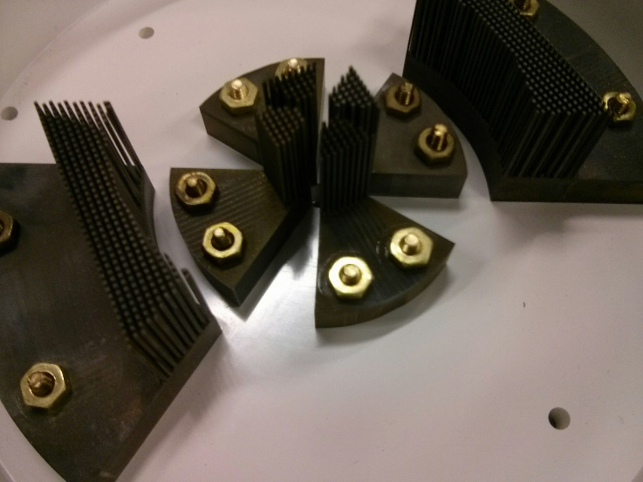



Active Collimator

Slide 20
Active Collimator Status
Fully assembled and installed
Electrical contact between RF connector and screw verified
Preamp shield box constructed and installed
Readout electronics have been finished and installed
Readout electronics tested using a signal injected into the preamps
Controls software in progress

Slide 21
Diamond Radiator Status
Brendan Pratt
University of Connecticut

Slide 22




Simulation of background generation
initial design concept

Slide 23

A Better Concept from
Ken Livingston

Slide 24

Prints by: Vladislav Razmyslovich

Slide 25

Prints by: Vladislav Razmyslovich

Slide 26
Now We just need to create the “dog ear”

Slide 27


UC30-14-C225

Slide 28


Slide 29
What’s Next?
Keep refining ablation process until “turn key”
  Thin (3) JD70 diamonds
Proposal submitted for upcoming CHESS run
  characterize thinned JD70’s
Begin machining diamond goniometer mount (next 2 weeks)
Waiting for thinned JD70-1 from collaborator SINMAT
  Originally 1.3mm, will be thinned using VPIE to 0.350mm then RCMP to 0.300mm.

