Slide 1
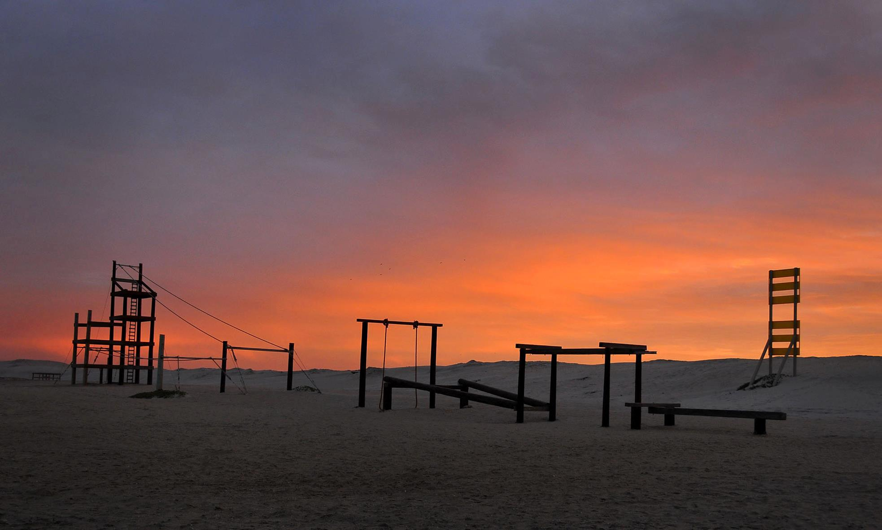


Tagger Microscope
Construction Update
GlueX Collaboration Meeting
JLab, Oct. 4-6, 2012
J. M^{c}Intyre, A. Barnes, R. Jones

Slide 2
GlueX Collaboration Meeting, JLab
October 4-6, 2012
Outline
Contract Status
  Q.A. plan
  construction plan
Preparations for construction
  populating the construction space
Microscope electronics
  adaptation for 50 micron pixel SiPMs
  scintillation yield with cosmic rays

Slide 3
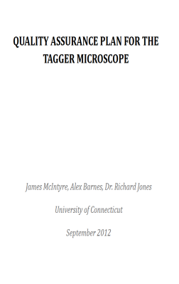
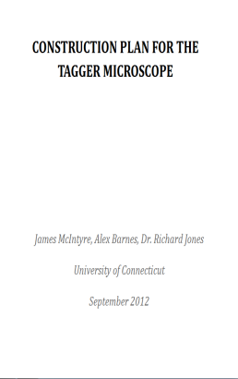
GlueX Collaboration Meeting, JLab
October 4-6, 2012
Contract Status
Quality Assurance & Acceptance Test Plan
  Draft – Sept. 2012
  Currently revising based on feedback
    Copy location:
    https://docs.google.com/document/d/1JL40gx7tPDDFu4aSiad3fTemAp0yiVBPI6D8FB5zb6o/edit
Construction Plan
  Draft – Sept. 2012
  ~ 50 page document
  Detailed instructions for construction
  Currently revising based on feedback
    Copy location:
    https://docs.google.com/document/d/15OreBfdhb5mdpdXz6KMTVQt8ZWMU-4OV9i8Y6vp97Ms/edit

Slide 4
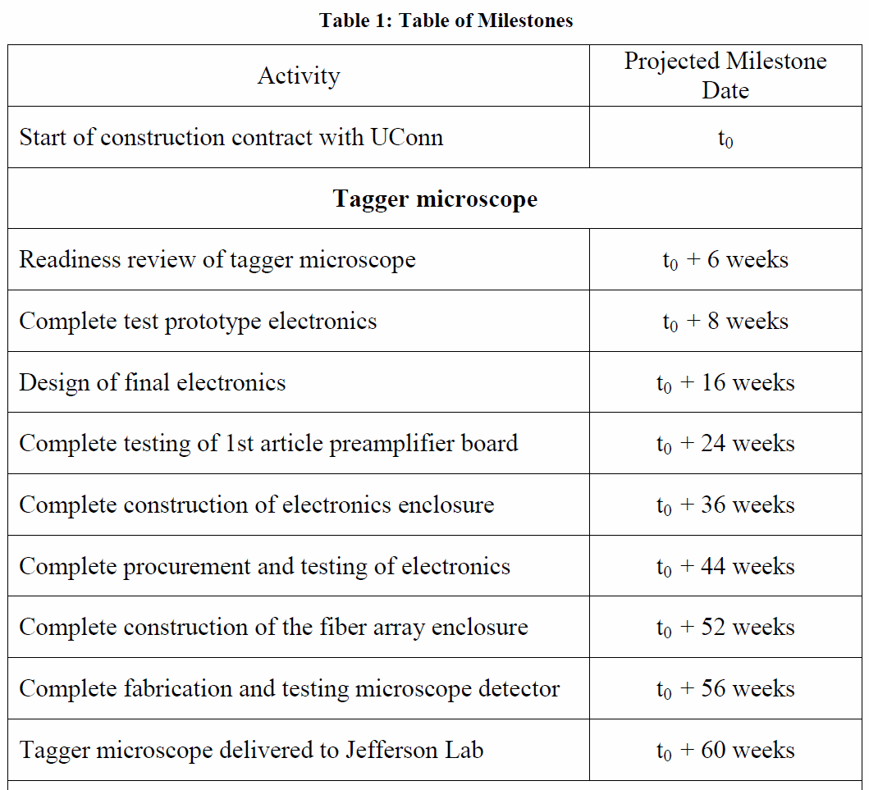
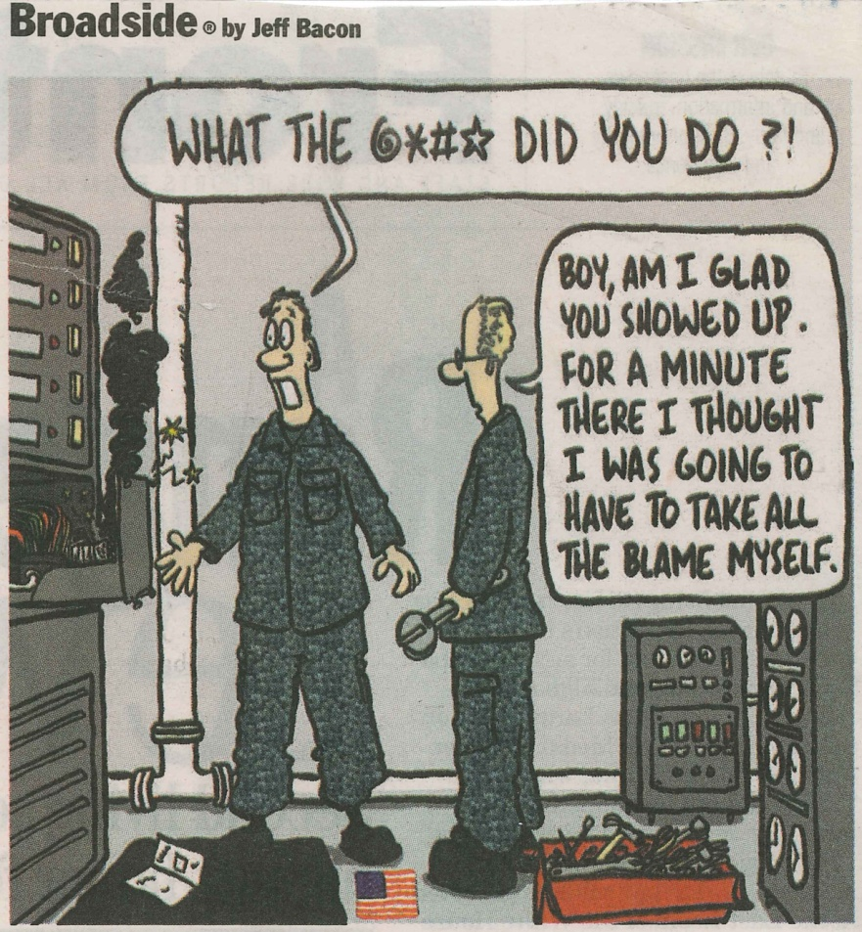
GlueX Collaboration Meeting, JLab
October 4-6, 2012
Construction Status
Contract timeline
  Tagger Microscope
  t₀ - October 2012 → ???

Slide 5
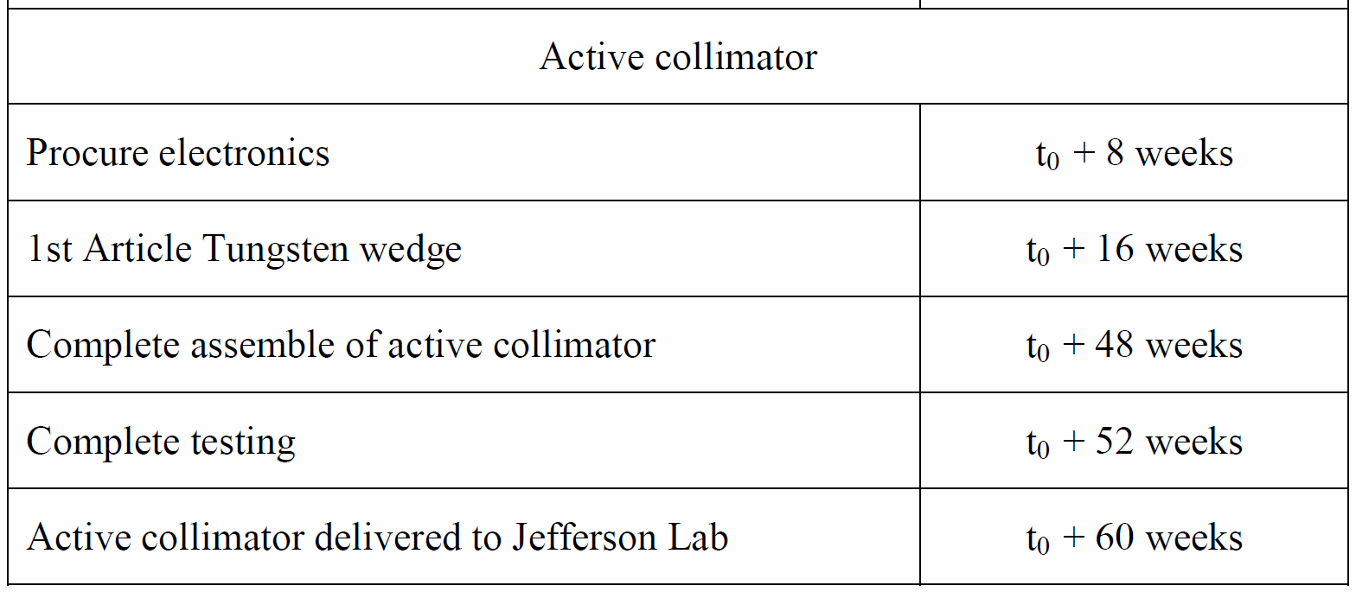
GlueX Collaboration Meeting, JLab
October 4-6, 2012
Construction Status
Contract timeline
  Active Collimator

Slide 6
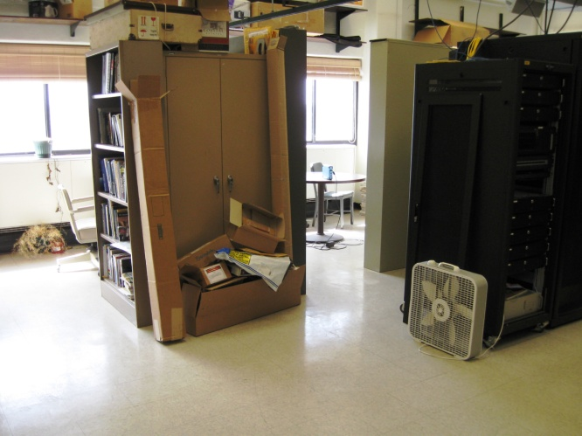
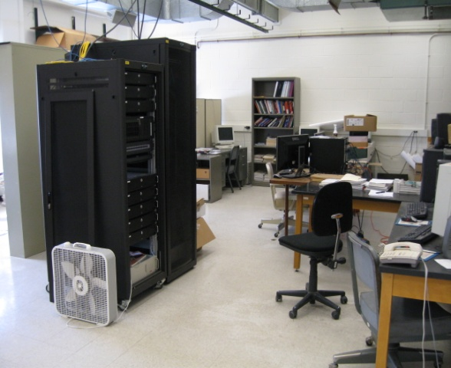
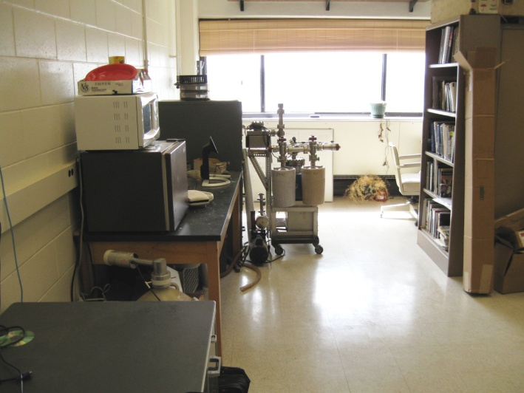
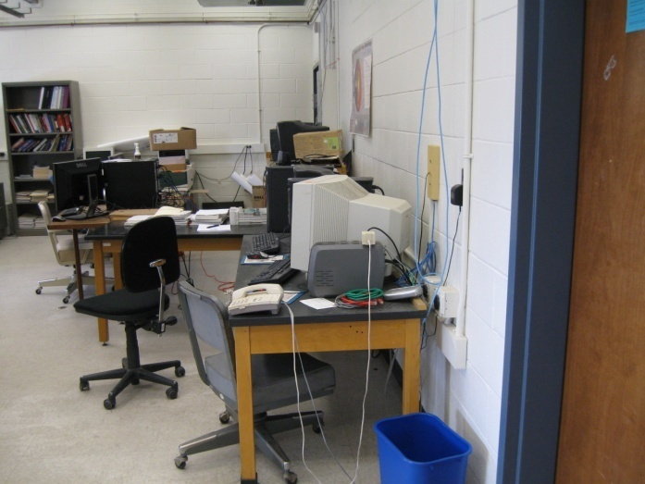
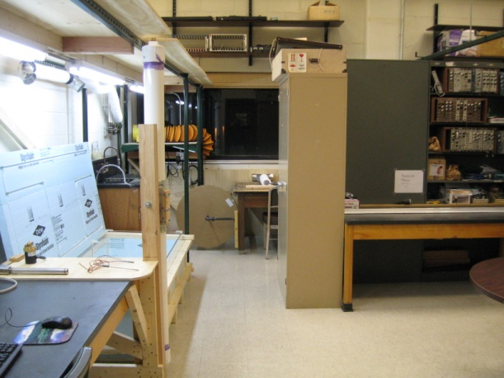
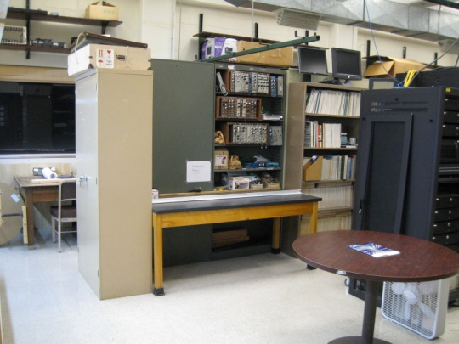
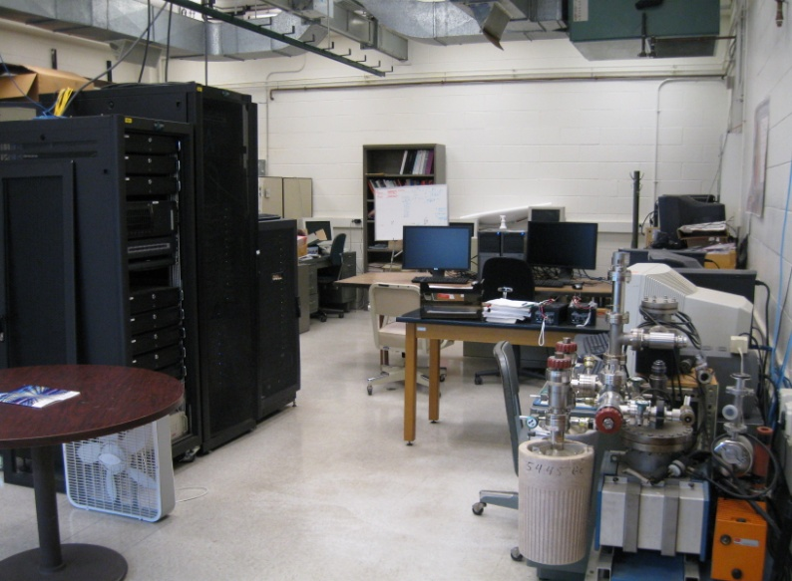
GlueX Collaboration Meeting, JLab
October 4-6, 2012
Preparations for Construction
Before
After

Slide 7
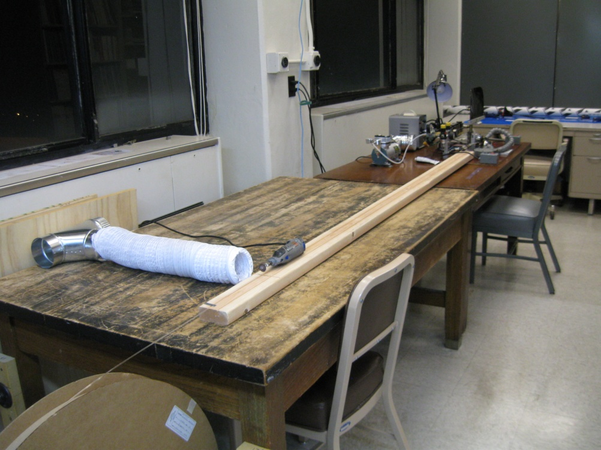
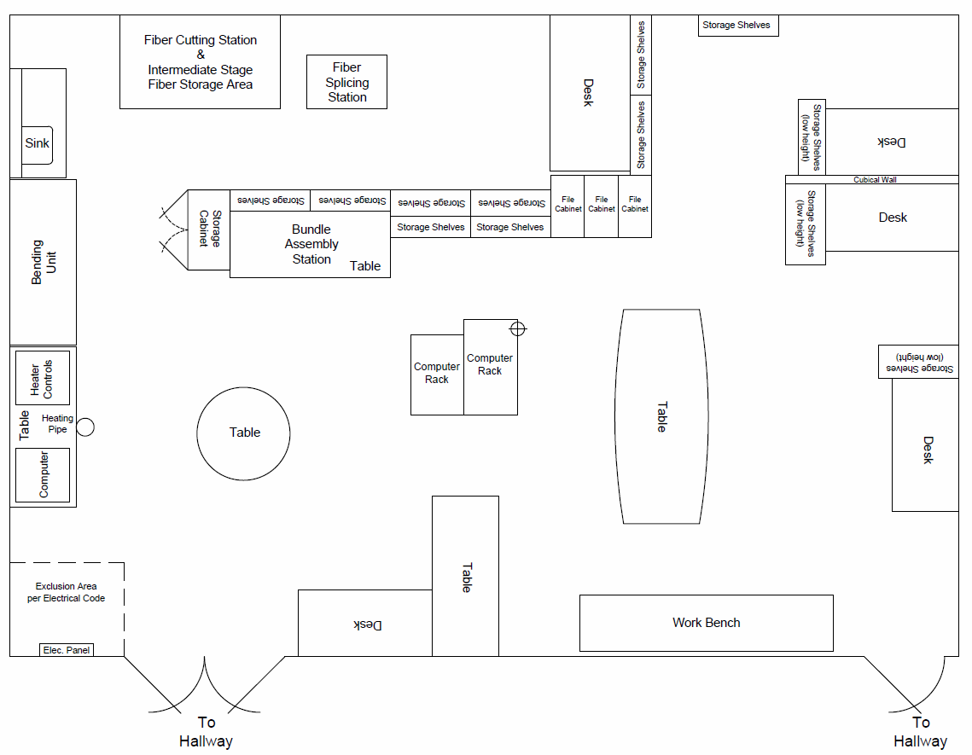
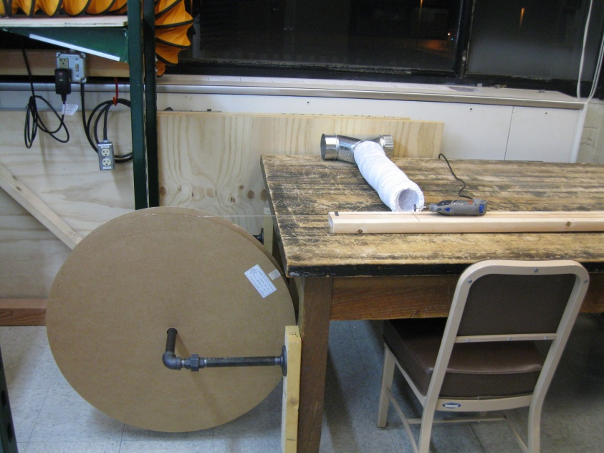
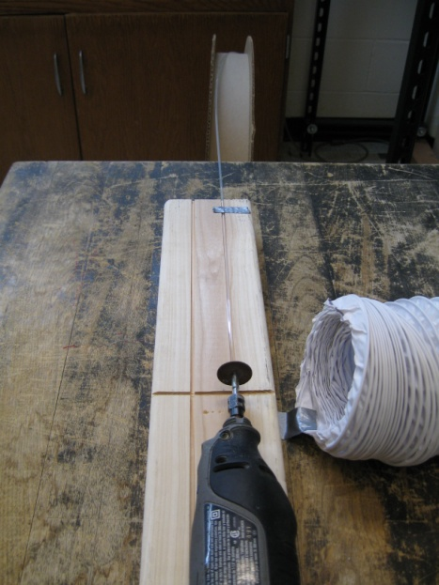
GlueX Collaboration Meeting, JLab
October 4-6, 2012
Populating the Construction Area
Fiber Cutting Station

Slide 8
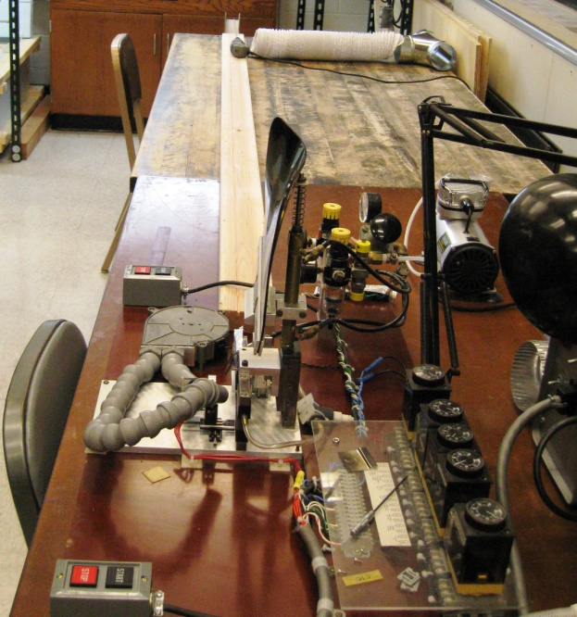
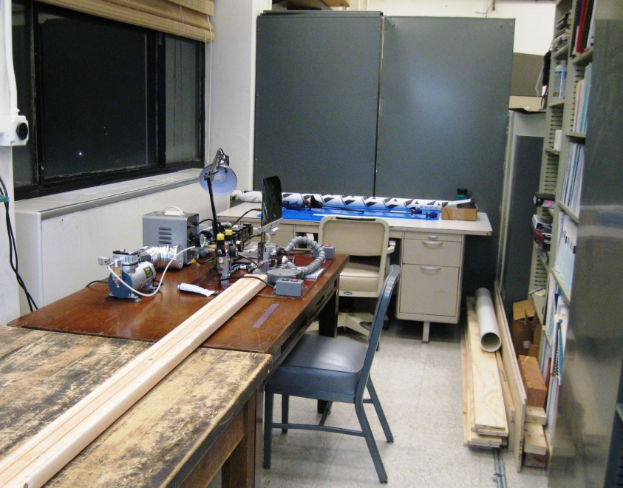
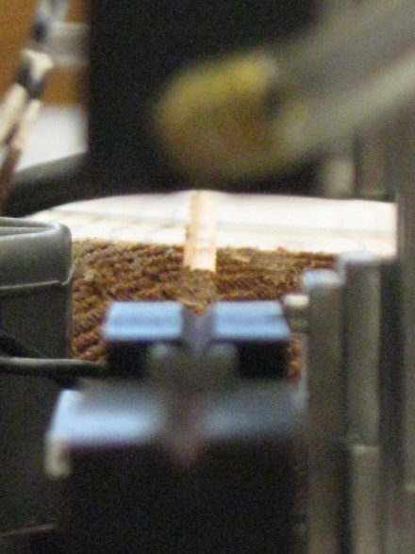
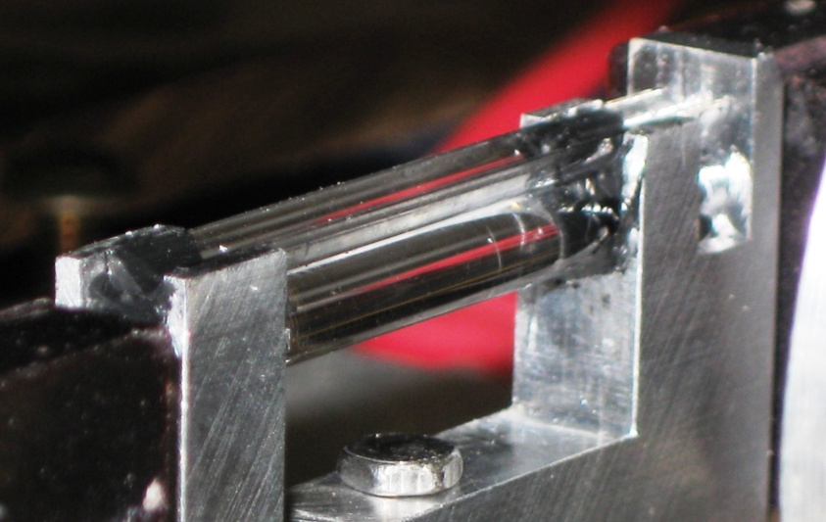
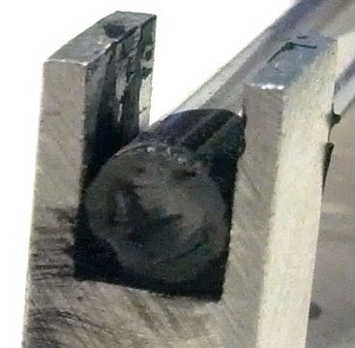
GlueX Collaboration Meeting, JLab
October 4-6, 2012
Populating the Construction Area
Fiber Splicing Station

Slide 9
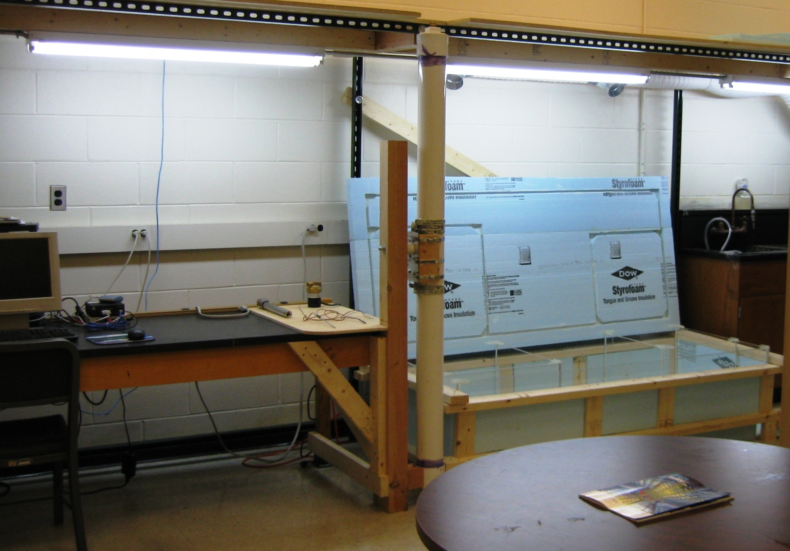
GlueX Collaboration Meeting, JLab
October 4-6, 2012
Populating the Construction Area
Heat Treating Fibers

Slide 10
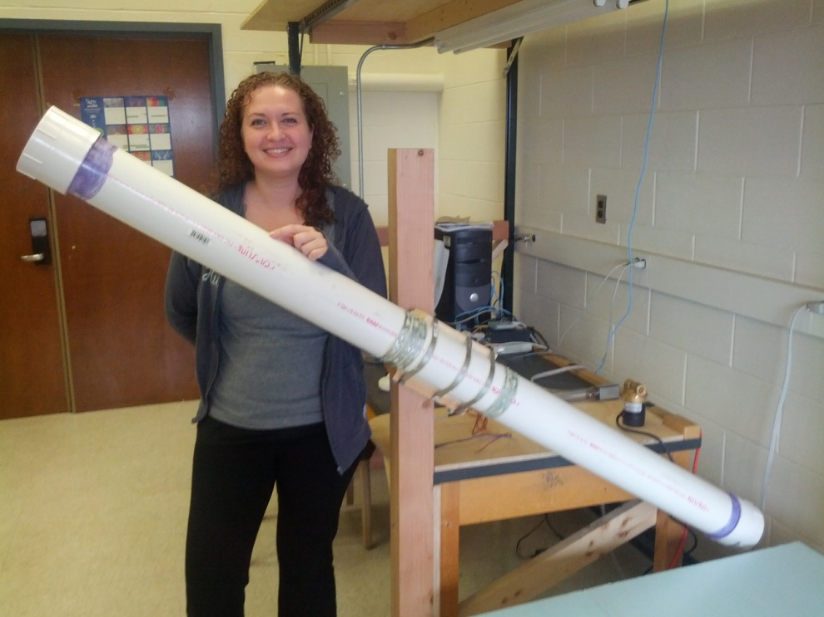
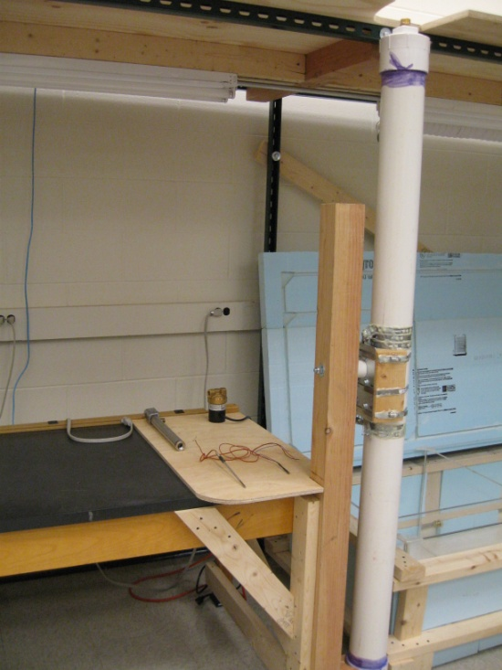
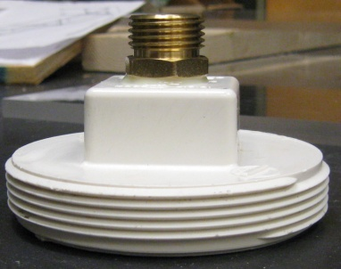
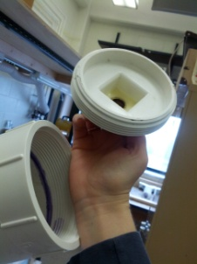
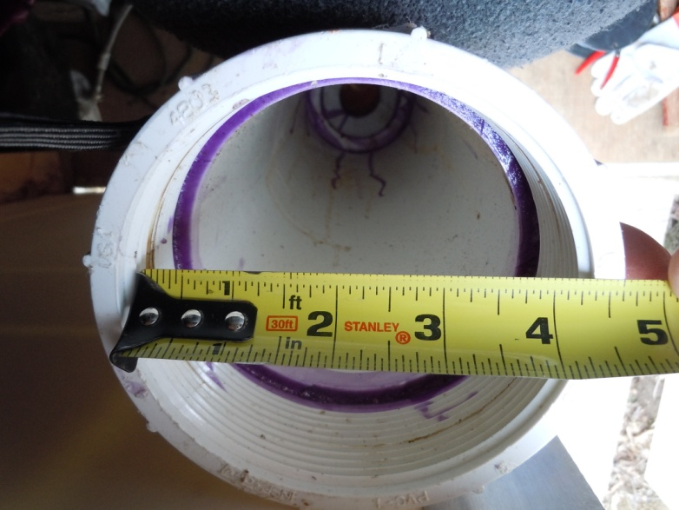

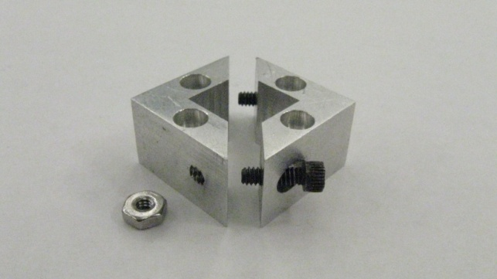
GlueX Collaboration Meeting, JLab
October 4-6, 2012
Populating the Construction Area
Heat Treating Fibers

Slide 11
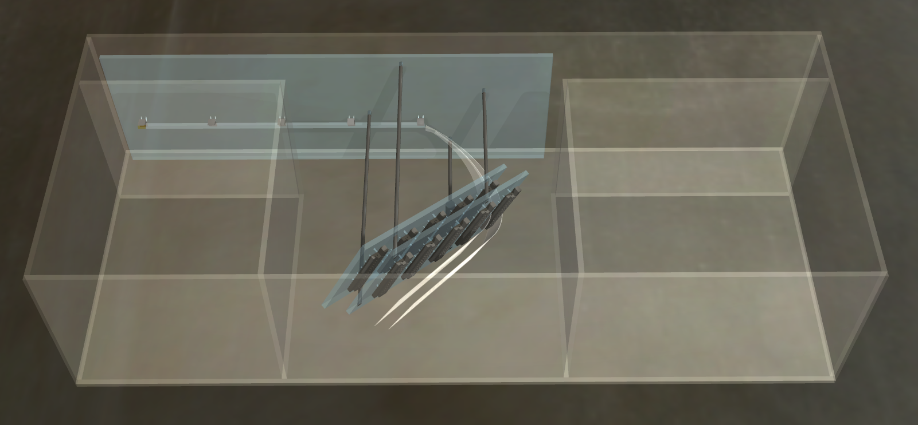
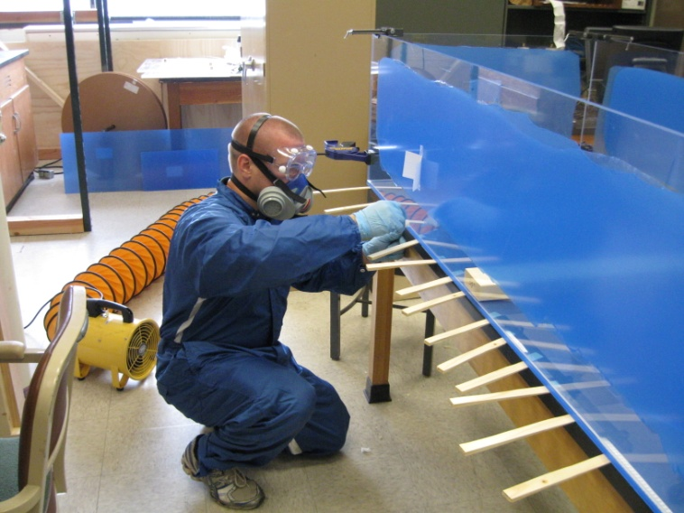
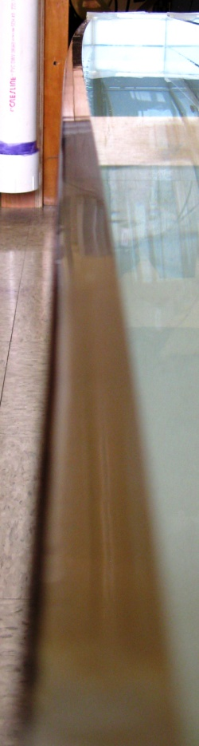
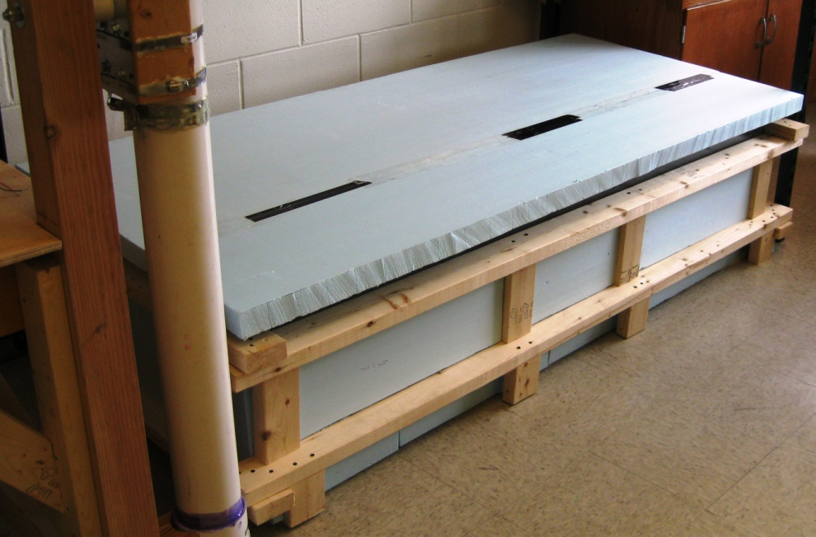
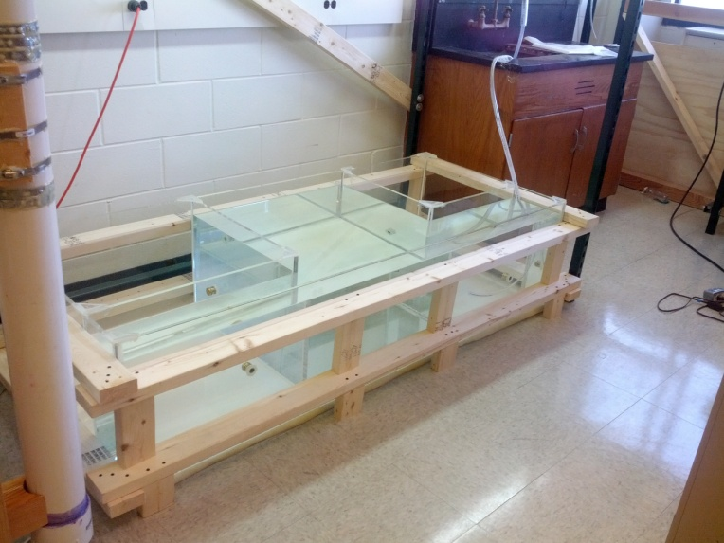
GlueX Collaboration Meeting, JLab
October 4-6, 2012
Populating the Construction Area
Heat Treating Fibers

Slide 12
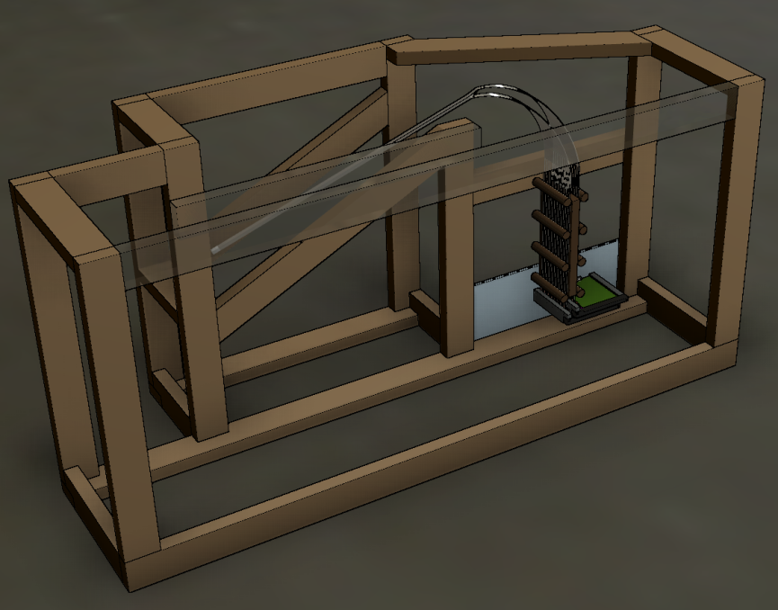
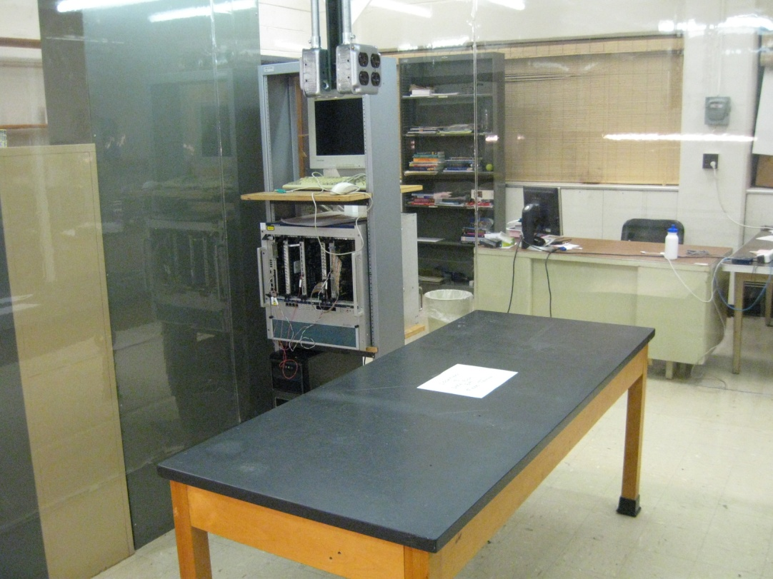
GlueX Collaboration Meeting, JLab
October 4-6, 2012
Populating the Construction Area
Fiber Testing Station
(inside a clean room)
Dark Box
(main frame)
Allows for testing of:
  Single fibers
  Bundled fibers
  Cooling unit for the electronics’ enclosure

Slide 13
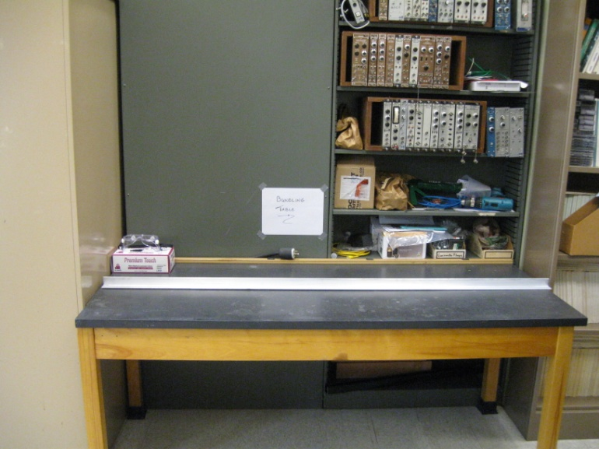
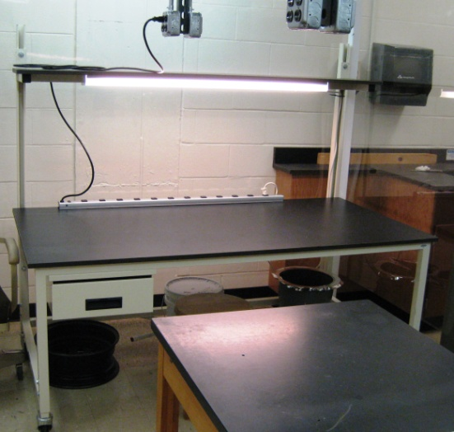
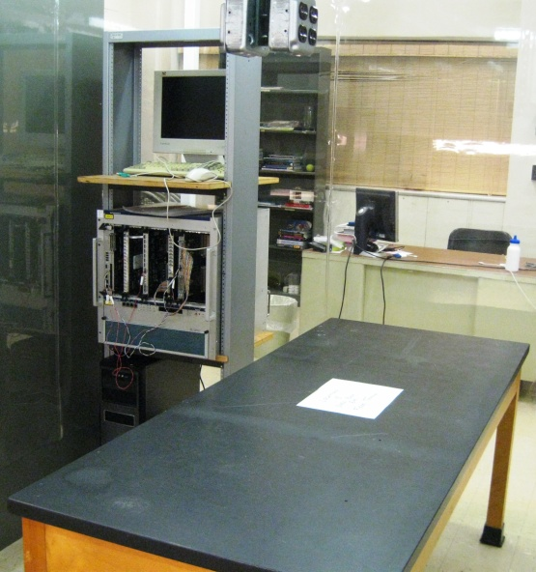
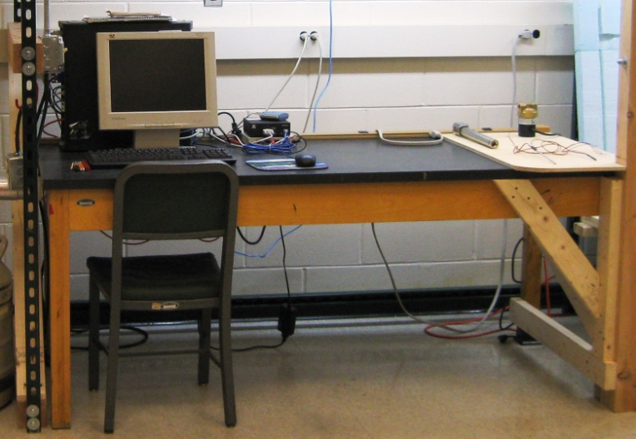
GlueX Collaboration Meeting, JLab
October 4-6, 2012
Populating the Construction Area
Staging Areas &Work Stations
Bundling Table
Work Table
(Clean room)
Heat Treating Station
Fiber Testing Station
(Clean Room)

Slide 14
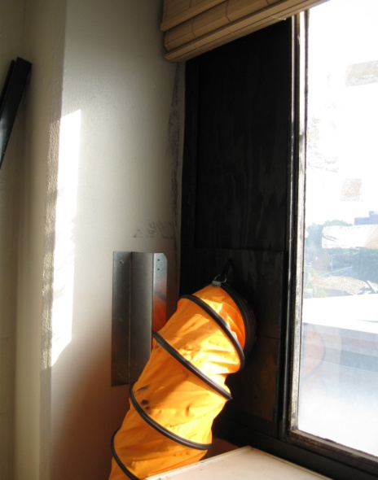
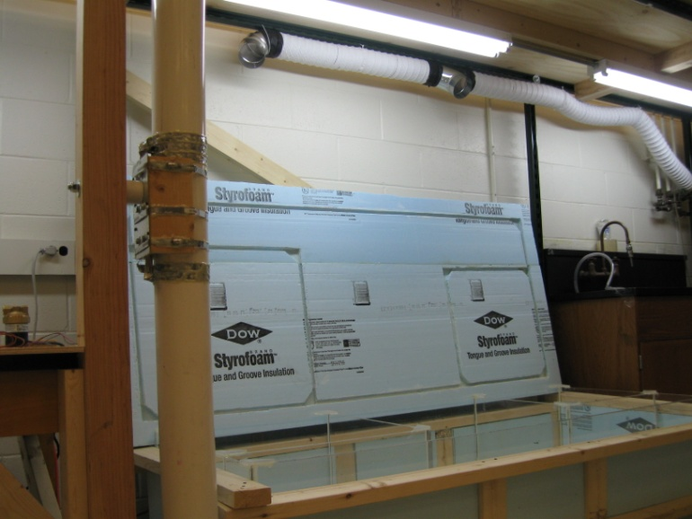
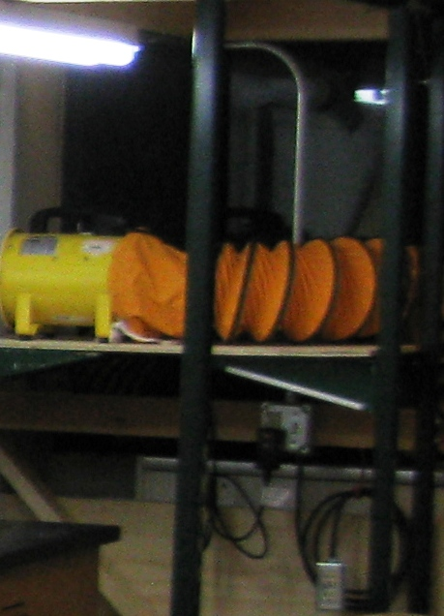
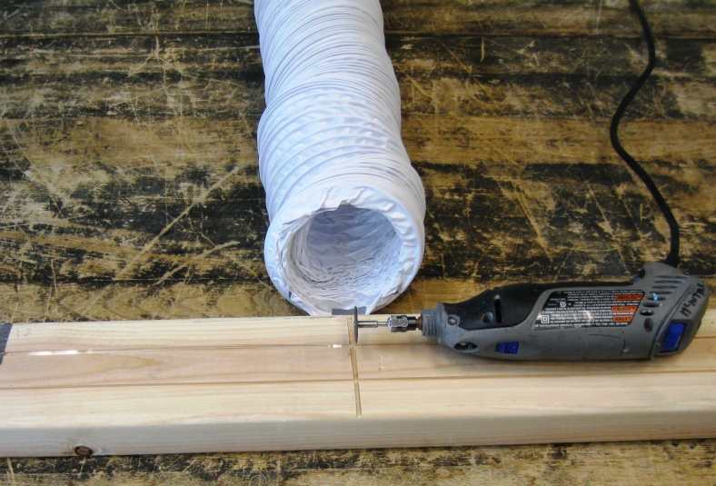
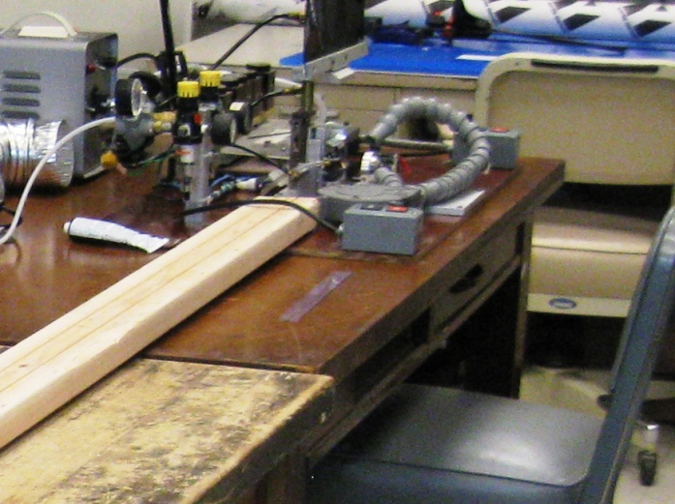
GlueX Collaboration Meeting, JLab
October 4-6, 2012
Populating the Construction Area
Ventilation Unit

Slide 15
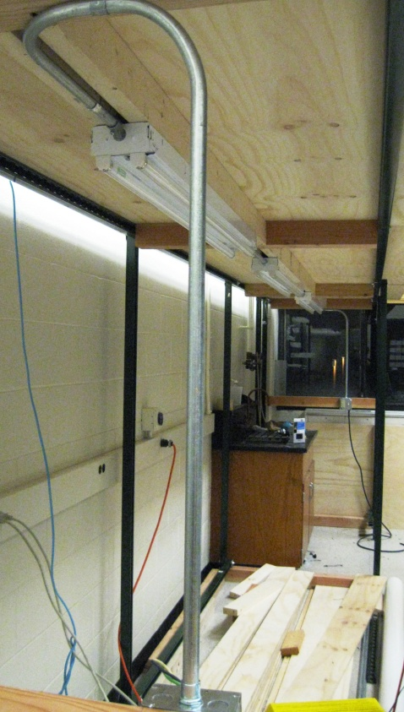
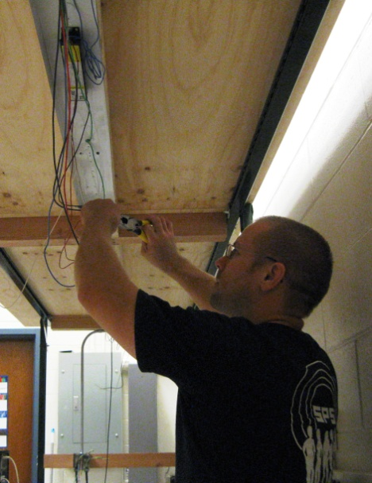
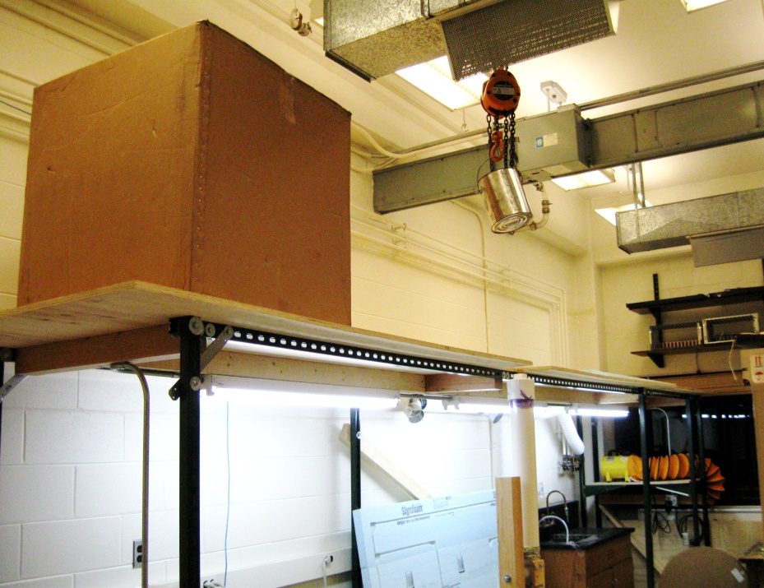
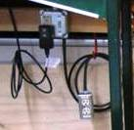
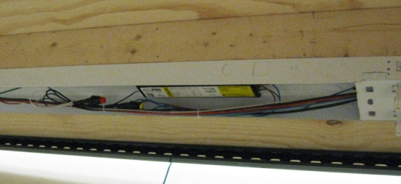
GlueX Collaboration Meeting, JLab
October 4-6, 2012
Populating the Construction Area
Additional Infrastructure
Lighting & Outlets
Bundle Storage

Slide 16


GlueX Collaboration Meeting, JLab
October 4-6, 2012
Tagger Microscope Electronics
Experimental setup
  Current testing bench:
  Dark chamber
  NIM bin and modules
  Can be used for all aspects of quality assurance
Second testing bench:
  New dark chamber
  JLab FADC
  Computer with CODA
  Can be used for all aspects of quality assurance

Slide 17


GlueX Collaboration Meeting, JLab
October 4-6, 2012
Tagger Microscope Electronics
Electronics changes
  Change from 25 µm to 50 µm SiPM:
  Gain ~2.7x larger with 50 µm
  Lowered amplifier gain to compensate
  Found 30% power reduction
Differences:
  Increased 3 resistors while keeping operating voltages the same
  Included parallel RC circuit to push low frequency gain ‘bump’ out of the operating range
25 µm
50 µm

Slide 18
GlueX Collaboration Meeting, JLab
October 4-6, 2012
Tagger Microscope Electronics
Future plans
  Engineering update of preamplifier, backplane, and control boards
  Submit design for fabrication and component population
  Solder Eurocard connectors and SiPMs in lab
  Perform basic board quality tests
  Measure output pulse shape, gain, cross-talk
  Run boards for an extended period of time to burn them in

Slide 19

GlueX Collaboration Meeting, JLab
October 4-6, 2012
Tagger Microscope Scintillation Yield
Bench Tests with Cosmic Rays
(from June mtg, 25 micron pixel SiPM)
1pe = 5 channels
single fiber readout with 250MHz FADC
trigger on the same channel
only tail of spectrum visible
pedestal tail
from cosmic rate integral: median ~16pe
130 pe / axial electron track
19
adc channels

Slide 20

GlueX Collaboration Meeting, JLab
October 4-6, 2012
Tagger Microscope Scintillation Yield
Bench Tests with Cosmic Rays : update
(since June mtg, 50 micron pixel SiPM)
sum column 3
trigger
sum column 1
gain is re-balanced at 5chan/pixel
cosmic yield: 30 pe (MP)
300 pe/axial electron track
(specification is 220)
✓

Slide 21
GlueX Collaboration Meeting, JLab
October 4-6, 2012
Summary
Quality assurance & acceptance test plan being revised
Construction plan written and being reviewed
Infrastructure needed for construction is ~85% complete
On track for readiness review (previously estimated - 11/2012)
Scintillation yield with 50-micron pixel SiPM’s meets requirements
Electronics prototyping phase is completed
Construction to begin as soon as contract is in place

Slide 22
GlueX Collaboration Meeting, JLab
October 4-6, 2012
Questions?

