Slide 1
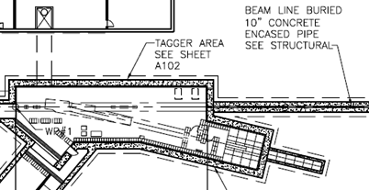



Tagger Microscope
Tagger Magnet
Photon Beam
e⁻ Beam
Tagger Microscope
(Top View)

Slide 2

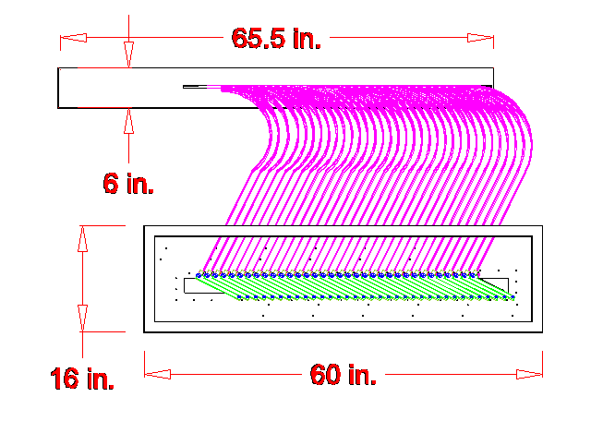
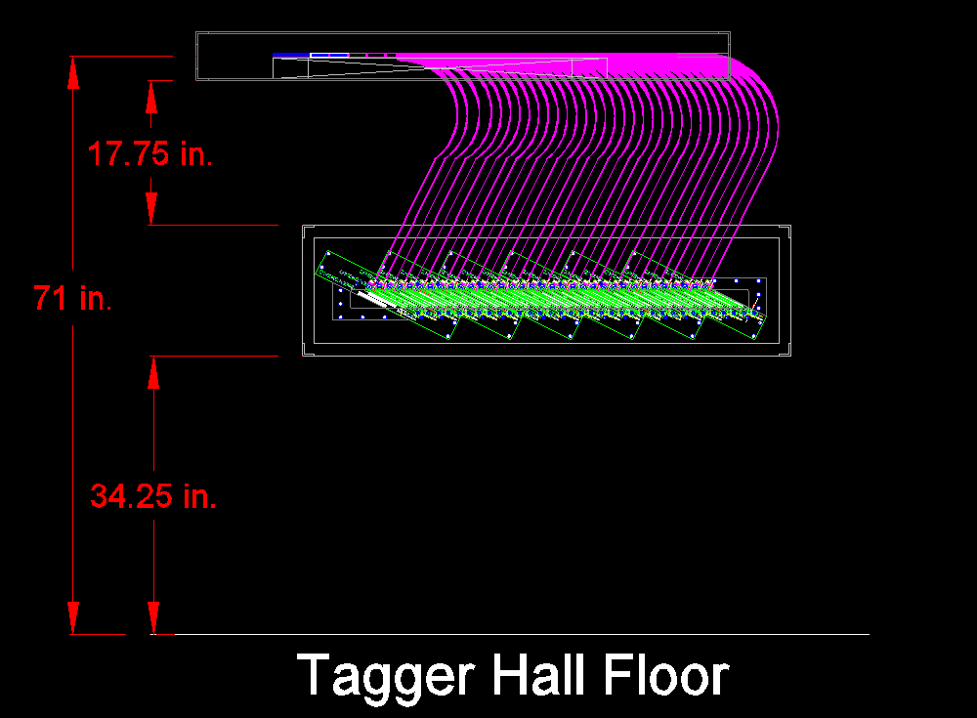
Tagger Microscope
Back View

Slide 3
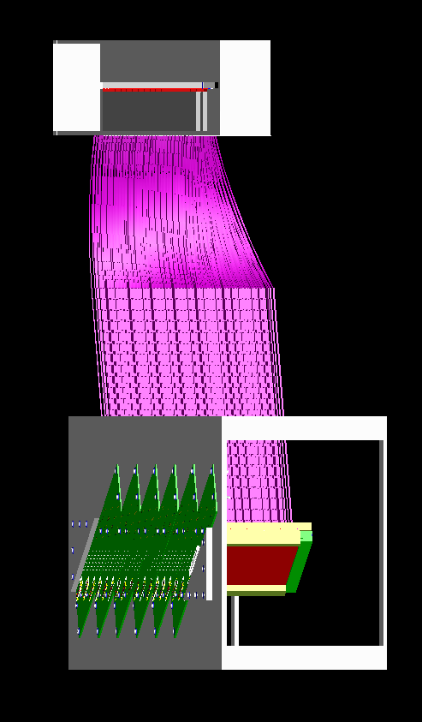

Tagger Microscope
e⁻ View
SiFi Bundle Array
Parallel Railing System

Slide 4
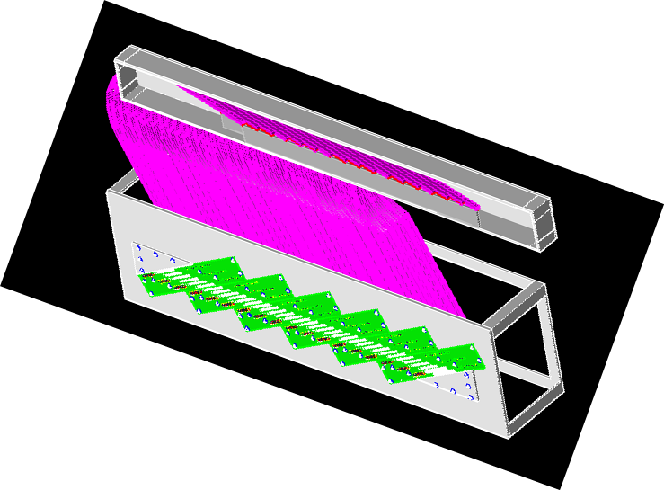
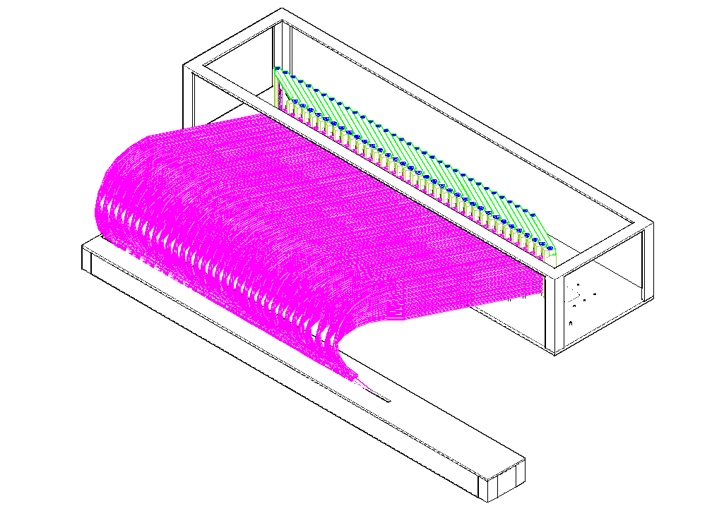
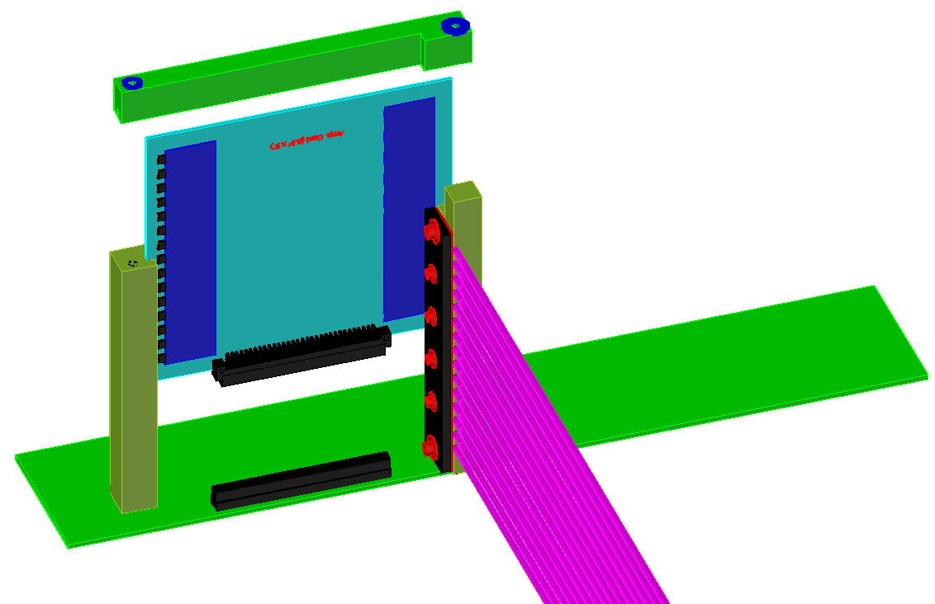
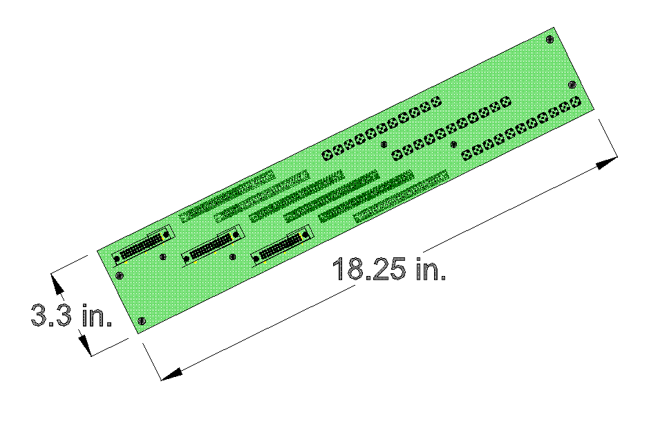
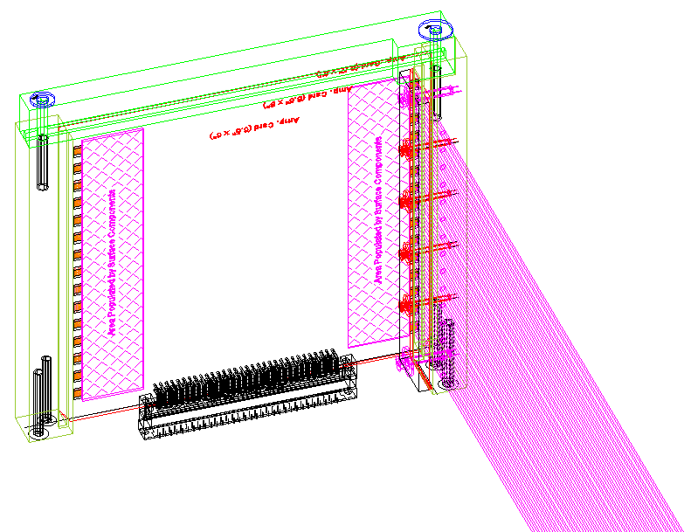
Tagger Microscope
Backplane Board
Amplifier Board
Euro Connector

