Slide 1
Diamond Detectors
John Smedley
"Single crystal diamond photodiode for soft X-ray radiometry"
Jeffrey W. Keister and John Smedley
Nuclear Instruments and Methods in Physics Research Section A: Accelerators, Spectrometers, Detectors and Associated Equipment, Volume 606, Issue 3, 21 July 2009, Pages 774-779

Slide 2
Why Diamond?
Radiation hard
Fast; nearly equal mobility for both carriers
High thermal conductivity
Robust ohmic contacts
Solar blind
Low leakage
Low absorption
  Transmission devices (beam monitors and windows)

Slide 3
Diamond as a Detector
X-rays excite energetic electrons which scatter to produce carriers
Soft x-rays generate carriers near incident surface, allowing electron and hole motion to be separated by biasing
Harder x-rays go all the way through, creating a column of charge
Initial oxygen termination achieved by acid etch or ozone exposure
Diamond metalized on both surfaces with 3mm diameter electrodes
Leakage is <1 pA for oxygen terminated diamonds, even for 1kV bias
Two detector geometries
X-rays
Diamond
Metalized both sides
X-rays

Slide 4
Metal-Diamond Interface
We will consider two types of contacts:
  Contacts which allow charge carriers to pass with sufficient ease to require the diamond to remain charge neutral on average. These contacts allow photoconductive gain, and we’ll call them injecting.
  Contacts which restrict the flow of charge to an extent sufficient to allow the diamond to charge. We’ll call these contacts blocking.
For diamond with oxygen surface termination, all metal contacts tested (Ti/Pt, Pt, Al, Cu, Nb, & Mo) have been blocking
Oxygen can be removed by thermal annealing, causing contacts to become injecting (remember this – it will come up later)
For Moly, thermal annealing has been used to create injecting Mo₂C contacts

Slide 5
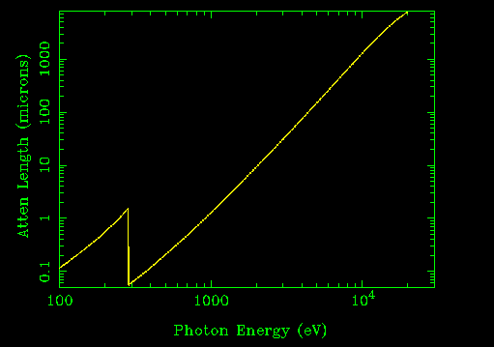
Responsivity
The “responsivity” of a photodetector (in A/W) is given by:
W: mean ionization energy – energy required to create an e-h pair
This model assumes complete collection of the carriers
As we’ll see, this assumption is good most of the time (except near the C edge)

Slide 6
Trapping and Pulsed Bias
Initially, DC bias was used on detector
  For soft x-rays, hole response was much lower than expected, and non-linear with flux
By pulsing the bias on the detector (using an amplified square wave for bias)
  Hole response matched the model prediction for bias field greater than 0.1 MV/m -> nearly all charge collected
  Works for wide range of frequencies (1 Hz to >10kHz) and duty cycles (up to 99%)
  During off cycle, x-ray illumination generates carriers which drift toward and neutralize trapped charge

Slide 7
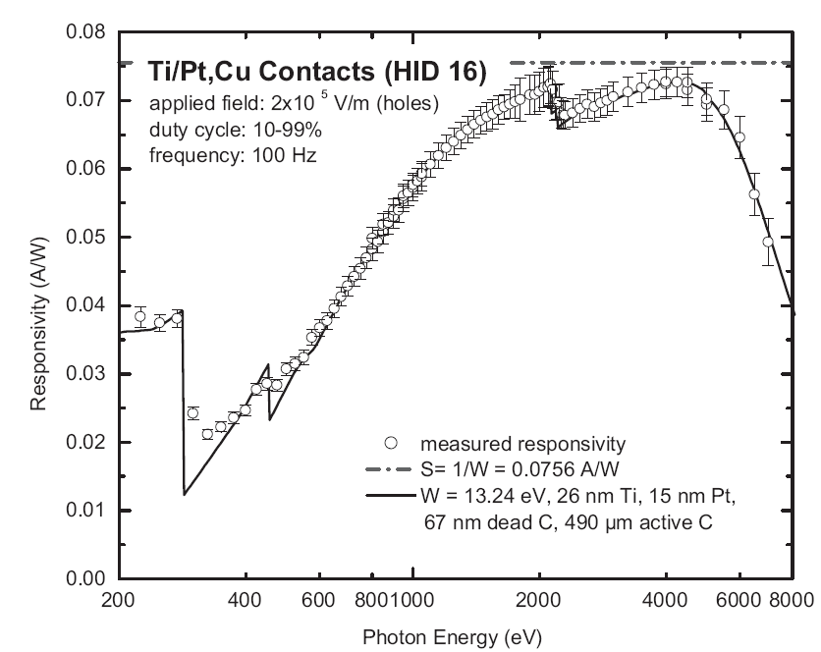
J. Keister & J. Smedley, NIM A, 606 774 (2009)

Slide 8
Hole collection saturated for 0.3 mm thickness

Slide 9
What about electrons?
Electron response depends strongly on type of electrical contacts
For blocking contacts, electrons exhibit significantly more trapping than holes
  Lower duty cycle of pulsed bias to avoid signal loss
  Never collect all electrons
For injecting contacts, photoconductive gain is observed
  Trapped electrons act as effective “doping” of material
  Holes are injected from opposite electrode
Hole lifetime
Hole transit time

Slide 10
Photo-conductive gain onset when holes can cross diamond

Slide 11
Electron Response, injecting

Slide 12
Electron and hole response, blocking
No Photoconductive Gain

Slide 13
Responsivity Conclusions
Holes have larger CCD than electrons in these synthetic diamonds (due to ultra low N content)
Charge collection for holes is limited only by diffusion of carriers if field is low – for E>0.1 MV/m, all holes collected
Simple model of Responsivity yields a pair creation energy of 13.3 +/- .5 eV
Electron trapping occurs in bulk diamond; cannot collect all electrons – leads to PC gain w/ injecting contacts
Can sweep trapped charge by irradiating diamond w/o bias

Slide 14
White Beam Test
Diamond detector used on beam at X28C, with 17W of X-ray power, ranging from 6 keV to 15 keV
Intercepted ~3% of beam
Ion chamber used for low power calibration, copper calorimeter for higher power
Generated 40 mA of current in a 2mm² area
2 A/cm²
Can see NSLS ring
repetition frequency
on detector

Slide 15
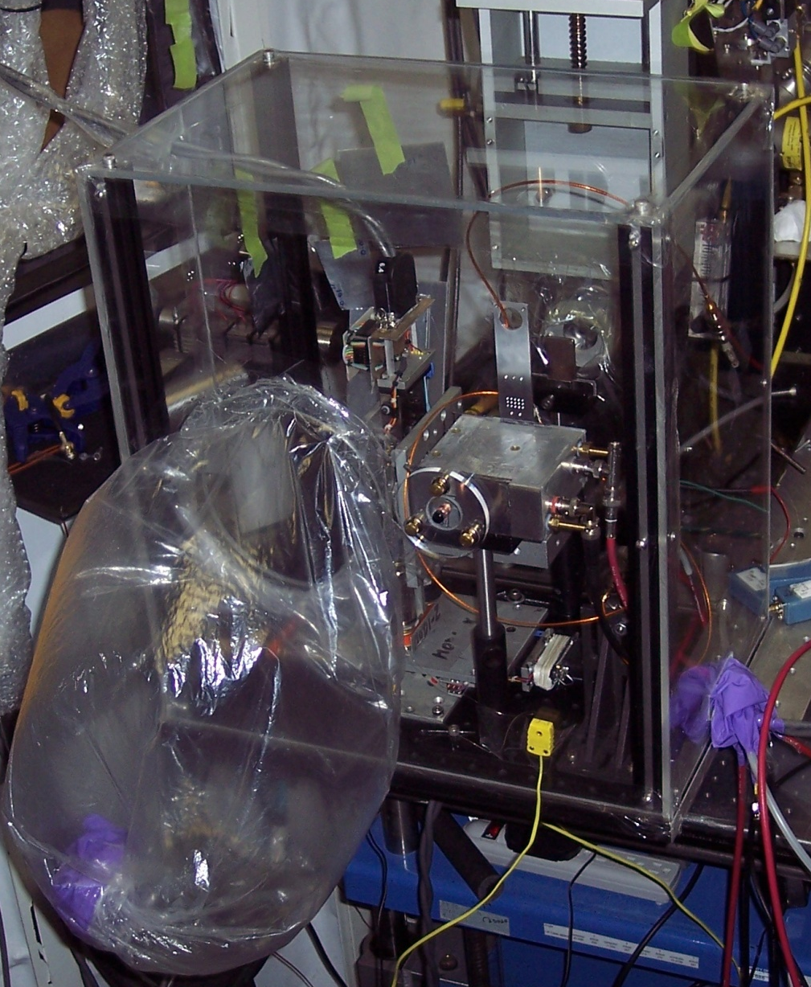
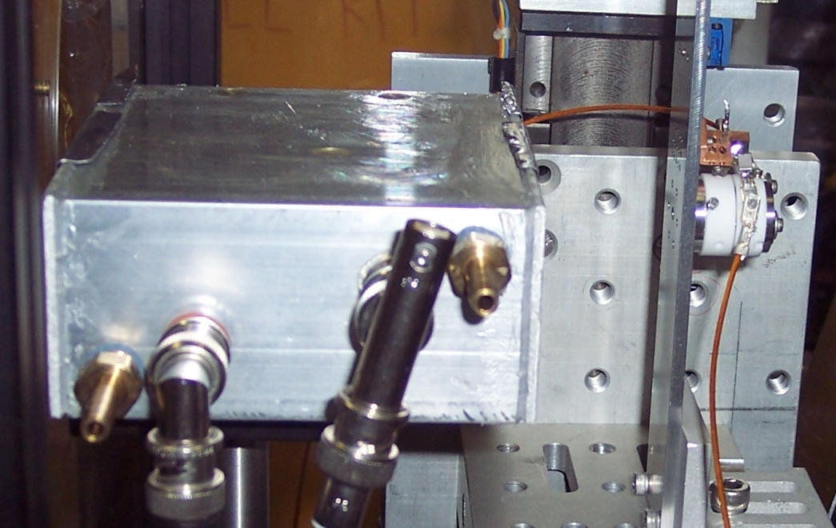
X28c Setup
X-ray port
Beam defining aperture
Diamond Detector
Ion Chamber
Calorimeter

Slide 16
Detector Response
300V DC bias (0.6 MV/m)

Slide 17
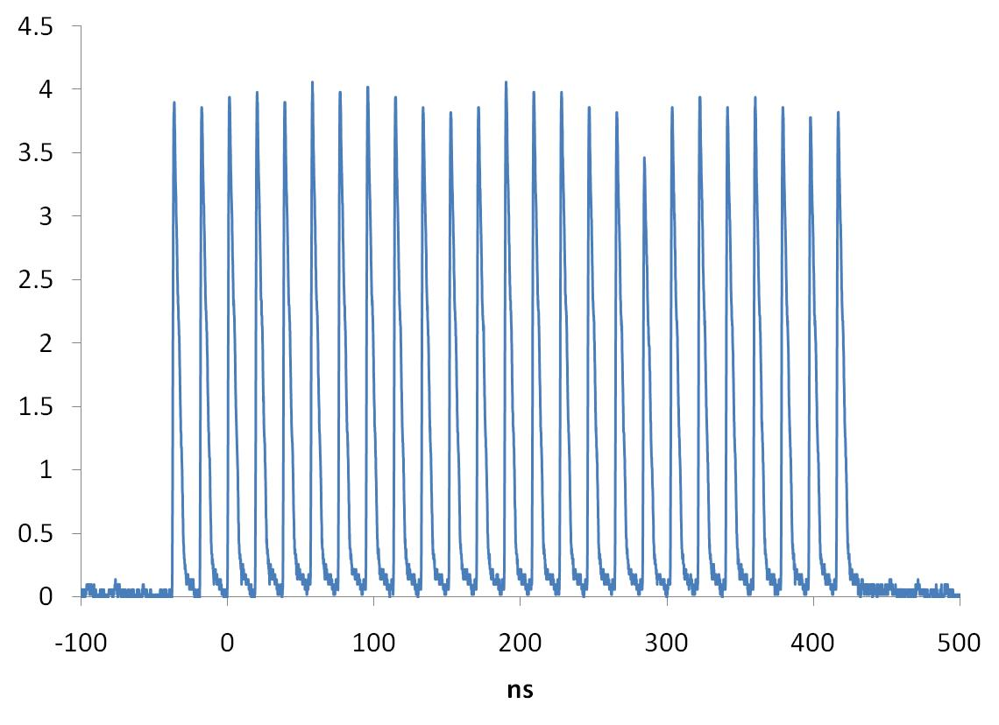
Pulse response, 2 MV/m

Slide 18
Radiation Hard?
The diamond was not obviously harmed by absorption of 10⁸ rads of x-rays
However, continuously driving 16+ mA of current at up to 1 kV bias (16 W of electrical power) caused significant heating of device
This lead to a change in the nature of the response
  Initially, diamond was a diode, with blocking contacts
  During high flux measurement, photoconduction was observed for negative bias
  This change in the contact was permanent – loss of oxygen?
Subsequent response maps showed that photoconductive region is tiny (~200 microns across), and that a region of PC gain for opposite polarity is present in the unirradiated area

Slide 19
4.5 mm Al attenuator

Slide 20
0.25 mm Al attenuator
PC gain for negative bias

Slide 21
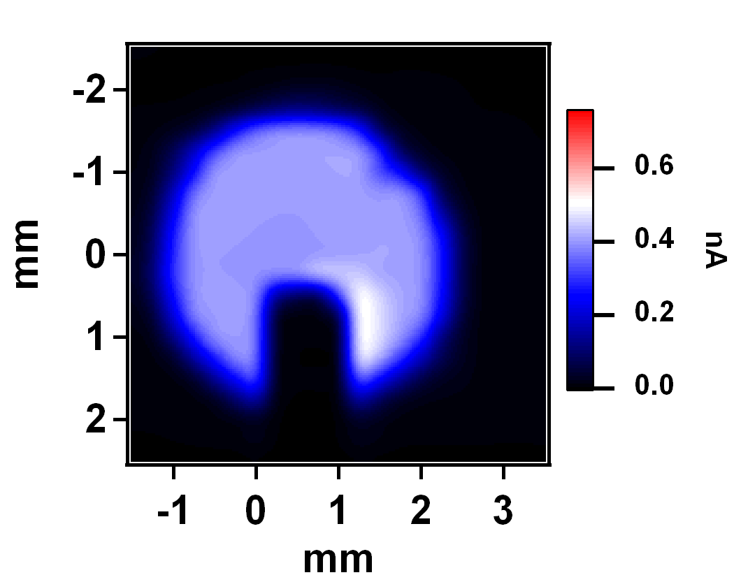
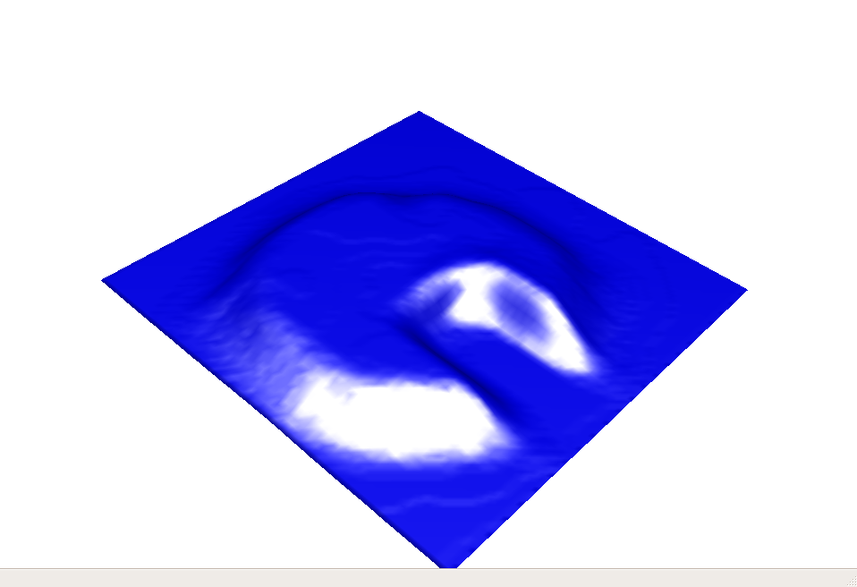
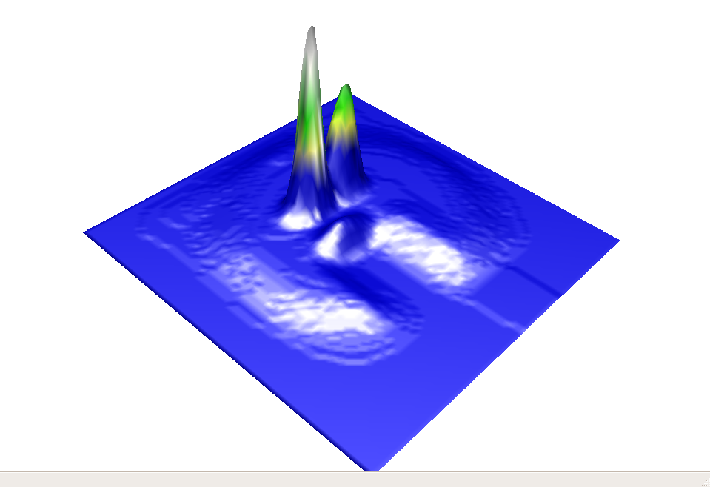
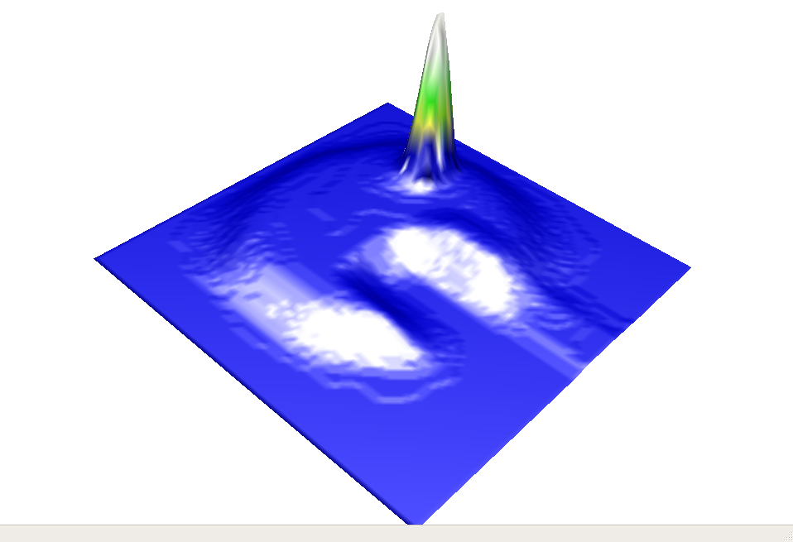
HID14 in X15
(80%, 100V, 1kHz, 19keV)
HID18 in X6B
(80% ,-100V, 1kHz, 19keV)
HID18 in X6B
(80% ,+100V, 1kHz, 19keV)

Slide 22
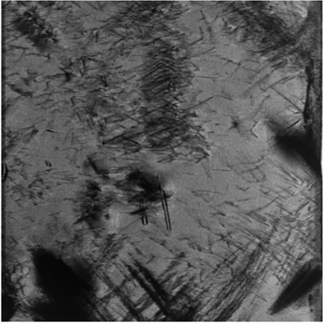
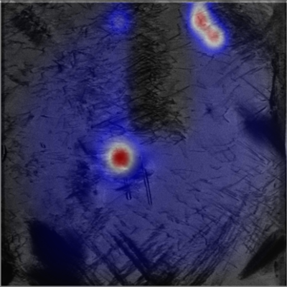
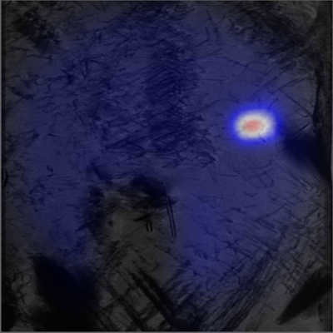
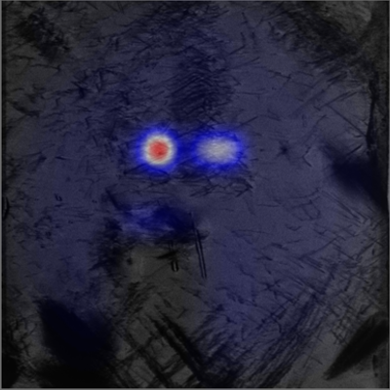
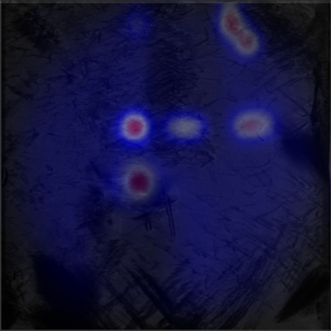
Localized charge trapping causing localized gain
Related to defects/inclusions?

Slide 23
Conclusions & Thoughts
Diamond detector response is linear from 100pW – 1W incident x-ray power, and predictable for photon energies from 0.2-28 keV
For soft x-rays, pulsed bias allows clearing of trapped charge to achieve (nearly) full charge collection
Above 4keV, DC bias is adequate, even at high flux
  Pulsed bias is still useful to prevent PC gain, and limit current
Temporal response of detector is consistent with carrier velocity and thickness
Up to 40 mA (2 A/cm²) passed through diamond
Due to it’s mechanical and thermal properties, diamond is already a candidate to replace beryllium for x-ray windows for some NSLS II beamlines – can we instrument these windows?

Slide 24
Thank you for your attention!
Thanks to Jen Bohon, Wei Chen, Elaine DiMasi, Jim Distel, Bin Dong, Dan Fischer, Joe Harder, Abdel Isakovic, Cherno Jaye, Jeff Keister, Zhenxian Liu, Erik Muller, Veljko Radeka, Balaji Raghothamachar, Triveni Rao, Pavel Rehak, Bill Smith, Jean Jordan-Sweet, John Walsh
C-AD Diamond Team: Ilan Ben-Zvi, Andrew Burrill, Xiangyun Chang, David Pate, Erdong Wang, Qiong Wu
Simulations: Richard Busby, Dimitre Dimitrov
Beamlines: U2A, U2B, U3C, U7A, X3B, X6B, X8A, X16C, X19C, X20A&C, X28C

Slide 25

Photoconductive Gain
Photons produce initial carriers
Electrons drift through diamond
Some electrons are trapped in material
Act as effective p-type doping as long they are trapped
hν
On average, one hole is injected into diamond for each trapped electron, keeping material charge neutral
Holes drift through diamond
New holes enter, each time adding current
Process continues until the hole is trapped in the material or the trapped electron is neutralized
Hole lifetime
Hole transit time

Slide 26
Electron Transport in Diamond
Photon Generated, Detector Case
Energy
hν
Empty States
E_{g}
Surface Trap
Surface Trap
Bulk Trap
Filled States
Some photons lost to absorption in metal layer (atomic absorption edges)
Photons produce energetic electrons via photoelectric absorption
Penetration depth strong function of photon energy
Electrons scatter, produce electron-hole pairs
Some e⁻ lost to recombination at metal interface, possibly surface trapping
Bias determines which carrier crosses diamond for soft x-rays
For harder x-rays (>3 keV), both carriers participate
Carriers lose energy via e⁻-e⁻ and e⁻-phonon scattering
Eventually, e⁻ reaches the conduction band min, hole reached valance band max
Some carriers are trapped
Most drift through
Current induced on far electrode as soon as carriers begin moving
Trapped carriers modify field in diamond
Other surface metallized
Some e⁻ trapped at surface
Most will be collected

Slide 27
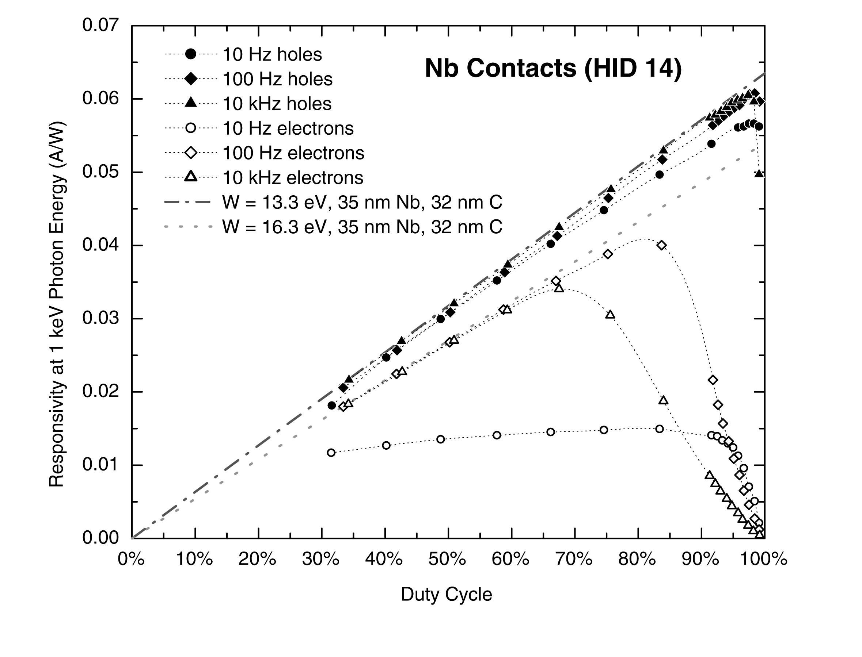

Slide 28
Interface Layer Recombination
Carbon edge feature in responsivity is largely due to short absorption length (<100 nm)
Carriers produced near electrode may diffuse into metal and recombine, leading to loss of charge
This process is field dependent, leading to a charge collection efficiency which depends on the field
Electron trapping in the diamond can reduce the field dear the electrode, leading to increased recombination
For photon energies below 2 keV, when biasing for holes, the field required to saturate the collection reduces as photon energy increases, due to increased penetration depth
For photon energies above 4keV, the photons are being absorbed in the bulk of the diamond, making it impossible to differentiate electron motion from hole motion

