Slide 1



Defect-free Ultra-Rapid Polishing/Thinning of Diamond Crystal Radiator Targets for Highly Linearly Polarized Photon Beams
PI: Arul Arjunan
Sinmat Inc
Rajiv Singh
University of Florida
Richard Jones
University of Connecticut
Program Manager: Manouchehr Farkhondeh
DOE STTR #DE-SC-0004190
SBIR / STTR Exchange Meeting, Gaithersburg, August 6-7, 2014

Slide 2

Outline
Application: high-energy polarized photon source
    uniqueness of diamond as a radiator
    competing specifications: thickness vs. flatness
    proposed solution: a thick frame around the radiator
Two approaches investigated
    vapor phase ion etching with mask (Sinmat)
    milling by UV laser ablation (UConn)
Conclusions and Future Directions
SBIR / STTR Exchange Meeting, Gaithersburg, August 6-7, 2014 1

Slide 3
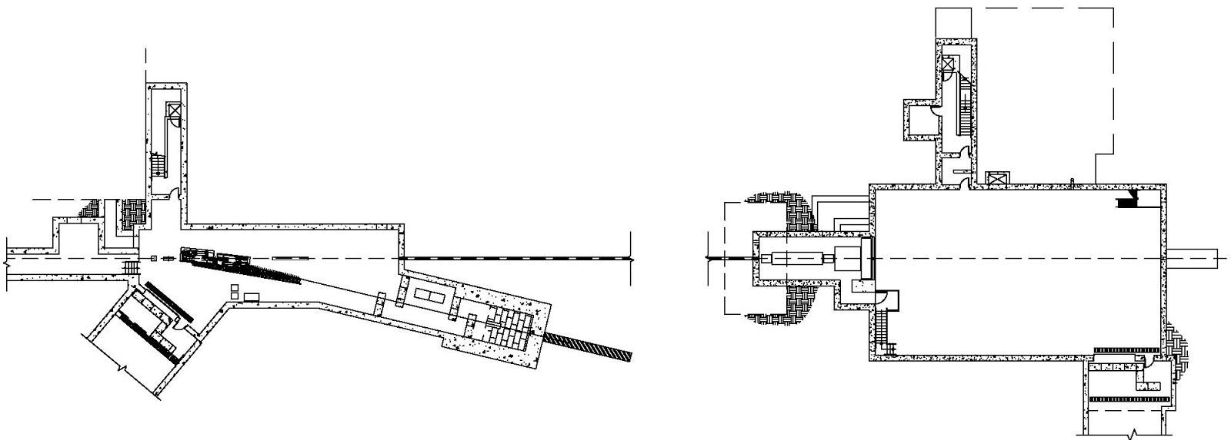
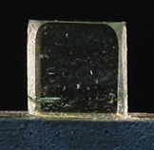
Diamond - a high-energy polarized photon source
Radiator
Coherent Bremsstrahlung
9 GeV polarized photon beam
Counting
House
Tagger
Pair
Spectrometer
Photon
beam dump
Top View
76 m
12 GeV
electron beam
GlueX detector
Collimator
Electron beam dump
Crystalline radiator => electrons “bremsstrahlung” from entire planes of atoms at a time
discrete peaks in energy spectrum
photons are polarized within the peaks
Diamond is the unique choice for crystal radiator
low atomic number
dense atomic packing
high thermal conductivity
radiation hard, mechanically robust, large-area monocrystals, ...
SBIR / STTR Exchange Meeting, Gaithersburg, August 6-7, 2014 2

Slide 4
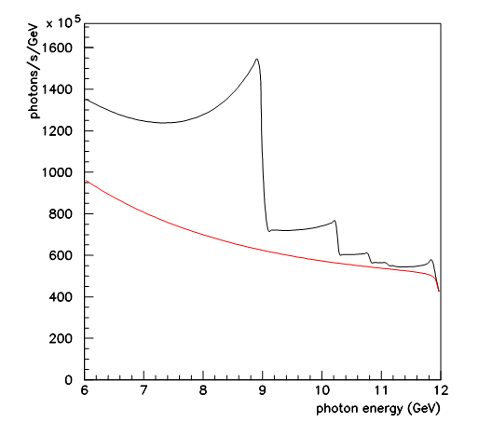
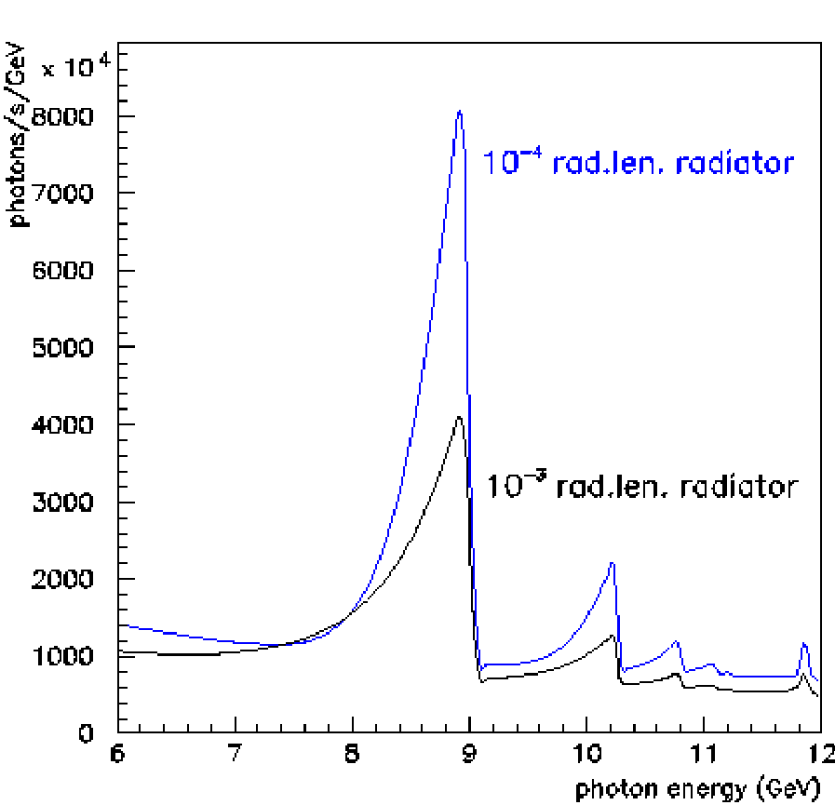
Coherent bremsstrahlung beam properties
Bremsstrahlung spectrum with (black) and without (red) an oriented diamond crystal radiator
Same spectrum, after cleanup using
small-angle collimation
SBIR / STTR Exchange Meeting, Gaithersburg, August 6-7, 2014 3

Slide 5
Diamond radiator requirements
thickness 10⁻⁴ radiation lengths ~ 20 microns
“mosaic spread” of the crystal planes ~ 20 μrad RMS
crystal appears as a mosaic of microscopic quasi-perfect domains
Actually includes other kinds of effects
  distributed strain
  plastic deformation
Measured directly by X-ray diffraction: “rocking curves”
SBIR / STTR Exchange Meeting, Gaithersburg, August 6-7, 2014 4

Slide 6
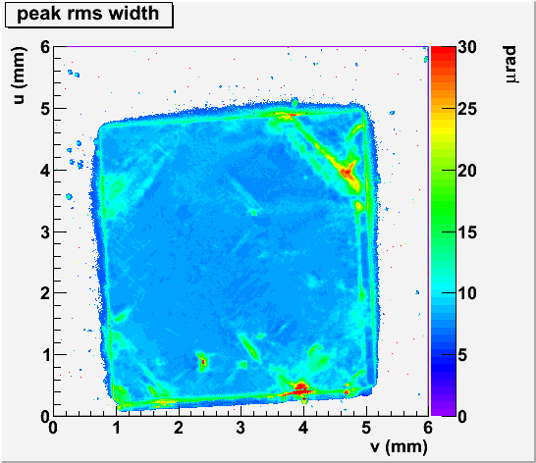
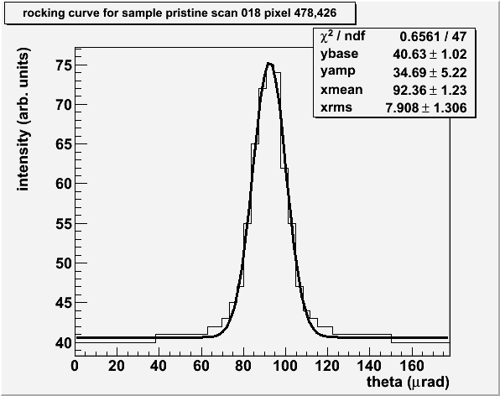
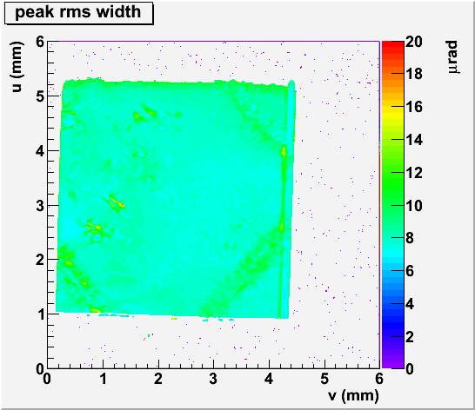
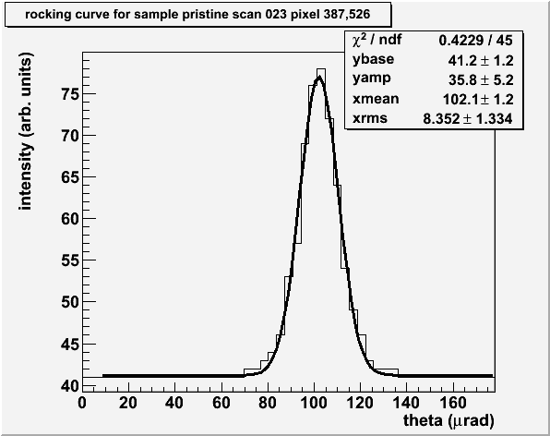

E6 single-crystal CVD(!) diamond
Very close to theoretical rocking curve RMS width for diamond !
but…
These crystals are 300 microns thick.
X-ray measurements performed at Cornell High Energy Synchrotron Source (CHESS)
SBIR / STTR Exchange Meeting, Gaithersburg, August 6-7, 2014 5

Slide 7
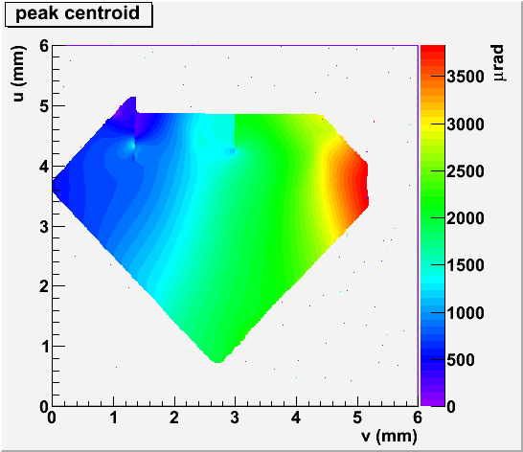
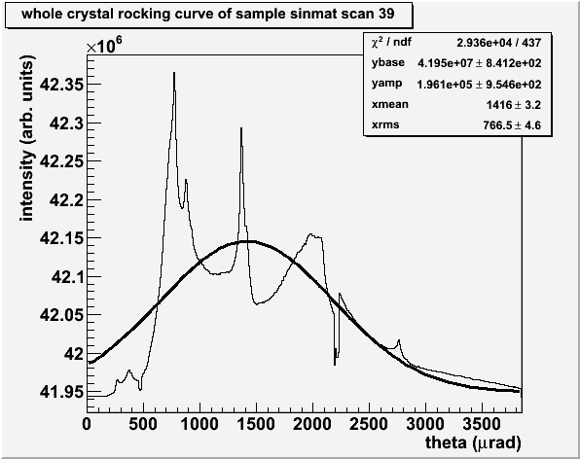
E6 CVD diamond thinned to 15 microns
Sample was thinned using proprietary Sinmat RCMP process (presented in early talk)
very fragile -- notice the corner broken off
rocking curve shows very large bending deformation
(0,1,0)
(1,0,0)
X-ray measurements performed at Cornell High Energy Synchrotron Source (CHESS) - STTR phase 1
SBIR / STTR Exchange Meeting, Gaithersburg, August 6-7, 2014 6

Slide 8
Primary R&D challenge in Phase 2
Understand and overcome the thin diamond warping problem.
Diamonds appear to warp
severely when thinned to
20 microns.
Try to stiffen the diamond by
leaving a thick outer frame
around the 20 micron region.
Warping is from combination of
mounting and internal stresses.
Frame around 20 micron window is still part
of the single crystal, acts like a drum head.
SBIR / STTR Exchange Meeting, Gaithersburg, August 6-7, 2014 7

Slide 9
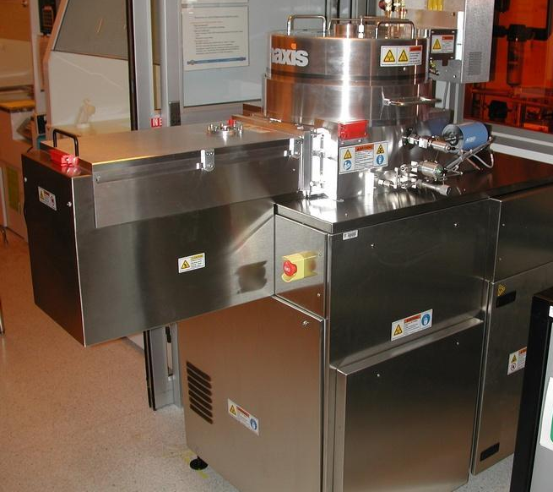
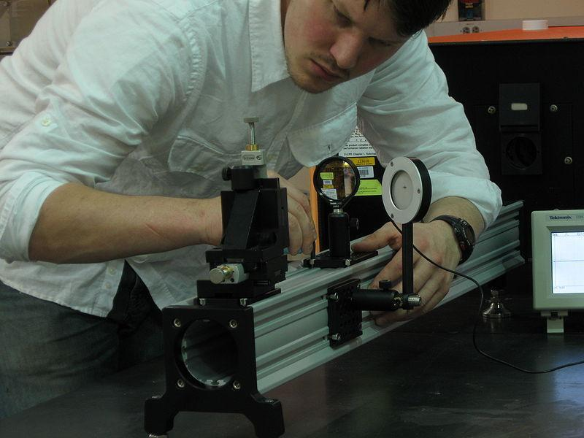
Two-prong method of attack
Chemical etching using a mask - Sinmat
  Step 1: Deposit a metallic mask covering the outer frame region.
  Step 2: Etch masked sample using oxygen VPIE.
      Monitor removal rates, expect >50 microns/hr
      Watch when mask sputters away, when gone return to step 1.
  Step 3: Measure central thickness, remove residual mask when done.
2. Precision milling with a UV laser - UConn
  New ablation facility built at UConn for this project
    5W pulsed excimer laser generates 5W at 193 nm
    UV optics to expand beam, focus to 0.1mm spot
    evacuated ablation chamber with tilted sample holder
    3D motion controls to raster the diamond across the beam
  Software developed to generate smooth flat ablated surface
SBIR / STTR Exchange Meeting, Gaithersburg, August 6-7, 2014 8

Slide 10
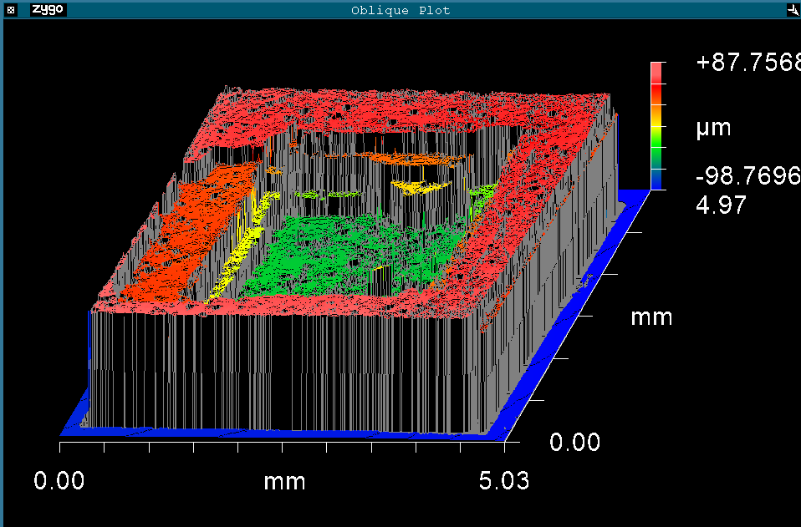
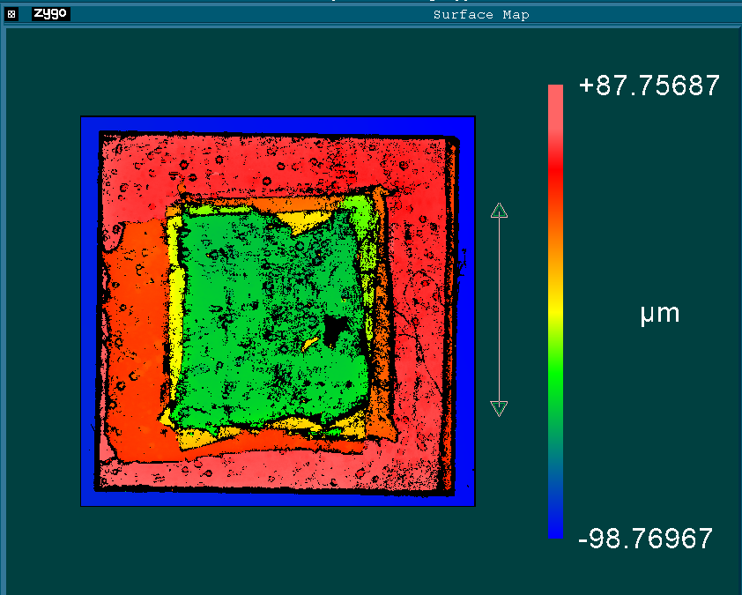
APPROACH 1: Chemical etching
Slight misalignment shows 4 masks were needed.
Frame thickness is 185 microns
Central region is 55 microns thick
Etched surface shows significant roughness, pits 10 microns deep
Careful monitoring needed to prevent burn-through below 50 μm
SBIR / STTR Exchange Meeting, Gaithersburg, August 6-7, 2014 9

Slide 11
Vapor Phase Etch Process
2um Al using sputter
metal cover
mask
Diamond etching recipe
Gases O2 & Ar gas RIE/ICP= 500W / 1500W
Diamond
2um Al using Sputter
Diamond
Diamond
RIE/ICP etching
SBIR / STTR Exchange Meeting, Gaithersburg, August 6-7, 2014

Slide 12
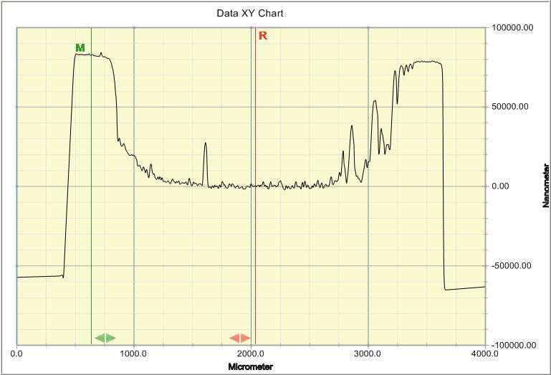
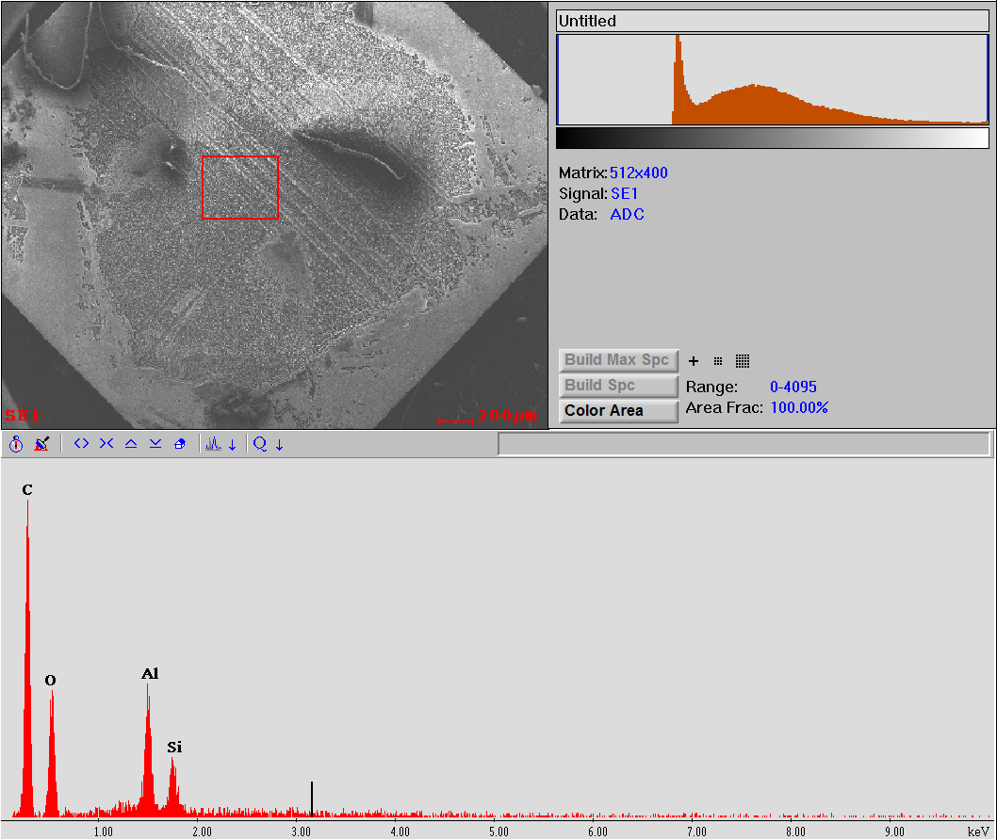
Vapor Phase Etch Process
80um
Etch rate continuously reduced with progressive etching
Al mask re-sputtered on the sample
SBIR / STTR Exchange Meeting, Gaithersburg, August 6-7, 2014 11

Slide 13
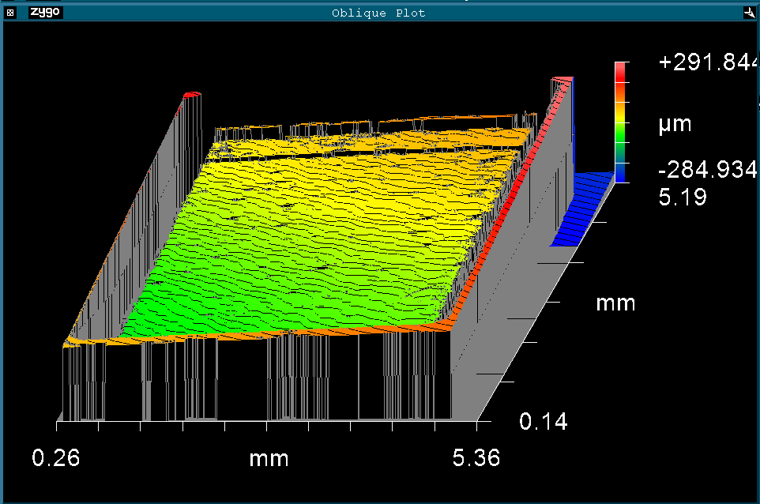
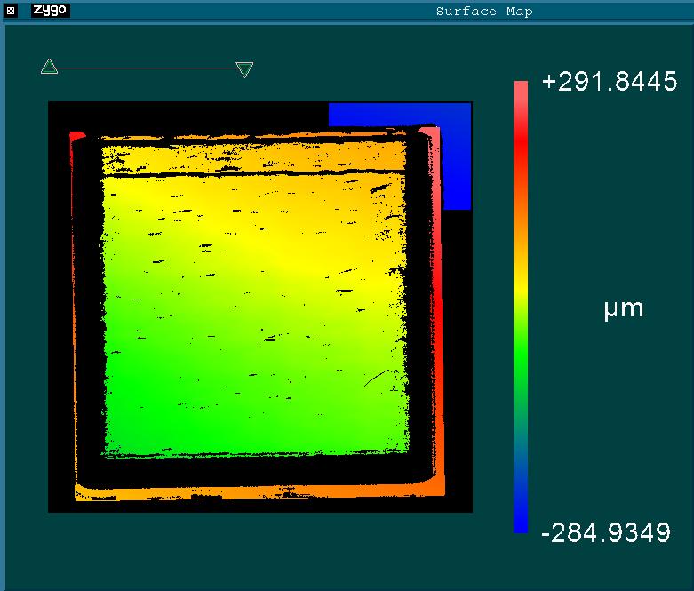
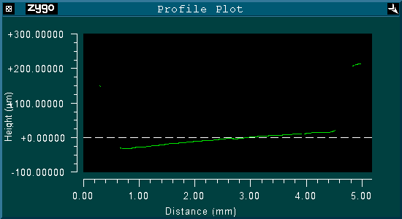
APPROACH 2: Laser ablation
200 microns removed in 8hr
surface roughness < 1 μm
risk of burn-through below 50 μm thickness
SBIR / STTR Exchange Meeting, Gaithersburg, August 6-7, 2014 12

Slide 14
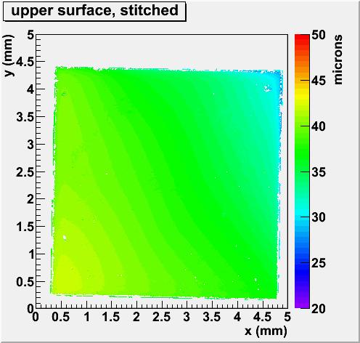
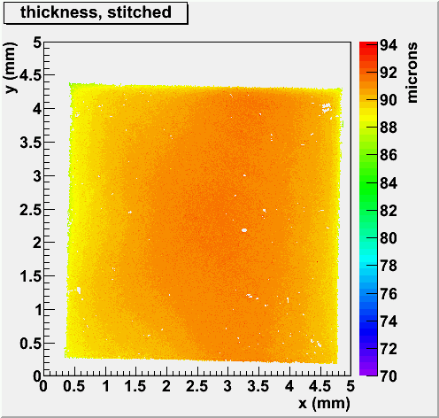
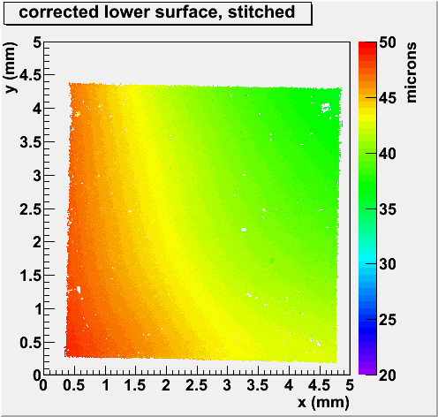
Uniform sample S90
surface and thickness profiles (Zygo 3D)
SBIR / STTR Exchange Meeting, Gaithersburg, August 6-7, 2014 13

Slide 15
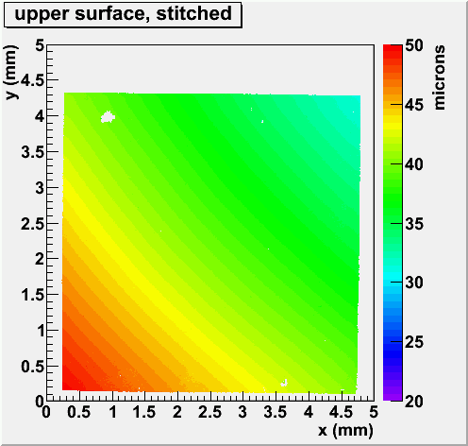
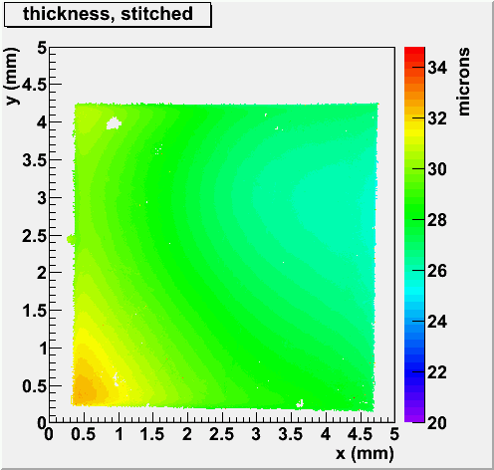
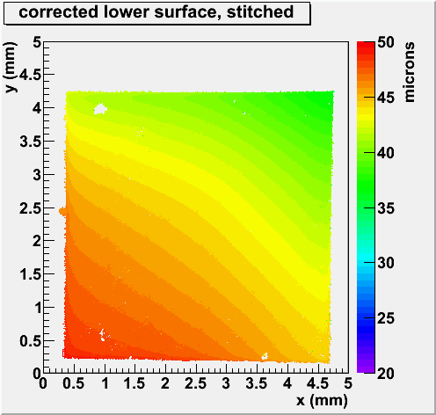
Uniform sample S30
Final polish with RCMP technique
SBIR / STTR Exchange Meeting, Gaithersburg, August 6-7, 2014 14

Slide 16
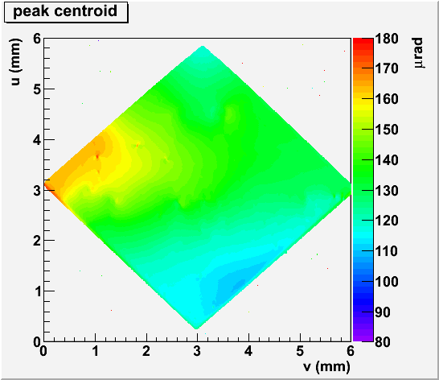
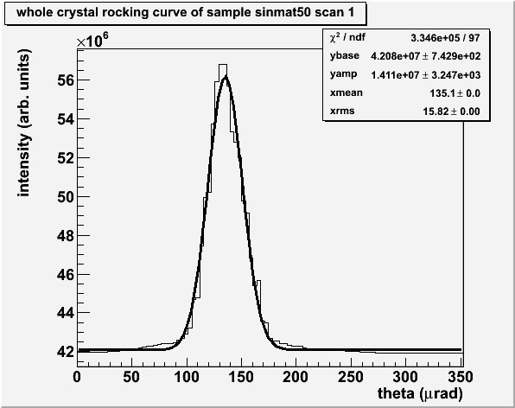
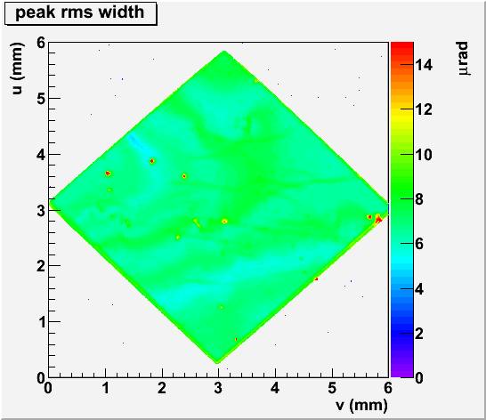
X-ray assessment: S90
whole-crystal rocking curve (220)
not as flat
as S150, but
still in spec.
SBIR / STTR Exchange Meeting, Gaithersburg, August 6-7, 2014 15

Slide 17
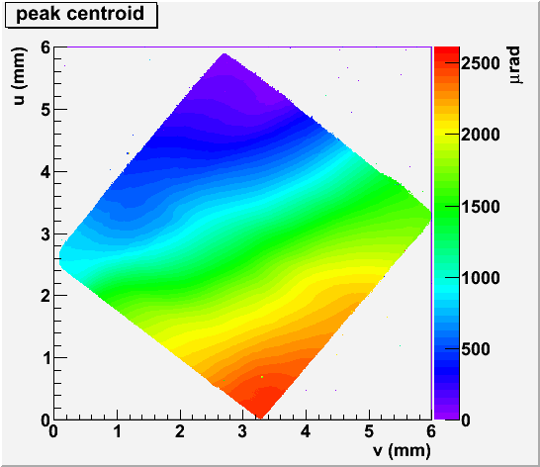
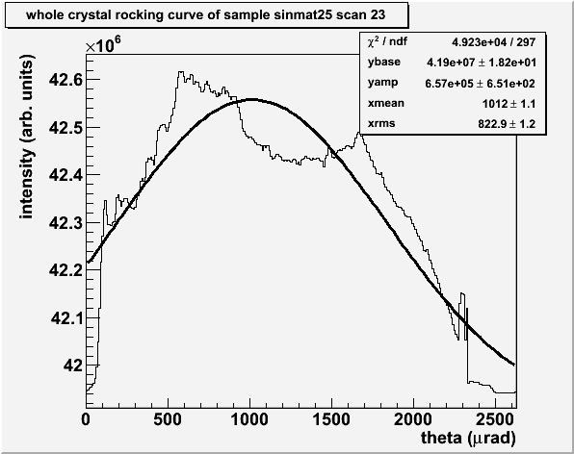
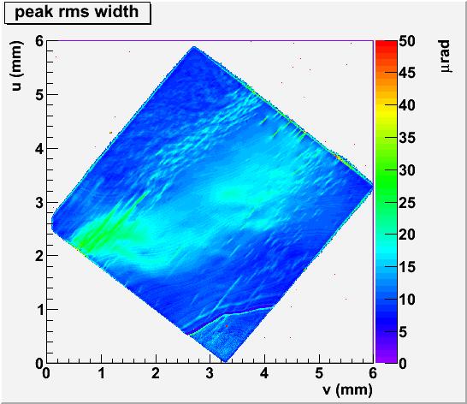
X-ray assessment: S30
rocking curve of S30 Sinmat
challenge
lies here!
SBIR / STTR Exchange Meeting, Gaithersburg, August 6-7, 2014 16

Slide 18
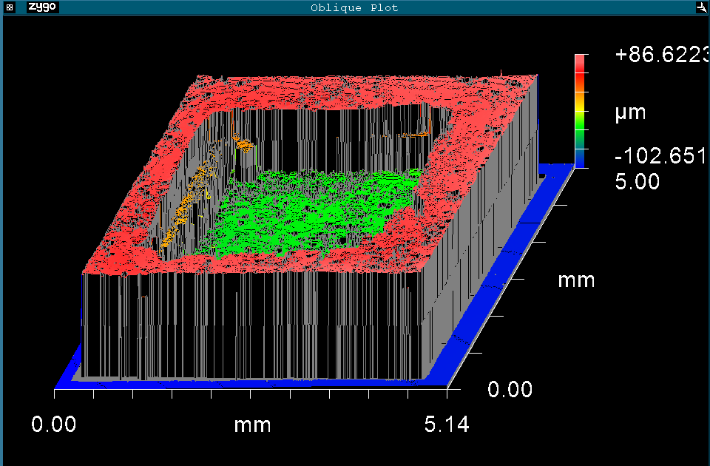
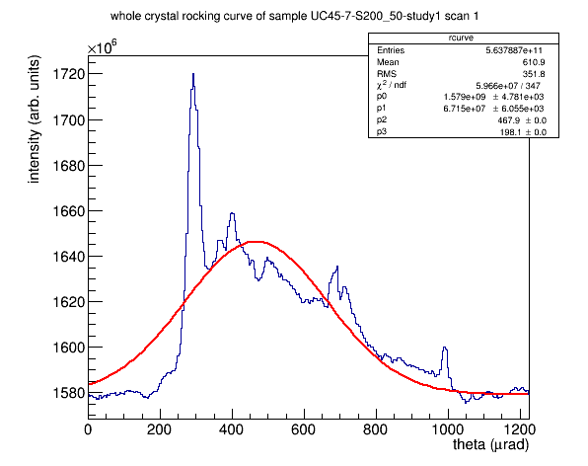
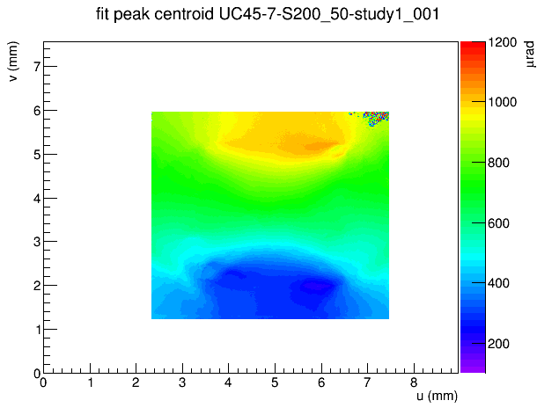
X-ray diffraction: S200_50
352µrad rms
result: large bending strain across crystal
SBIR / STTR Exchange Meeting, Gaithersburg, August 6-7, 2014 17

Slide 19
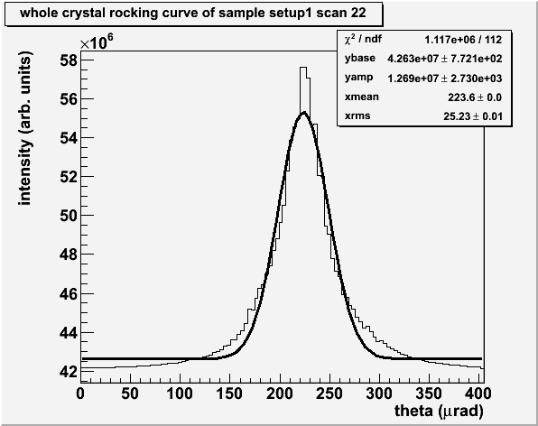
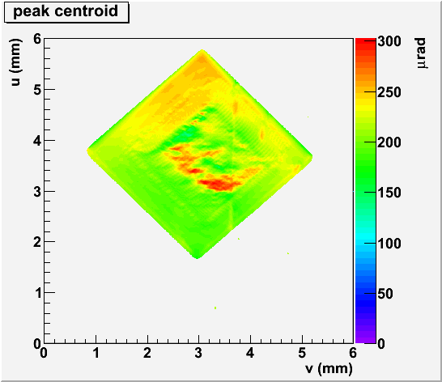
X-ray diffraction: UC300_40
surface was not treated after ablation
excellent result for thinned diamond!
SBIR / STTR Exchange Meeting, Gaithersburg, August 6-7, 2014 18

Slide 20
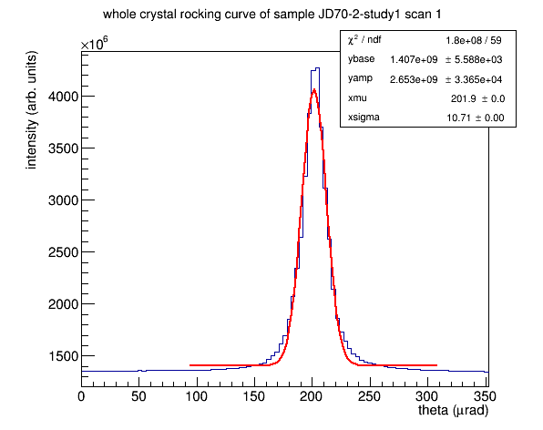
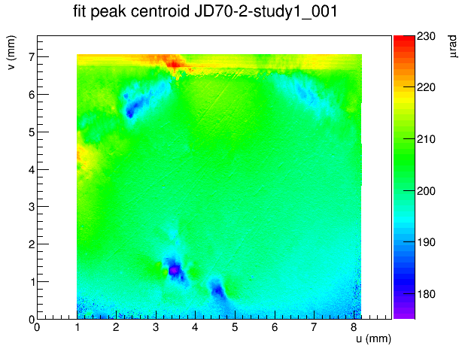
Next steps: large-area 7x7 mm²
excellent crystal quality
very large thickness 1.2mm
SBIR / STTR Exchange Meeting, Gaithersburg, August 6-7, 2014 19

Slide 21
Summary of Methods
parameters method | 20 µm thickness | cut rate | multiple sample | quality
Reactive CMP | ✓ | ✓ | ✓ | x
Vapor Phase Etch process | ✓ | ✓ | ✓ | x
Laser ablation | ✓ | x | x | ✓
SBIR / STTR Exchange Meeting, Gaithersburg, August 6-7, 2014 20

Slide 22
Plan: combine the 2 approaches
VPIE
870µm
removed
RCMP
30µm removed
300µm
1.2mm
330µm
Sent to UConn
Laser
Ablation
280µm
removed
300µm
20µm
SBIR / STTR Exchange Meeting, Gaithersburg, August 6-7, 2014 21

Slide 23
Summary
Developed a three-step process to thin diamond samples
Step 1: Vapor phase etching process (75 micron/hr)
Step 2: Polish surface defects with RCMP process
Step 3: Cut thin central window using laser ablation
Validated results of all proposed steps using X-ray diffraction
Designed a custom diamond diffraction setup at CHESS
Optimized procedures to obtain 3 rocking curves per hour
Developed analysis code to assess X-ray diffraction topograph
Developed custom analysis code for 2-surface profilometry
Expected by Phase 2 completion
3 production-quality crystals 7x7 mm² with 20 micron window
draft publication for NP instrumentation journal
SBIR / STTR Exchange Meeting, Gaithersburg, August 6-7, 2014 22

Slide 24
Acknowledgements
UConn students
  Brendan Pratt (grad)
  Igor Senderovich (grad)
  Fridah Mokaya (grad)
  Alex Barnes (grad)
  Liana Hotte (undergrad)
University of Florida students
  Jinhyung Lee (grad)
  Jong Cheol Kim (grad)
  Minfei Xue (grad)
Nathan Sparks - Catholic University
Ken Finkelstein - CHESS staff and collaborator
This work is based upon research conducted at the Cornell High Energy Synchrotron Source (CHESS) which is supported by the National Science Foundation and the National Institutes of Health/National Institute of General Medical Sciences under NSF award DMR-1332208.
This work was supported by the United States Department of Energy through STTR award number DE-SC0004190, and by the National Science Foundation through grant number 1207857.
SBIR / STTR Exchange Meeting, Gaithersburg, August 6-7, 2014 23

