Slide 1

Diamond Radiator Machining and Characterization
Brendan Pratt, Fridah mokaya, alex barnes, Richard jones
University of connecticut

Slide 2
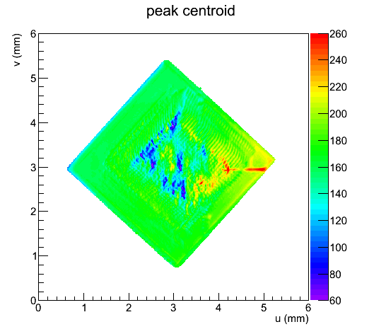
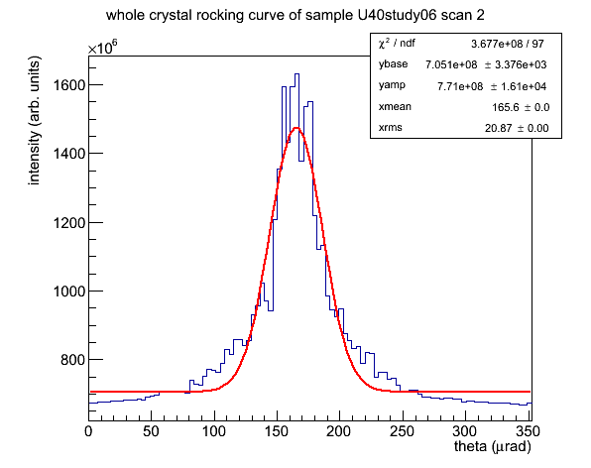
CHESS X-ray Rocking Curves: U40
40µm window

Slide 3
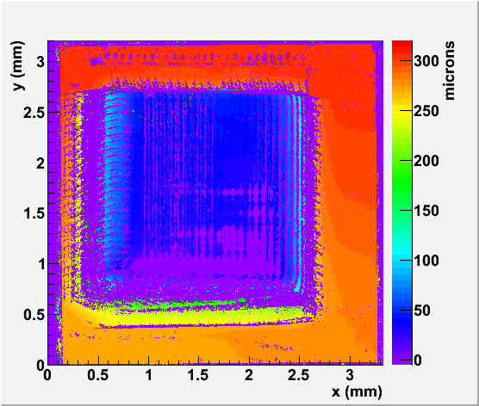
3D Zygo Imaging: U40
top surface measurements with Zygo
approximate bottom surface depth,
Zygo measurement on next slide
Thinned “picture framed” window

Slide 4
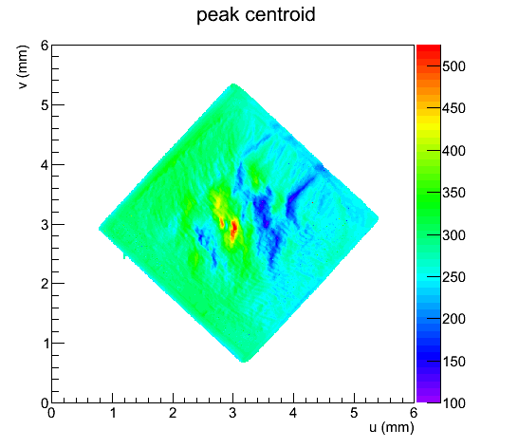
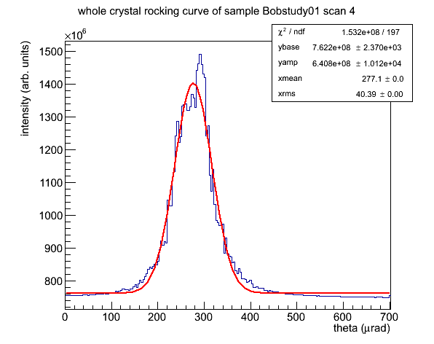
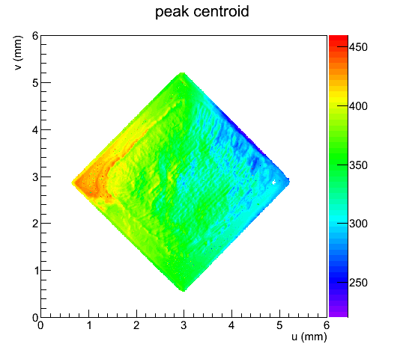
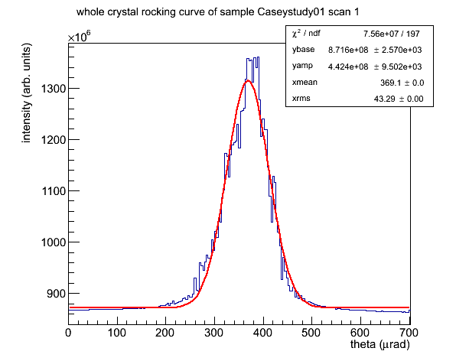
CHESS X-ray Rocking Curves: UConn-B
CHESS X-ray Rocking Curves: UConn-C

Slide 5
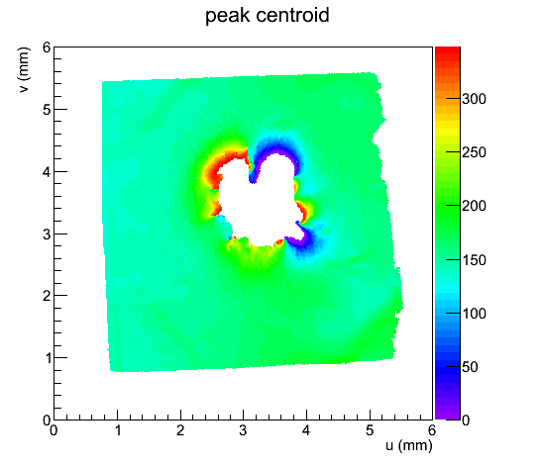
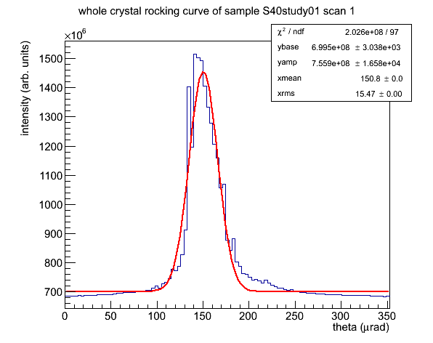
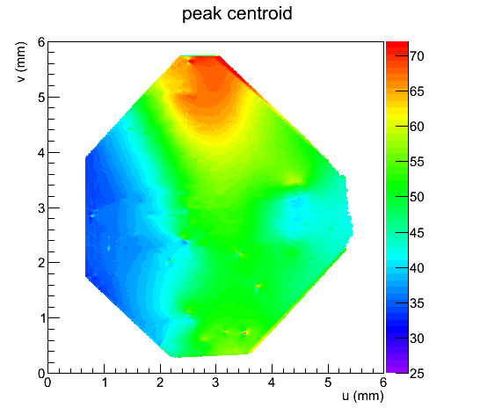
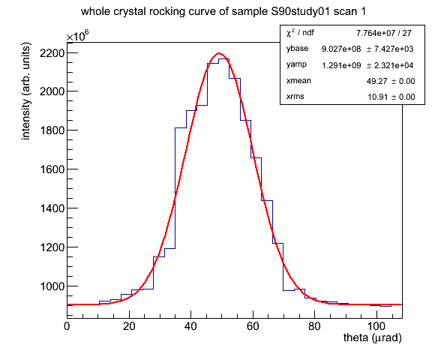
CHESS X-ray Rocking Curves: S40
Vapor Ion Etching Burn-Through Region
CHESS X-ray Rocking Curves: S90

Slide 6
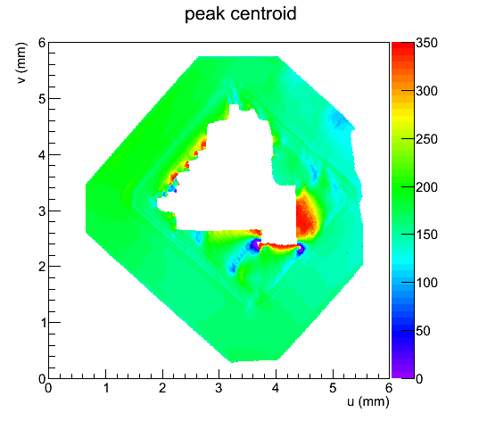
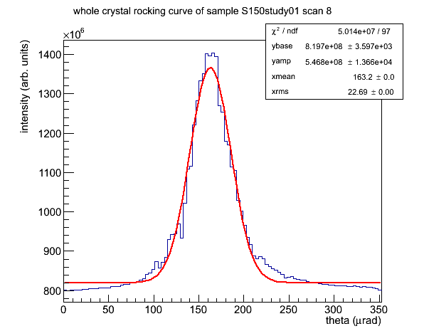
CHESS X-ray Rocking Curves: S150
Laser Ablation Burn-Through Region

