Slide 1

Hall D Fast Feedback System
Performance and configuration

Slide 2
Fast Feedback specifications
Stability σ_{x} <200μm, σ_{y} <200μm at collimator
Ability to run without active collimator
Current range 500nA <I <5 μA
σ_{x} <200μm, σ_{y} <200μm at radiator
I<1 μA f up to third harmonic of 60Hz
I>1 μA f up to 1Khz
Alternate bpm choices must be available

Slide 3
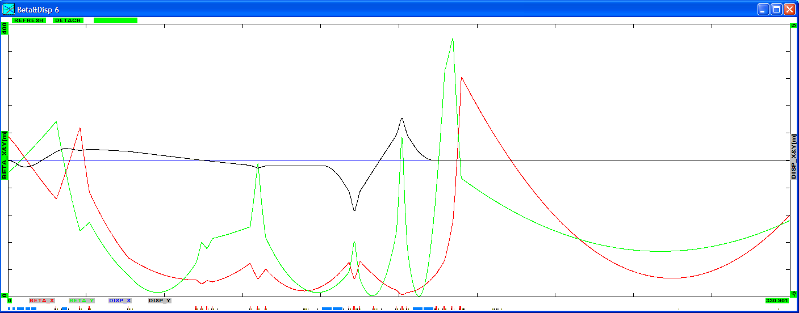
Hall D optics configuration
Bpm #1
Bpm #2
correctors

Slide 4
Input conditions
Simulated Mismatching/rematching the beamline
  9 different mismatched configurations
Simulated incoming orbit fluctuations:
  σ_{x} ,σ_{y} =1mm RMS, σ_{x’},σ_{y’} =1 μrad RMS

Slide 5
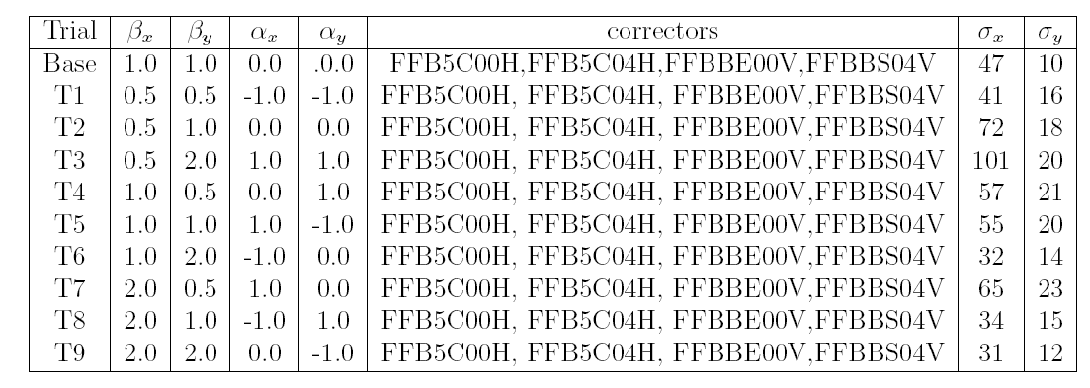
Performance with active collimator for various input conditions
IPMBT02,IPM5C02,IPM5C12,ACTCOL

Slide 6
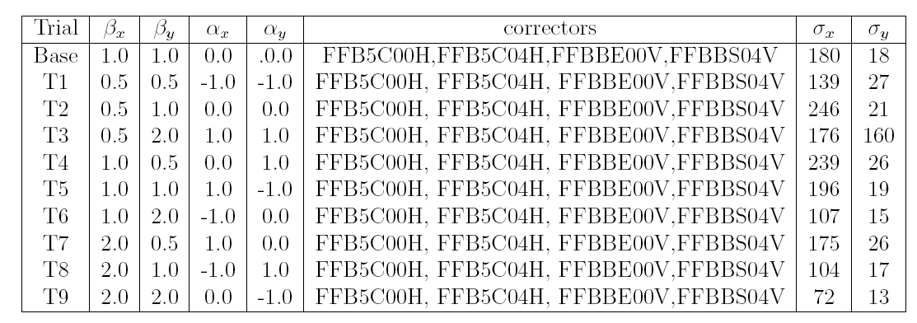
Performance without active collimator for various input cond.
IPMBT02,IPM5C02,IPM5C07,IPM5C12

Slide 7
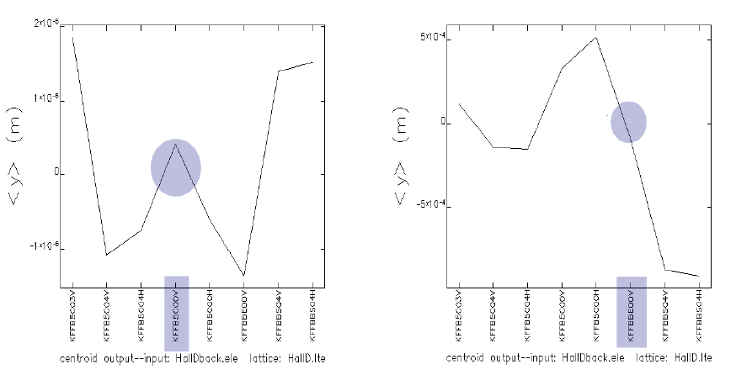
Choosing the correctors
to radiator
X’<>0, X=0
X<>0, X’=0

Slide 8
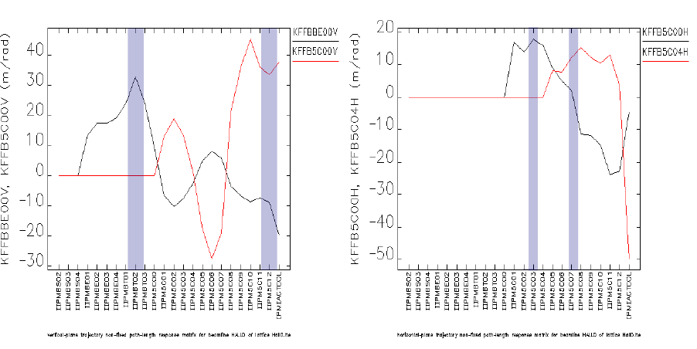
Choosing the bpms

Slide 9
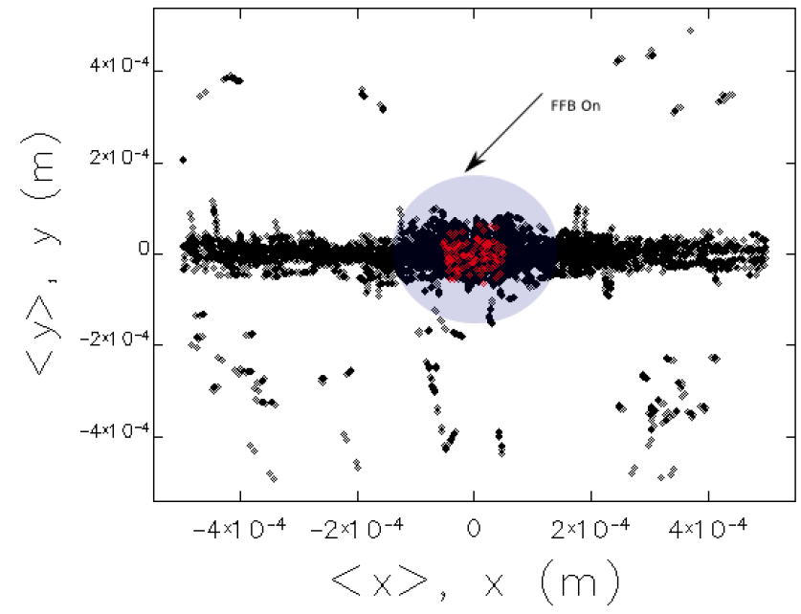
FFB on vs FFB off at collimator

Slide 10
Dynamic range
FFB is currently configured to taper off correction past 400 Hz
May be modified to go up to 1Khz if necessary
Actual bandwidth is around 2Khz so could in principle correct up to 1Khz.

Slide 11
conclusions
FFB system can meet all (most) of the requirements
System is robust to tuning of line due to mismatches
If mismatch greater, then will need to tune upstream of hallD
Several choices of bpm and correctors are possible
Correctors can easily be moved on beamline once we determine optimal configuration
System can work with/without active collimator

